Slide 1
Unit4 What Would You Do? Form , Meaning & Function
Mega Goal 2.3
Done by: Entisar Al-Obaidallah

Slide 2
Lesson Objectives
01
02
03
Form
Form
Use
04
05
06
defferentiate
Form
Apply
Sentences using Future Progressive
Sentences using Future Perfect
Time Expressions for the future correctly
Between used to and be used to correctly
Sentences using was\were going to (Future in the past)
The rules to do exercises correctly

Slide 3
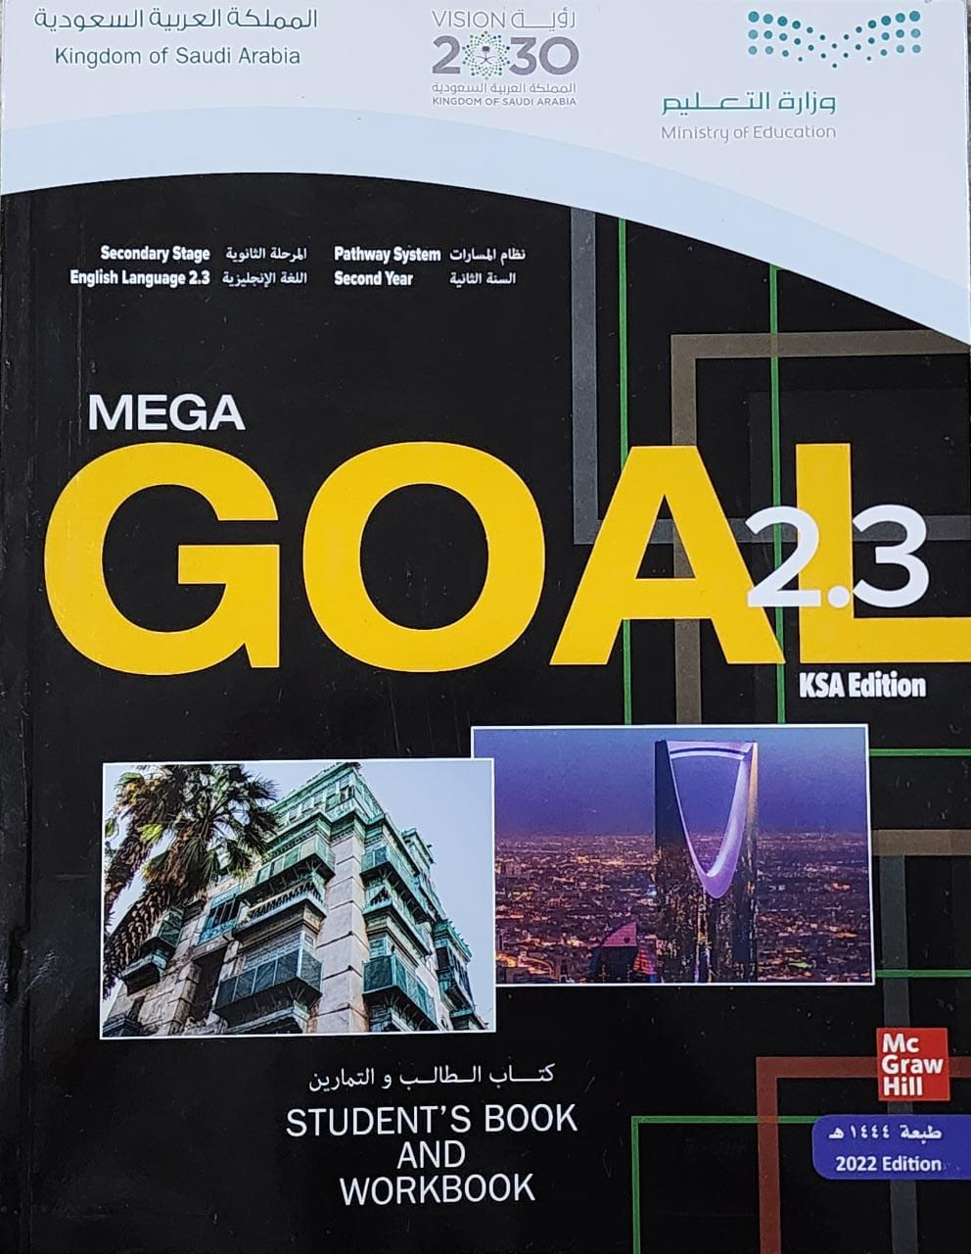
Book Open
Page ( 58 )

Slide 4
Future Progressive
Use
use for continuous actions in at a certain time in the future *
will
be
V -ing
Form
Example
In two months, I will be graduating.
positive(+)
Will you be graduating in two months?
Question(?)
Yes , I will
Short answer (+)
Negative ( - ):
I/you/He/She/It/We/They
will not/won’t be graduating
No , I won’t
Short answer (-)

Slide 5
The Expressions for the Future Progressive
In two months, …
In a year, …
A week from today, ….
At this time tomorrow, …
This time tomorrow, …
On Thursday
During the next three months
➔(These expressions refer to a specific point in time or to a period of time.)

Slide 6
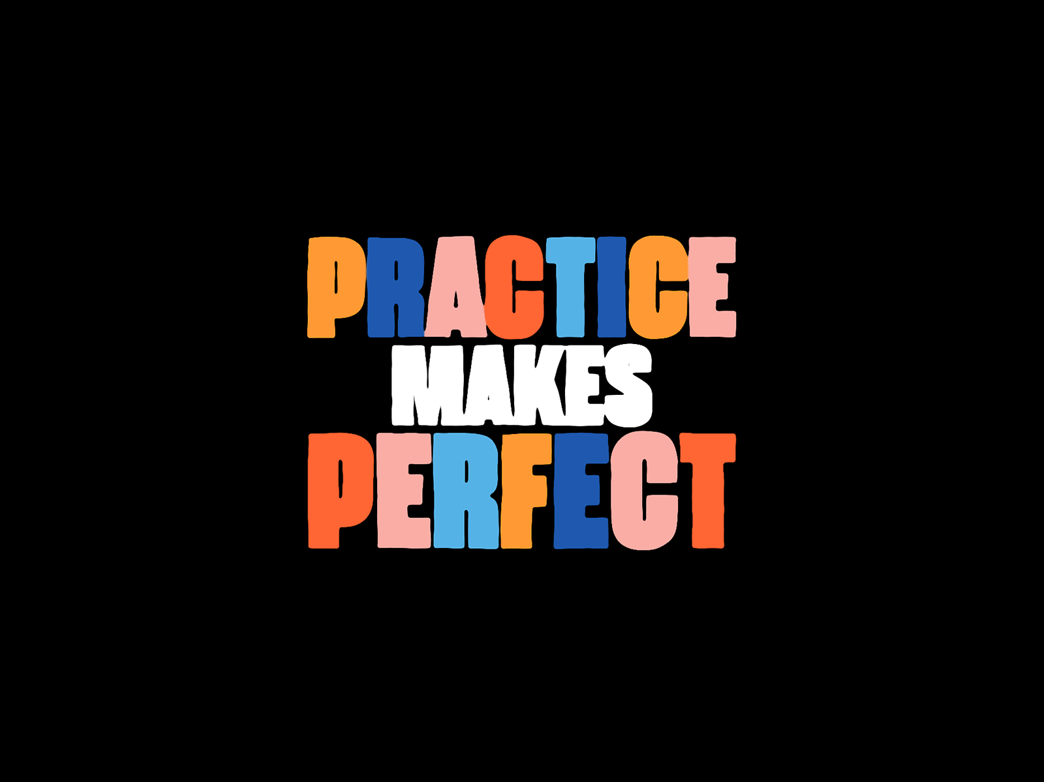

Slide 7



Complete using Future Progressive
I ( fly) to Dubai at 9:00 O’clock tomorrow
will be flying

Slide 8


Complete using Future Progressive
Don't phone me at 3:00. I ( sleep)
will be sleeping

Slide 9
Futurec Perfect
Use
➔used to express the idea that an action will be completed in the future, (before / by) a specific time in the future
Form
will
have
V.pp(3)
Example
By 8:00 pm tonight, she will have completed her homework.
positive(+)
By 8:00 pm tonight, will she have completed her homework ?
Question(?)
Yes , she will
Short answer (+)
No , she won’t
Short answer (-)

Slide 11







Complete using Future Perfect
I (go) to bed
by 9 pm.
won’t have gone
21:00 tonight

Slide 12

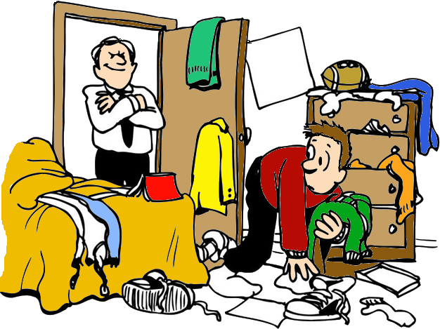
Complete using Future Perfect
I my room by Friday
will have cleaned
Clean room - Friday

Slide 13

Complete using Future Perfect
I harder by
11:00a.m on Thursday
will have studied
study harder- 11:00 am
on Thursday

Slide 14
The Expressions for the Future Perfect
By 6 am, …
By 2030, …
By next weekend………..
By then, …
By November,……….
By the end of this month, …….
Before ….. ,
➔(All these expressions mean at the end of a period of time)

Slide 15
Book Open
Page ( 59 )

Slide 16
Used to:
We use Used to +infinitive when we want to say that something happened regularly in the past, but that it doesn’t happen any more .
Use
Form
subject
Used to
V1 infinitive
Example
Nora used to eat chocolate a lot .
positive(+)
Nora didn’t use to eat chocolate a lot .
negative(-)
Did Nora use to eat chocolate a lot ?
Question(?)

Slide 17
Positive Form !
I You He She It We They | USED TO | play tennis. V(1) O
Example
In old days
Women used to wash their
dirty clothes by hand.
Now
They use washing machine.

Slide 18
Negative Form !
I You He She It We They | DIDN’T | USE TO | play tennis.
Example
In old days ,People didn’t USE TO travel by car and plane but now they do.
Note : For the negative , use didn’t use to ( omit the – d)

Slide 19
Question Form !
DID | I You He She It We They | USE TO | play tennis?
Example
Did people use to travel by horse carriages ?
Yes, they did
Did people use to use calculator to make calculation ?
No, they didn’t

Slide 20
Be Used to
to talk about something that has become
familiar or habitual .
Use
Form
Be
Used to
Gerund or noun
am - is – are
Example
He is used to living alone
be
modal
modal
Note : For the negative , use be + not + used to ( don’t omit the – d)

Slide 21
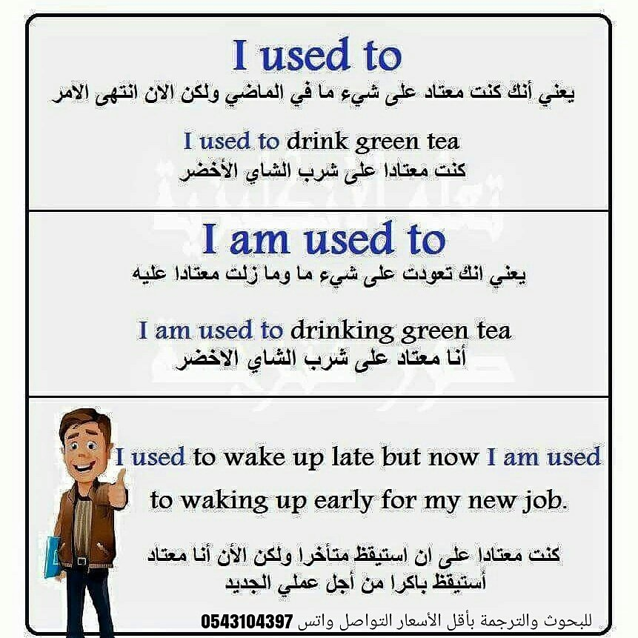
Summary

Slide 22
Be (was-were) going to
Use
to talk about a prediction for the future made in the past, or a past plan that was not carried out
Form
Be( was- were)
Going to
V infinitive
Example
I was going to visit my aunt when I went to Riyadh but she had gone to Dubai for the summer ( so I didn’t visit her).
We were going to move to Riyadh next year , but we were offered better jobs here ( so we didn’t go)

Slide 23
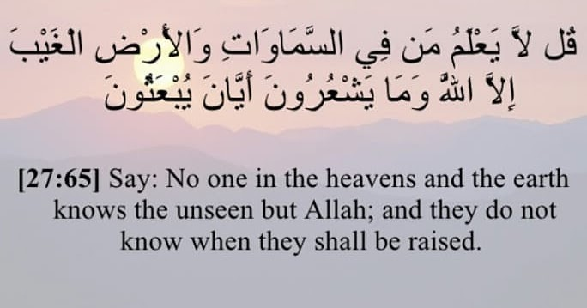
Remember

Slide 24
Home work
Workbook , page ( 120 ) , exercise ( N)

Slide 25

thanks

