Slide 1
Unit 6
The Gender Divide
Grammar
Mega Goal 5
Done by: Entisar Al-Obaidallah

Slide 2
Lesson Objectives
Distinguish
Practice
01
02
Use
Apply
03
04
Between Verb+ infinitive or gerunds with different meanings
Passive forms of an infinitive and gerunds
Auxiliary Verbs after But & and correctly
the rules to do the exercises correctly

Slide 3

Open your student’s book p. (84)

Slide 4
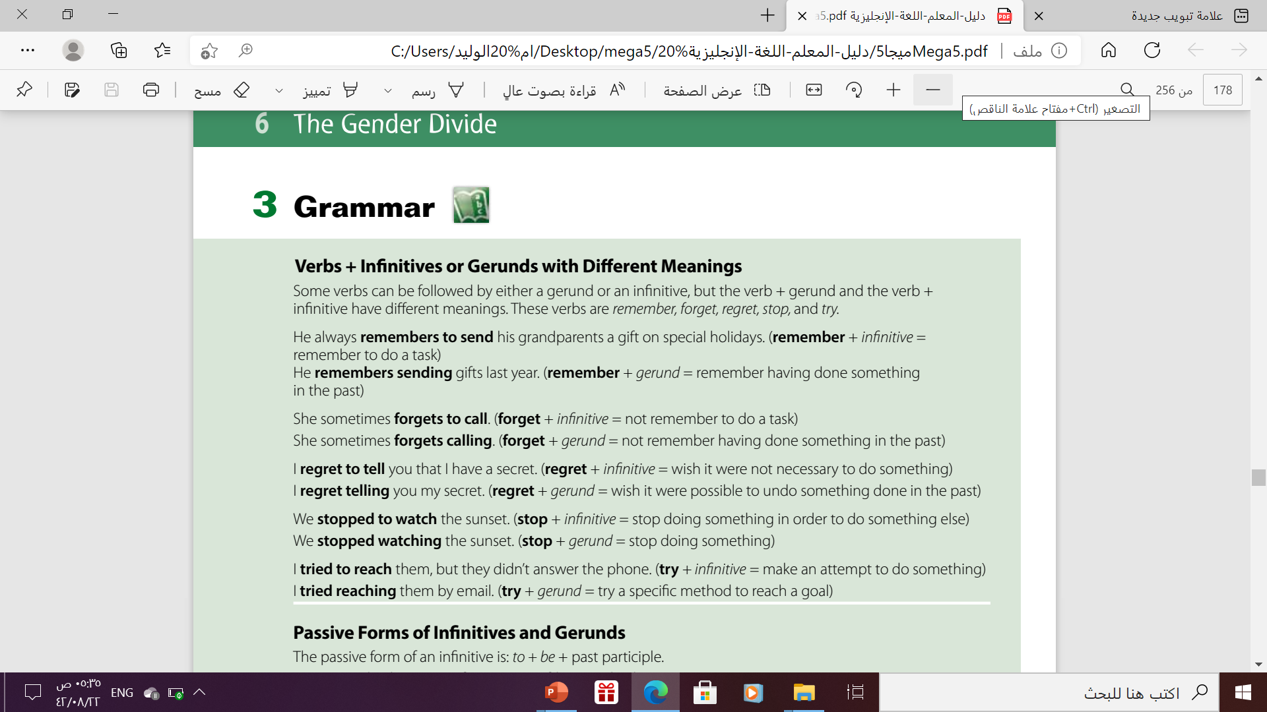

Slide 5


Verbs + Infinitives or Gerunds with different meaning :
remember
stop
try
forget
regret
We can use those verbs followed by either infinitive or gerund
But the meaning will be different

Slide 6
Verbs + Infinitive or Gerunds
Gerunds
Infinitive
Vs.
“To + the base form” of the verb.
Buy → to buy
The “ ing” form of the verb.
Live → living
I recommend reading this book.
Don’t forget to buy your grandma a gift

Slide 7
Remember
Remember + Gerund
Remember + infinitive
V+ ing
To +v
I remember playing on sand when I was a child
I remember to call my friend tonight
(Remember done something in the past)
( Remember to do a task in present or future )

Slide 8








Forget
Forget + Gerund
Forget + infinitive
V+ ing
To +v
I forget feeding the cat . I fed it twice.
You forget to close the door .I found it opened
(Not remember having done something in the past )
(Not remember to do the task )

Slide 9
Regret
Regret+ Gerund
Regret + infinitive
V+ ing
To +v
I regret watching this film it was boring .
I regret to tell you that I have a secret
wish It were possible to undo something done in the past
Wish it were not necessary to do something

Slide 10
Stop
Stop + Gerund
Stop + infinitive
V+ ing
To +v
We stopped watching the sunset.
We stopped to watch the sunset.
(stop doing something )
stop doing something in order to do something else

Slide 11
Try
Try + Gerund
Try + infinitive
V+ ing
To +v
I tried taking an aspirin but it didn't help
Try to be quiet when you come home late.
Test ( experiment ) something
to do something that is not easy

Slide 12
02
Passive Forms of Infinitive and Gerund

Slide 13
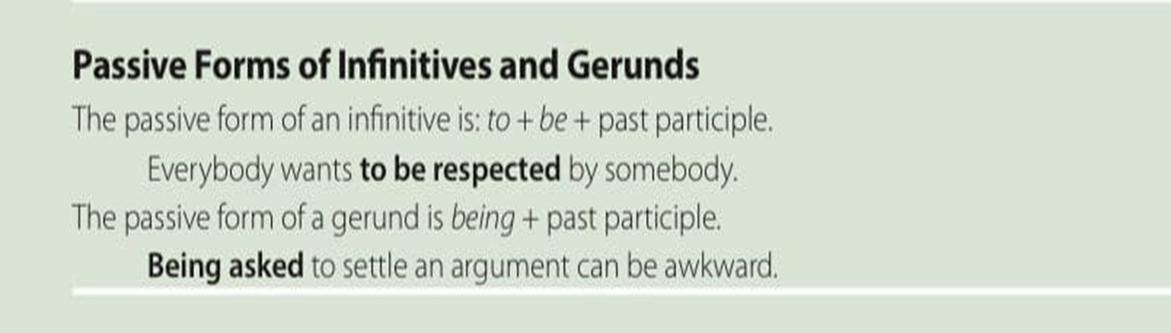
Passive of the infinitive
Passive of the Gerund
To + be + v3
Being + v3

Slide 14
1) The passive form of infinitives :
to
be
V(3) Past Participle
Example
active
You need to fix my car
passive
My car needs to be fixed

Slide 15

2) The passive form of gerunds :
being
V(3) Past Participle
Example
I remember my father reading to me when I was child
active
I remember being read to me when I was a child.
passive

Slide 16
03
Auxiliary Verbs after But & And

Slide 17
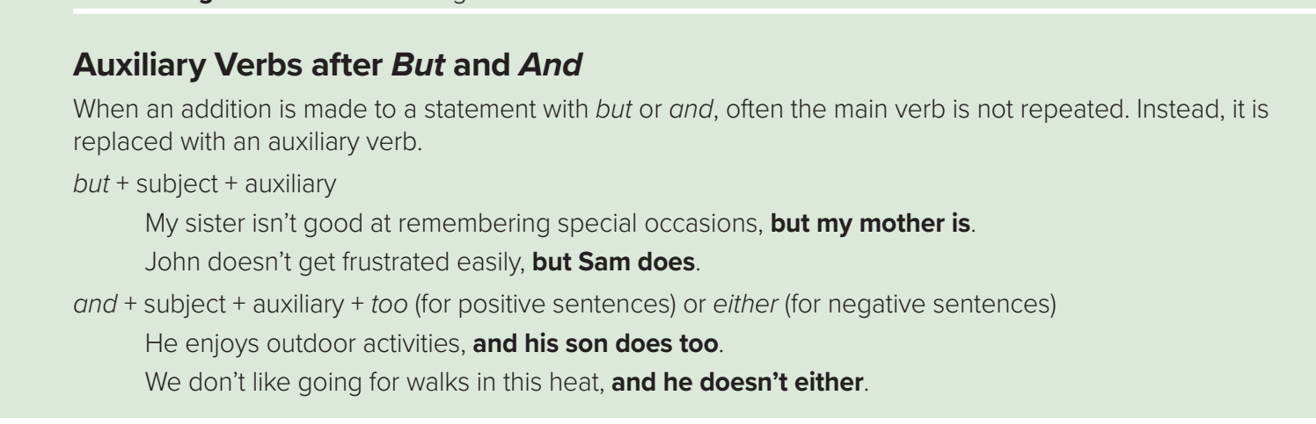

Slide 18
Auxiliary Verbs after( But & And )
When additional is made to statements with but, and the main verb is not repeated.
It is replaced with an auxiliary verb.
do – does – did
have – has – had
is – are – am
Was – were

Slide 19
( But + subject + auxiliary: )
My sister isn’t good at remembering special occasions , but my mother is.
“ my mother “ remember.

Slide 20

and + subject + auxiliary + too → (+)
He enjoys outdoor activities.
He enjoys outdoor activities , and his son does too.
and + subject + auxiliary + too (for positive sentences)

Slide 21
and + subject + auxiliary + either → (-)
We don’t like going for walks in the heat.
We don’t like going for walks in the heat , and he doesn’t either.
and + subject + auxiliary + either (for negative sentences)

Slide 22

➔only statements with and are followed by too or either.
➔Statements with but do not use too or either

Slide 23
Homework
Workbook , p. (58) , exercise ( C)

Slide 24

Thanks!

