Slide 1


Slide 2
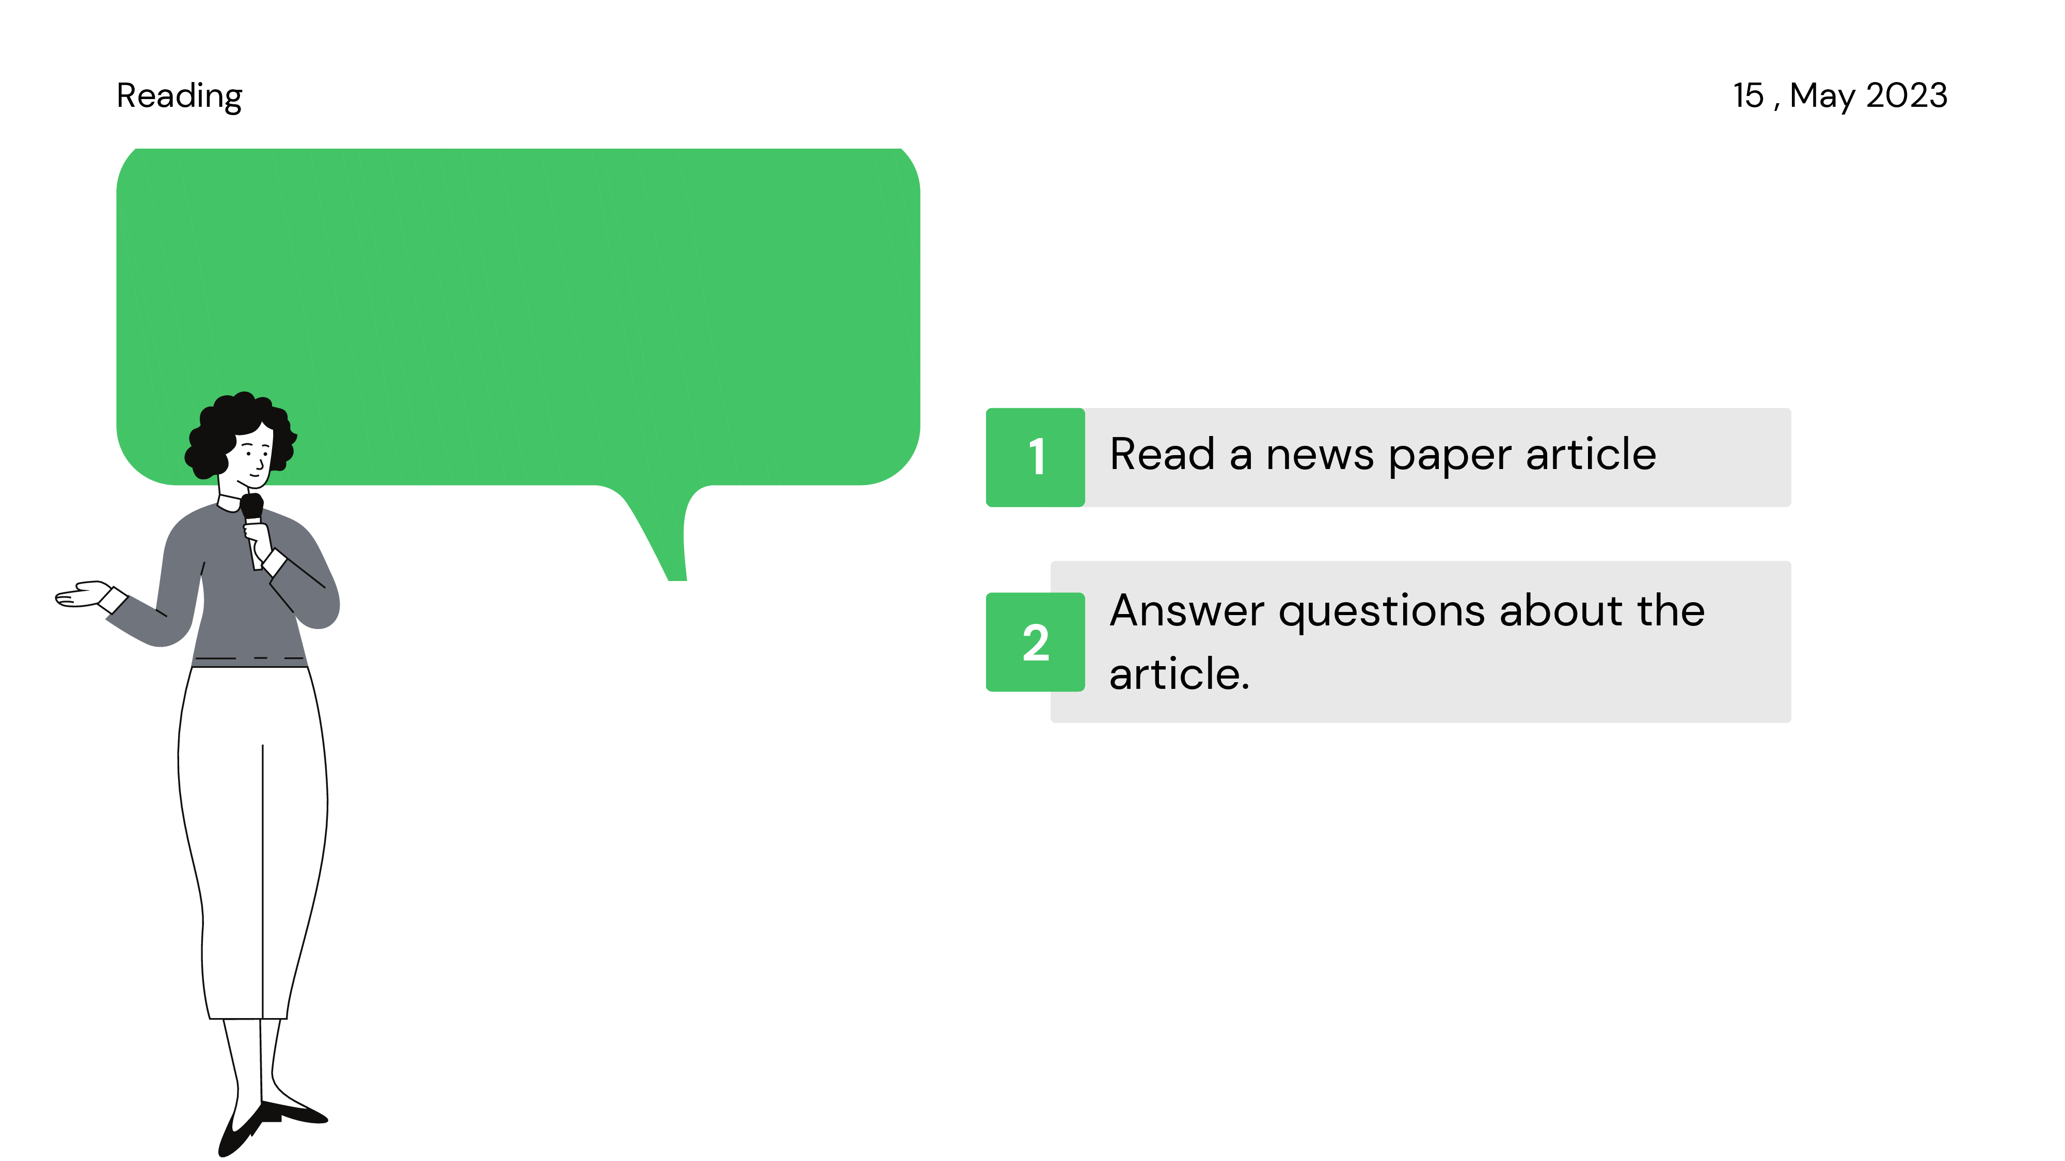
Learning objectives

Slide 3
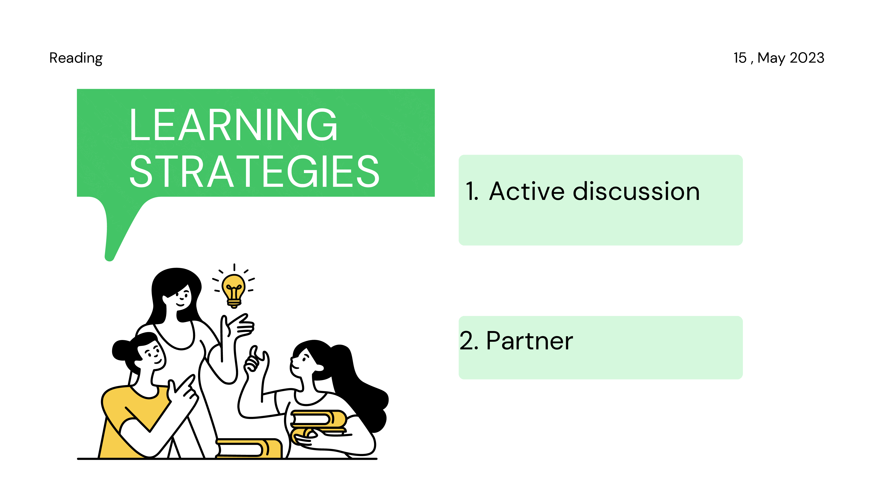

Slide 4
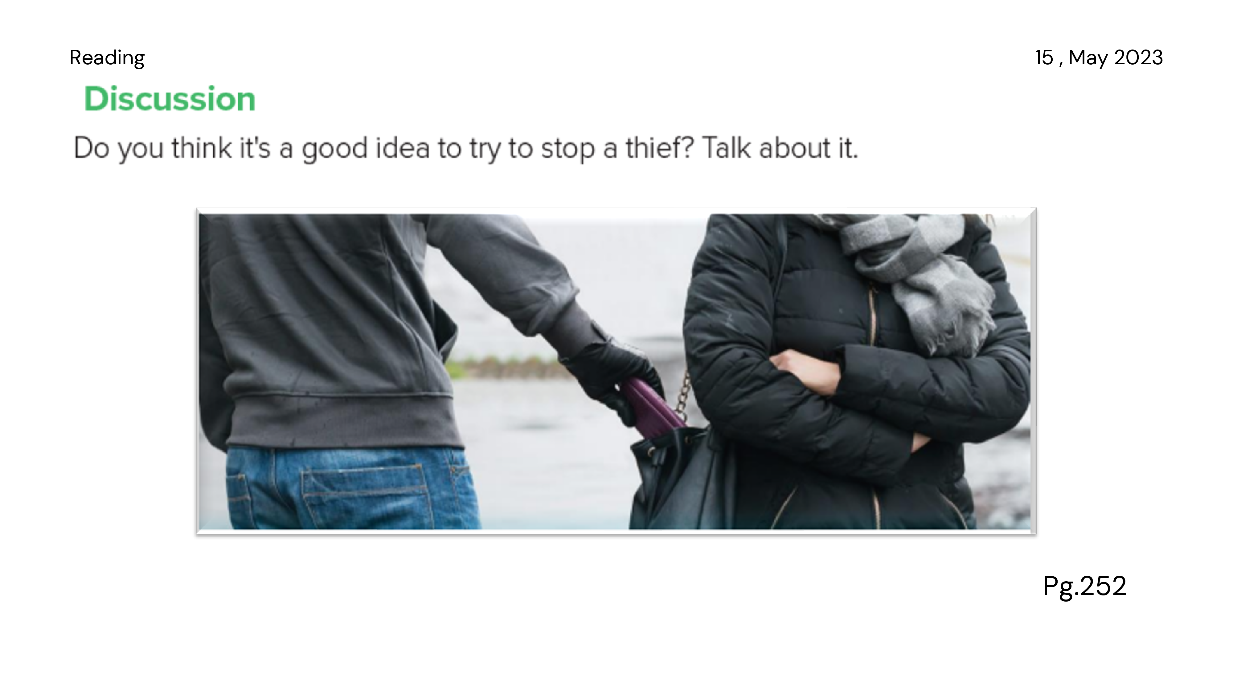

Slide 5


Slide 6
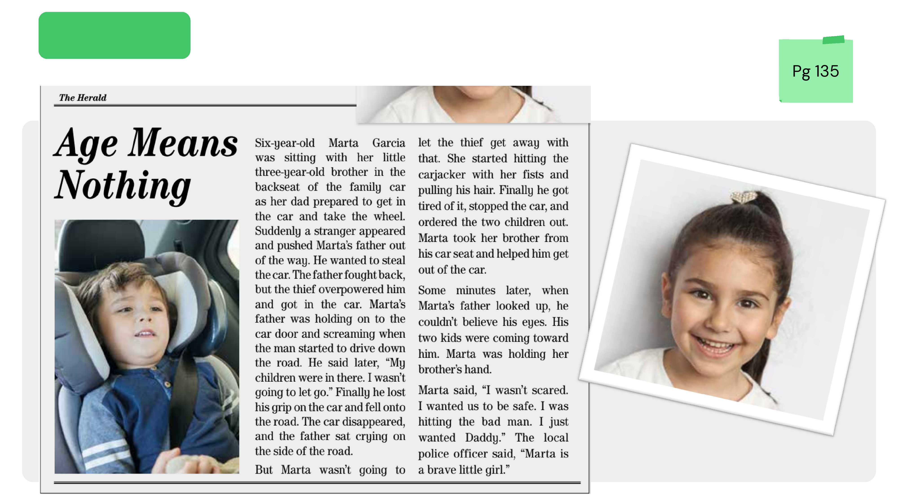


Slide 8
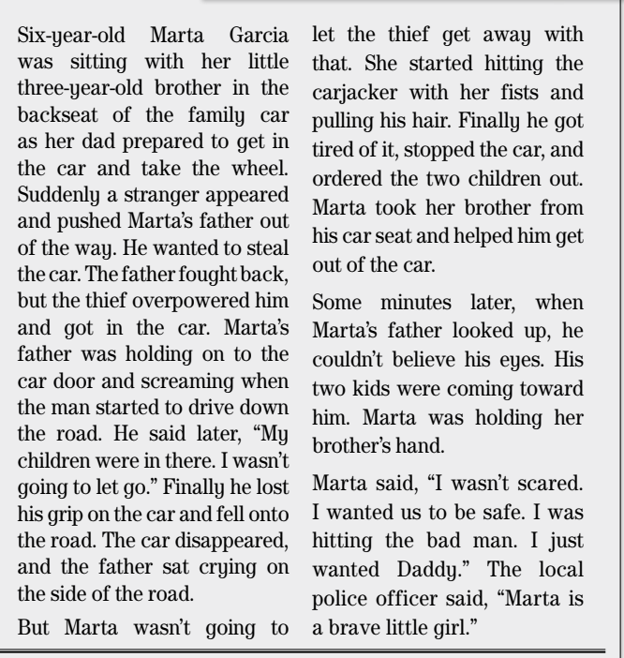
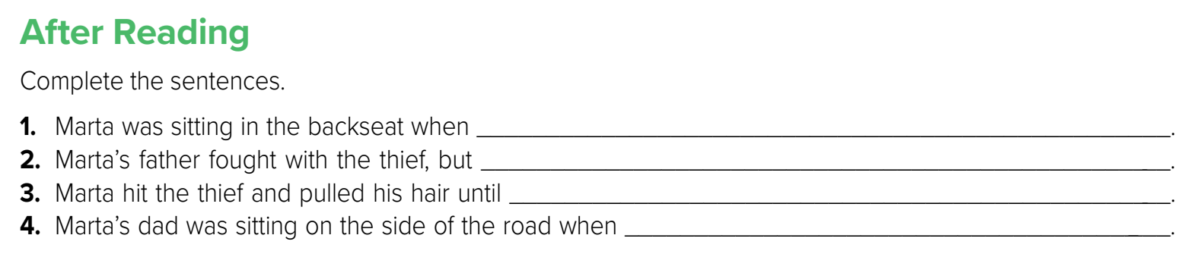
1. a stranger pushed her father out of the way, got in the car, and drove away.
2. the thief overpowered him and got in the car.
3. he stopped the car and ordered the children out.
4. he saw his two children walking toward him.
Pg. 135

Slide 9
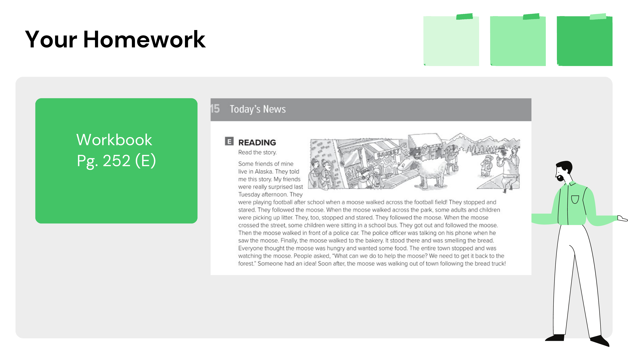

Slide 10
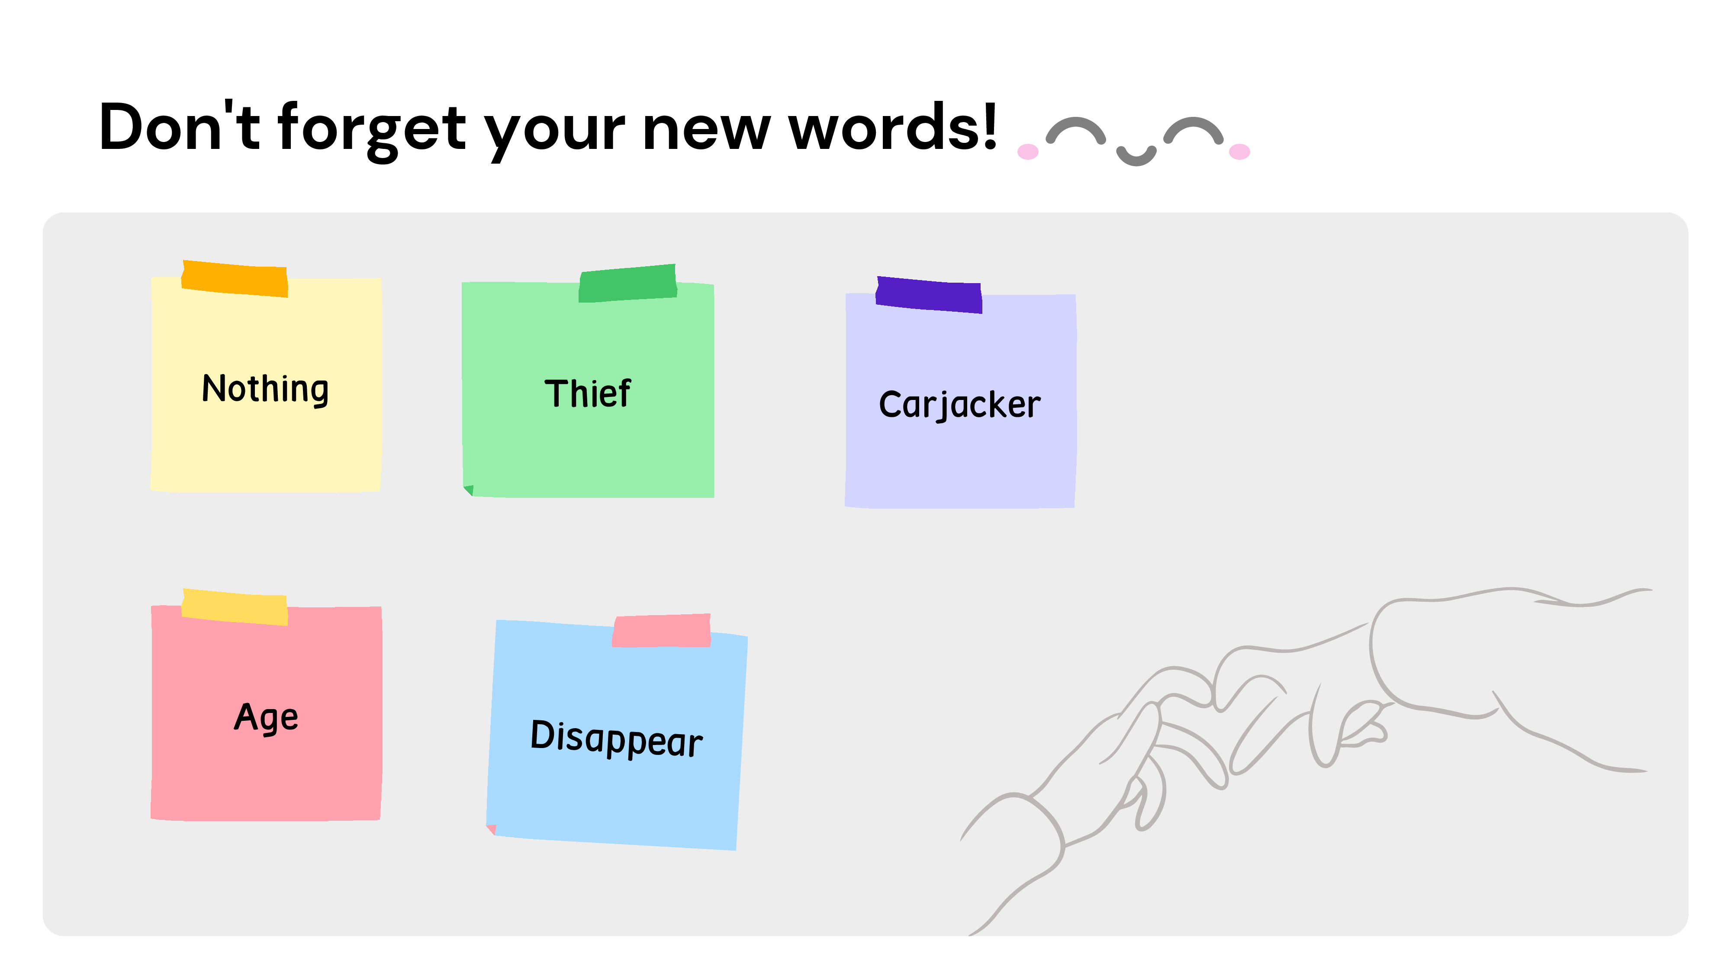

Slide 11

By T. Waad Alanazi

