Slide 1

Making Choices
Unit 5

Slide 2
Form, meaning & function
Objectives
Use " wish " in a sentence
Present imaginary situations with conditional sentences

Slide 3
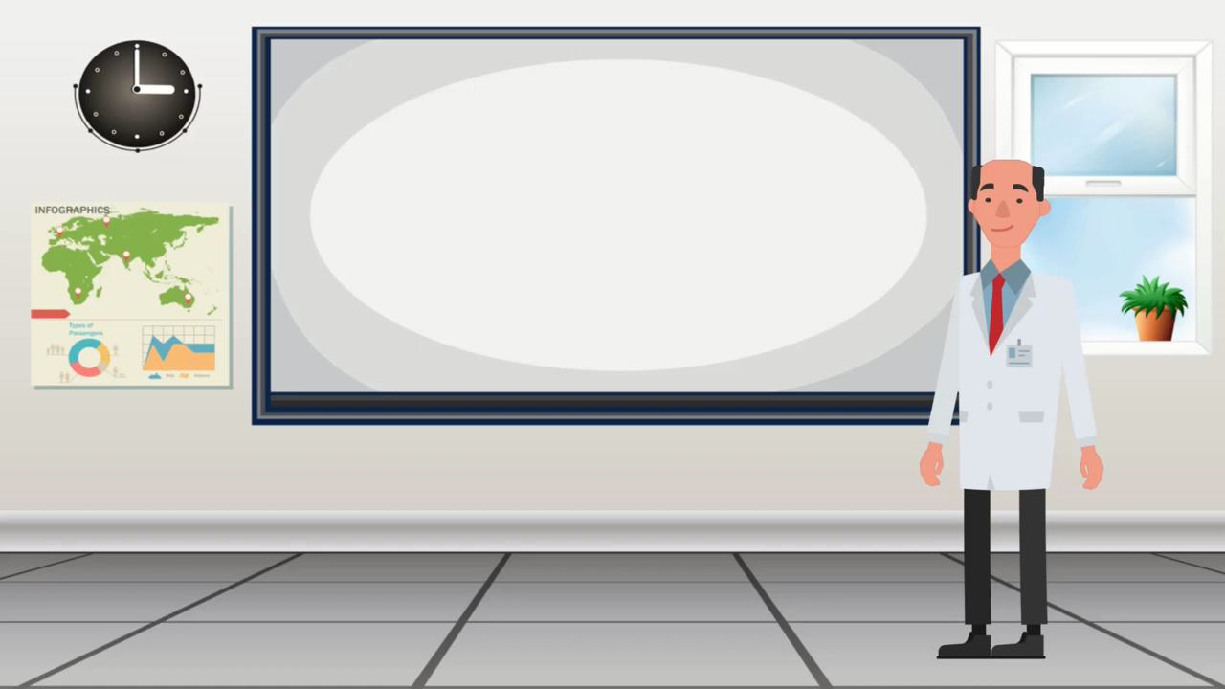

Slide 4
Grammar
2nd Conditional
“If” Clause
Grammar
If + past Simple
Would + Infinitive

Slide 5
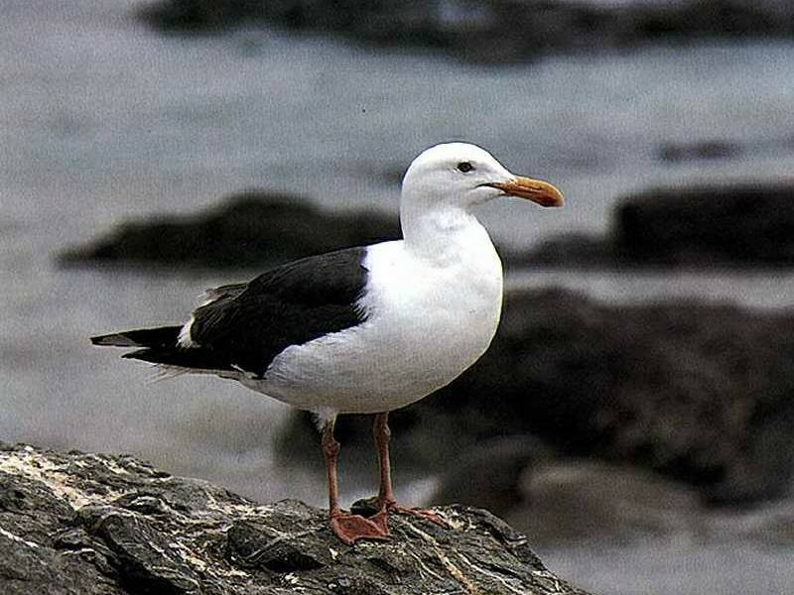
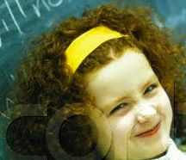

Slide 6
would
were
What you do if you a bird?
were
If I a bird,
would
I fly around the world.
would
I eat raw fish.
if I were a bird.
I would eat raw fish

Slide 7
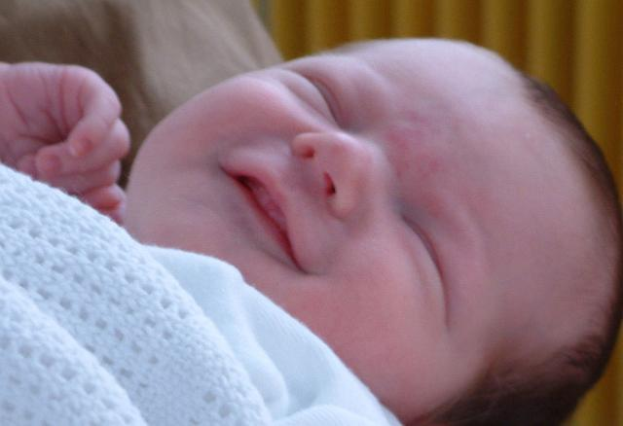
would
were
What you do if you a
baby?
were
If I a baby,
would
sleep all day.
I
cry a lot.
would
I
drink lots of milk.

Slide 8

would
What you do if you
a man?
were
If I
were
would
a man, I
play in the street.
If I
were
would
a man, I
travel with my friends.

Slide 9
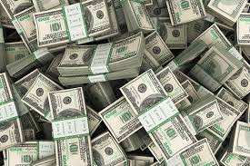
What would you do if you were a billionaire?

Slide 10
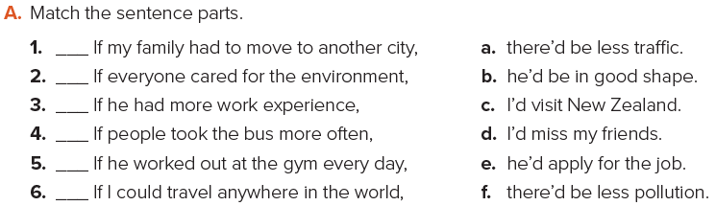

P. B. p. 123
d
f
e
a
b
c

Slide 11
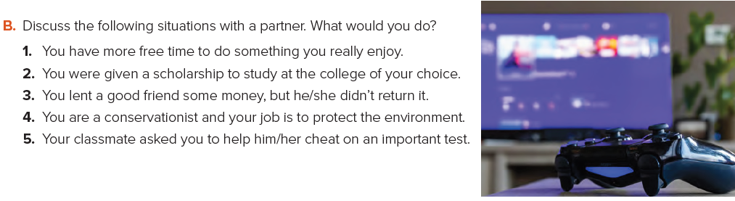
P. B. p. 123

Slide 12



https://www.liveworksheets.com/lu1298117hm

Slide 13
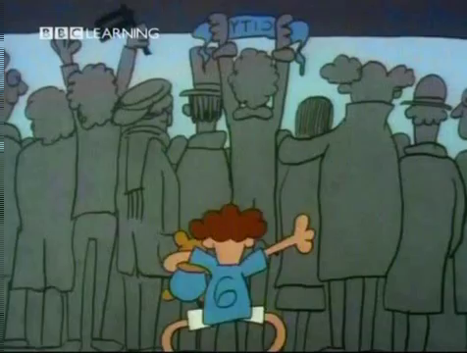

Slide 14
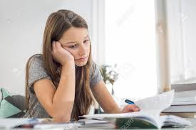
Wish
What does she wish?
Nada wishes she were at the mall.
Nada wishes she was at the mall.

Slide 15
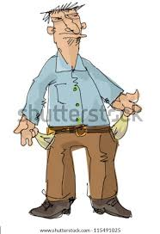
Wish
What does he wish?
He wishes he were / was rich.

Slide 16
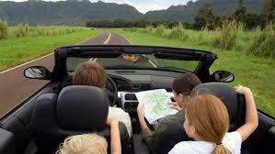
Wish
What do you wish?
We wish we flow to California.

Slide 17
Wish
What do you wish?
I wish you tried harder.
I wish I …………………………… .

Slide 18
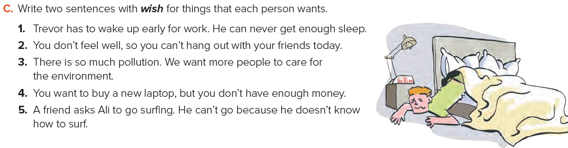
P. B. p. 123

Slide 19
Trevor wishes he didn’t have to wake up early.
He wishes he could get more sleep.
2. I wish I felt better.
I wish I could hang out with my friends today.
3. We wish there wasn’t so much pollution.
We wish more people cared for the environment.
4. I wish I had a new laptop.
I wish I had enough money to buy one.
5. Ali wishes he could go surfing.
He wishes he knew how to surf.

Slide 20
https://www.liveworksheets.com/vn1043050ej

Slide 21


