Slide 1

Unit 12
Culture Shock
Lesson 7
Forms, meaning & Functions

Slide 2











بسم الله الرحمن الرحيم
Day:
Date:

Slide 3




Learning Objectives
Use past perfect correctly
Use time expressions with past perfect correctly
Make negative sentences in the past perfect .
Differentiate between the different cases of the past perfect

Slide 4

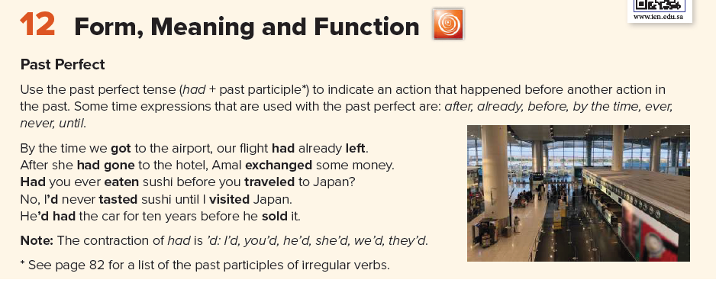
Page 133

Slide 5
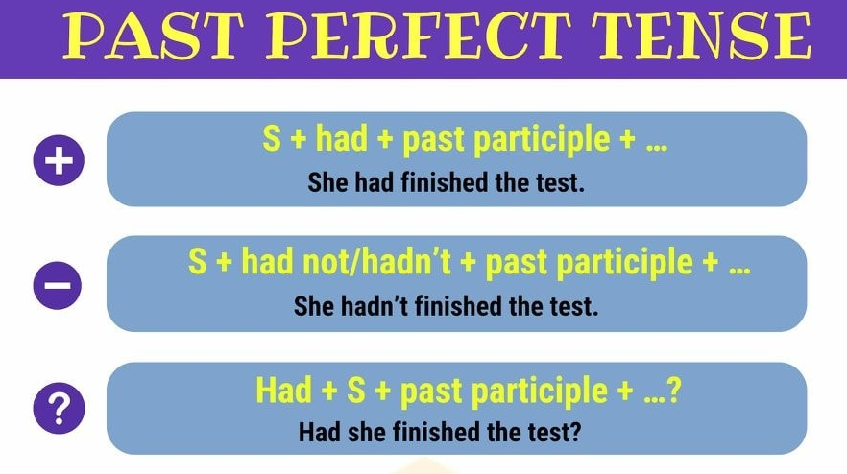

Slide 6
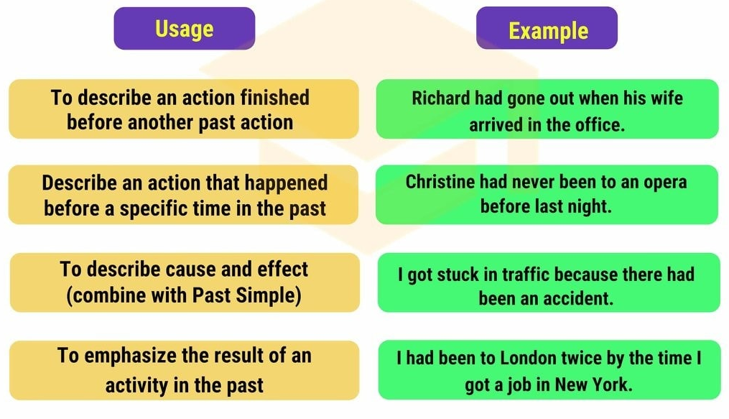

Slide 7






Practice

Slide 8
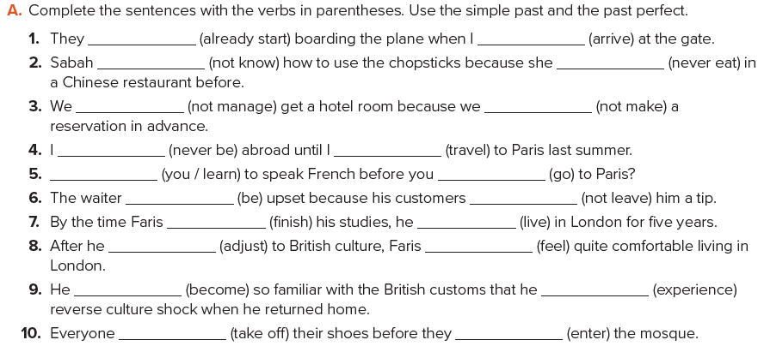
had already started
arrived
didn’t know
had never eaten
didn’t manage
hadn’t made
had never been
traveled
Had you learned
went
was
hadn’t left
finished
had lived
had adjusted
felt
had become
experienced
had taken
entered
Page 133

Slide 9
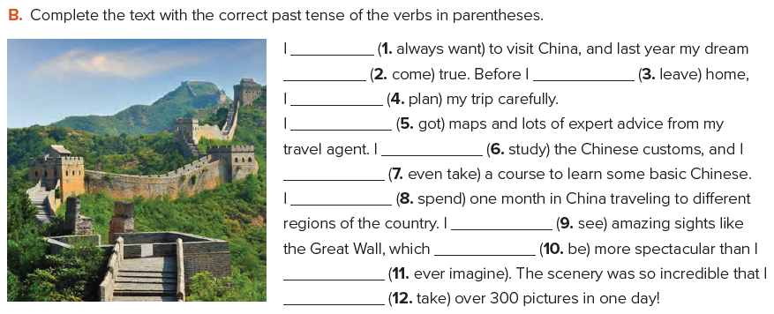
had always wanted
came
left
had planned
had gotten
had studied
had even taken
spent
saw
was
had ever imagined
took
Page 133

Slide 10


Home Work

