Slide 1

Unit 12
Culture Shock
Lesson 6
Writing

Slide 2



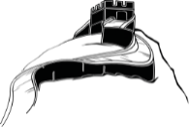







بسم الله الرحمن الرحيم
Day:
Date:

Slide 3




Learning Objectives
Use the verb " used to " with gerunds and infinitive
Explain quotes
Write an email about culture differences.
Differentiate between gerunds and infinitives in sentences

Slide 4
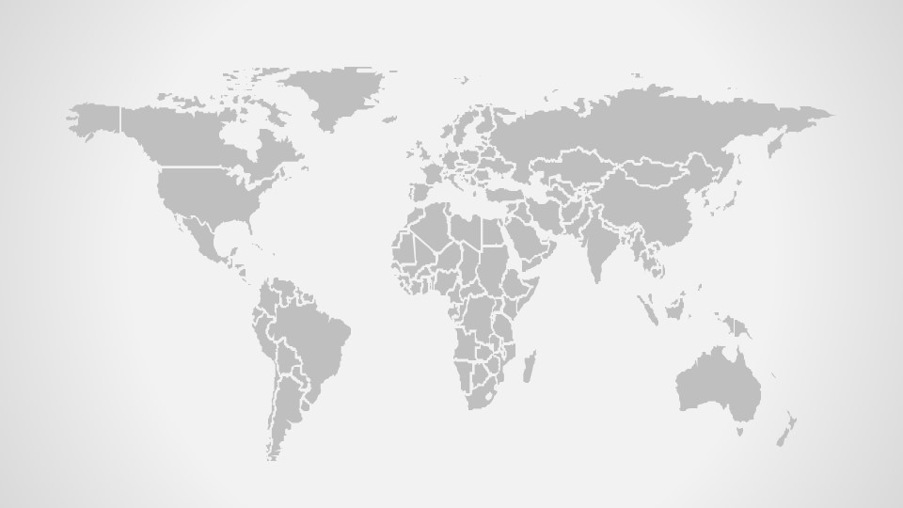
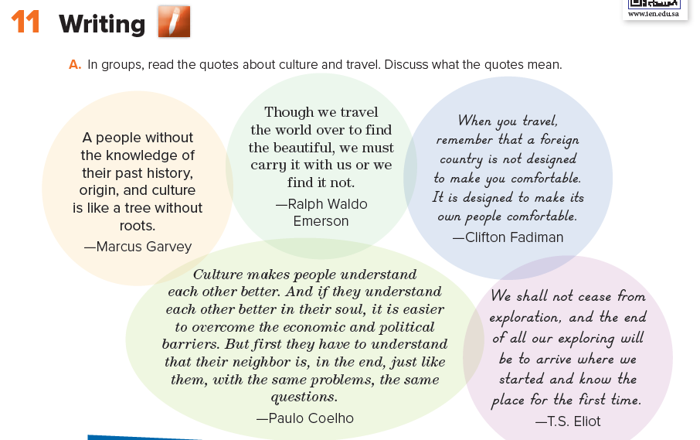
Page 132

Slide 5
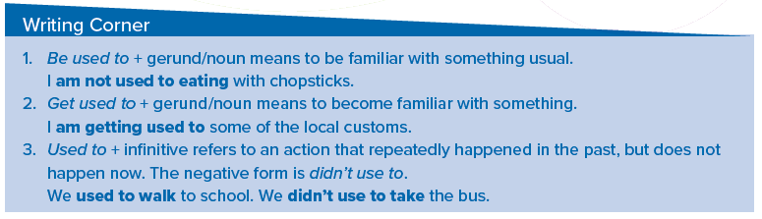
Page 132

Slide 6
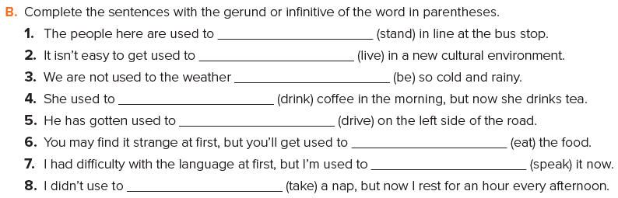
standing
living
being
drink
driving
eating
speaking
take
Page 132

Slide 7
I was invited to my Korean friend’s house during my visit to Korea last year .
They were very nice but I notice something strange about their eating habits which is slurping.
In my country it’s rude to make sounds while eating
but in Korea it’s something ordinary further more it’s
consider as a sign of that they like the food and this make the person who made the food happy
Page 132

Slide 8





Home Work
Workbook page 250

Slide 9
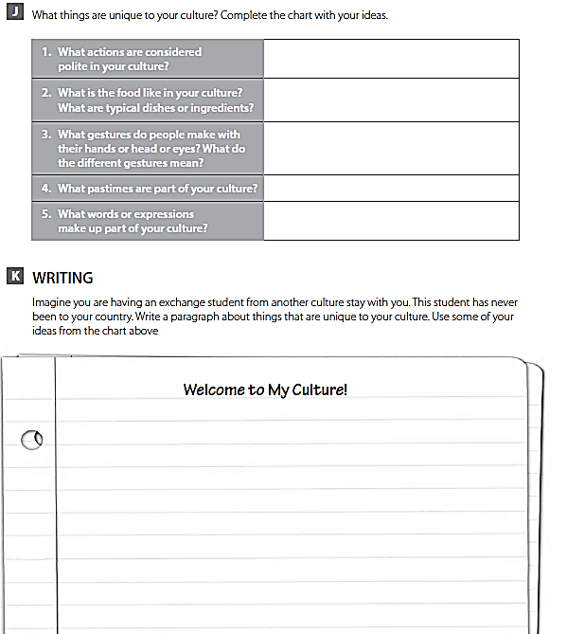
In my culture it’s polite to shake hands, look at someone when talking and listening to them and open a door for others
The food here are rich of flavors and fatty. Typical ingredients are rice, wheat, lamb, chicken, yogurt, seafood and dates
People raise their hands with a nod to say hello to other people far from them. Holding your fingers together means be patient or wait.
Football , electronic games
-(may Allah give you health) it’s a blessing usually said instead of a ( thank you )
-(Absher ) it’s a polite response you could say when somebody ask you to do something. As if you are saying ( sure I’ll do it …don’t worry)

