Slide 1

Unit 12
Culture Shock
Lesson 5
Reading

Slide 2











بسم الله الرحمن الرحيم
Day:
Date:

Slide 3




Learning Objectives
Read about different cultures
Design a list of advices to a traveler
Answer the questions
Identify the main idea of the passage

Slide 4

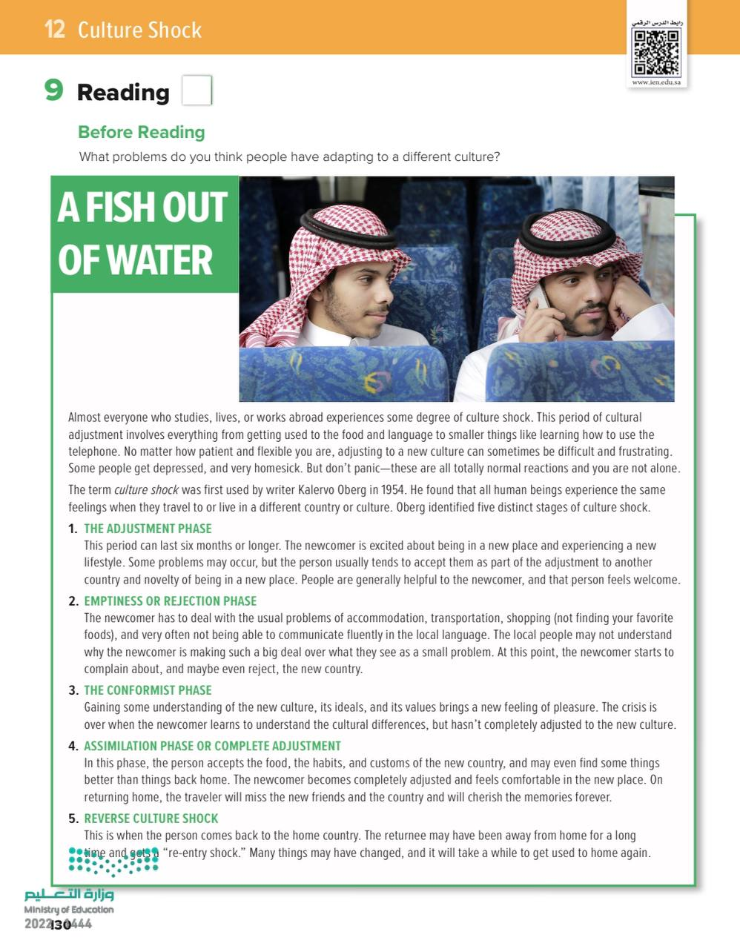
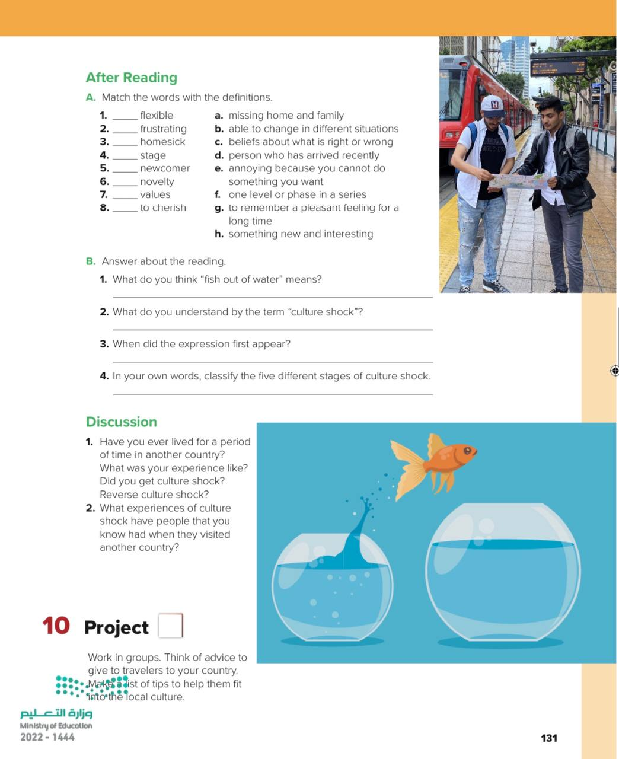
Before Reading
Pages 130 & 131

Slide 5
Before Reading
What is the title?
Do we have subtitles?
How many pictures are there? Paragraphs? Lines?
Scan: What is the passages talking about?
Skim: Find in the passage: Names, dates…
Pages 130 & 131

Slide 6

Pages 130 & 131

Slide 7


Slide 8

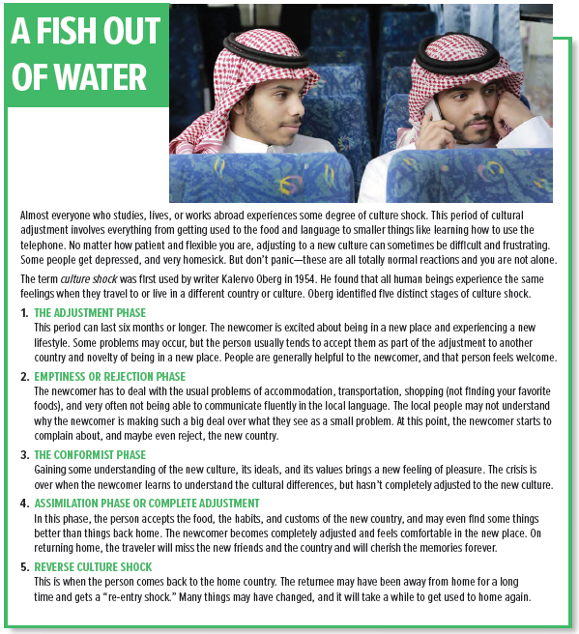
Page 130

Slide 9
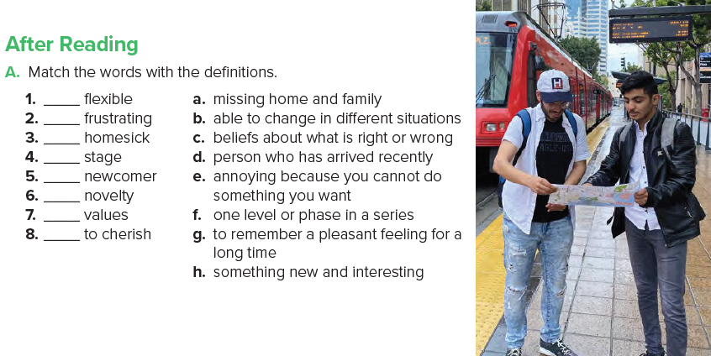
b
e
a
f
d
h
c
g
Page 131

Slide 10
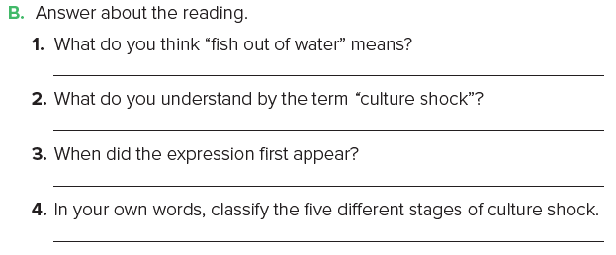
being in a new place and not being comfortable
the period of adjustment when someone moves to a new country
It was used by the writer Kalervo Oberg in 1954.
Adjustment Phase - Emptiness or Rejection Phase - Conformist Phase - Assimilation Phase or Complete Adjustment - Reverse Culture Shock
Page 131

Slide 11
Mind-map
Main Idea
Paragraph 1
Paragraph4
Paragraph 6
Paragraph 2
Paragraph 3
Paragraph 5
Pages 130 & 131

Slide 12

Page 131

Slide 13
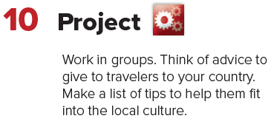
Page 131

Slide 14





Home Work
Workbook page 249

Slide 15
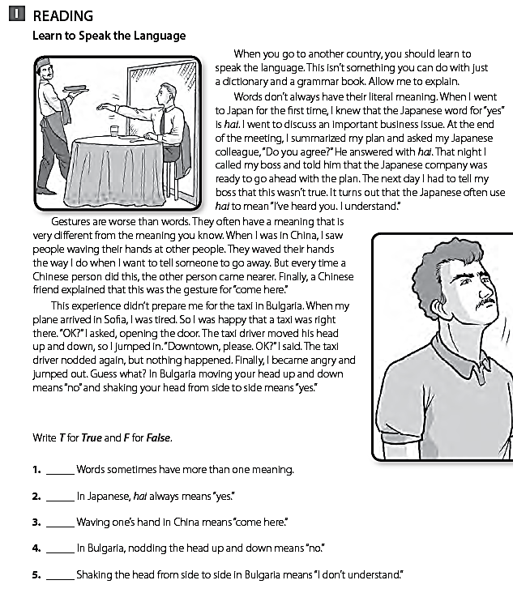
T
F
T
T
F

