Slide 1

Unit 12
Culture Shock
Lesson 3
Language in context

Slide 2











بسم الله الرحمن الرحيم
Day:
Date:

Slide 3




Learning Objectives
Extract some gestures from listening audio
Produce the reduction of /TD
Discuss a common situations
Answer questions related to personal experiences

Slide 4
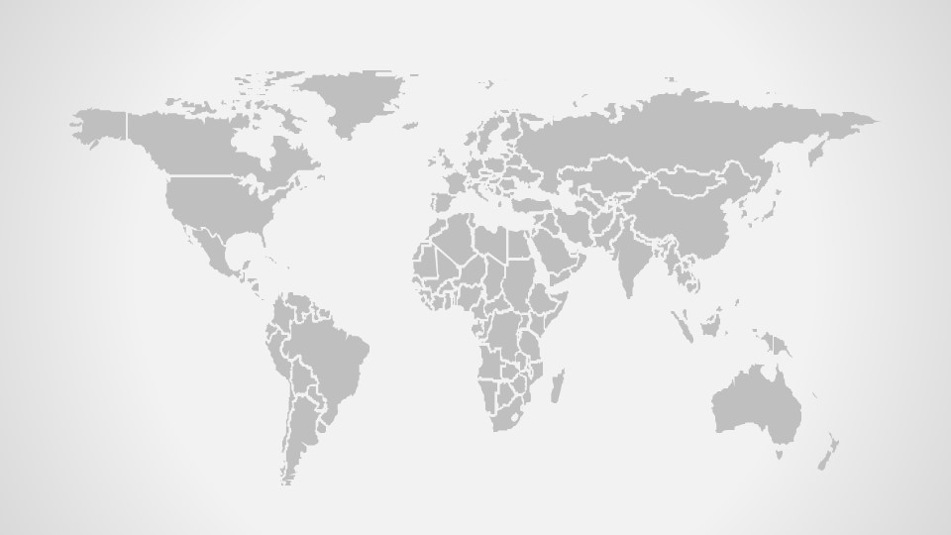
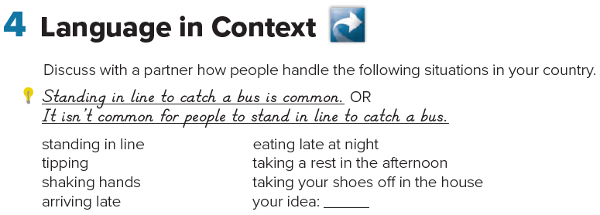
1-It’s a good idea to tip the waiters in S.A.
-Tipping the waiter is a good idea in S.A.
2-It’s polite for businessmen to shake hands.
-Shaking hands is polite in my country
3-It’s not a good idea to arrive late in Germany.
-Arriving late is not a good idea in Germany
4-It’s not advisable to eat late at night.
-Eating late at night is not advisable.
Page 128

Slide 5
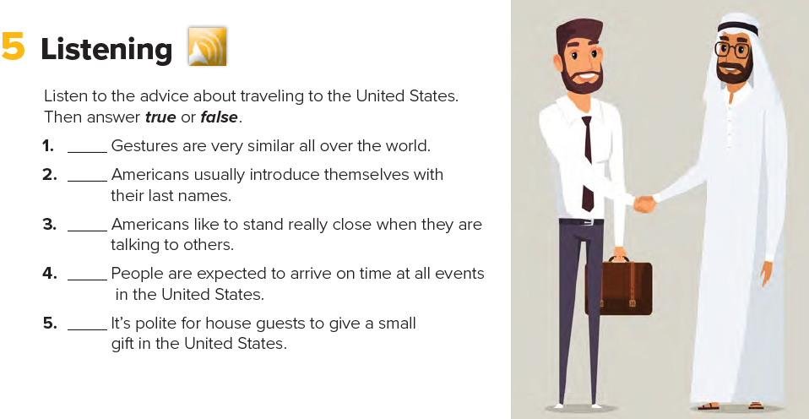

F
F
F
T
T
Page 128

Slide 6
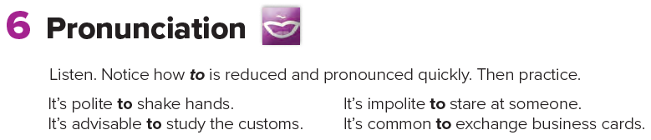
Page 128

Slide 7
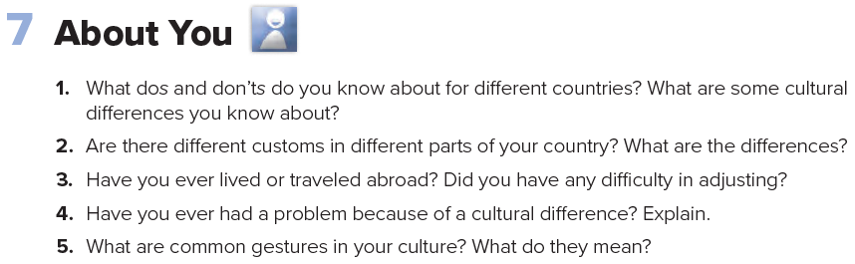
Page 128

Slide 8





Home Work
Workbook page 247

Slide 9
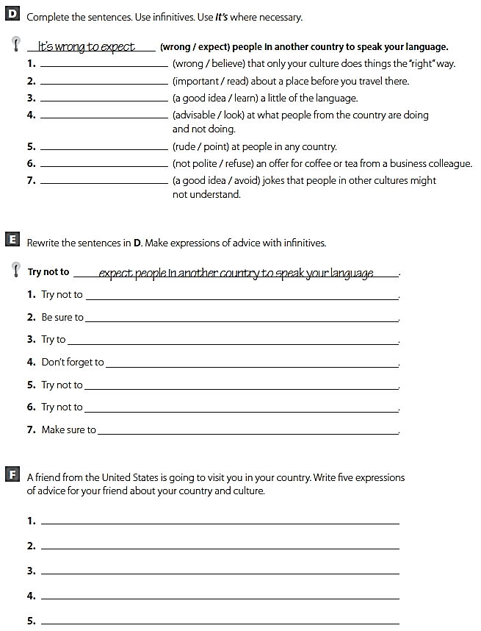
It’s wrong to believe
It’s important to read
It’s a good idea to learn
It’s advisable to look
It’s rude to point
It’s not polite to refuse
It’s a good idea to avoid
believe that only your culture does things the “right” way.
read about a place before you travel there.
learn a little of the language.
look at what people from the country are doing and not doing.
point at people in any country.
refuse an offer for coffee or tea from a business colleague.
avoid jokes that people in other cultures might not understand.

Slide 11






USA
PERU
EUROPE
AUSTRALIA

