Slide 1

Unit 16
What did you do last week?
Writing

Slide 2
بسم الله الرحمن الرحيم
Day:
Date:

Slide 3
Objectives
01
Write the directions for preparing this dish
02
Use sequence words
03
Prepare a presentation about a regional dish

Slide 4
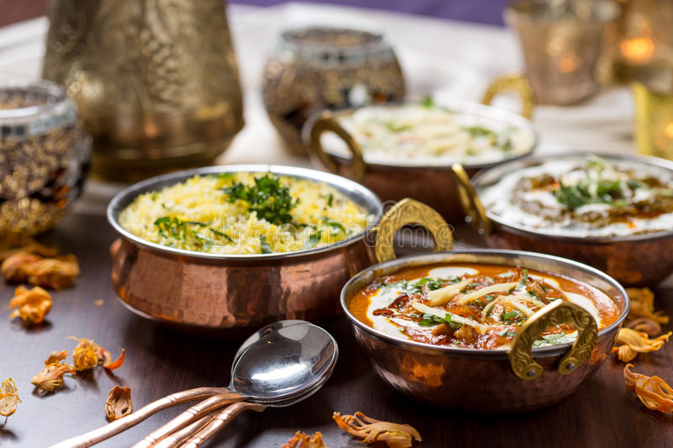
Warm up
What is your favorite food? Why?
Do you like Indian food, Chinese food? Italian food?...etc.

Slide 5
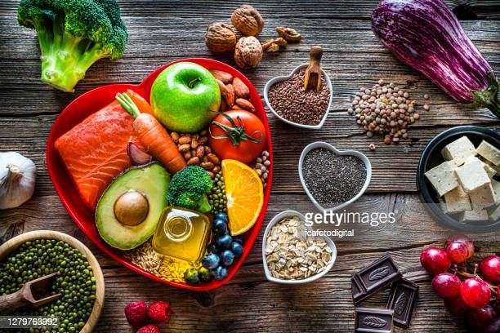
Page 146

Slide 6
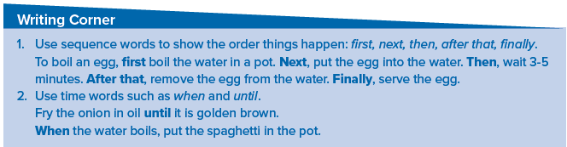
Page 146

Slide 7
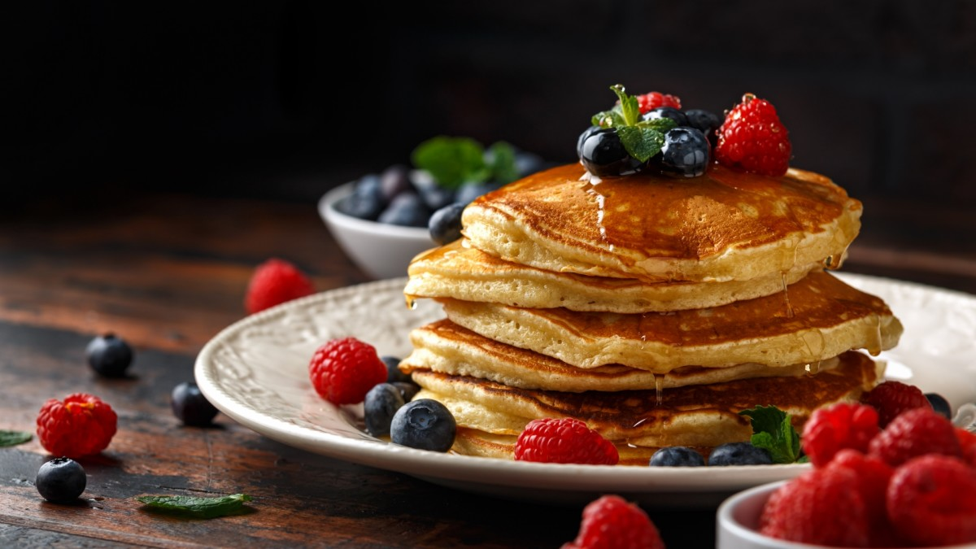
Page 146

Slide 8
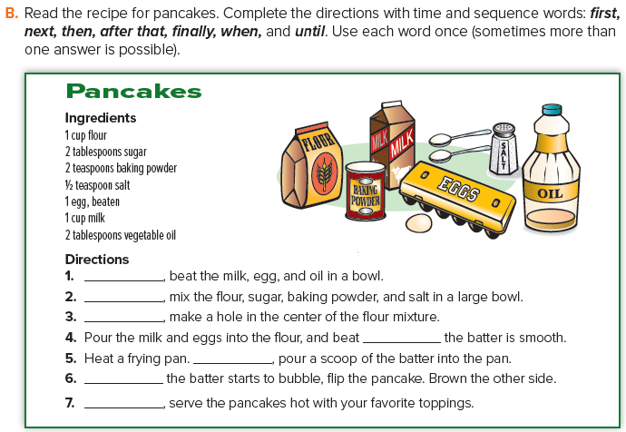
First
Next
Then
until
after that
When
Finally
Page 146

Slide 9
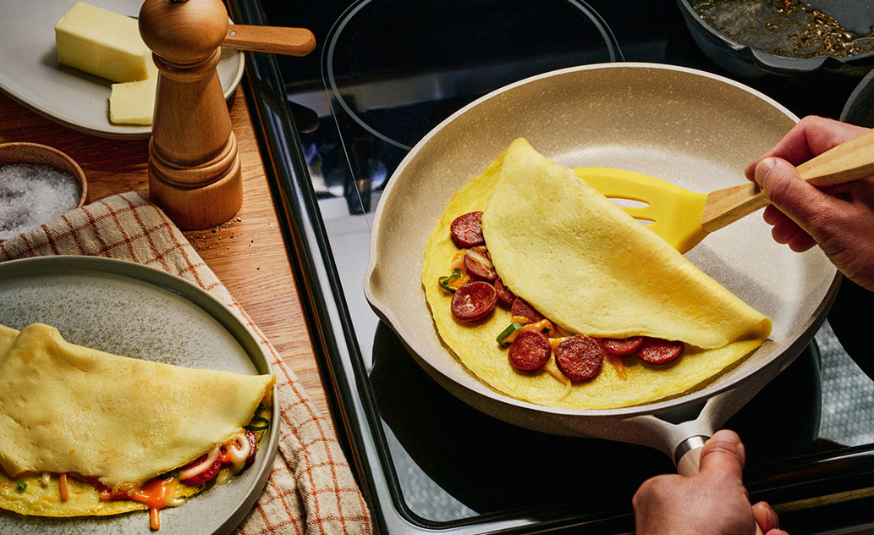
Ingredients:
2 eggs
2 tbsp ( 30 mL ) water
Pinch salt
Pinch pepper
Filling ingredients
Omelet
Instructions:
First, Whisk eggs, water, salt and pepper.
After that, heat the frying pan.
Next, pour in egg mixture. Tilt and rotate the frying pan to allow uncooked egg to flow into empty spaces.
When eggs are almost set ,fold over onto filled half.
Finally, Cook for a minute, then enjoy.
Page 146

Slide 10

Page 146

Slide 11
Homework
Page 256

Slide 12
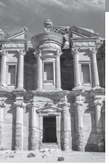
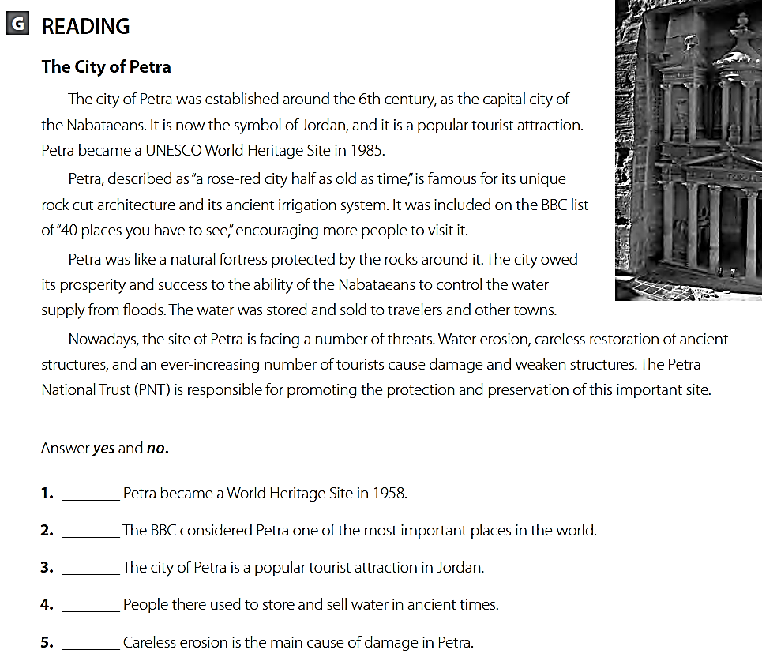
no
yes
yes
yes
no

Slide 13
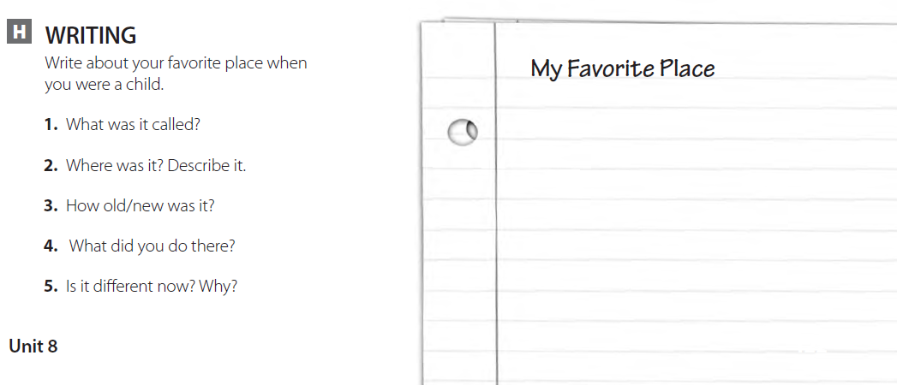
When I was young, my favorite place was my grandfather’s garden. It was between tall buildings in the center of the city, but it was full of flowers and trees. Grandfather planted a tree for each child that was born in the family and watched them grow. When I went back many years later, the garden was no longer there. The plants were gone. There were just rocks and an old wooden chair in the middle of it; grandfather’s chair.

Slide 14
THANK YOU

