Slide 1


Slide 2

Suggest a title for a summary.
Follow steps to write a summary.
Create a chain diagram from a story.
Use adverbs of degree correctly.

Slide 3
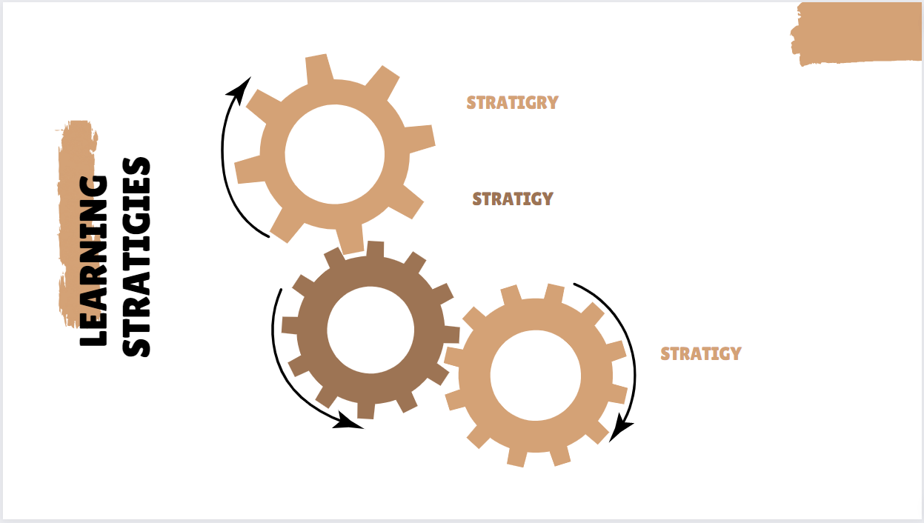
Thursday 21/10/1444 H
Active discussion
Heads together.

Slide 4


Slide 5

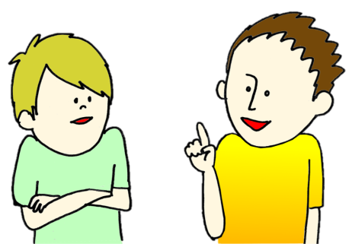





1
6
2
7
⇒
3
8
4
9
5
10
tekhnologic
She was …… eating when her friend arrives
( was – were )
We …… leaving the house when the telephone rung
( was – were )
I was studying when my mother …….
( calling – called )
( Was – Were ) he taking a test?
( Was – Were ) they doing their homework?
They / swim / rain / start
Nada / sleep / the father / call
Was he …… ( sleeping – slept )?
Was he sleeping?
Yes, ………………..
Were you studying?
No, ….………………..

Slide 6


136

Slide 7

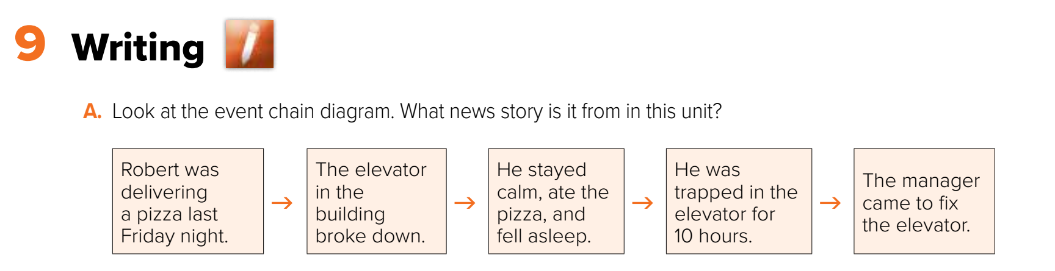

Thursday 21/10/1444 H

Slide 8
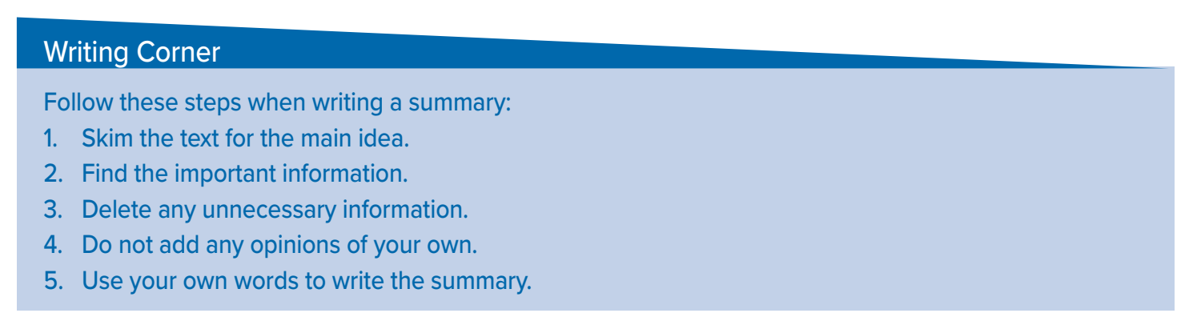

Slide 9

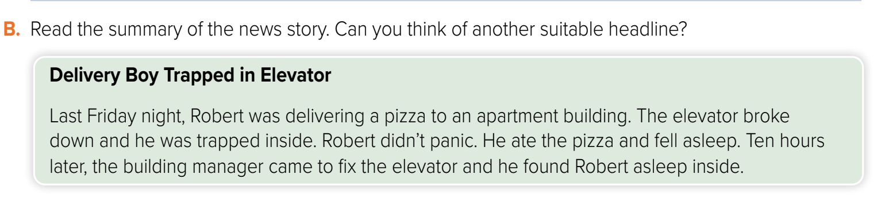

Slide 10

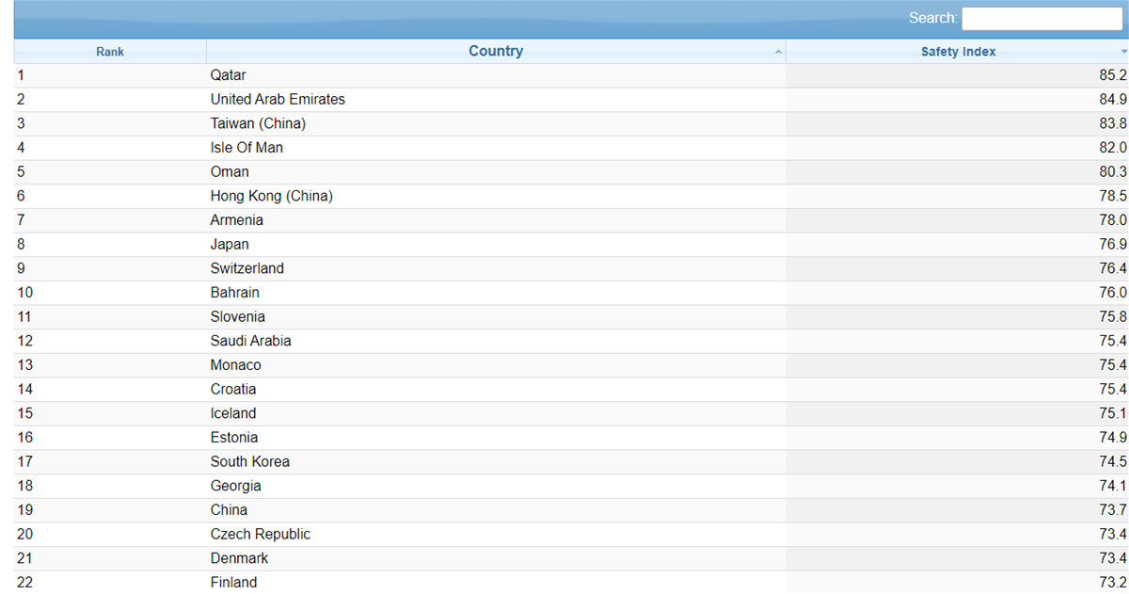

The Safest Countries:

Slide 11

before leaving the house :

Slide 12
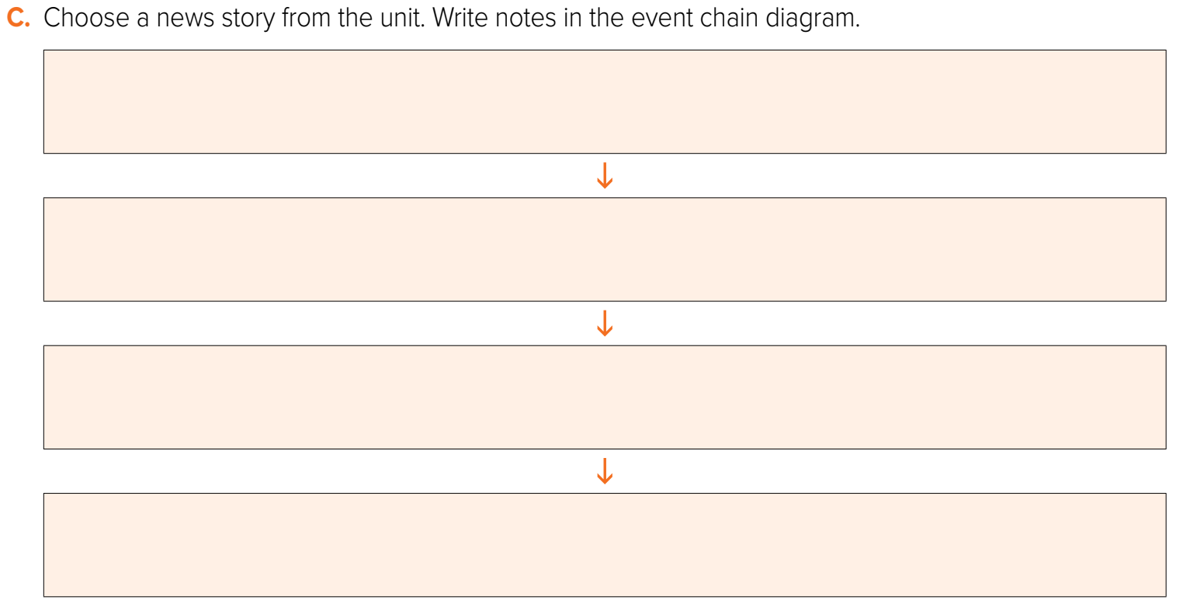
Robert was delivering a pizza
The elevator broke down and he was trapped inside
Robert didn’t panic. He ate the pizza and fell asleep
The building manager came to fix the elevator and he found Robert asleep inside

Slide 13

Asleep in the Elevator
Robert was delivering a pizza. The elevator broke down and he was trapped inside. Robert didn’t panic. He ate the pizza and fell asleep. Then the building manager came to fix the elevator and he found Robert asleep inside.

Slide 14

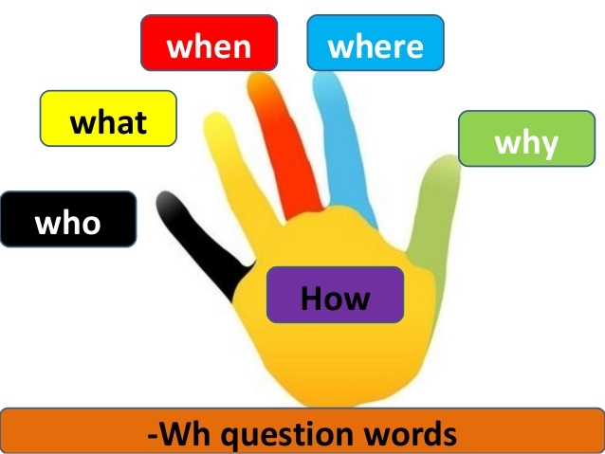
Homework

Slide 15


Slide 16

I’m extremely happy
I’m not very happy
I’m happy

Slide 17
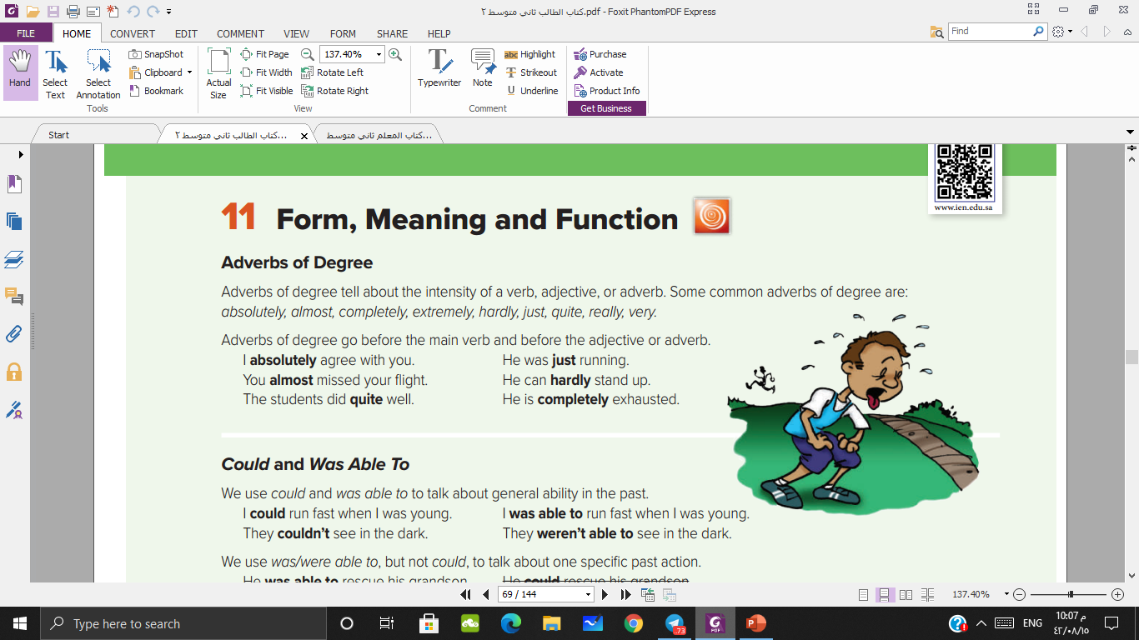

Slide 18
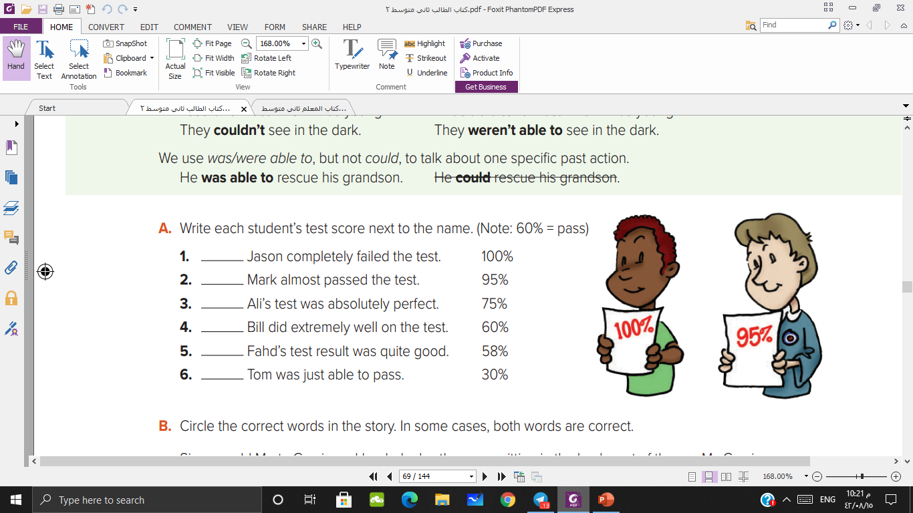
10%
59%
100%
90%
85%
60%

Slide 19
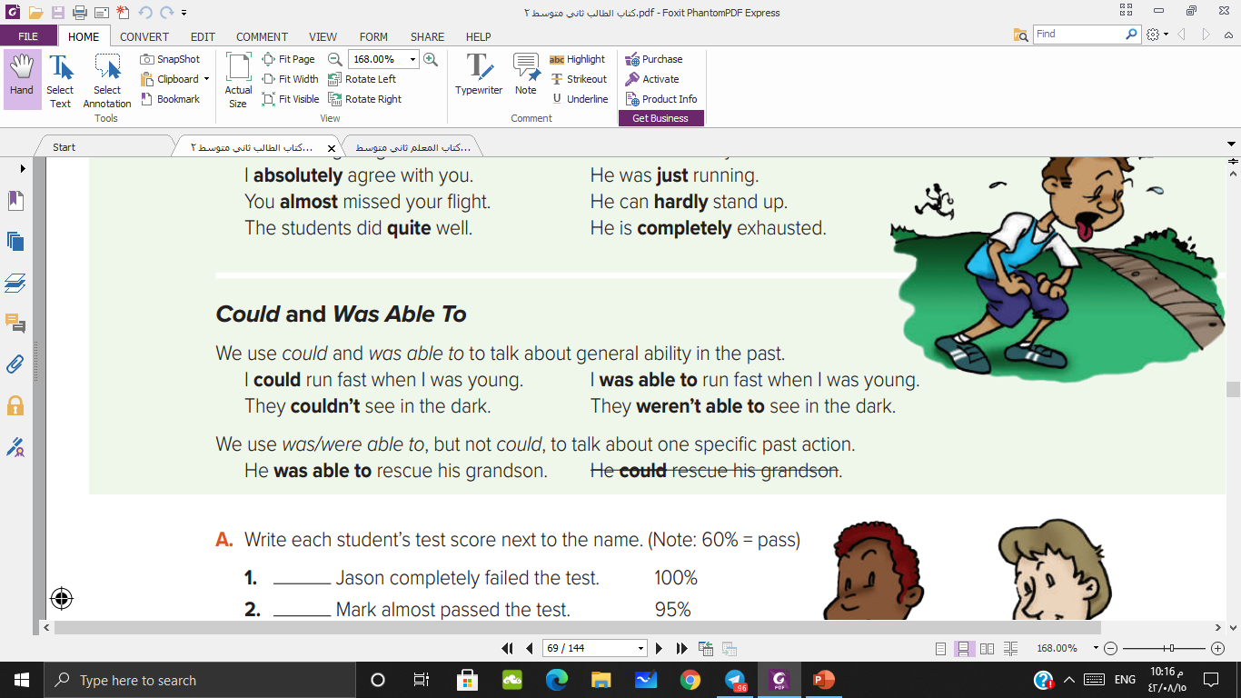

Slide 20
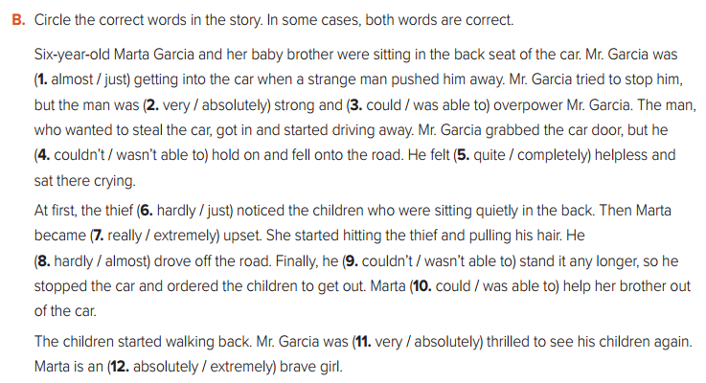

Slide 21
Have a nice WEEKEND

