Slide 1
Writing unit 12

Slide 2
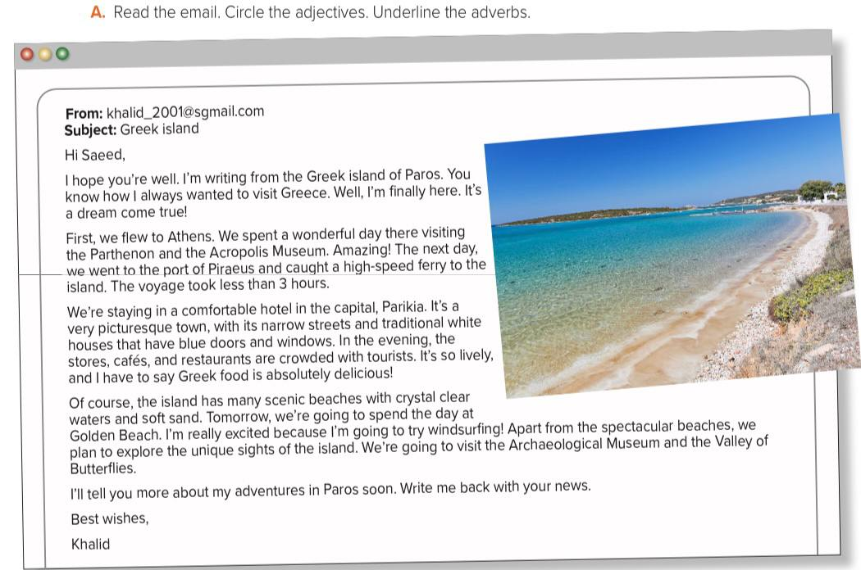

Slide 3
Where is khalid?
How did he travel ?
What is it like there in evening ?
What activities is he goning to do there?

Slide 4
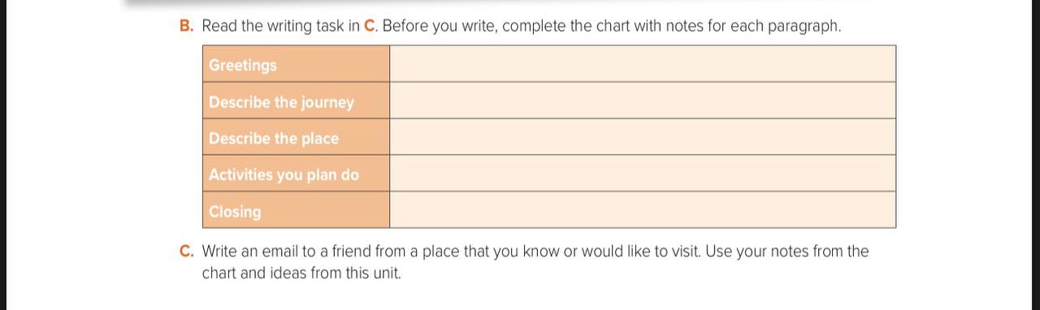
Hi - I hope you are well
Wonderful – amazing
Comfortable hotel – crowded – lively –scenic -
Windsurfing – visit museum
Write me back – best wishes

