Slide 1

It’s going to be fun
Form , meaning and function

Slide 2
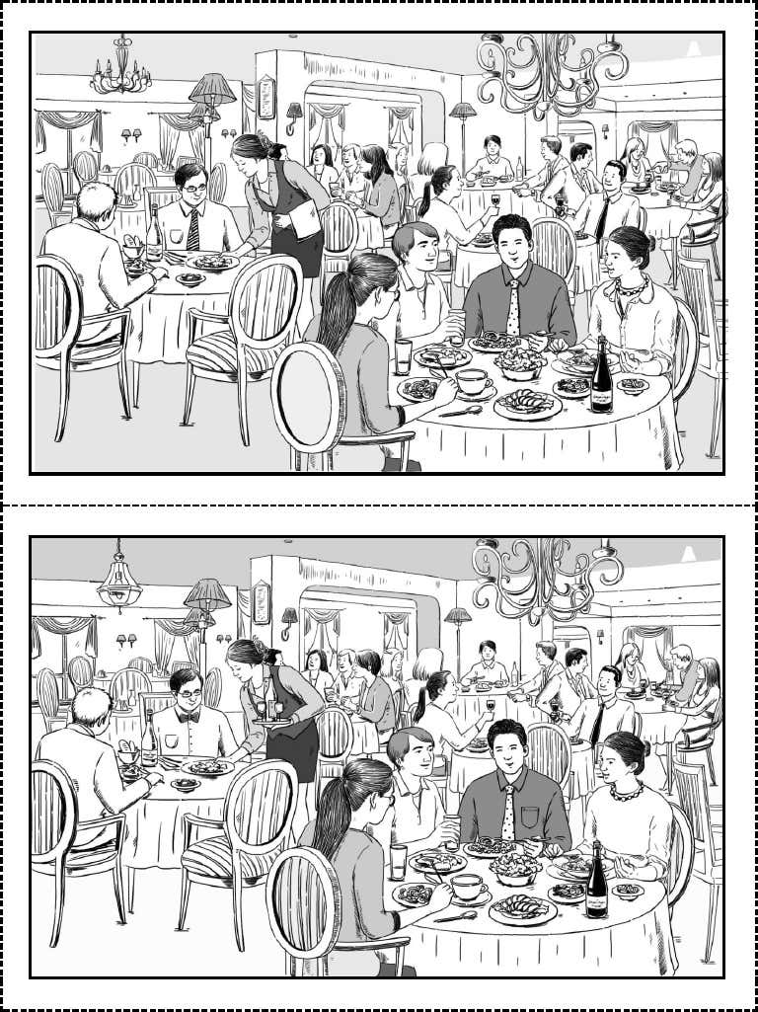
Form , meaning and function

Slide 3
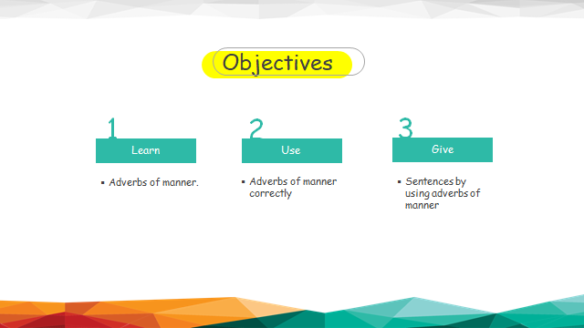
غ

Slide 4
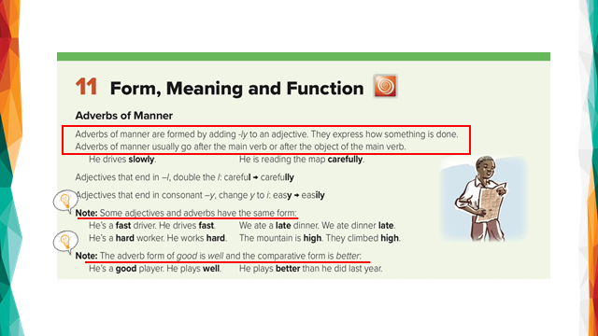

Slide 5
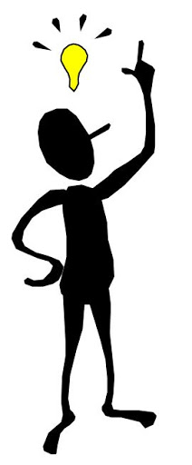
Adverbs of manner
You can make lots of adverbs by using adjectives.
Slow (adj)
Slowly (adv)
+ ly
quick (adj)
+ ly
quickly (adv)

Slide 6

Adjectives that end in L
Careful carefully
Adjectives that end in y
Easy easily

Slide 7


Some an adjective and an adverb have the same form
Fast (adj)
Fast (adv)
Hard (adj)
Hard (adv)

Slide 8
Some an adjective and an adverb have the same form
late (adj)
late (adv)
High (adj)
High (adv)

Slide 9
The adverb of good is well
good(adj)
Well (adv)

Slide 10
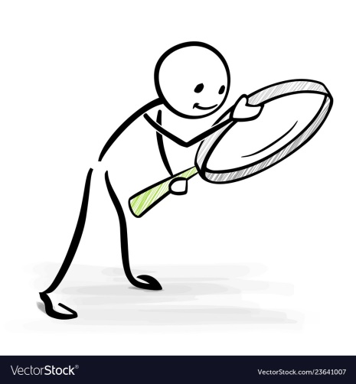
For example:
He is a good writer. ( adj)
He writes well . ( adv)
You are a fast runner ( adj)
You run fast ( adv)

Slide 11
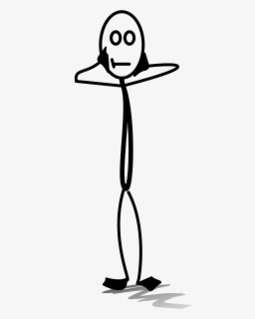
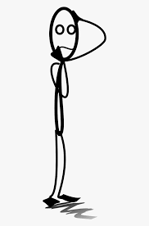
Adjectives
Describe the subject ( things \ people )
For example:
Bader is a slow driver .
Adverbs
Describe the verb ( action ).
For example:
Bader drives slowly .

Slide 12
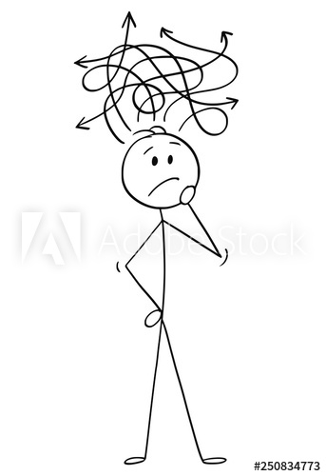
S adj
Sara is a quiet talker
S v adv
Sara talks quietly.

Slide 13
قال تعالى( وعباد الرحمن الذين يمشون على الأرض هونا و اذا خاطبهم الجاهلون قالو سلاما و الذين يبيتون لربهم سجدا وقياما)

Slide 14
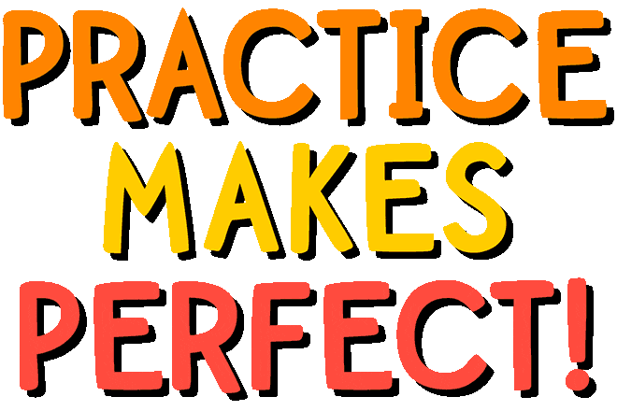
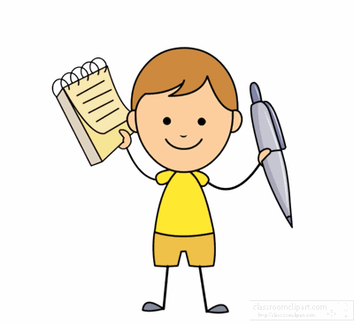

Slide 15


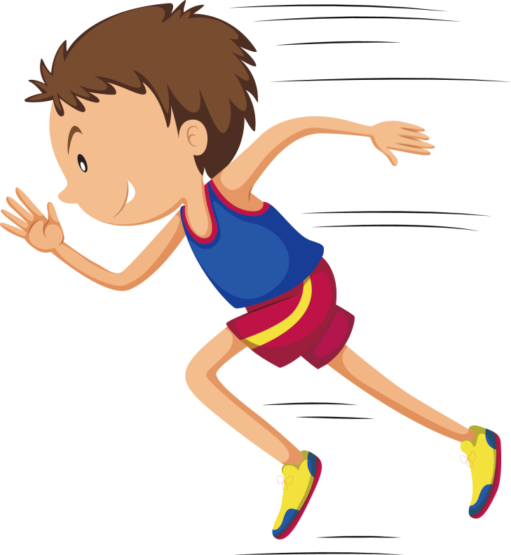

He ran __________
quickly
quick
soft

Slide 16
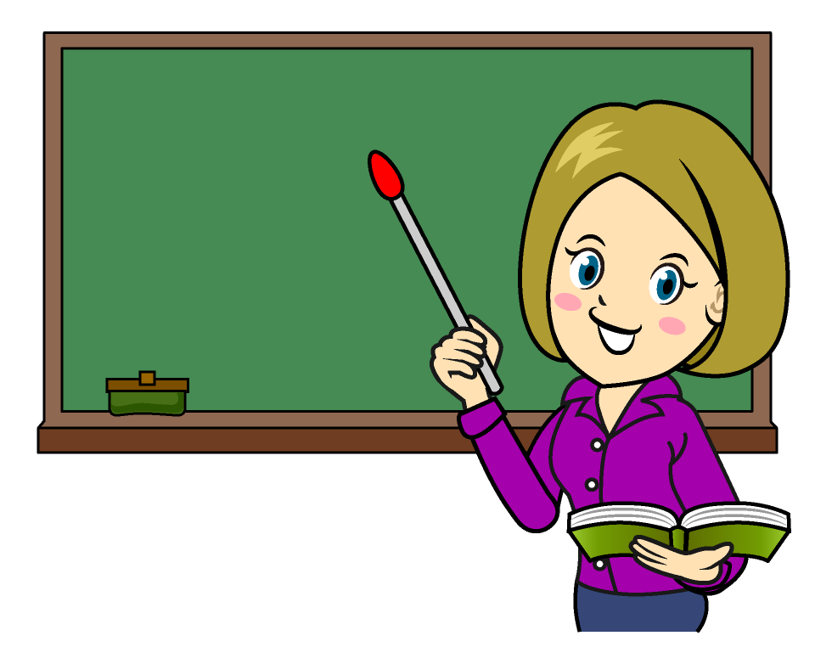
The English teacher spoke __________
soft
hard
slowly

Slide 17
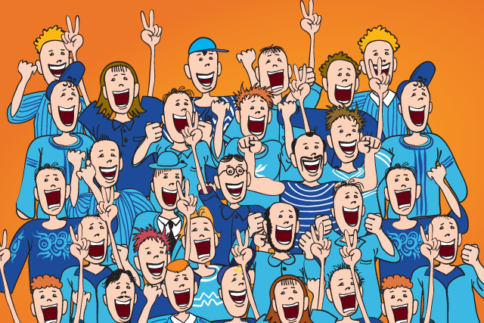
The audience laughed ______
loudly
loud
silent

Slide 18
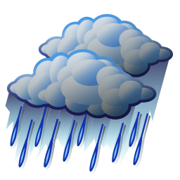
The rain fell _____ during the storm
hardly
hard
boring

Slide 19



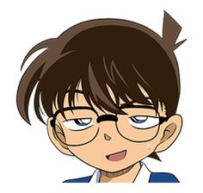


Al
Find the fib
Ali runs fastly

Slide 20
Al
Find the fib
They walk quick

Slide 21
Al
Find the fib
She talk loudly

Slide 22
Al
Find the fib
He is a slowly driver

Slide 23
Al
Find the fib
Sara writes will

Slide 24

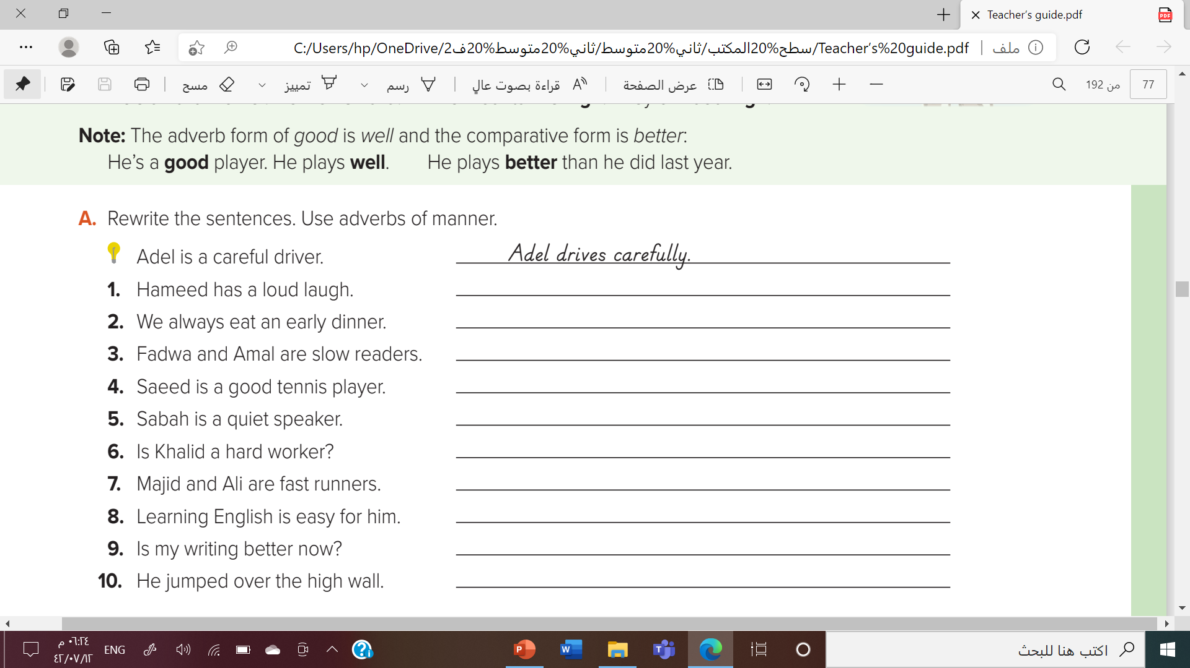

Hameed laughs loudly
We always eat dinner early
Fadwa and Amal read slowly.
Saeed plays tennis well.
Sabah speaks quietly
Does Khalid work hard?
Majid and Ali run fast.
He learns English easily.
Do I write better now?
He jumped high over the wall.

Slide 25



Slide 26
