Slide 1
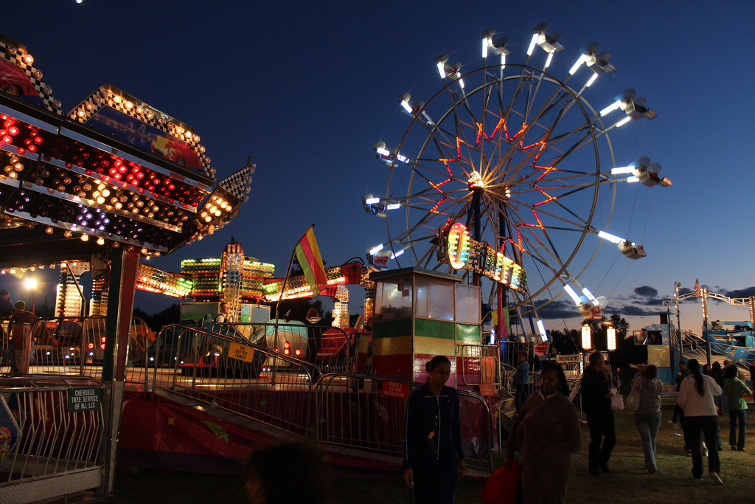
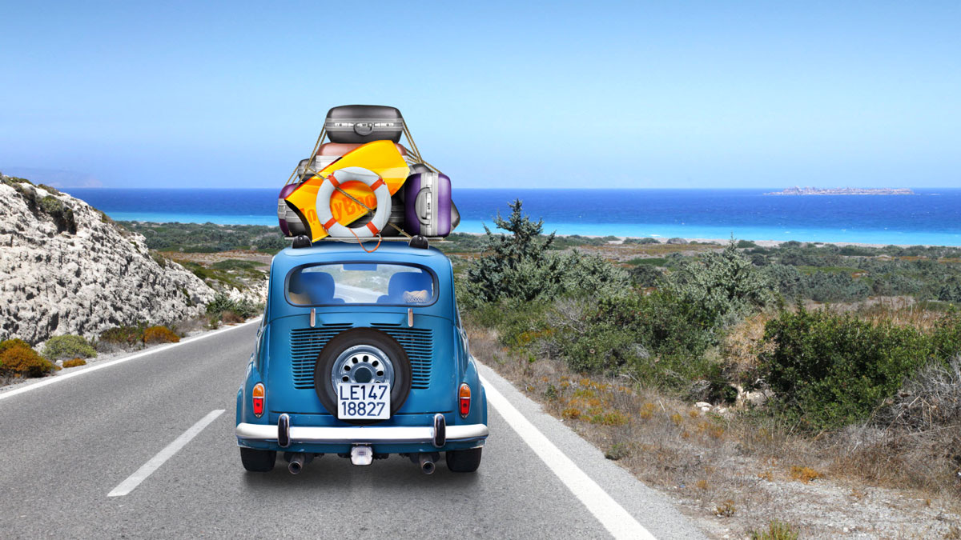
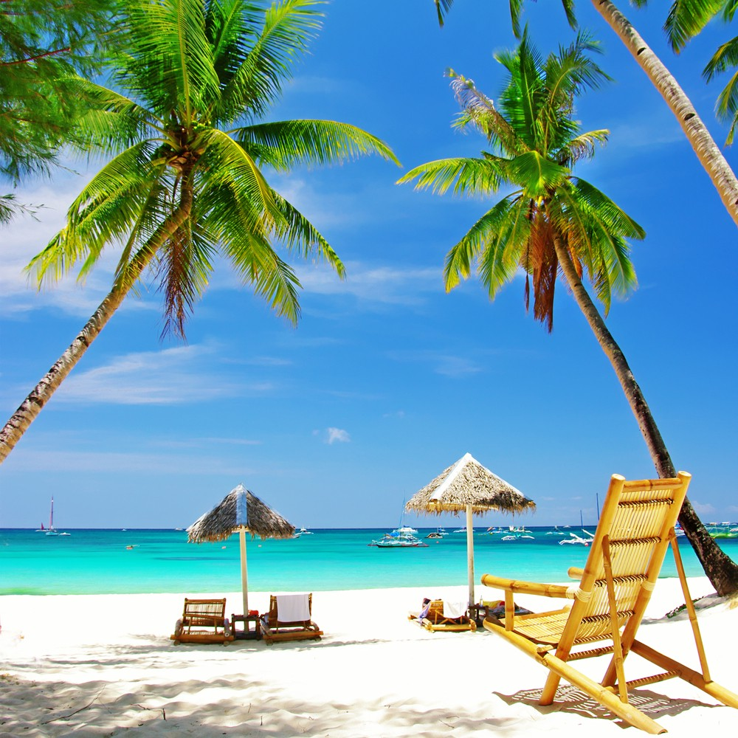
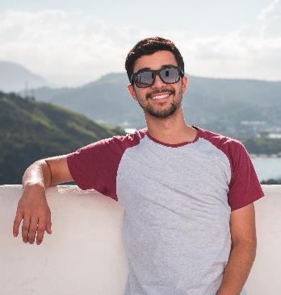
Unit 4 It’s going to be fun
Listen and discuss
Tr. Nora Khalid

Slide 2


Slide 3


Vocabulary
Vacation activities
Travel destinations
Clothes and
travel items

Slide 4


Did you travel last year? Where? Why

Slide 5
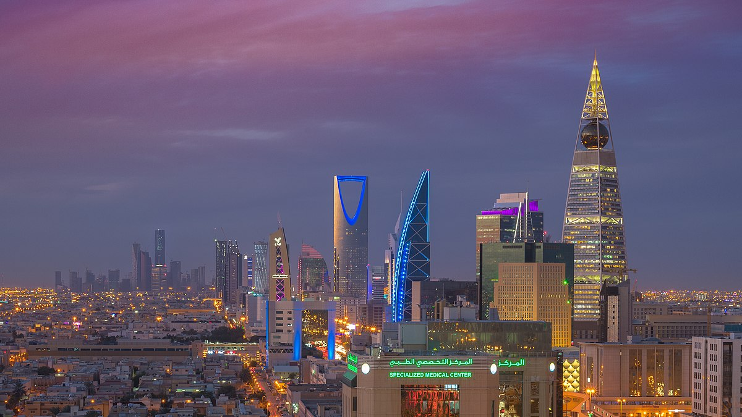
I am going to go to Riyadh on my next vacation. I’m going to go by plane. I’m going to stay for 10 days. I’m going to visit the Kingdom Tower.

Slide 6
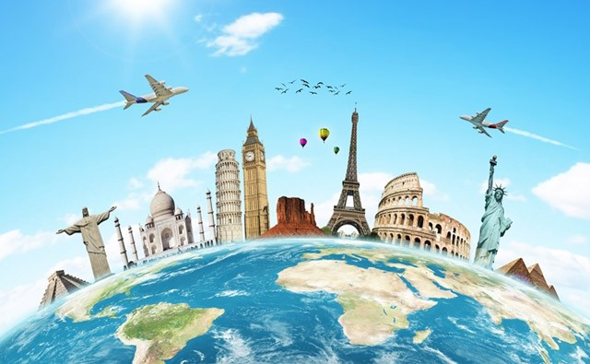
Where are you going to go on your next vacation? Are you going by car or by plane? Are you going to stay for a long time?

Slide 7
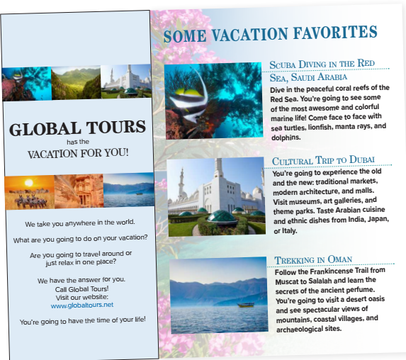
What is the brochure for?
For vacation places
What’s the name of the company on the brochure?
Global Tours
What does the first picture show?
Marine Life
What does the second picture show?
A modern mosque.
What does the third picture show?
Mountains.

Slide 8
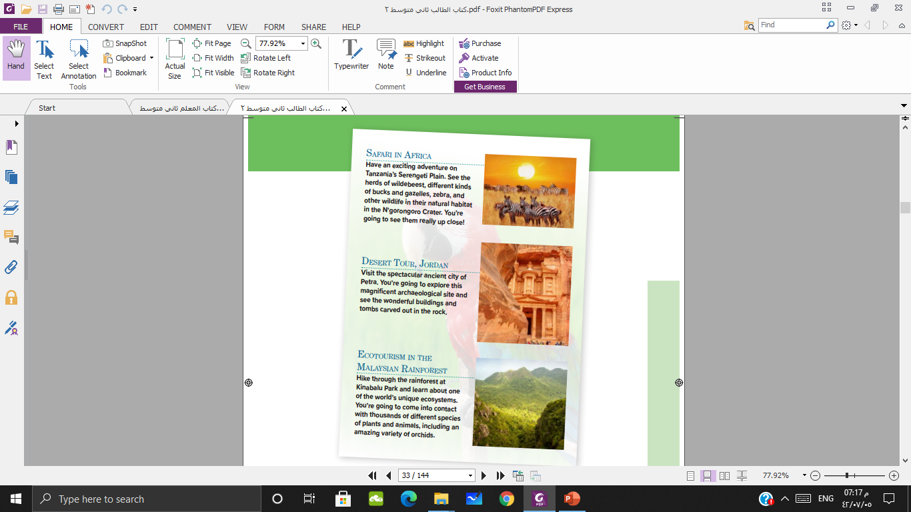
What does the fourth picture show?
Wildlife
What does the first picture show?
Desert
What does the fifth picture show?
Rainforest

Slide 9
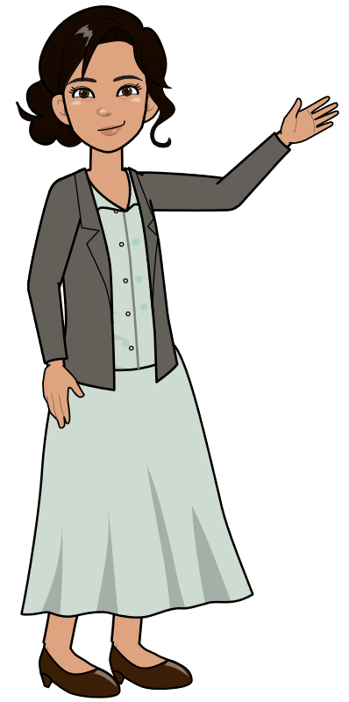
Which country should you visit if you want to see
museums and modern architecture?
Dubai
How about if you want to follow an ancient trail?
Oman
Where can you go on a safari and see wildlife in
their natural habitat?
Africa

Slide 10
What about if you want to go scuba diving?
Saudi Arabia
How about if you want to visit archaeological sites like tombs
Jordan
Which country is a good place to visit if you are interested in ecosystems?
Malaysia

Slide 11
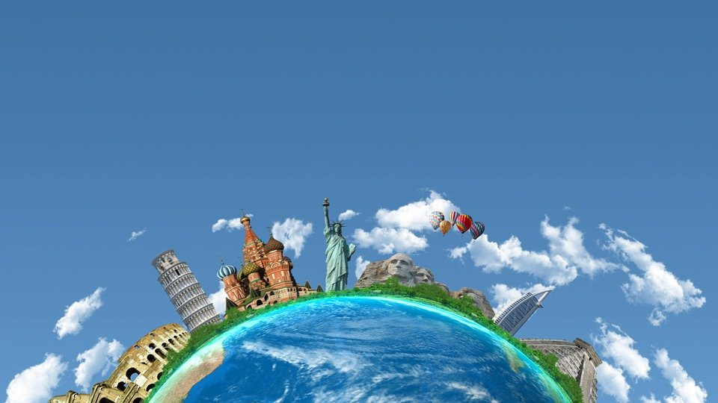
What kind of vacation do you prefer?

Slide 12
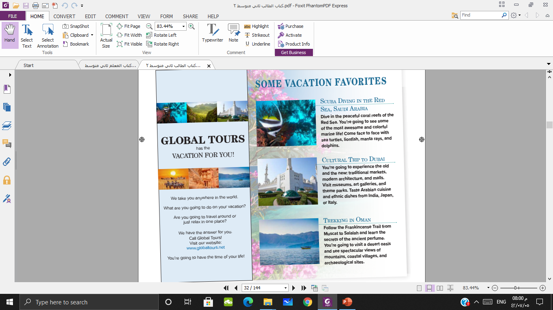


Slide 13
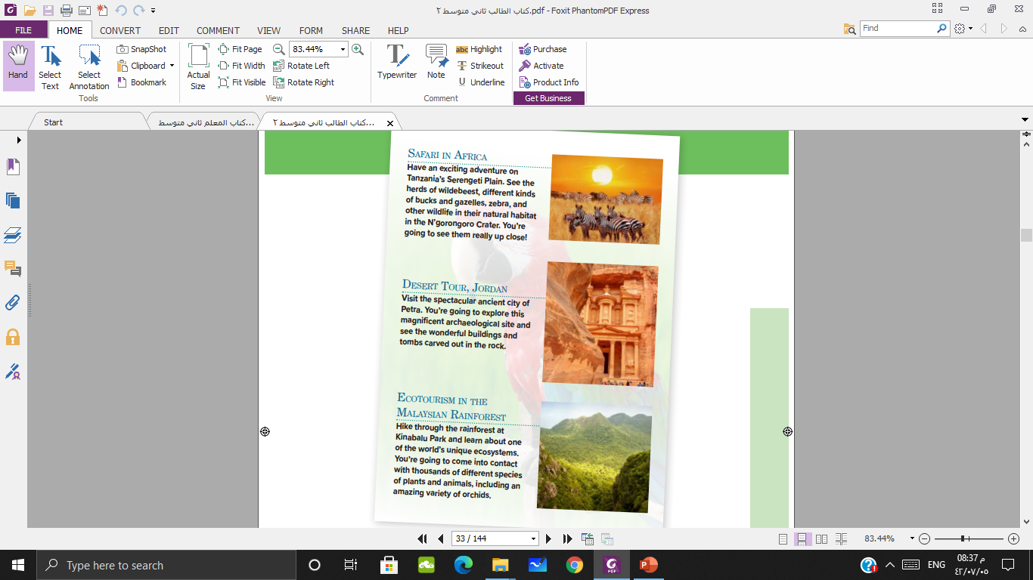

Slide 14
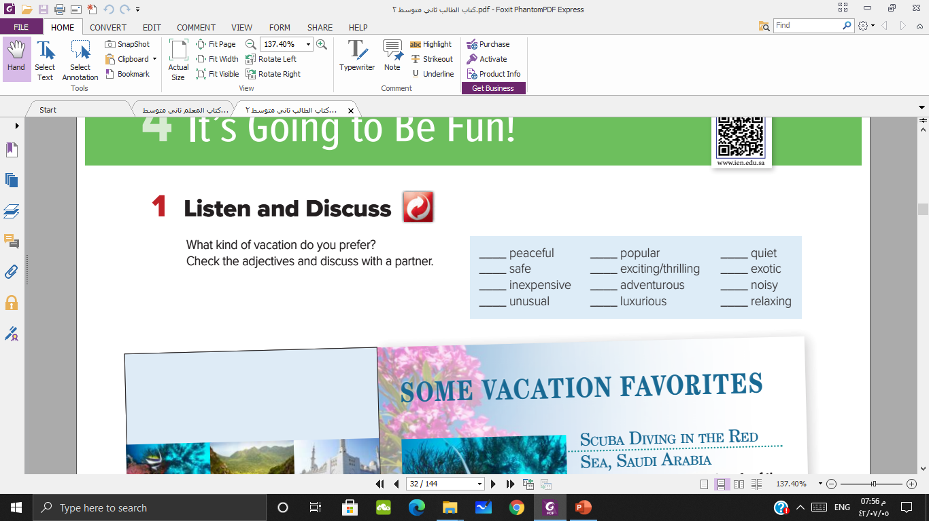


Slide 15
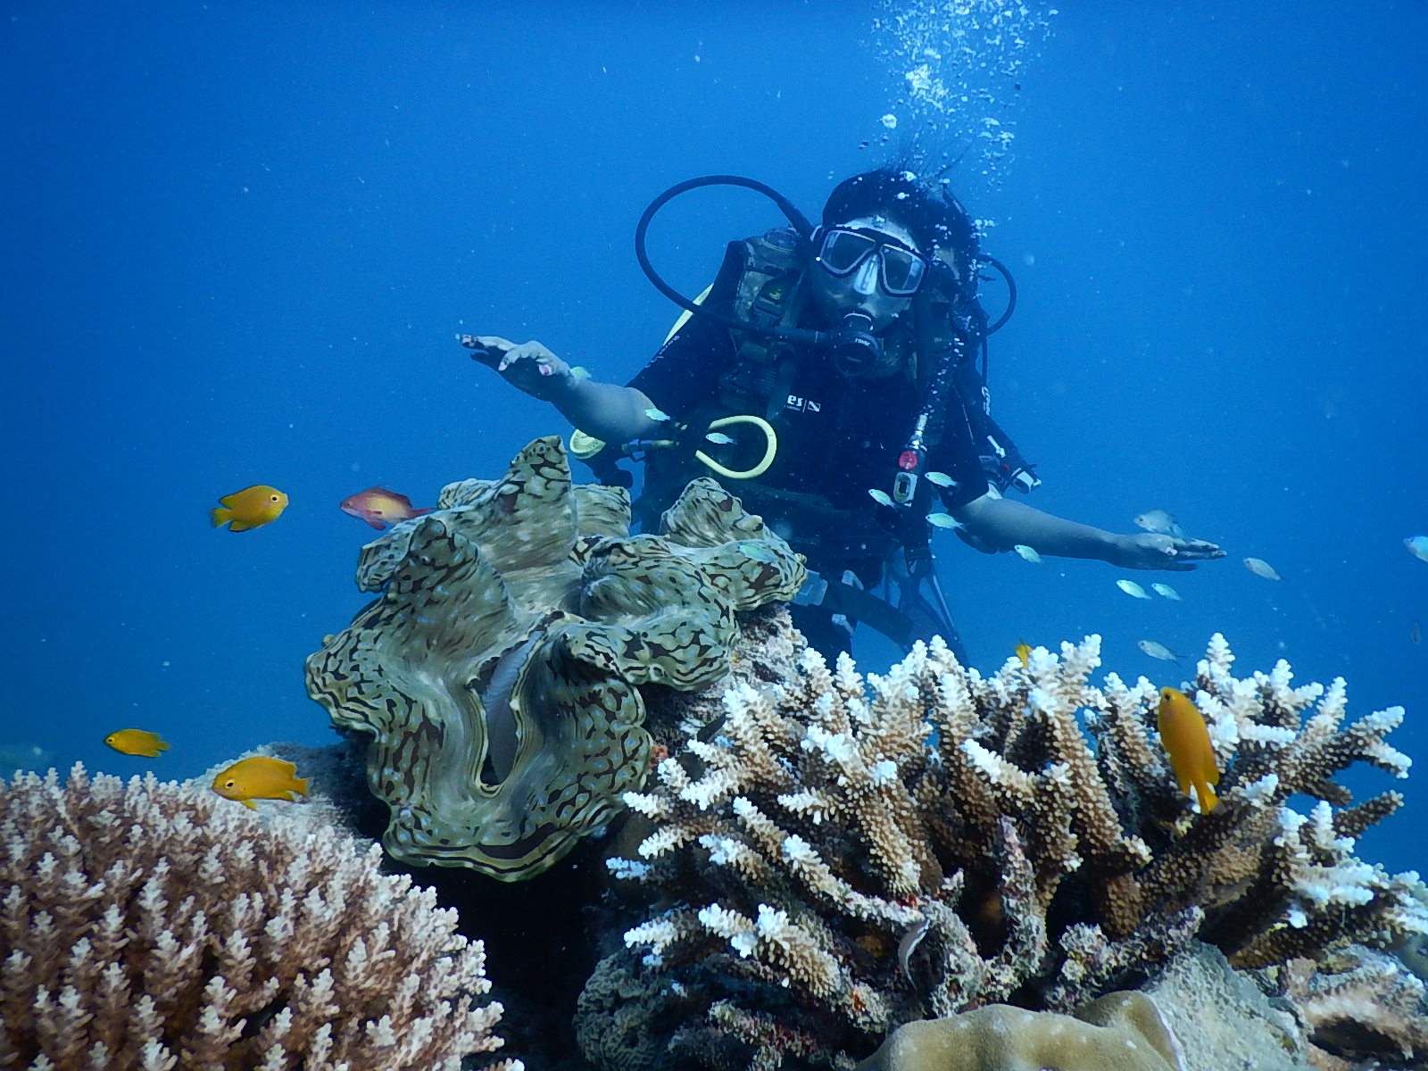
The scuba diving vacation in Saudi Arabia is going to be …………….

Slide 16
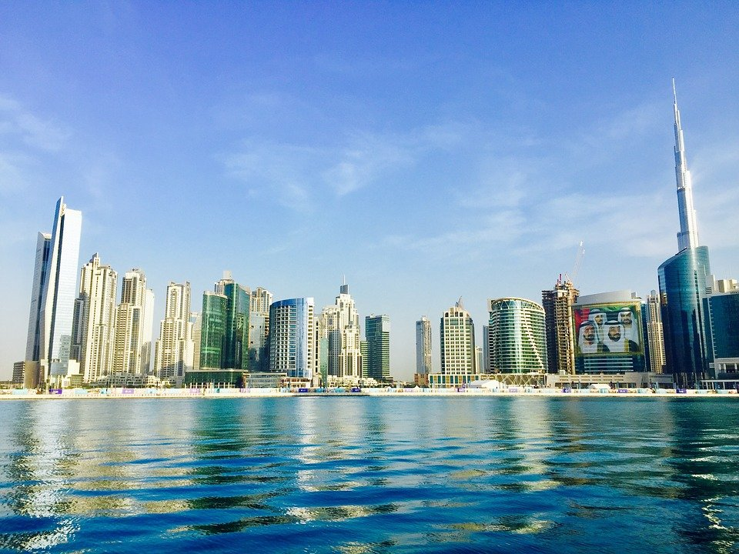
The visit to Dubai ___is going to be …………….

Slide 17
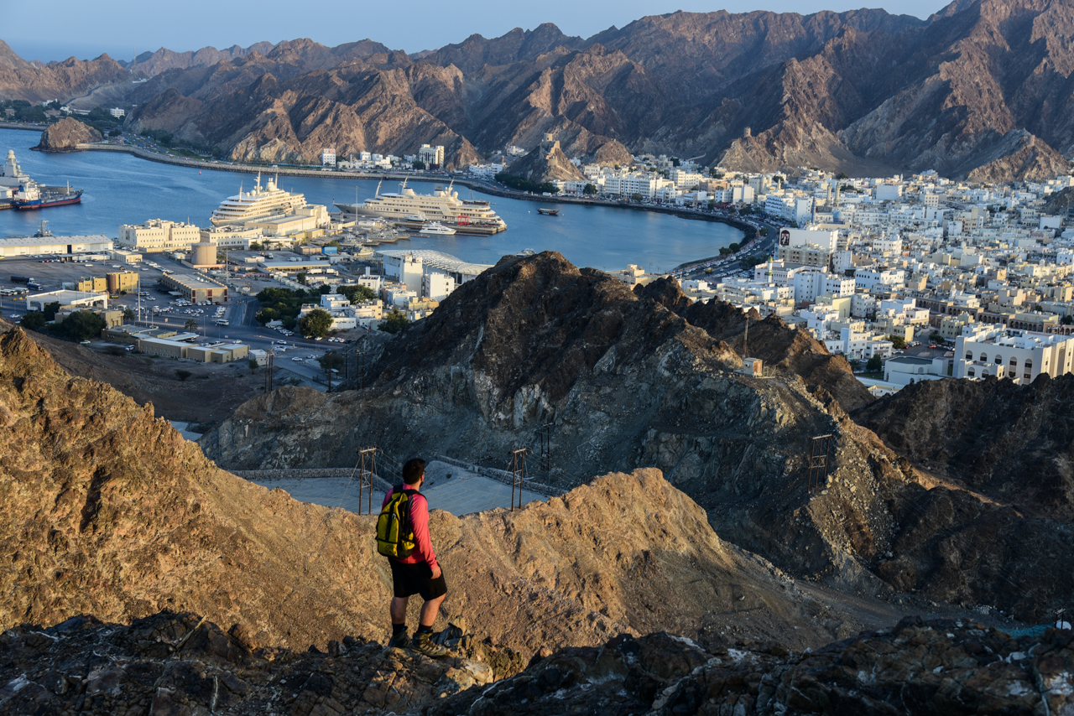
The trek in Oman is going to be …………….

Slide 18
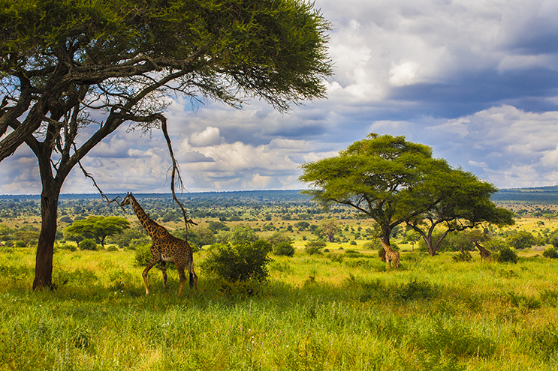
The safari in Tanzania is going to be …………….

Slide 19
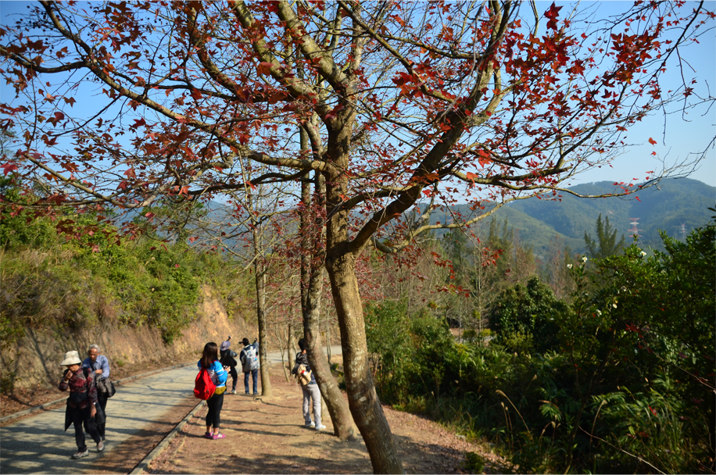
The hike in the Malaysia rainforest is going to be …………….

Slide 20

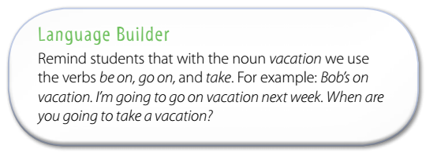

Slide 21
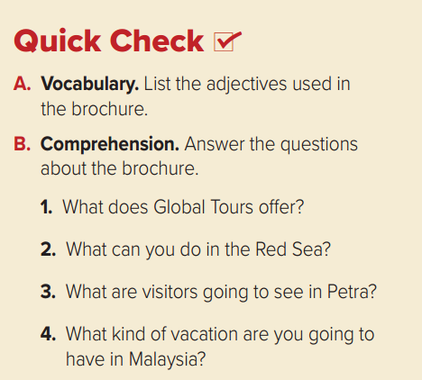
Global Tours offers a vacation anywhere in the world. It offers different kinds of vacations. You can travel around or relax in one place.
You can go scuba diving in the peaceful coral reefs and see colorful marine life.
In Petra, visitors are going to see an ancient city with wonderful buildings and tombs carved in the rock.
In Malaysia, you’re going to hike through the rainforest and learn about the unique ecosystem. You’re going to come into contact with different species of plants and animals.

Slide 22
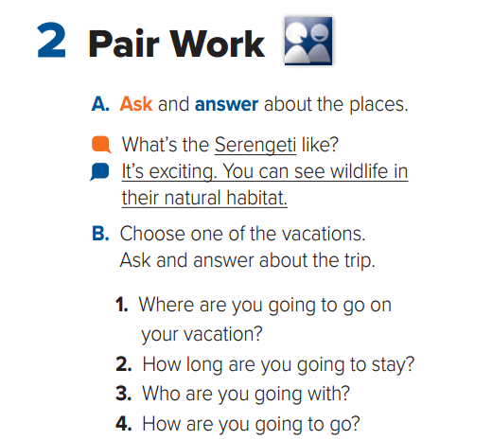

Slide 23
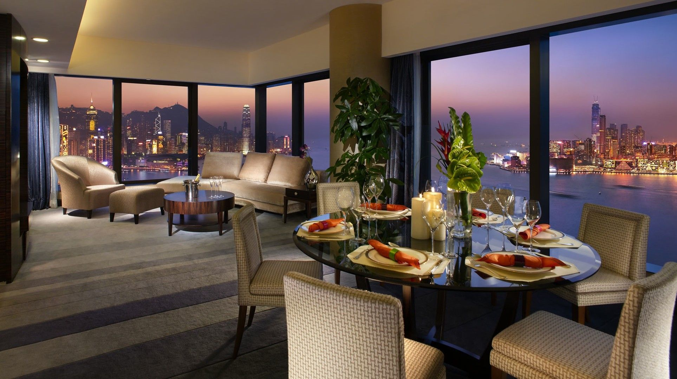
inexpensive
This restaurant is ……………..
exotic
luxurious

Slide 24
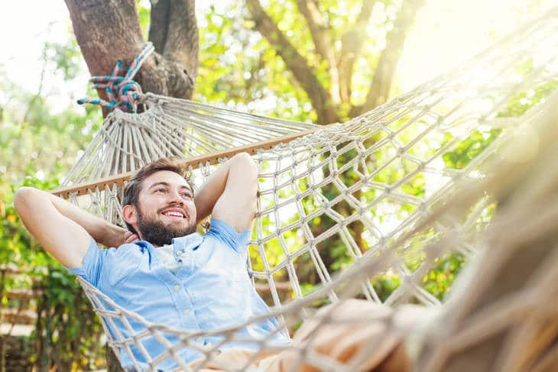
relaxing
The man is having a ……. time after work.
noisy
exotic

Slide 25
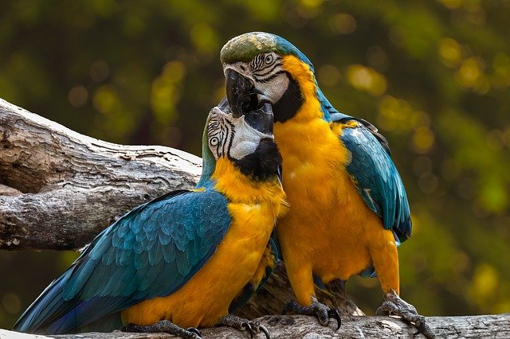
inexpensive
These birds are …………….. I like them.
exotic
safe

Slide 26
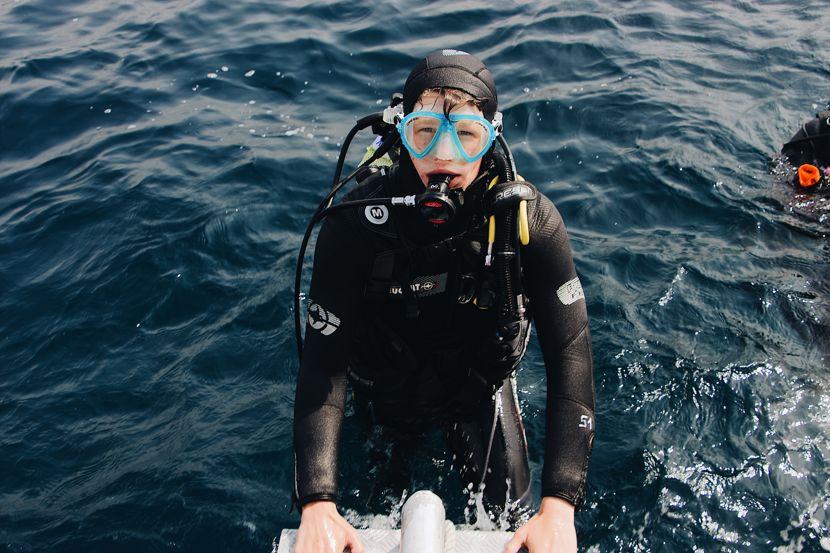
noisy
I like diving because I’m a …………. person.
adventurous
peaceful

Slide 27

P 101
A – B

Slide 28
