Slide 1


Slide 2

Wednesday 19/10/1444 H
Read a news paper article
Answer questions about the article.

Slide 3
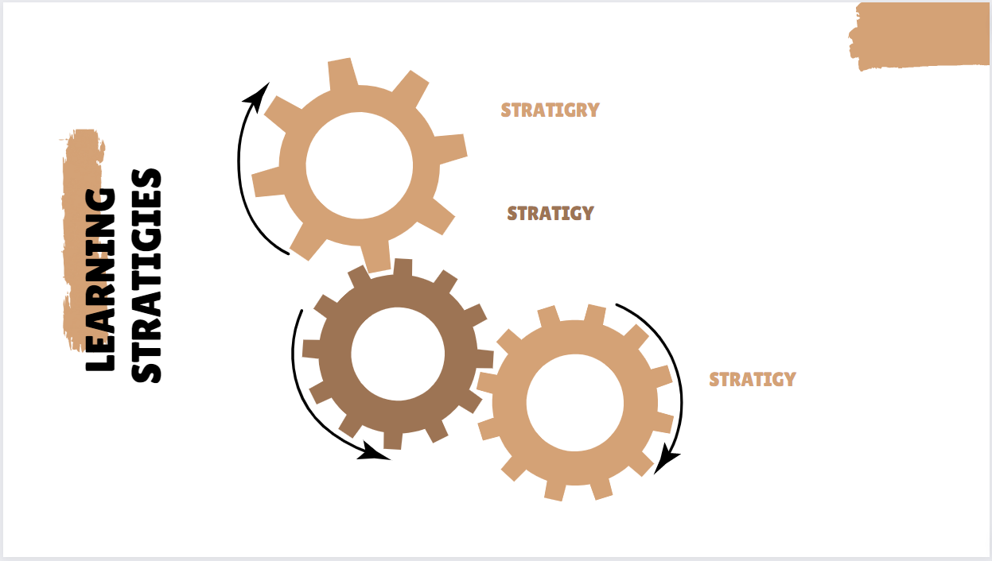
Wednesday 19/10/1444 H
Active discussion
I- partner

Slide 4

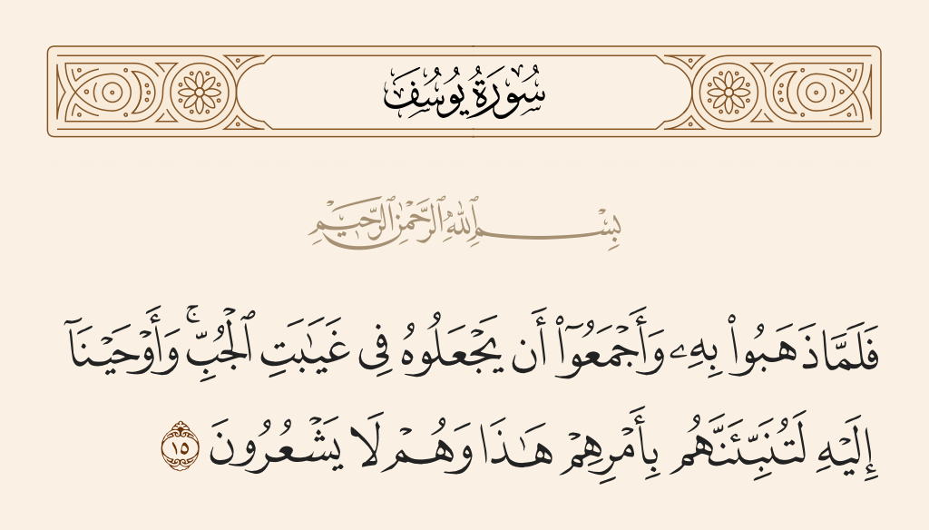
Wednesday 19/10/1444 H
Pg. 132

Slide 5

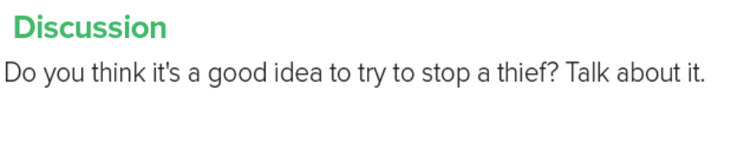
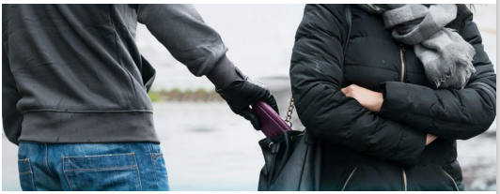
Wednesday 19/10/1444 H
Pg.252

Slide 6
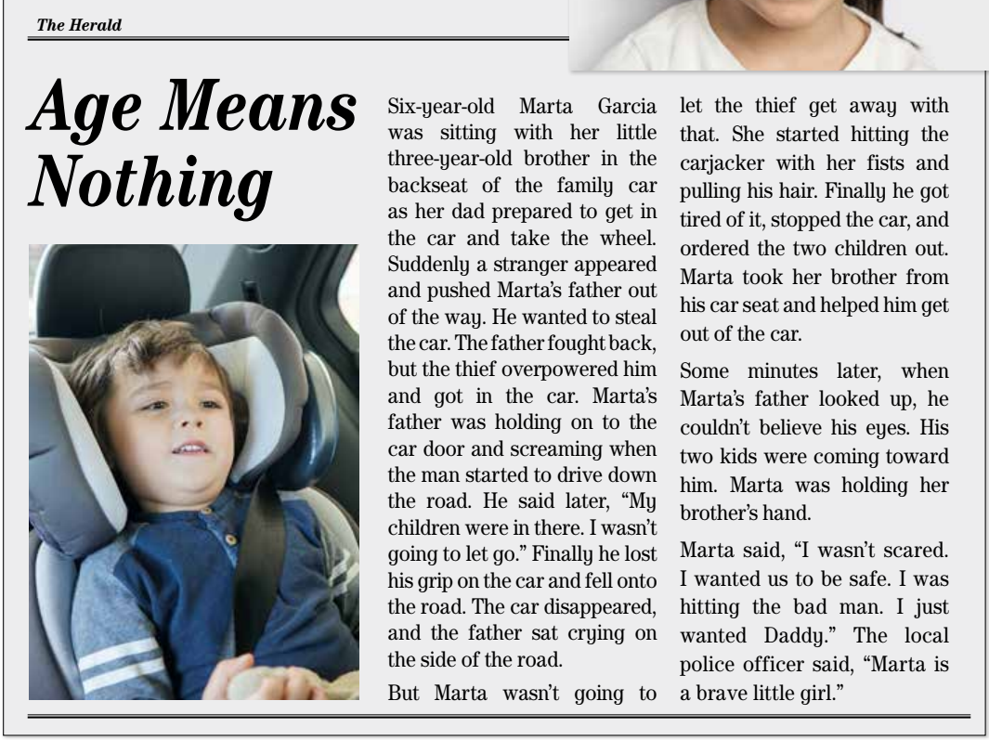

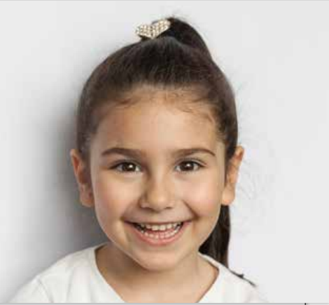
Wednesday 19/10/1444 H
Pg. 135

Slide 7

Wednesday 19/10/1444 H
Read a news paper article
Answer questions about the article.

Slide 8
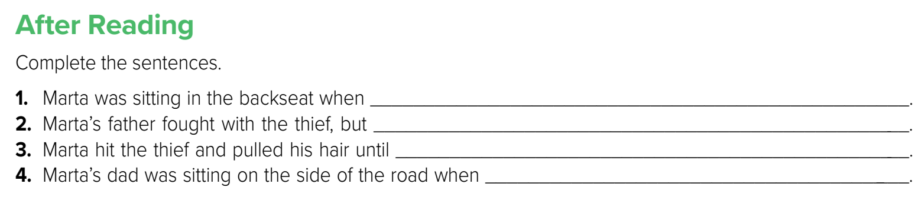

Wednesday 19/10/1444 H
Pg. 135

Slide 9
Wednesday 19/10/1444 H
1. a stranger pushed her father out of the way, got in the car, and drove away.
2. the thief overpowered him and got in the car.
3. he stopped the car and ordered the children out.
4. he saw his two children walking toward him.
Pg. 135

Slide 10
Wednesday 19/10/1444 H
Read a news paper article
Answer questions about the article.

Slide 11


Wednesday 19/10/1444 H
Homework
Workbook
Pg. 252 (E)

Slide 12
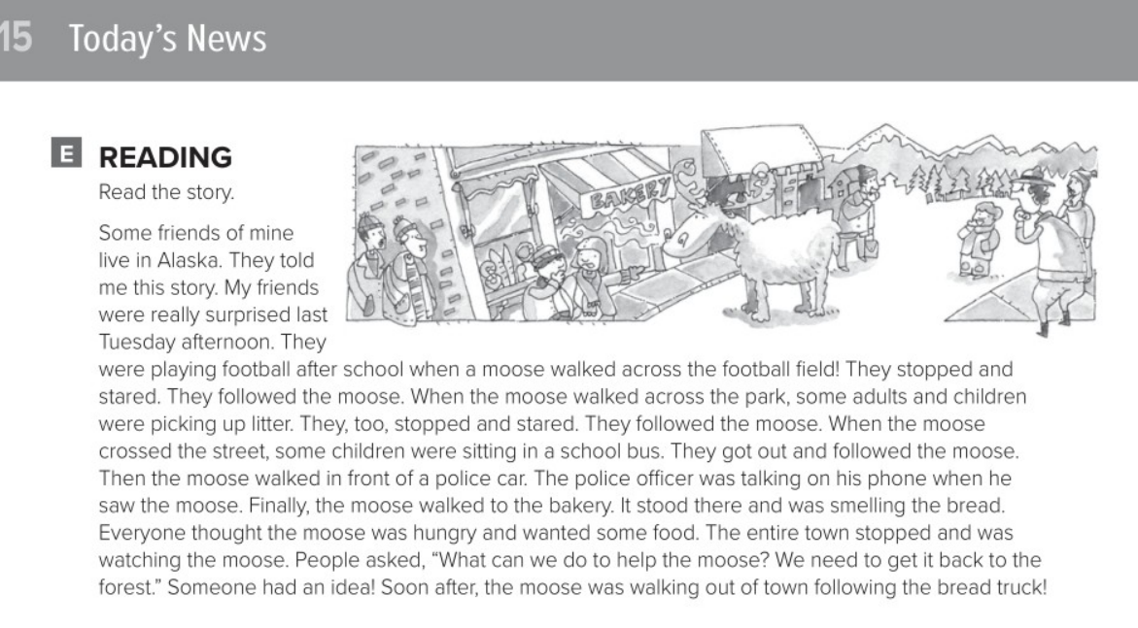
Wednesday 19/10/1444 H
Pg.252

Slide 13
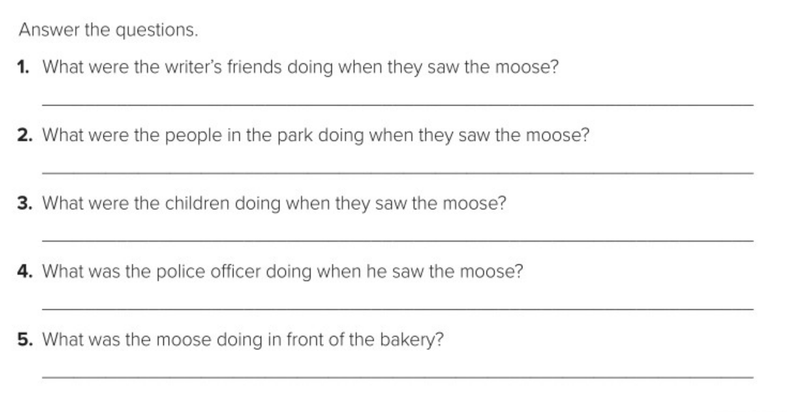
Wednesday 19/10/1444 H
The writer’s friends were playing football when they saw the moose.
The people in the park were picking up litter when they saw the moose.
The children were sitting in a school bus when they saw the moose.
The police officer was talking on his phone when he saw the moose.
The moose was smelling the bread.
Pg.252

