Slide 1
Unit 15 Today’s News Reading
Page 135

Slide 2
Learning objectives :
Identify the main idea of reading.
Answer questions about the reading.

Slide 3
Before Reading :
What is the title?
Do we have subtitles?
How many pictures are there? Paragraphs? Lines?
Scan: What is the passages talking about?
Skim: Find numbers, names of people & name of places

Slide 4
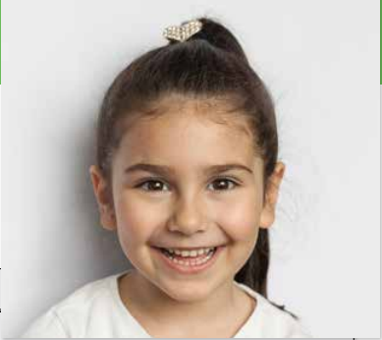
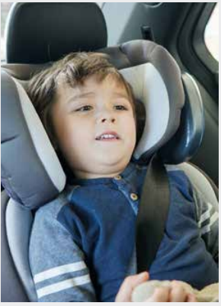
How old is the little girl in the first picture?
What about the child in the car seat?

Slide 5
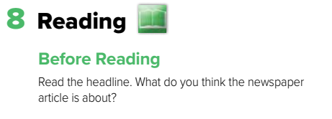

Slide 6
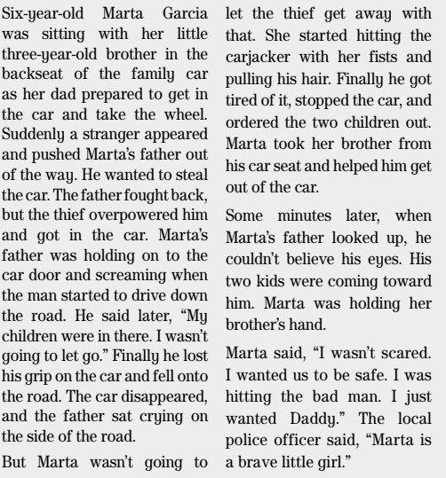
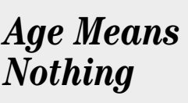


Slide 7
most newspaper articles and stories try to answer the questions Who, What, Where, When, and Why.
Who was in the car?
Where were they?
When did this happen?
What did Marta do?
Why did she do it?
How old was she?

Slide 8
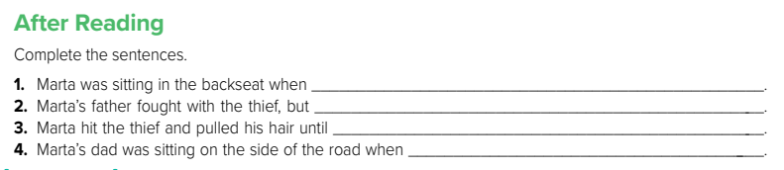
A stranger pushed her father out of the way, got in the car, and drove away.
The thief overpowered him and got in the car.
He stopped the car and ordered the children out.
He saw his two children walking toward him

Slide 9
Discussion :
Do you think it's a good idea to try to stop a thief? Talk about it.

Slide 10
Homework
Page 252

Slide 11
Have a nice day

