Slide 1

Unit 14 reading P.127

Slide 2

Objectives:
Practice the reading strategy: understanding tone.
Answer questions about the message.

Slide 3
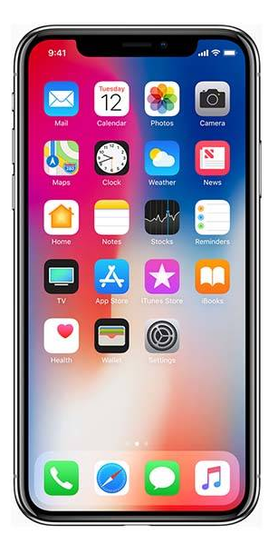


How do people communicate with each others?

Slide 4
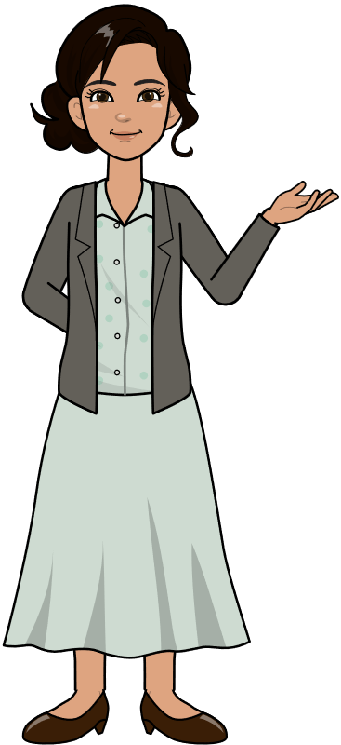

In an emergency, whom would you call?

Slide 5
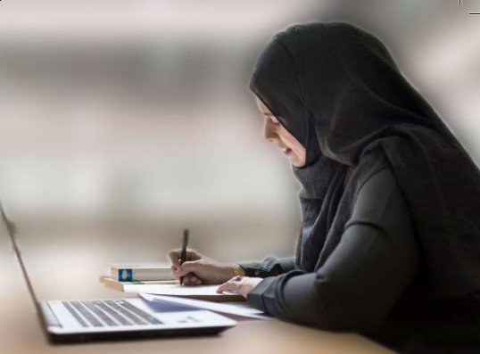
When do people usually write messages or leave notes?
What can you see? Describe!

Slide 6
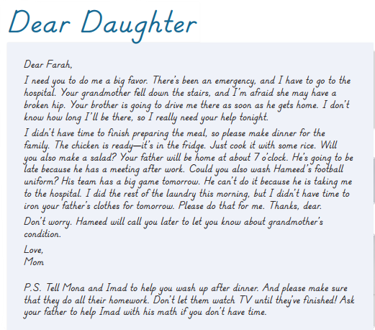
What is it?
The title
The writer / the reader

Slide 7


Slide 8
What’s the relationship between the writer and the reader?
They are a family (Mother – daughter)
Is the language formal or informal?
It’s informal
How did the mother use the informal language? Give some examples
She used contractions
She used informal words like “dear” “love”

Slide 9
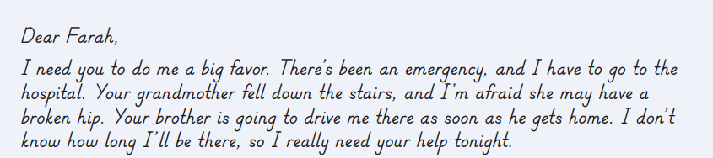
What’s the emergency?
The grandmother fell down the stairs and she is in a hospital
what’s Hameed going to do?
He is going to drive his mother to the hospital

Slide 10
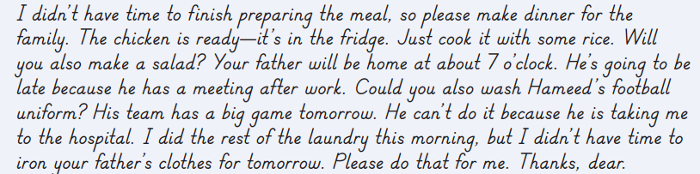
What does the mother want Farah to do?
make dinner, wash Hameed’s football
uniform, and iron her father’s clothes
Why can’t Hameed wash his uniform?
Because he’s taking his mother to the hospital

Slide 11
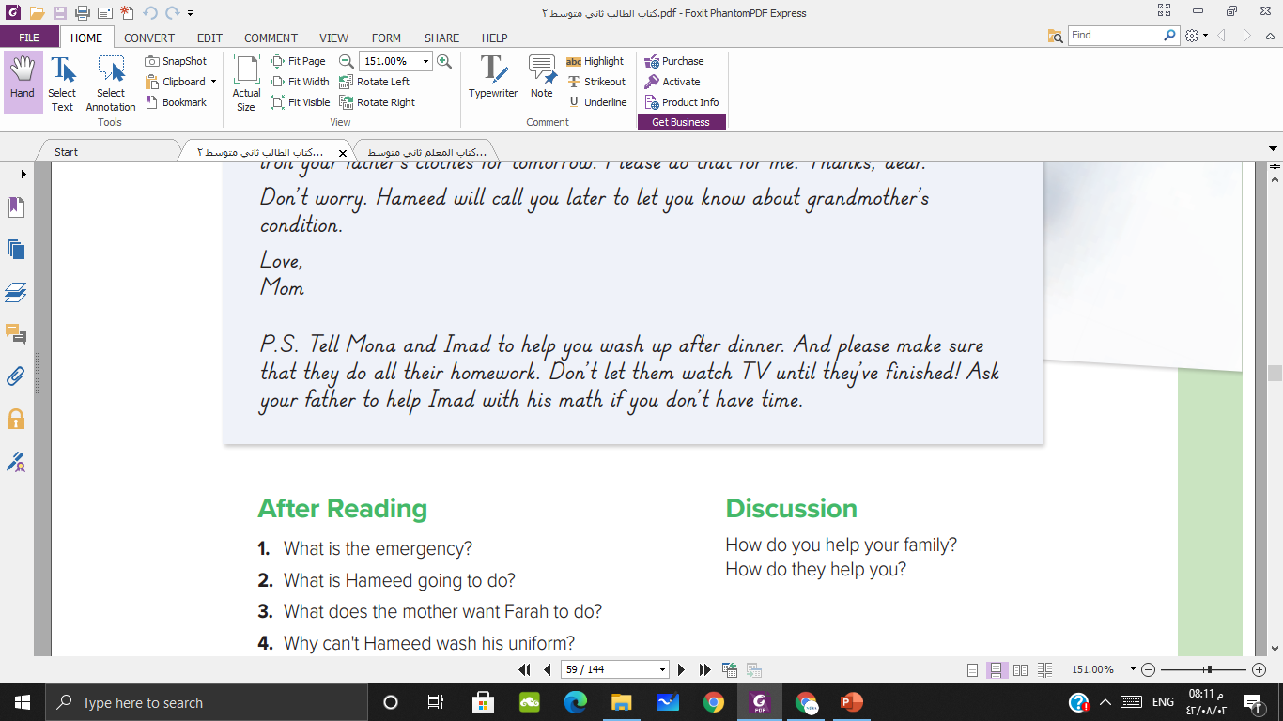
What should Farah’s younger brother and sister do
They should wash up and do all their homework

Slide 12
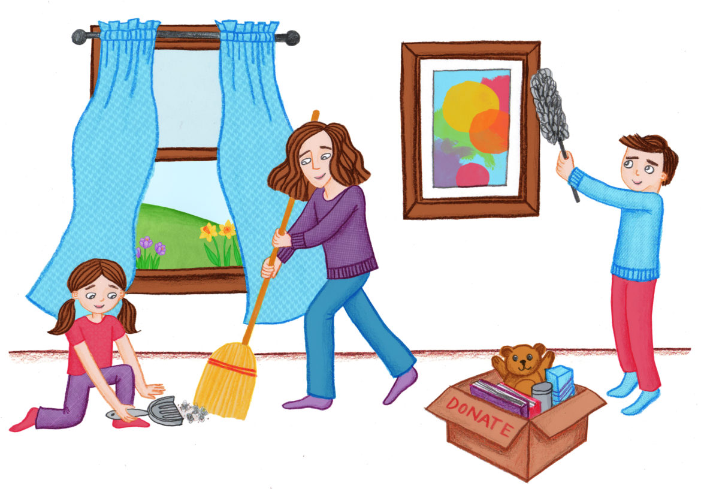
How do you help your family?
How do they help you?

Slide 13

حَدَّثَنَا إِسْحَاقُ، قَالَ‏:‏ أَخْبَرَنَا عَبْدُ اللهِ بْنُ الْوَلِيدِ، عَنْ سُفْيَانَ، عَنْ هِشَامٍ، عَنْ أَبِيهِ قَالَ‏:‏ سَأَلْتُ عَائِشَةَ‏:‏ مَا كَانَ النَّبِيُّ صلى الله عليه وسلم يَصْنَعُ فِي بَيْتِهِ‏؟‏ قَالَتْ‏:‏ مَا يَصْنَعُ أَحَدُكُمْ فِي بَيْتِهِ‏؟‏ قَالَتْ‏:‏ مَا يَصْنَعُ أَحَدُكُمْ فِي بَيْتِهِ، يَخْصِفُ النَّعْلَ، وَيَرْقَعُ الثَّوْبَ، وَيَخِيطُ‏
Hisham said, "I asked 'A'isha, 'What did the Prophet, may Allah bless him and grant him peace, do in his house?' She replied, 'He did what one of you would do in his house. He mended sandals and patched garments and sewed.

Slide 14

Page: 248
Ex : G

Slide 15


