Slide 1


تصميم :
المعلمة
عبير العنزي

Slide 2

Functions with Will
Page: 55

Slide 3




Slide 4
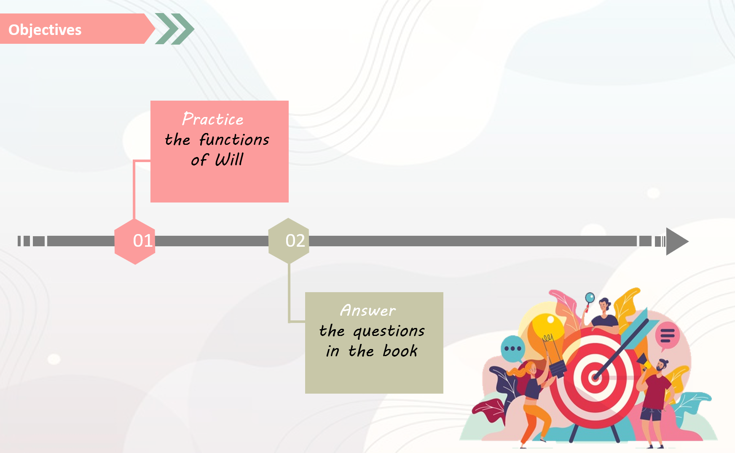

Slide 5

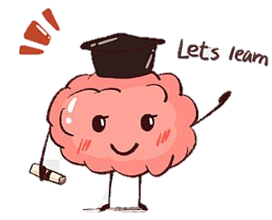
Will
is used to express the simple future

Slide 6

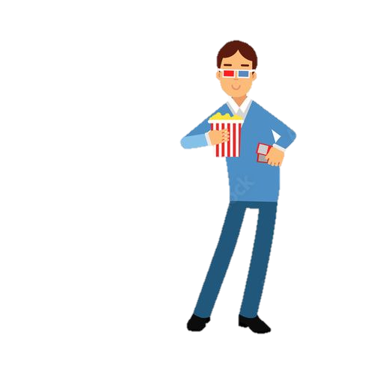
I will go to the cinema tonight.

Slide 7
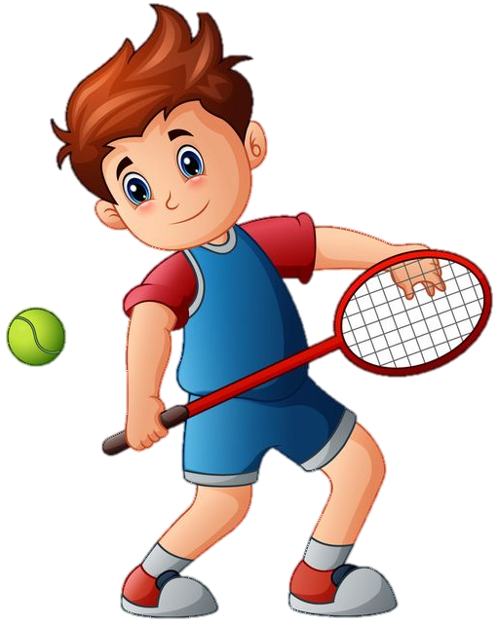
He will play tennis tomorrow.

Slide 8

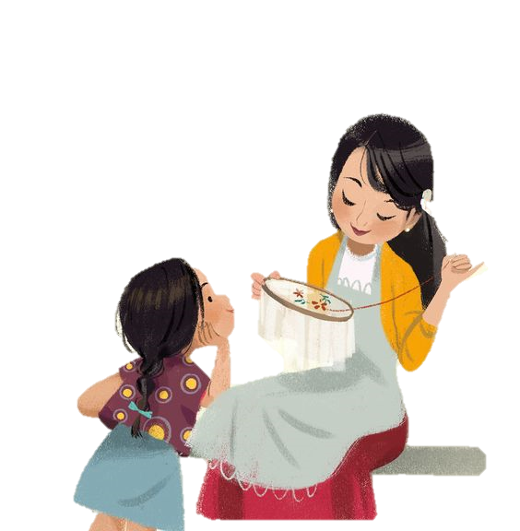
Request
when requesting someone to do something

Slide 9

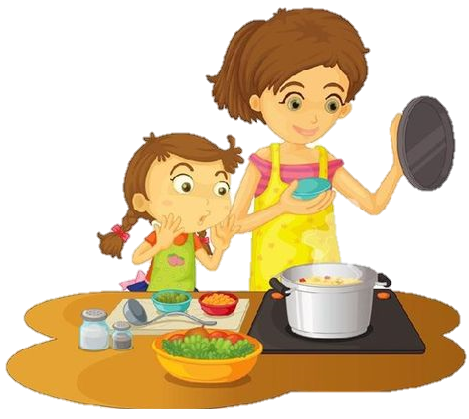
Will you help me cook dinner, please?

Slide 10
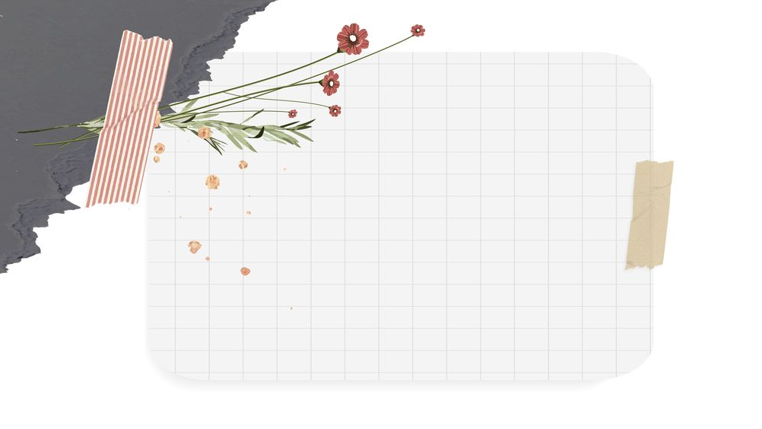
offer

Slide 11
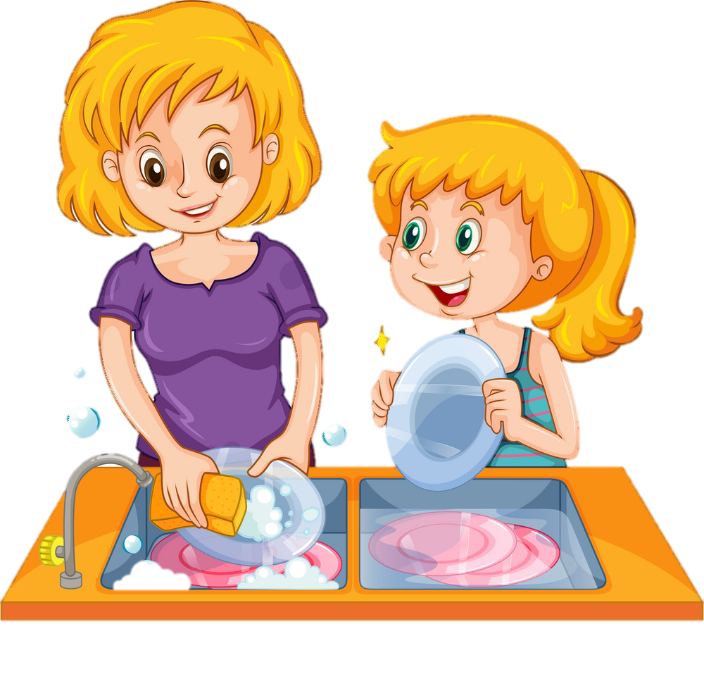
You look tired.
I'll finish the dishes for you.

Slide 12



Promise

Slide 13

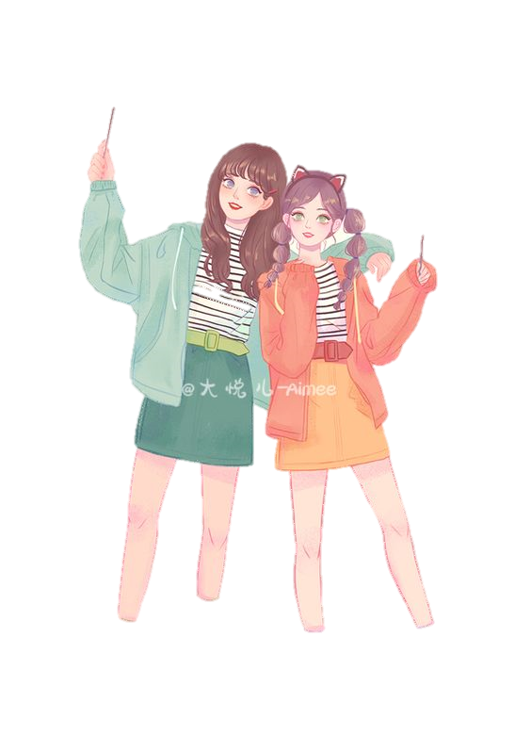
I will stay with you during difficult times.

Slide 14

Don't worry, I won't tell anyone.

Slide 15

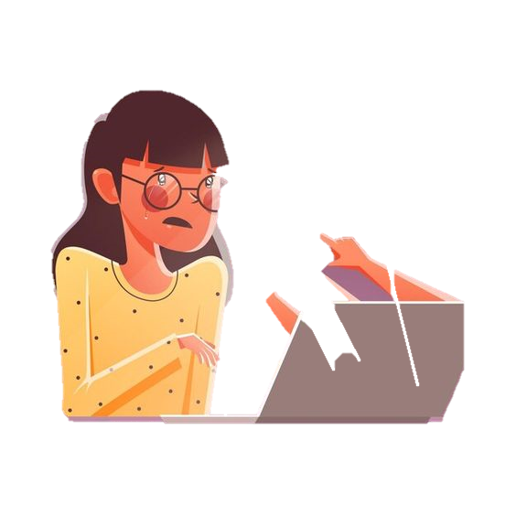
Threat

Slide 16
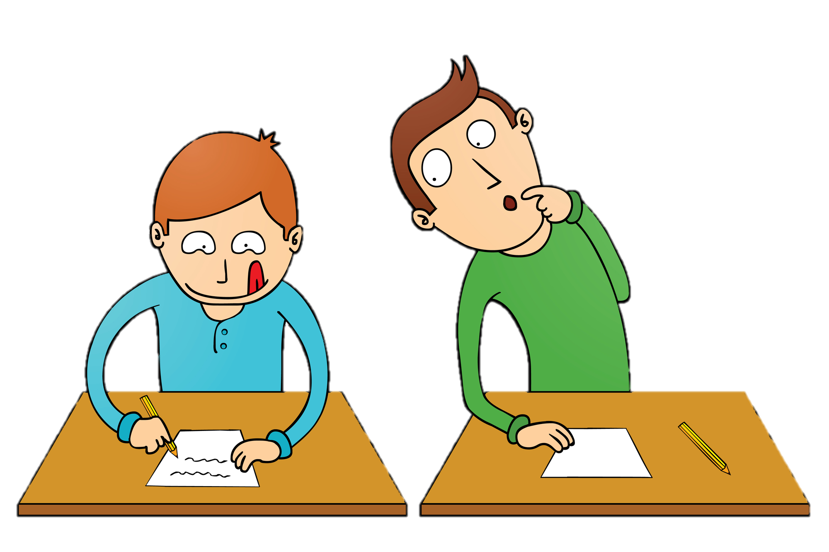
If you cheat again, I’ll tell the teacher.

Slide 17


Refusal
You use WON'T when someone refuses to do something.

Slide 18

She won't listen to anything I say.

Slide 19


Deduction

Slide 20

I think it’ll rain tonight

Slide 21

She will be a successful lawyer one day

Slide 22


Instant Decision

Slide 23
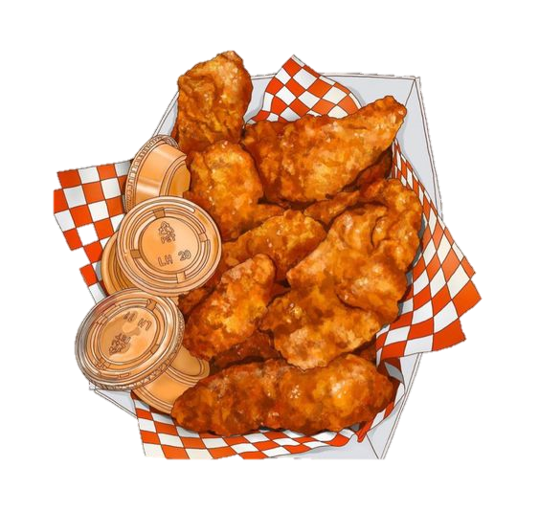
What would you like to eat?
“I will have the chicken.”

Slide 24



Farewell

Slide 25

I’ll see you tomorrow.

Slide 26
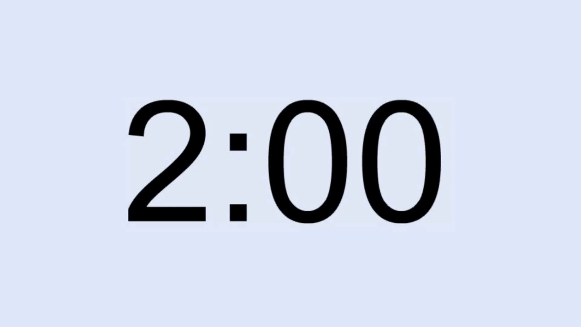
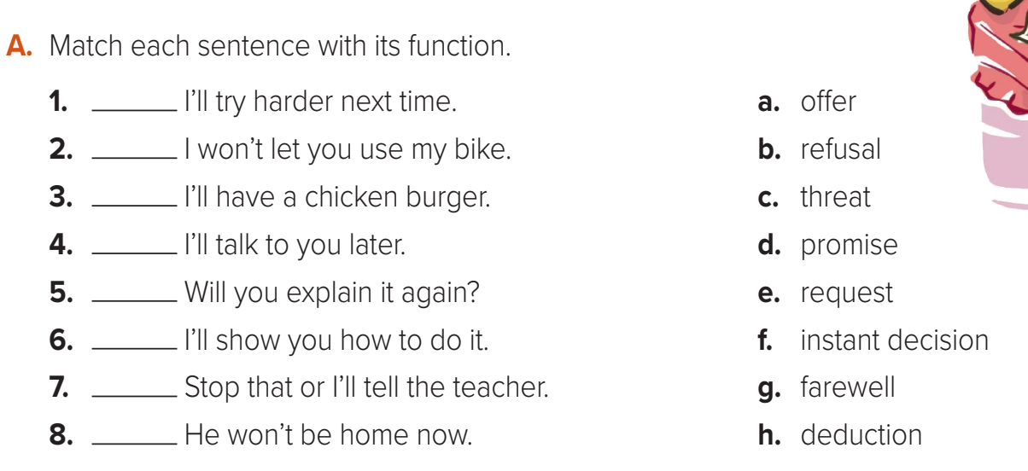
D
B
F
G
E
A
C
H

