Slide 1
Super Goal 4

Slide 2
Unit 6

Slide 3

The objectives of the lesson :
At the end of this session, the students will be able to :
Read the message
Start a discussion about family

Slide 4
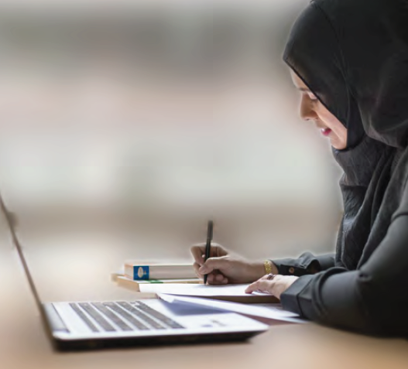
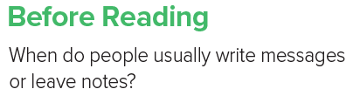
What is the woman doing?
Who is she writing the note to?

Slide 5

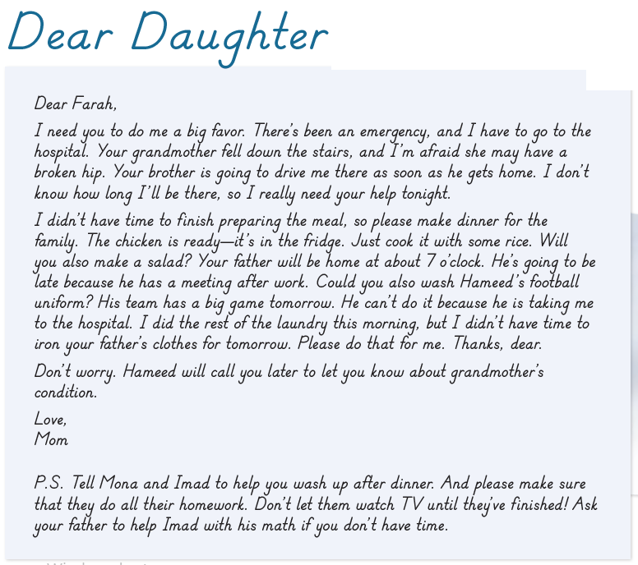

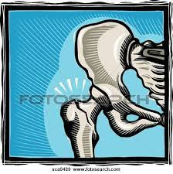
Listen and read a long

Slide 6
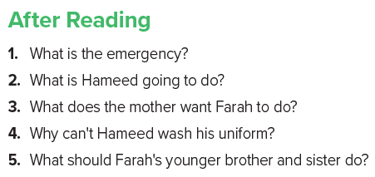
1. The grandmother fell down the stairs and she’sgoing to the hospital.
2. Hameed is going to drive his mother to the hospital.
3. She wants Farah to make dinner, wash Hameed’s football uniform, finish the laundry and iron her father’s clothes.
4. Because he’s taking his mother to the hospital.
5. They should help Farah in the washing up and they should do all their homework.

Slide 7
