Slide 1
U:6 Can you do me a favor?
Grammar & Listening

Slide 2

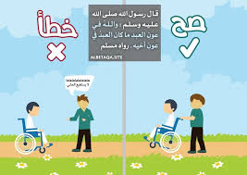
.

Slide 3
Objectives
01
02
03
Compose requests with can/ could/ will/or would
Use I’ll or let me to give offers
Use want to + object noun/pronoun + infinitive to get someone to do something
04
Use tell and ask to get someone to do something

Slide 4
Objectives
05
06
Listen to get phone messages
produce the reduction of could you

Slide 5
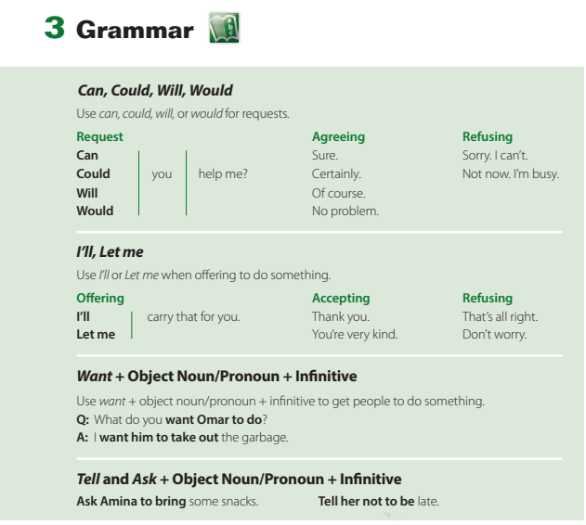
Page 50
Note: (could )and (would) are more polite than (can) and (will)
.

Slide 6
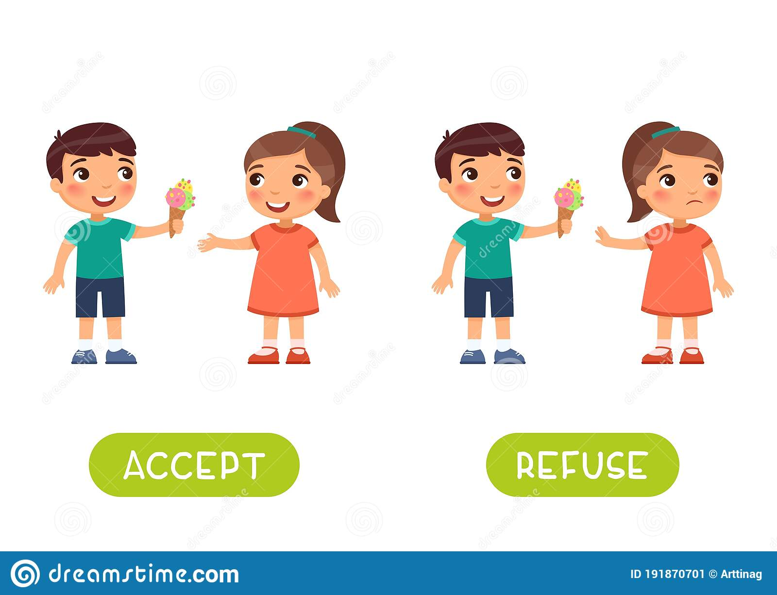
Requests / offers ; ACCEPT OR REFUSE THEM
I’ll give you some ice cream.
Thanks you’re so kind.
I’ll give you some ice cream.
No, not now

Slide 7
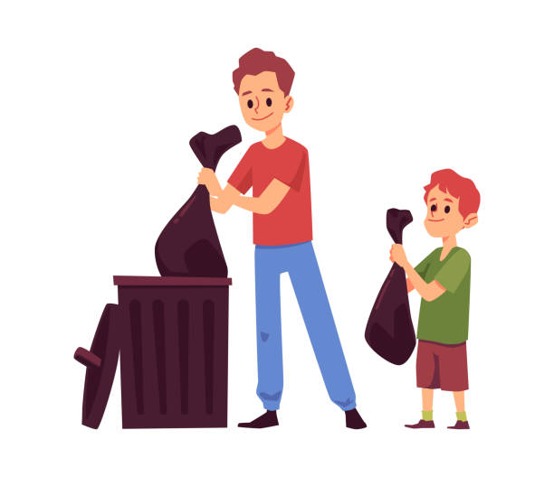
Page 50
Want to
.
I
Want
him
to
Take
Out the garbage
A
subject
Want
Noun/ objective pronoun
to
Verb (inf)
complement

Slide 8
Page 50
Want to( forming questions)
.
What
Do/ does
subject
want
Objective pronoun
To do?
What
do
You
want
Him
To do?

Slide 9
Tell and ask
.
subject
Ask /tell
Noun/ objective pronoun
to
Verb (inf)
complement
I
Asked/ told
Ahmad
not
to
Take
Out the garbage
Page 50

Slide 10


Re-range the following sentence write your answers in the chat box
.
some snacks
Asked/ told
bring
I
Aminah
to
to
Carry the bag
him
she
wants

Slide 11
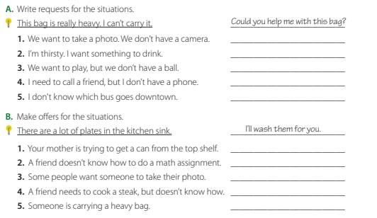
yes
Could we borrow your camera?
.
Will you get me something to drink
No
Can we borrow your ball?
Can I borrow your cell phone?
Could you tell me which bus goes downtown
Let me get the can for you.
I’ll help you do the math assignment
. I’ll take the photo for you.
Let me show you how to cook a steak.
Let me carry your bag for you.

Slide 12
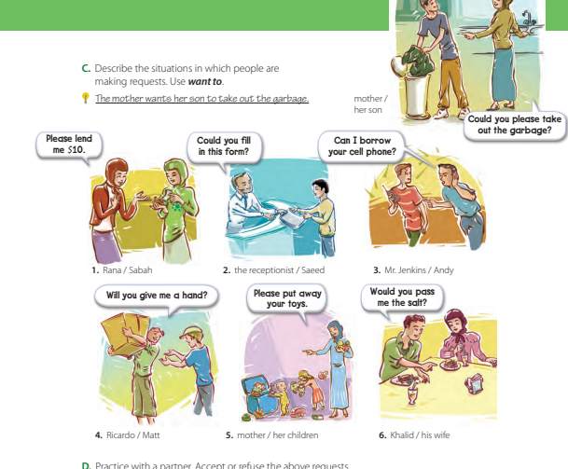

.
1.Rana wants Sabah to lend her $10.
2.The receptionist wants Saeed to fill in the form/
3. Mr. Jenkins wants Andy to lend him the cell phone
4.Ricardo wants Matt to give him a hand.
5.The mother wants her children to put away their toys
6.Khalid wants his wife to pass him the salt

Slide 13
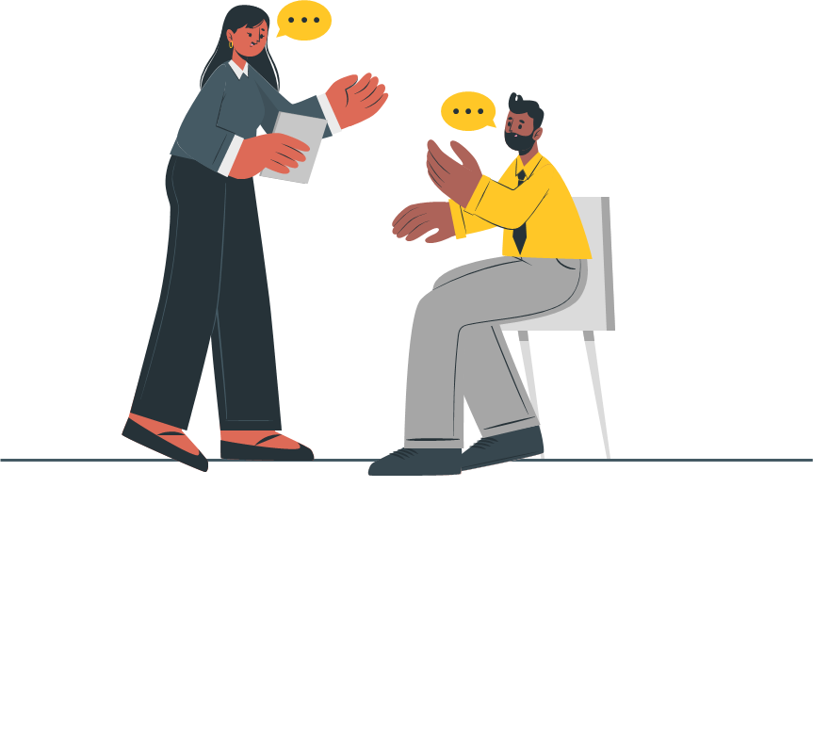
D. Practice with a partner. Accept or refuse the above requests.
.

Slide 14
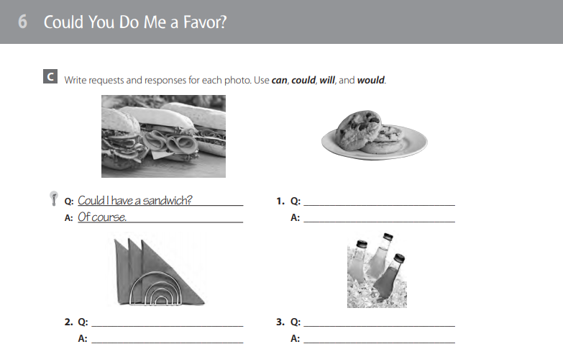
Homework : page 112. 113
EX c-D-E-F

Slide 15

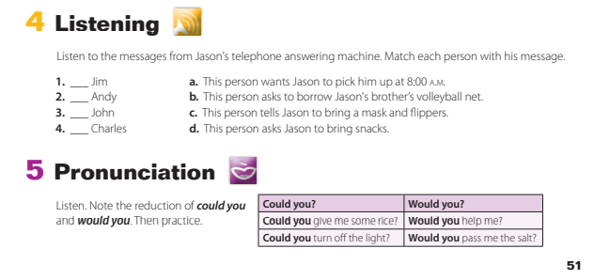
Listening & pronounciation page 51
d
a
b
c

Slide 16
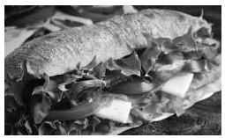
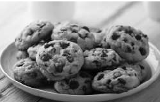


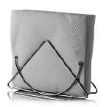
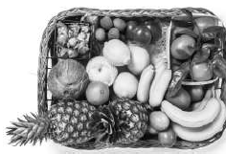


Page 112
Can I have a cookie?
Not now.
Would you get me a napkin?
Will you give me a soda?
Certainly.
Of course.

Slide 17

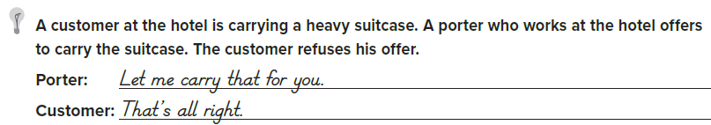
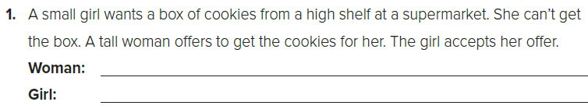
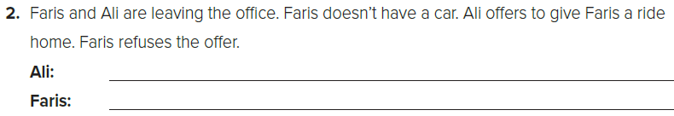
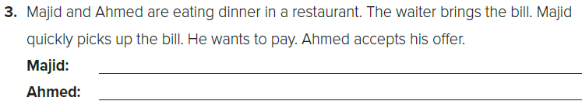
Page 112
Let me get that for you.
Thank you.
I’ll give you a ride home.
That’s all right, thanks..
Let me pay for dinner.
You’re very kind.

Slide 18
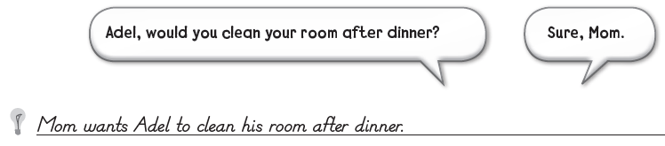
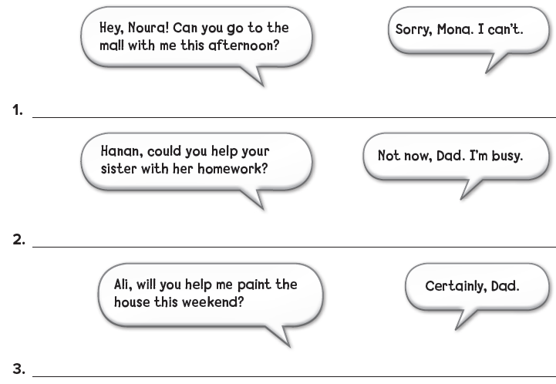
Page 113
Mona wants Noura to go to the mall with her this afternoon.
Dad wants Hanan to help her sister with her homework.
Dad wants Ali to help him paint the house this weekend.

Slide 19


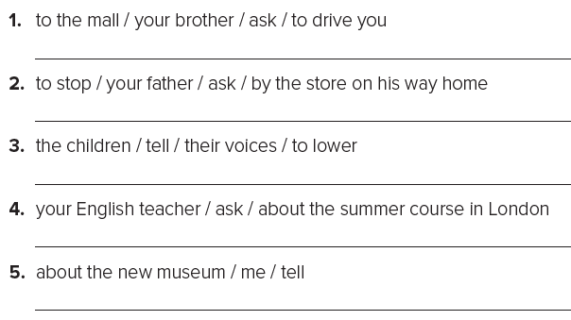
Page 113
Ask your brother to drive you to the mall.
Ask your father to stop by the store on his way home.
Tell the children to lower their voices.
Ask your English teacher about the summer course in London.
Tell me about the new museum.

Slide 20
Thank you! See you next class!

