Slide 1

Unit 13 page 121
11 Form, Meaning, and Function

Slide 2
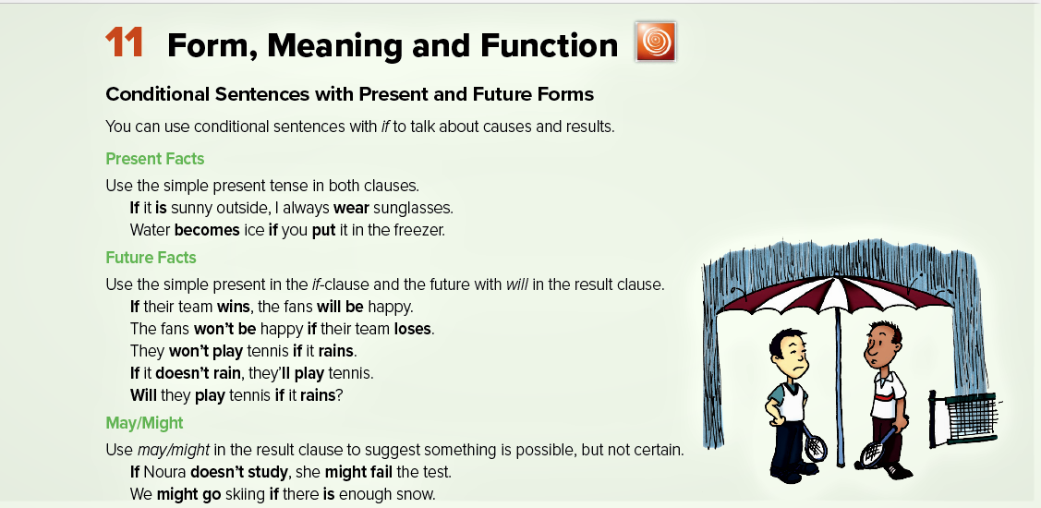

Slide 3

Present facts
Usage
To talk about causes and results
Form
If + present simple, + present simple
Present simple + if + present simple

Slide 4

Examples
Conditional
Result
(1) If you freeze water, it becomes a solid.
It becomes a solid if you freeze water.
(2) If you touch a fire, you get burned.
You get burned if you touch a fire.

Slide 5

Future Facts
Form
If + present simple, + future simple “ will + V”
future simple “ will + V” if + present simple

Slide 6

Examples
(1) If it rains, I will not go to the park.
I will not go to the park if it rains.
(2) If Alahli wins, the fans will be happy.
the fans will be happy if Alahli wins

