Slide 1


Super Goal 4
Unit 4 - It’s going to be fun
Form, Meaning and Function
By: Sara Alamri

Slide 2

Objectives
Classify
the given words
01
02
Use
adverbs of manner

Slide 3

Warm Up
What are the part of speech?
https://www.liveworksheets.com/2-qx669898tt

Slide 4

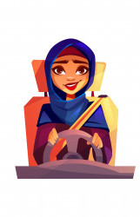


Adverb of manners
adj
Adv
expresses how something is done.
ly
1. She drives slowly
2. She drives the car slowly
How
slowly
does she drive

Slide 5
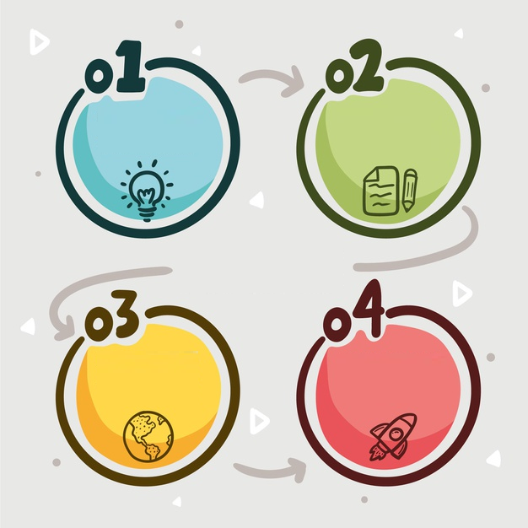
Adv of manner
double the l
Adjectives
end in -l
Adjectives
end in -y
Change y to i
Careful - carefully
Easy- easily
Adjectives
= Adverb
Adverb of
good
Good – well
In comparative: Better
Fast- hard- late- high

Slide 6

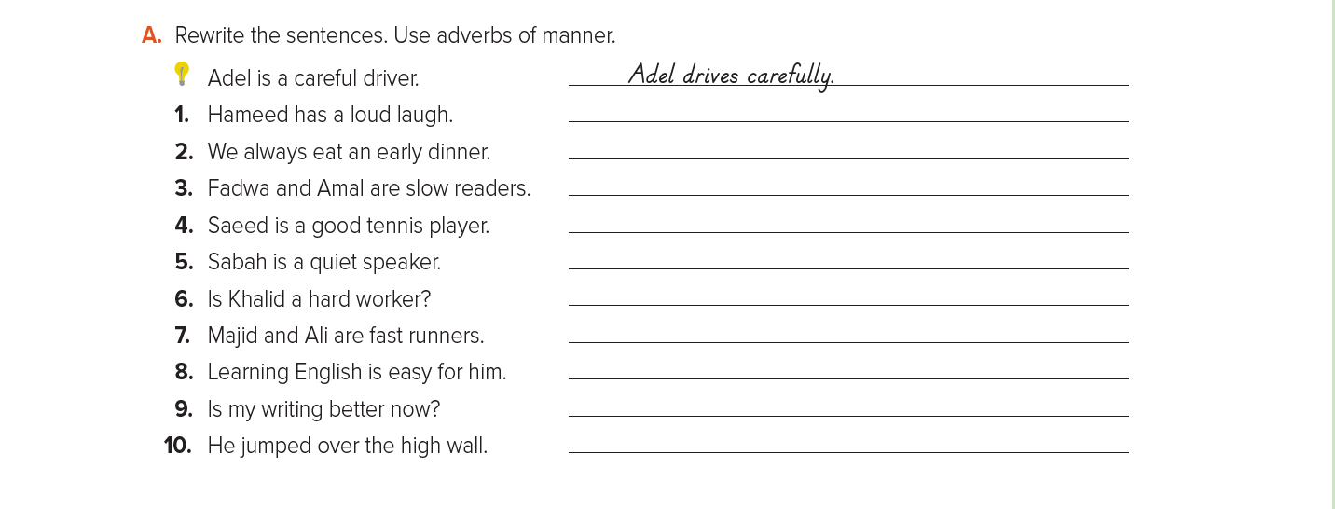

Ex: A
P. 33
Hameed laughs loudly
Fadwa & Amal read slowly
Sabah speaks quietly
Majid & Ali run fast
He jumped high over the wall

Slide 7

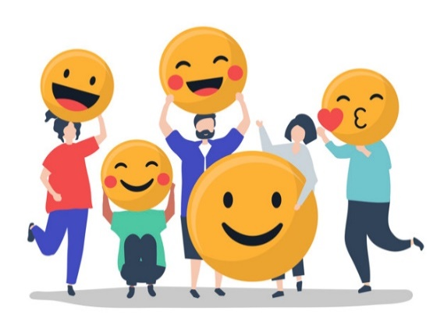


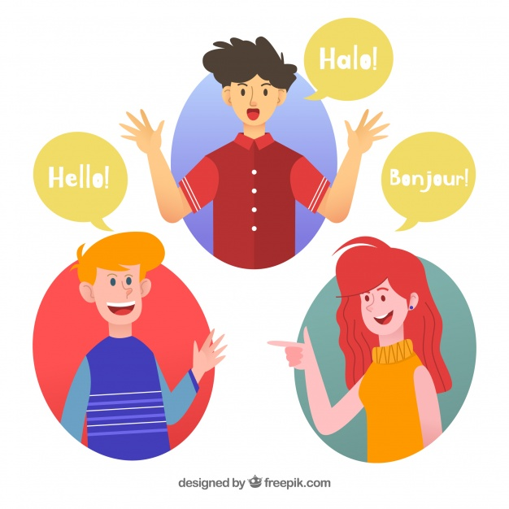
Write sentences about the given pictures applying future tense
live
shop
She’s shopping carefully
They are going to live happily
speak
Speak languages good
He’s going to speak loudly
They’re speaking languages well

Slide 8

