Slide 1
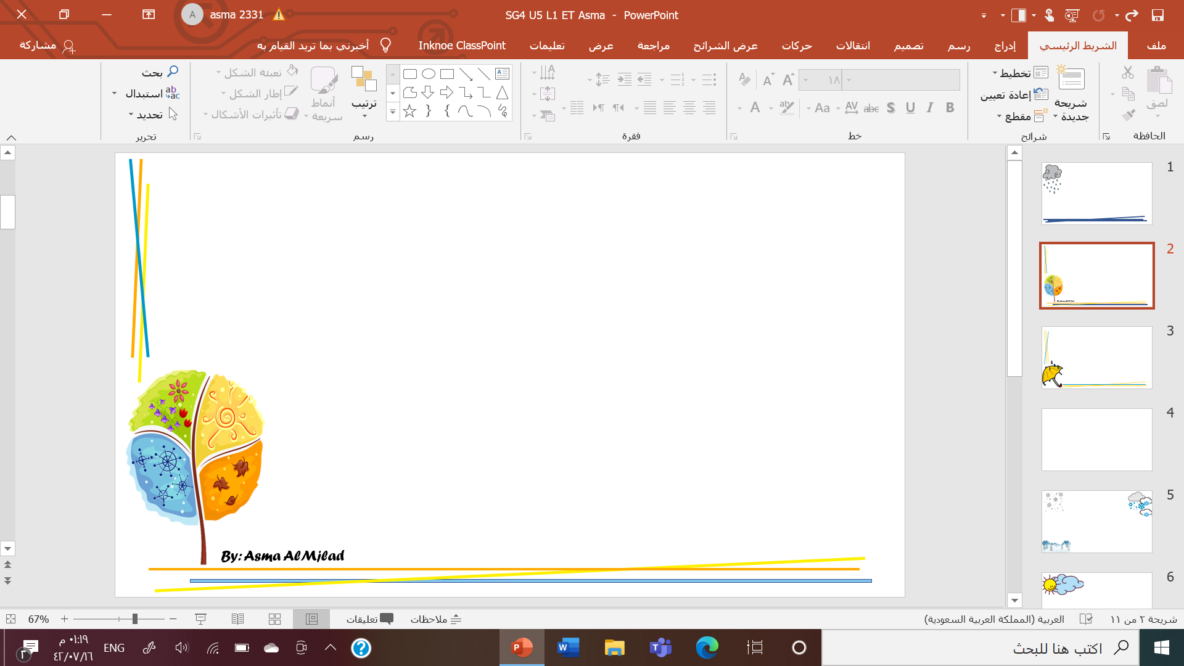
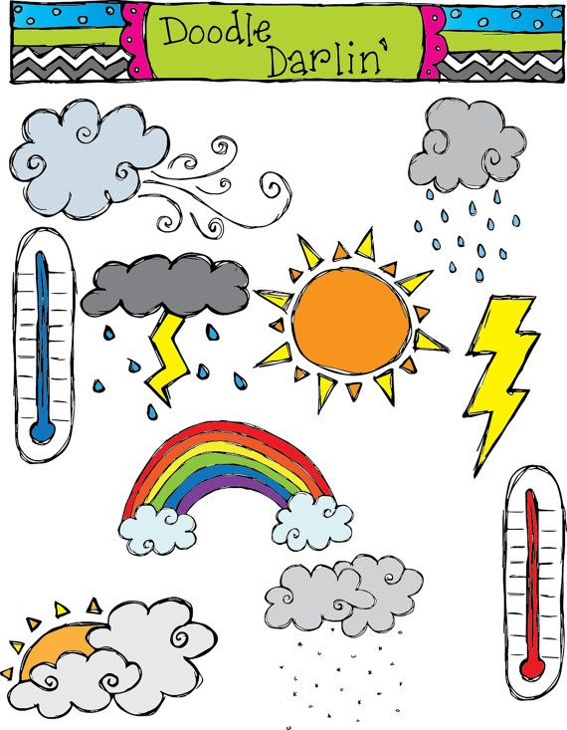
What is the weather like ?
Listen and discuss

Slide 2

Objectives
Compare weather around the world
Talk about seasons
Talk about future activi

Slide 3
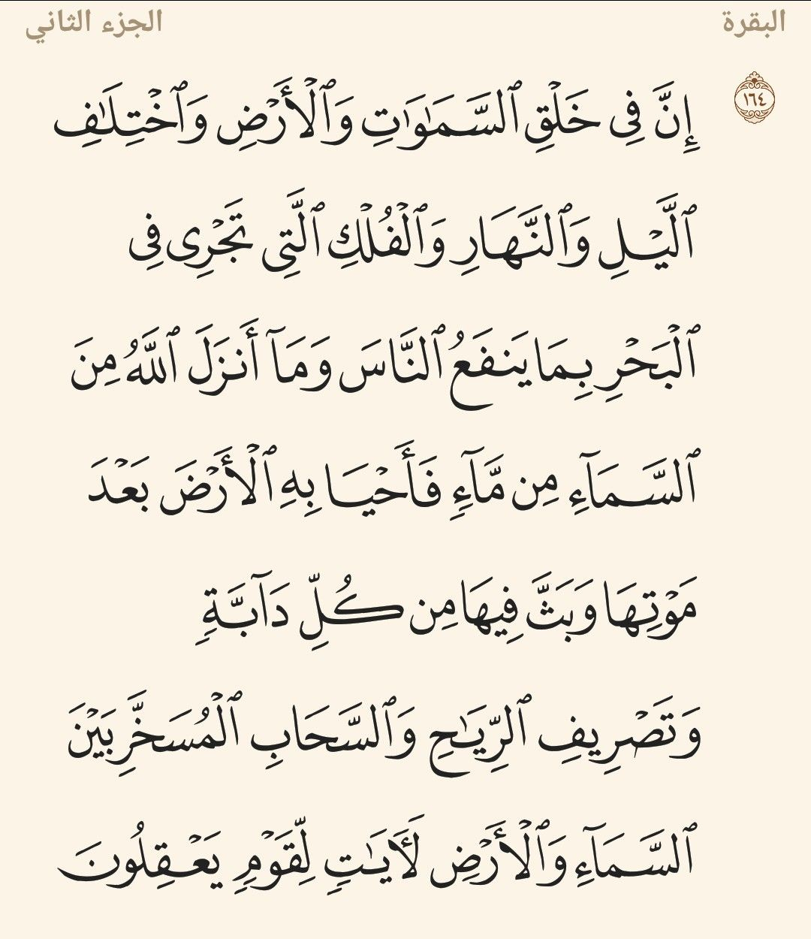

Slide 4
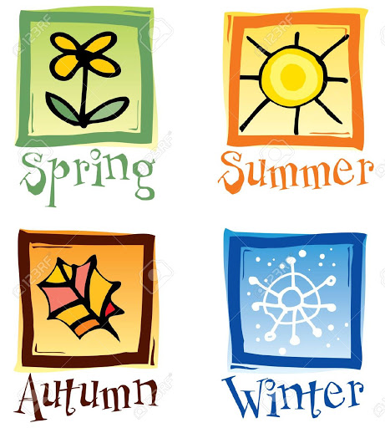
What is your favorite season
Is it hot \cold?
What do you love about it ?

Slide 5
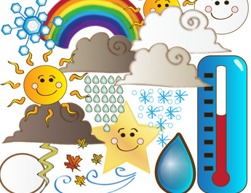

Let’s chick the weather
By: Asma AlMjlad

Slide 6
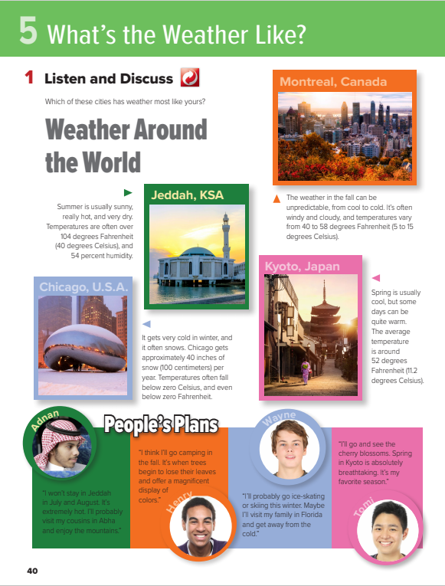
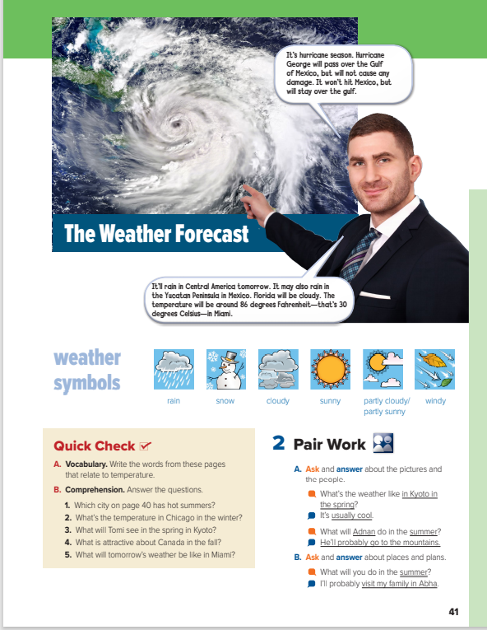


Slide 7
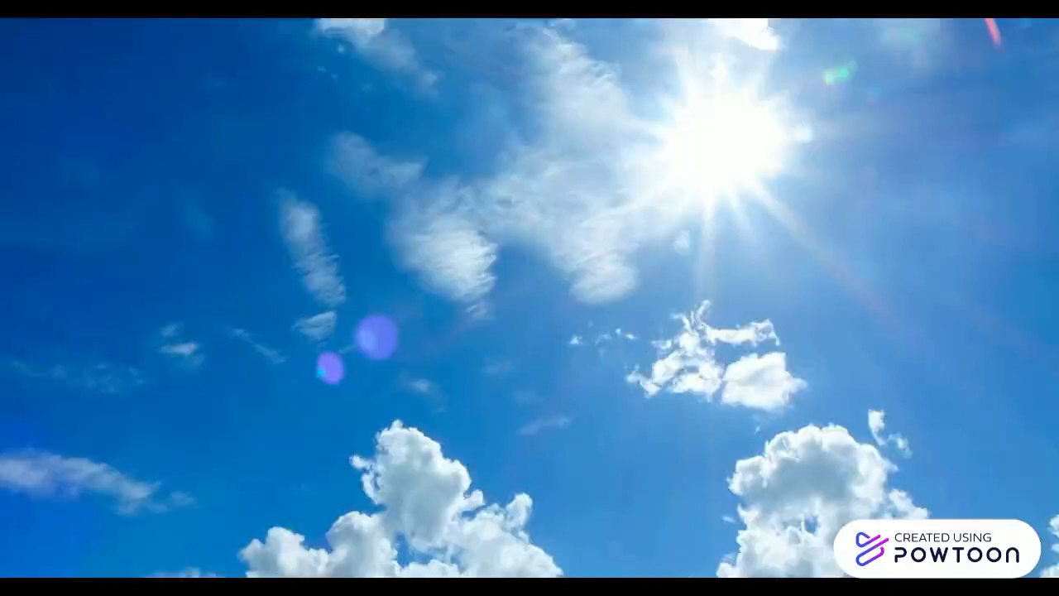

Slide 8
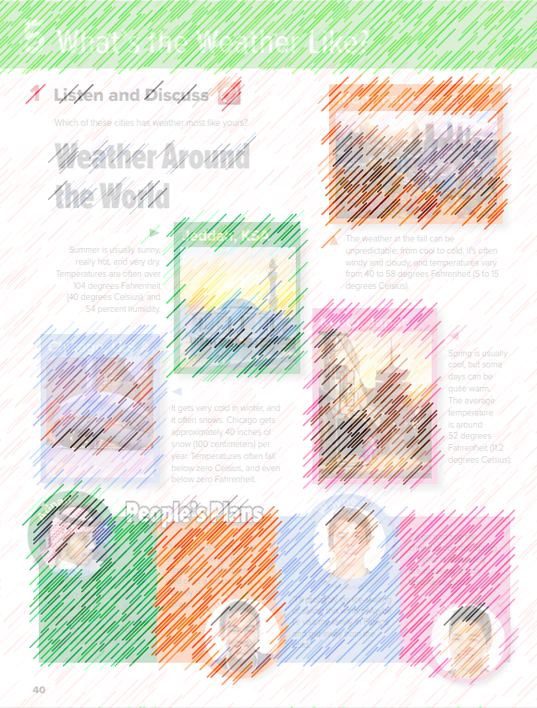
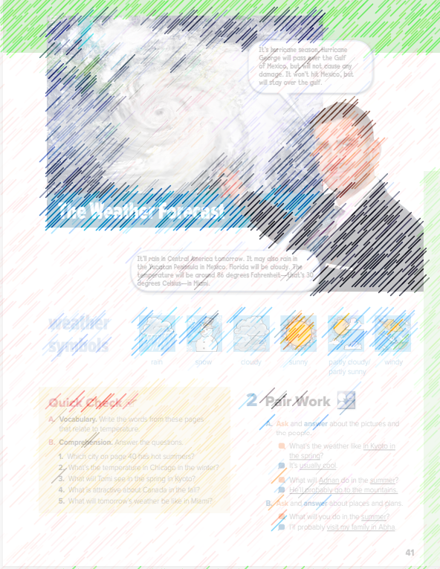
How can you tell it’s hot?
Where does it look hot?
Does it look humid or dry there?
What kinds of things do people probably do in the summer?
Where does it look cold?
What do you think the temperature is there?
? What kinds of activities can people do in the winter?

Slide 9
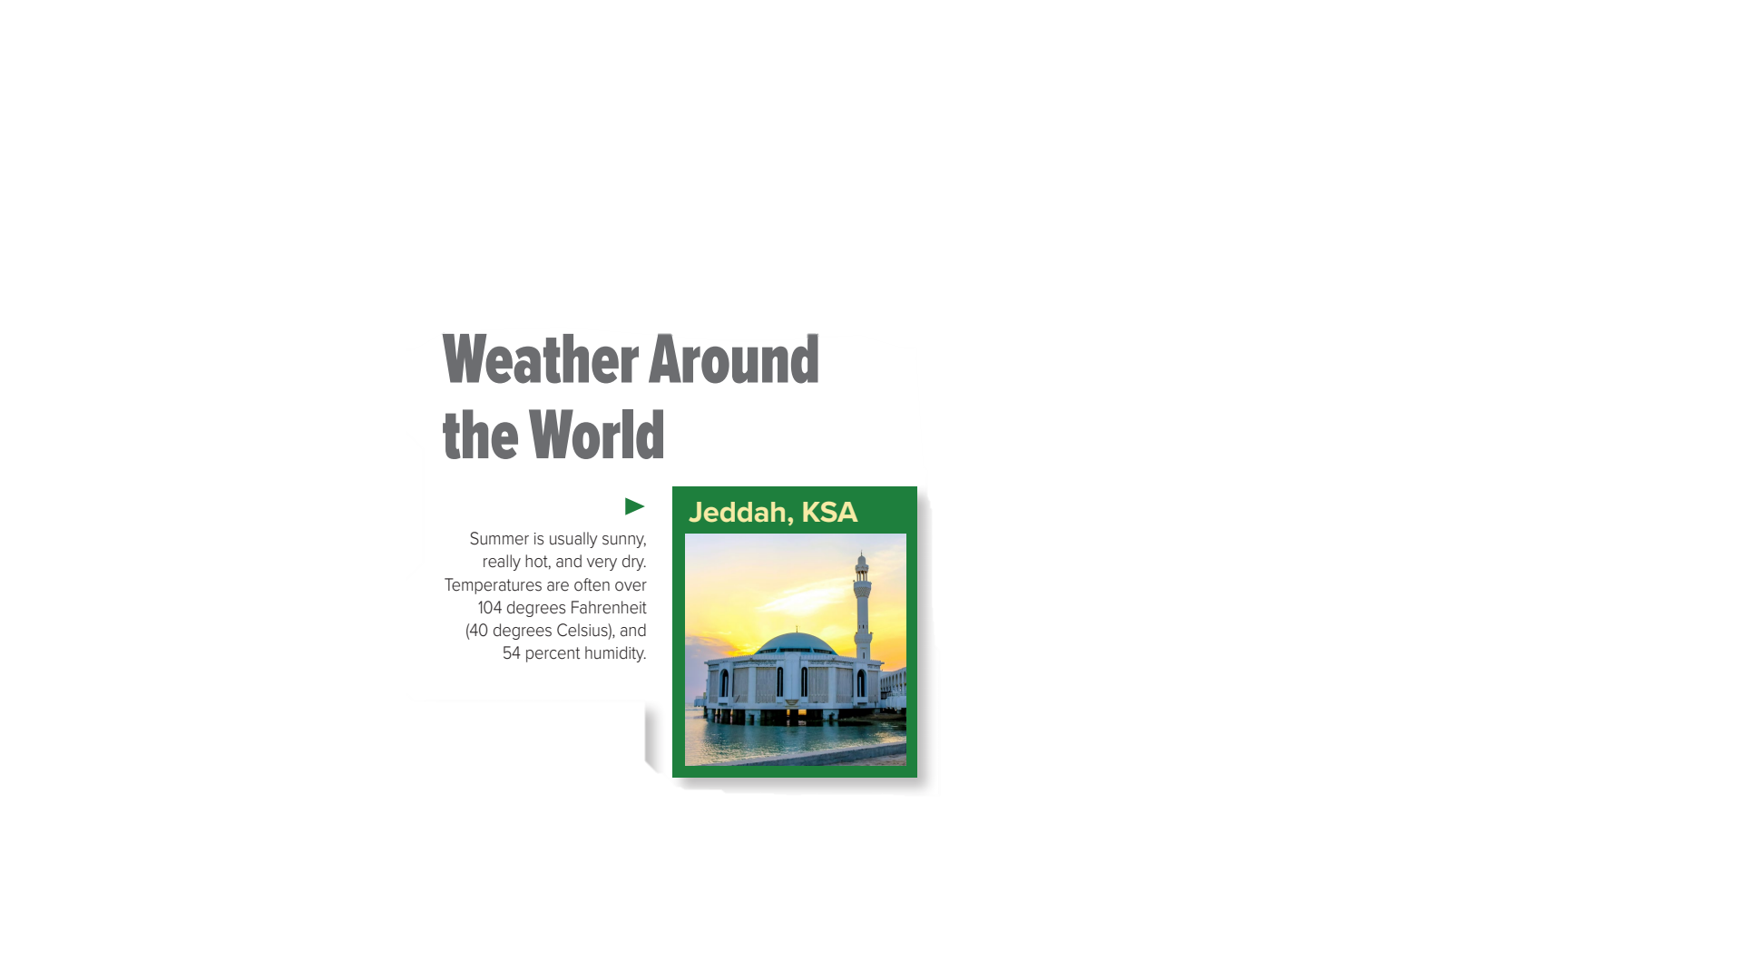
What time of the year is it in Jeddah ?
How do you know?

Slide 10
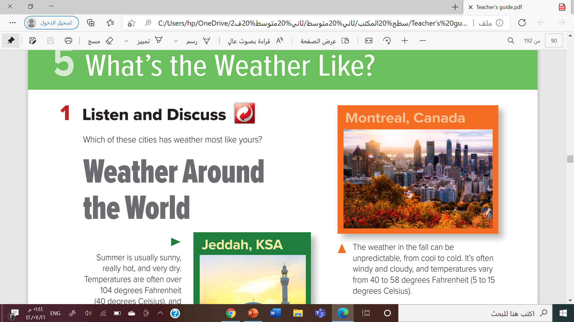

What time of the year is it in Montreal?
How do you know?
What kinds of things do people in Montreal probably like to do in the fall?

Slide 11
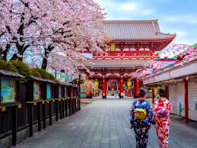
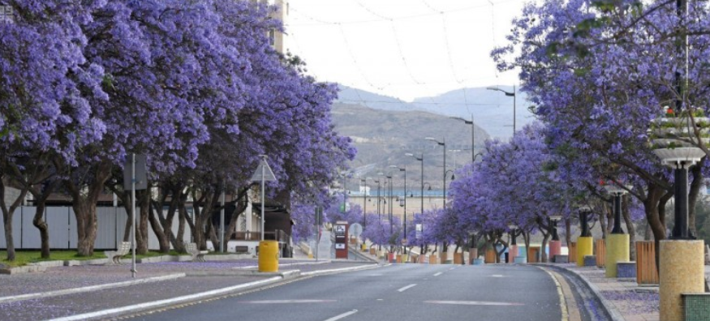
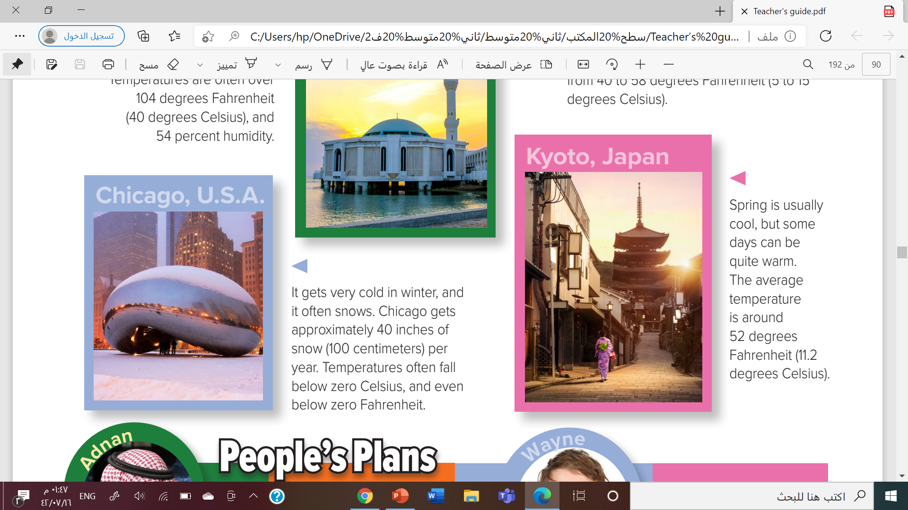

What time of year are there beautiful cherry blossoms in Japan?
What do you think the weather is like? What activities do people in Japan do in the spring?

Slide 12
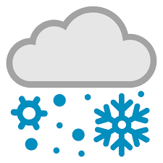

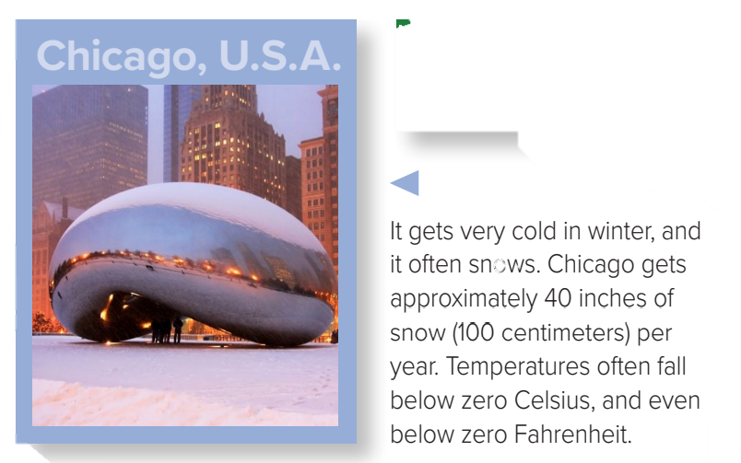
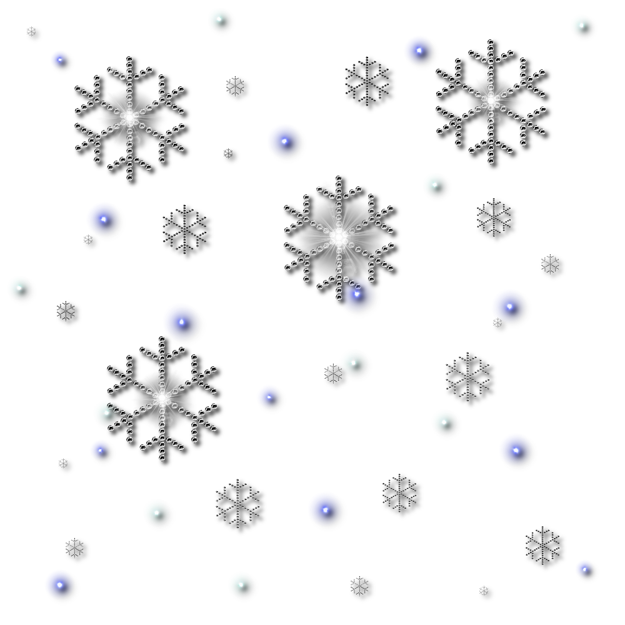
What time of the year is it in Chicago ?

Slide 13
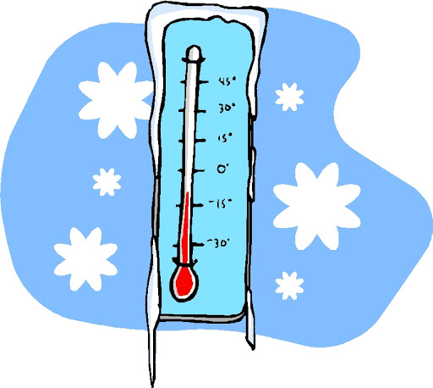
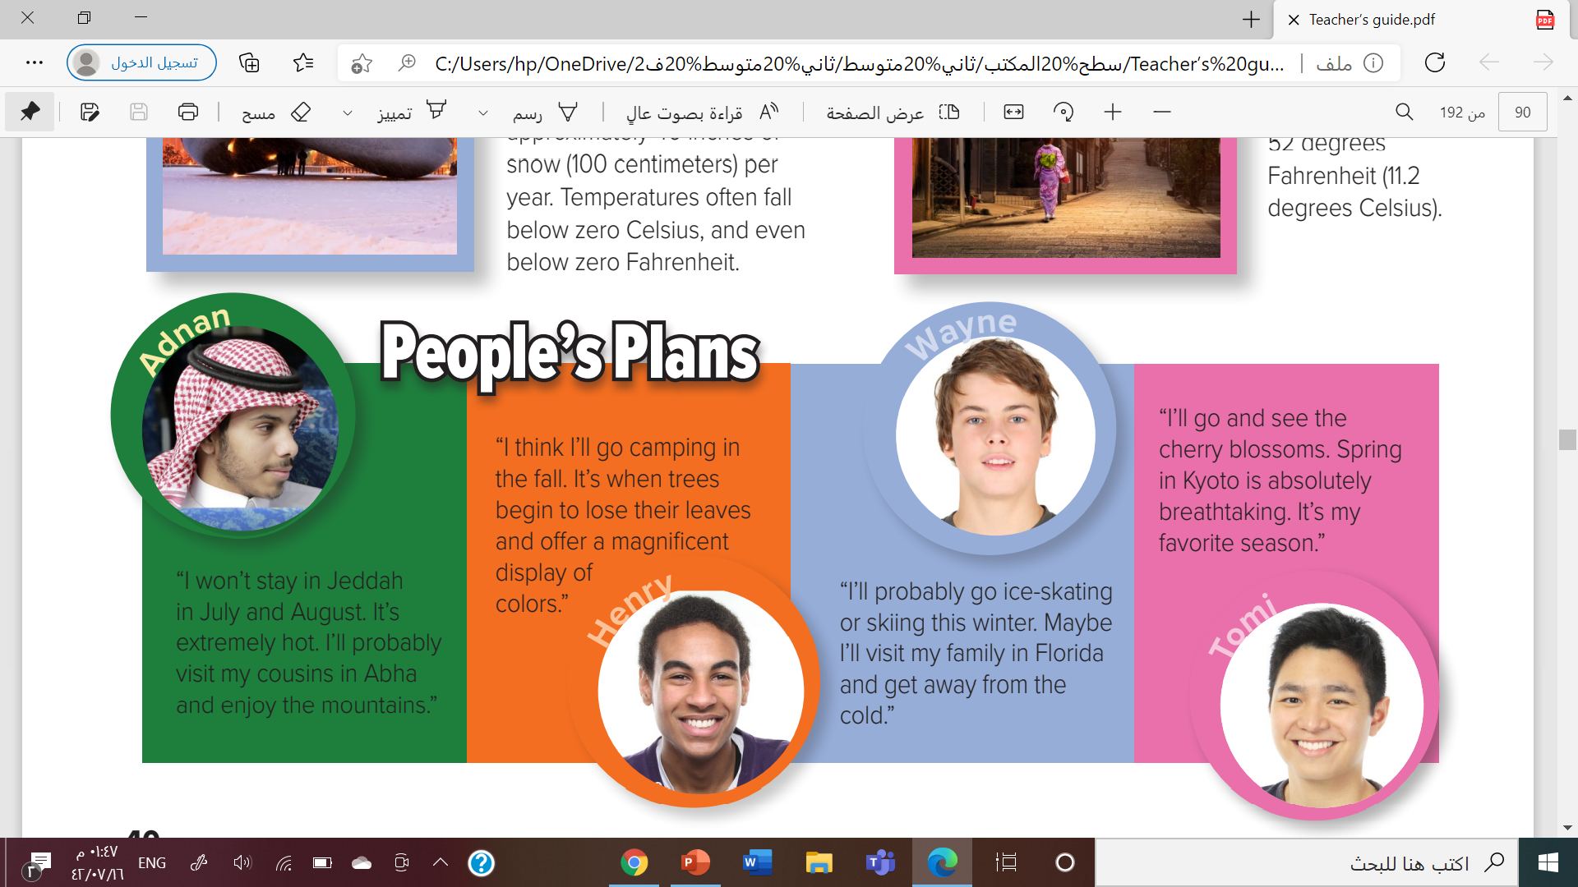
Where is Adnan from?

Slide 14

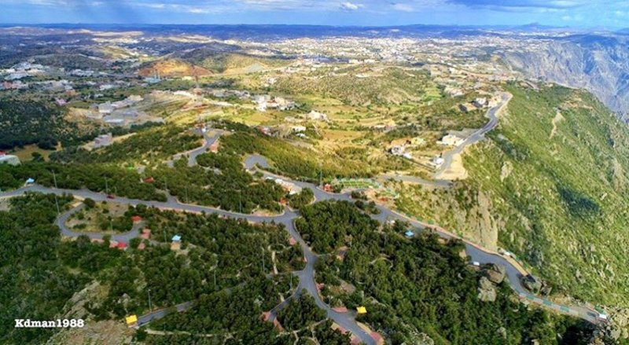
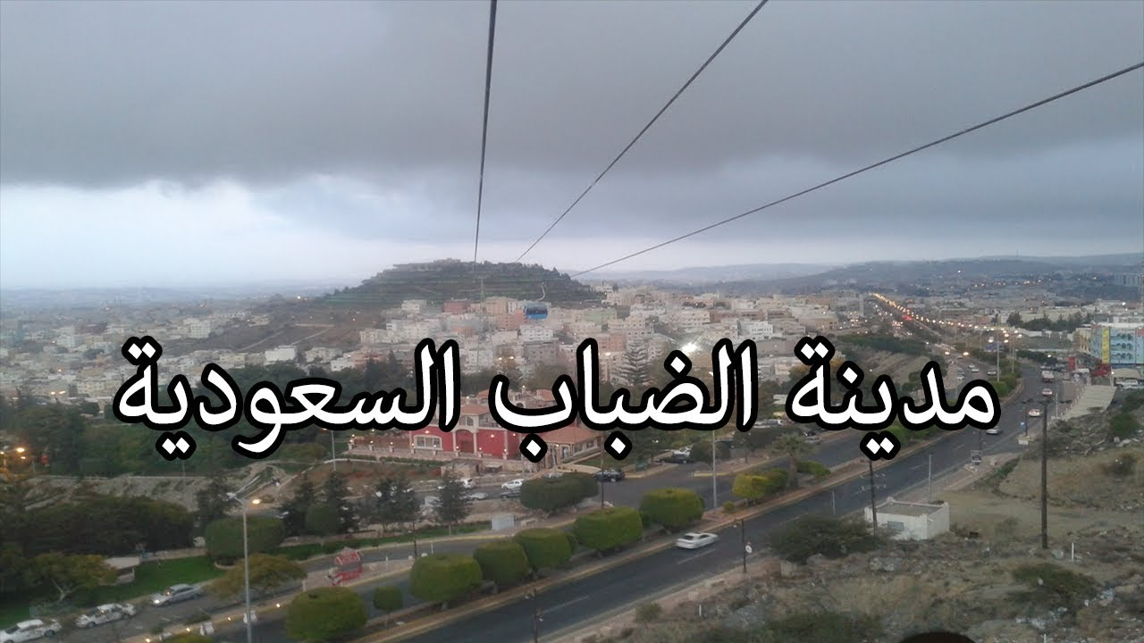
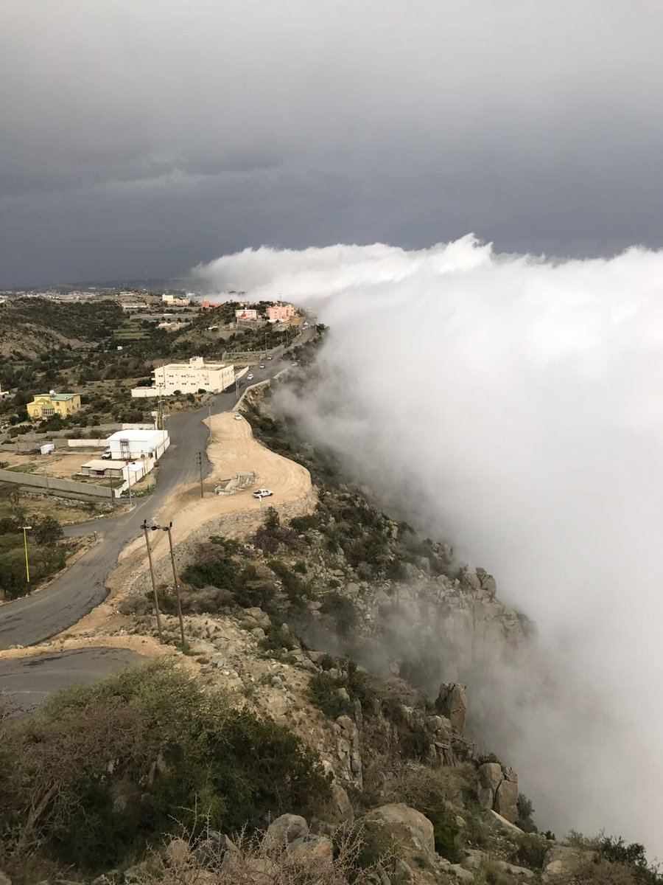
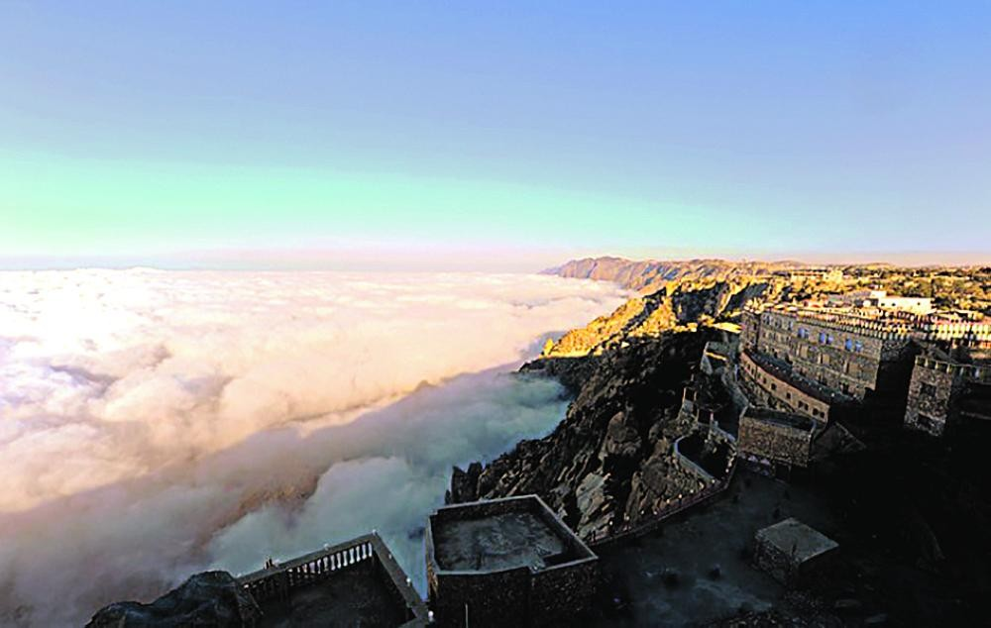

Which of these cities has weather most like yours?
It is foggy and rainy

Slide 15
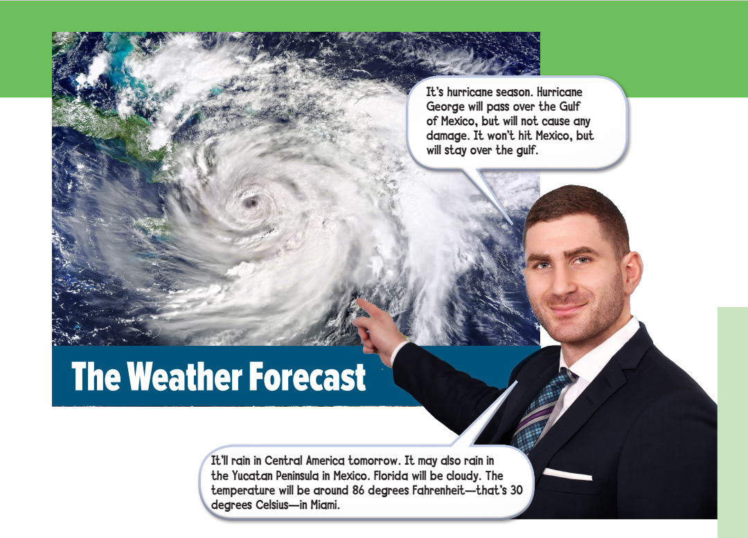
What is he pointing at?
What part of the world is he going to talk about?
Where is the weather going to be cloudy?

Slide 16

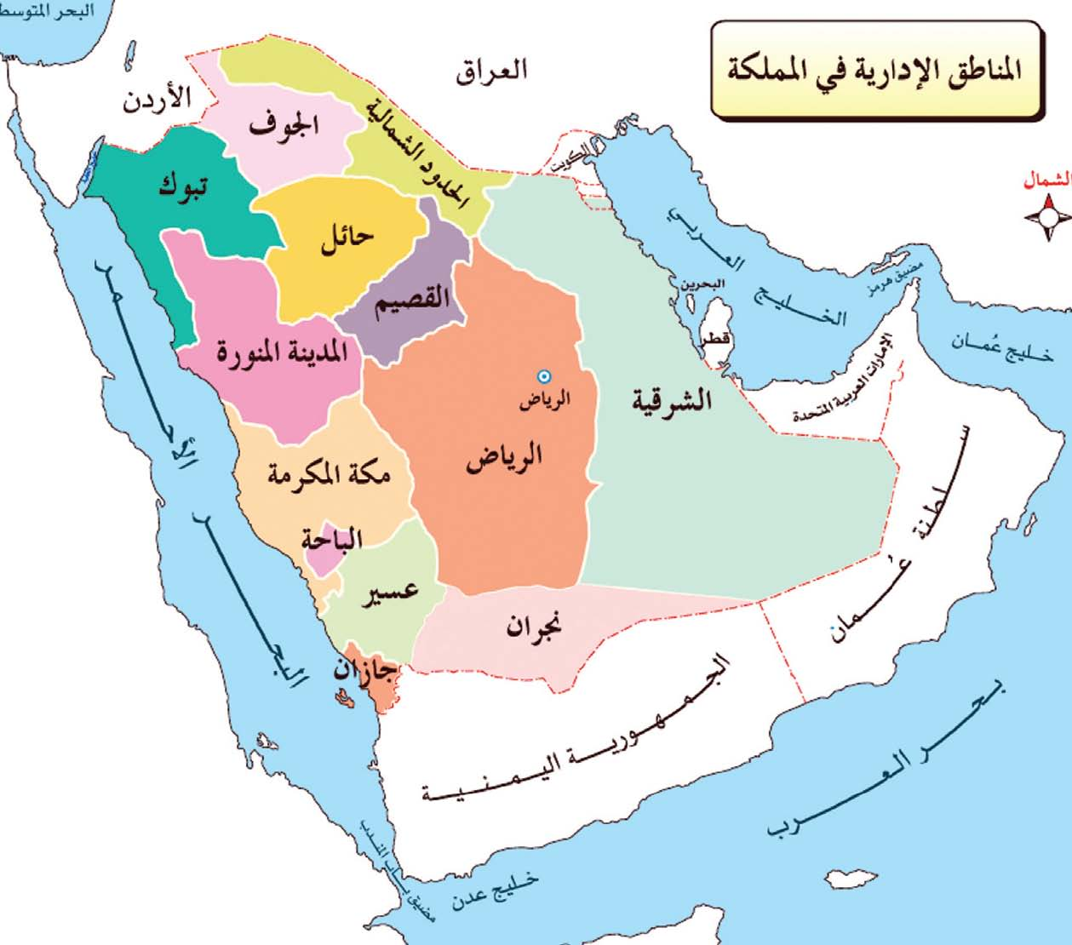

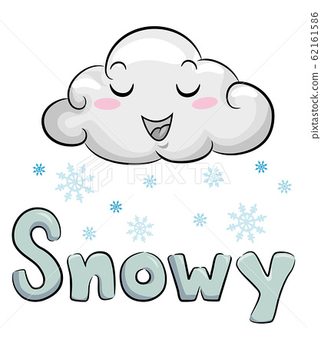
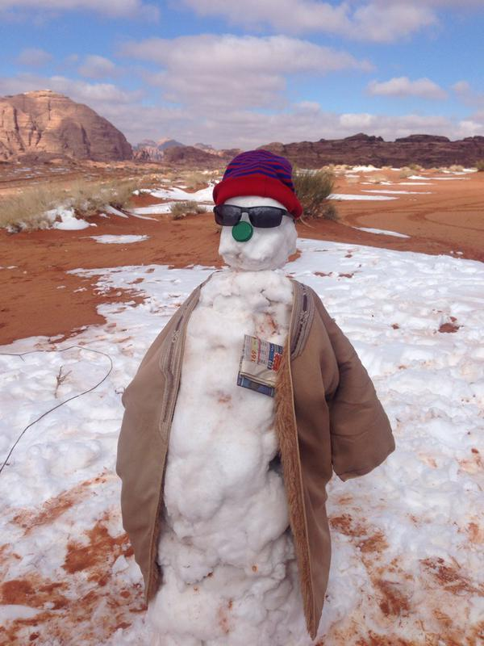

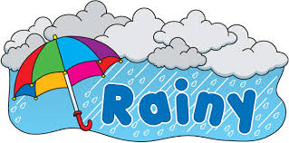

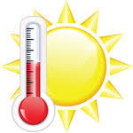
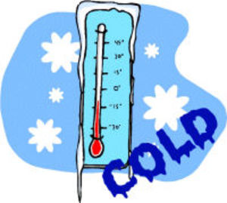
What is the weather in your city?

Slide 17
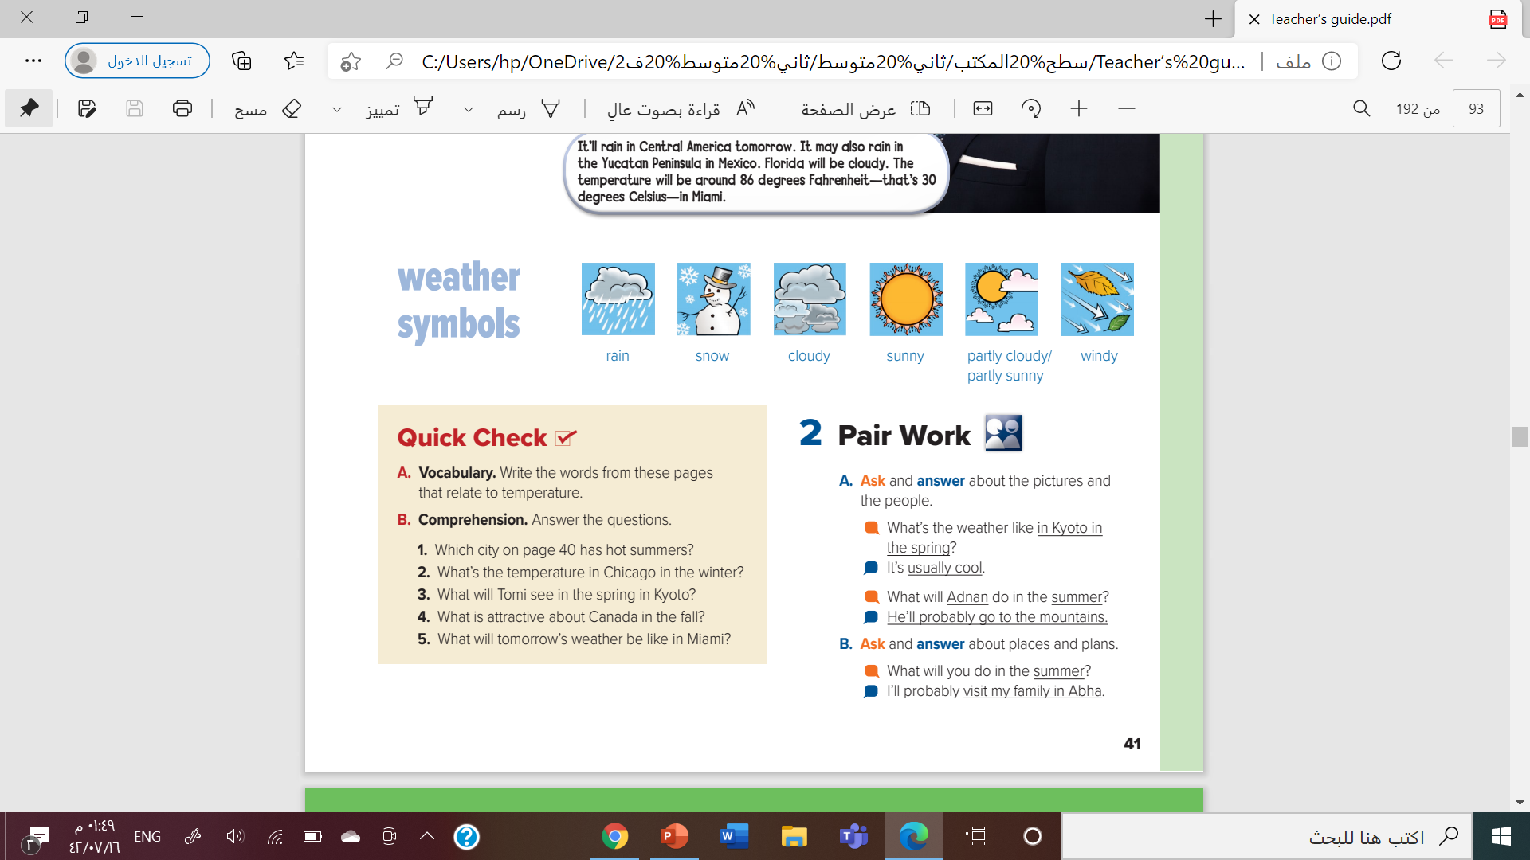


Create your own symbols

Slide 18

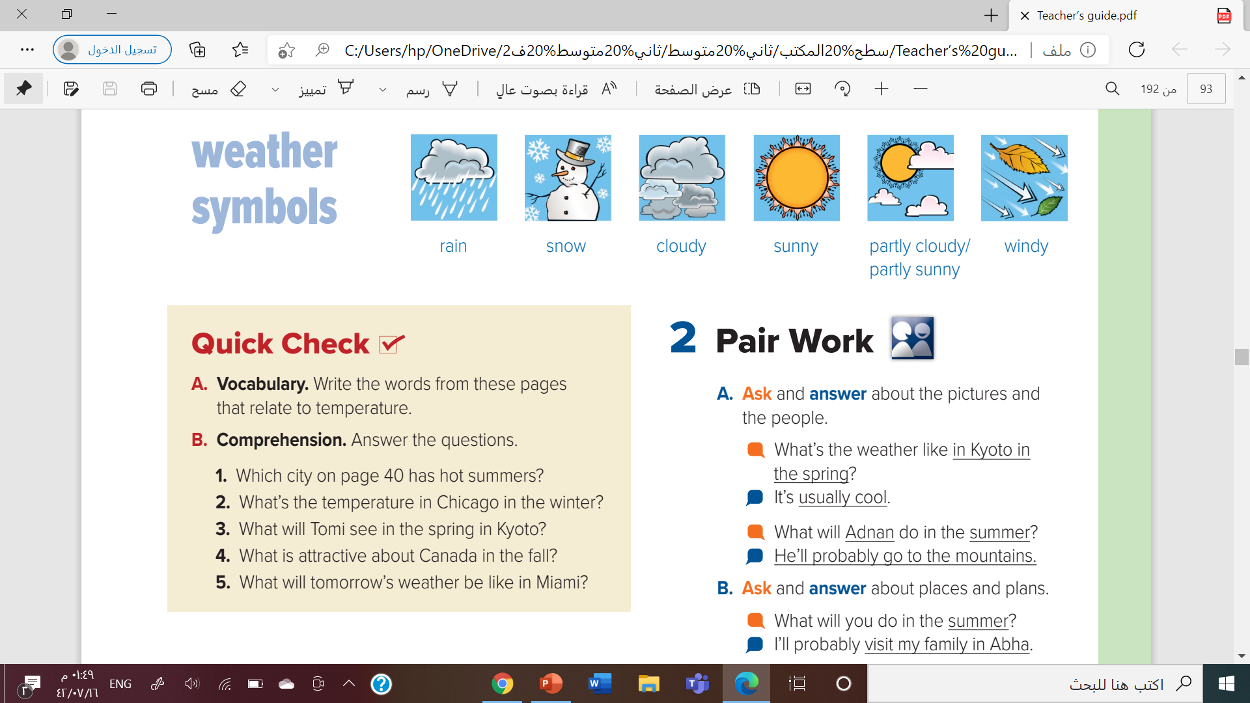

Slide 19
1. Jeddah has hot summers.
2. In winter, temperatures in Chicago often fall below zero Celsius, and even below zero Fahrenheit.
3. Tomi will see cherry blossoms in the spring in Kyoto.
4. In Canada in the fall, the leaves on the trees change color.
5. The weather in Miami will be warm tomorrow, about 86 degrees Fahrenheit, 30 degrees Celsius.

Slide 20

What’s the weather like?
What’s it like outside?
What’s the weather like in Jeddah in the summer?
What’s the weather like in Arar in the winter ?

Slide 21



Slide 22
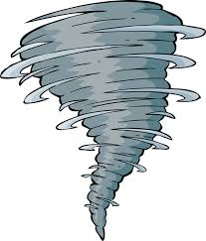

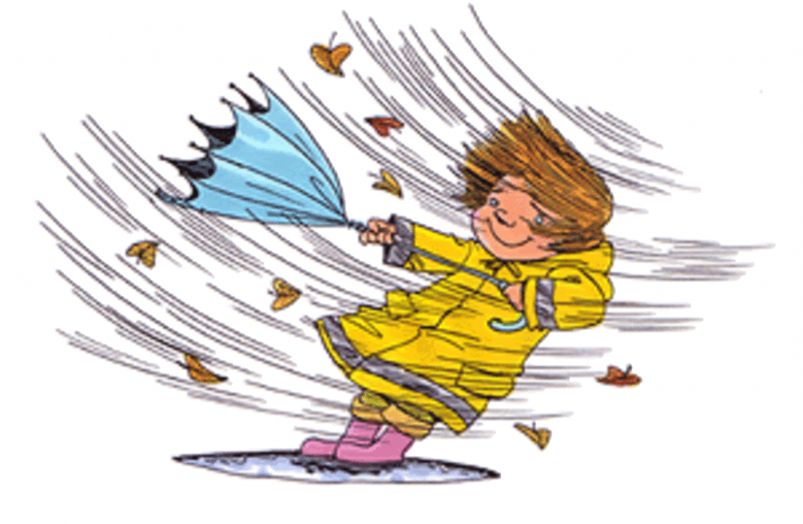
Page : 241

Slide 23



