Slide 1
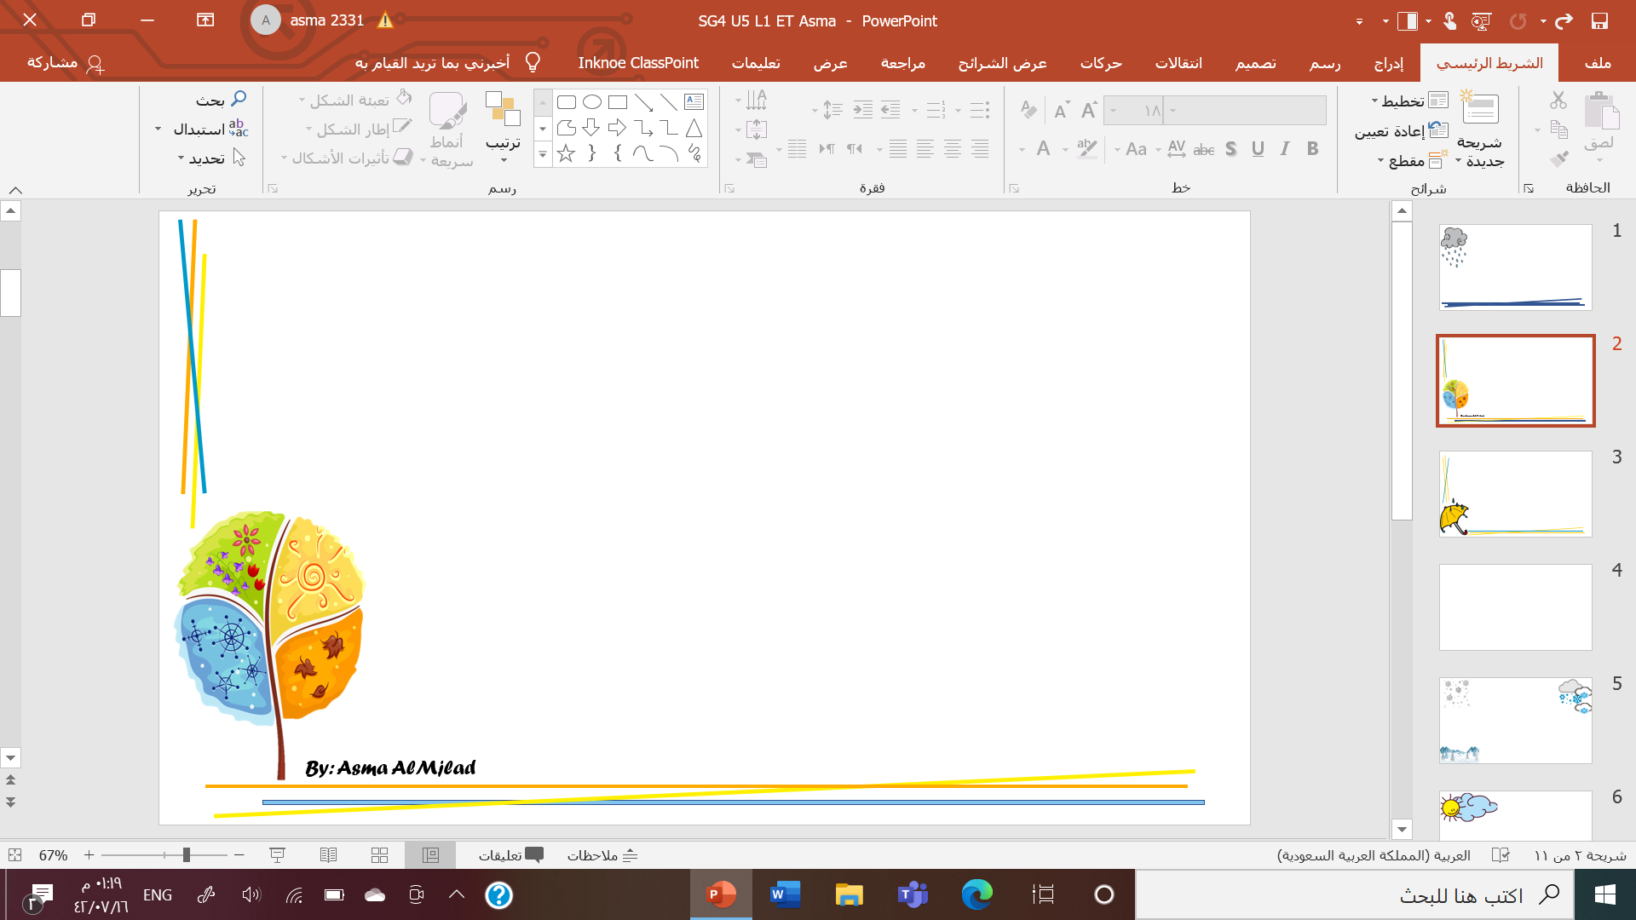
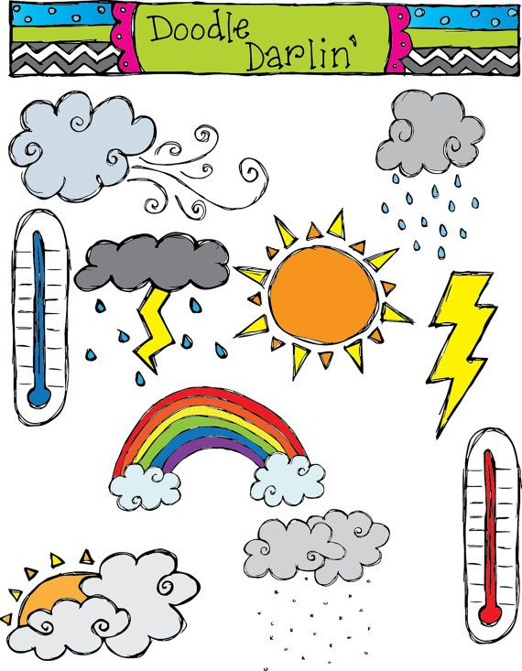
What is the weather like ?
Listening and conversation

Slide 2

Objectives
Improve listening skill
Improve reading skill
Learn new expression
Use expression correctly

Slide 3
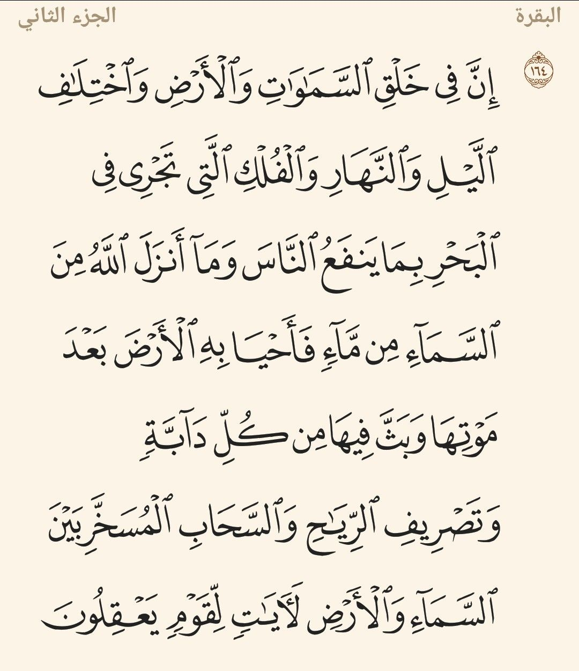

Slide 4
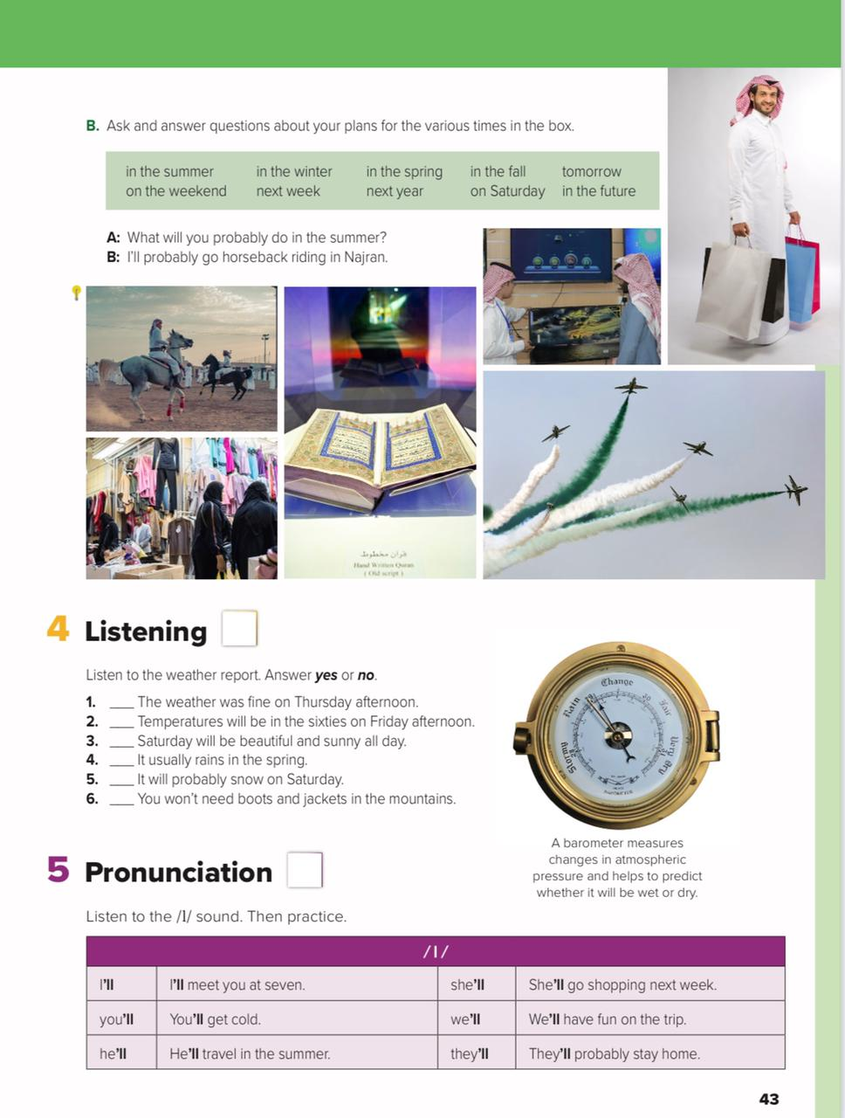
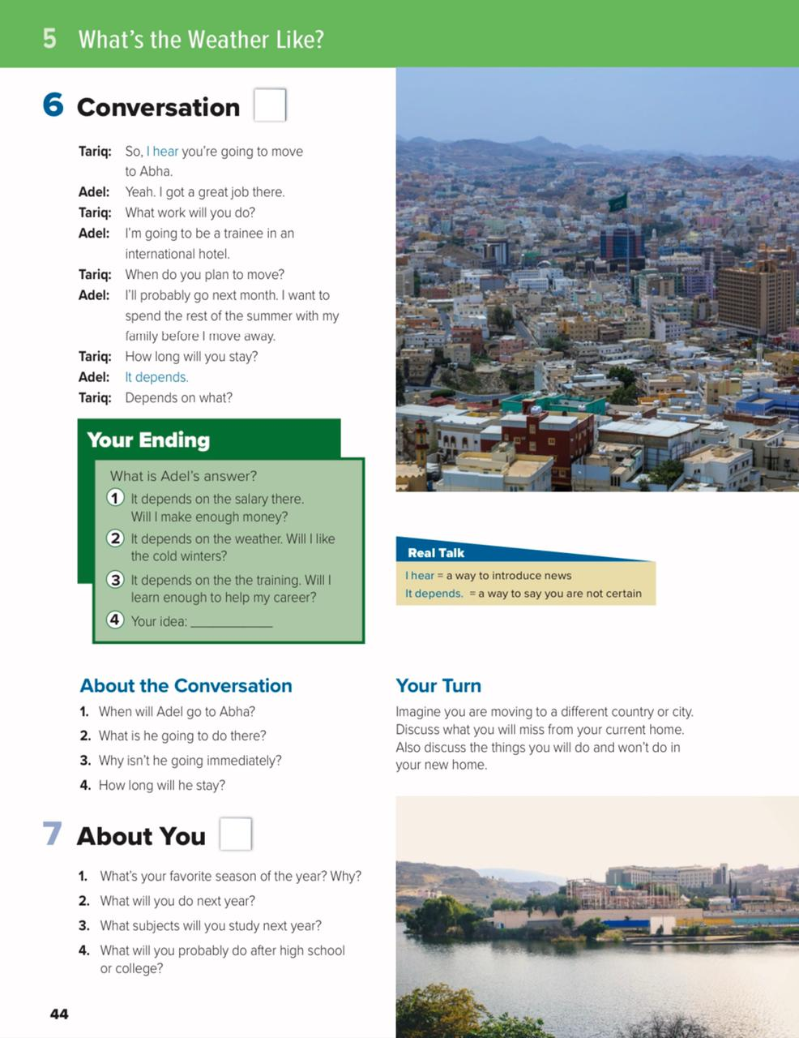

Slide 5

Video
https://youtu.be/XJ4lbuFwYNU

Slide 6
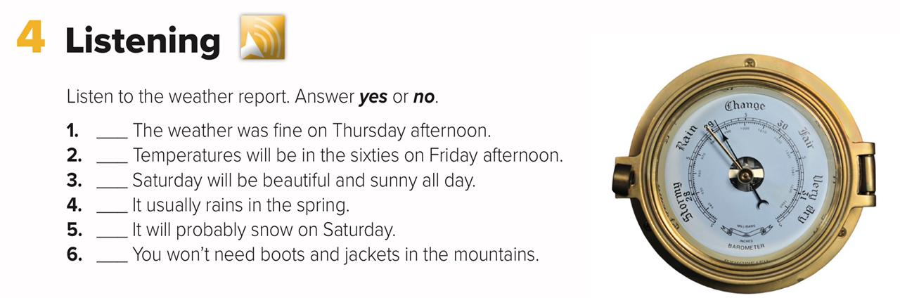
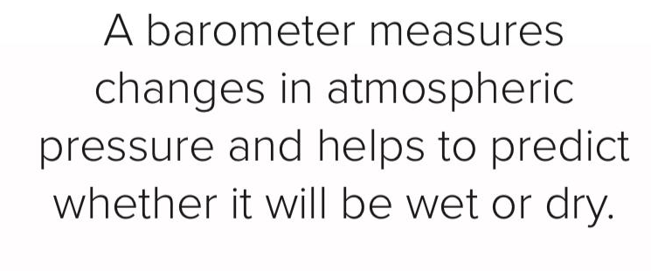

Slide 7
No
No
No
Yes
No
No

Slide 8

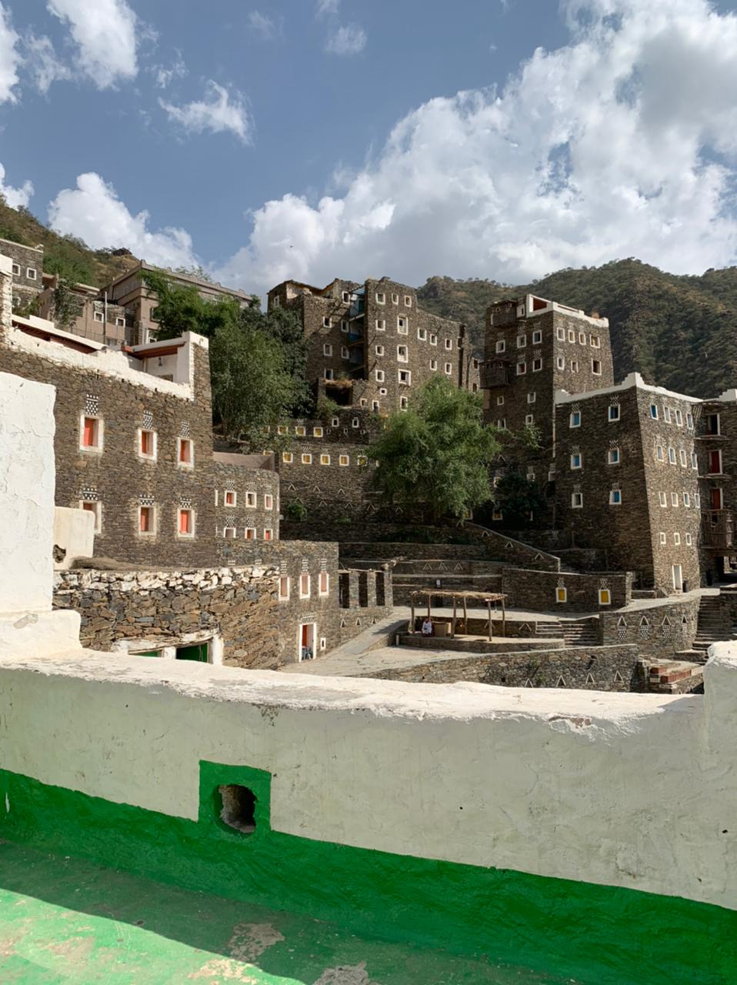
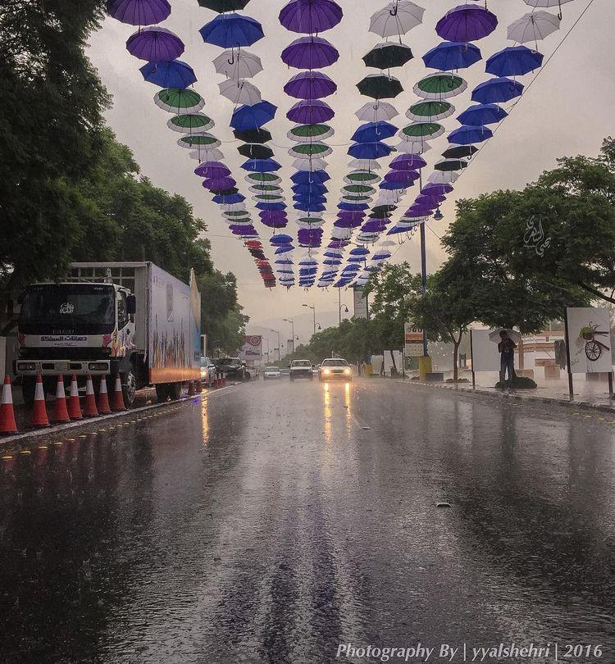
Warm up
Do you know this city?

Slide 9

It’s
ABHA
What do you know about Abha?
What is the weather like there?
Have you ever been there?
Is it a place you would like to visit? Why or why not?

Slide 10
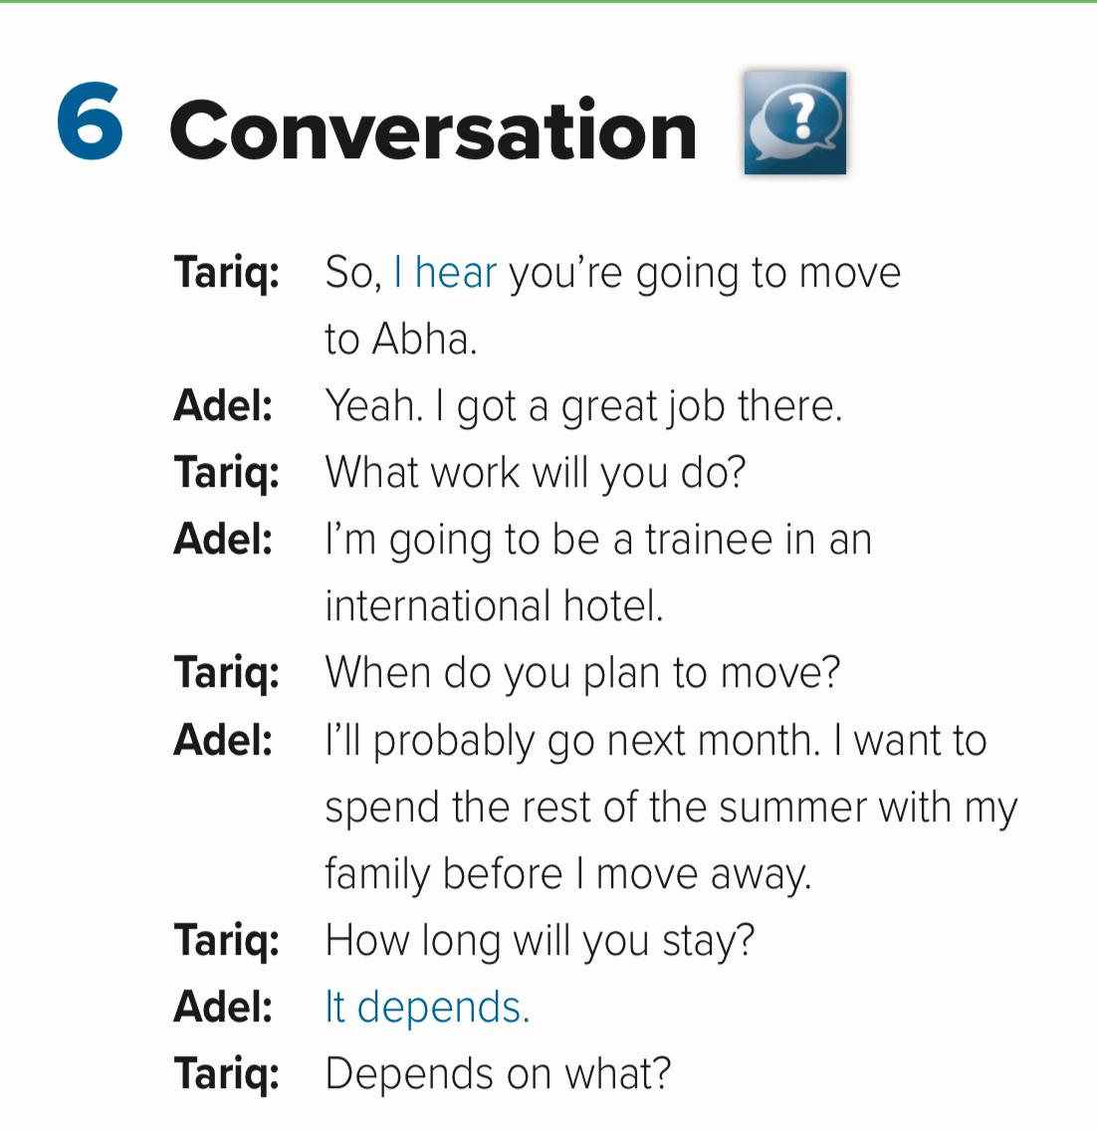

Slide 11
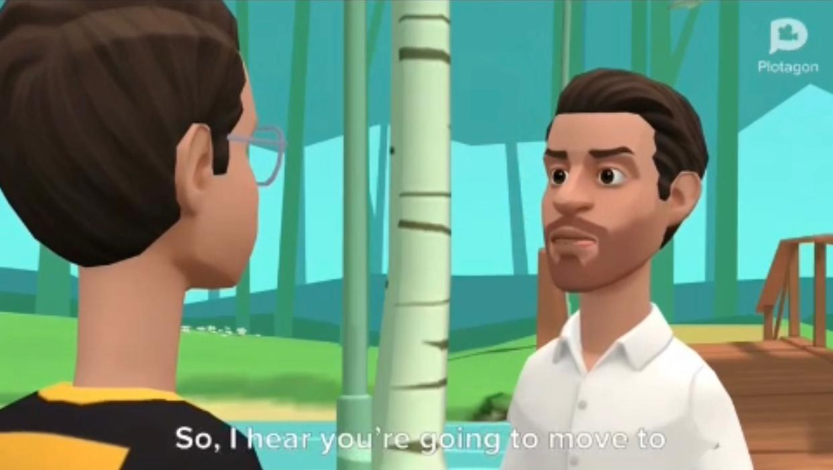

Slide 12
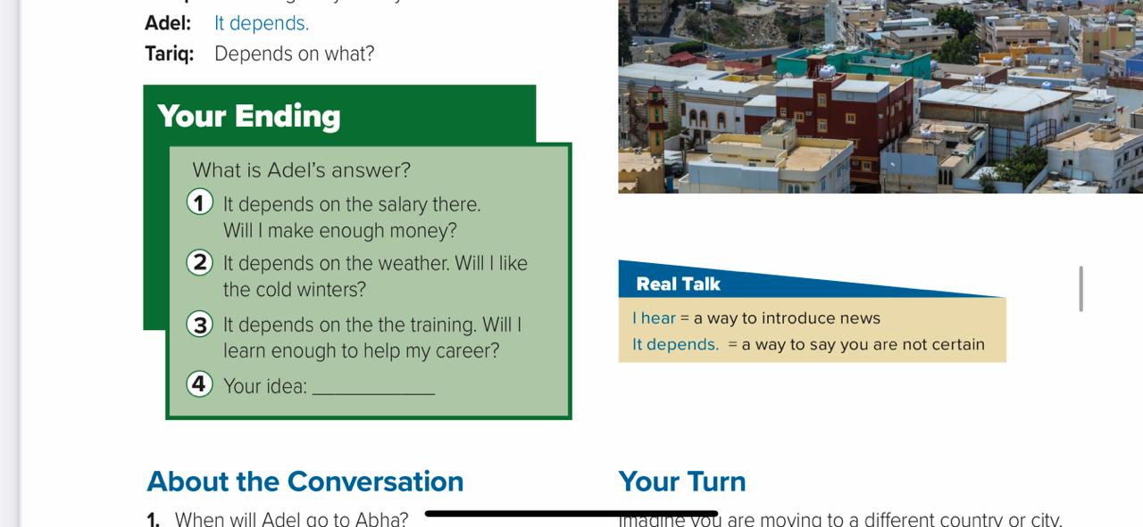

Slide 13
Who says I hear?
What news did he hear?
Did he find out from Adel that he’s going to move to Abha, or did he hear about it from someone else?

Slide 14


Slide 15


Slide 16
1. Adel will probably go to Abha next month.
2. He’s going to work there. He’s going to be a trainee in an international hotel.
3. He wants to spend the rest of the summer with his family before he moves away.
4. He doesn’t know.

Slide 17
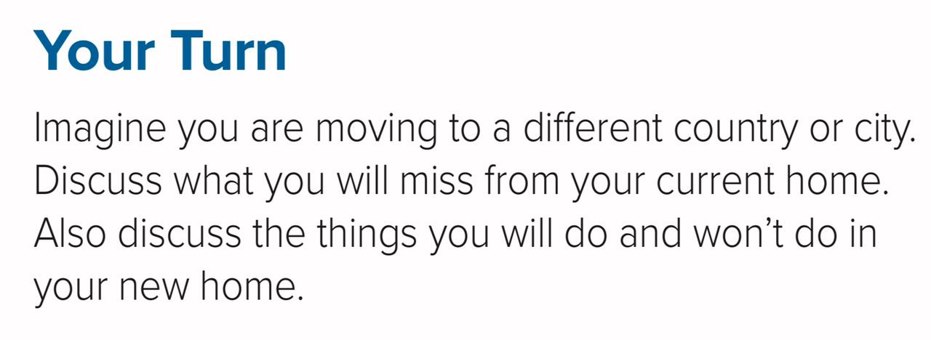


Slide 18
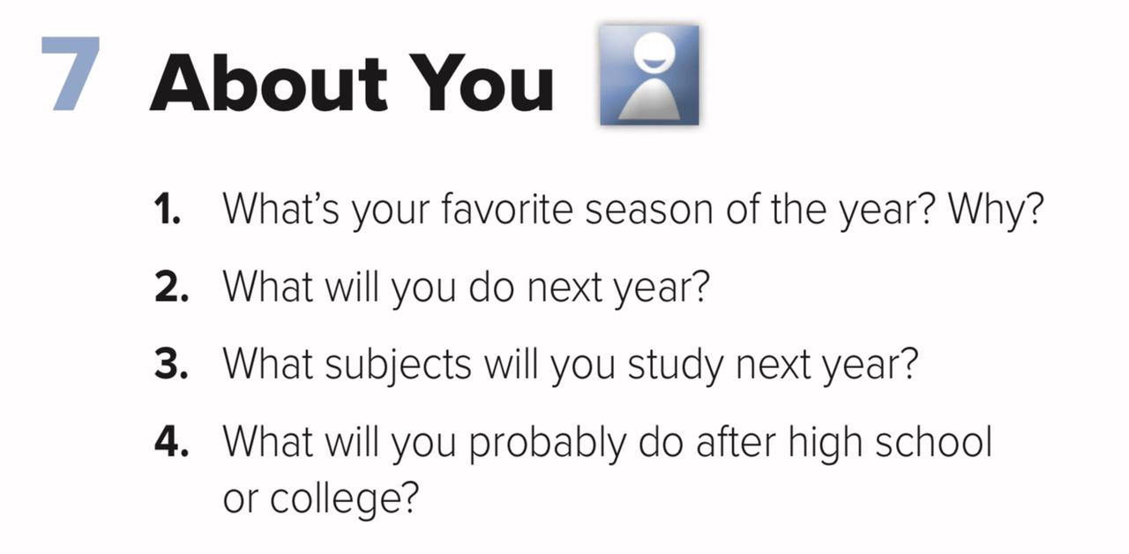

Slide 19



