Slide 1

U 5
Grammar
Tr. Nora Khalid

Slide 2


Use future with will
Apply information questions
Listen for specific information
Produce the /l/ sound

Slide 3


Slide 4


Slide 5
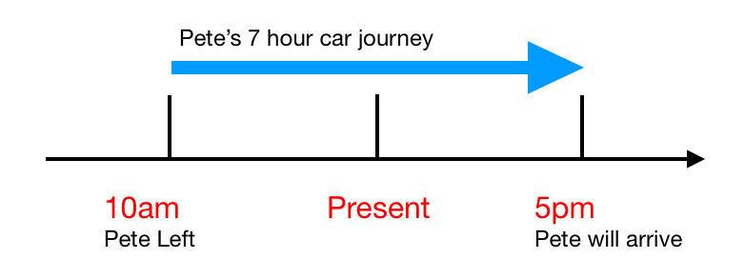

Slide 6
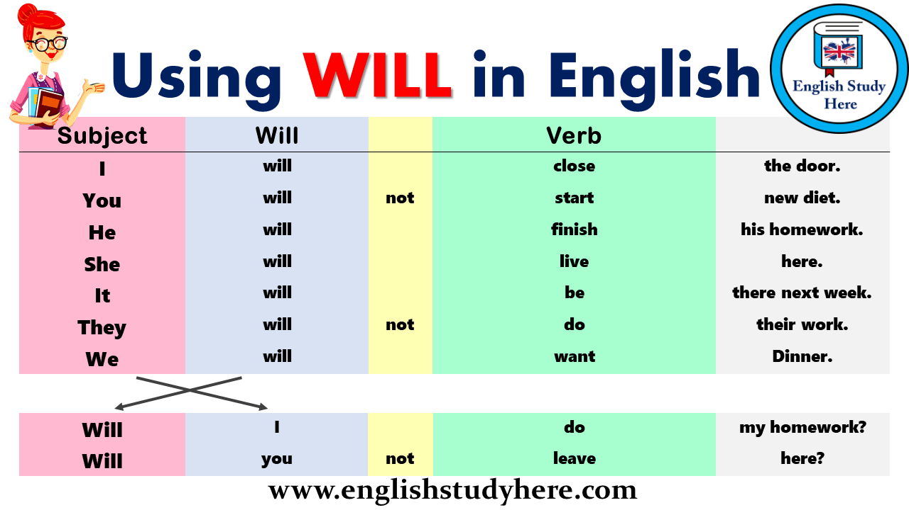

Slide 7
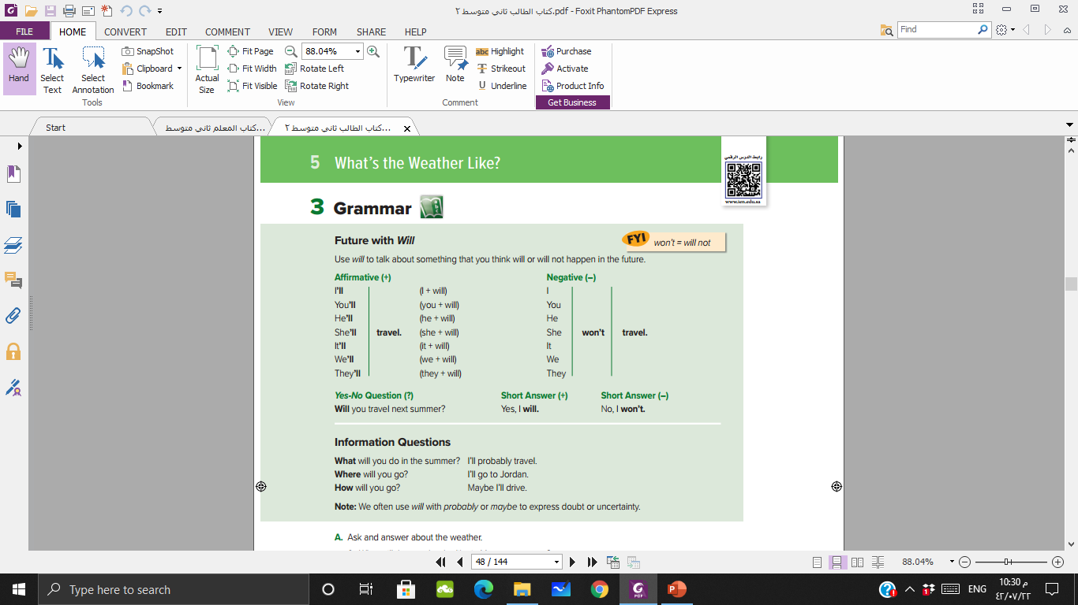




Slide 8

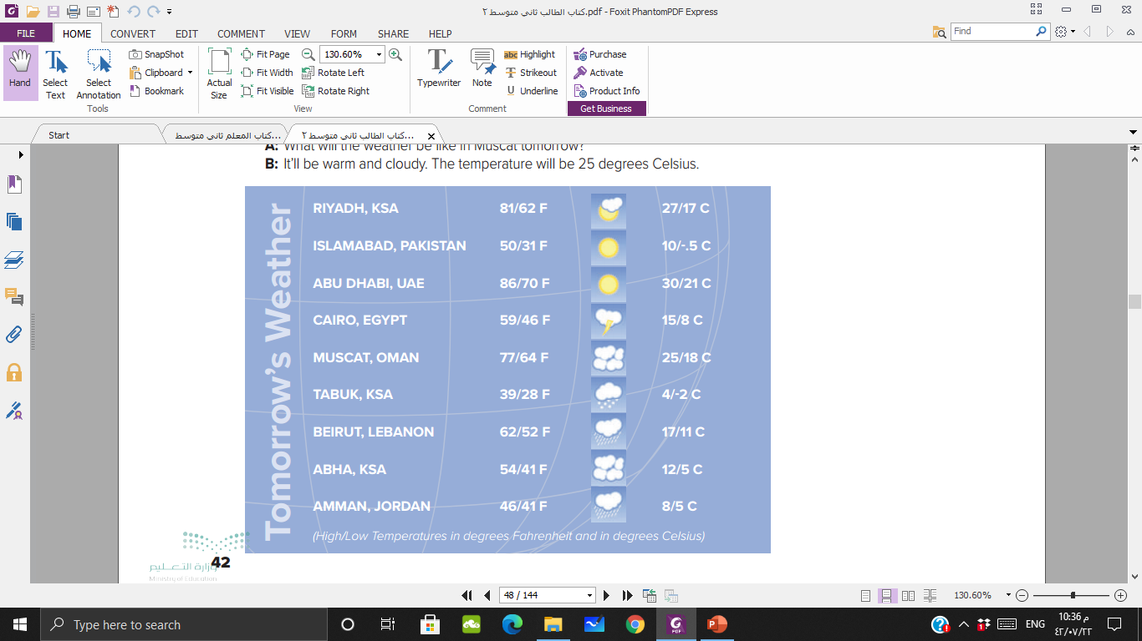
What will the weather be like in ……… tomorrow?
It will be …………..
It will be very warm and partly cloudy
It will be cool and sunny
It will be hot and sunny
It will be cool and rainy
It will be quite warm and cloudy
It will be cold and snowy
It will be a bit warm and rainy
It will be cool and rainy
It will be cool and rainy

Slide 9
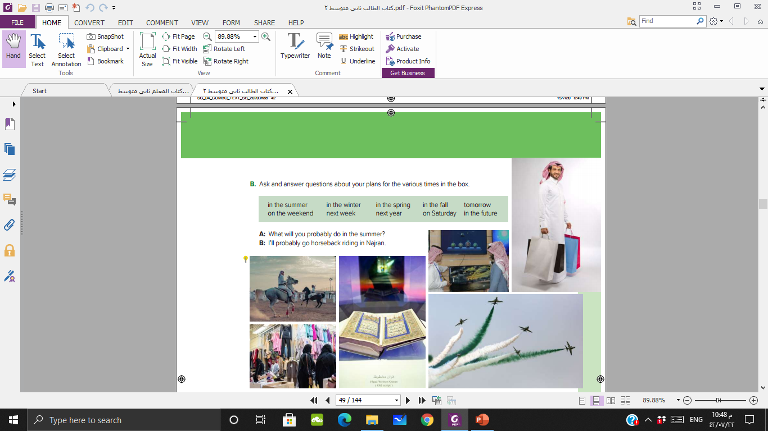



Slide 10

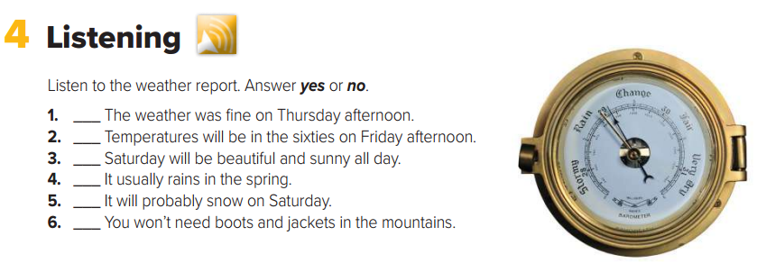
No
No
No
Yes
No
No

Slide 11
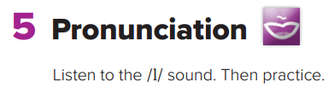


Slide 12

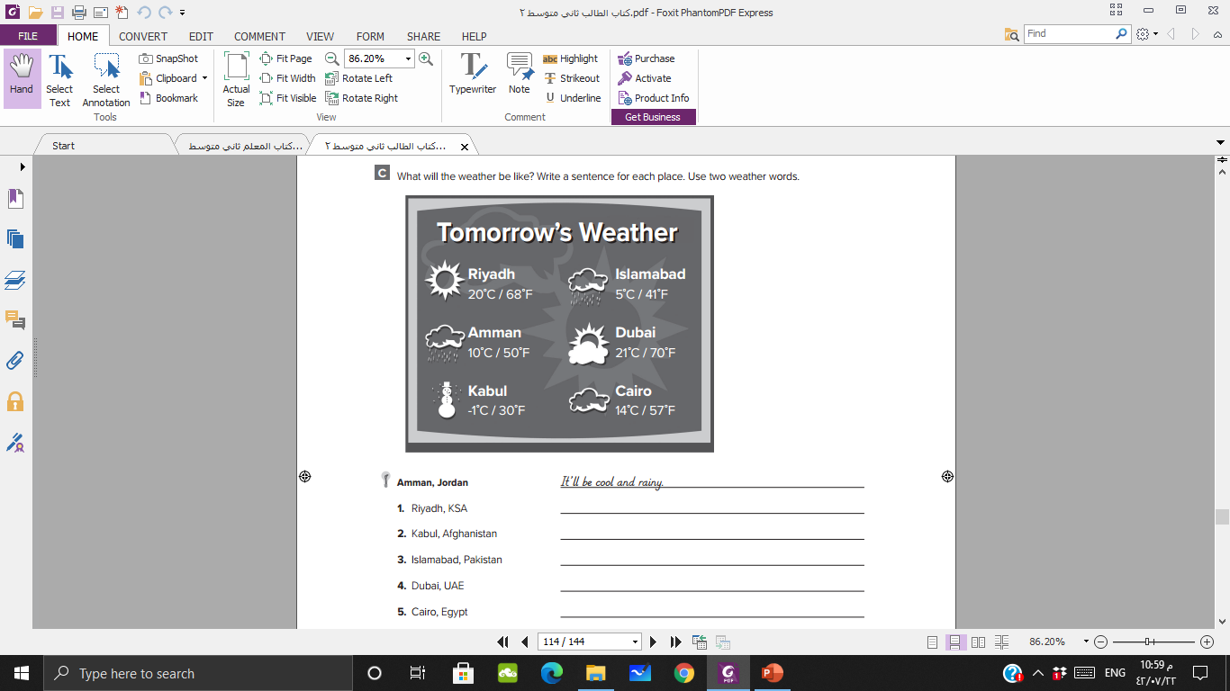
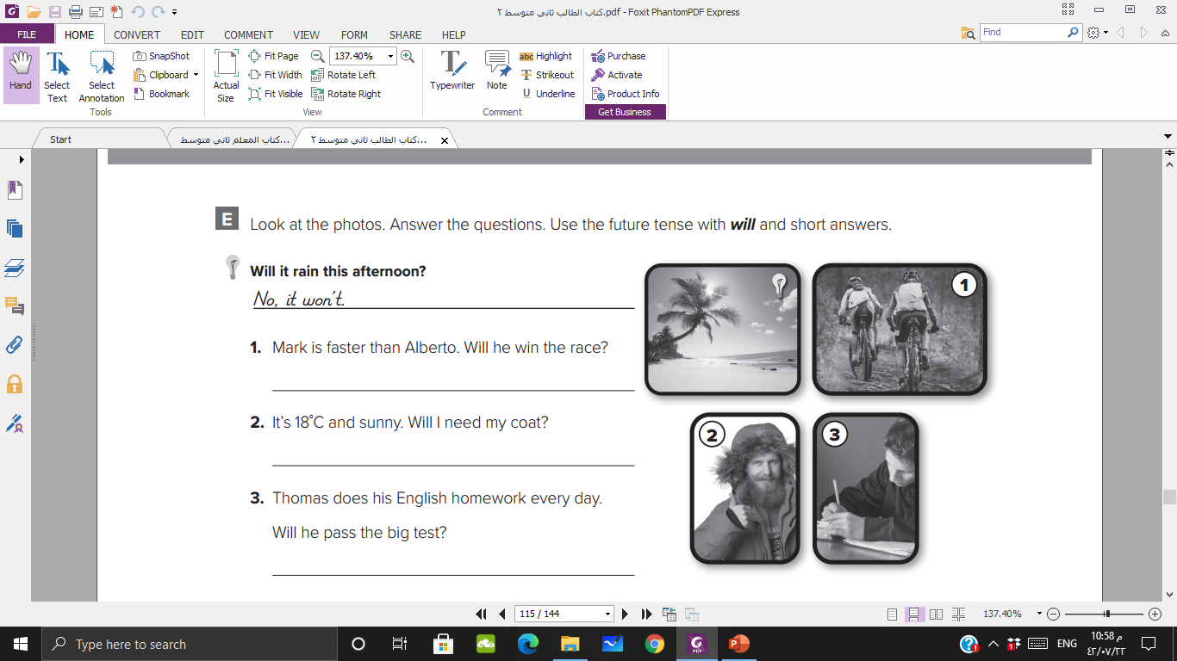

Slide 13

https://learningapps.org/watch?v=p3qie3sqa21

Slide 14


