Slide 1
11 Form, Meaning and Function
Unit 3
Ahmad Abdallah & Abdulrahman Mohammed

Slide 2
Our Goals is :-
01
03
Adjectives
04
Adjectives from Verbs and Nouns
Both… and… / Neither… nor… / Either… or…
Unit 3
11 Form, Meaning and Function
All / Both / Neither / None
02

Slide 3

Unit 3
11 Form, Meaning and Function
Open Your Book
Page 44 & 45

Slide 4
Adjectives
What Position of Adjectives ?
Use adjectives to describe nouns. Place adjectives either after the verb be or before a noun.

Slide 5
Position of Adjectives
Before Noun
After The Verb
Dolphins are intelligent.
Dolphins are intelligent animals
Cats are very independent.
Tigers are very independent animals
Giant pandas may become extinct in the future
Giant pandas are an endangered species

Slide 6
Adjectives from Verbs and Nouns
A lot of adjectives are formed from verbs and nouns.
Many adjectives are formed by adding the following
suffixes:
: -y
:-ful
: -less
Example:
Health
Healthy
Use
Useless
: -ate
: -al
: -ive
Impression
Impressed
: -ous
: -ic
: -ed or ing
Care
Careful
Energy
Energetic

Slide 7
Adjectives from Verbs and Nouns
Noun
Adjective
Health is very important
Keeping pets healthy is very important.
You won’t get much use out of that bag.
That bag is useless.
The tall buildings in Dubai made a big impression on the tourists.
I felt impressed when I saw the very tall hotel.

Slide 8
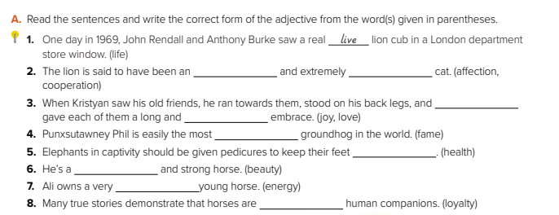
affectionate
cooperative
joyfully
loving
famous
healthy
beautiful
energetic
loyalty

Slide 9
All / Both / Neither / None
Use all, both, neither and none to compare two or more things, places, animals or people.
All
None
Both
Neither
. All or none refer to three or more people or things.
both and neither refer to two people or two things.
Neither means not one and goes with singular verbs and nouns.

Slide 10
03
All / Both / Neither / None
(All / Both/ Neither/ None + of + subject +auxiliary verb or main verb.)
All (For All)
None (For Nothing)
Neither (this nor that)
Both (both of them)
All of them are teachers.
None of them are math teachers.
Both of them are teachers
Neither of them is a math teacher.
All of them teach science
None of them teach math.
Both of them teach science
Neither of them teaches math.

Slide 11
Both… and… / Neither… nor… / Either… or…
Both/and
(All of Them)
(When connecting two subjects with both...and, be sure to use a plural verb)
Both my father and his boss were present at the meeting.
Both camels and elephants are intelligent animals.

Slide 12
04
Both… and… / Neither… nor… / Either… or…
Neither nor / Either or
(No This Or This) (This Or This)
(When connecting two subjects using either or, or neither nor, the choice to use a singular or plural verb depends on the subject that is closer to the verb.)
Neither my uncle nor my brothers want to see that documentary.
My favorite animal is either an elephant or a camel.

Slide 13
Thanks!
Please keep this slide as attribution

