Slide 1
Unit 3
Amazing Animals
Conversation & Listening
Mega Goal 2.3
Done by: Entisar Al-Obaidallah

Slide 2
Lesson Objectives
Read the conversation for specific information
Answer some questions about the conversation
Match the new vocabulary with its meaning
Use the “Real Talk” in a sentence.
Stress the Y and J sounds

Slide 3
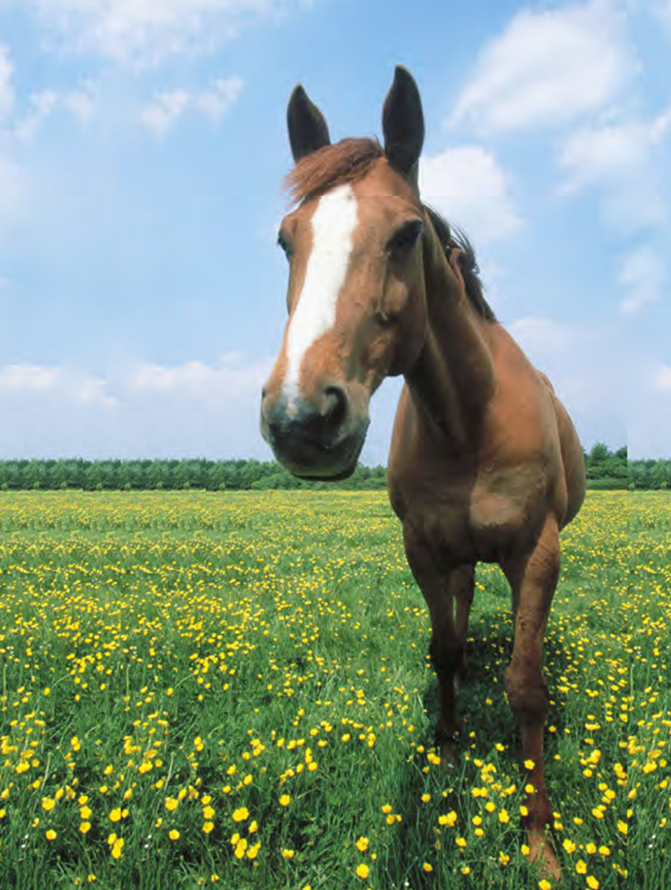


Warm up
Look at the picture..
What do you think our lesson will be about??

Slide 4
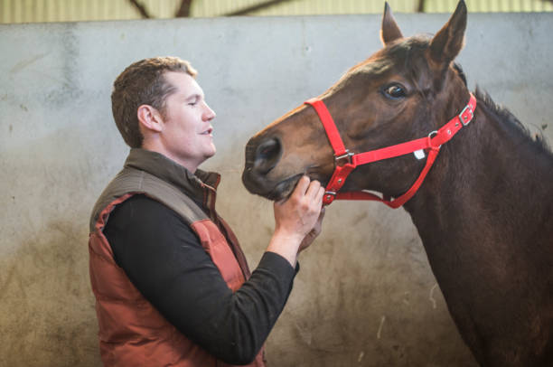
Warm up
Who should be
the boss in the relationship between the man and
the horse?
Have you ever tried to train an animal
of any kind?
How did you do it? Was it difficult?

Slide 5

Book Open
page ( 38 )

Slide 6
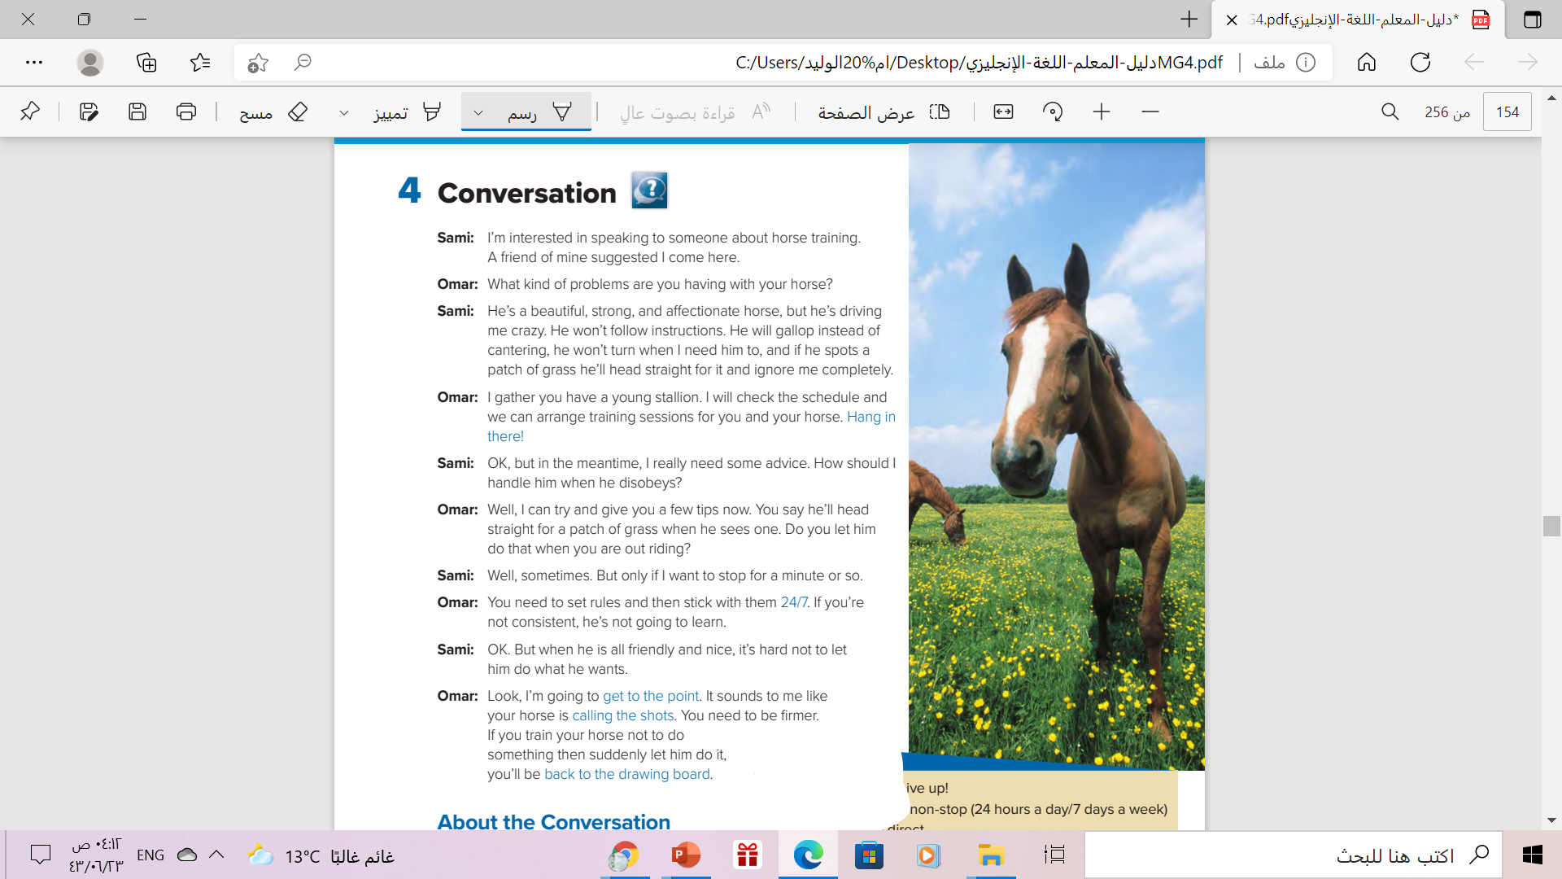
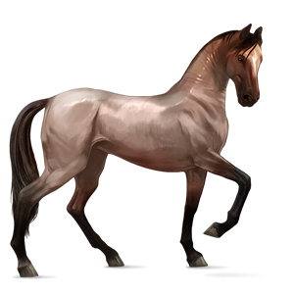
How many persons are there ?
Two persons
Who are they?
Sami and Omar
What are they talking about?
About horse training

Slide 7


Read along as you listen
page.( 38 )

Slide 8

Do you think that Sami’s
problem is that he’s too strict with
his horse or
not strict enough?
Sami isn’t strict enough.
He can’t say no to the horse.

Slide 9


Slide 10
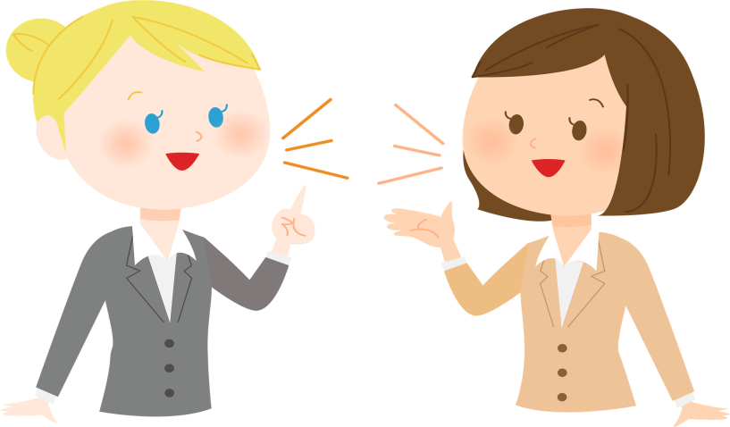
Who says ………
Hang in there!
Omar

Slide 11
Who says ………
24/7
Omar

Slide 12
Who says ………
get to the point
Omar

Slide 13
Who says ………
calling the shots
Omar

Slide 14
Who says ………
back to the drawing board
Omar

Slide 15
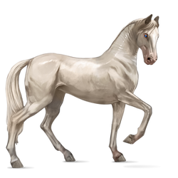
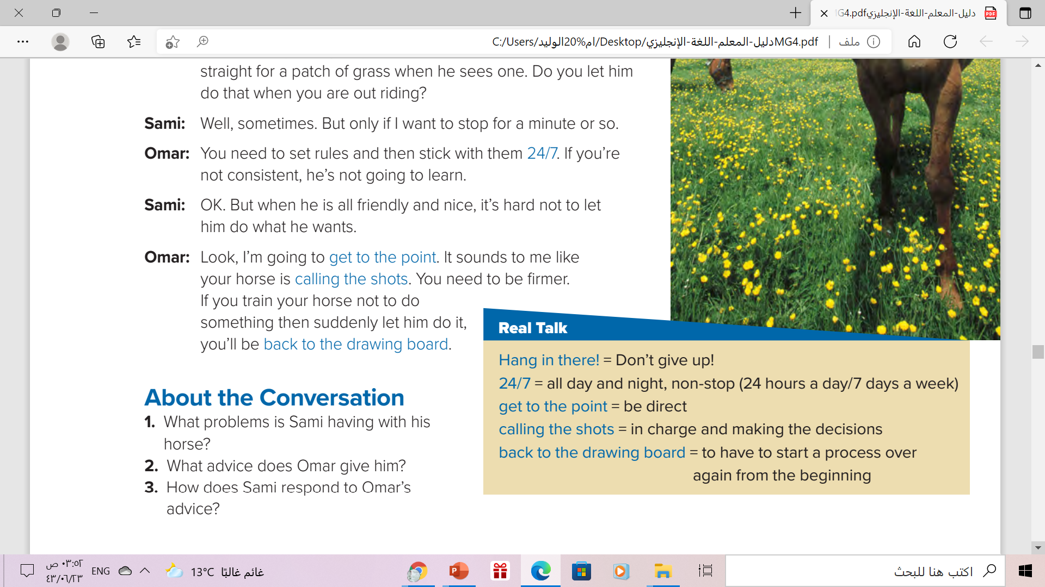
 Read the words and their meanings:
Omar is the one who uses
all of these expressions.

Slide 16
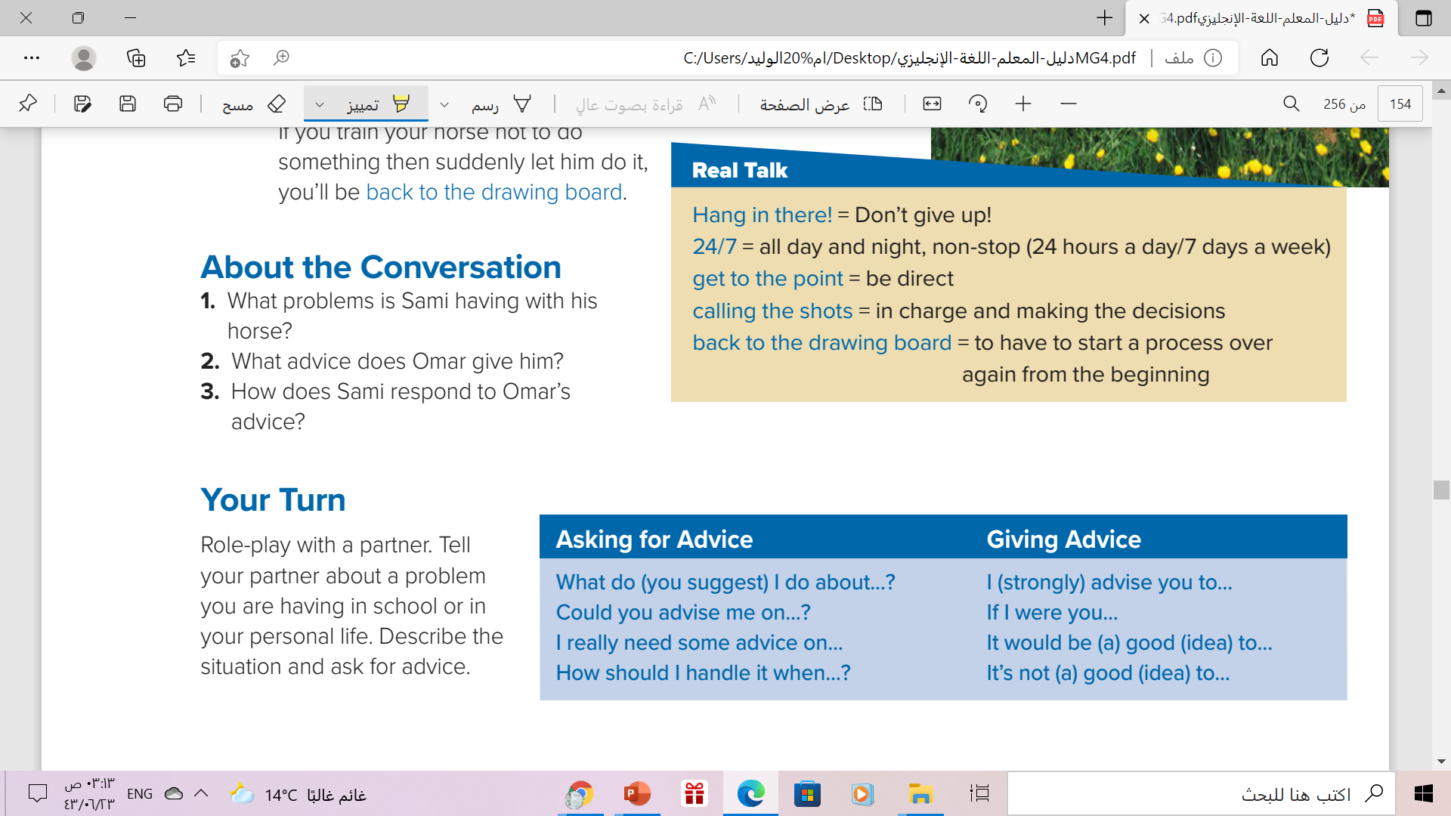
His horse doesn’t follow instructions, will gallop instead of cantering, and won’t turn when he needs him to.
He tells him that he needs to set rules and stick by them.
Sami says it is hard not to let his horse have his way.

Slide 17
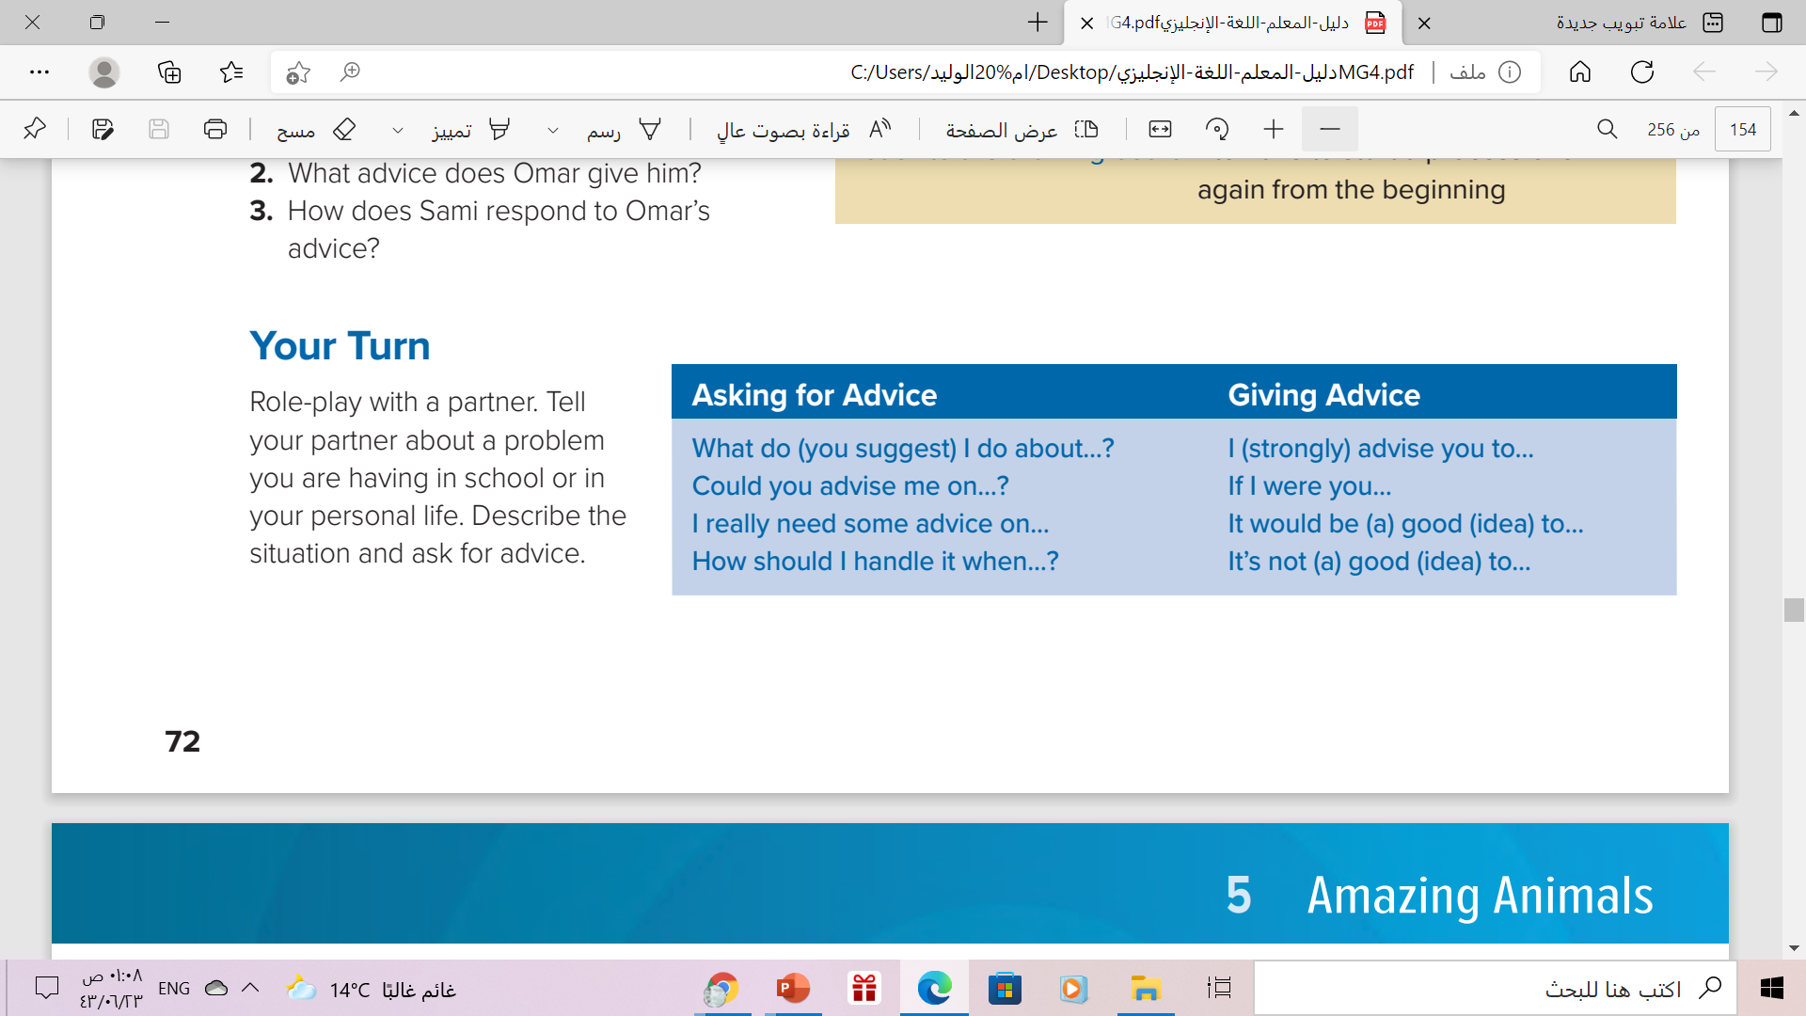

Phrases like these make our speech sound more
polite.
They also prepare the listener for what you are
going to say

Slide 18
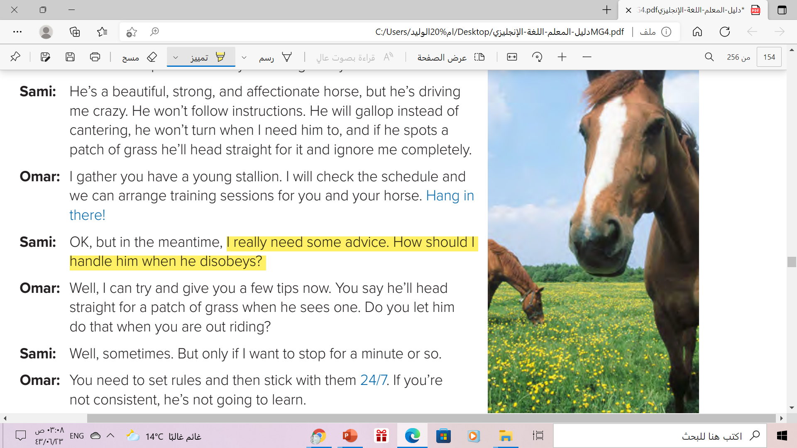
Which phrases are used
in the conversation?

Slide 19
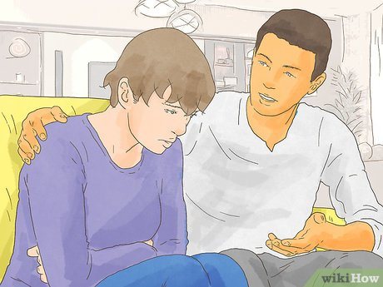

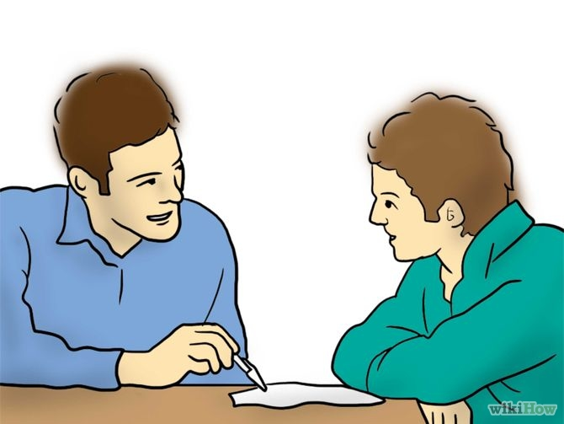
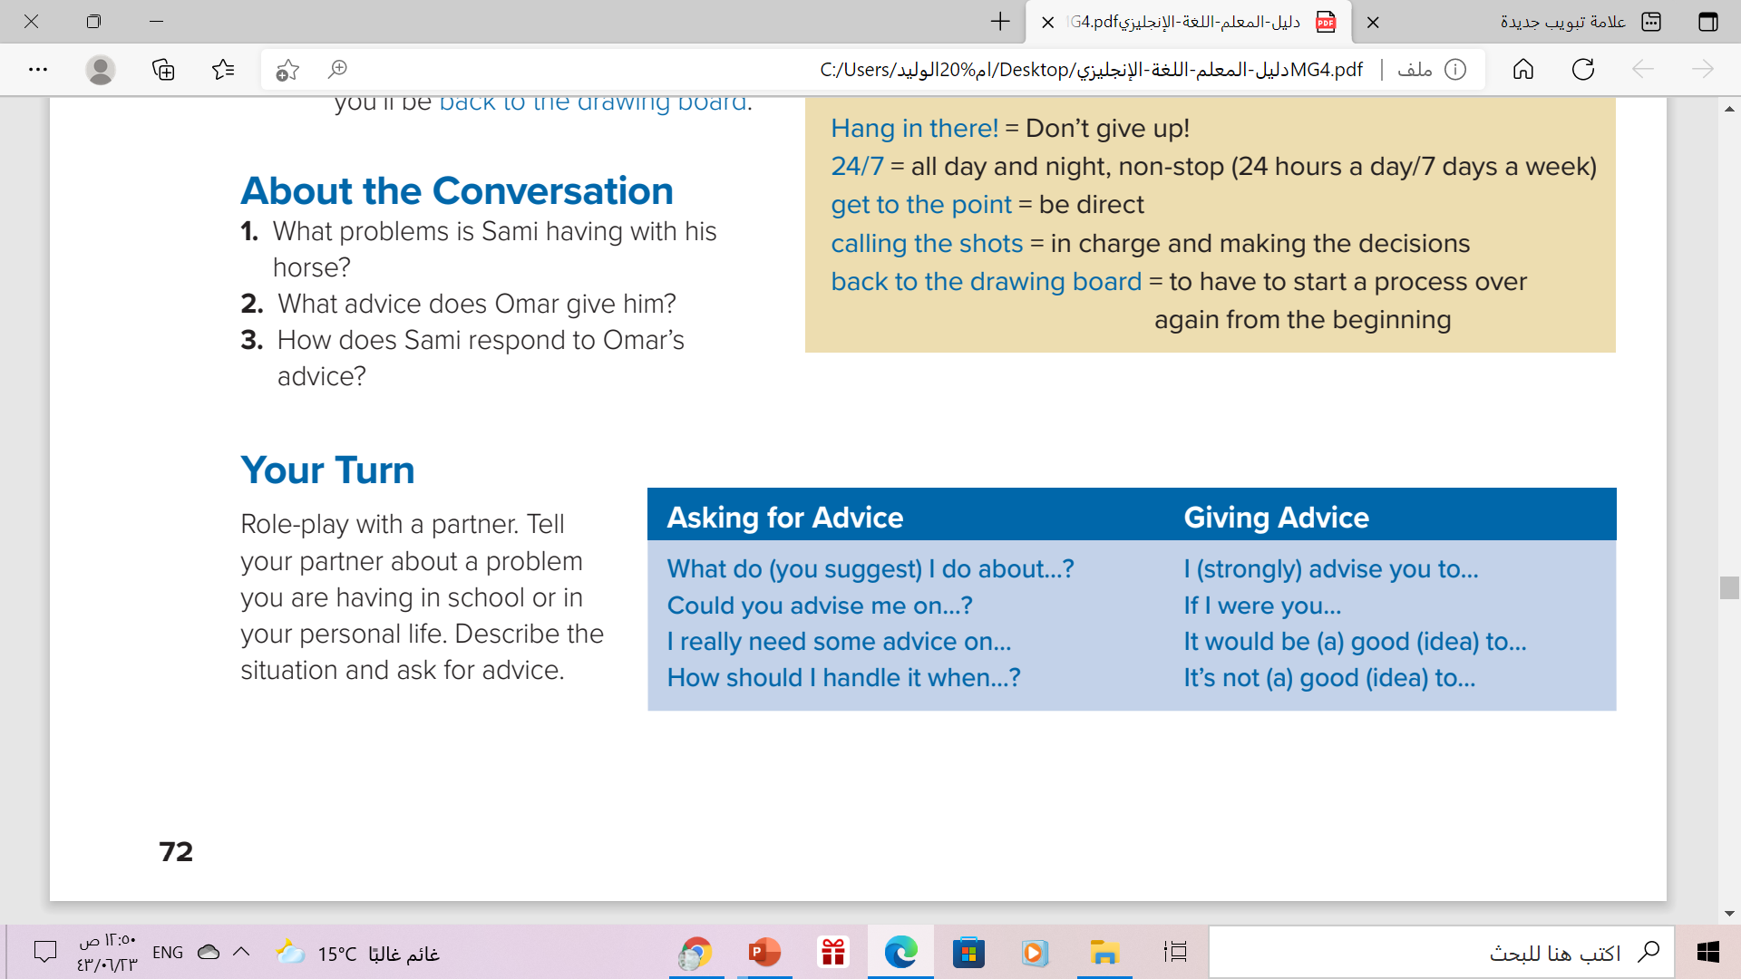
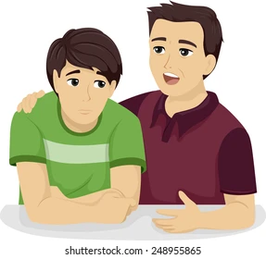

Slide 20
Book Open
page ( 39)

Slide 21
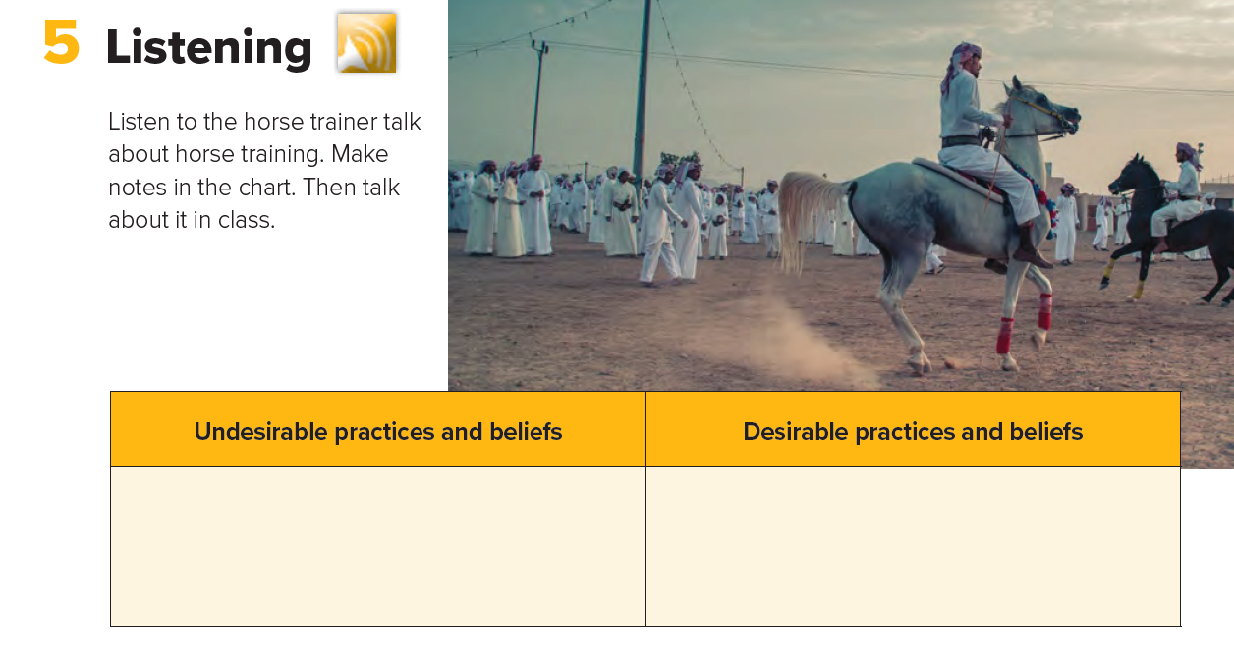
Break the horse’s spirit
Rule by fear
Use harsh treatment and extreme force.
Create a willing and accepting partner
Owners need to be firm leaders
Rule the horse with respect
Communication is the secret to natural horsemanship.
Get to know your horse’s body language, natural tendencies.
The horse needs time and patience.

Slide 22
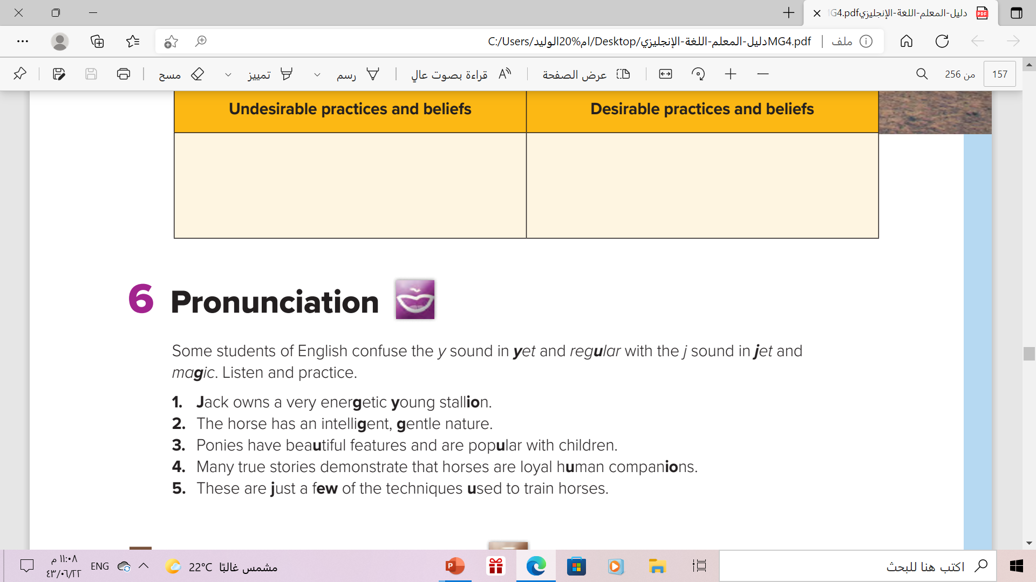

Slide 23
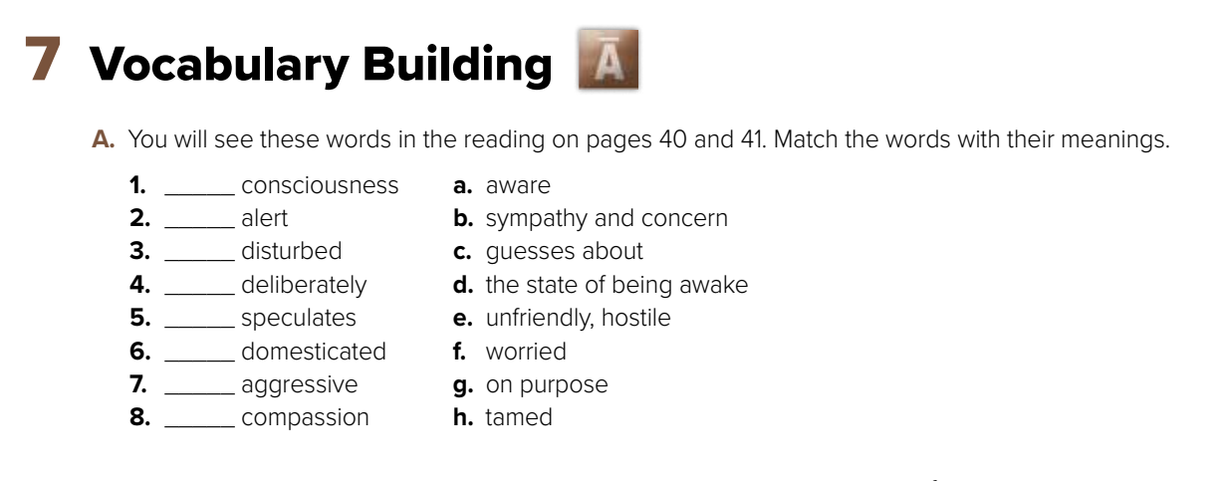
Match the words with their meanings
d
a
f
g
c
h
e
b

Slide 24
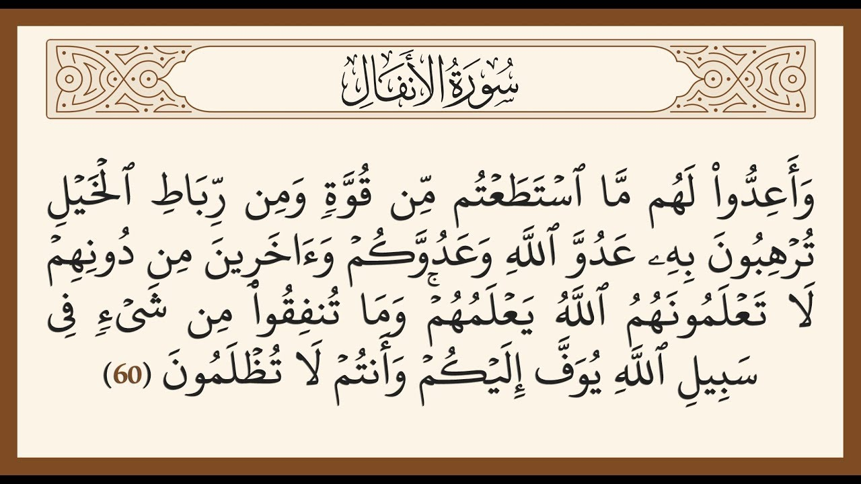

Slide 25
Homework
workbook
p. (104) , exercise (G)

Slide 26
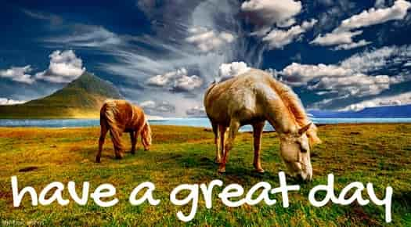
THANKS!

