Slide 1


Slide 2

Good Morning

Slide 3
Unit -3-
If It Hadn’t Happened

Slide 4
3- Grammar

Slide 5
Should Have + Past Participle
Conditional Sentences: Hypothetical Situations in the Past
If with Could and Might

Slide 6
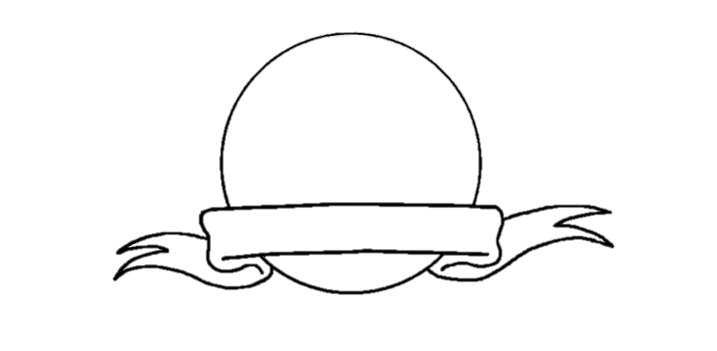



Revision

Slide 7



Warm Up
Objectives
T
The students will be able to :
1 – express regret with should have + past participle .
2 – correlate a situation and result .
3 – originate a regret according to a given situation .
4 – write about a situation in the past using the past perfect + would .
5 - form a sentence about missing opportunity using if-clause + could/would .
6 -Share positively in pair work

Slide 8


Warm Up
Find the Fib
If you heat ice , it melted
If you heat ice , it melts
Should Have + Past Participle

Slide 9

Should Have + Past Participle

Slide 10
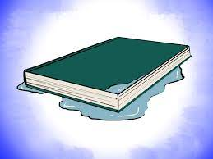
I should have studied well the exam.
(But, I didn’t.)
I shouldn’t have left my book outside in the rain.
(But, I did.)

Slide 11
We use it talk about regrets. Use this form to talk about
things you wish you had done or hadn’t done.
I should have studied well the exam.
(But, I didn’t.)
I shouldn’t have left my book outside in the rain.
(But, I did.)

Slide 12

Form
I should have studied well the exam.
Subject + should + have + V3
Negative
I shouldn’t have left my book outside in the rain.
Subject + should + not + have + V3

Slide 13
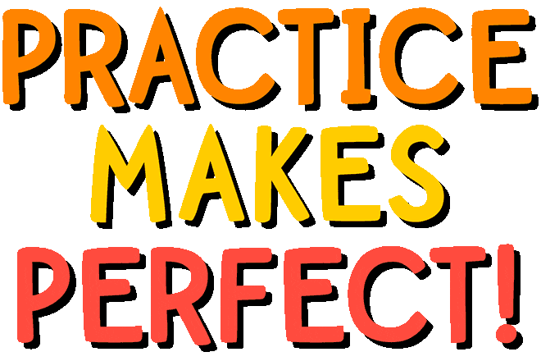

Slide 14
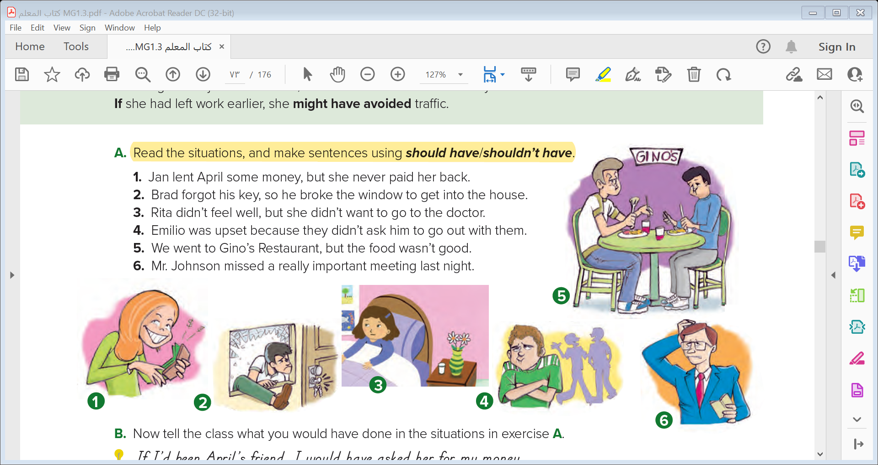
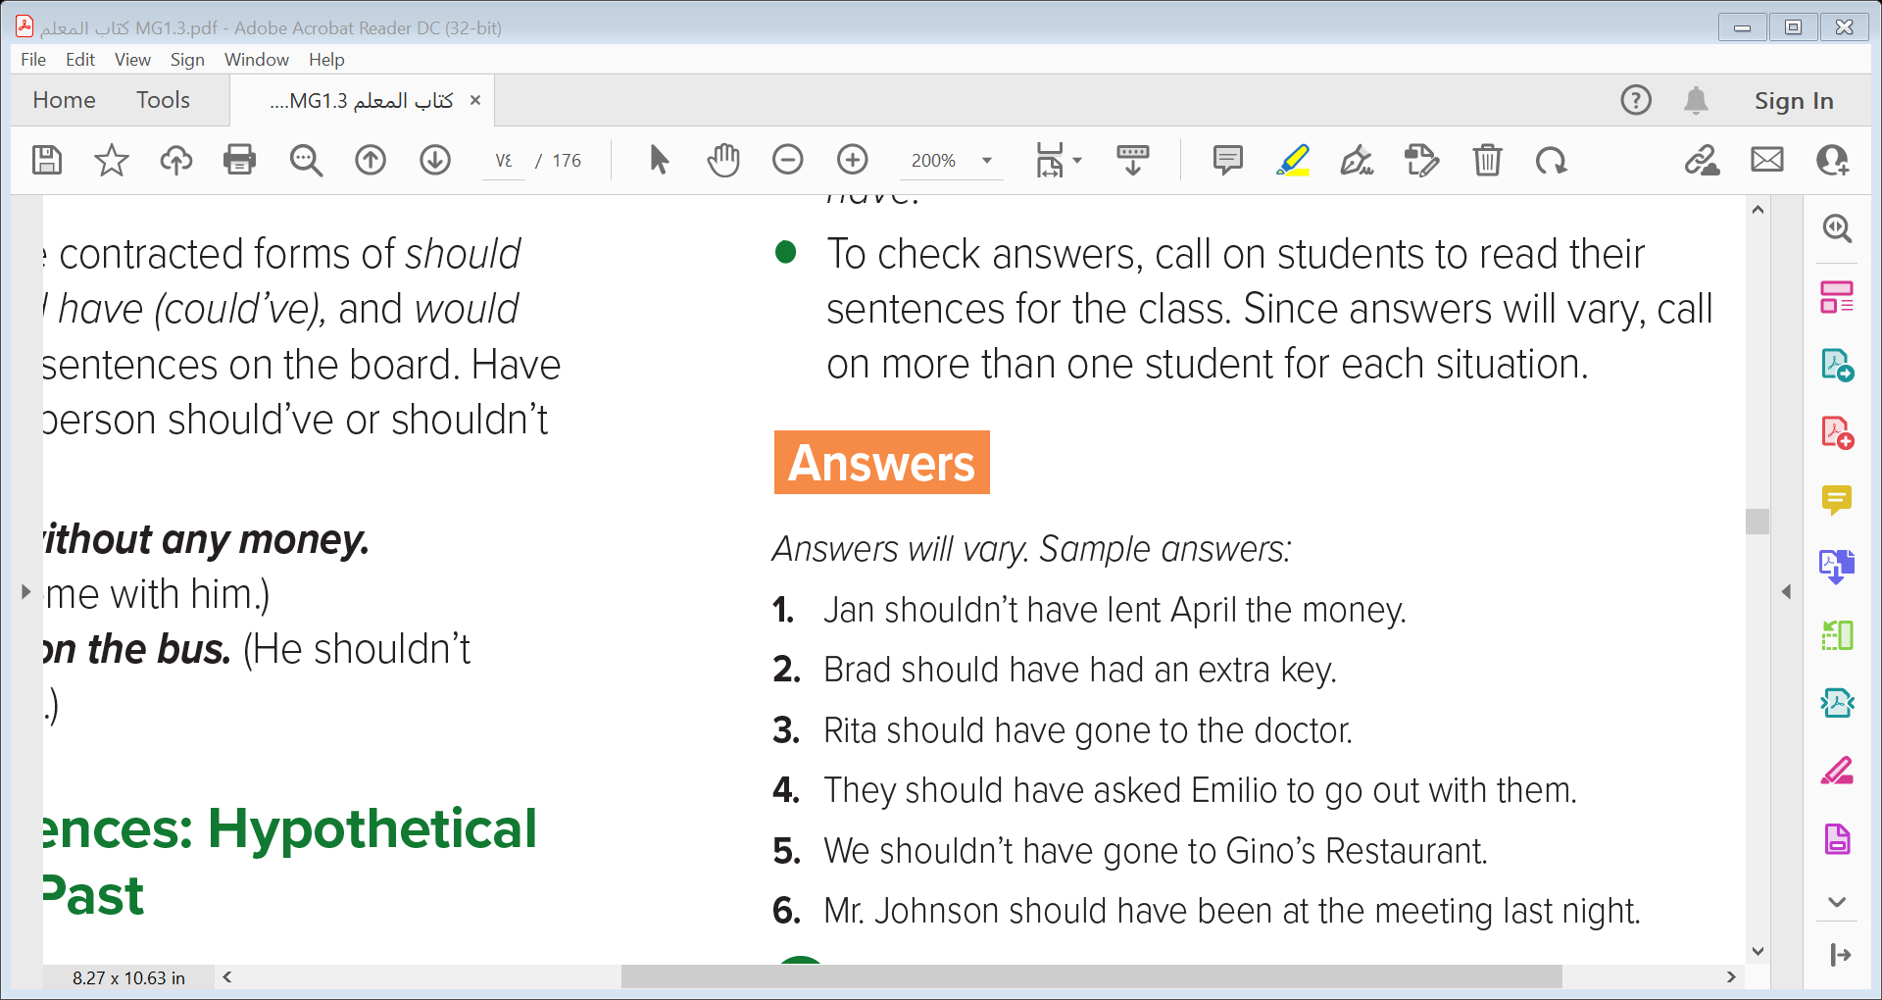
6
5
4
1
2
3

Slide 15
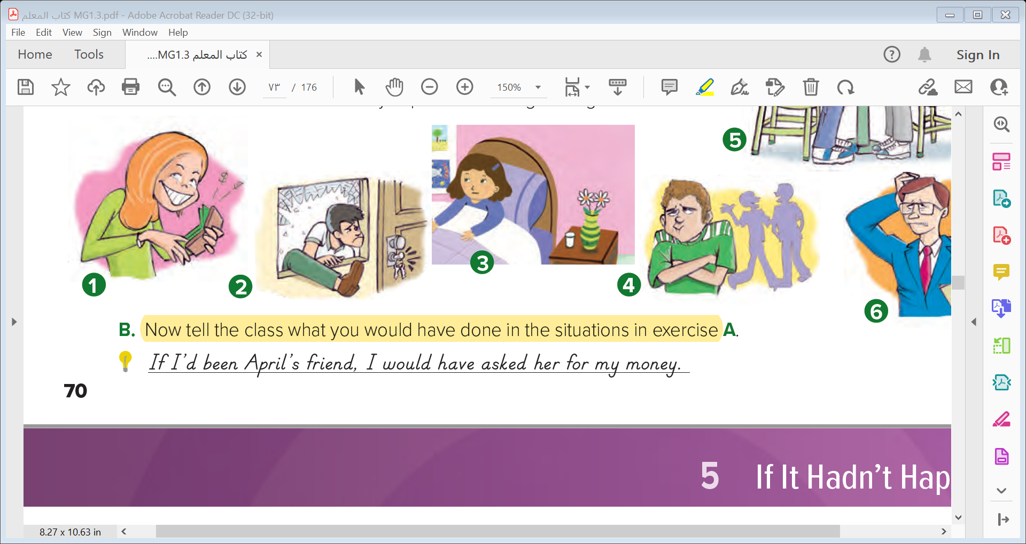


Conditional Sentences: Hypothetical Situations in the Past
1- If I’d been April’s friend, I would have asked her for my money .
2- If I’d forgotten my key, I would have climbed in the window .
3- If I’d been sick, I would have gone to the doctor right away .
4- If I’d been Emilio, I would have been upset too .
5- If I’d gone out to eat, I would have gone to a French restaurant.
6- If I’d been Mr. Johnson, I would have gone to the meeting .

Slide 16

Conditional Sentences: Hypothetical Situations in the Past

Slide 17

If I hadn’t found my book, I would have been in trouble.
(I found it and so I wasn’t in trouble.)
If I had studied the exam, I would have passed the exam.
(I didn’t study hard, so I didn’t pass the exam.)

Slide 18

We use it to talk about things that didn’t happen in the past and
had a result in the past or to talk about things you would have done differently.
If I hadn’t found my book, I would have been in trouble.
(I found it and so I wasn’t in trouble.)
If I had studied the exam, I would have passed the exam.
(I didn’t study hard, so I didn’t pass the exam.)

Slide 19


If conditional
A result in the past
If
Past perfect
would
Past participle
have
If I had studied the exam, I would have passed the exam.
If I hadn’t found my book, I would have been in trouble.

Slide 20

If I hadn’t learned English, I wouldn’t understand you.
(I learned English, so I understand you.)
If we had won, we would be celebrating.
(We didn’t win, so we aren’t celebrating.)

Slide 21
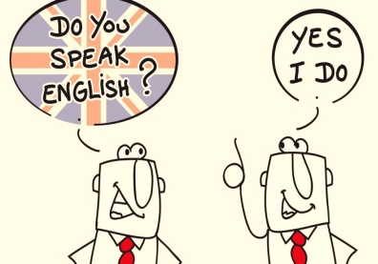
Use if + past perfect + would + (not) base verb/be + -ing to talk about things that didn’t happen in the past and have a result in the present
If I hadn’t learned English, I wouldn’t understand you.
(I learned English, so I understand you.)
If we had won, we would be celebrating.
(We didn’t win, so we aren’t celebrating.)

Slide 22

If conditional
A result in the present
,
If
Past perfect
would
infinitive
If I hadn’t learned English, I wouldn’t understand you.
,
If
Past perfect
would
be
V- ing
If we had won, we would be celebrating.
Note: I’d = I + had or I + would

Slide 24
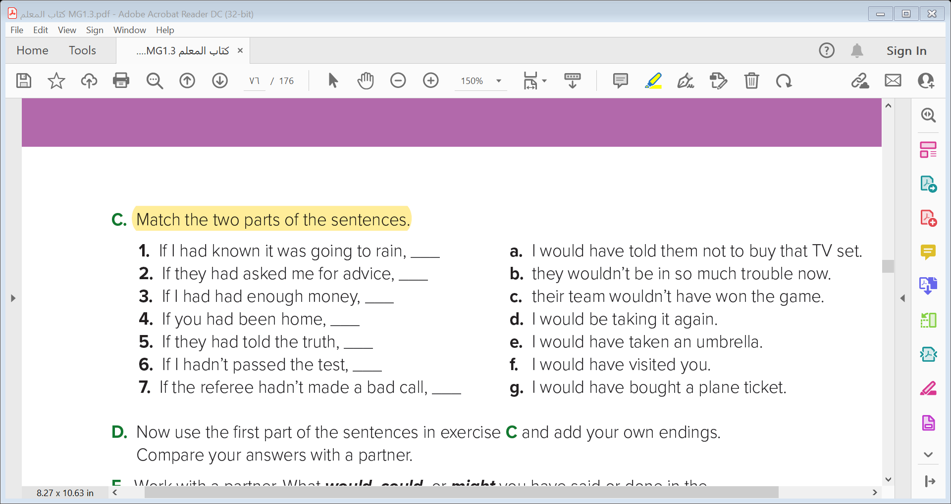
e
a
g
f
b
d
c

Slide 25
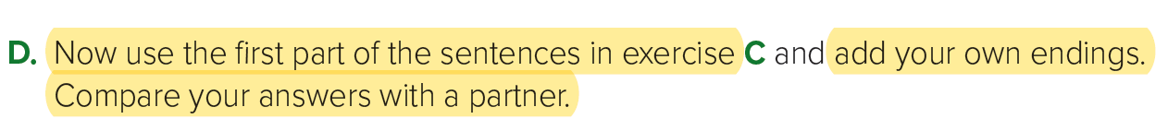
1- If I had known it was going to rain, I wouldn’t have gone to the beach.
2- If he had asked me for advice, I would have told him not to buy that TV set.
If with Could and Might
3- If I had had enough money, I would have gone to Spain last summer.
4- If you had been home, I would have shared the cookies with you.
5- If they had told the truth, their parents wouldn’t have grounded them.
6- If I hadn’t passed the test, my parents would have been upset.
7- If the referee hadn’t made a bad call, our team would have won the big game.

Slide 26

If with Could and Might

Slide 27
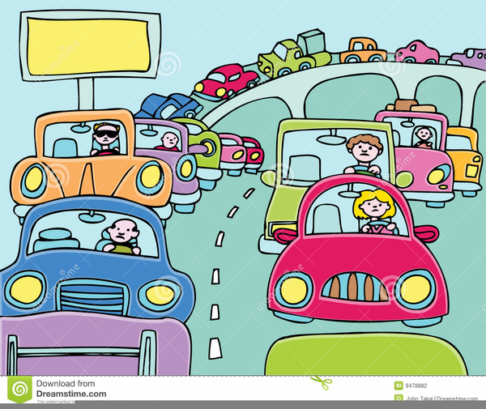
If I had gotten a job last summer, I could have saved more money.
If she had left work earlier, she might have avoided traffic

Slide 28

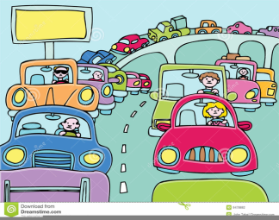
Use if and could/might + past perfect to talk about possibilities and missed opportunities
If I had gotten a job last summer, I could have saved more money.
If she had left work earlier, she might have avoided traffic

Slide 29


If conditional
Possibility
,
If
Past perfect
might
have
Past participle
If I had gotten a job last summer, I could have saved more money.
If conditional
ability
,
If
Past perfect
could
have
Past participle
If she had left work earlier, she might have avoided traffic

Slide 30
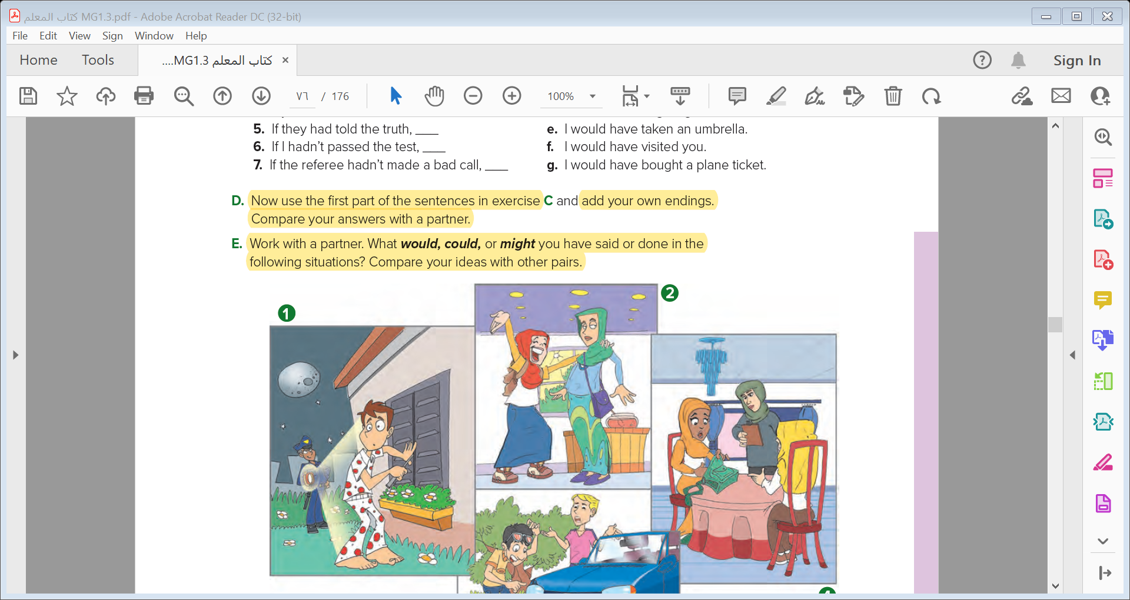
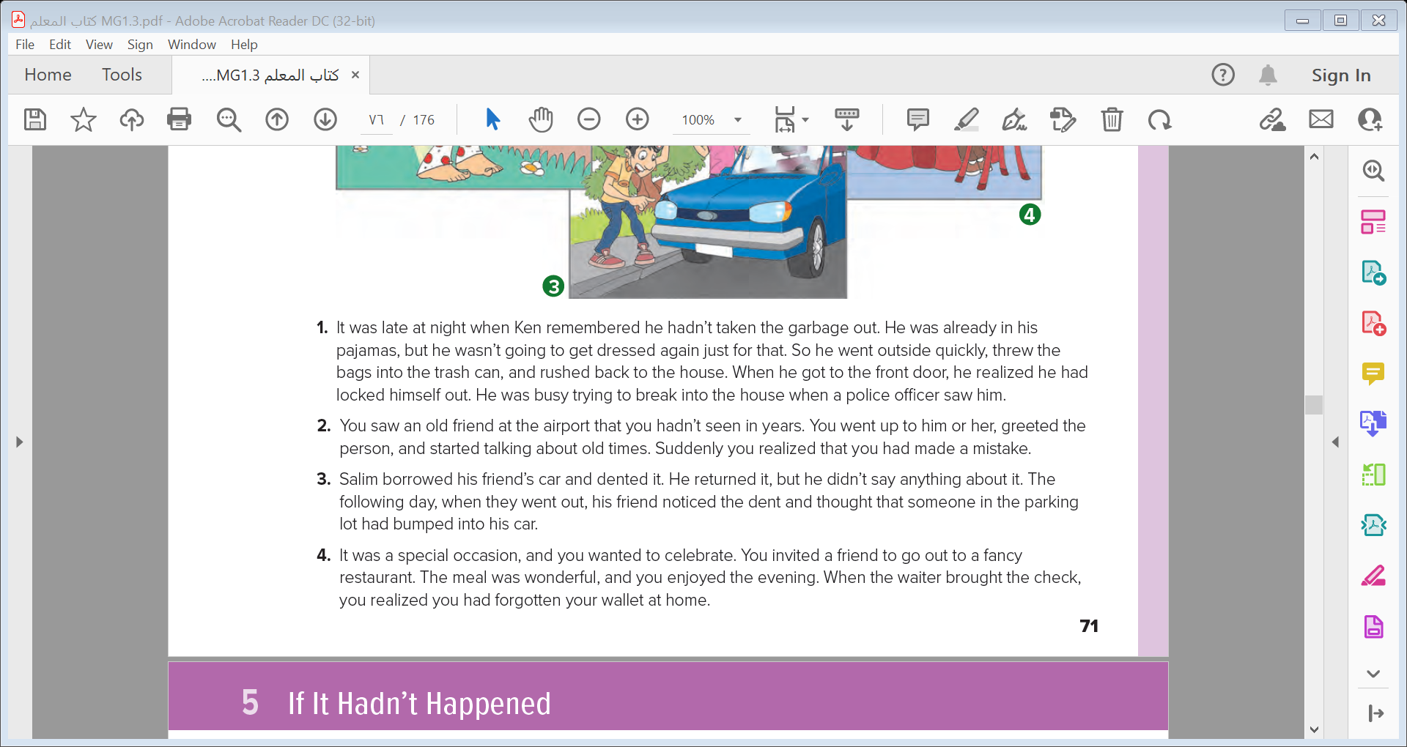
1
2
3
4

Slide 31
1- I would have taken my key if I had gone out at night. I might have waited until morning to take out the garbage. I would have explained the situation to the police officer.
2- I would have apologized to the person. I would have said that the person looked like a friend of mine. I might have continued the conversation and introduced myself to the person.
3- I would have told my friend the truth about the dent. I might have had the dent fixed.
4- I would have explained the situation to my friend and asked her to pay. I might have asked the restaurant if it accepted checks. I could have called my brother and asked him to bring my wallet to the restaurant.
1
2
3
4

Slide 32
Venn
Diagram
Conditional Sentences: Hypothetical Situations in the Past

Slide 33


