Slide 1
Unit 3 If It Hadn’t Happened Listen & Discuss
Mega Goal 1.3
Done by: Entisar Al-Obaidallah

Slide 2
Lesson Objectives
01
02
03
Talk
Describe
Listen
04
05
06
Discuss
Match
Answer
about discoveries and inventions and how things would have been different
without them
the pictures using their own words
for specific information
missed opportunities and
regrets
The words to form new words and expressions
True –False questions about the passage

Slide 3

Warm Up
Discovery
Invention
What is the different between “ invention” and “ discovery” ?
is recognizing something that already exists for the first time, that nobody has found before. ➔Example :
how Christopher Columbus discovered the Americas.
is creating something totally new with one’s own ideas and development.
➔Example :
Plane – Television- Computer

Slide 4
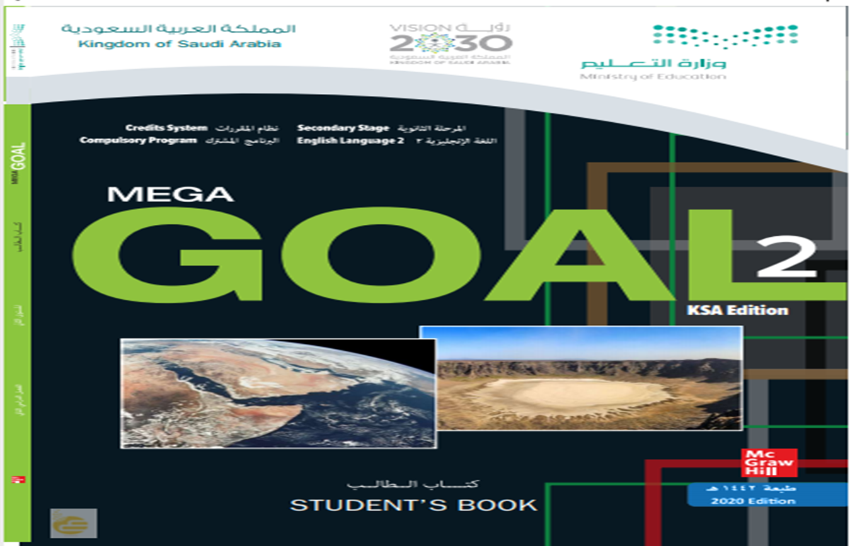
Open
Your student’s book
p. 34

Slide 5
01
Before Reading

Slide 6
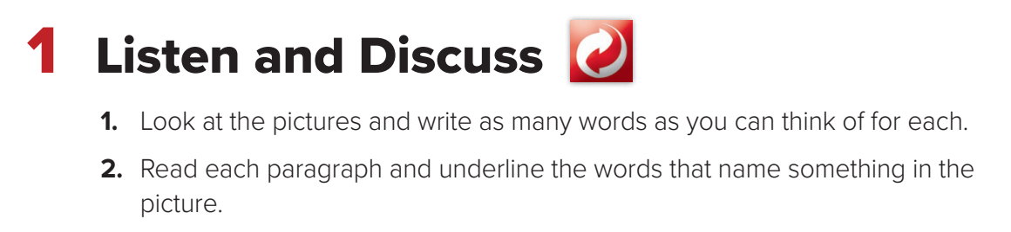
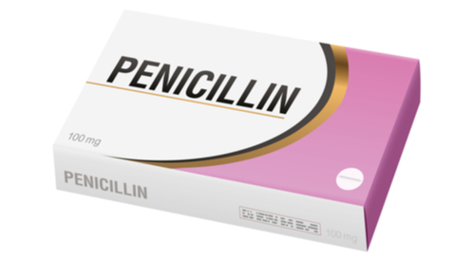
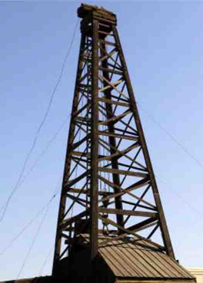
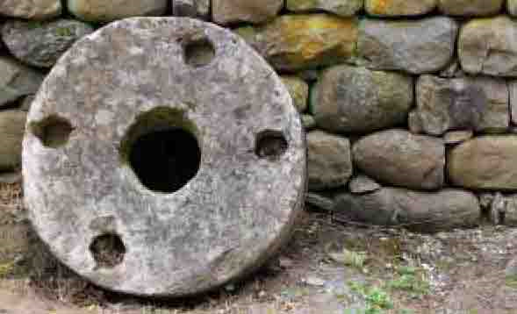


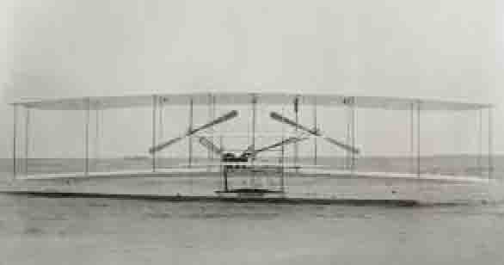
1- wheel
6- penicillin
3- oil
4-computer
2- airplane
5-electricity

Slide 7

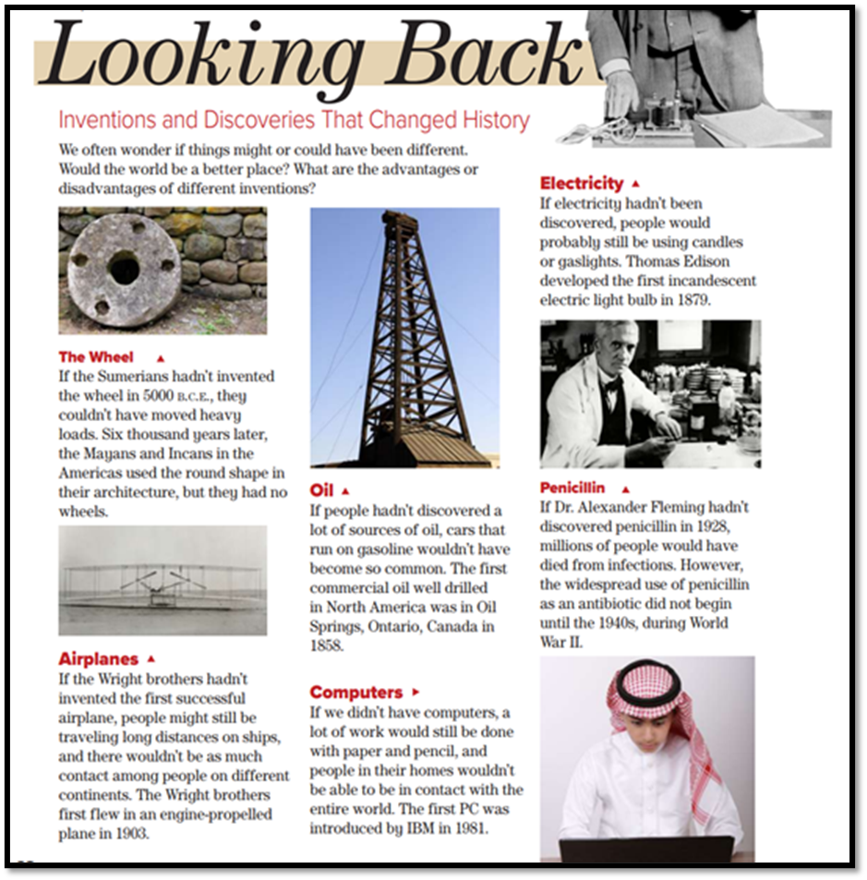
What is the title of the passage ?
5
Looking Back
1
How many subtitles are there?
3
6
There are 6 subtitles
2
How many pictures are there?
4
There are 6 pictures

Slide 8
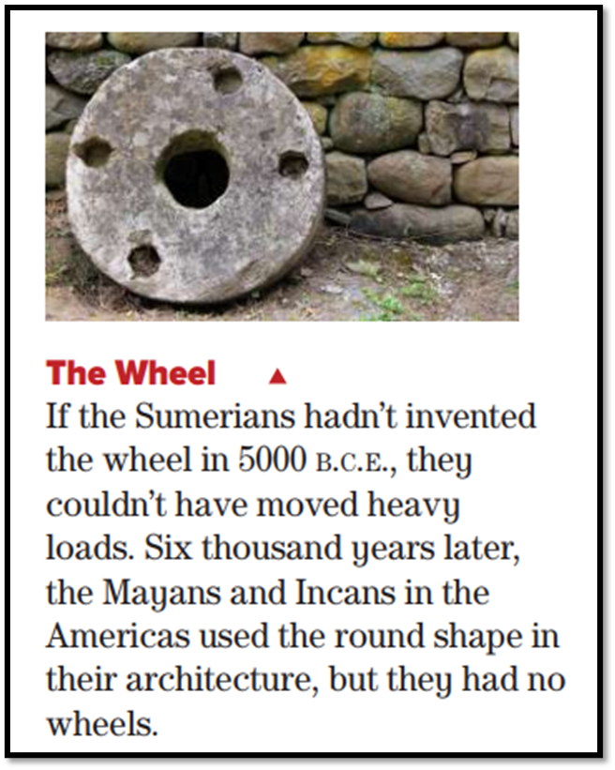
What can you see in this picture ?
The wheel
Is it invention or discovery?
It is invention
Who invented the wheels?
The Sumerians

Slide 9
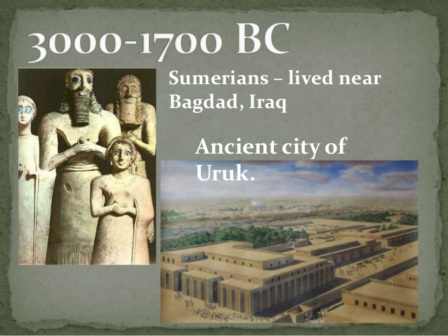
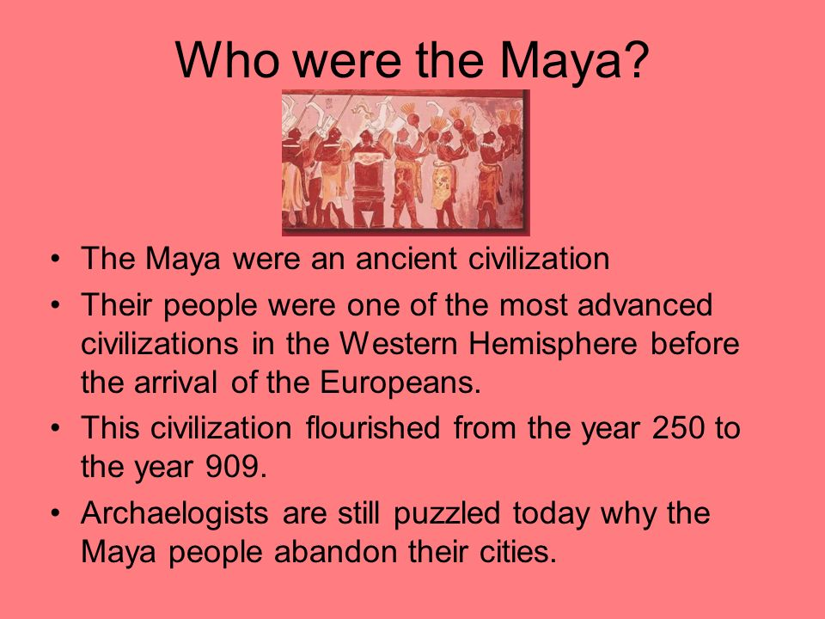

Slide 10
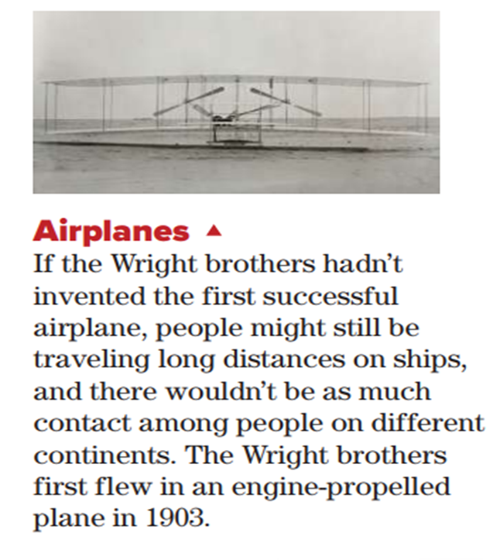
What can you see in this picture ?
Airplanes
Is it invention or discovery?
It is invention
Who invented the first successful airplane?
The Wright brothers

Slide 11
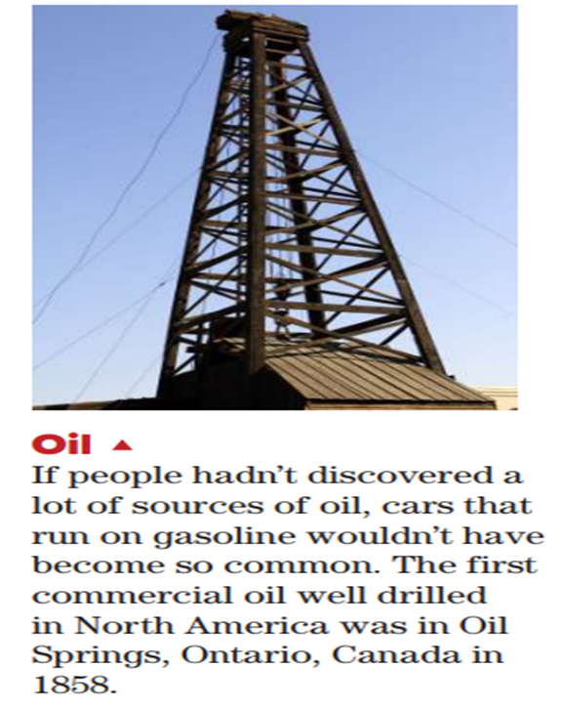
What can you see in this picture ?
oil
Is it invention or discovery?
It is discovery
Where did the first commercial oil drill in North America?
In Oil Springs, Ontario ,Canada

Slide 12

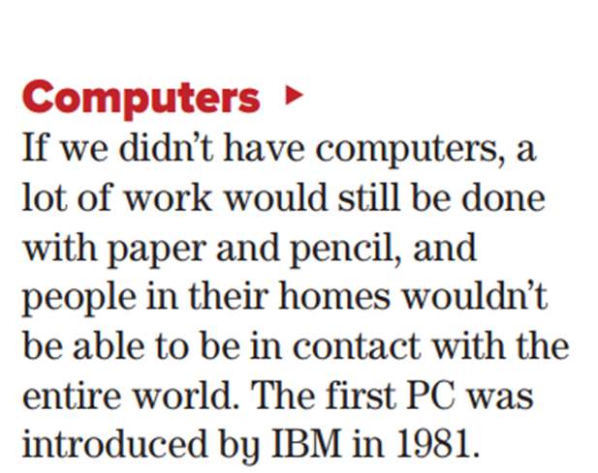
What can you see in this picture ?
computer
Is it invention or discovery?
It is invention
When was the first PC introduced?
It was introduced by IBM in 1981

Slide 13
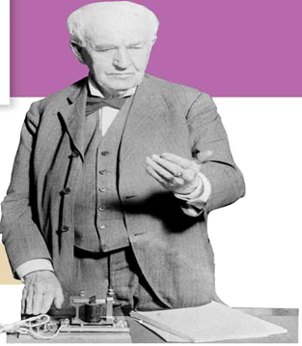
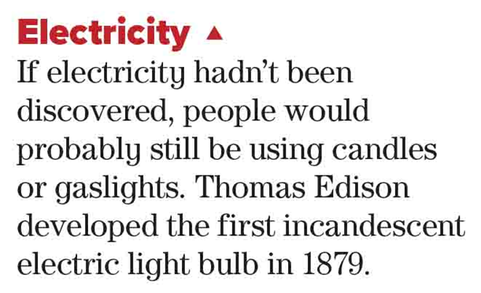
What does this paragraph about?
electricity
Is it invention or discovery?
It is discovery
Who developed the first electric light bulb?
Thomas Edison

Slide 14
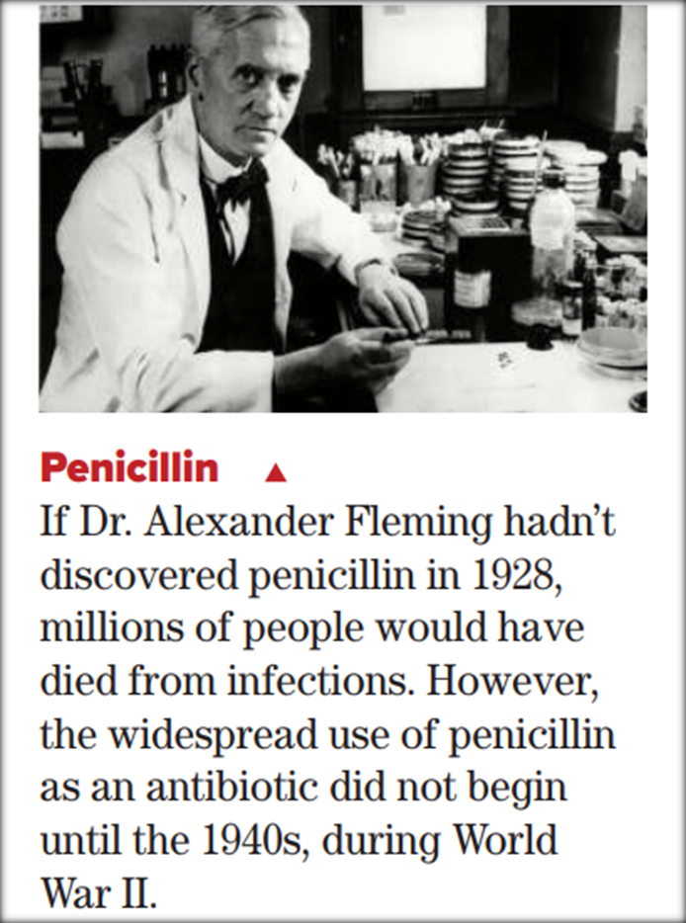
What does this paragraph about?
penicillin
Is it invention or discovery?
It is discovery
Who discovered it ?
Dr. Alexander Fleming

Slide 15
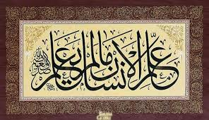
From The Holy Qura’an

Slide 16
Open
Your student’s book
p. 35

Slide 17
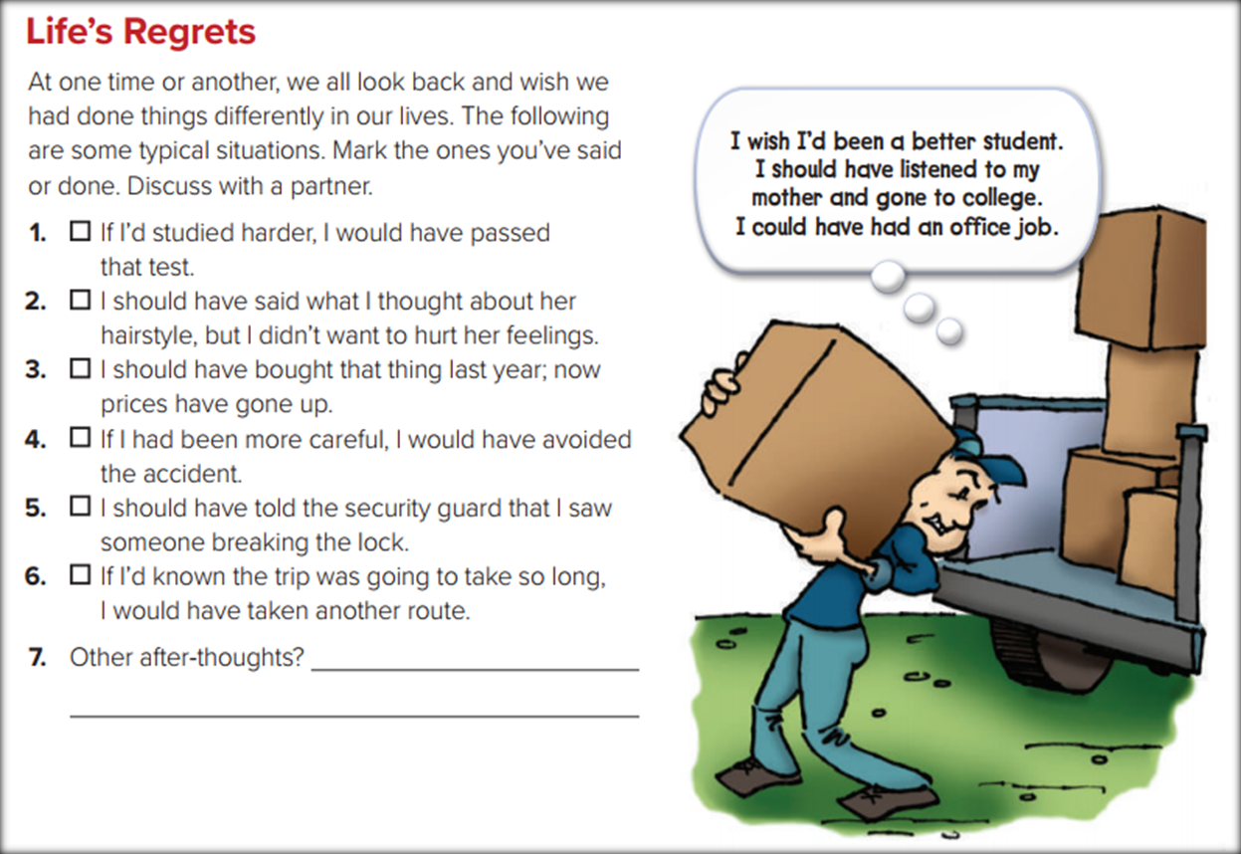
What can you see in this picture ?
What does he regret

Slide 18
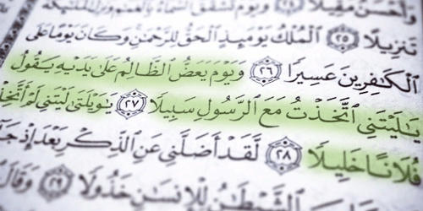
From The Holy Qura’an

Slide 19
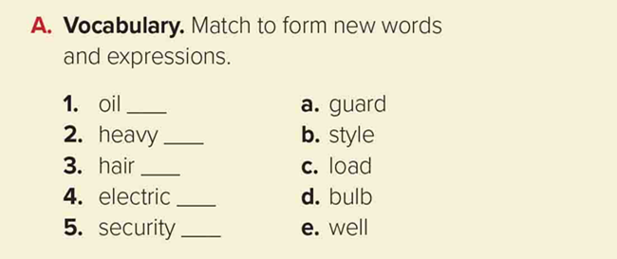
e
c
b
d
a

Slide 20
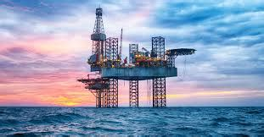
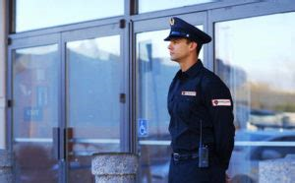
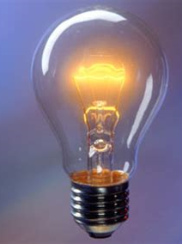
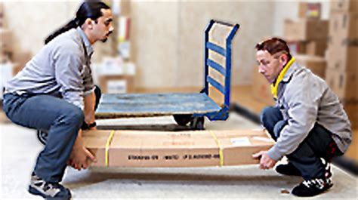
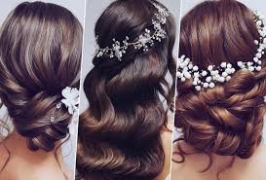
Match the pictures with the correct expressions:
Oil well – hair style – heavy load – security guard – electric bulb
Oil well
security guard
electric bulb
hair style
heavy load

Slide 21
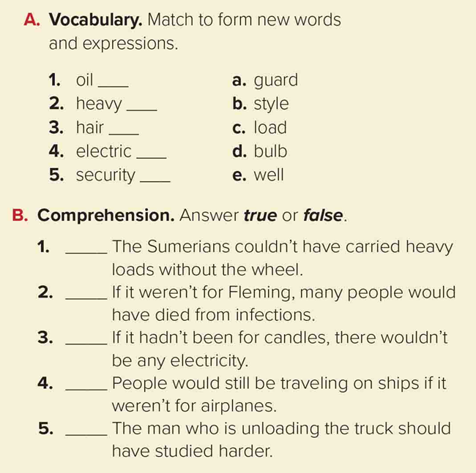
Quick check
True
True
False
True
True

Slide 22
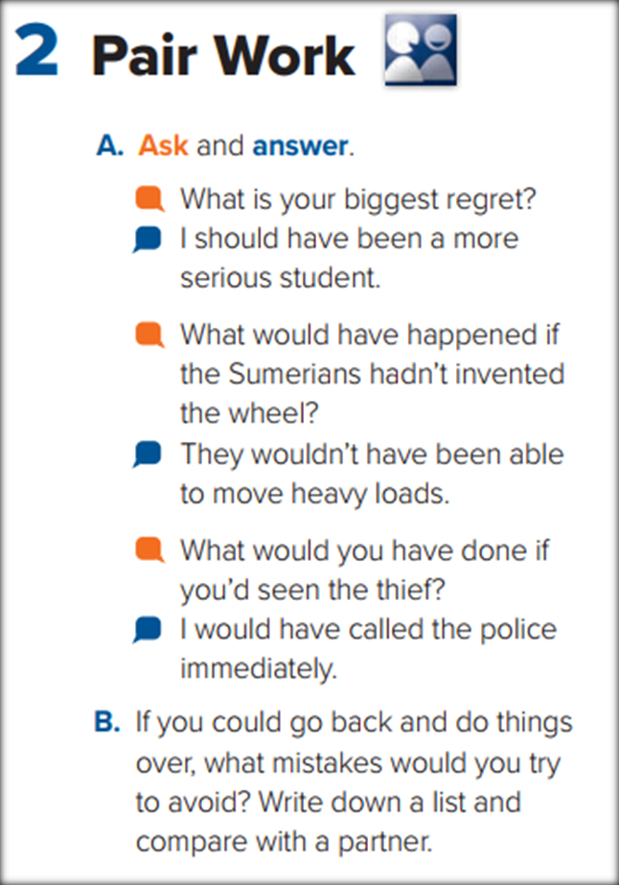

Slide 23
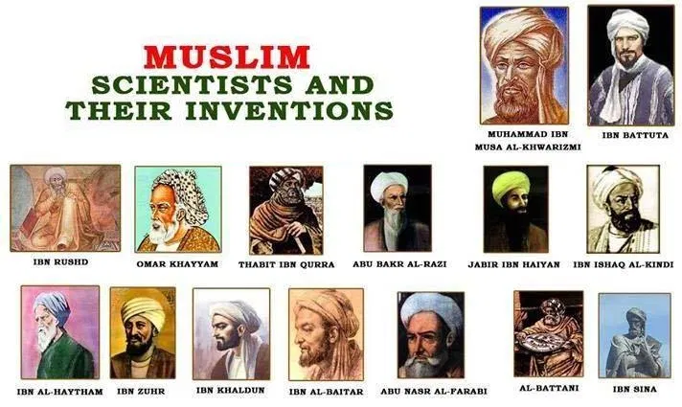
➔These are examples of Muslim scientists in the Islamic Golden Age.
We must be proud of them, and they should be the idols for the new generation

Slide 24
Homework
Workbook p.99 , exercise (A)

Slide 25

Thanks

