Slide 1
Mega Goal 5
Unit 2
Influential People
Listen & Discuss
Done by : Entisar Al-Obaidallah

Slide 2
01
02
03
04
Talk
Lesson Goals
talk about fame and fortune
Discuss
qualities a person needs to e be successful?
Read
To answer some questions
Complete
the sentences with suitable word

Slide 3
What does this phrase mean?
Influential People.
Influential People is someone or something that has an impact on or shapes how people act or how things occur.

Slide 4

Open your studetn’s book p. 20

Slide 5
investment
What qualities do you think a person needs to make a fortune?
ambitious
confidence
Have vision & passion
salesmanship
risky

Slide 6
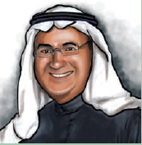
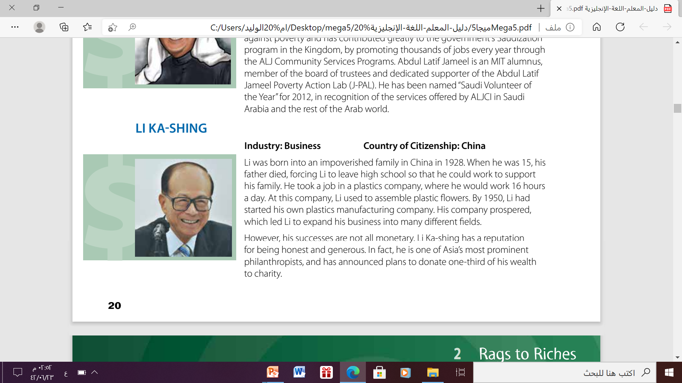
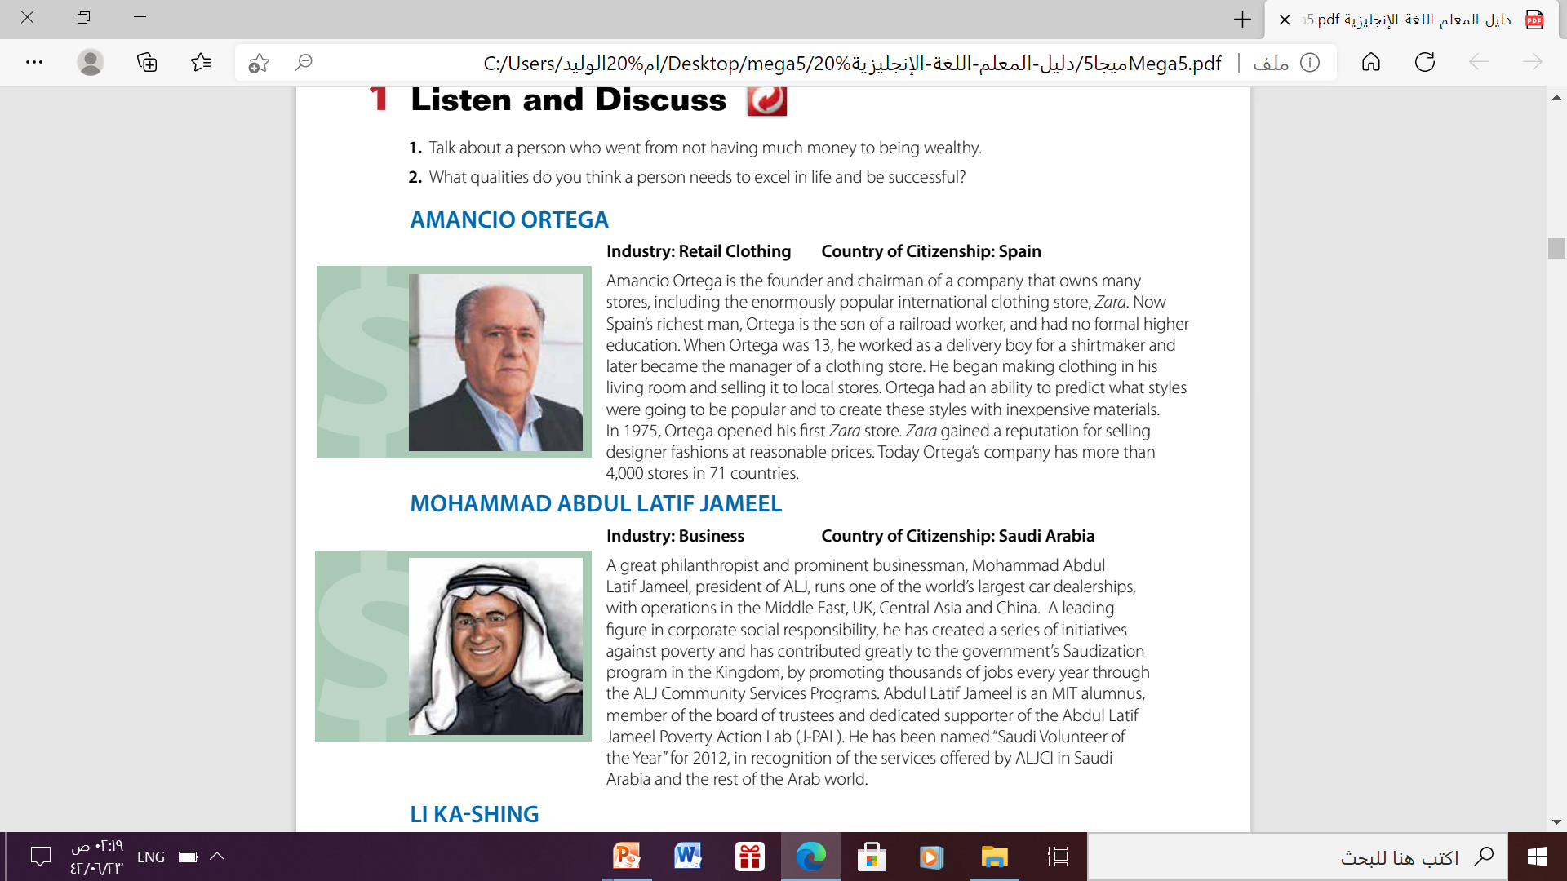
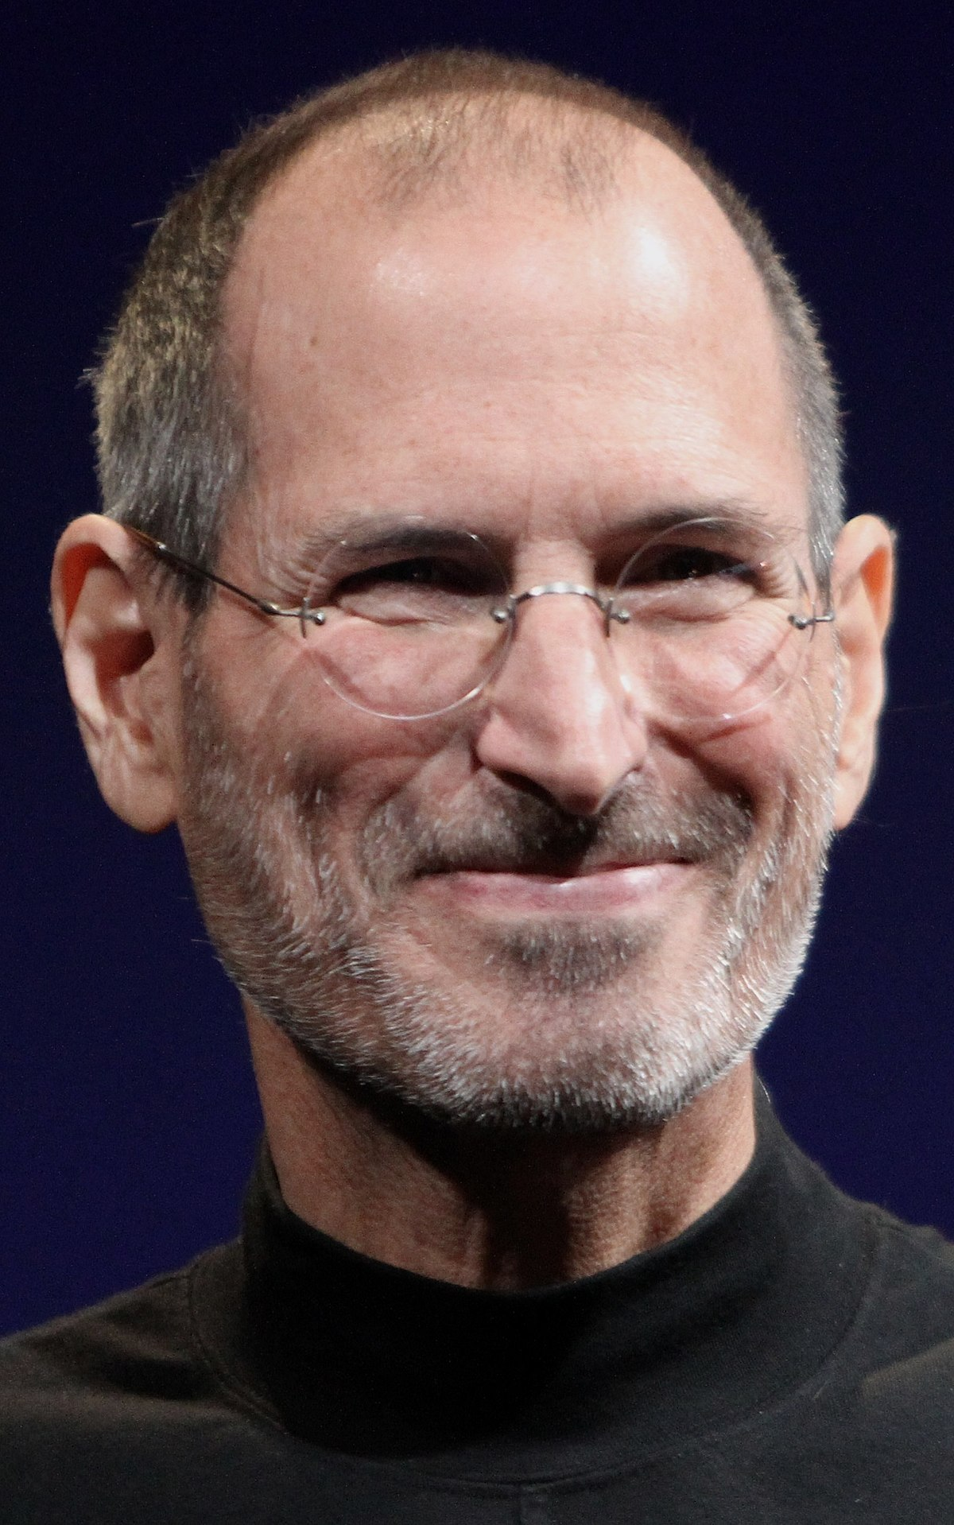
Do you recognize any of these people?
Do you recognize any of these people?
Do you recognize any of these people?
Do you recognize any of these people?
Do you recognize any of these people?
Mohammed Abdul Latif Jameel
LI KA-SHING
AMANCIO ORTEGA
STEVEN PAUL JOBS

Slide 7

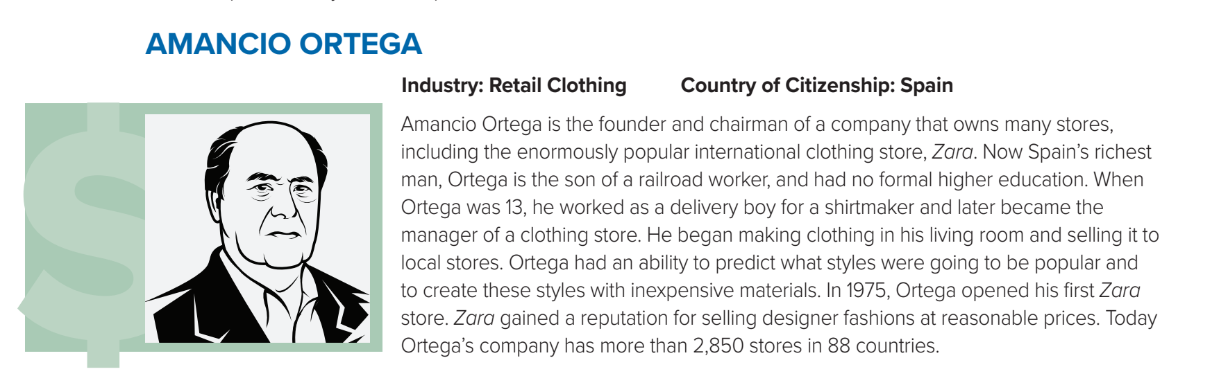
01
What does industry refer to?
(This is the business or career in which the person made their money.)
Refers to the place where
the person is a current citizen.
Where are his stores located?
What kinds of stores does Amancio Ortega own?
in 88 countries, or all over the world
clothing stores

Slide 8
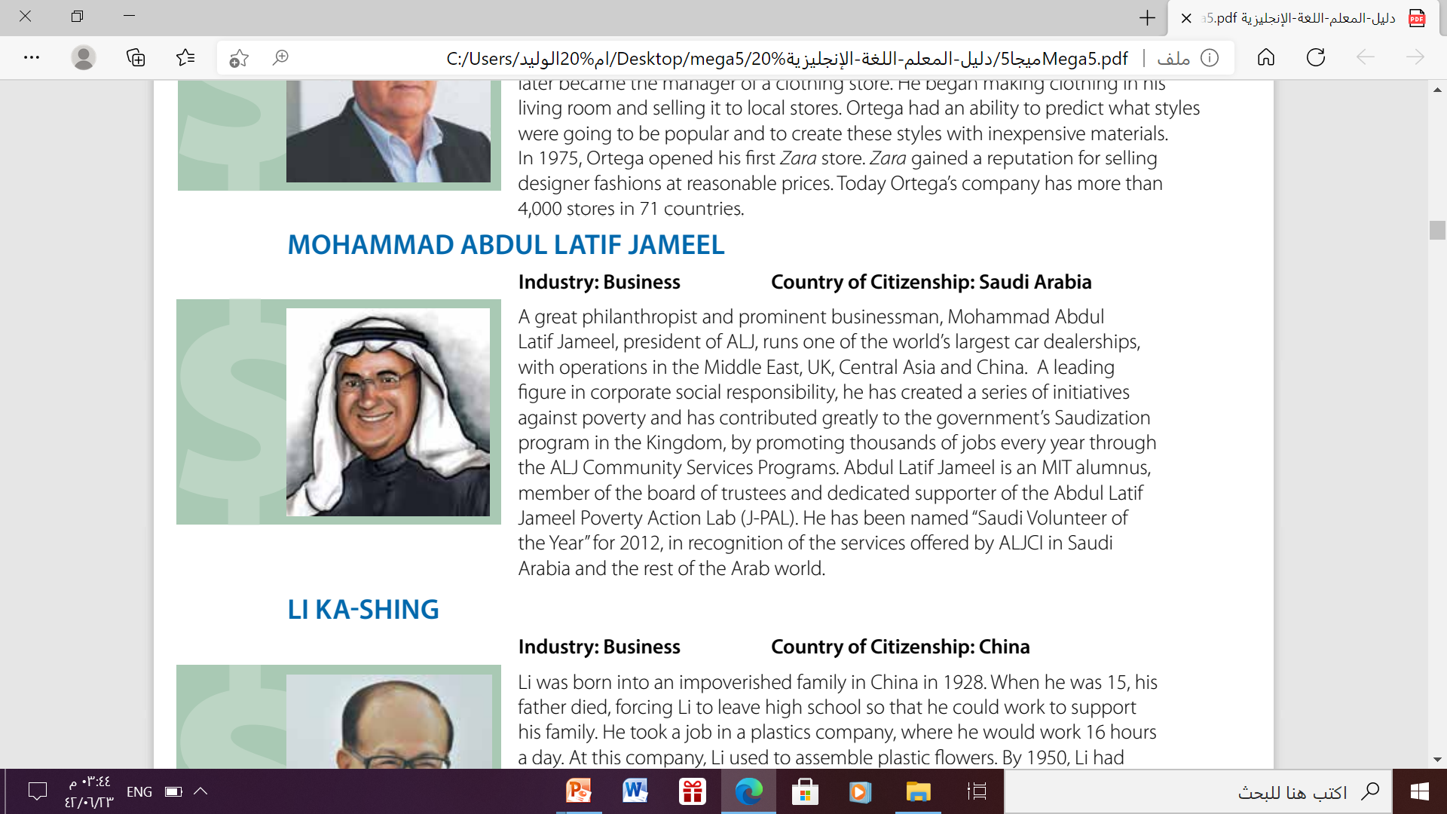
02
What kind of company does he run?
one of the world’s largest car dealerships, with operations in the Middle East, UK , Central Asia &China
How did he contribute to the government’s Saudization program in the Kingdom of Saudi Arabia?
by offering and creating thousands of jobs every year through the ALJ
Community Services Programs

Slide 9
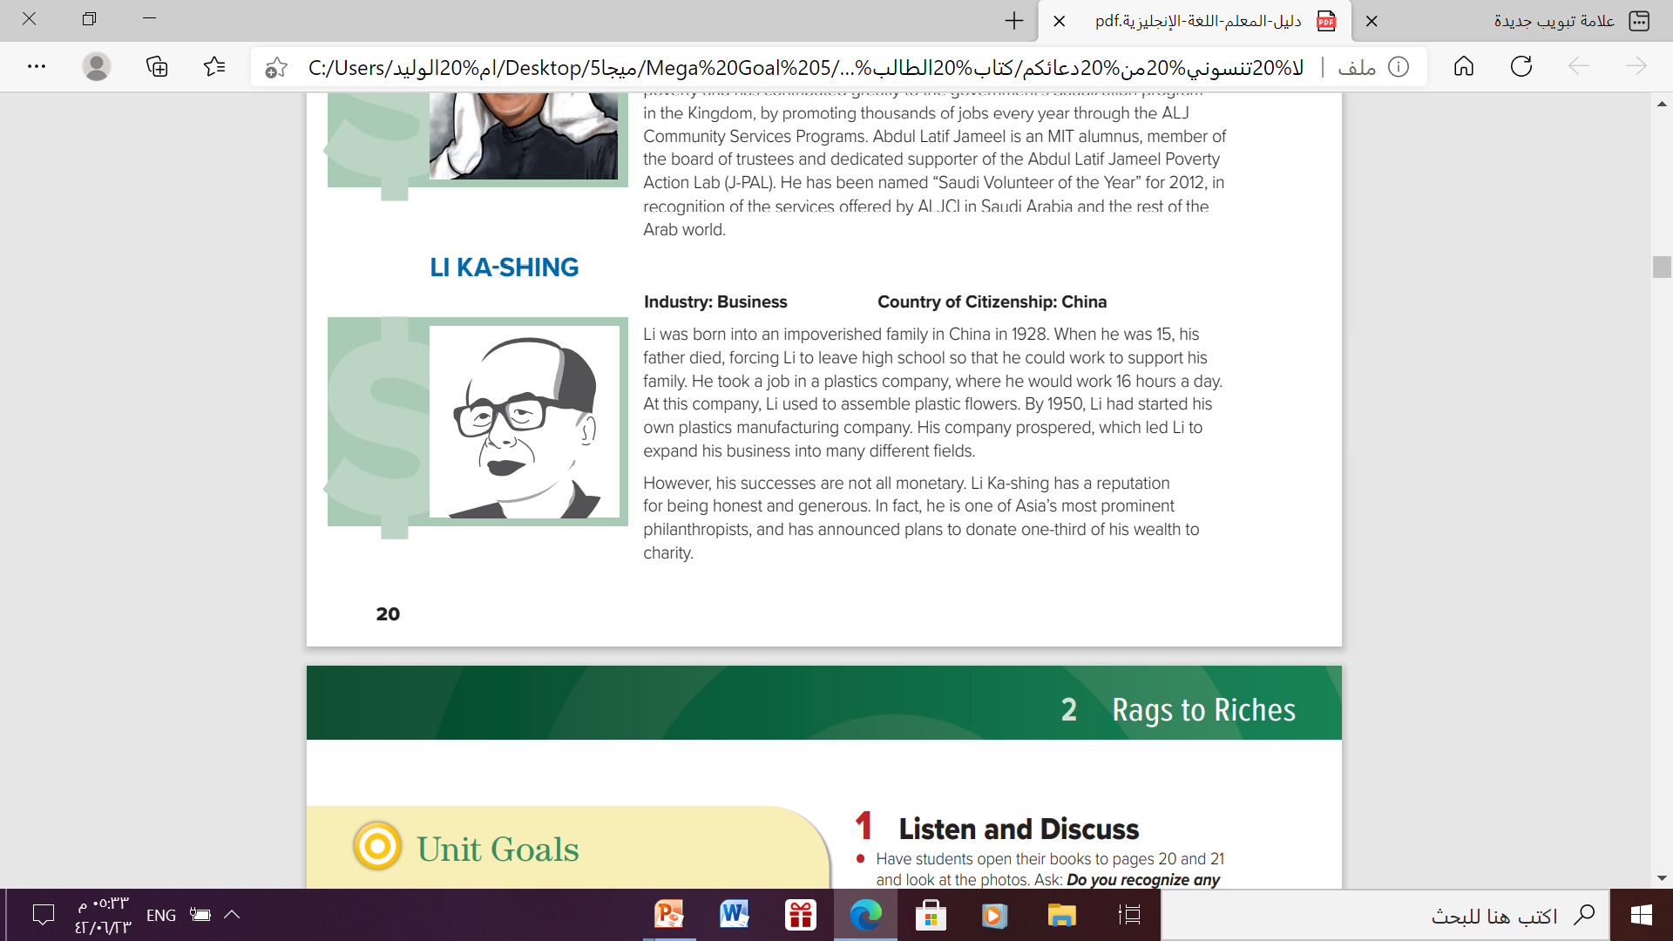
03
What kind of business did Li Ka-shing start out in?
Plastics
What else is he known for?
being honest,
generous,
and
a philanthropist

Slide 10
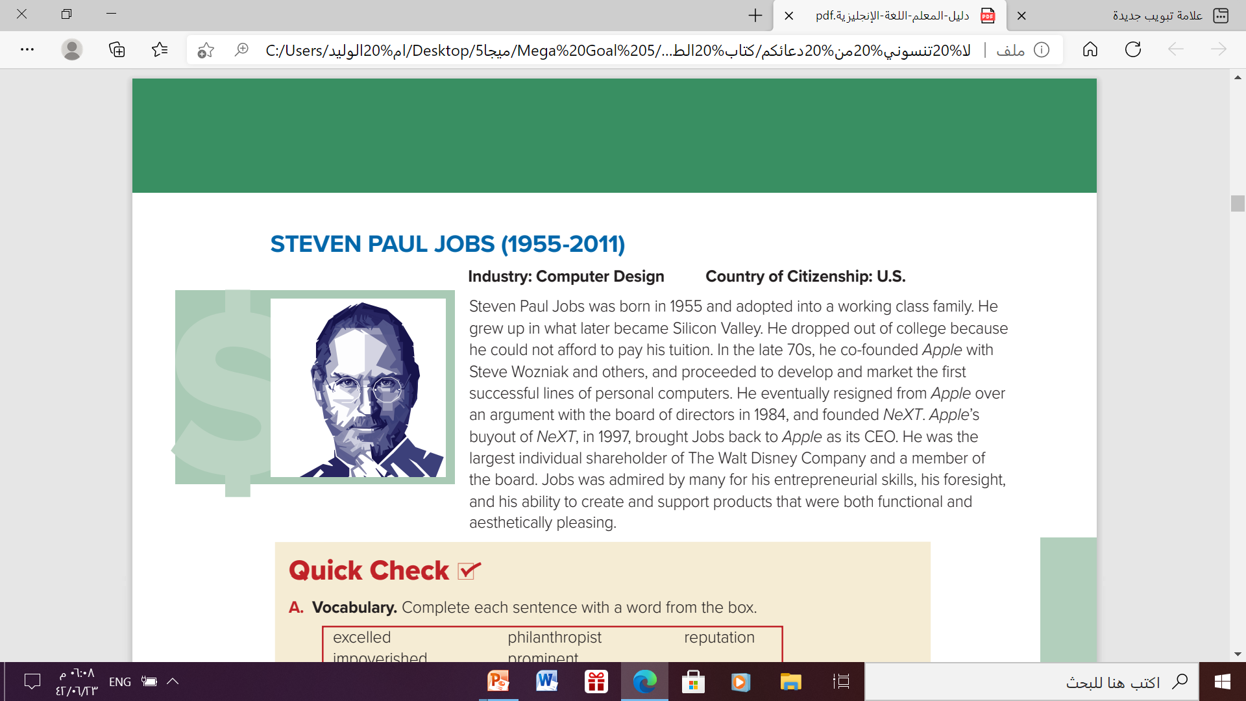
04
What was Steven Paul Jobs most famous for?
He co-founded Apple with Steve Wozniak
Why had
he resigned from Apple?
What is the meaning of CEO?
A chief executive officer
He had resigned over an
argument with the board of directors in 1984

Slide 11
Open your student's book p. 21

Slide 12
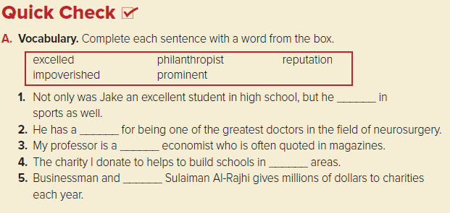
excelled
Excelled is defined as done very well
philanthropist
someone who gives money to help people who are poor or sick
reputation
the general belief or opinion that other people have about
impoverished
very poor
prominent
very well known and famous

Slide 13
excelled
reputation
prominent
impoverished
philanthropist

Slide 14
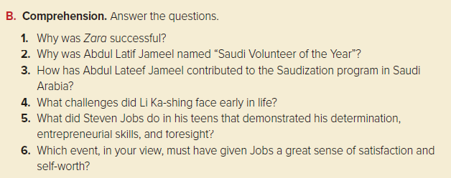
1.It sold designer fashions at a reasonable price.
2. In recognition of the services offered by ALJCI in Saudi Arabia and the rest of the Arab world.
3. By offering thousands of job opportunities on an annual basis.
4. He was poor and had to leave high school when his father died to help support his family.
5. Although he dropped out of college, he co-founded Apple, and developed and marketed personal computers.
6. Whereas he argued and resigned from Apple, Jobs was brought back and became Apple’s CEO.

Slide 15
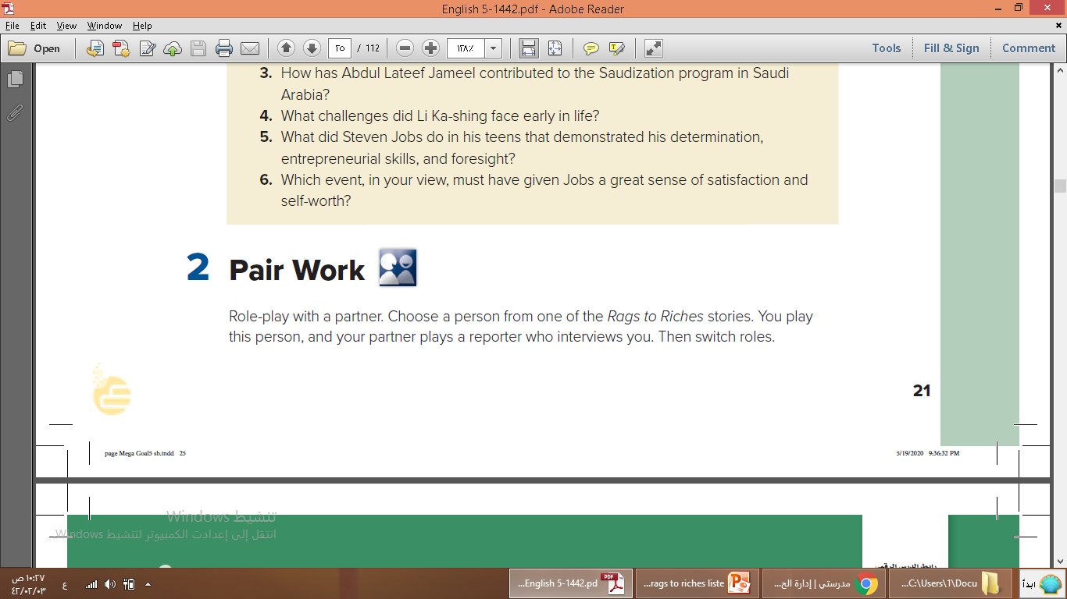
Do you recognize any of these people?
Do you recognize any of these people?
Do you recognize any of these people?
Do you recognize any of these people?
Mohammed Abdul Latif Jameel
AMANCIO ORTEGA
LI KA-SHING
STEVEN PAUL JOBS

Slide 16
Home Work
Workbook p. 11 - Exercises(A+B)

Slide 17
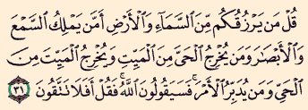
Remember
Big numbers catch your audience’s attention

Slide 18

Thanks

