Slide 1
Unit 2
Influntial People
Mega Goal 5
Grammar
Done by : Entisar Al-Obaidallah

Slide 2



Lesson Objectives
1
Defferentiate
3
Practice
2
Use
4
Apply
between used to or Be used to correctly
Using was /were going to with future in the past
Would for repeated action in the past
the grammatical rules to do the exercises

Slide 3
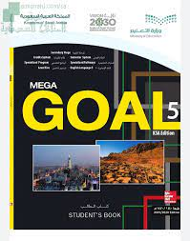
Open
your student’s book
p.(22)

Slide 4
1
Used to vs Be used to
SECTION 1
SECTION 2
SECTION 3
SECTION 4

Slide 5
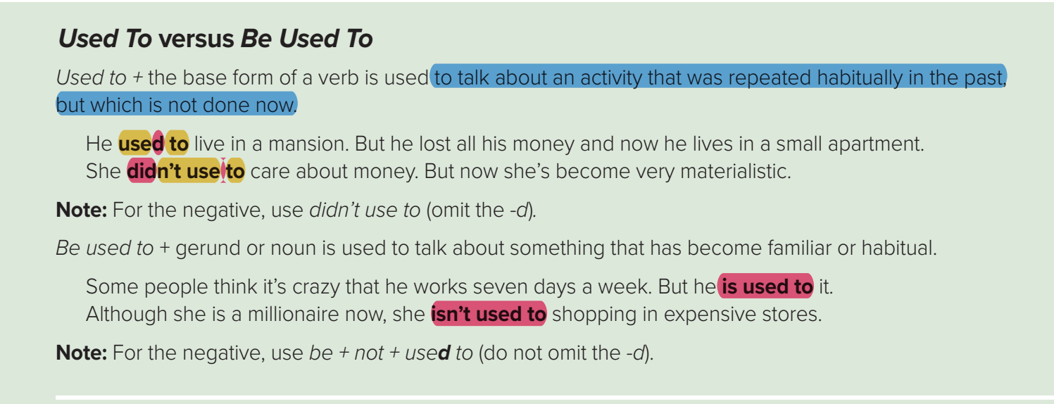

Slide 6
Used to
used to talk about an activity that was repeated habitually in the past,
but which is Not done now

Slide 7
The structure :
Examples:
Used to + v ( base form )
I used to study English every year
1- continual action
2- Not now
Examples:
She used to live in Saudi Arabia
She didn’t use to live in Saudi Arabia
Did she use to live in Saudi Arabia ?
Affirmative (+)
Negative (-)
Question(?)

Slide 8
Be used to
to talk about something that has become
familiar or habitual.

Slide 9
The structure :
(am – is – are)
Be + used to + Noun or Gerund (Verb + ing )
Examples:
She is used to shopping every week .
She isn’t used to shopping every week .
Is she used to shopping every week?
Affirmative (+)
Negative (-)
Question(?)

Slide 10
2
Would for repeated actions in the past versus Used to
SECTION 1
SECTION 2
SECTION 3
SECTION 4

Slide 11
Would vs Used to
Would
can be used to talk about an action that happened regularly in the past.
Here, would means the same thing as used to.
Example:
I used to drink coffee every morning but now I drink tea
=
I would drink coffee every morning but now I drink tea
Used to
can be used to talk about a situation that was true (without habitual action) in the past.
Example:
I used to live in London 3 years ago 
I would live in London 3 years ago ✗

Slide 12
Let’s Practice

Slide 13
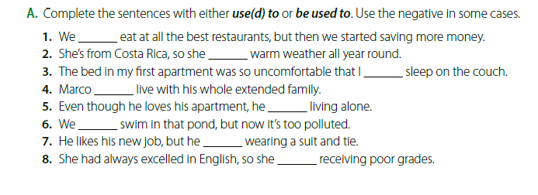
used to
Is used to
used to
used to
isn’t used to
used to
isn’t used to
wasn’t used to

Slide 14
3
Was/Were going to
( Future in the Past)
SECTION 1
SECTION 2
SECTION 3
SECTION 4

Slide 15
Was-Were going to
Was/Were + going to + the base form of a verb is used to talk about:
1- a prediction for the future made in the Past.
2- a past plan that was not carried out.
Form : was / were + going to + V( base form)
Example:
I knew you were going to go to the party
I thought she was going to make a delicious dinner .
I was going to visit my cousins , but they came to visit me instead.
It I was going to rain , but suddenly the sun appeared .
A prediction for the future made in the past
Past plan not carried out

Slide 16
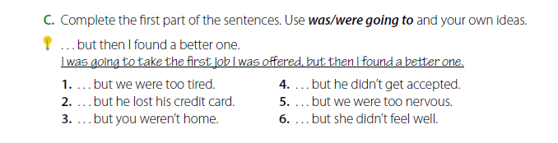
1. We were going to watch a film tonight, but we were too tired.
2. He was going to pay for dinner, but he lost his credit card.
3. I was going to ask you to go out tonight, but you weren’t home.
4. She was going to attend that university, but she didn’t
5. We were going to drive the new car, but we were too nervous.
6. He was going to run in the race, but he didn’t feel well.

Slide 17

Homework
Workbook p. 12 , exercise (c)

Slide 18

THANKS!

