Slide 1

Mega Goal 1.3
U: 2
I Wonder What Happened
Listen and Discuss
By: Yousef Hilal Alyazedi

Slide 2
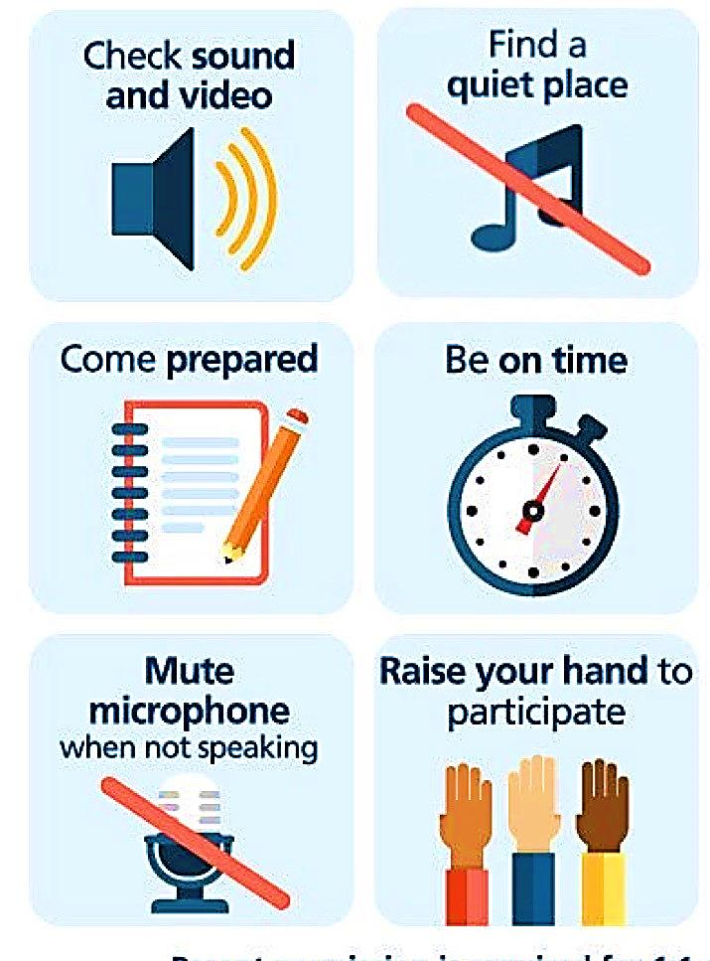
Online Classroom Rules

Slide 3

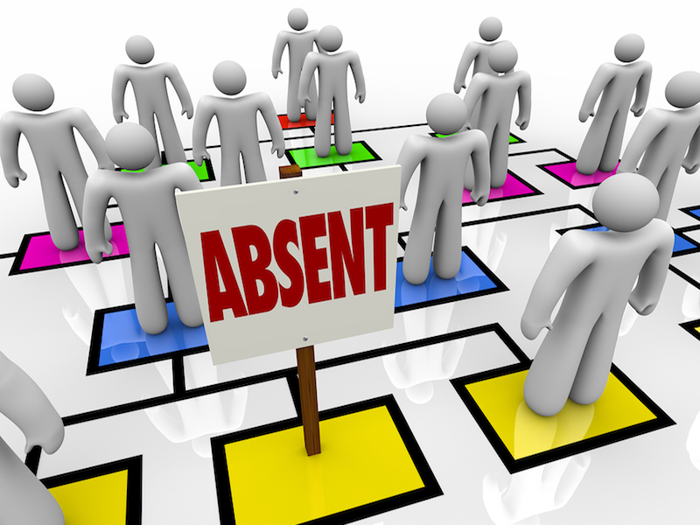

Slide 4

Lesson Objectives
The students will be able to :
predict what happened in the pictures .
relate the sentences to the pictures .
use predicting expressions ( might / must / could / ... )
ask questions about the photos using ( might / could / must / ... ) .
summarize events according to a picture .

Slide 5

https://www.liveworksheets.com/1-ae1768715ti

Slide 6

Keep
your books
closed

Slide 7

Warm Up
Have ever been involved in or heard of a situation that was mysterious and seemed to have no logical explanation ?

Slide 8


The activity of guessing possible answers to a question without having enough information to be certain .

Slide 9
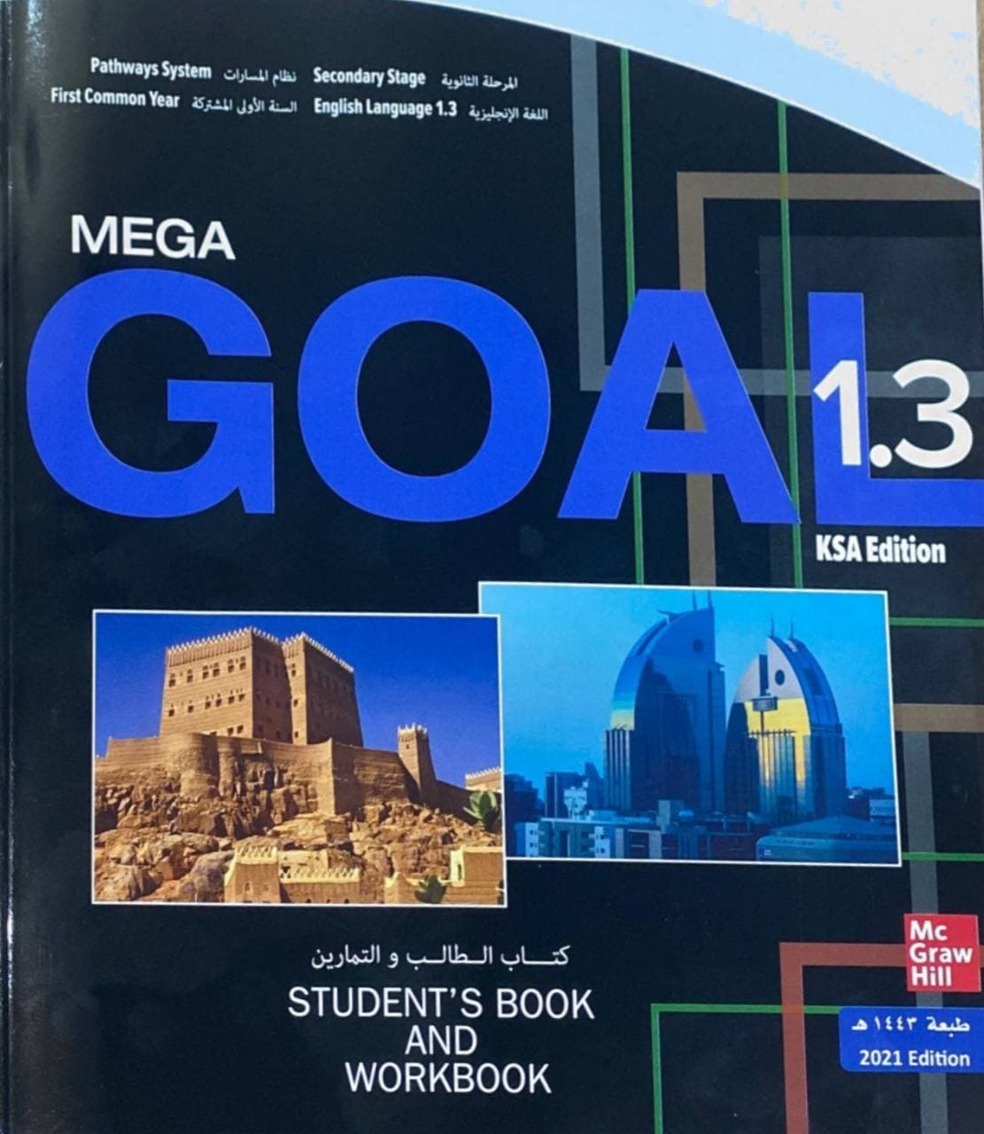

Open your Student’s book at page: 20

Slide 10
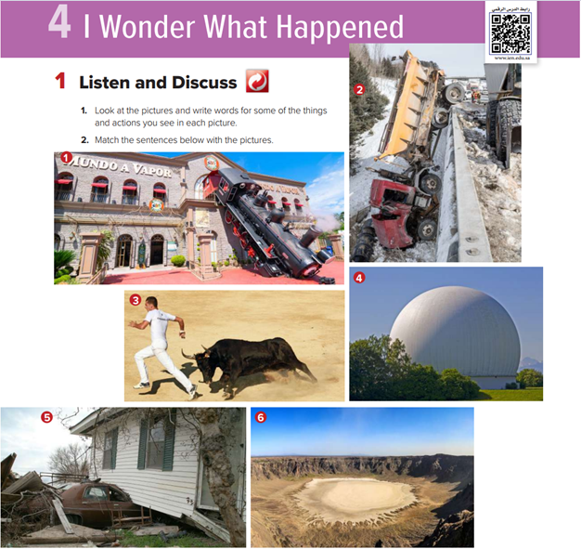


Slide 11
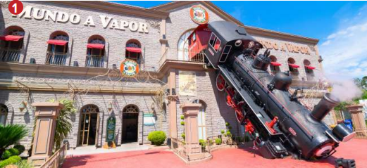
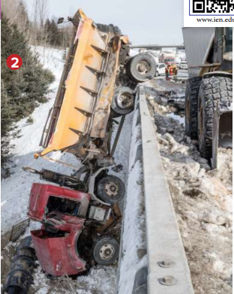
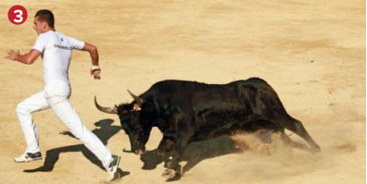
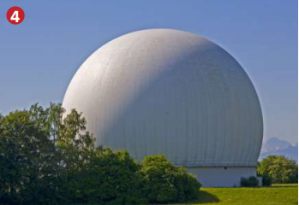
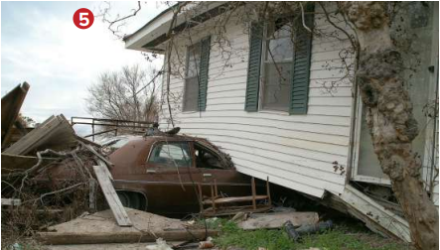
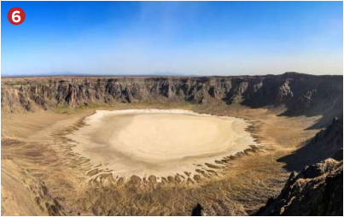

Discuss the following pictures and speculate about them .

Slide 12
What can you see in this picture ?
train
accident
house
What might have happened ?
It might have been
An accident
An advertisement

Slide 13
What can you see in this picture ?
truck
road
bridge
accident
What could have happened ?
It could have been an accident
The driver could have been driving fast .

Slide 14
What can you see in this picture ?
man
bull
chasing
fighting
Why is the bull angry ?
The man could have teased the bull
It could have been a competition .

Slide 15
What can you see in this picture ?
trees
sky
dome
mystery
What could have happened ?
It could have been something from the outer space.
It could have been a new design .

Slide 16
What can you see in this picture ?
house
tornado
hurricane
What could have happened ?
It could have been a natural disaster .
It could have been a tornado.

Slide 17
What can you see in this picture ?
land
hole
sky
What might be happened ?
It might be a volcano .
It might be a fireball falling down from the sky .

Slide 18
What can you see in this picture ?
man
sunglasses
What could have happened ?
It could have been advertisement for new brand of glasses .

Slide 19
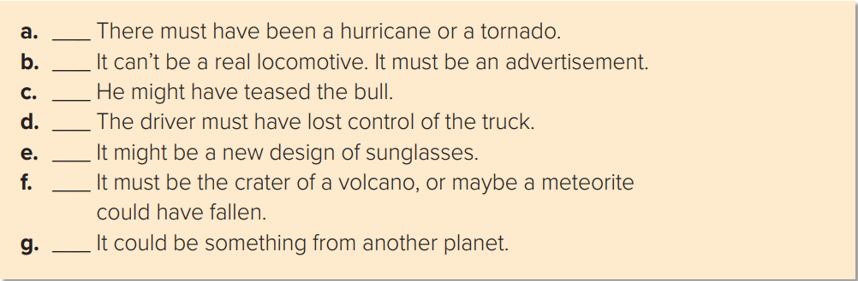
5
1
3
2
7
6
4

Slide 20
Ways to speculate about events
Can’t be
Could be
Must be
Must have
Might be
Might have

Slide 21

Quick Check
https://wordwall.net/resource/11788094

Slide 22
Open your Student’s book at page: 21

Slide 23
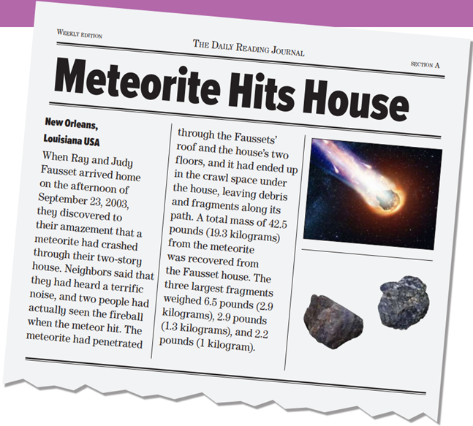
Is this article taken from newspaper ?
What is it about ?
Where is New Orleans located ?
What happened to Ray & Judy Fausset’s house ?
It was struck by a meteorite .
When did that happen ?
How many people actually seen the fireball when the meteorite hit?

Slide 24
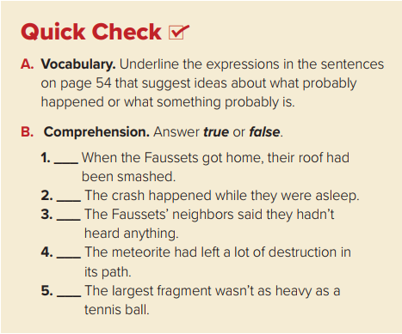
true
false
false
true
false

Slide 25
Quick Check
https://wordwall.net/resource/11792863

Slide 26
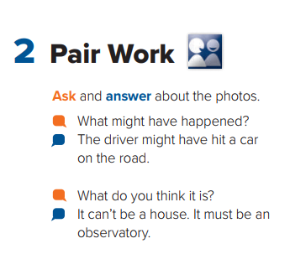

Slide 27
Match the words to their meanings
terrific sound
go through
meteorite
strong sound
penetrated
the ball of fire
debris
way
path
pieces are fallen from the meteorite

Slide 28

Workbook P. 89 , ( A )

Slide 29

