Slide 1


Slide 2


Slide 3
Unit -1-
Complaints ,Complaints

Slide 4
4-Language in context
5-Listening
6-Pronunciation
7-About you

Slide 5
Objectives
The students will be able to :
explain an instruction in ones own words .
Complete the missing letters of the word according to the audio .
write problems according to a listening audio .
practice the stress in a compound noun .
Share positively in pair work

Slide 6
4-Language in context

Slide 7
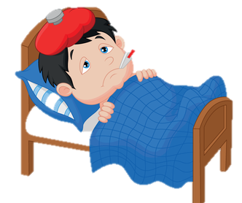
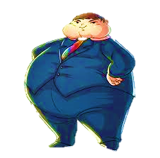
Give them an advice
You should see a doctor .
You had better lose weight .

Slide 8
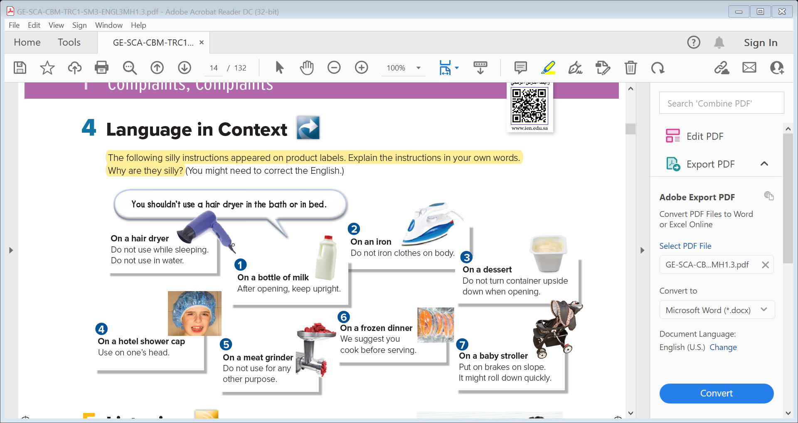

Slide 10
You should keep the bottle upright after opening .

Slide 11
You had better not iron clothes on body .

Slide 12
You shouldn’t turn container down when opening .

Slide 13
You must use on your head only .

Slide 14
You ought to use only with meat .

Slide 15
You must cook before serving .

Slide 16
You had better put on brakes on slope .

Slide 17




Slide 18

5-Listening

Slide 19

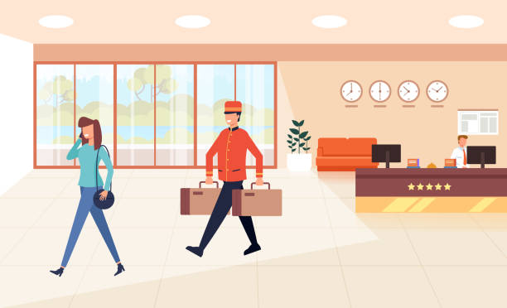
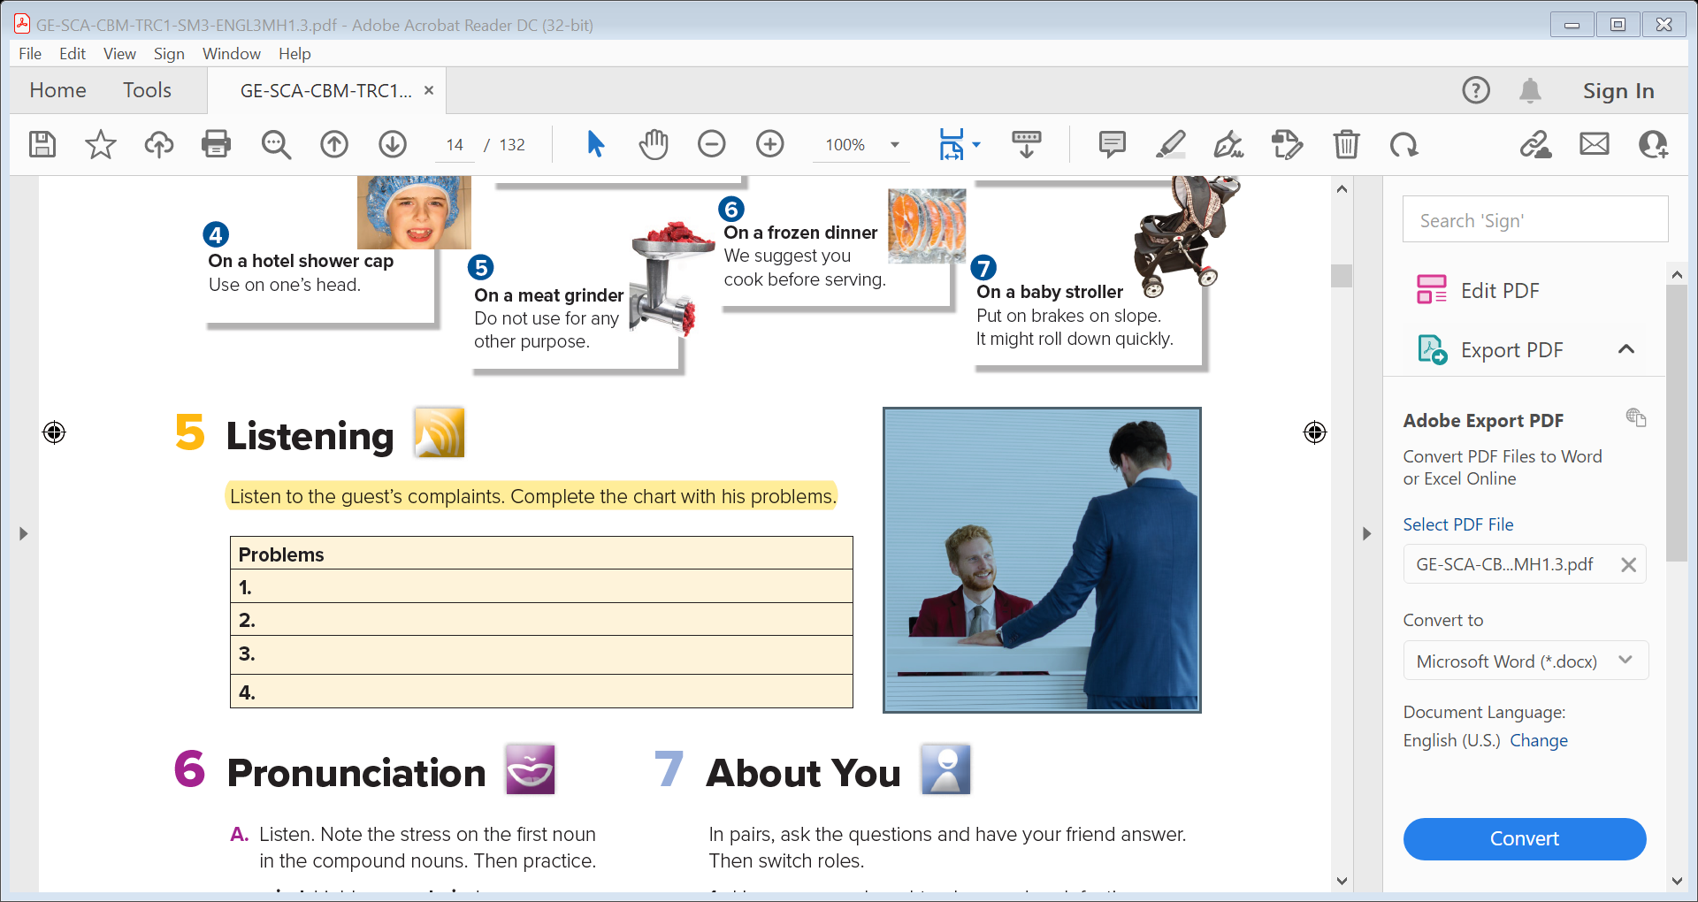
1- Where is this place?
1- What conversation do you think would be said?

Slide 20

The shower isn’t working. There’s no hot water.
The bathtub leaks .
The neighbor snores so loudly that the wall shake and the guest can’t sleep.
The towels and sheets aren’t changed every day .

Slide 21
6-Pronunciation

Slide 22
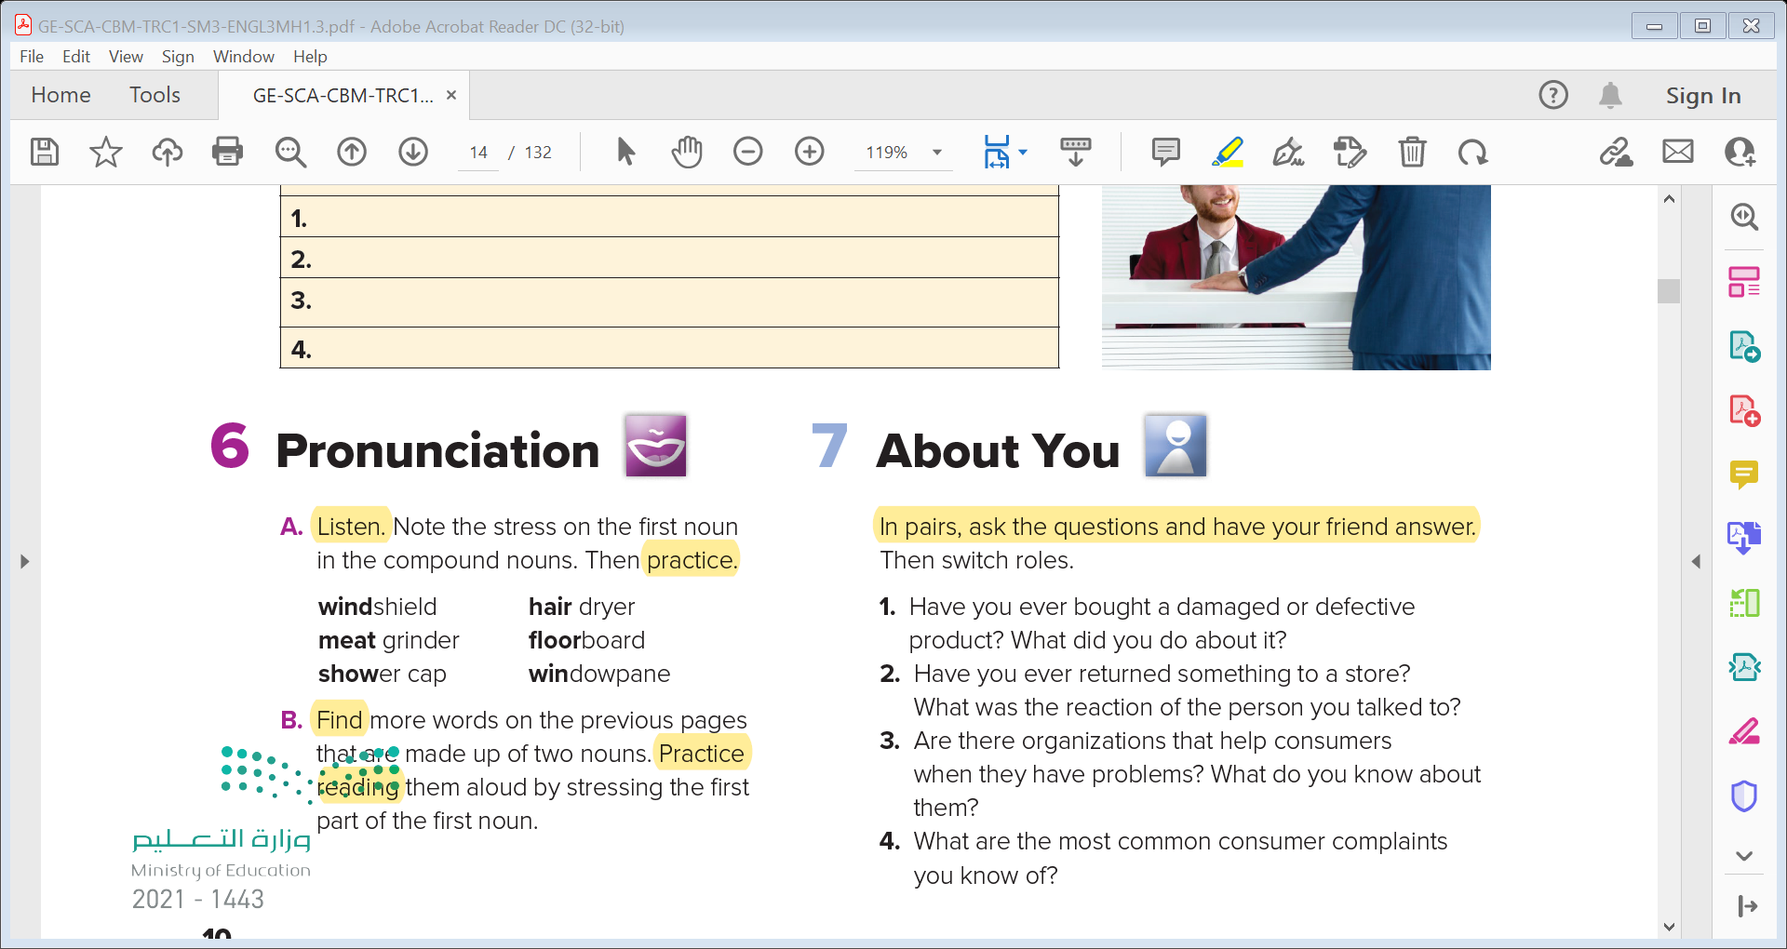

Slide 23
7-About you

Slide 24


Slide 25
