Slide 1


Slide 2

Good Morning

Slide 3
Unit -3-
If It Hadn’t Happened

Slide 4
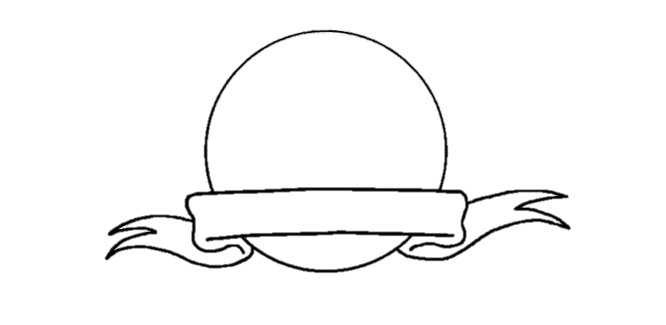



Revision

Slide 5
4-Language in context
5-Listening
6-Pronunciation
7-About you

Slide 6
Objectives
4-Language in context
The students will be able to :
dramatize a hypothetical situation .
summarize a person's regret accordion to audio .
practice reduction of "could have, should, have, and would have“ .
Share positively in pair work.

Slide 7
4-Language in context

Slide 8
The following talks about a message that was found in a bottle. Imagine you found the message.
Discuss with a partner what you would have thought if you had found the bottle and what you would have done with the money
In 19 49, Jack Wurm, an unemployed man,
was walking aimlessly on a California
beach when he came a cross a bottle that
had floated onto the beach. In it was
a piece of paper with t his message:
“To avoid confusion, I leave my entire
estate to the lucky person who finds
this bottle and to my attorney, Barry
Cohen, share and share alike. Daisy
Alexander, June 20, 1937.” It was not
a hoax. Mr. Wurm receive d over
$6 mi l lion fro m Daisy
Alexander’s estate.

Slide 9
5-Listening
1- Who was walking on the beach ?
In 19 49, Jack Wurm, an unemployed man,
was walking aimlessly on a California
beach when he came a cross a bottle that
had floated onto the beach. In it was
a piece of paper with t his message:
“To avoid confusion, I leave my entire
estate to the lucky person who finds
this bottle and to my attorney, Barry
Cohen, share and share alike. Daisy
Alexander, June 20, 1937.” It was not
a hoax. Mr. Wurm received over
$6 million from Daisy
Alexander’s estate.
2- When ?
3- Where ?
4- What was he doing ?
5- What did he find ?
6- What was inside the bottle ?
7- What does the message say ?
9- When did Daisy write it ?
10- How much money did Jack receive ?

Slide 10





5-Listening
In 19 49, Jack Wurm, an unemployed man,
was walking aimlessly on a California
beach when he came a cross a bottle that
had floated onto the beach. In it was
a piece of paper with t his message:
“To avoid confusion, I leave my entire
estate to the lucky person who finds
this bottle and to my attorney, Barry
Cohen, share and share alike. Daisy
Alexander, June 20, 1937.” It was not
a hoax. Mr. Wurm received over
$6 million from Daisy
Alexander’s estate.
Without purpose
Being unclear
All the money and property
A lawyer
A joke

Slide 11


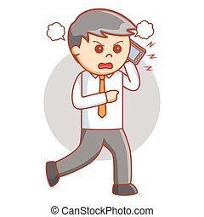

5-Listening

Slide 12

Listen to the people on the radio show, and complete the chart

Slide 13

6-Pronunciation
Reason | Regret | Name
 |  | J. Springfield
 |  | Saeed
His boss was very demanding, so he resigned . Now he thinks he shouldn’t have
He doesn’t know if he’ll be able to find another job .
He got fired because he is irritable and abrupt when he is under pressure .
He loves his job ,but he got fired .

Slide 14
6-Pronunciation

Slide 15
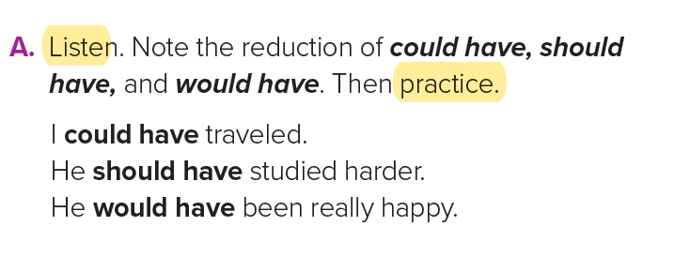
could
have
Could’ve
Would
have
Would’ve
Should
have
Should’ve

Slide 16
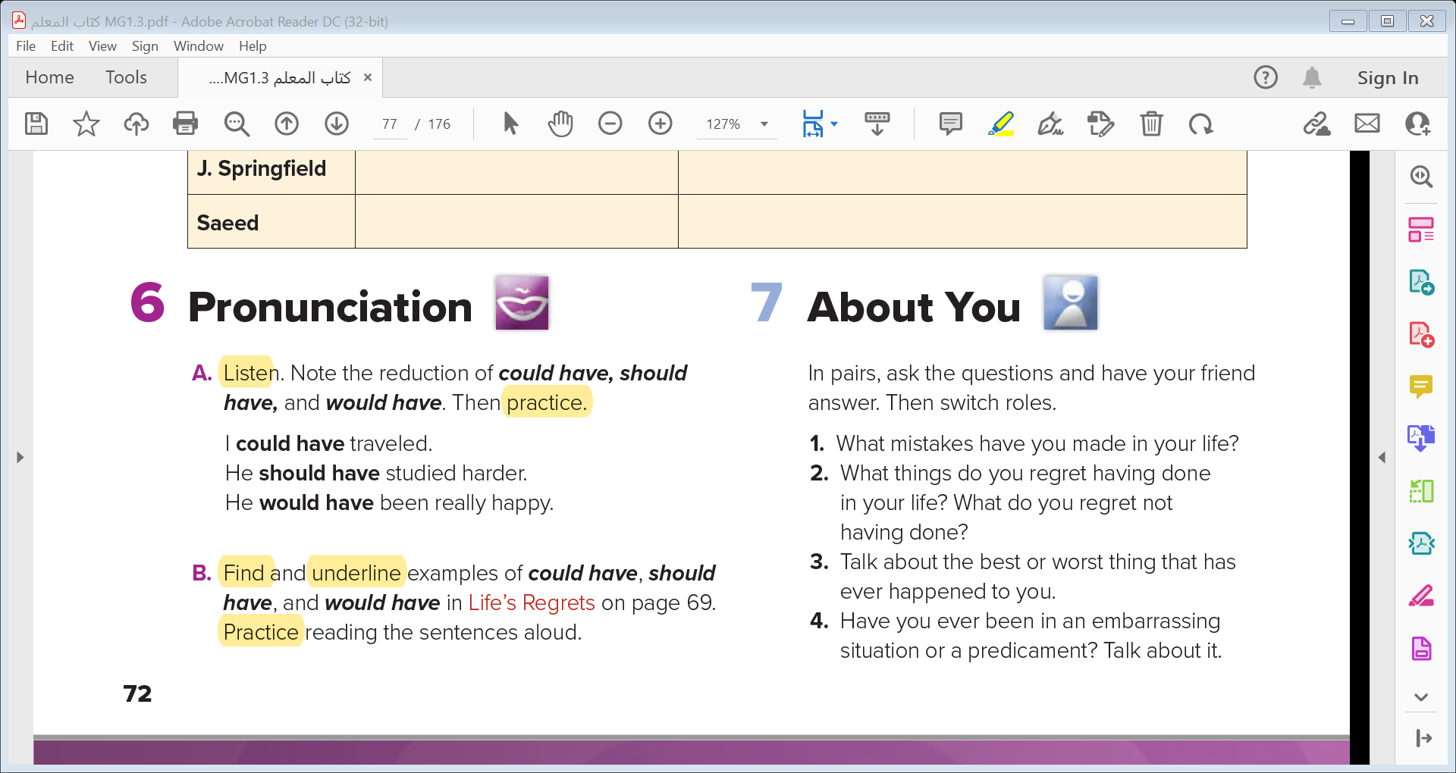
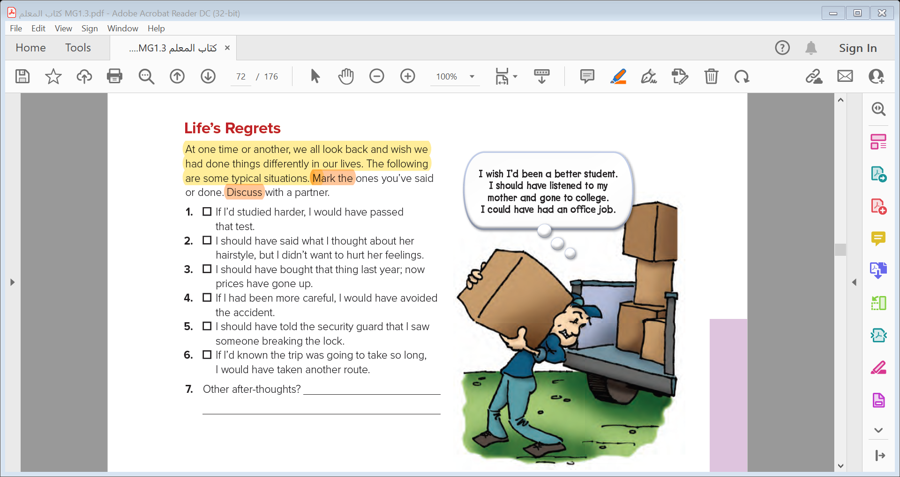
7-About you

Slide 17
7-About you

Slide 18

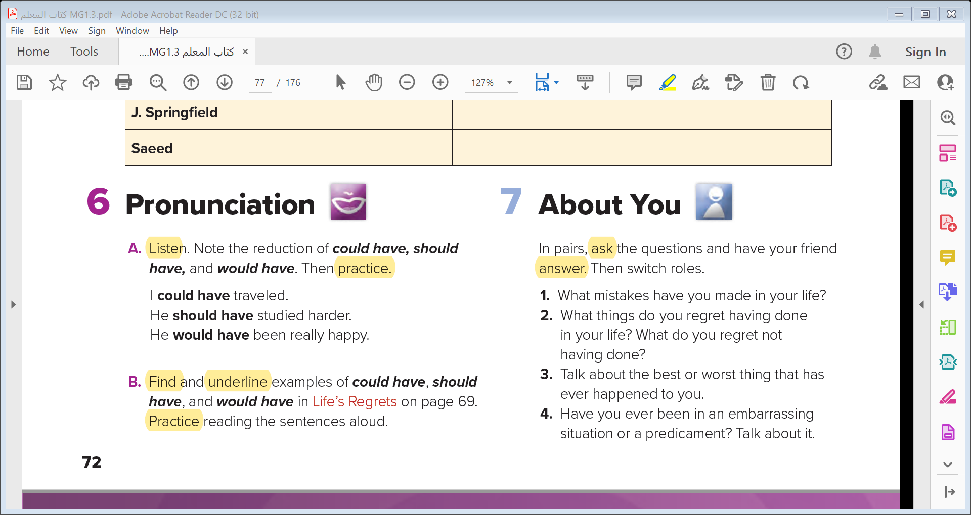

Slide 19


