Slide 1
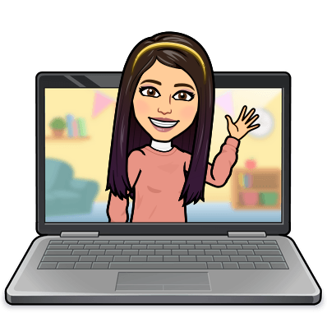

Hello My lovely students
I’m your teacher
Hanan AlShobaily

Slide 2




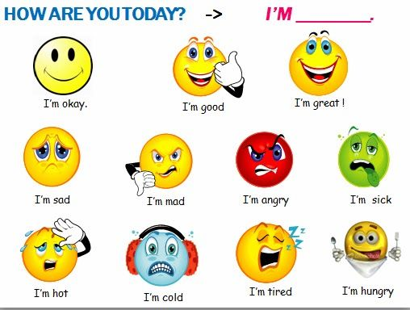
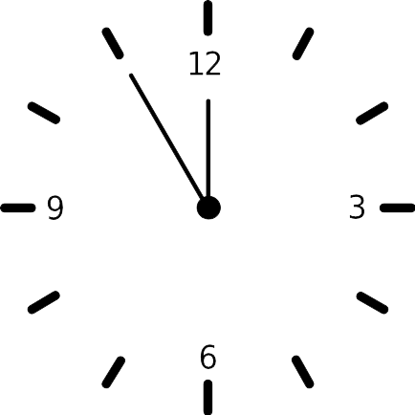


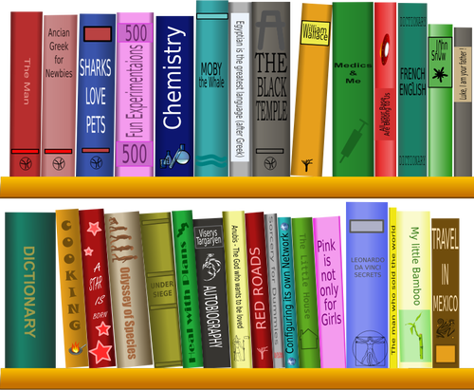
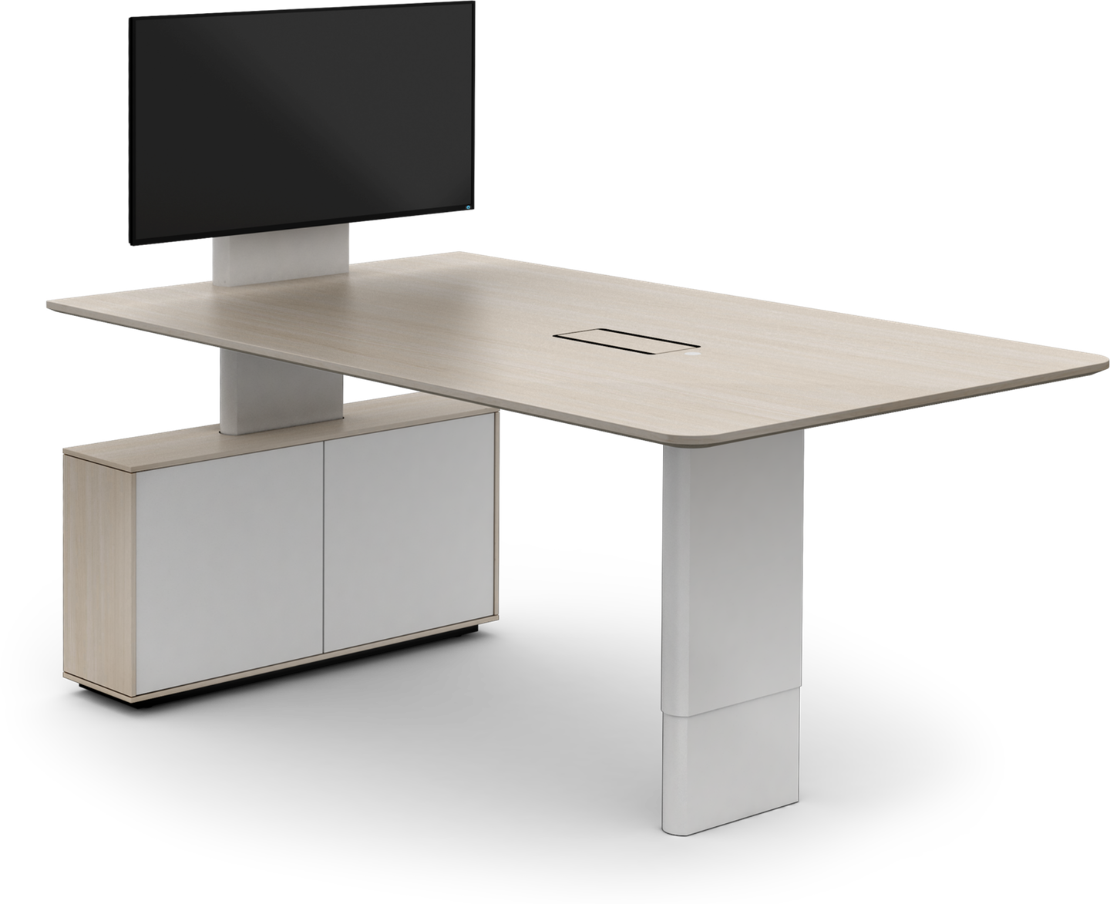
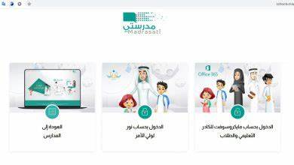







I love English

Slide 3
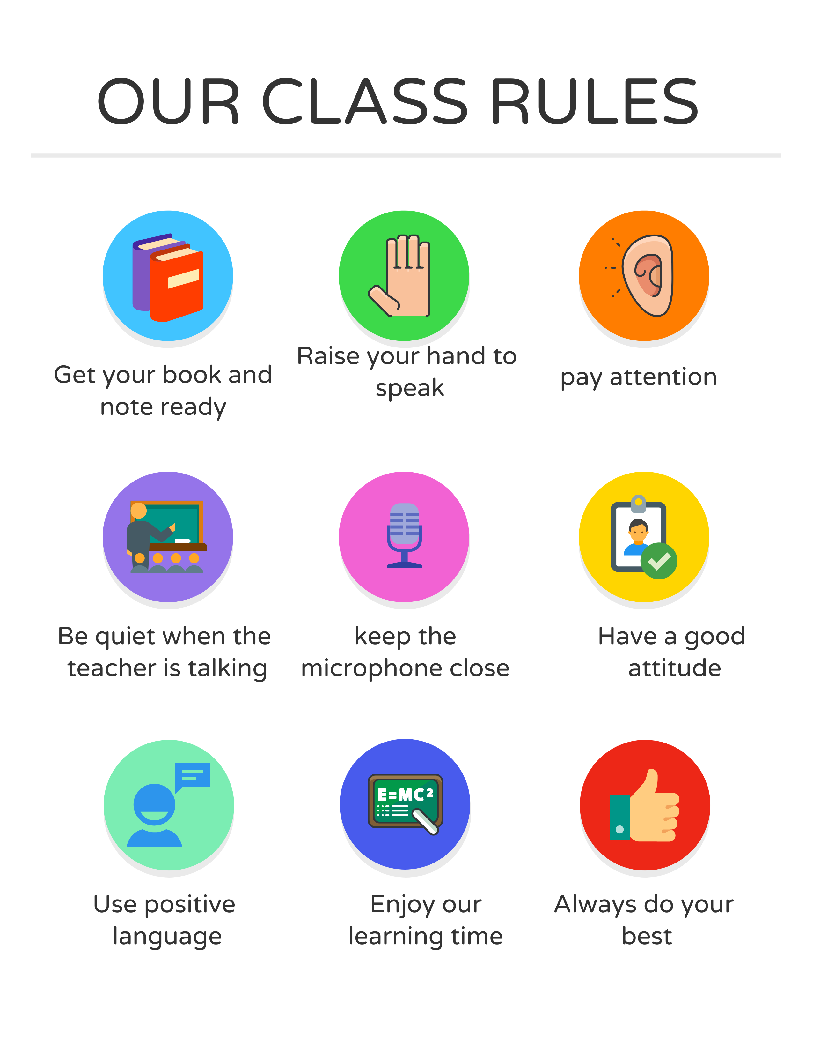

I love English

Slide 4
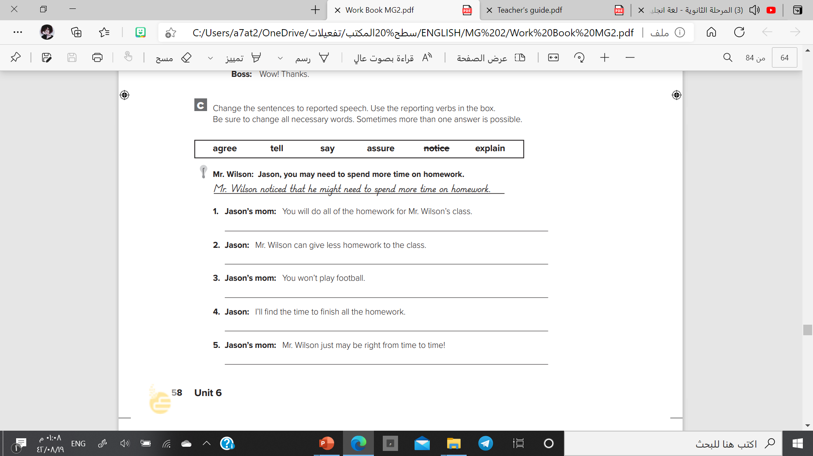
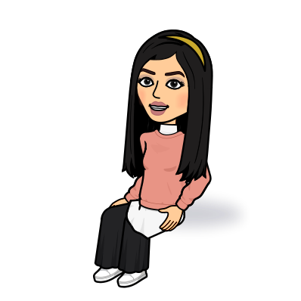
I love English
Let’s do the homework before starting the lesson.
Mega Goal 2 .. WB (58)
Jason’s mom told him that he would do all of the homework for Mr. Wilson’s class.
Jason said that Mr. Wilson could give less homework to the class.
Jason’s mom explained that he wouldn’t play football.
Jason assured his mom that he would finish all the homework.
Jason’s mom agreed that Mr. Wilson just might be right from time to time!

Slide 5




Let’s revise the previous lesson
https://wordwall.net/resource/13716404

Slide 6

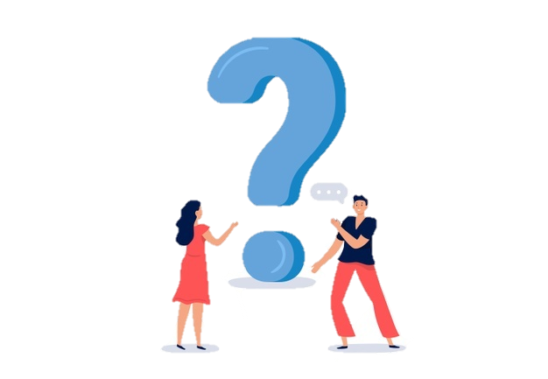
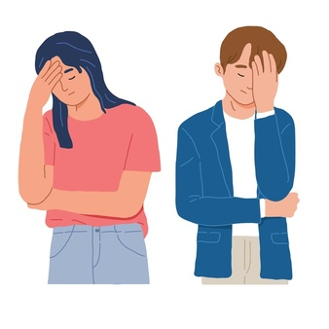
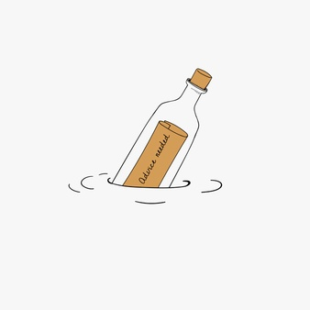
Mega Goal 2
Unit 6
(What They Said)
Language in Context
Listening
Pronunciation
About You
Conversation
Sunday
22/8/1442
I love English

Slide 7

I love English
Lesson Objectives
Students will be able to:
Report a speech about global warming.
Report mistakes in audio.
Distinguish between stressed and unstressed "that”.
Practice reading the conversation in pairs.
Answer specific questions based on conversation.
Use the “real talk” phrases in new sentences.

Slide 8
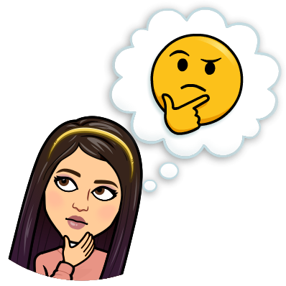

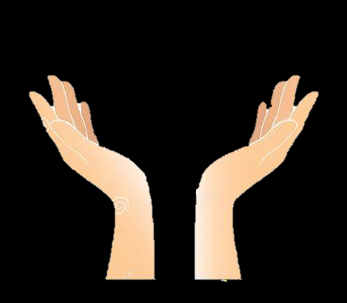
Warm Up
What does this mean?

Slide 9
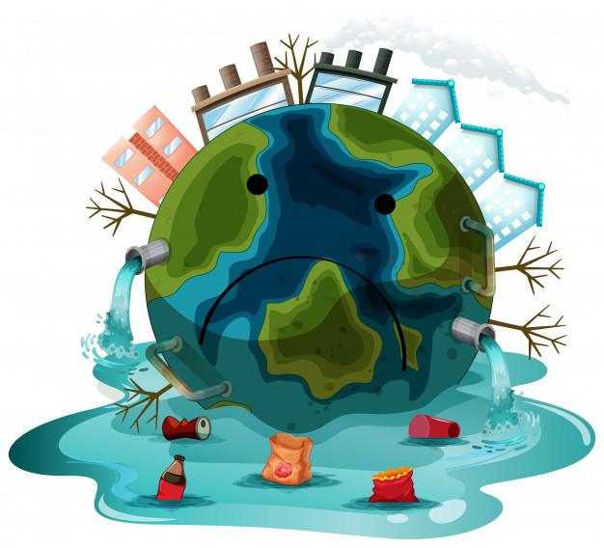
What are global issues?
Deforestation
Pollution
Illegal hunting
Global warming

Slide 10


It’s the only home we have
Let’s stop destroying our home

Slide 11
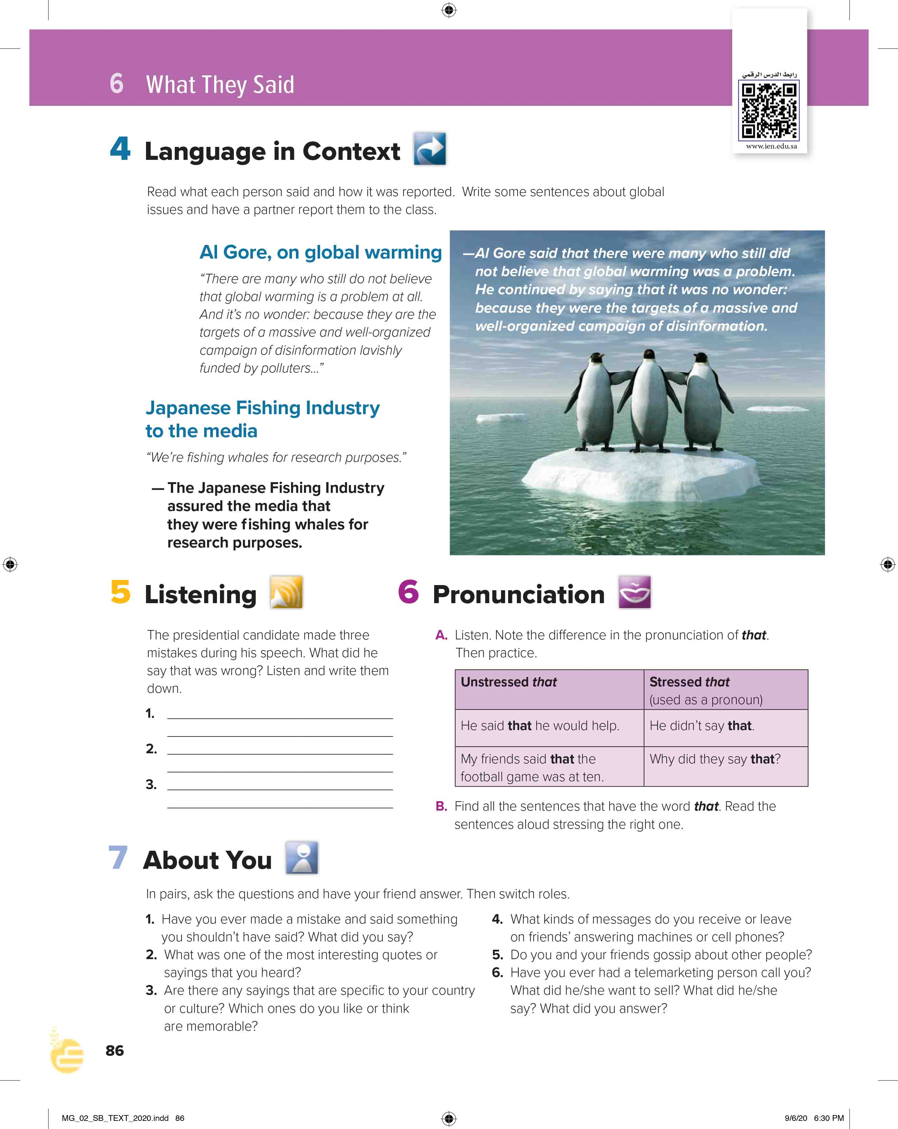

I love English
Open your Student’s book page: 86

Slide 12


Slide 13
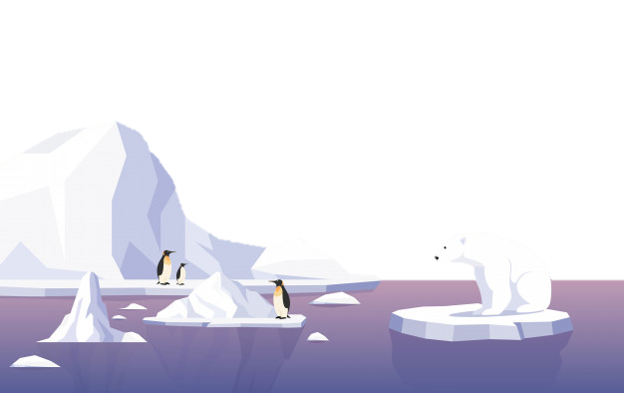
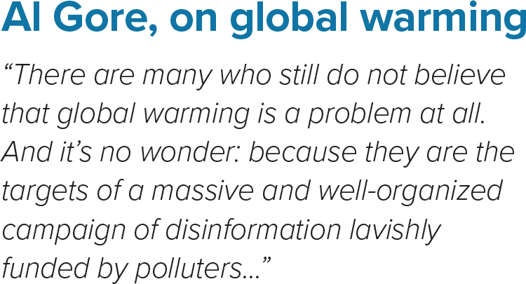
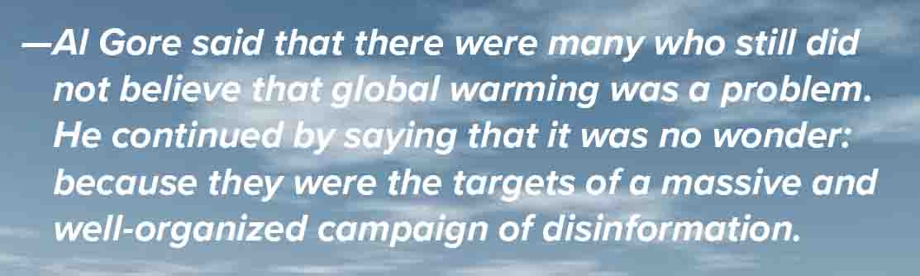

Slide 14
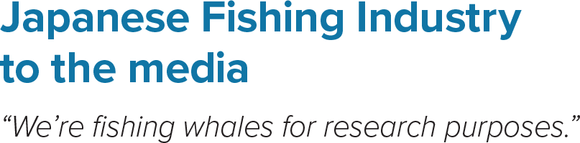
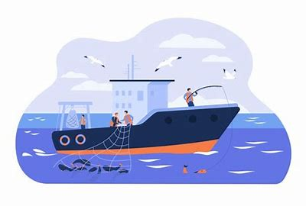
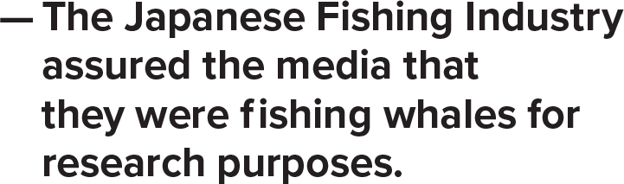


Slide 15
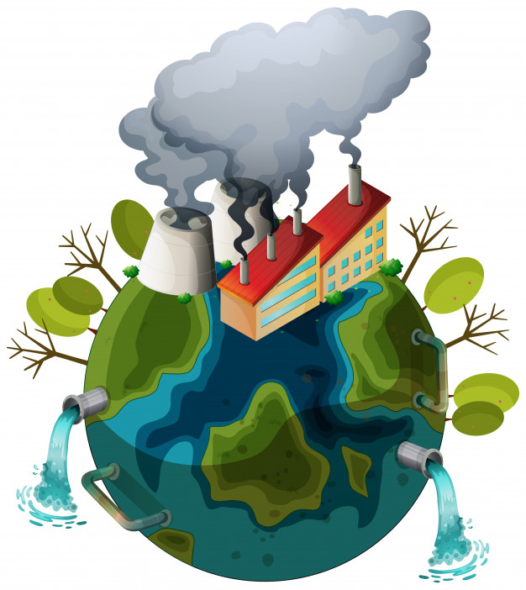

R. Buckminster Fuller
“Pollution is nothing but the resources we are not harvesting . We allow them to disperse because we’ve been ignorant of their values.”
R. Buckminster Fuller said pollution was nothing but the resources we were not harvesting. We allowed them to disperse because we had been ignorant of their values.

Slide 16
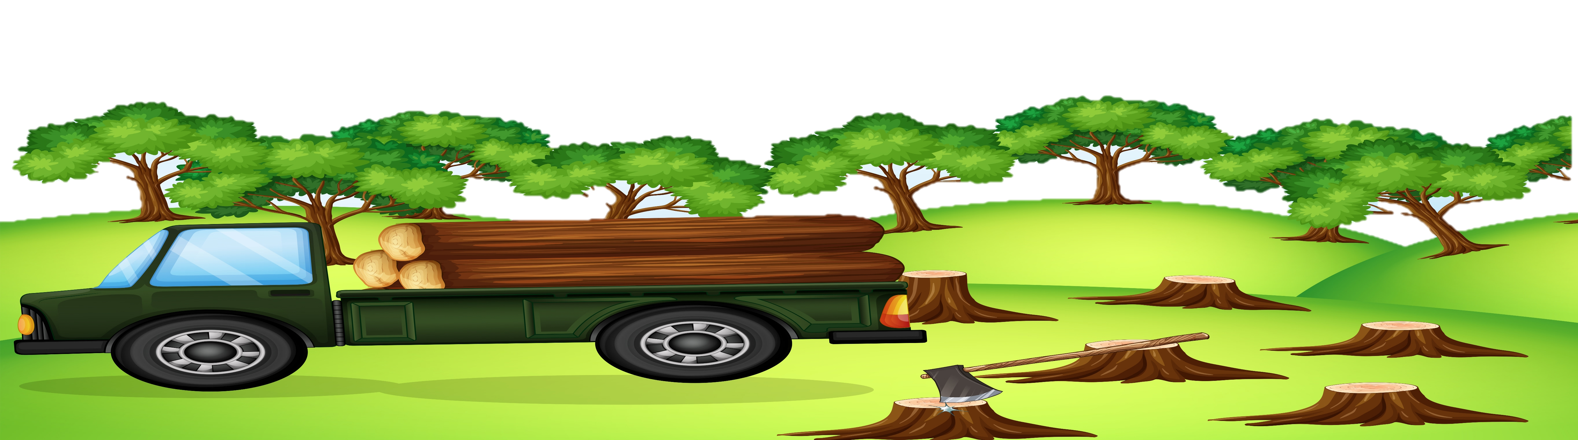
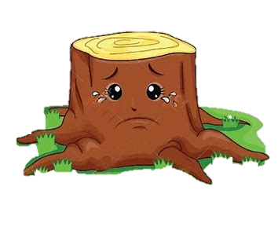
Mahendra Dhoni: “If you have forest, if you have green forest, the water table goes up . What happens with deforestation is the water level goes down and we all know how much importance drinking water has.”
Mahendra Dhoni said that if you had forest, if you had green forest, the water table went up. What happened with deforestation was the water level went down and we all knew how much importance drinking water had.

Slide 17

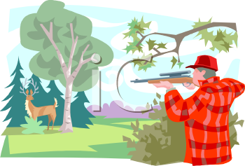
Paul Taylor: “We took their land away from them. We forced them to live on reserves. We gave them only limited legal rights. Their numbers plummeted and their societies collapsed.”
Paul Taylor said that they had taken their land away from them. They had forced them to live on reserves. They had given them only limited legal rights. Their numbers had plummeted and their societies had collapsed.

Slide 18



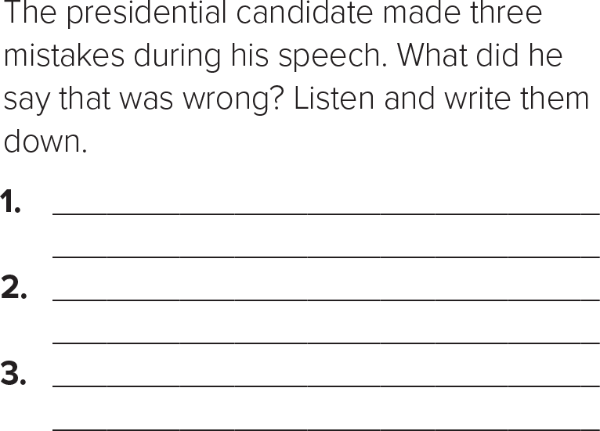
He said that he would raise unemployment.
He said that he would ask his staff to wake him up at any time, even during meetings.
He said that people who couldn’t read and write shouldn’t be in school.

Slide 19

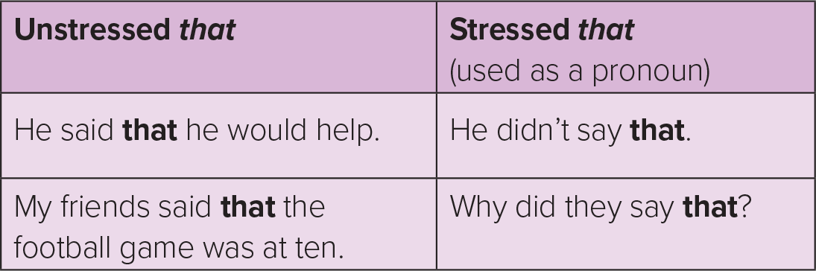
The word ( that ) is unstressed when it connects parts of the sentence.
The word ( that ) is stressed when it functions as a pronoun.

Slide 20

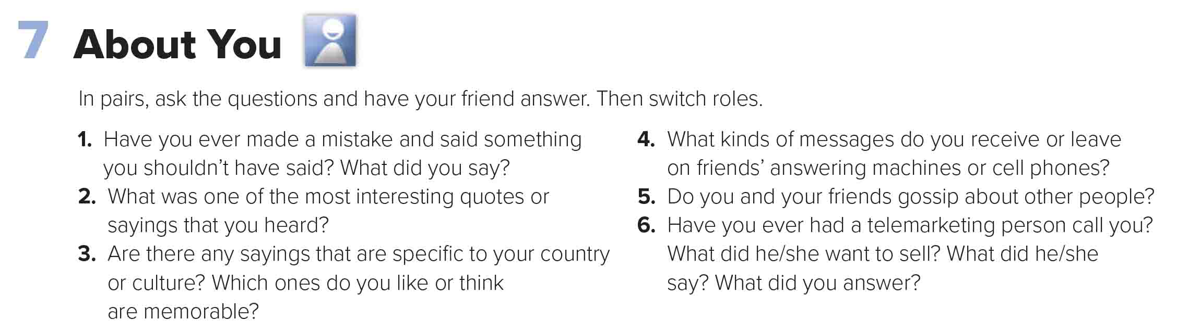


Slide 21



Slide 22
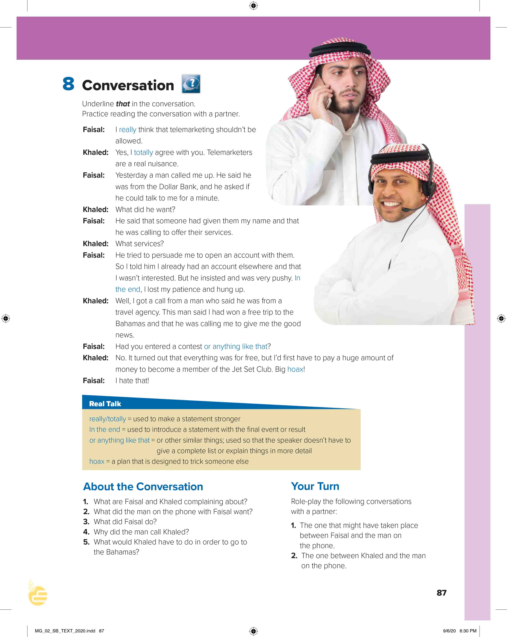
I love English
Open your Student’s book page: 87

Slide 23
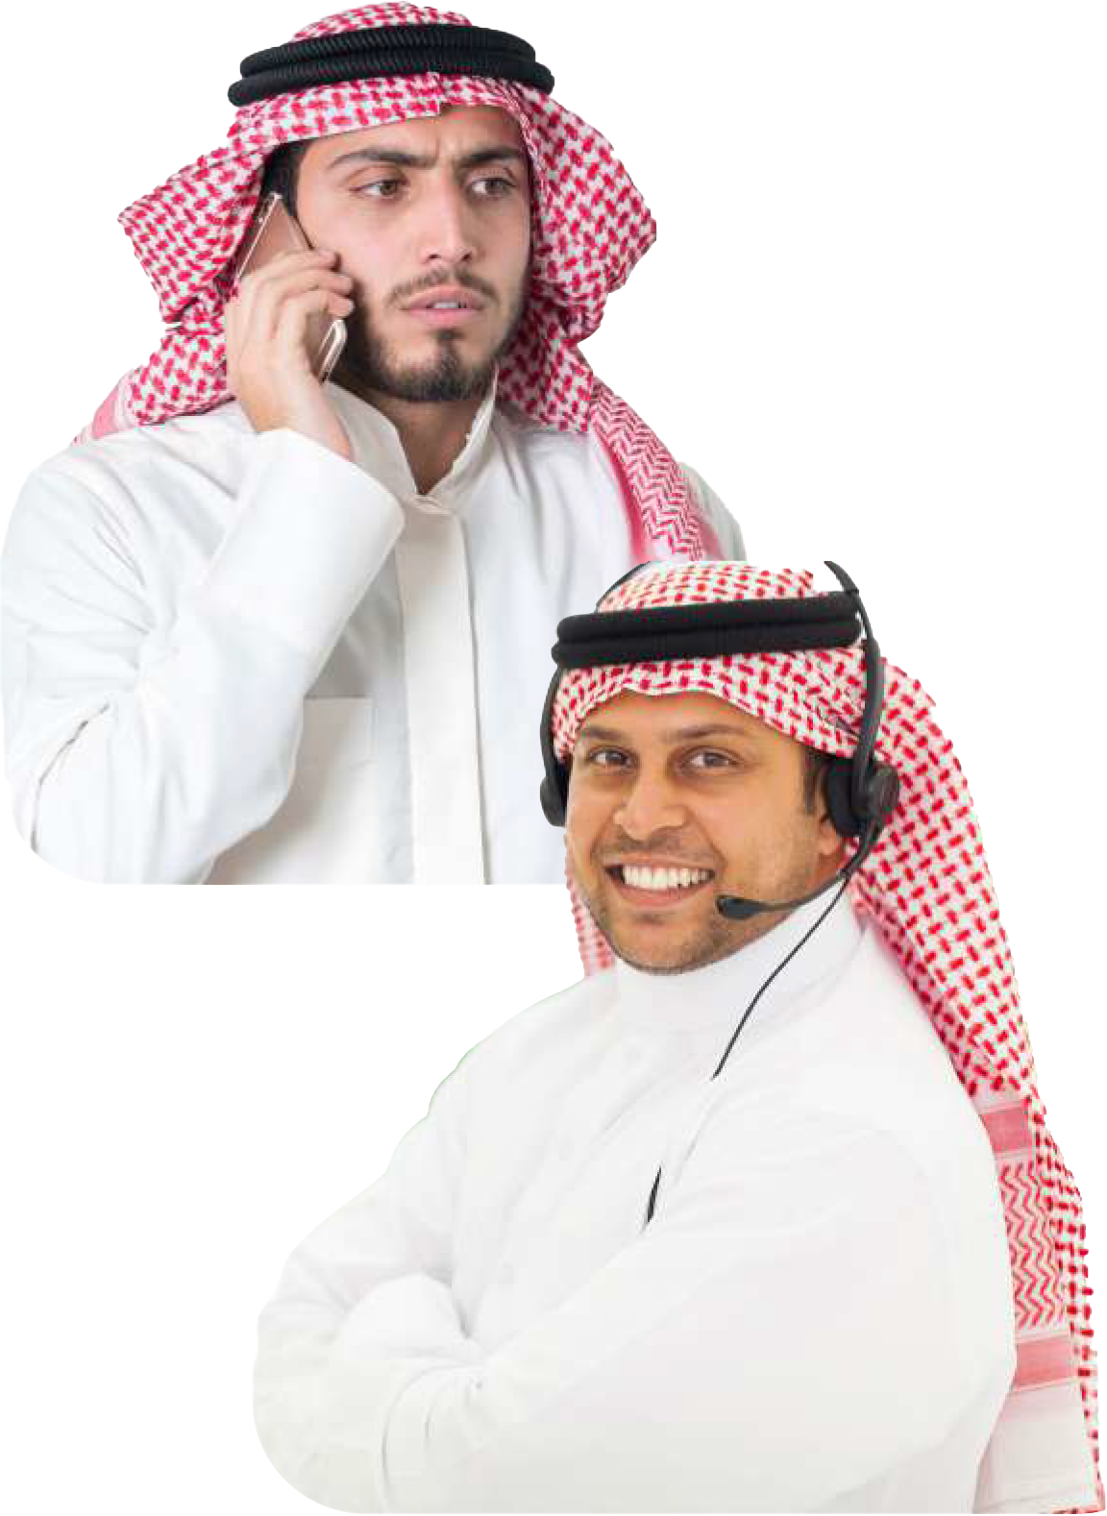
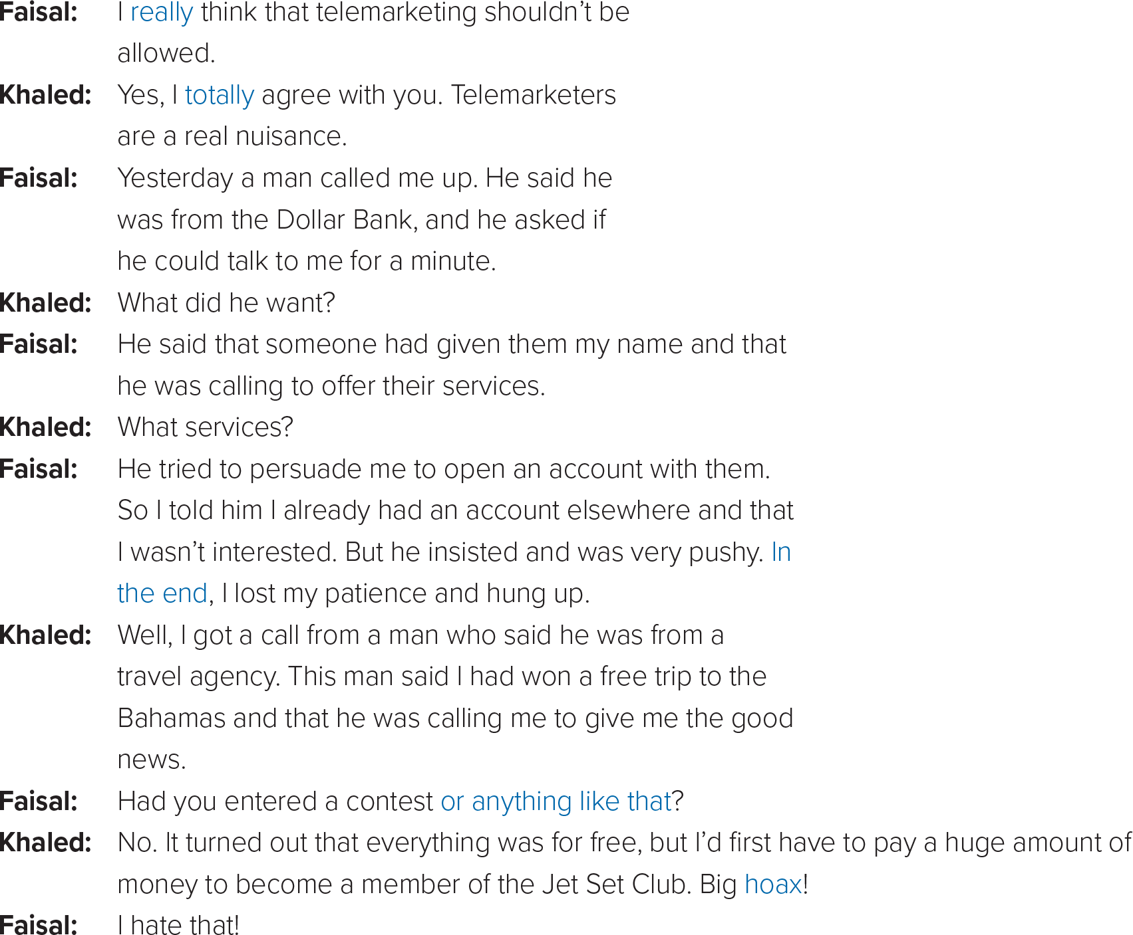

A way of selling products to people in which you telephone people to see if they want to buy something
Something that is very annoying.
Between whom did the conversation take place?
What are they talking about?
To try to get someone to do something.
Telemarketing calls
Somewhere else, some other place.
What was Faisal’s call about?
Opening account in a bank.
So determined to succeed that the person is rude.
What was Khaled’s call about?
Travel agency to offer him free ticket.

Slide 24
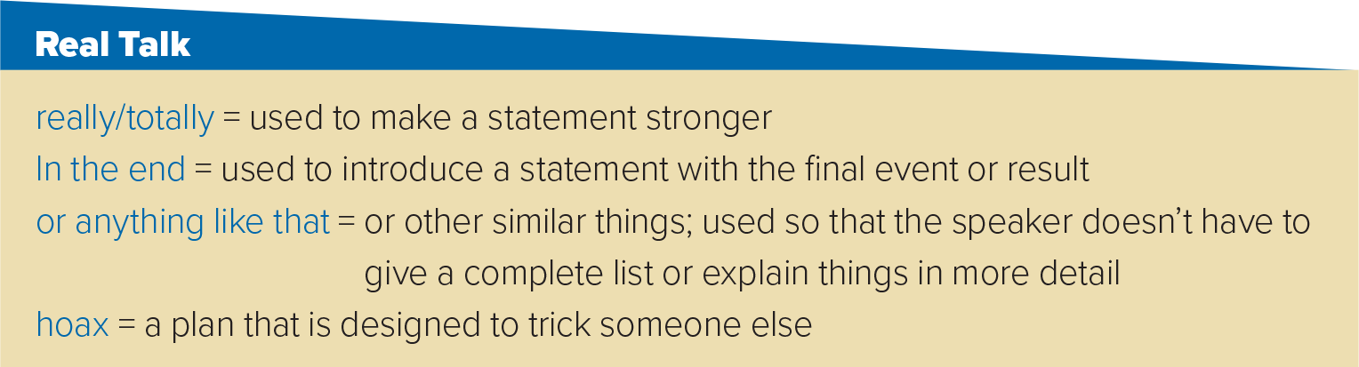
- That was really great movie.
- In the end, I saw that she was right.
- He wasn’t involved in drugs or anything like that.
- The bomb threat turned to be a hoax.

Slide 25

https://wordwall.net/resource/13774203

Slide 26
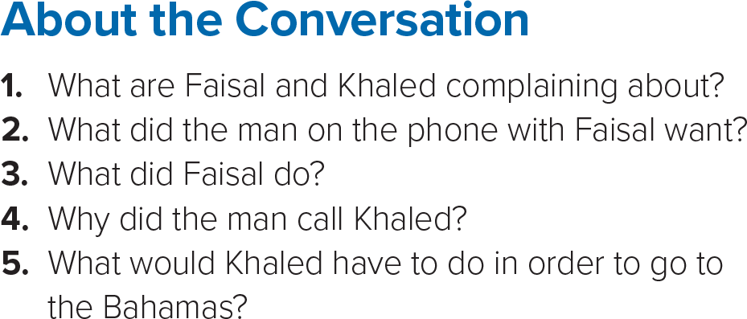

1- Faisal and Khaled are complaining about telemarketers.
2- The man on the phone with Faisal tried to persuade him to open an account at a bank.
3- Faisal lost his patience and hung up.
4- The man told Khaled that he had won a free trip to the Bahamas.
5- Khaled would have to pay a huge amount of money to join a club to go on the trip.

Slide 27
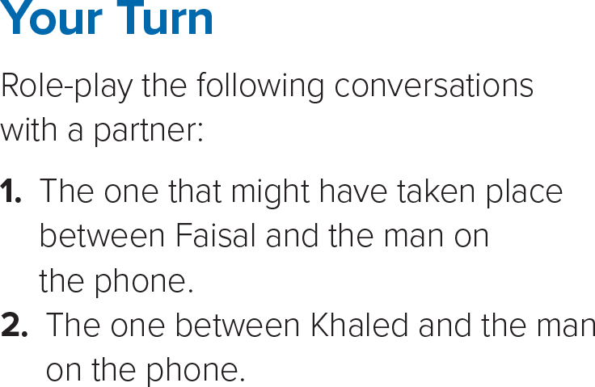

Slide 28

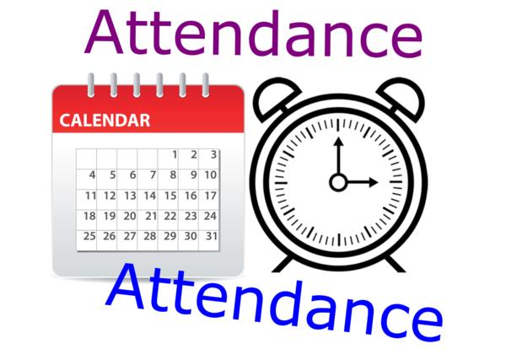
I love English

Slide 29



Homework
I love English

Slide 30
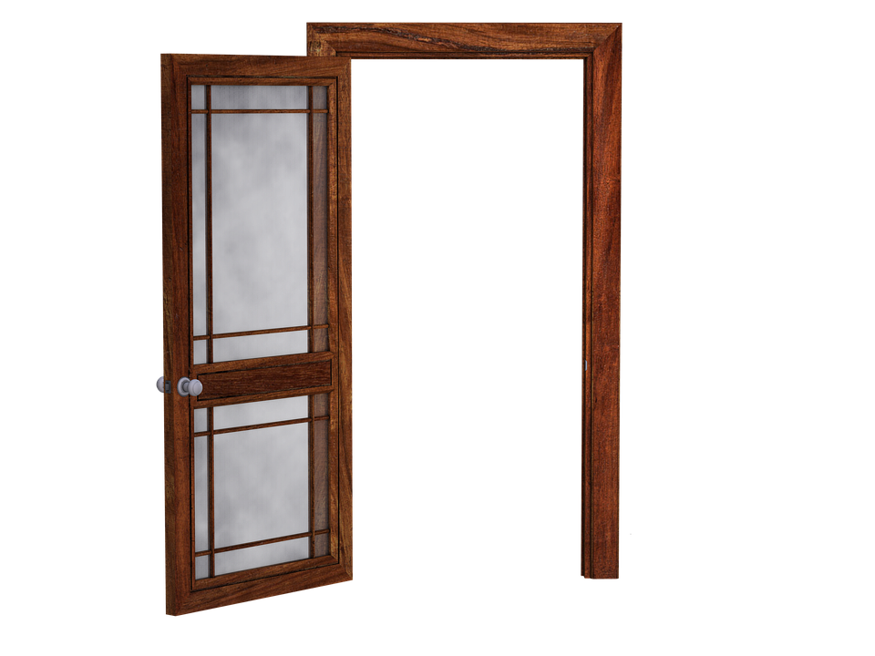
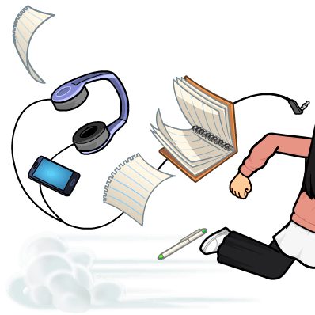
Homework

Slide 31
Homework

Slide 32
Homework

Slide 33
Homework

Slide 34
Homework

Slide 35

Homework

