Slide 1


Hello My lovely students
I’m your teacher
Hanan AlShobaily

Slide 2




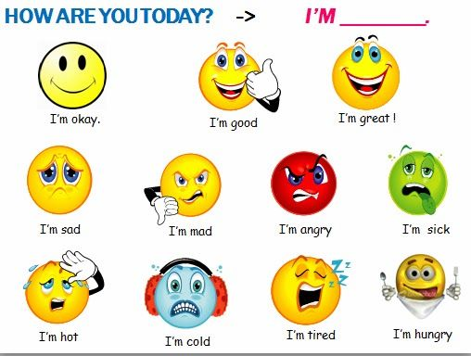
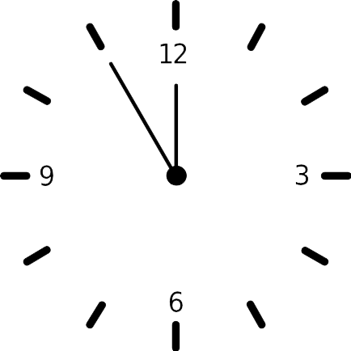



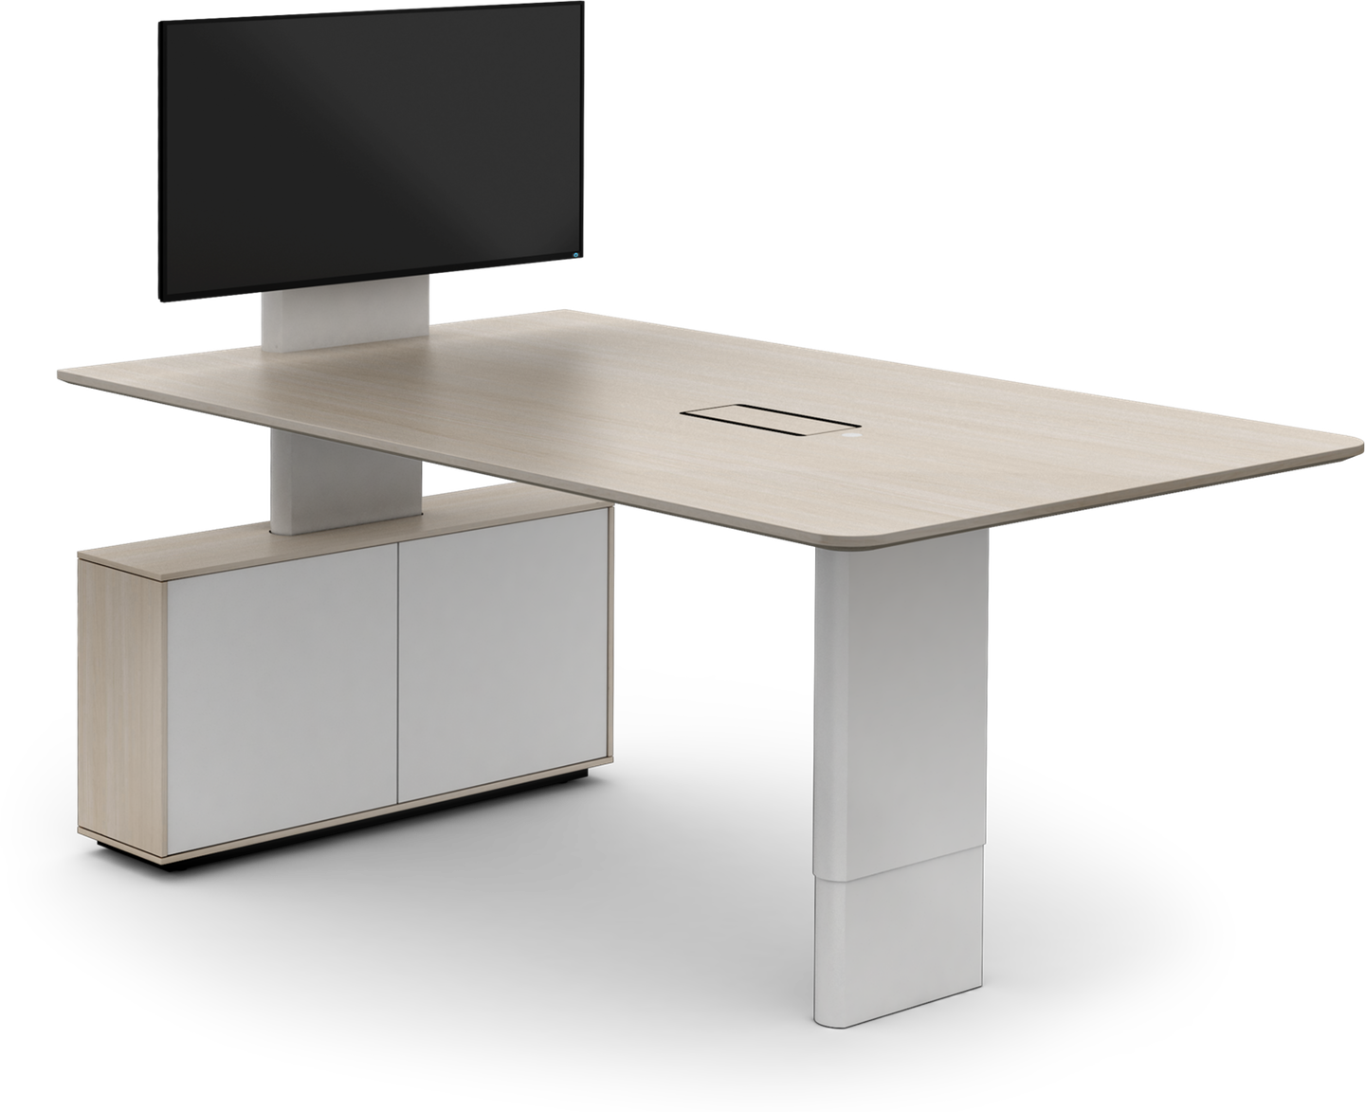








I love English

Slide 3


I love English

Slide 4

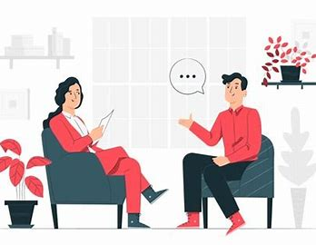


I love English
Mega Goal 2
Unit 6
(What They Said)
Listen and Discuss
Wednesday
18/8/1442

Slide 5

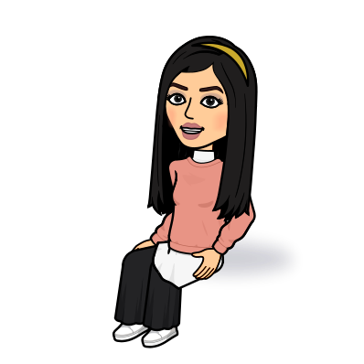
I love English
Lesson Objectives
Students will be able to:
Report what people said.
Answer specific questions through listening to an audio.
Match the words with their meanings.
Answer True or False questions correctly.

Slide 6
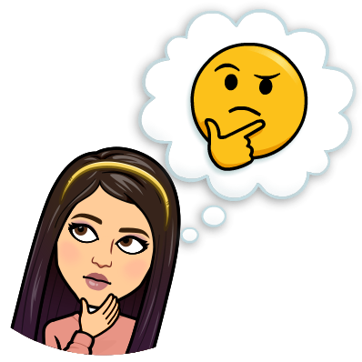
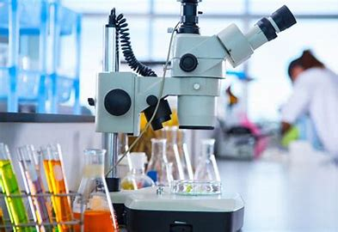


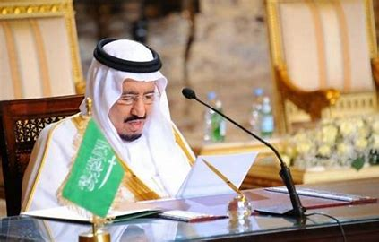
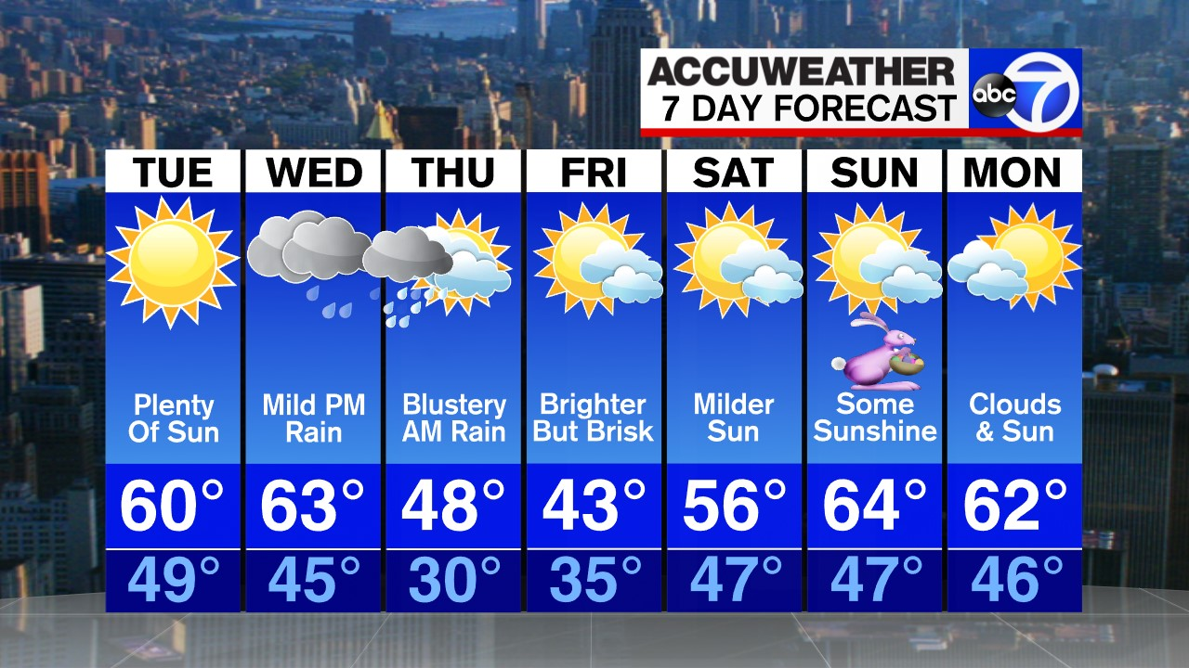
Warm Up
What’s this?
What kind of events does the news report?
Science
Sport
Health
Politics
Weather

Slide 7
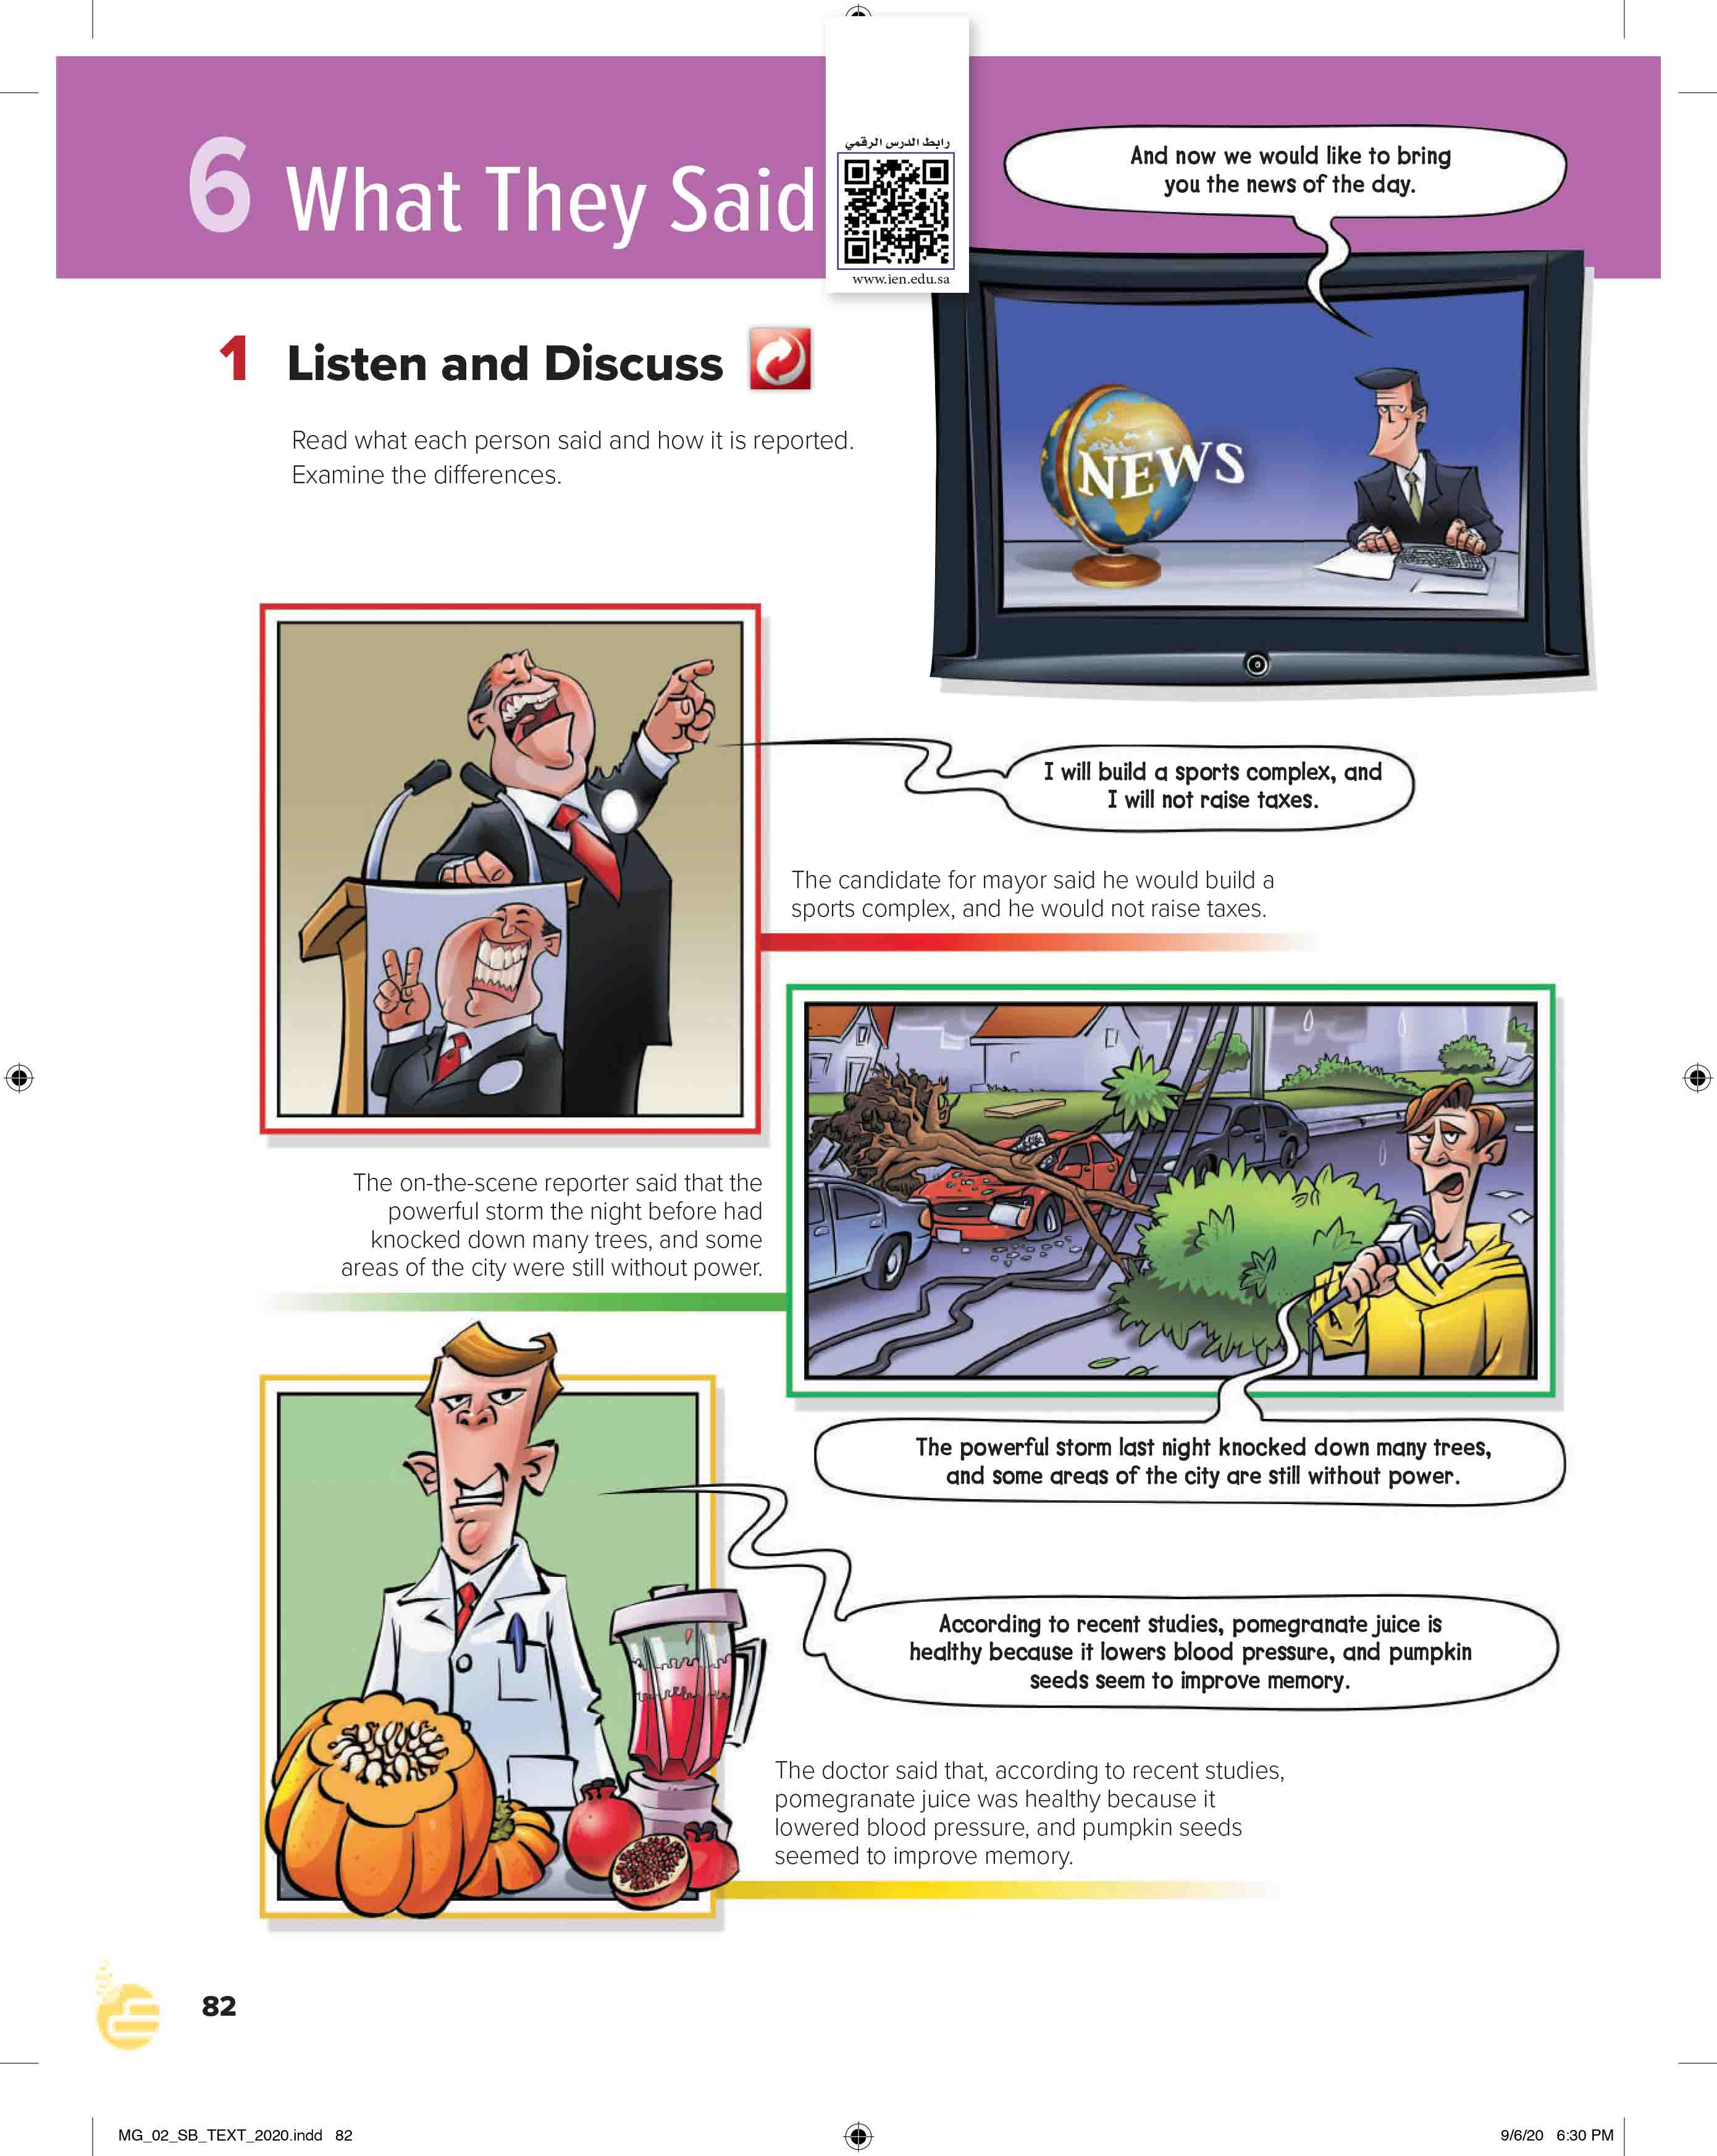

I love English
Open your Student’s book page: 82

Slide 8
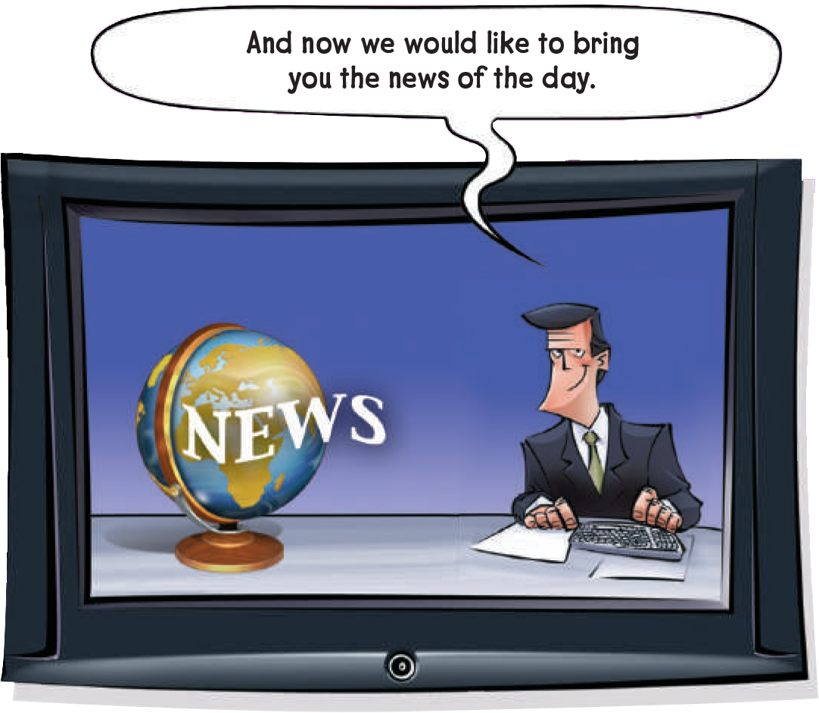
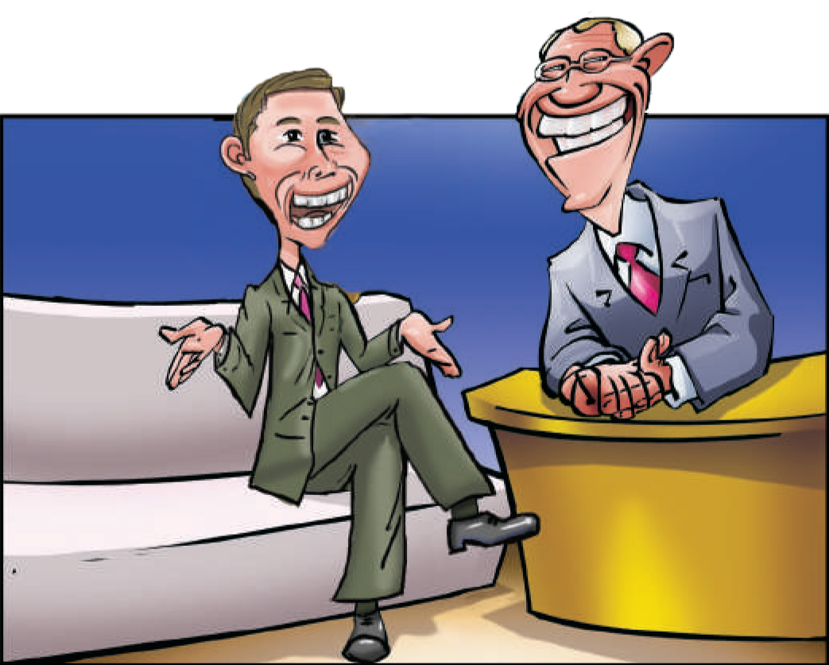
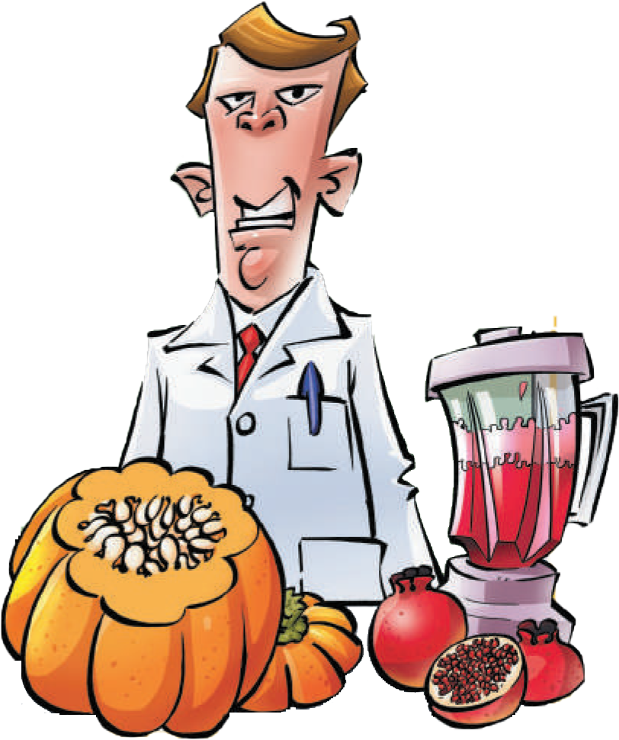
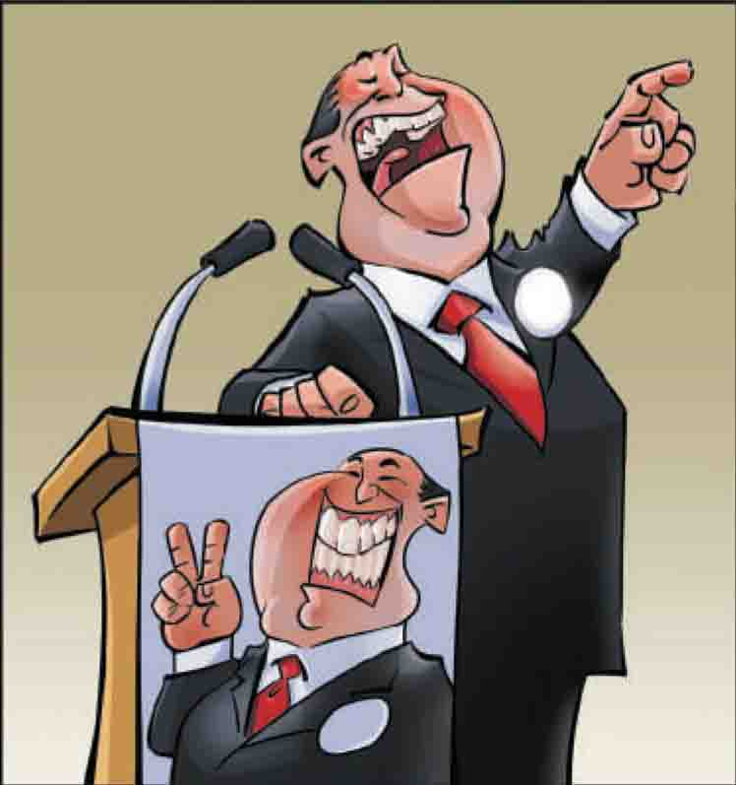
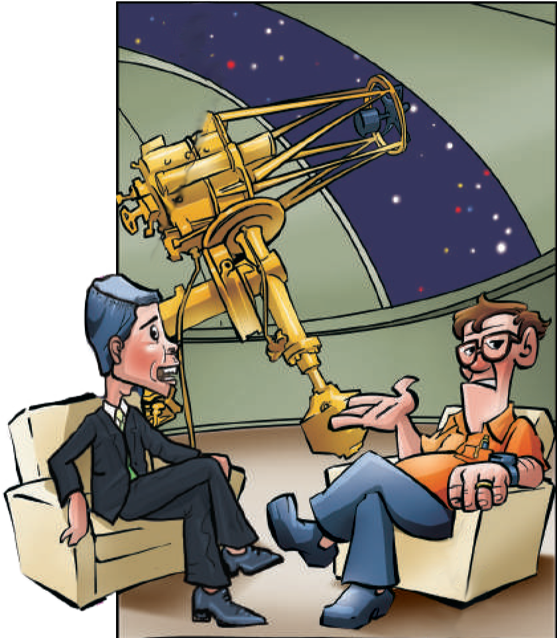
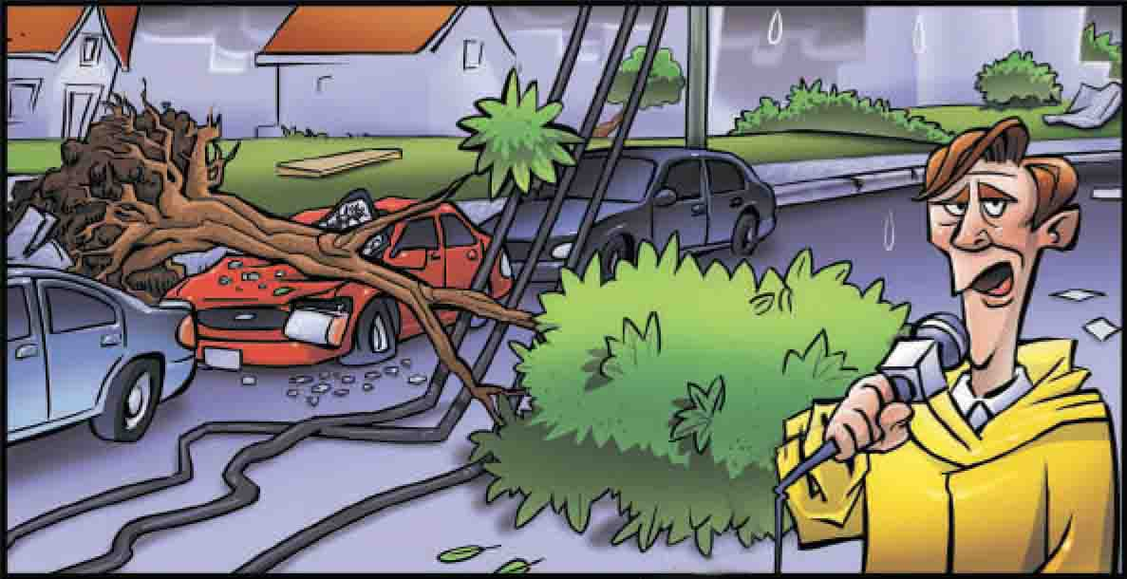
What did they say?

Slide 9
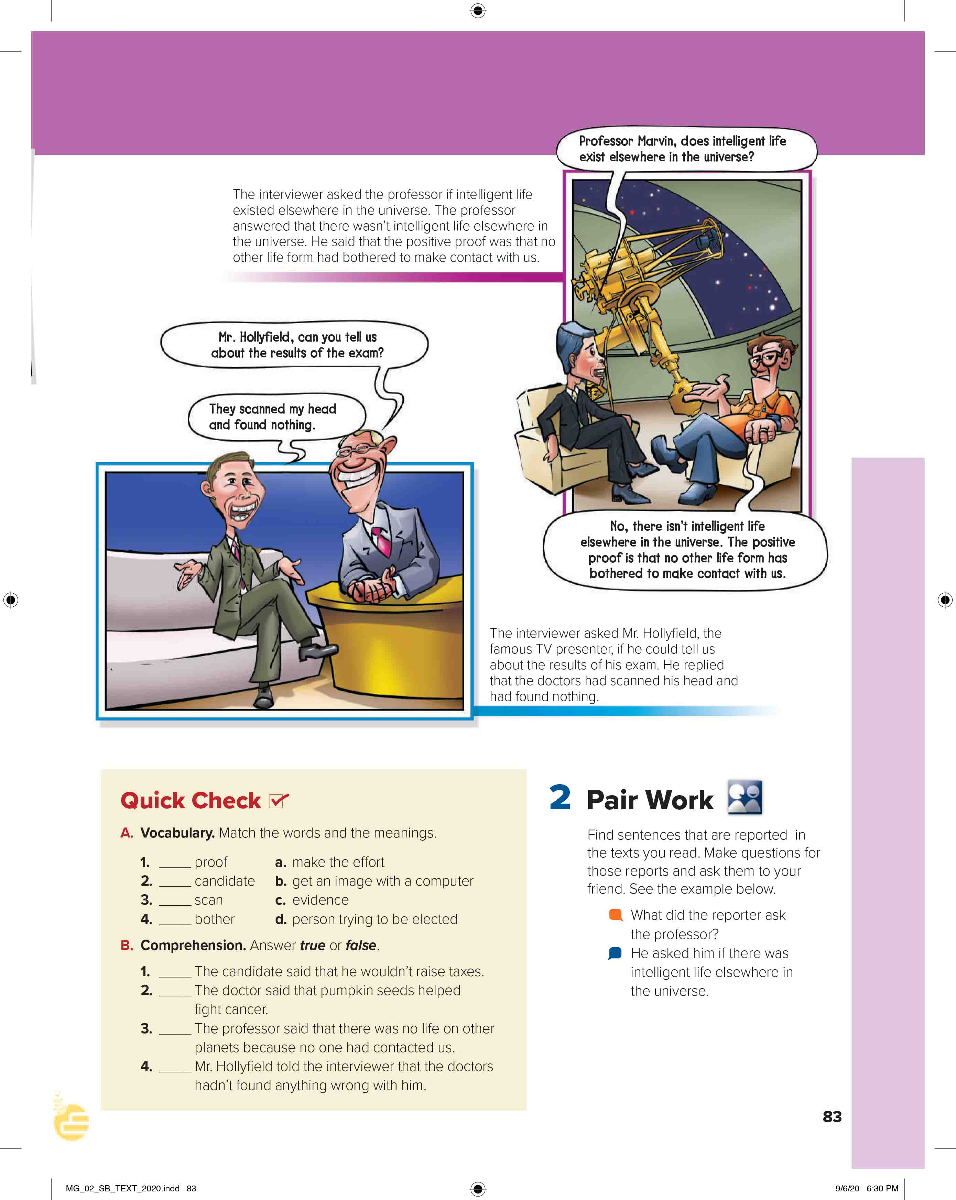

Skimming
What’s the title?
How many speech bubbles are there?
How many pictures?
What do the pictures show?

Slide 10



Slide 11


announcer

Slide 12
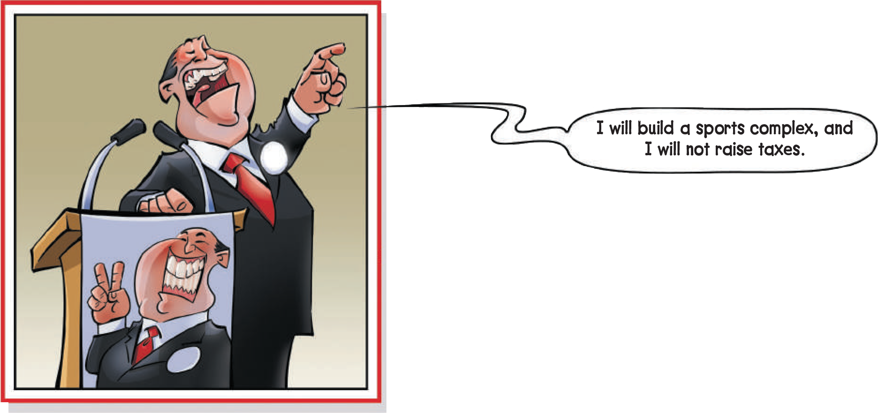

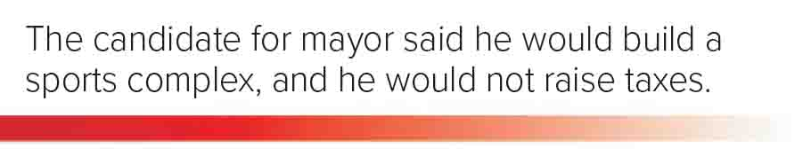
a sum of money demanded by a government for its support or for specific facilities or services
What did the candidate for mayor promise?
To build sport complex and not raise taxes.
Why do you think he promised this?
To gain votes.
a person who is competing to get a job or elected position.

Slide 13
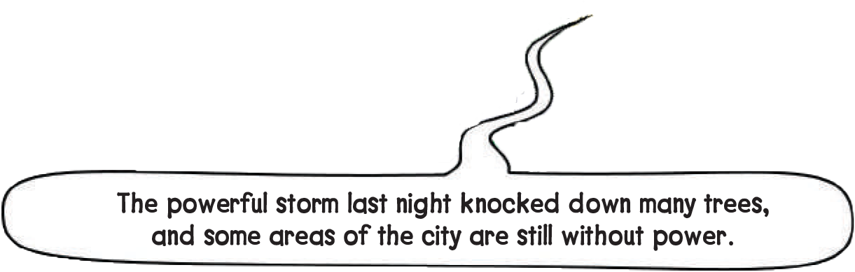
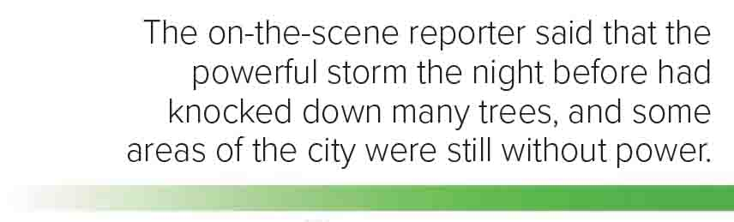
How much damage did the storm cause?
A lot of damage
to destroy and remove a building, wall, or other structure.
Someone whose job is to tell people about news events on TV or the radio.

Slide 14
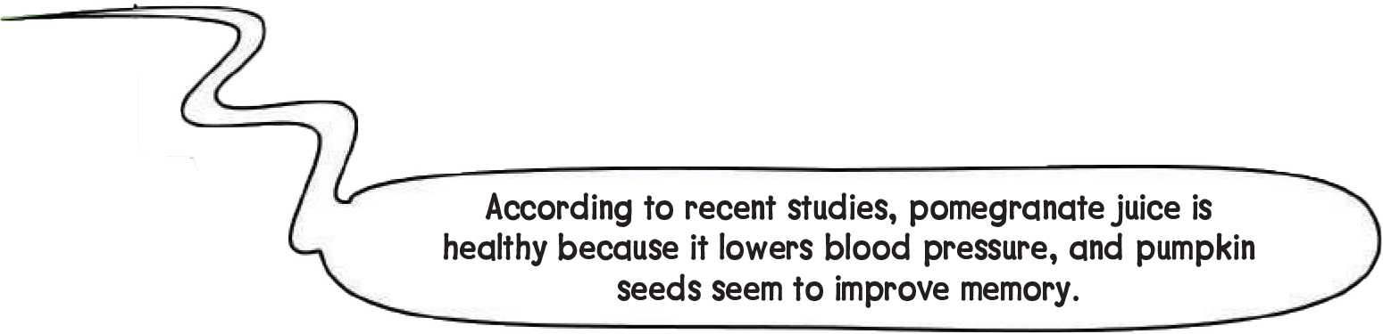
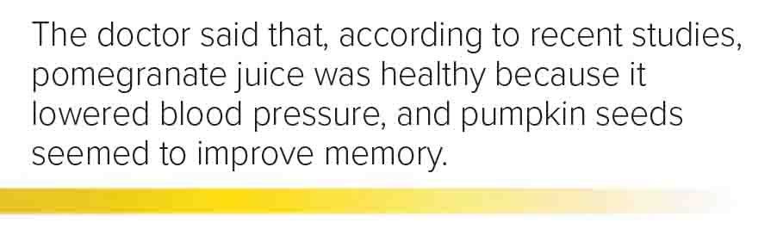
What did the doctor recommend to lower blood pressure?
Pomegranate juice.
What did the doctor say pumpkin seeds were good for?
Improving memory.
pomegranate
pumpkin

Slide 15


https://wordwall.net/resource/13641690

Slide 16
I love English
Open your Student’s book page: 83

Slide 17
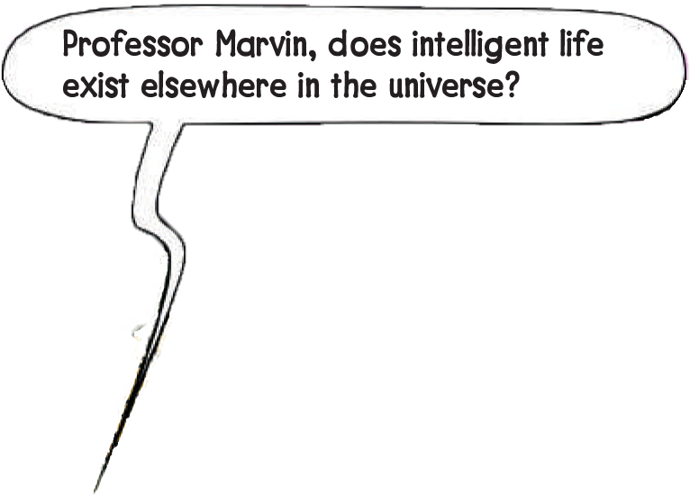
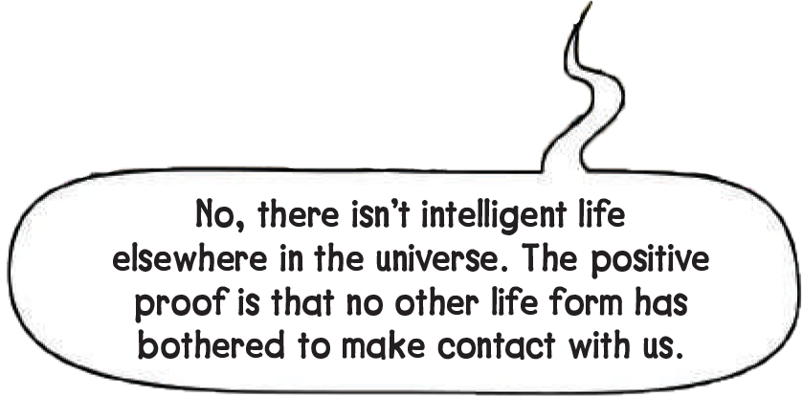
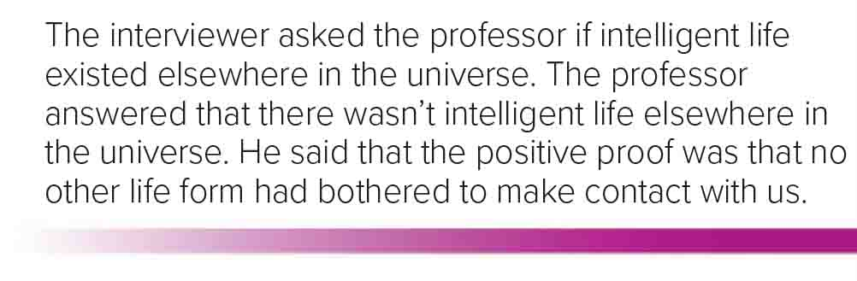
All space, including all the stars and planets.
Why did the professor say there was no life on other planets?
Because no one contacted us.
Evidence, fact or a piece of information which shows that something is true.
Make the effort

Slide 18
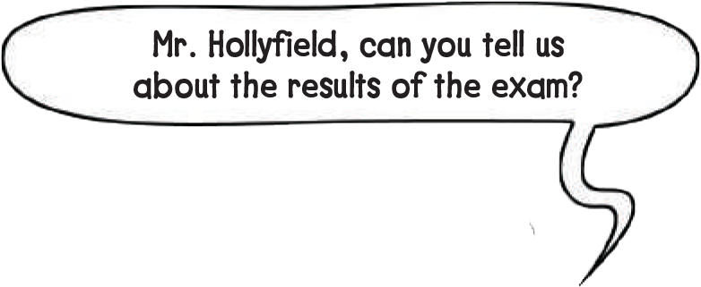
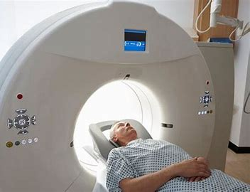
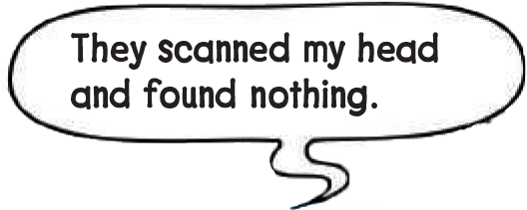
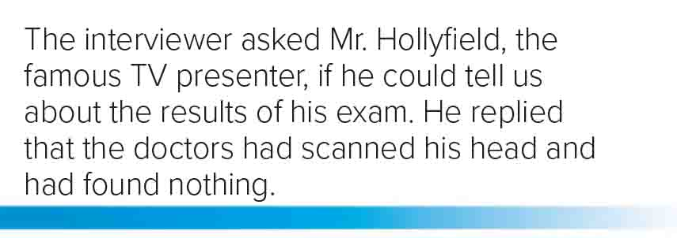

a medical examination, get an image with a computer
What is funny in the conversation with Mr. Hollyfield?
He intended to say that the doctor found no problems
with his head (or brain), but instead he said that they saw nothing in his head.
Can his reply have a different meaning that makes it funny? What is it?
Yes, that he has no brain.
Simple Present
Simple Past
Simple Past
Past Perfect

Slide 19

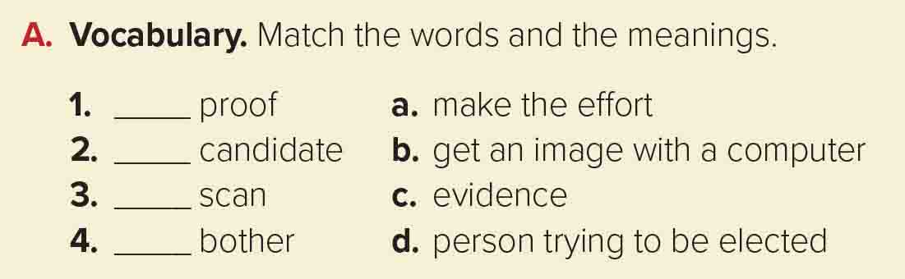

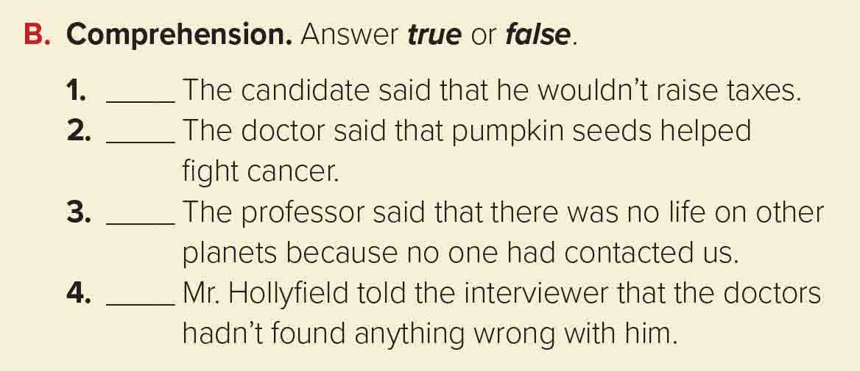
c
d
b
a
True
False
True
True

Slide 20

https://wordwall.net/resource/13640589

Slide 21
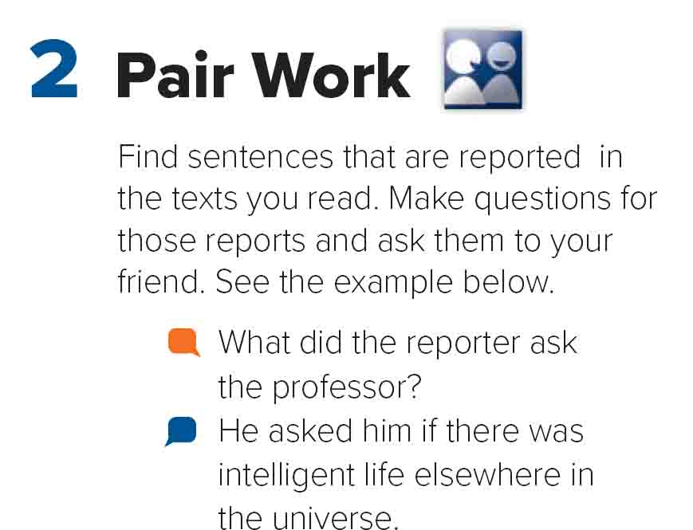


Slide 22
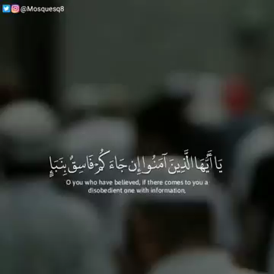


Slide 23

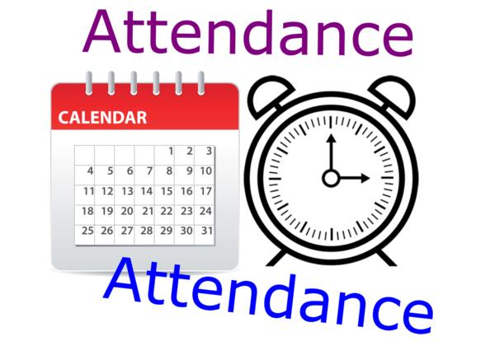
I love English

Slide 24



Homework
I love English
Work Book: Page 57

Slide 25

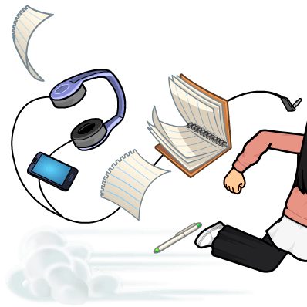
Homework
Work Book: Page 57

Slide 26
Homework
Work Book: Page 57

Slide 27
Homework
Work Book: Page 57

Slide 28
Homework
Work Book: Page 57

Slide 29
Homework
Work Book: Page 57

Slide 30

Homework
Work Book: Page 57

