Slide 1
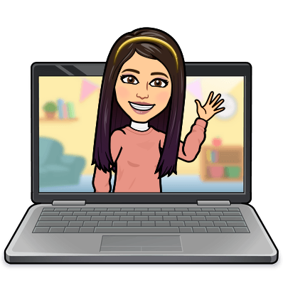

Hello My lovely students
I’m your teacher
Hanan AlShobaily

Slide 2
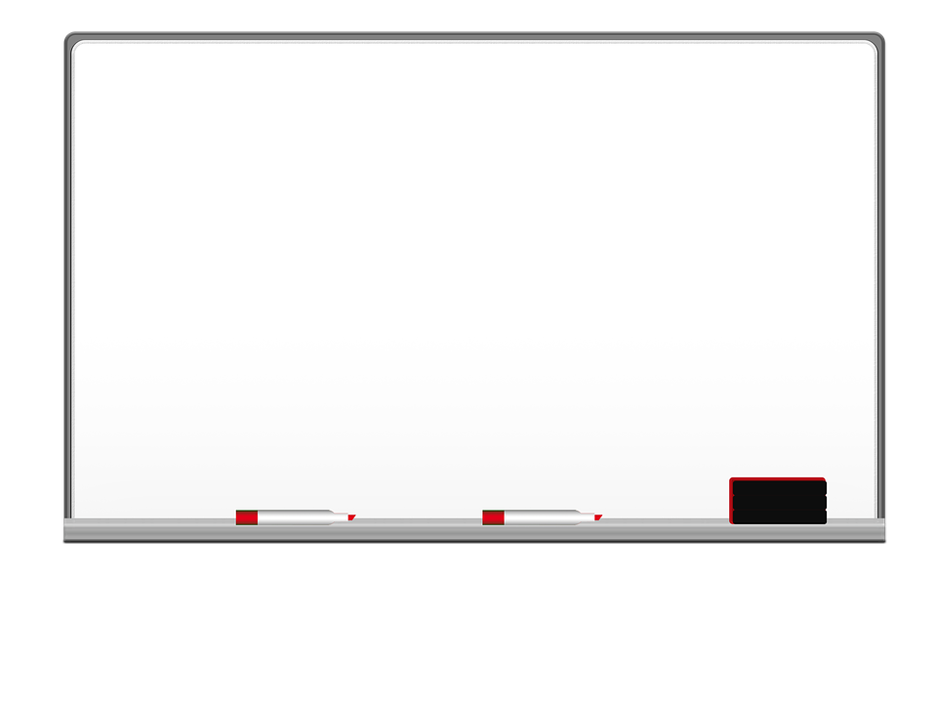

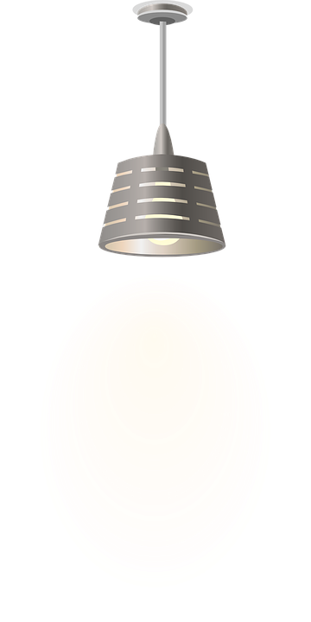

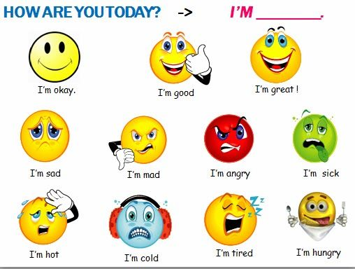
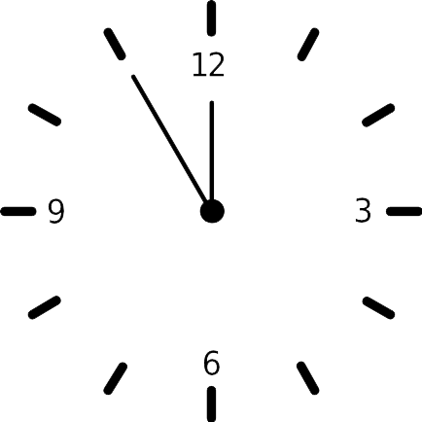



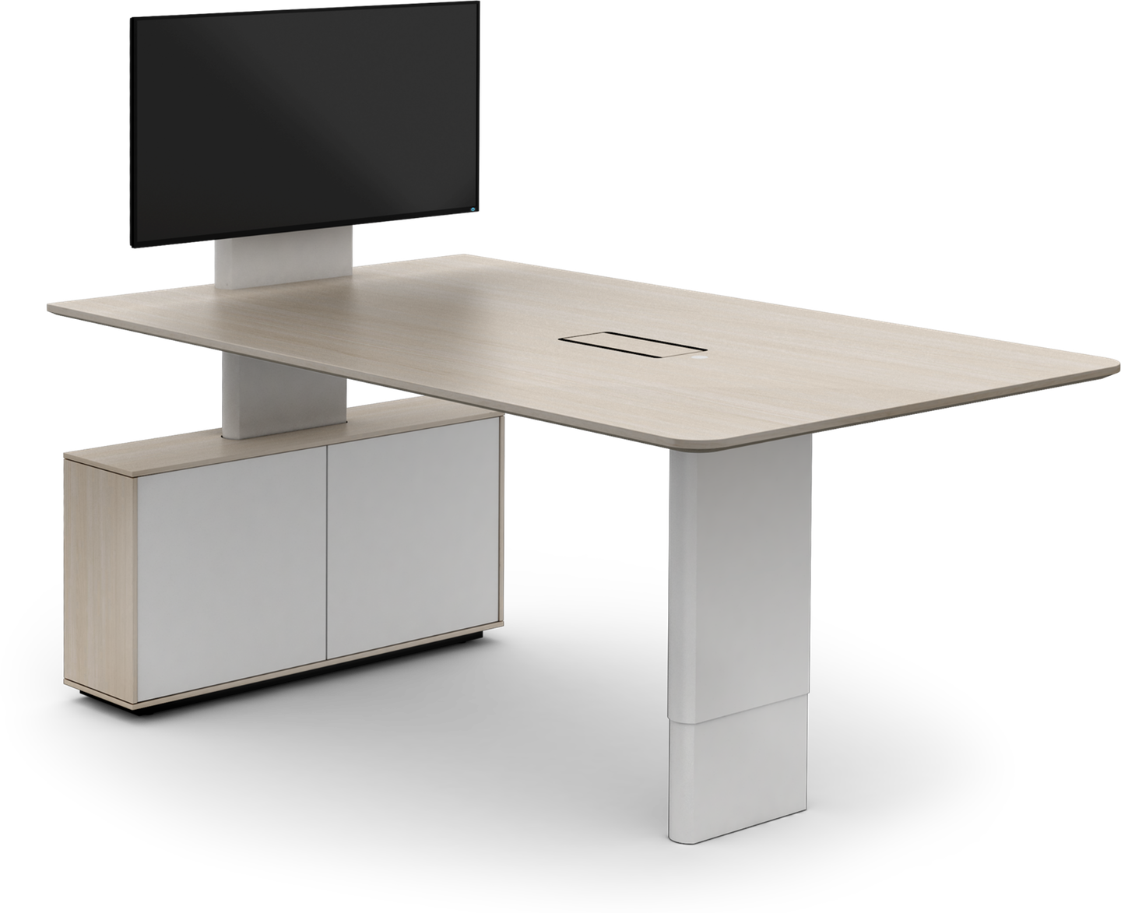
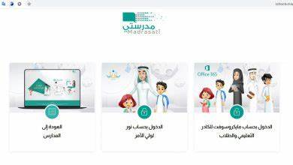




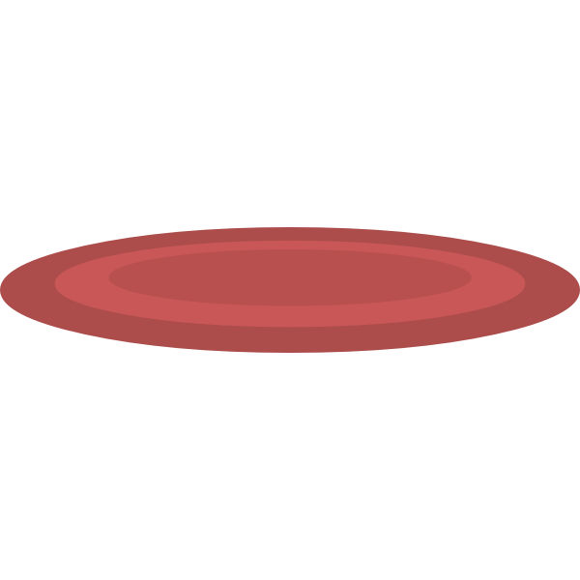


I love English

Slide 3
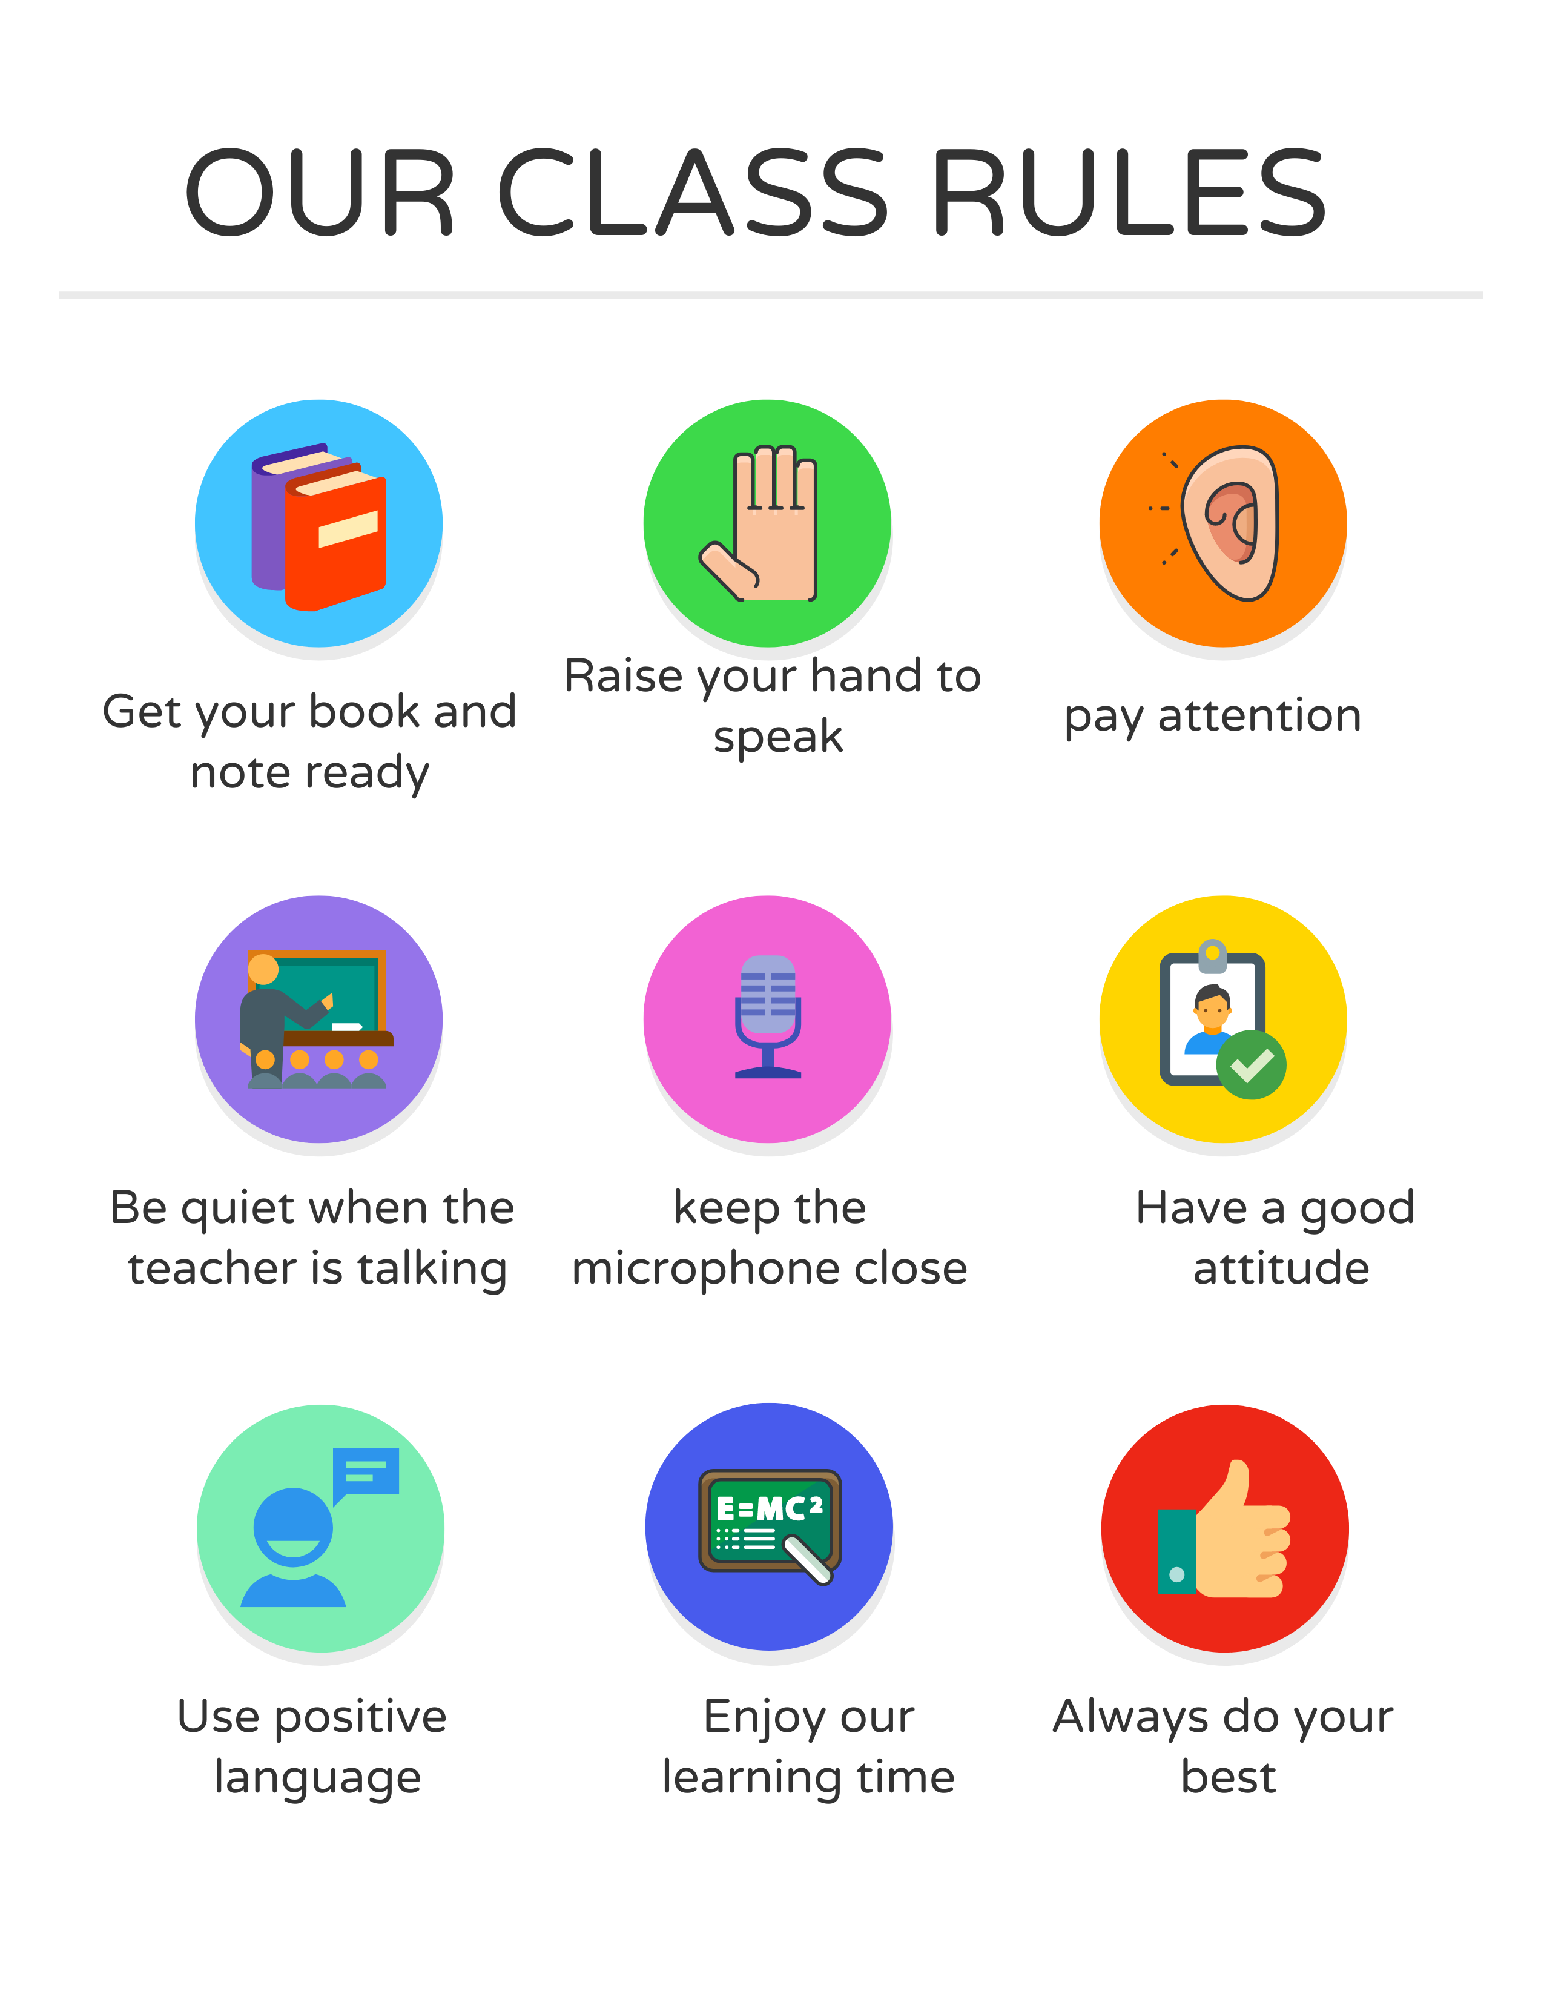
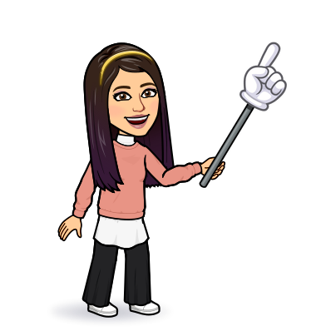
I love English

Slide 4

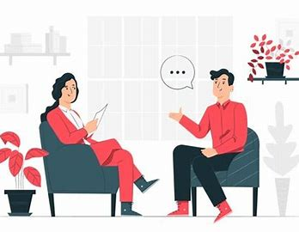


I love English
Mega Goal 2
Unit 6
(What They Said)
Writing
Wednesday
25/8/1442

Slide 5

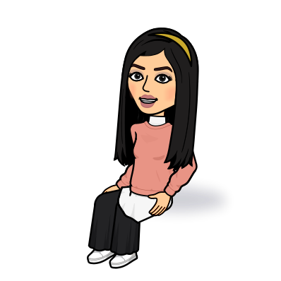
I love English
Lesson Objectives
Students will be able to:
Find answers to comprehension questions in the article.
Talk about feelings.
Indicate the problem mentioned in the article.
Analyze the text into its main elements.
Describe a location in an email.

Slide 6
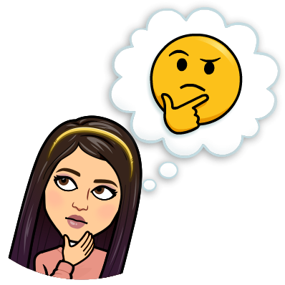
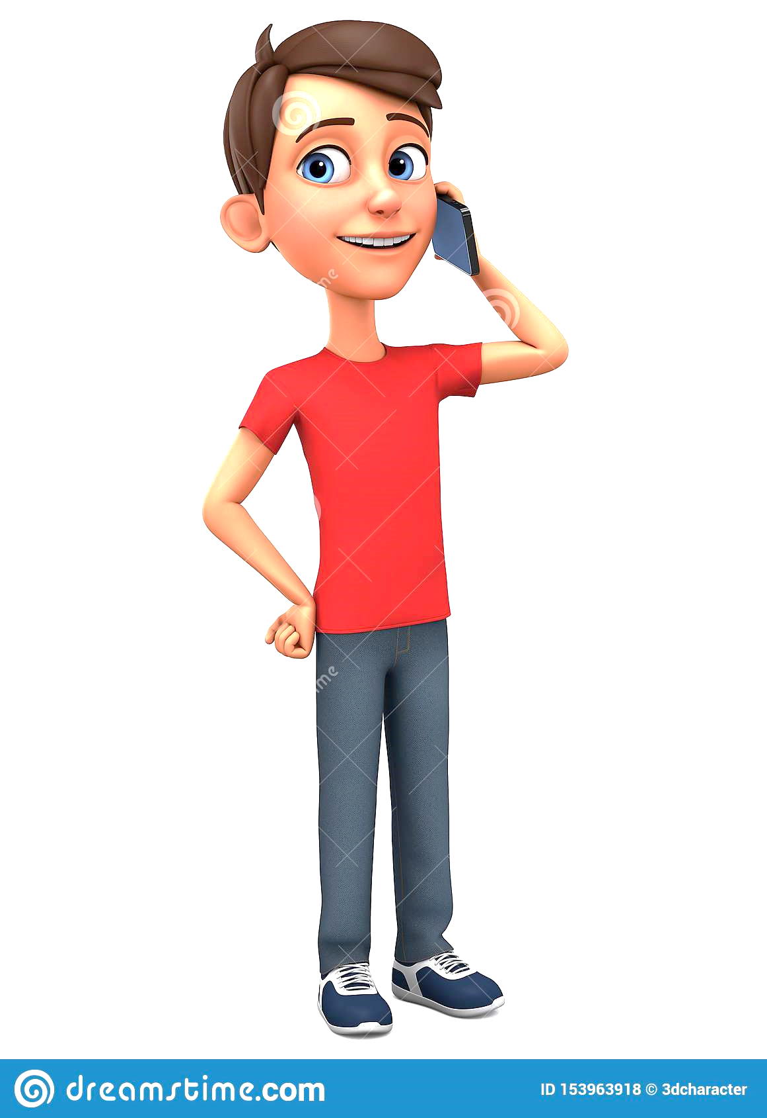
Warm Up
What do you think he is talking about?
vacation
jobs
emergencies
arrangements

Slide 7
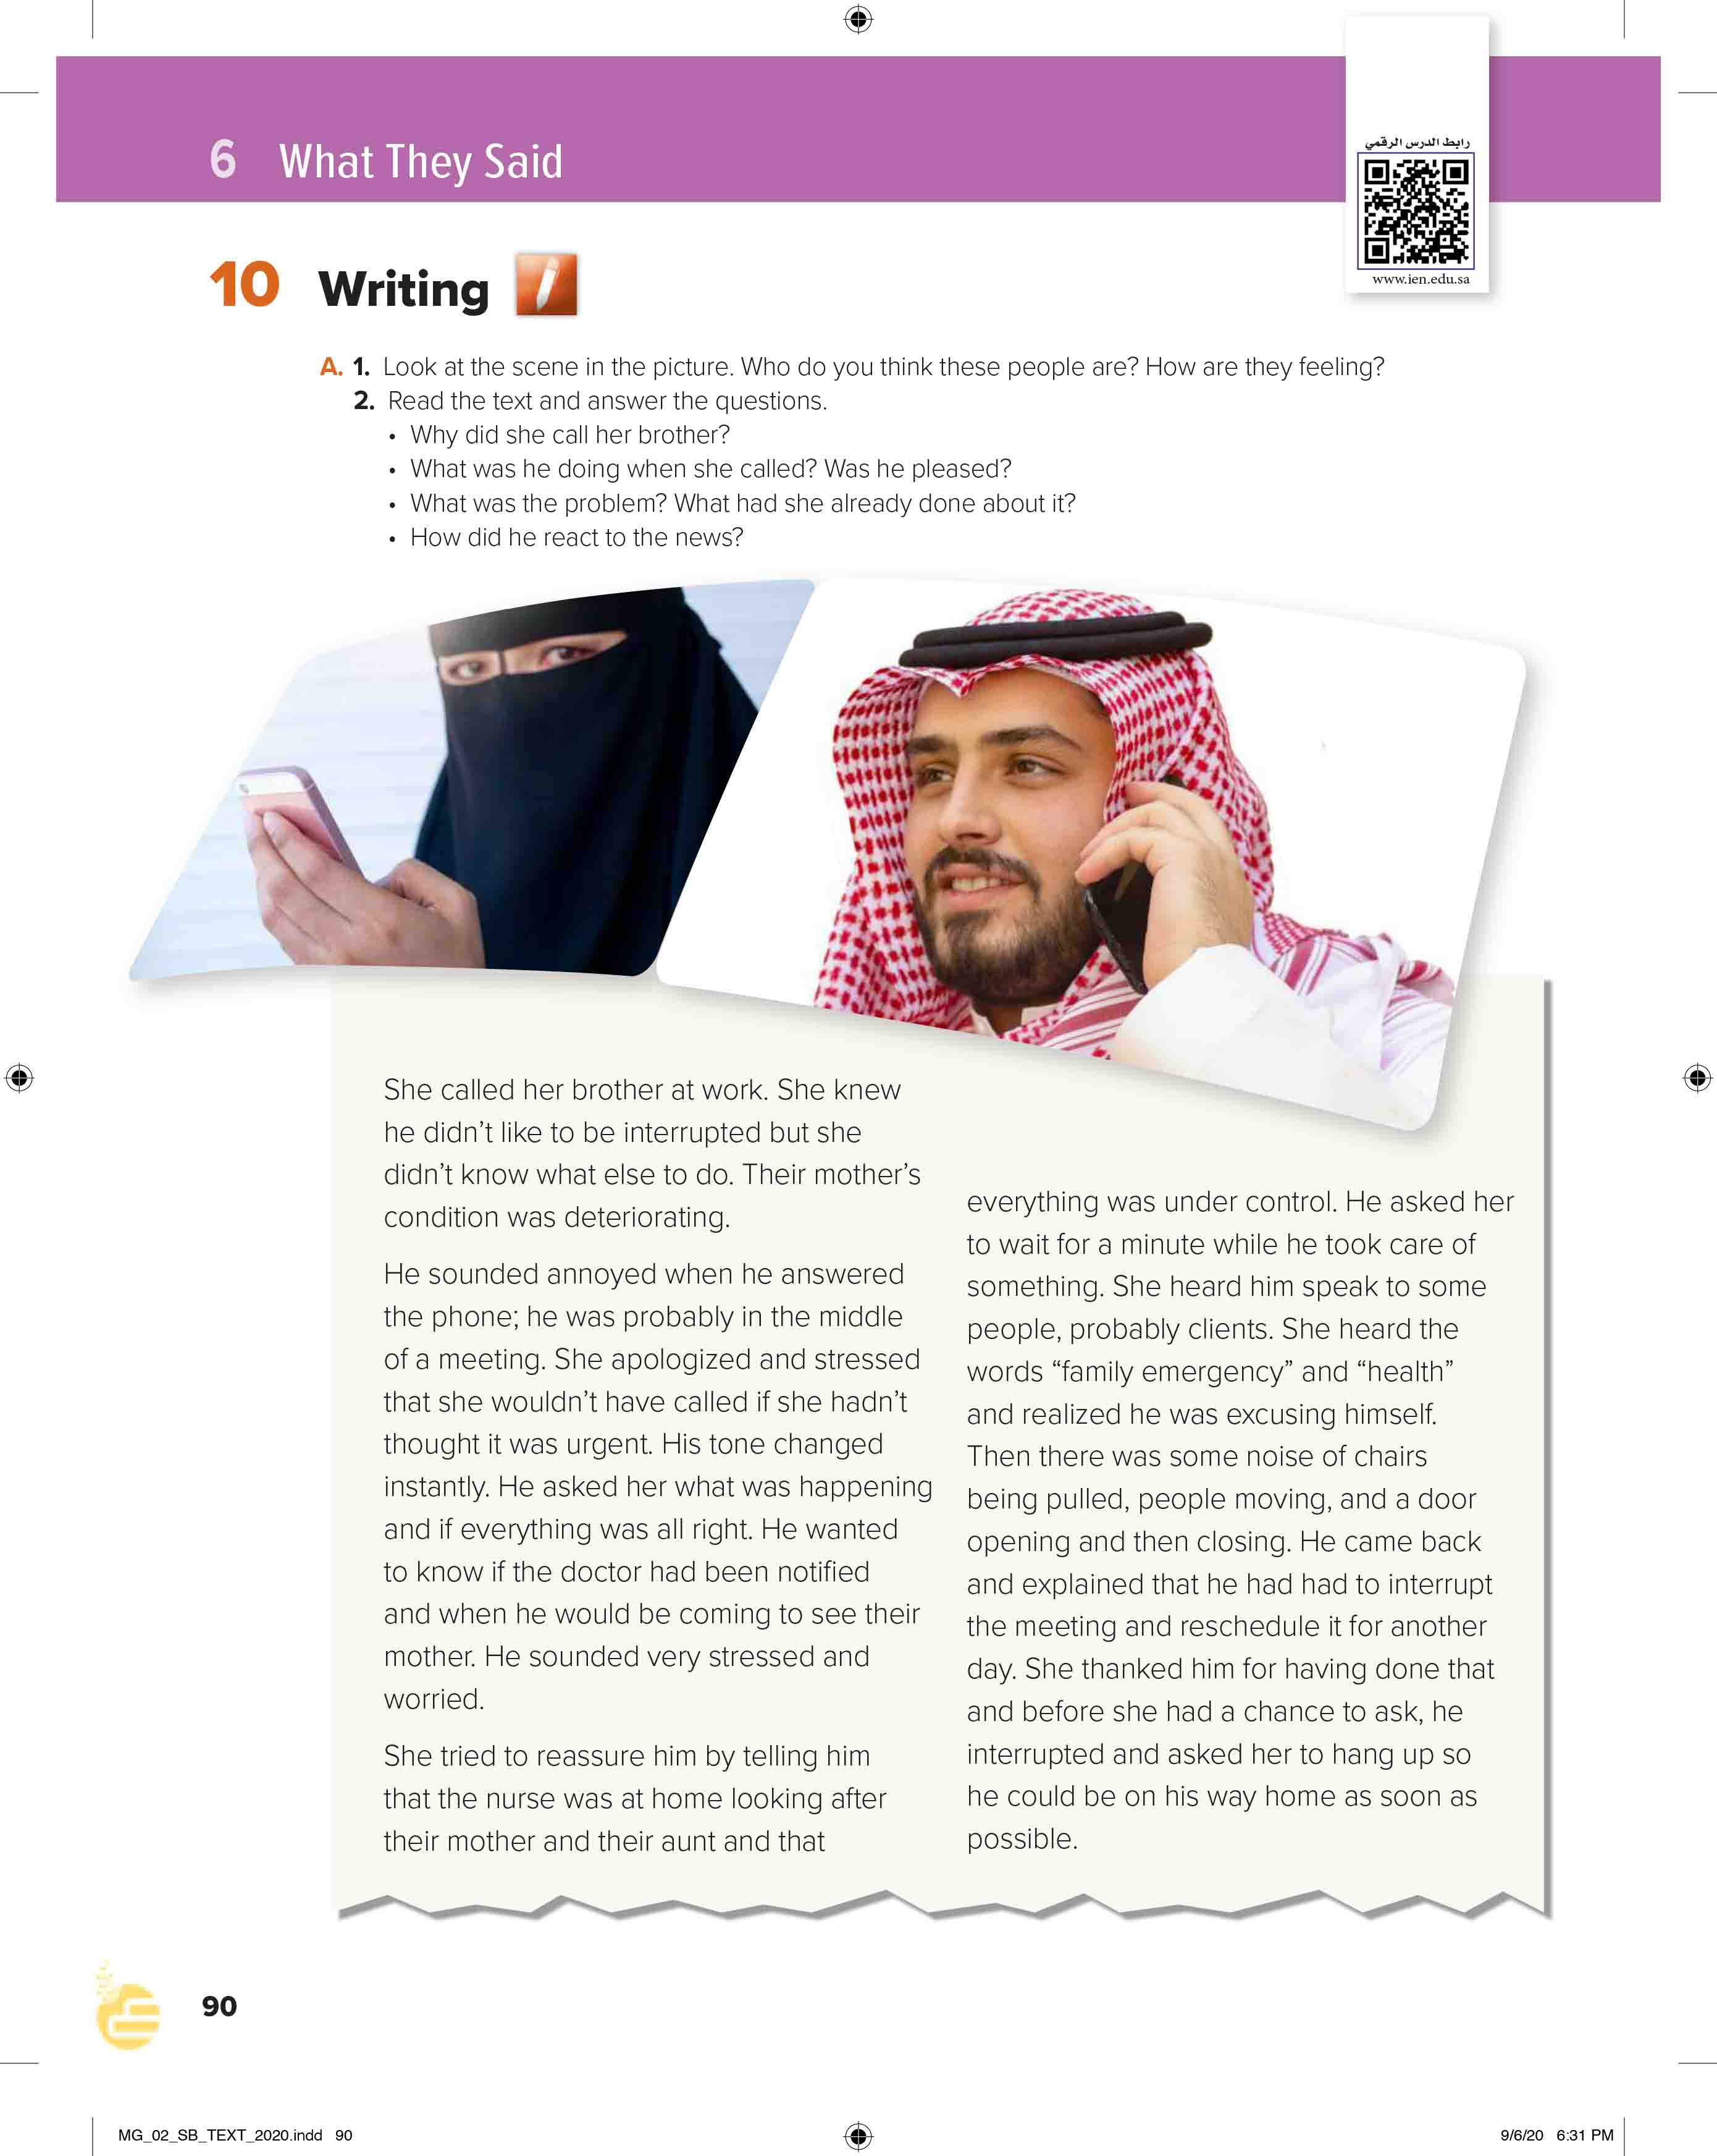
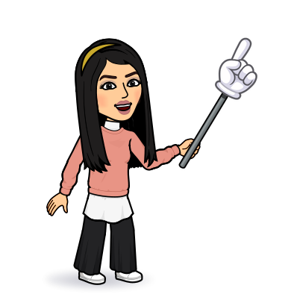
I love English
Open your Student’s book page: 90

Slide 8

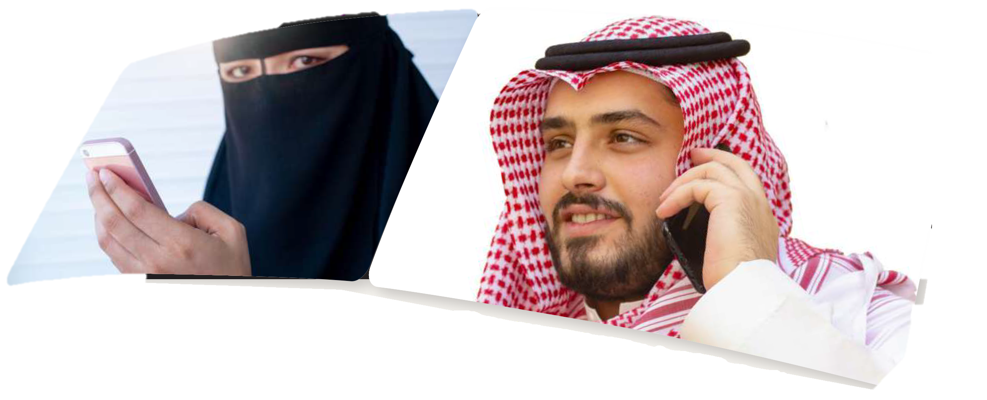

Slide 9
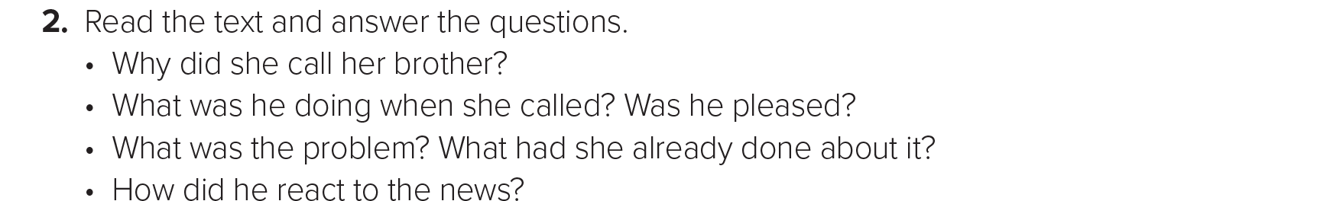
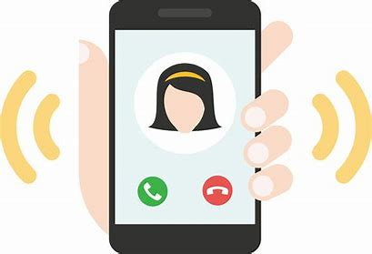

Slide 10

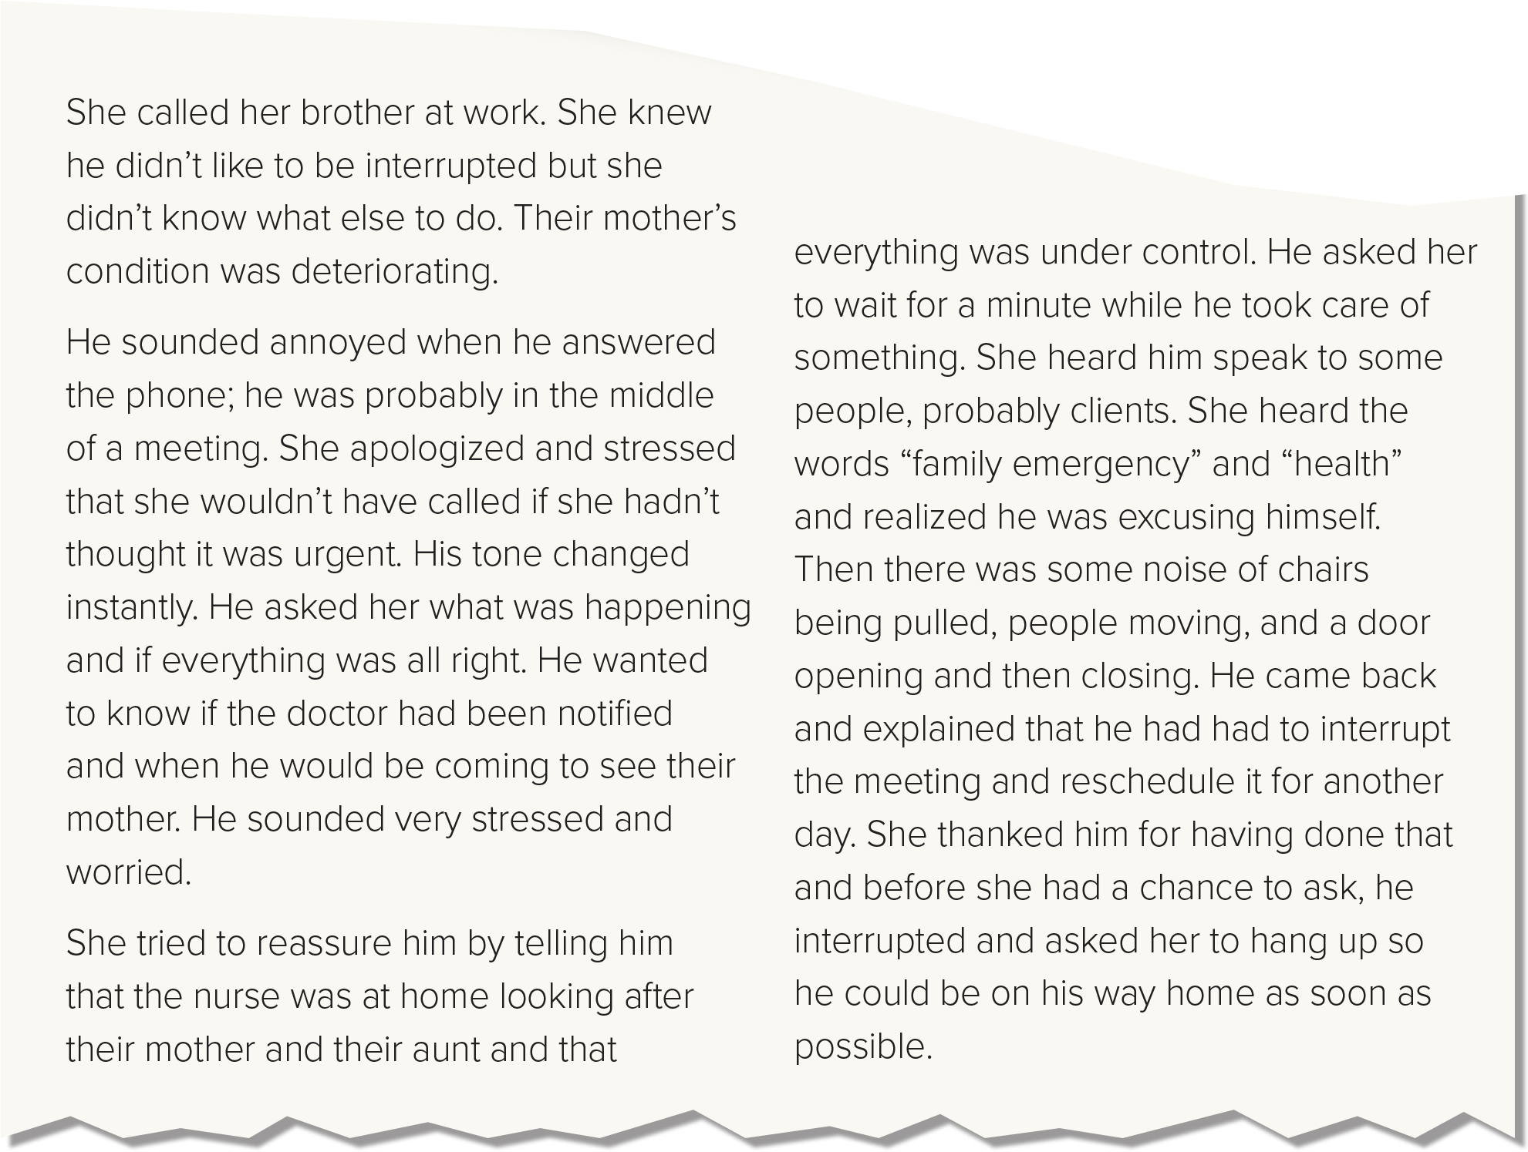

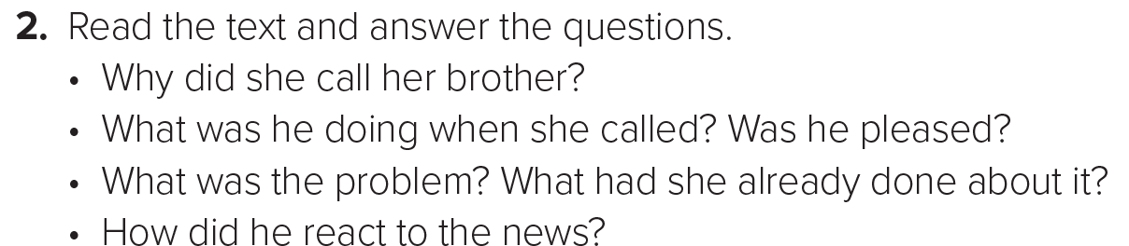
Because their mother’s condition was deteriorating.
He was in the middle of a meeting.
No, he wasn’t. He was annoyed.
Their mother was sick. She called the nurse and the nurse was at home looking after their mother and their aunt and that everything was under control.
He rescheduled the meeting for another day and went back home to see his mother.

Slide 11
Read and analyze the sentences
Strong adjectives
Verb tenses
Describe the events clearly
Describing in details what we smell, hear and feel

Slide 12
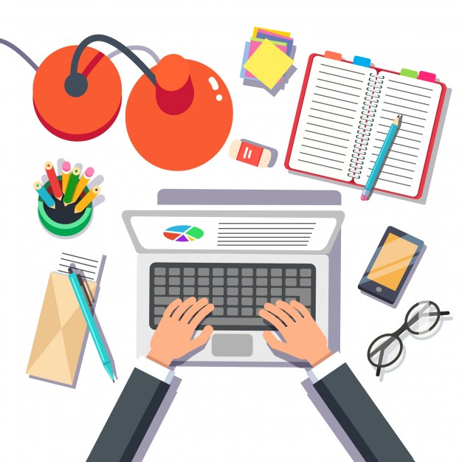
How to report an event?
Organize your event (order of incidents)
Putting the right content in your writing
Use strong adjectives and correct tenses

Slide 13
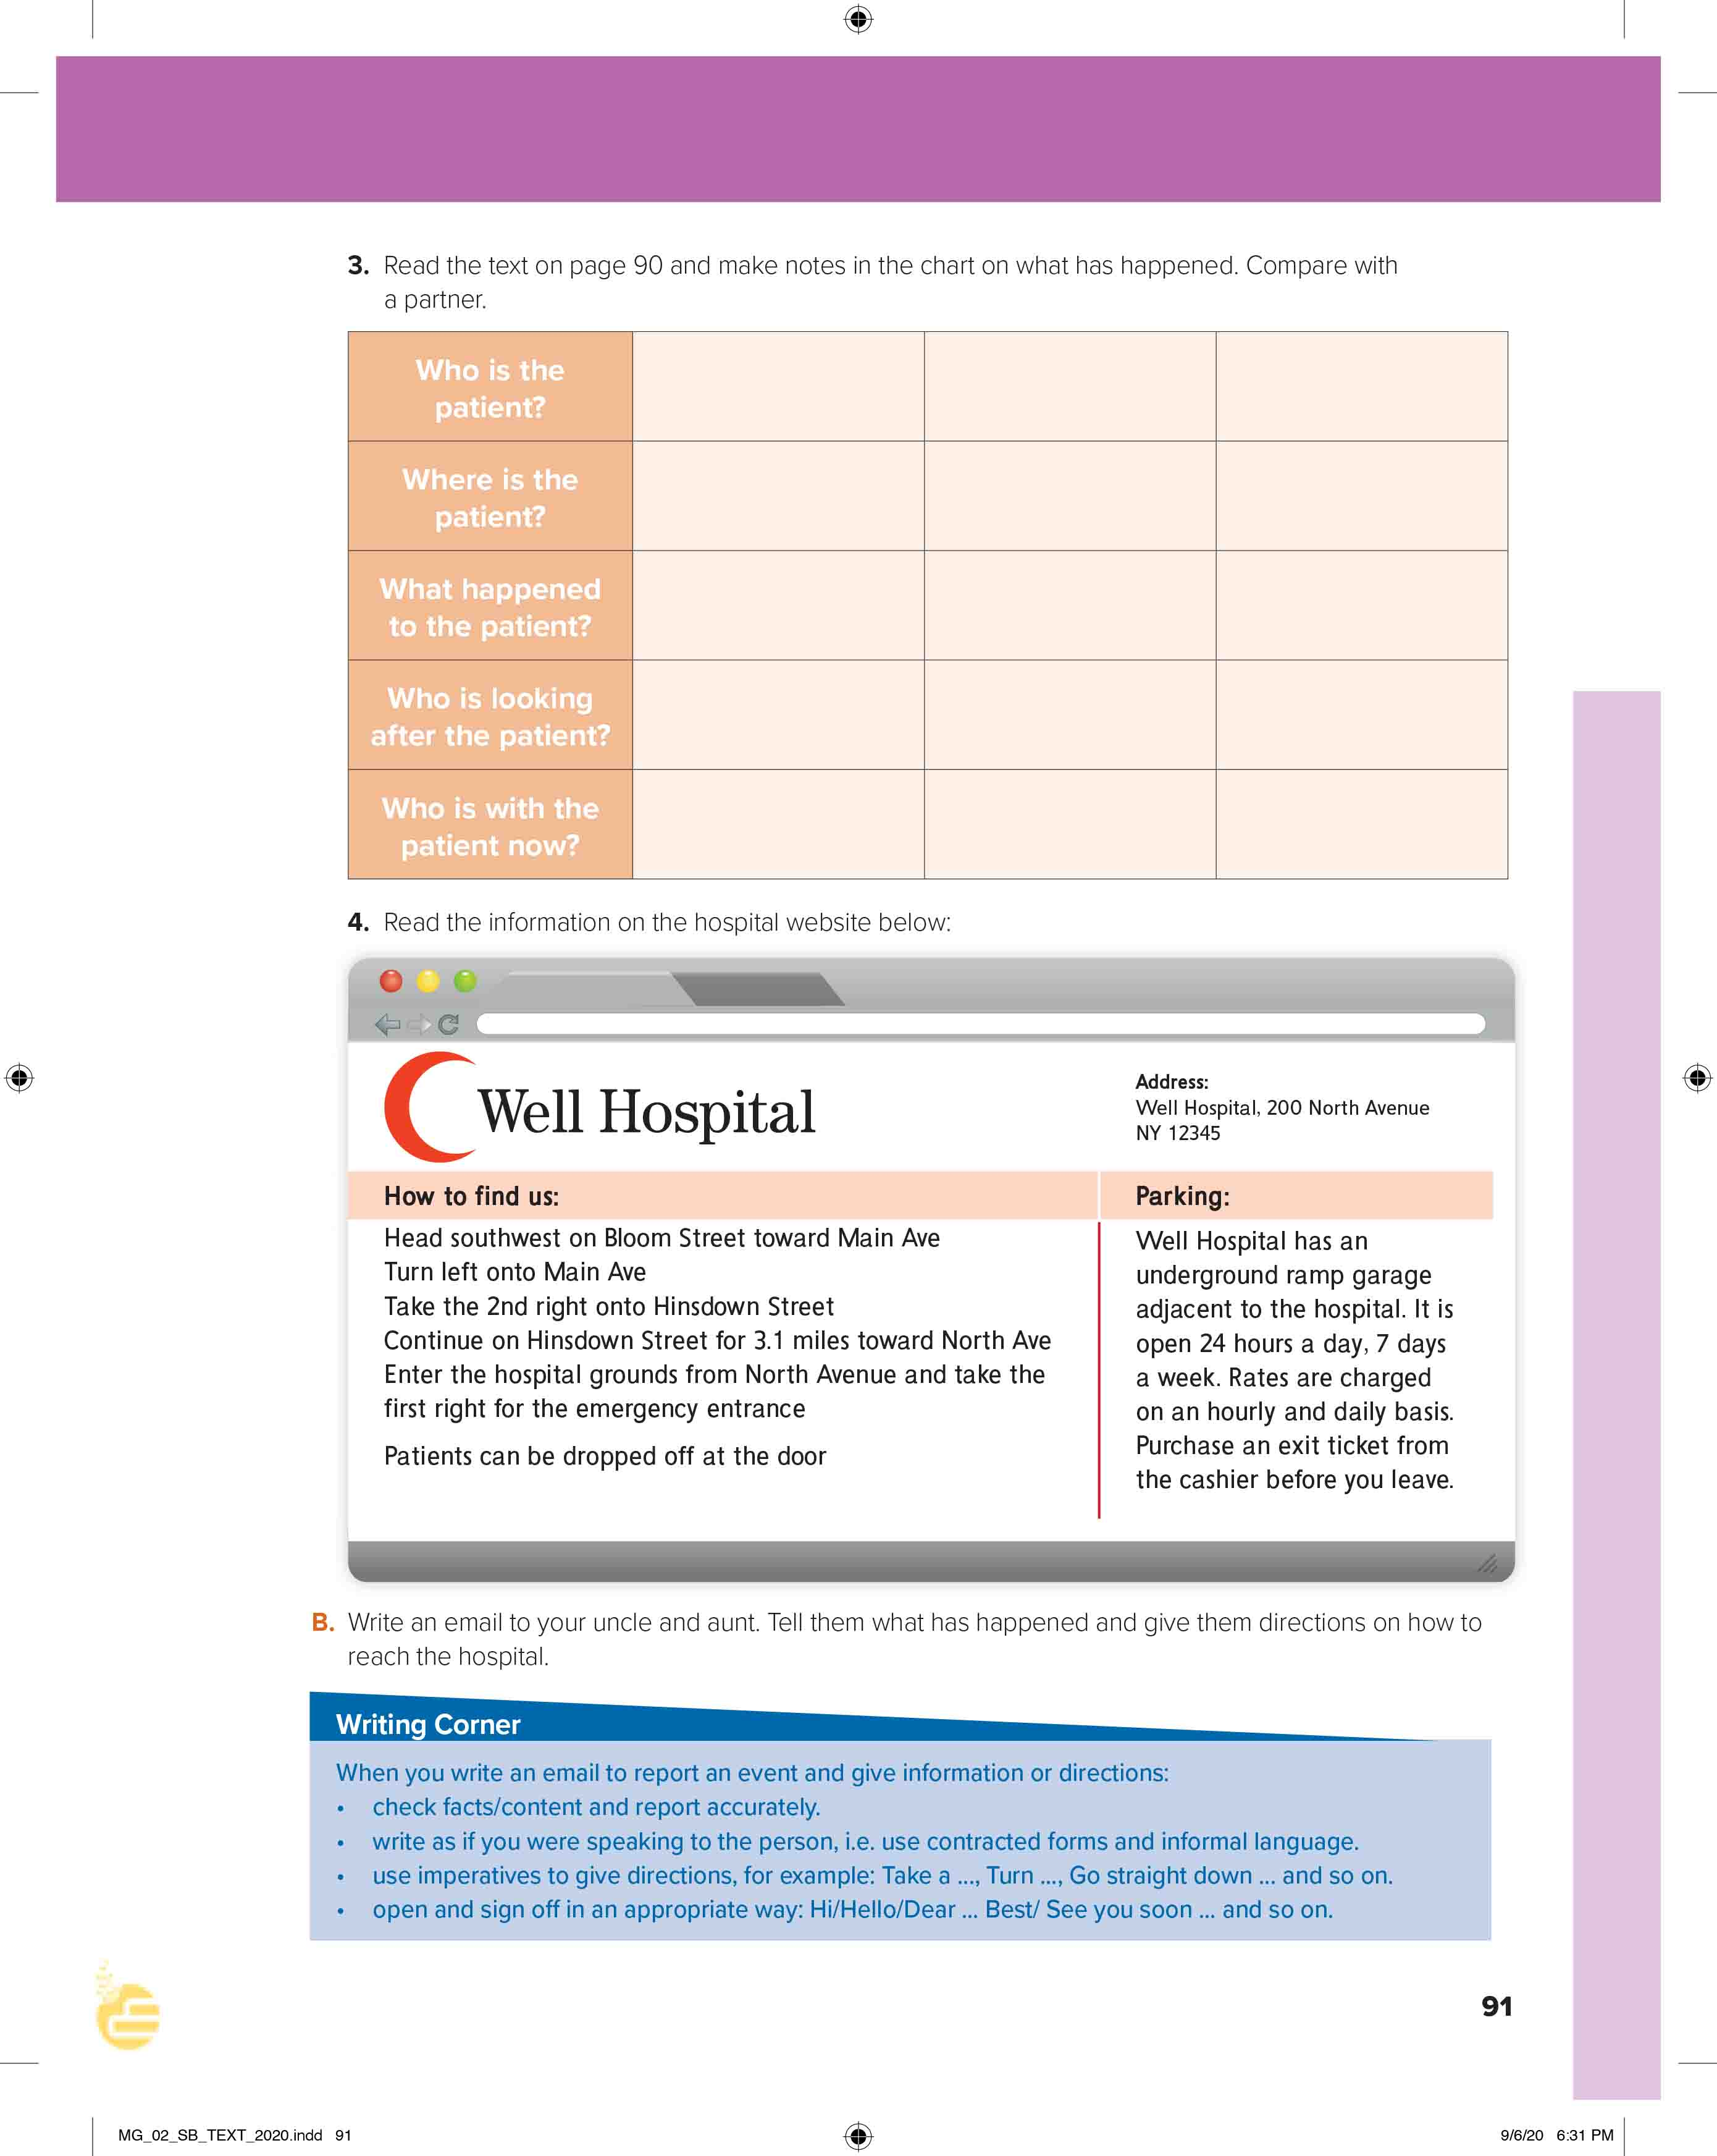
I love English
Open your Student’s book page: 91

Slide 14
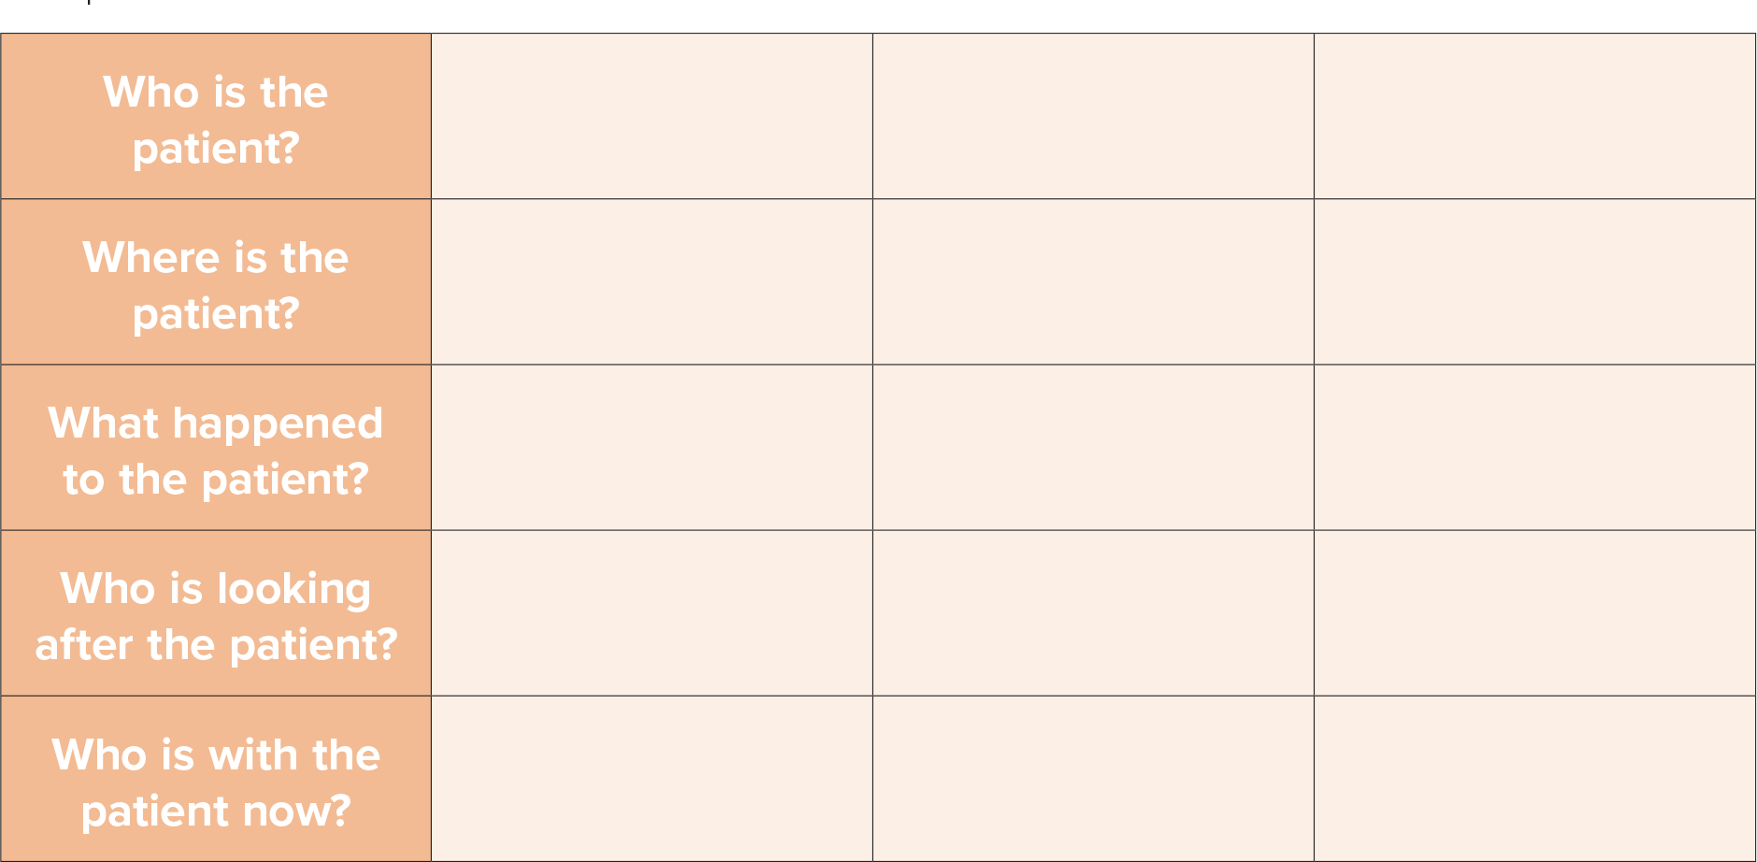
The mother
At home
Her condition was deteriorating
The nurse
The daughter and the aunt

Slide 15


https://wordwall.net/resource/13886935

Slide 16
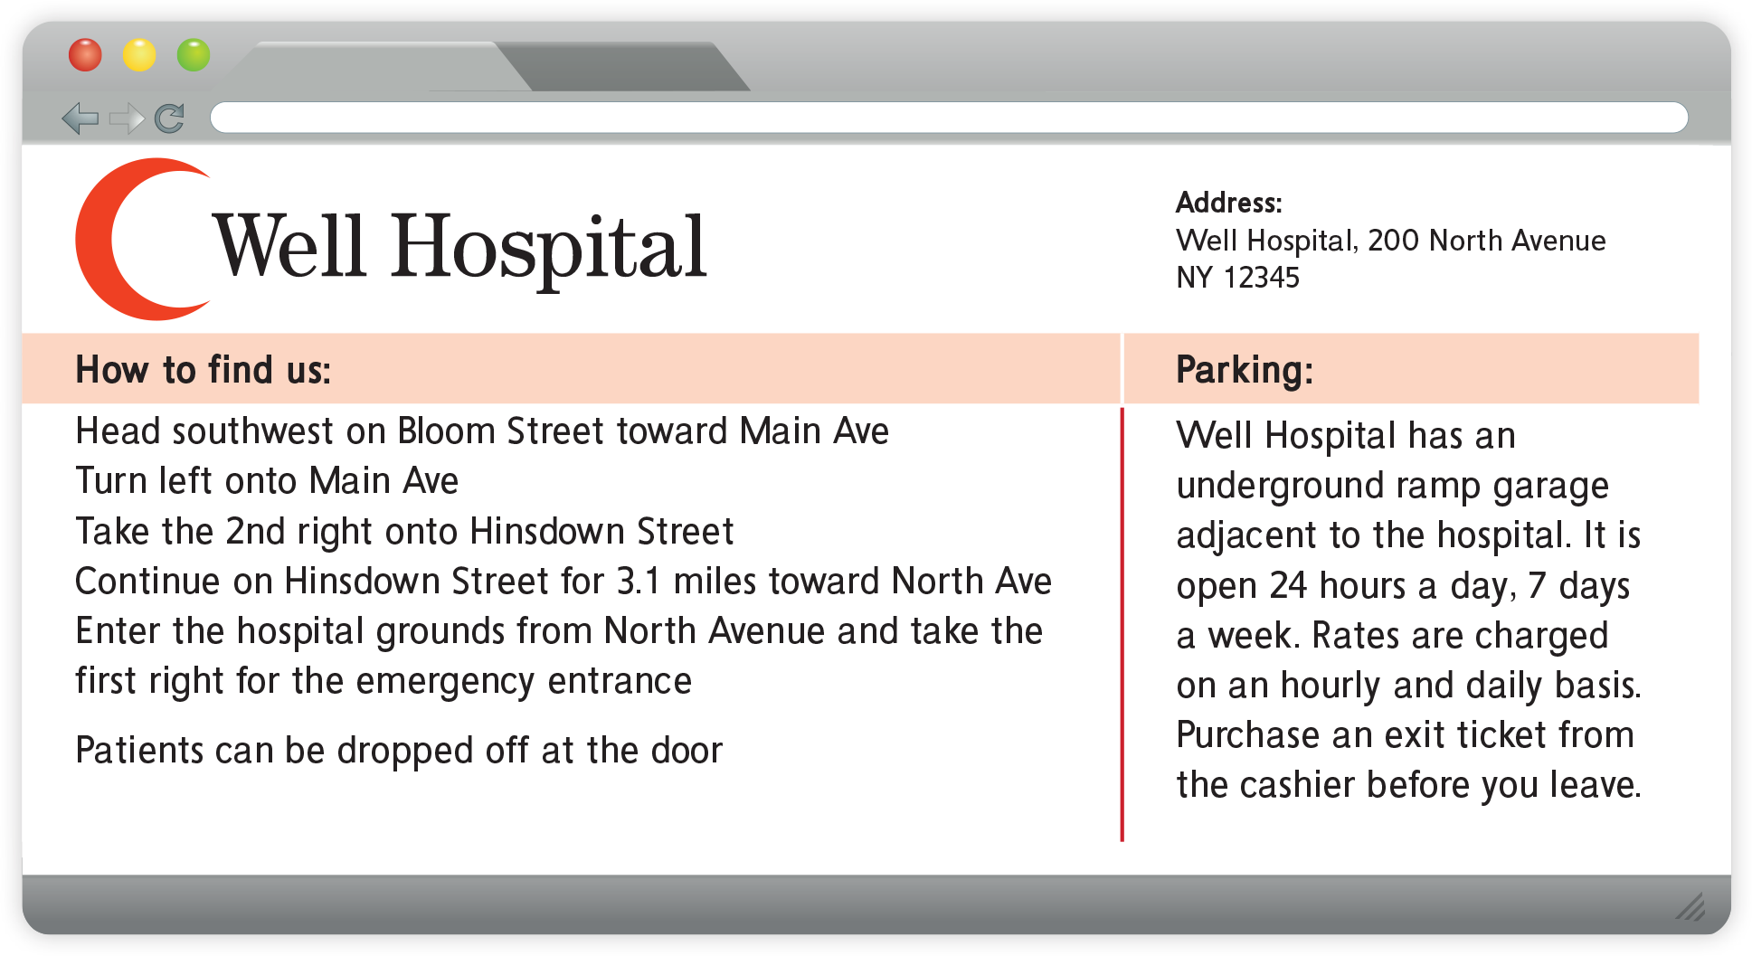
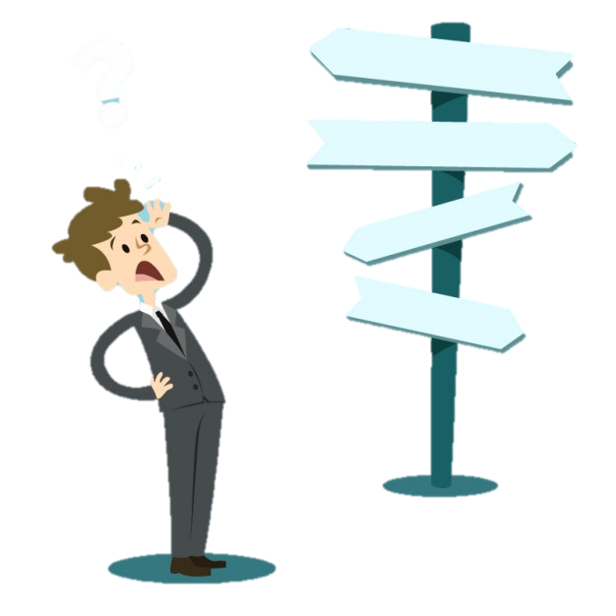
How to give directions?
?

Slide 17
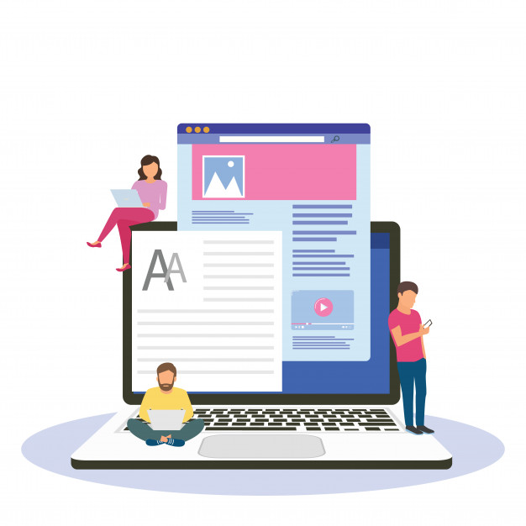
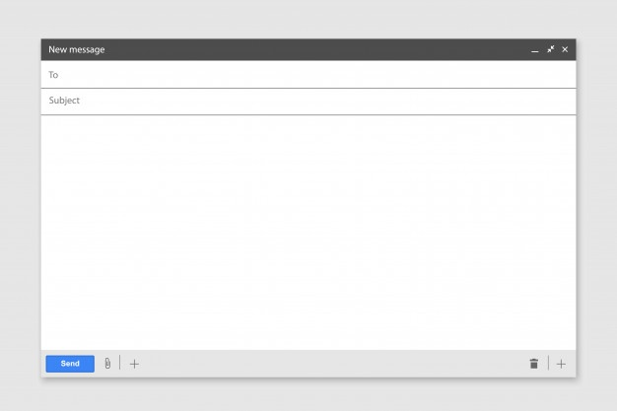
Your email should look like this
Opening
Dear ,………………………
Paragraph1
Report the event
Paragraph2
Give directions to the hospital
Sign off
See you soon

Slide 18
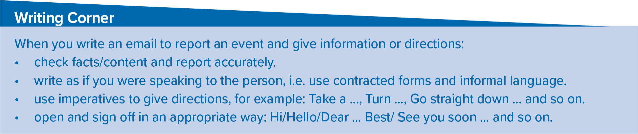

Slide 19

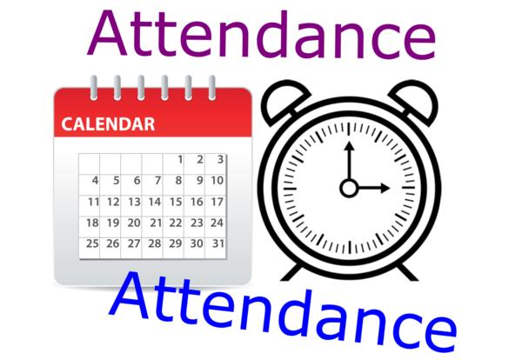
I love English

Slide 20



Homework
I love English
Work Book: Page 64

Slide 21
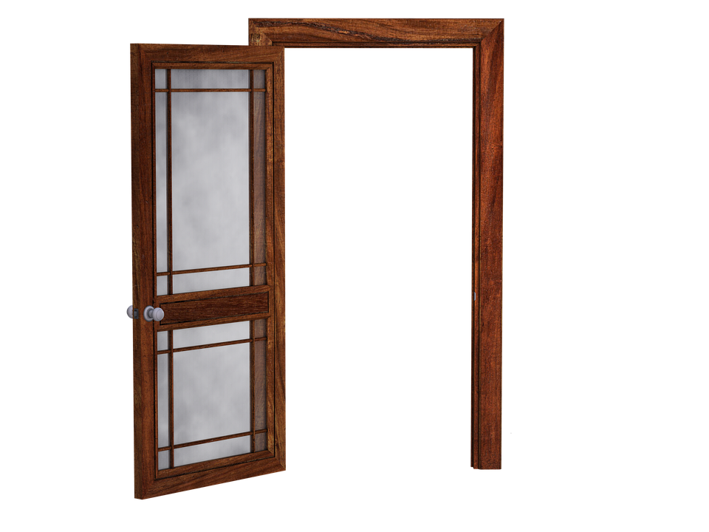
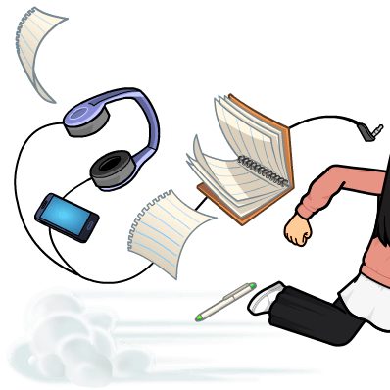
Homework
Work Book: Page 64

Slide 22
Homework
Work Book: Page 64

Slide 23
Homework
Work Book: Page 64

Slide 24
Homework
Work Book: Page 64

Slide 25
Homework
Work Book: Page 64

Slide 26

Homework
Work Book: Page 64

