Slide 1


Hello My lovely students
I’m your teacher
Hanan AlShobaily

Slide 2




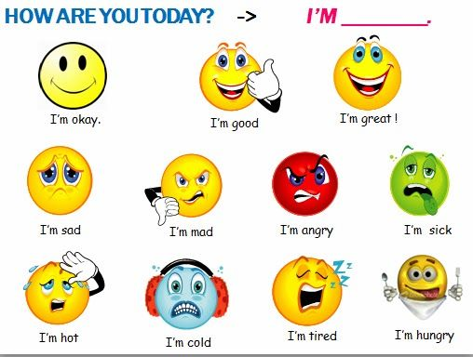




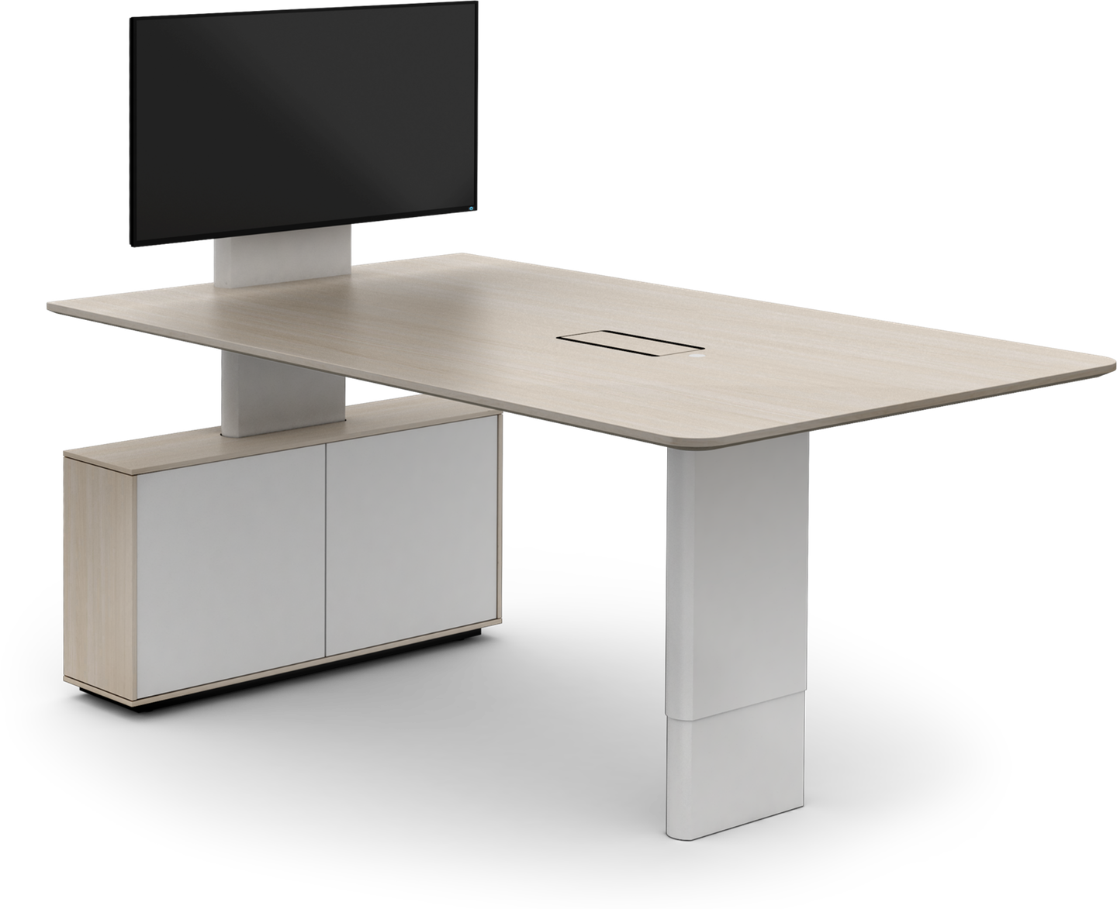
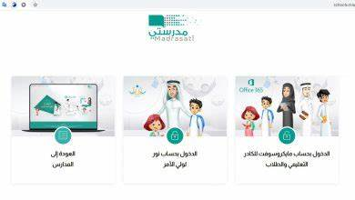







I love English

Slide 3


I love English

Slide 4


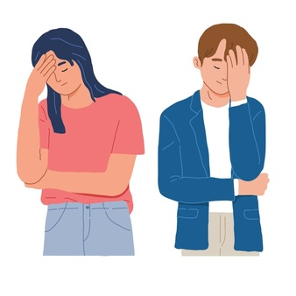


I love English
Mega Goal 2
Unit 5
(If It Hadn’t Happened)
Listen and Discuss
Sunday
8/8/1442

Slide 5


I love English
Lesson Objectives
Students will be able to:
discuss the top inventions.
give a reason for a good invention.
decide a life regret according to a list.
ask about a life regret.
use new expressions.
imagine the result of going back in the time to correct a mistake.

Slide 6



Warm Up
What’s the different between invention and discovery?
Invention
Creating something totally new with one’s own ideas.
Discovery
Recognizing something for the first time that already exist.
Something that is found.

Slide 7



Let’s start with a game
https://wordwall.net/resource/12982497

Slide 8
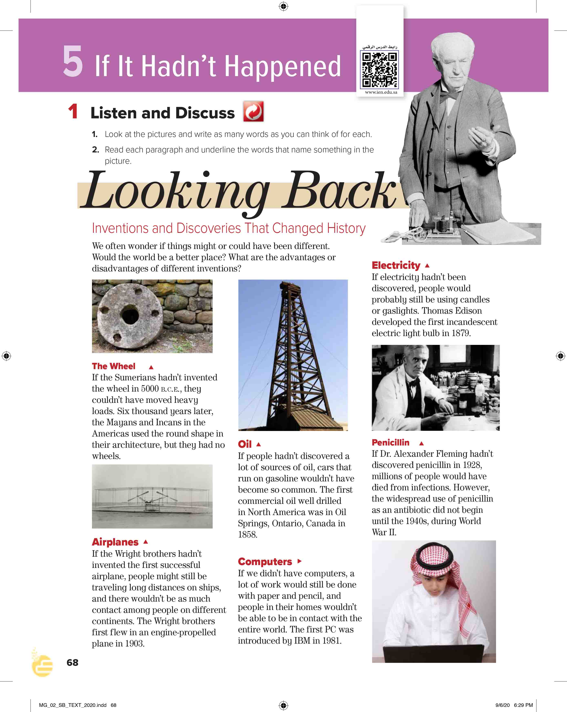

I love English
Open your Student’s book page: 68

Slide 9
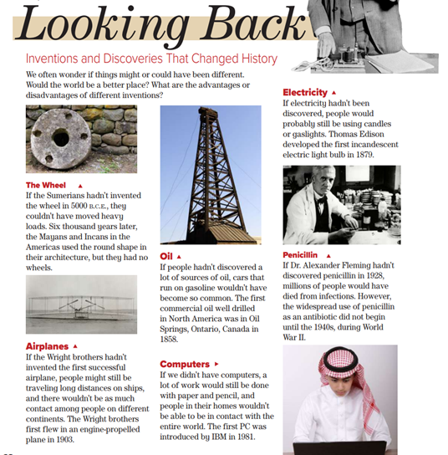
What’s the title?
How many subtitles are there?
How many pictures?
What do the pictures show?

Slide 10

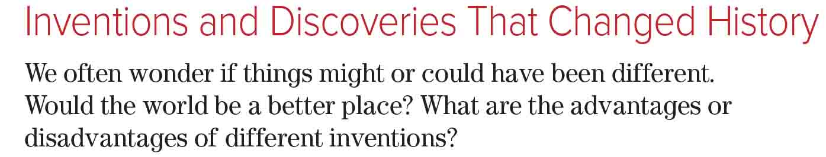

Slide 11

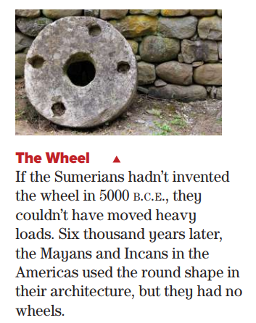


What can you see in this picture?
Is it invention or discovery?
Who invented the wheels?
When?
What could happen if the Sumerians hadn’t invented the wheels?
What shape did the Mayans and Incans use in their architecture?
Sumerians = a historical civilization lived in the southern part of Iraq.
B.C.E. = used after a date to show that it is before the birth of Christ

Slide 12
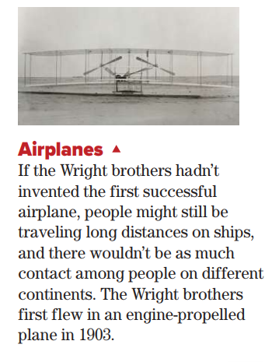
What can you see in this picture?
Is it invention or discovery?
Who invented the first successful airplane?
What might happen if the wright brothers hadn’t invented the first successful airplane?
When did the Wright brothers first fly?

Slide 13
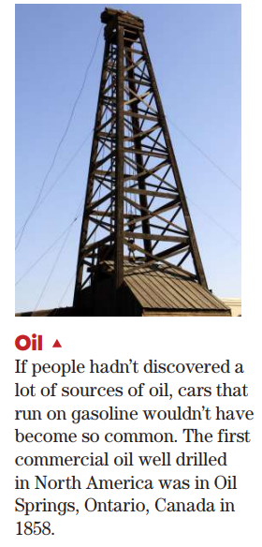
What can you see in this picture?
Is it invention or discovery?
What do we use oil for?
Factories, cars, machines and lots of things.
What would happen if people hadn’t discovered oil?
Where did the first commercial oil drill in North America?
When?

Slide 14


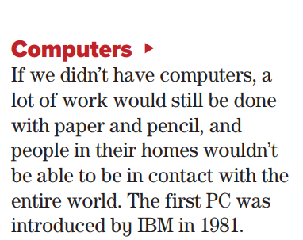
What can you see in this picture?
Is it invention or discovery?
What do we use computer for?
Doing our work, learning, surfing the net and send messages.
What would happen if they hadn’t invented computers?
When was the first PC introduced?
PC = Personal Computer
IBM = International Business Machines

Slide 15
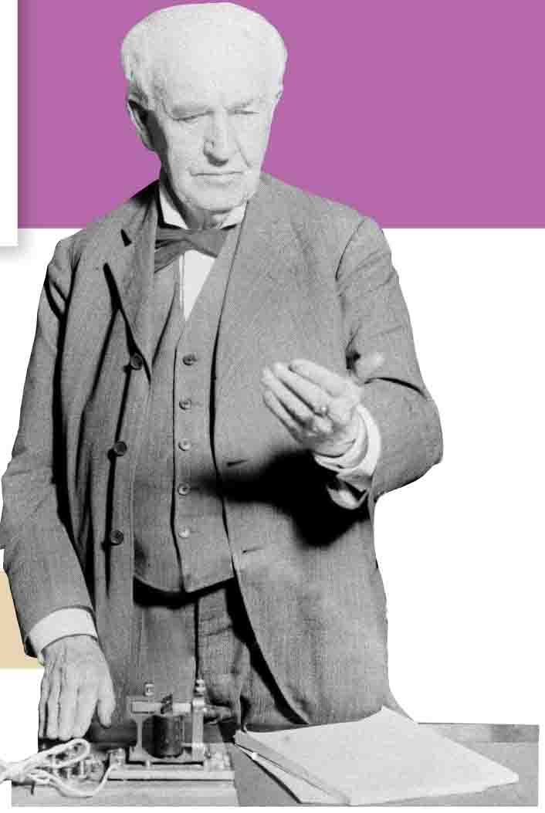
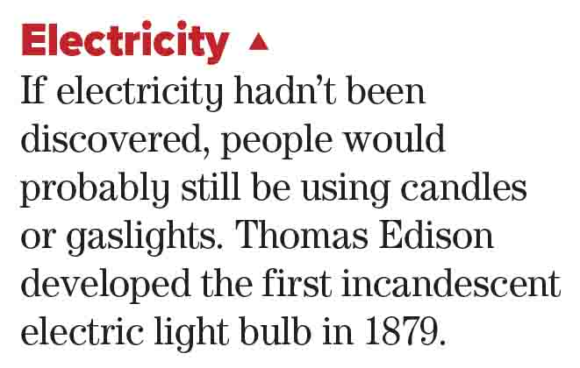
What can you see in this picture?
Who is he?
What does this paragraph about?
Is it invention or discovery?
What would happen if electricity hadn’t been discovered?
What did Thomas Edison develop?
When?

Slide 16
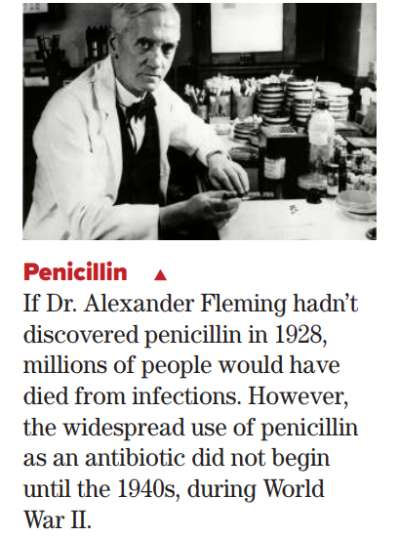
What can you see in this picture?
Who is he?
What did he discover?
When?
What would happen if he hadn’t discovered penicillin?
When did the widespread use of penicillin as an antibiotic begin?

Slide 17

https://wordwall.net/resource/12696875

Slide 18
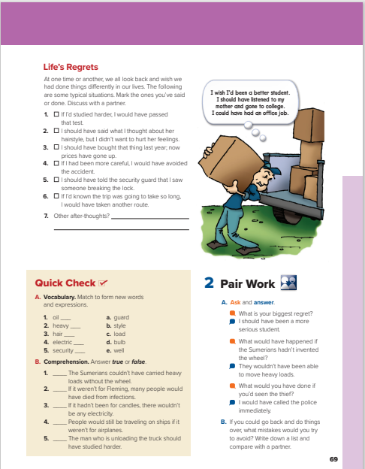
I love English
Open your Student’s book page: 69

Slide 19
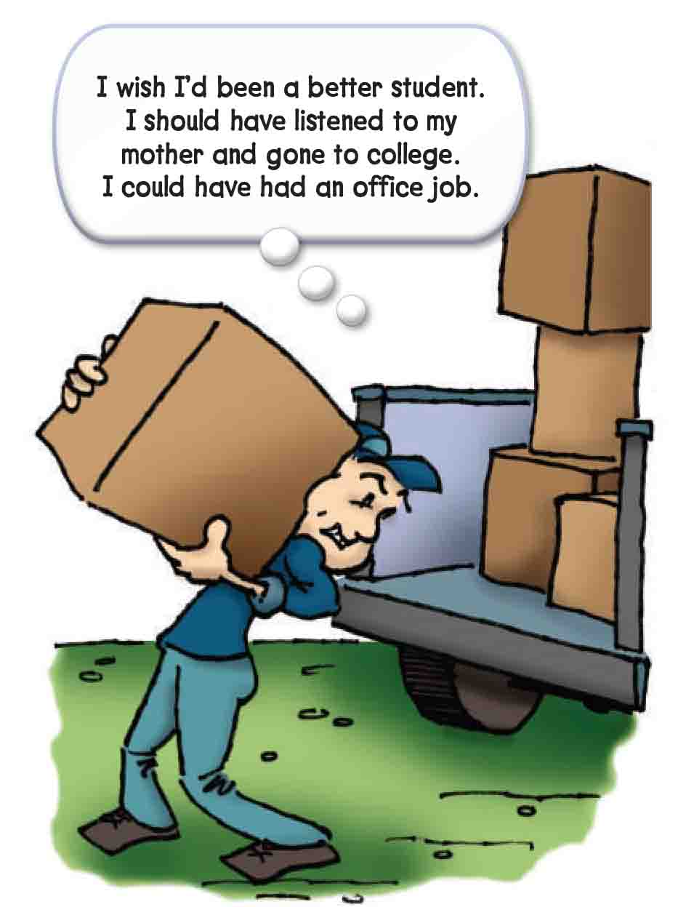
What can you see in this picture?
What’s wrong with this guy?
Is he happy?
What does he show?
Regret
What does he regret?

Slide 20
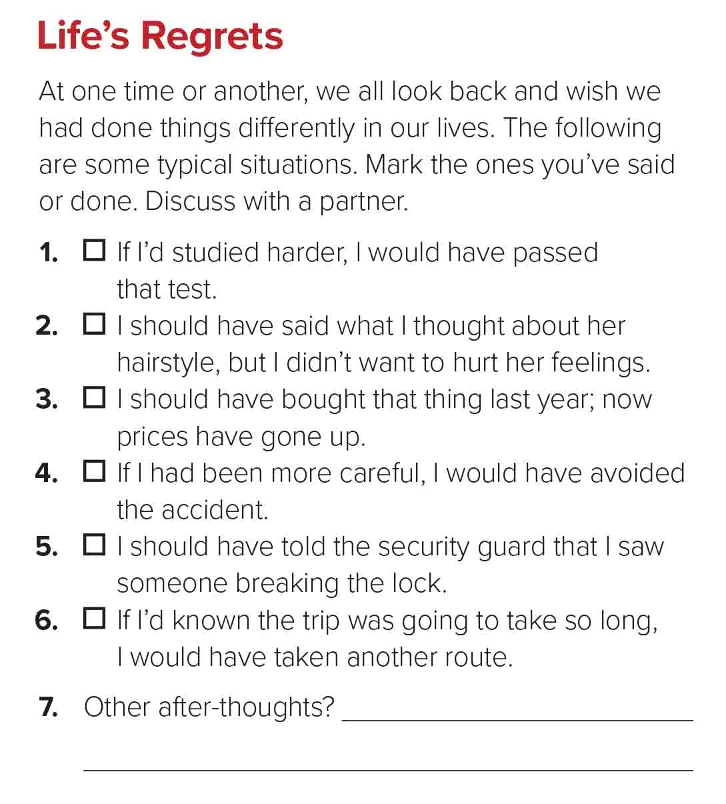


Slide 21

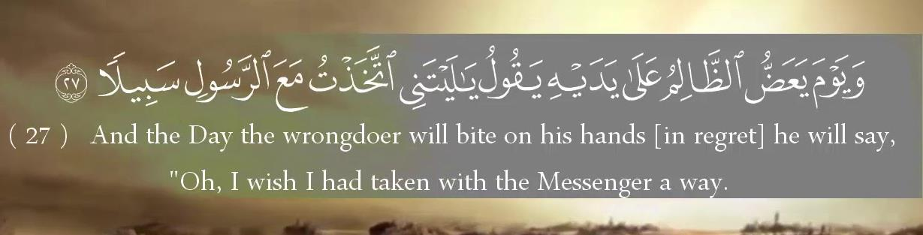
“Regret” in Quran

Slide 22

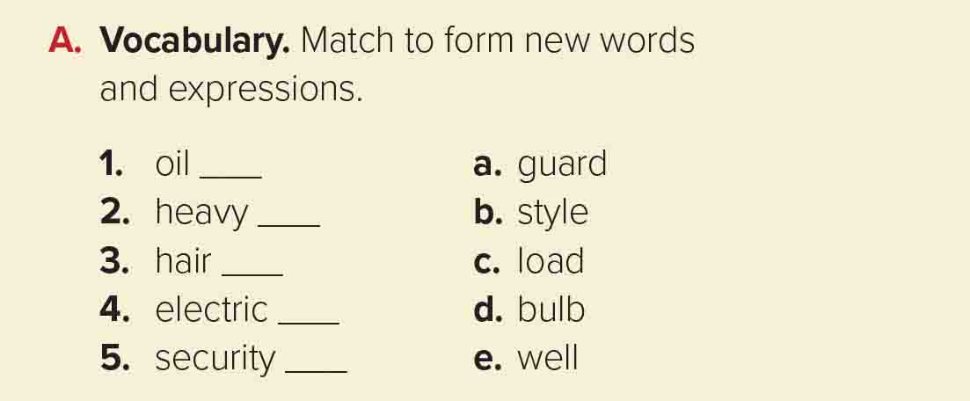

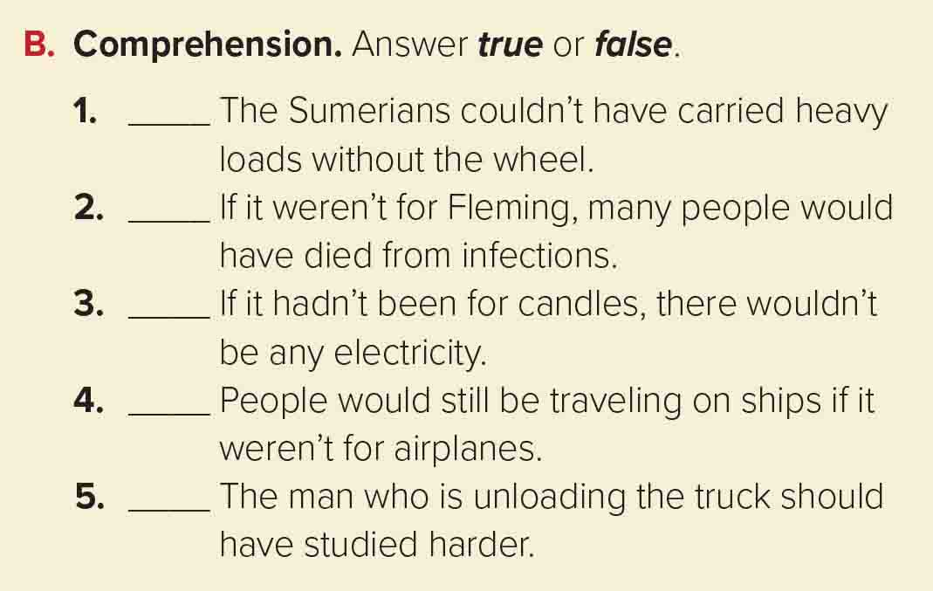
e
c
b
d
a
T
T
F
T
T

Slide 23

https://wordwall.net/resource/12693659

Slide 24
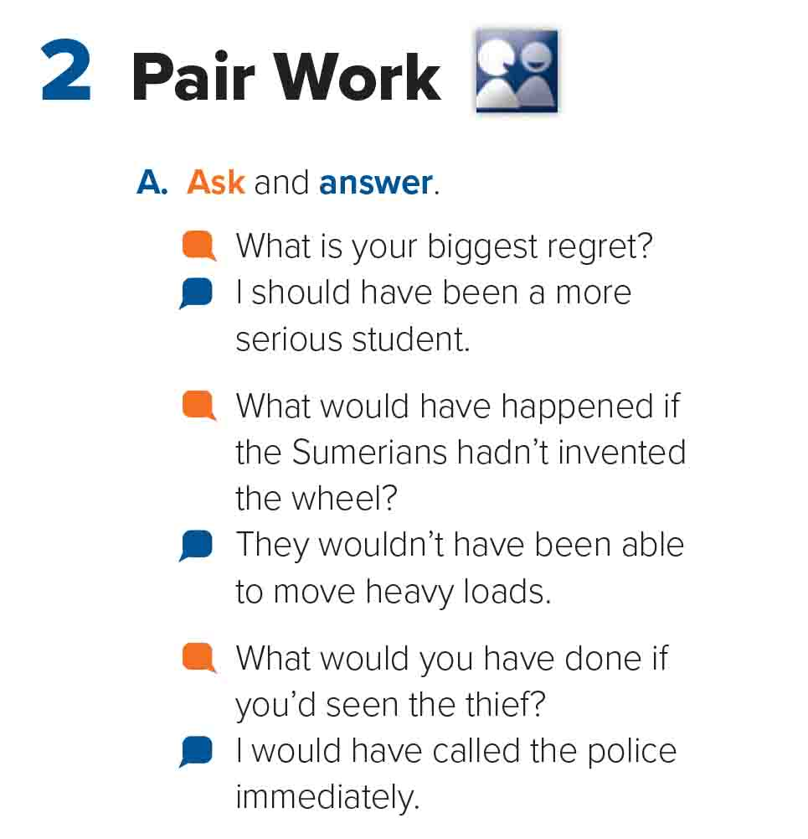


Slide 25
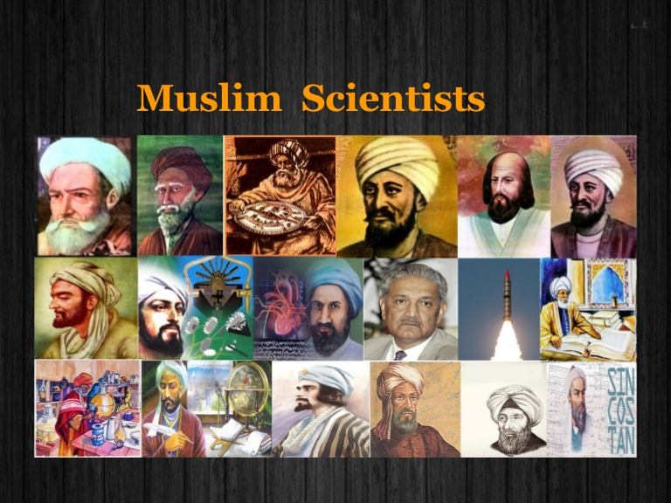

Our history is full of Muslim scientists.
We must be proud of them.

Slide 26


I love English

Slide 27



Homework
I love English
Work Book: Page 47

Slide 28

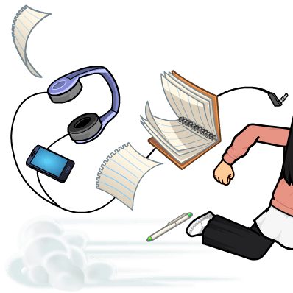
Homework
Work Book: Page 47

Slide 29
Homework
Work Book: Page 47

Slide 30
Homework
Work Book: Page 47

Slide 31
Homework
Work Book: Page 47

Slide 32
Homework
Work Book: Page 47

Slide 33

Homework
Work Book: Page 47

