Slide 1


Hello My lovely students
I’m your teacher
Hanan AlShobaily

Slide 2




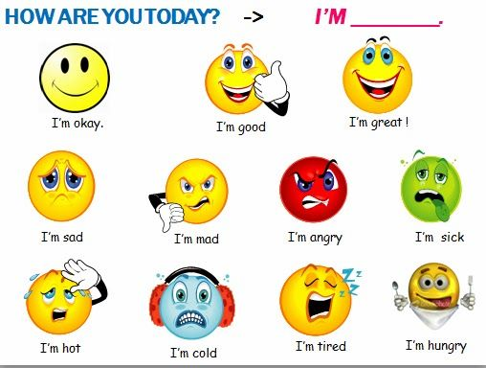
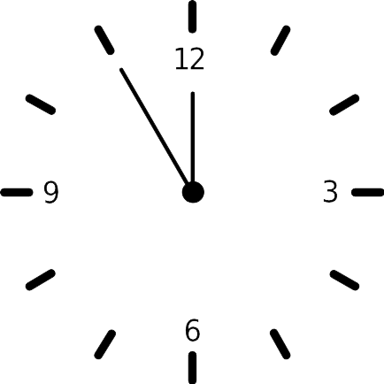












I love English

Slide 3


I love English

Slide 4



I love English
Have you ever been involved in or heard of a situation that was mysterious and seemed no logical explanation?

Slide 5
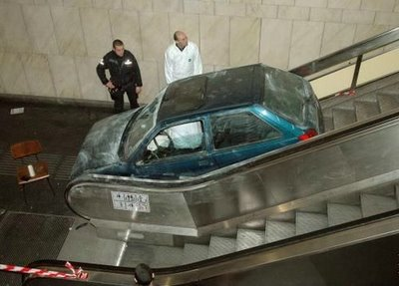

I love English
What might have happened?
It might be an advertisement.
He must have lost control of his car.

Slide 6



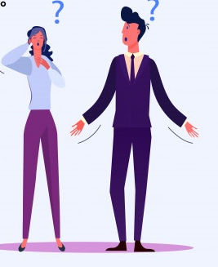


I love English
Mega Goal 2
Unit 4
(I Wonder What Happened)
Listen and Discuss
Sunday
23/7/1442

Slide 7

I love English
Lesson Goals
Students will be able to:
Predict what happened in the pictures.
Relate the sentences to the pictures.
Respond to questions about speculations.
Answer specific questions through listening to an audio.
Form sentences using at least 3 of the new words.

Slide 8
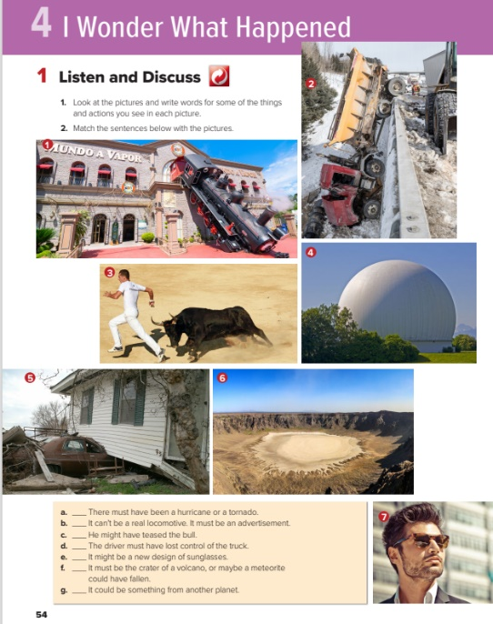

I love English
Open your Student’s book page: 54

Slide 9
Look at the pictures and write words for some of the things and actions you see in each picture.

Slide 10

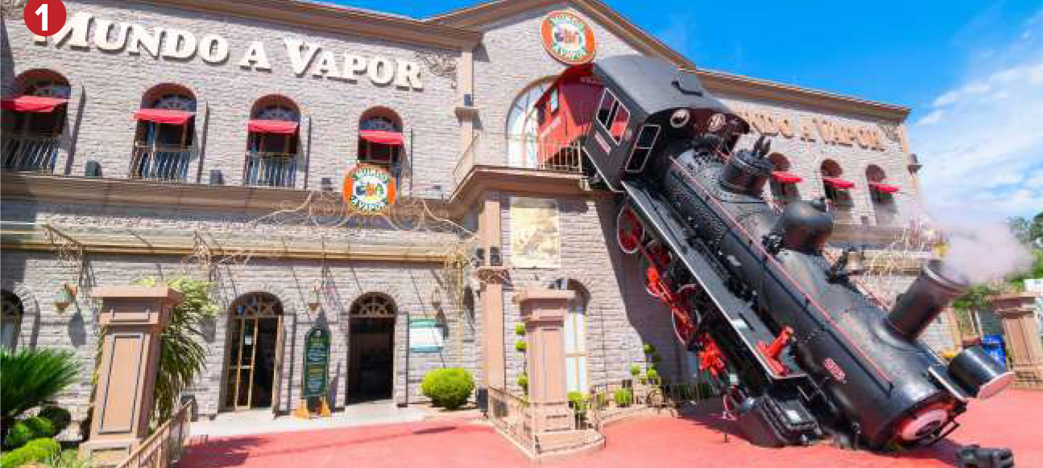
What could have happened?
train
accident
crash
house
hotel
Off track

Slide 11
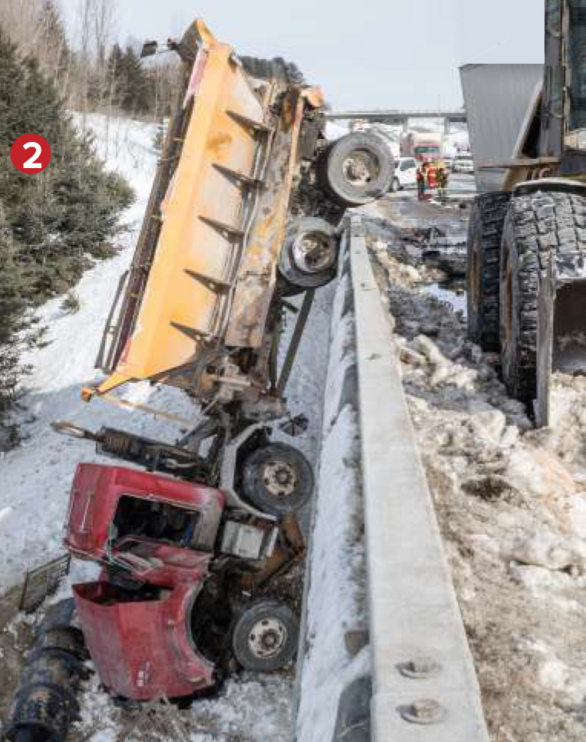
What could have happened?
truck
accident
crash
Flat tire
road
bridge

Slide 12
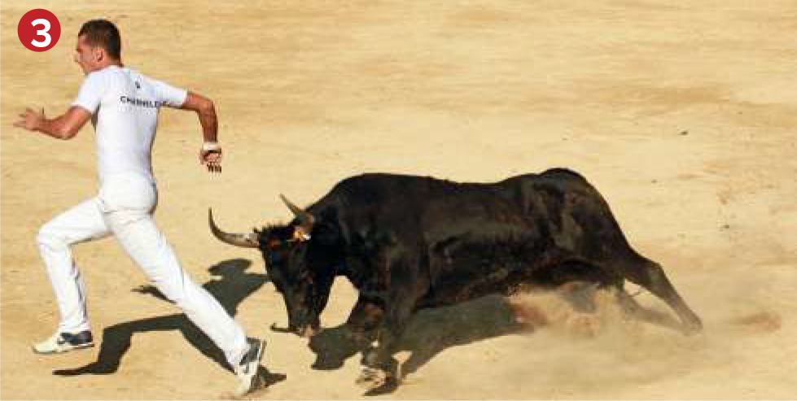
What could have happened?
bull
man
attack
chase
dangerous

Slide 13
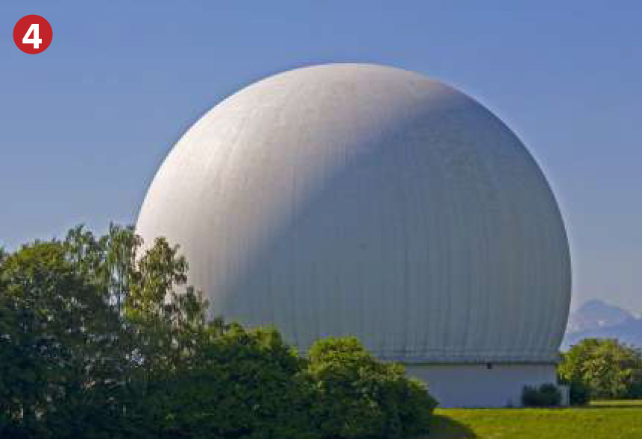
What could have happened?
sky
tree
dome
New design
strange
Outer planet

Slide 14
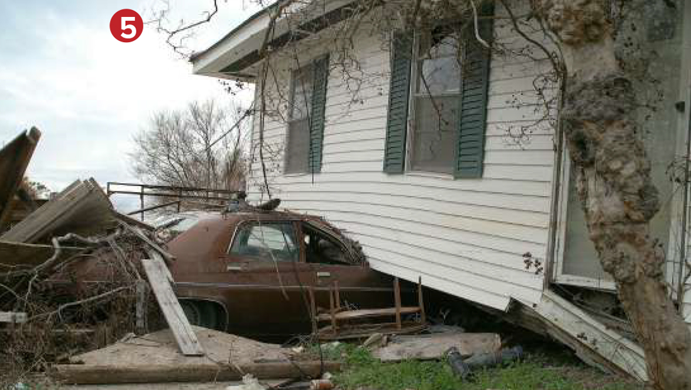
What could have happened?
house
car
Natural disaster
wind
accident
hurricane

Slide 15
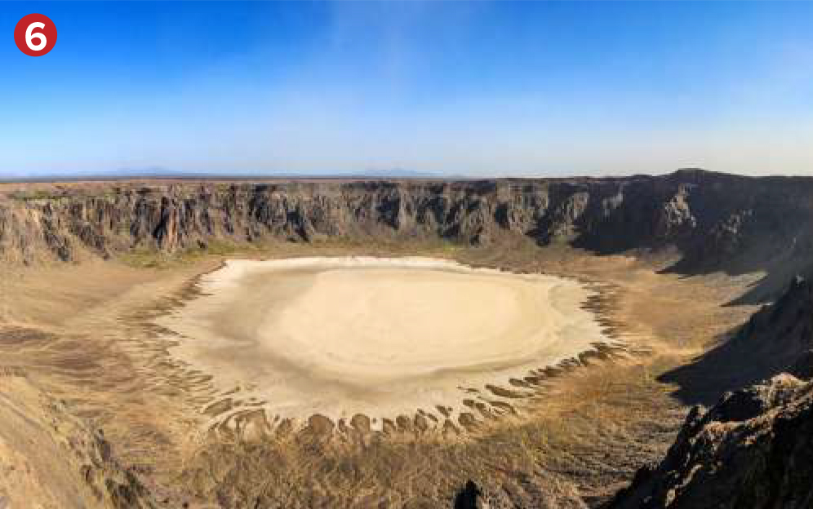
What could have happened?
hole
land
explosion
bomb
From the sky
volcano

Slide 16

What could have happened?
man
sunglasses
advertisement
New design
trend
model

Slide 17


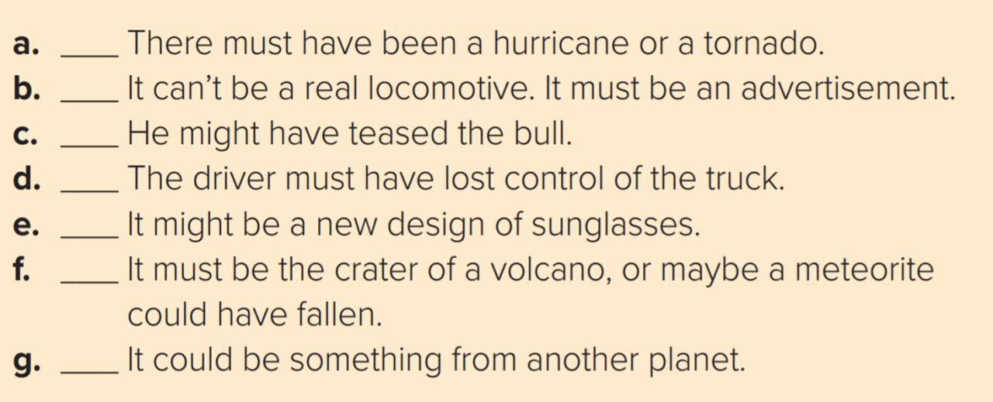
5
1
3
2
7
6
4

Slide 18
Ways to speculate about events
Can’t be
Could be
Must be
Must have
Might be
Might have

Slide 19


https://wordwall.net/resource/11788094

Slide 20
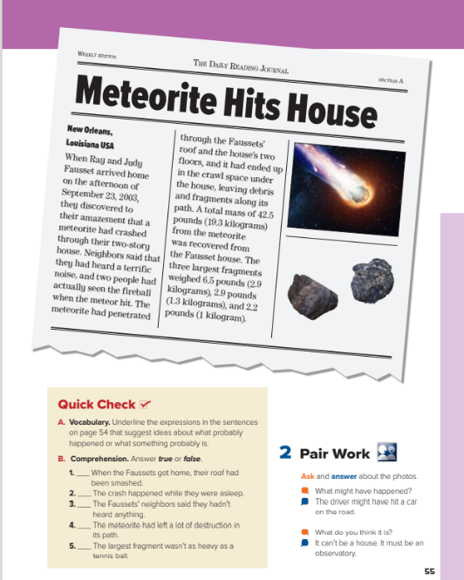
I love English
Open your Student’s book page: 55

Slide 21
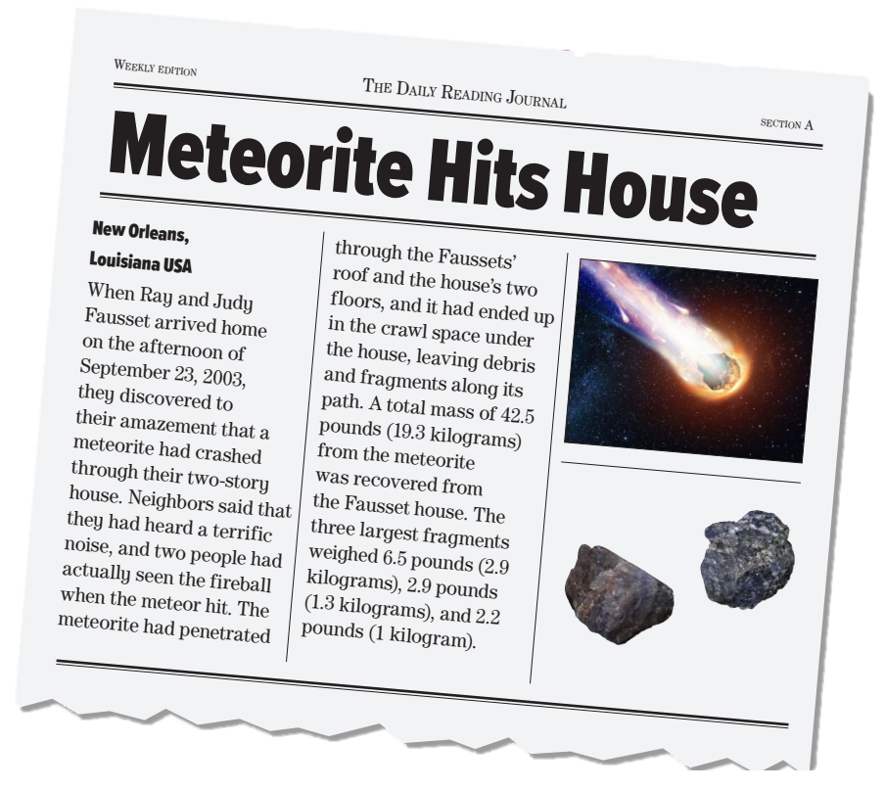

What’s this?
What’s the title of the article?
What do the pictures show?
What happened to Ray and Judy Fausset’s house?
It was struck by a meteorite.
When did that happen?
How many people actually seen the fireball when the meteorite hit?

Slide 22
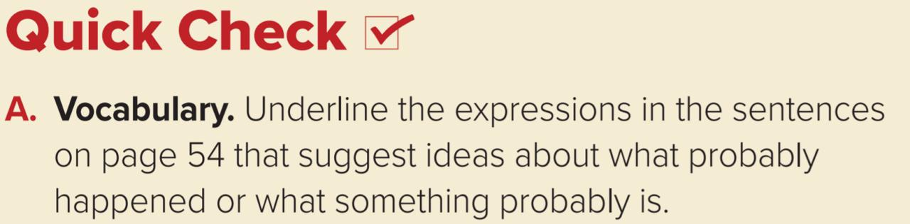
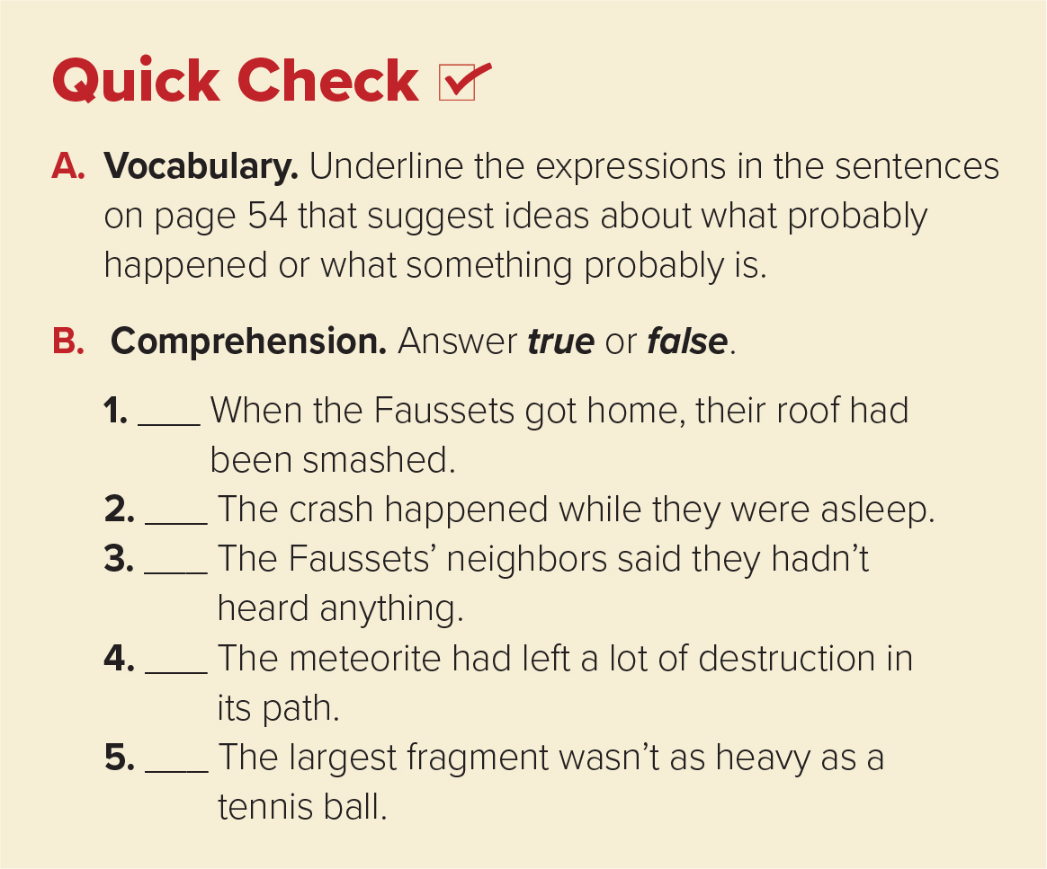

        must have been, can’t be, must be, might have teased, must have lost control, might be, must be, could have fallen, could be
true
false
false
true
false

Slide 23
Quick Check
Match the words to their meaning
meteorite
Meaning | Word
pieces are fallen from the meteorite
the ball of fire
strong sound
way
Go through
terrific sound
penetrated
debris
path

Slide 24
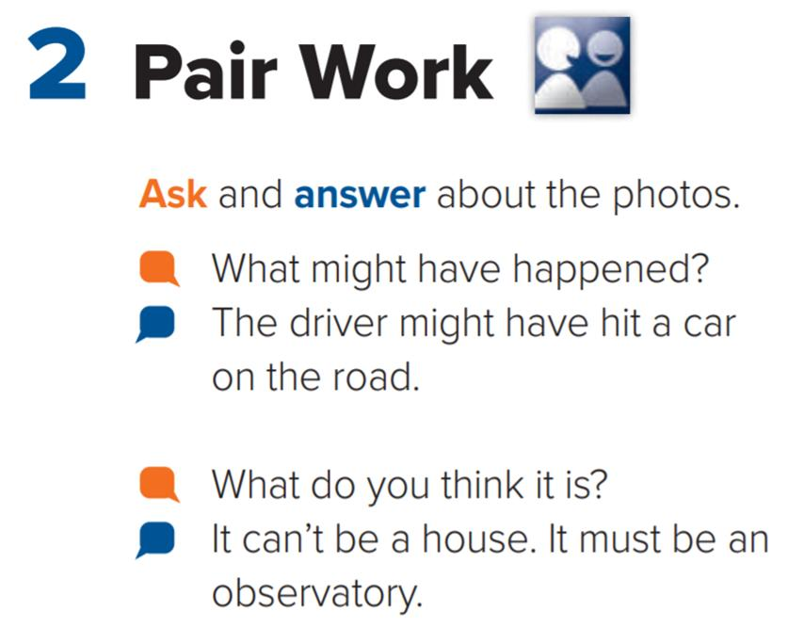


Slide 25



Slide 26


I love English

Slide 27




Homework
I love English
Work Book: Page 37

Slide 28


Homework
Work Book: Page 37

Slide 29
Homework
Work Book: Page 37

Slide 30
Homework
Work Book: Page 37

Slide 31
Homework
Work Book: Page 37

Slide 32
Homework
Work Book: Page 37

Slide 33

Homework
Work Book: Page 37

