Slide 1


Hello My lovely students
I’m your teacher
Hanan AlShobaily

Slide 2




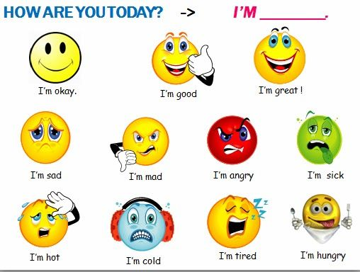




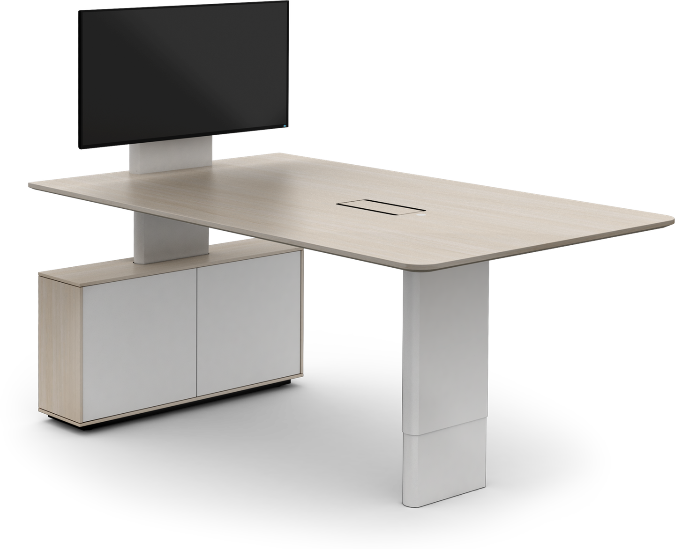
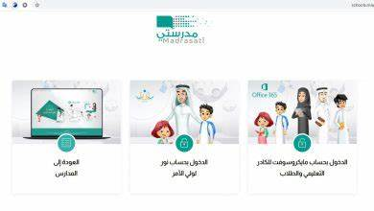







I love English

Slide 3


I love English

Slide 4



I love English

Slide 5


I love English
Revising the previous lesson
Choose the correct answer:
1- A way to start a conversation with a strange.
a. Excuse me
b. Beats me!
c. Gee!
2- Anything is possible.
a. weather balloon
b. weird
c. you never know

Slide 6

I love English
What does 2030 remind you of?
2030

Slide 7


I love English

Slide 8





I love English
What areas of developments are mentioned in vision 2030?
Education
Business
Employment
Culture
Healthcare

Slide 9




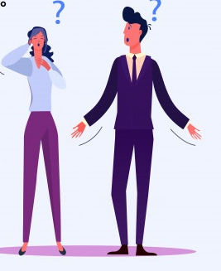


I love English
Mega Goal 2
Unit 4
(I Wonder What Happened)
Reading
Thursday
27/7/1442

Slide 10


I love English
Lesson Objectives
Students will be able to:
Provide answers for specific questions through scanning the text.
Answer specific questions based on a reading text.
List some areas of developments in vision 2030.
Identify the meaning of new words in the text.

Slide 11
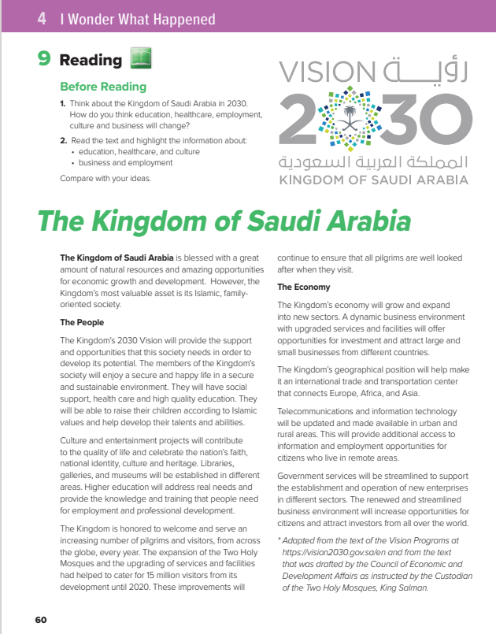

I love English
Open your Student’s book page: 60

Slide 12

Before Reading

Slide 13

Skimming
What’s the title?
How many paragraphs are there?
1
5
How many subheadings?
2
6
What do the pictures show?
7
3
8
4

Slide 14



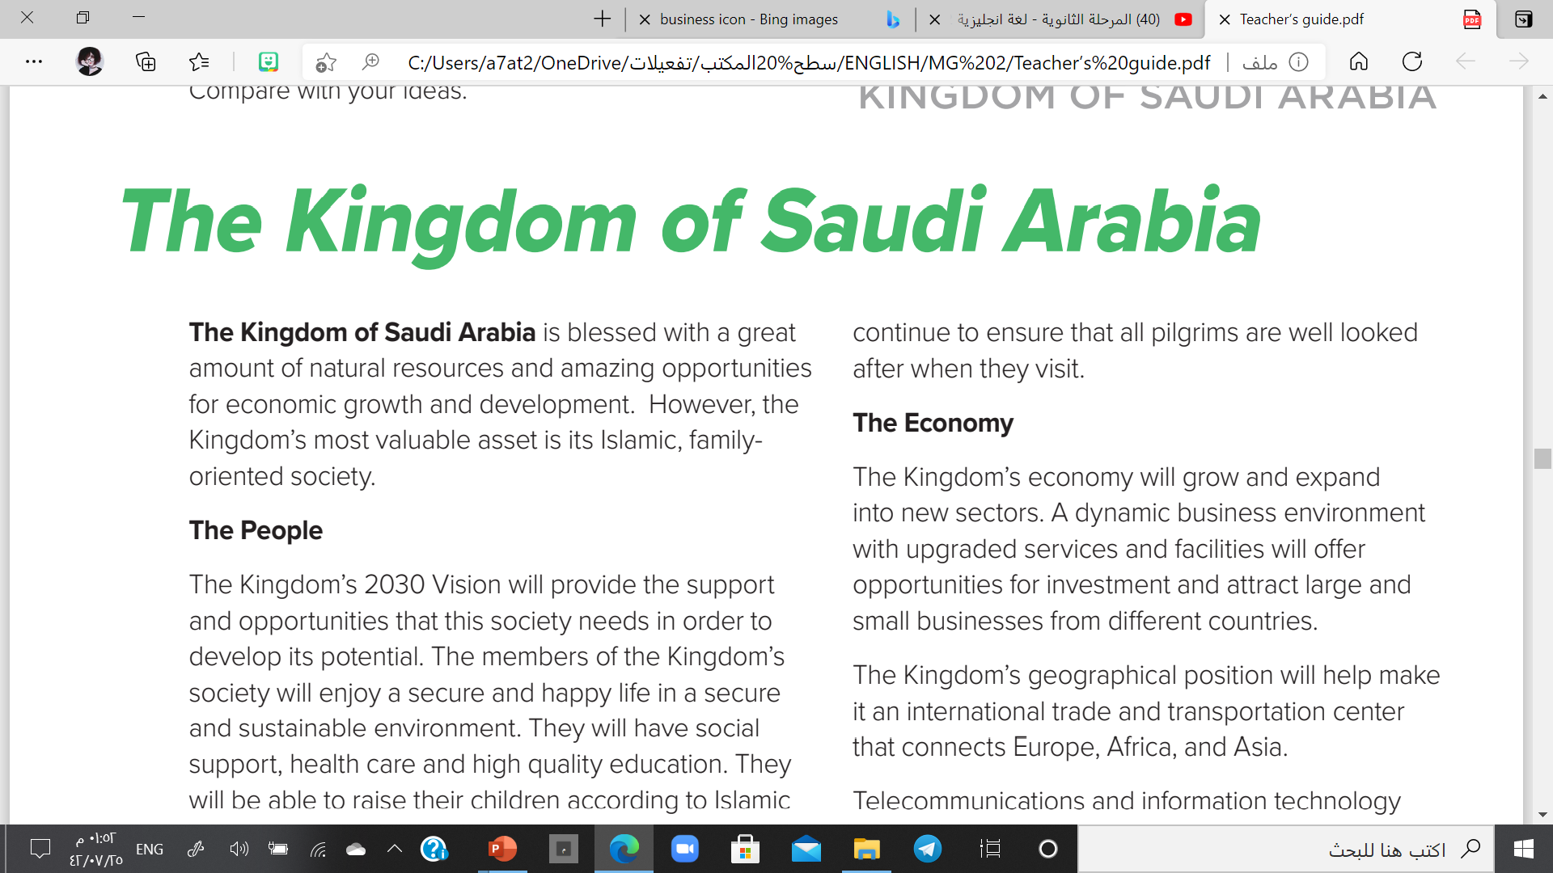
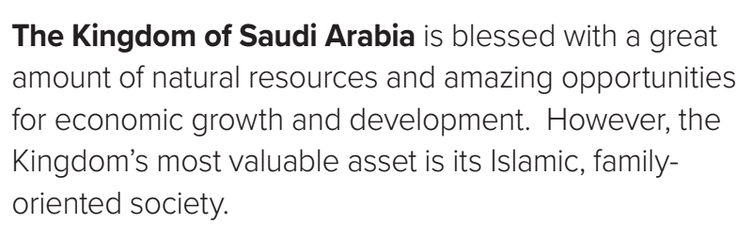
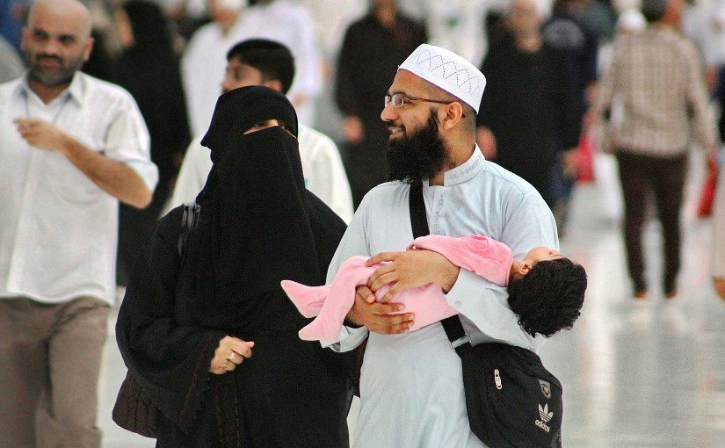
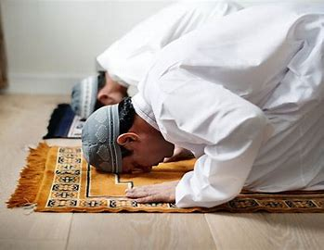
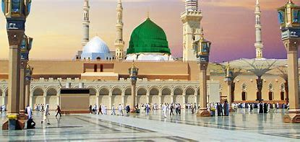
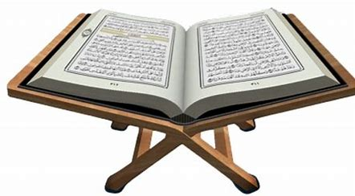
What is the kingdom’s most valuable asset?
asset = a useful or valuable quality, skill or person

Slide 15
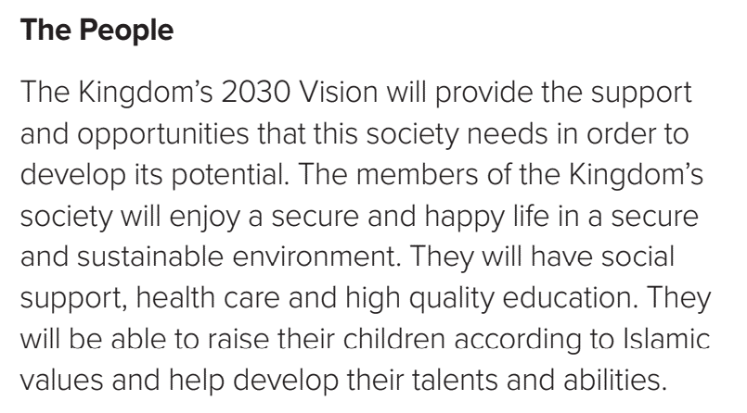

What will the Kingdom’s 2030 Vision provide the society?
Why?
What will the members of the kingdom enjoy according to 2030 vision?
potential = an ability that can be developed

Slide 16
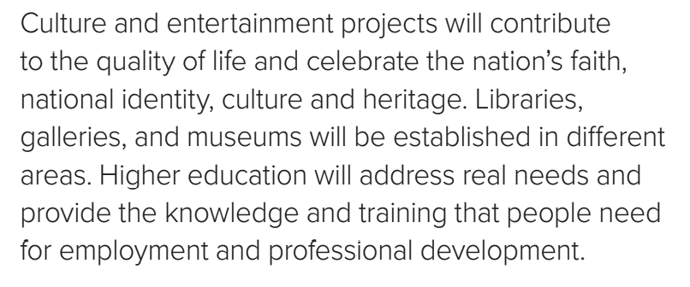
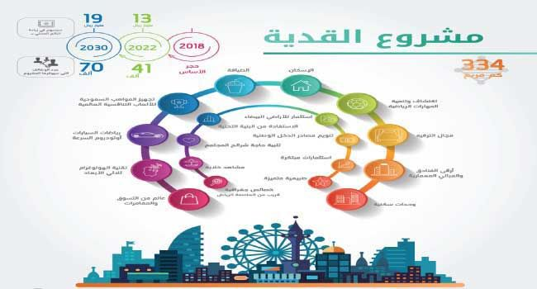
What will culture and entertainment project contribute?
What are they?
Will the higher education address real needs?
Yes, it will.
What will higher education provide?
contribute = play a significant part

Slide 17
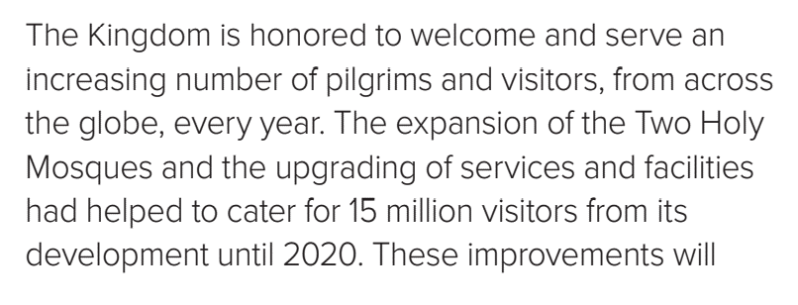

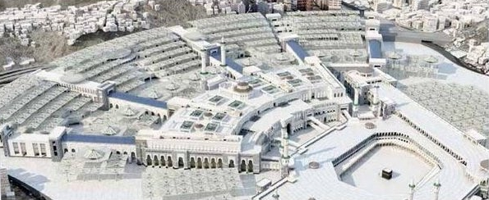
How many visitors did the expansion of the Two Holy Mosques provide with in 2020?
What is the main idea of this paragraph?
Services to the Holy Mosques

Slide 18
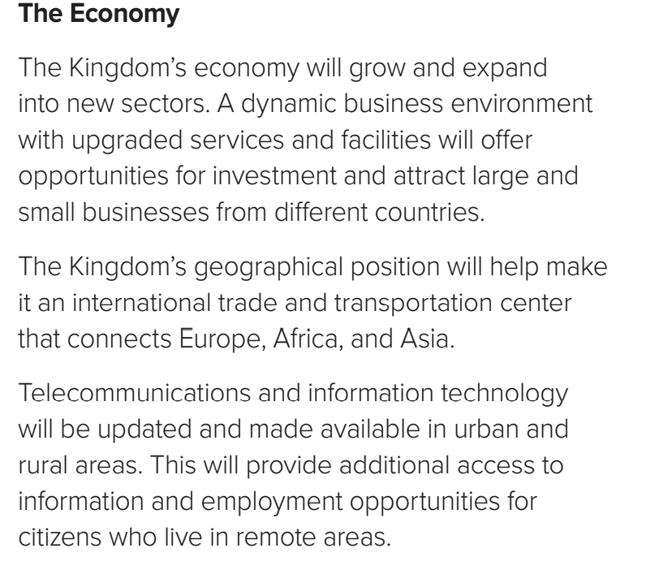
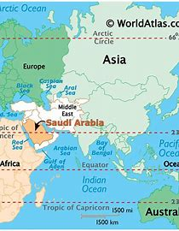


What will the dynamic business environment with upgraded services offer?
Does the kingdom have a strategic position?
Yes, it has.
Explain.
What will the telecommunication sector provide?
sectors = areas of an economy
investment = the act of spending money

Slide 19
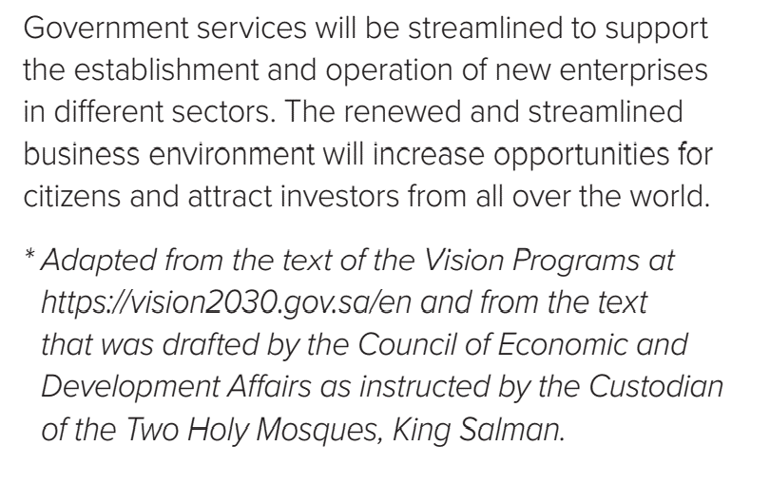

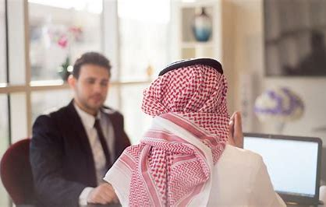
Why will the government services be streamlined?
What will the renewed and streamlined business environment increase?

Slide 20
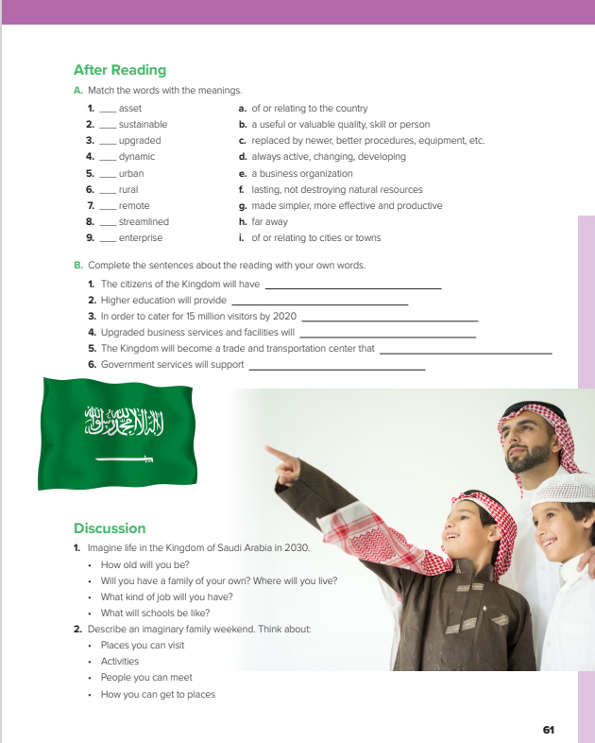
I love English
Open your Student’s book page: 61

Slide 21
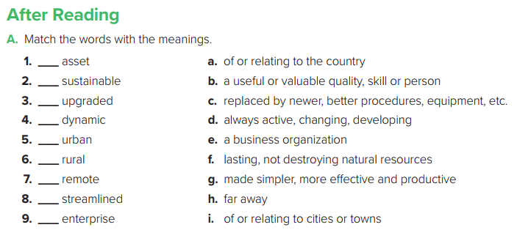

b
f
c
d
i
a
h
g
e

Slide 22
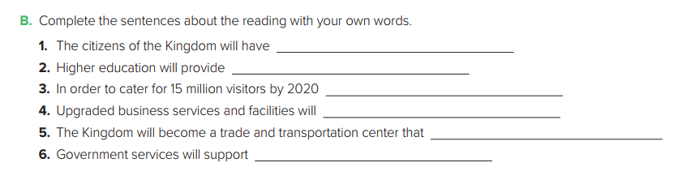
many job opportunities, health care and high quality education.
the training that people need for professional development.
services and facilities have been upgraded.
attract large and small businesses from different countries.
connects Europe, Africa, and Asia.
new businesses in different sectors.

Slide 23
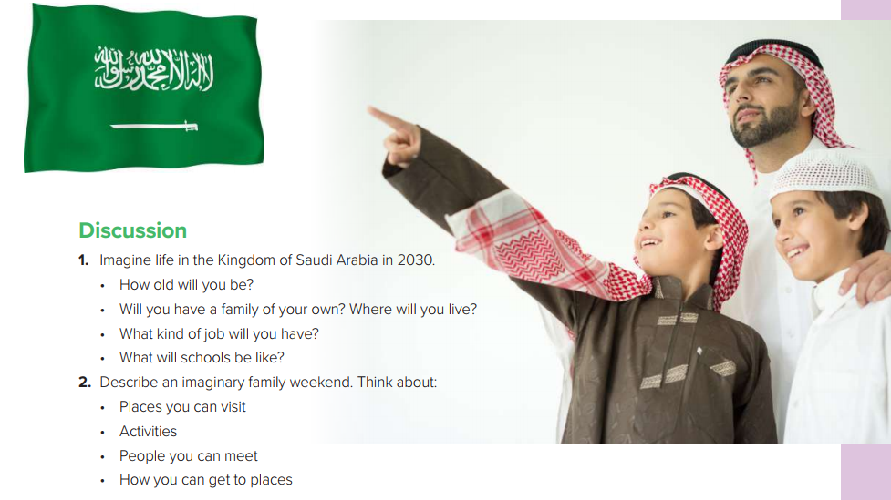

Slide 24
Match the words to their meaning
Meaning | Word
the act of spending money
an ability that can be developed
play a significant part
areas of an economy
potential
contribute
sectors
investment

Slide 25


https://wordwall.net/resource/12327076

Slide 26
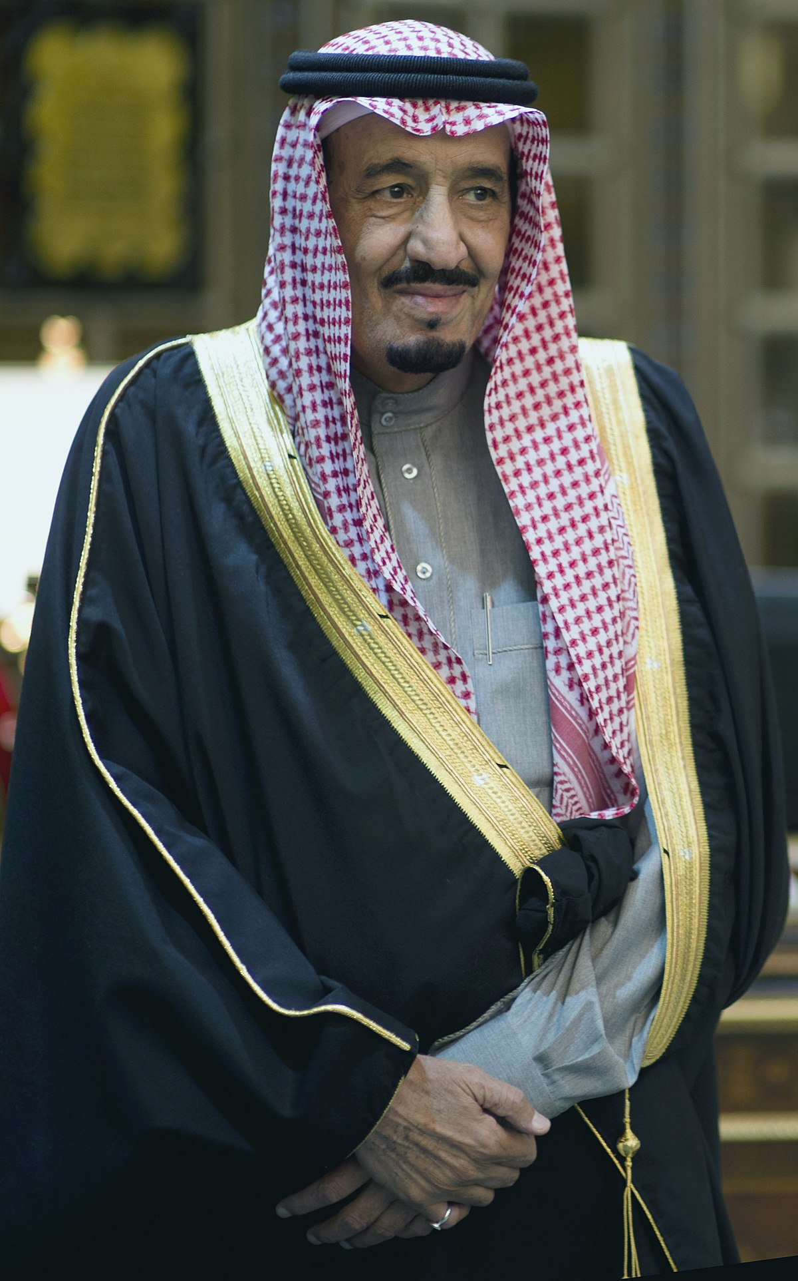
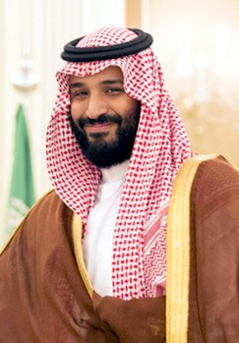
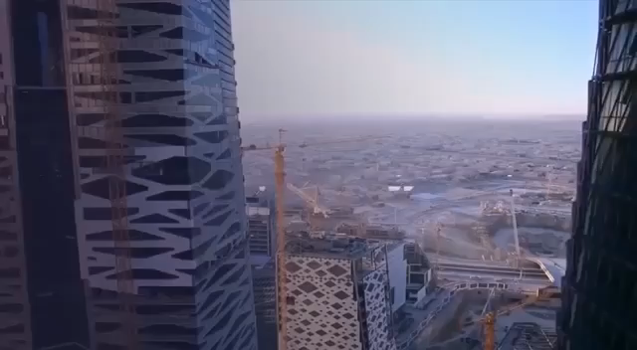

You are the future.
You must love your country,
support it,
and be so proud.

Slide 27

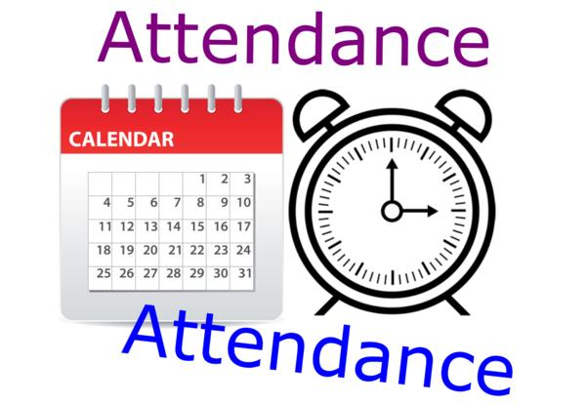
I love English

Slide 28




Homework
I love English

Slide 29

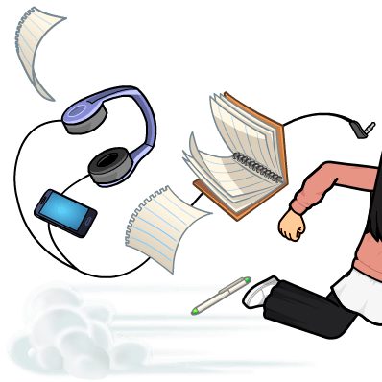
Homework

Slide 30
Homework

Slide 31
Homework

Slide 32
Homework

Slide 33
Homework

Slide 34

Homework

