Slide 1
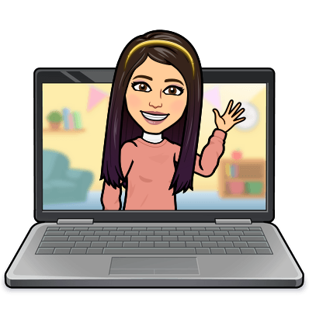

Hello My lovely students
I’m your teacher
Hanan AlShobaily

Slide 2
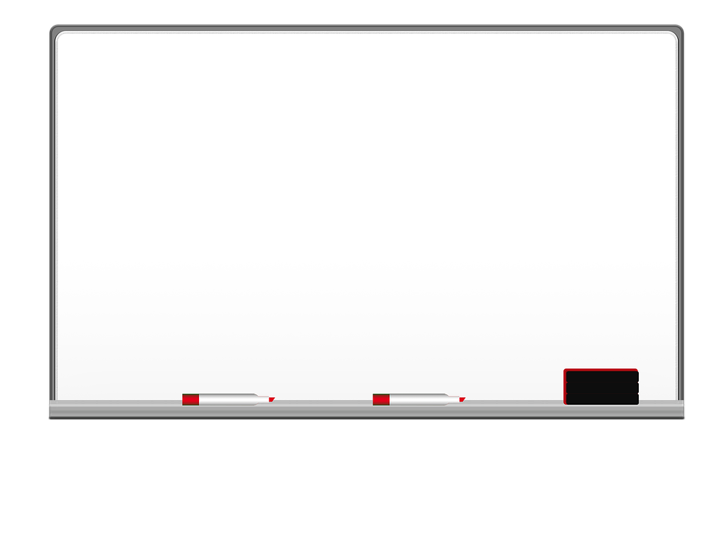
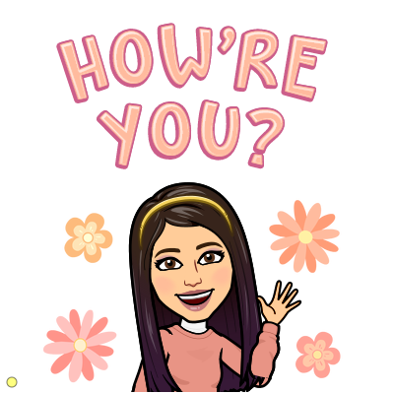

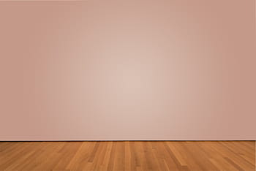
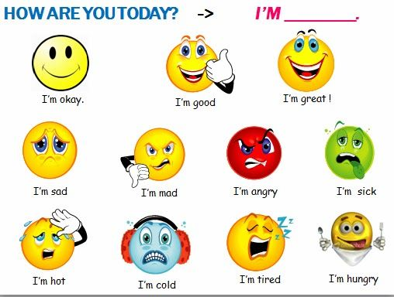
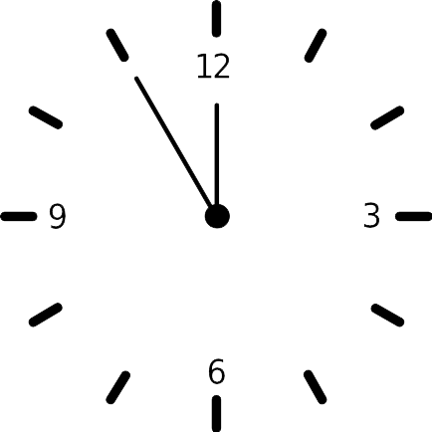



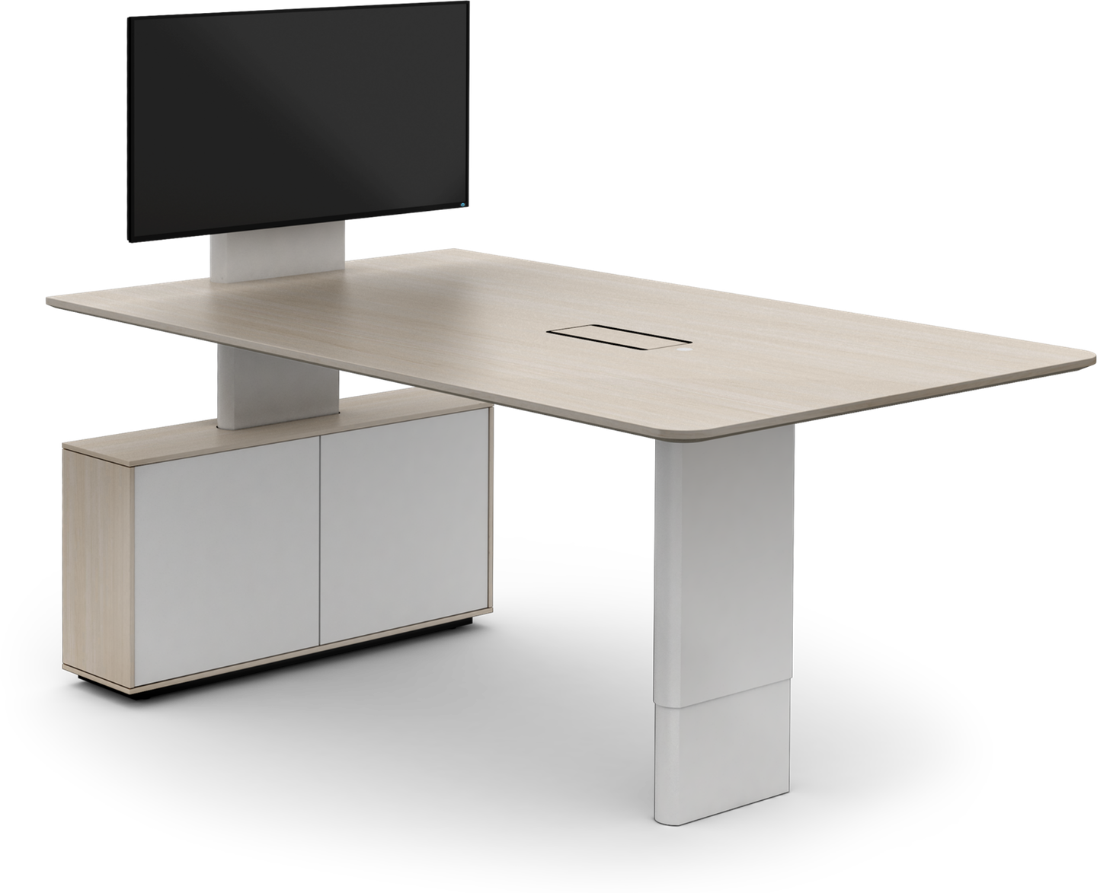
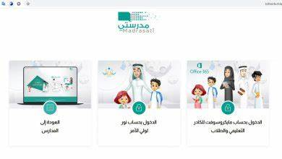
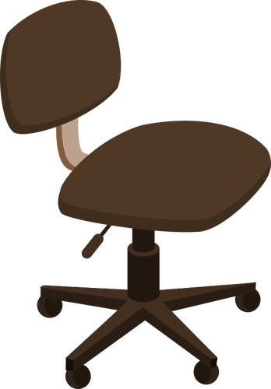

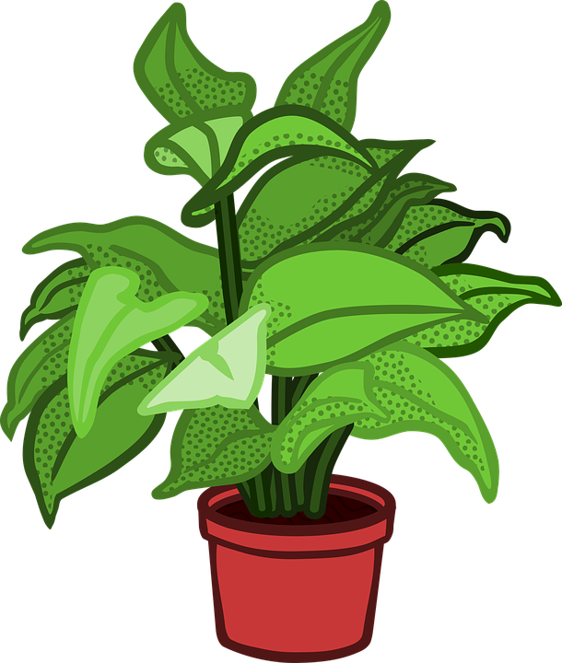
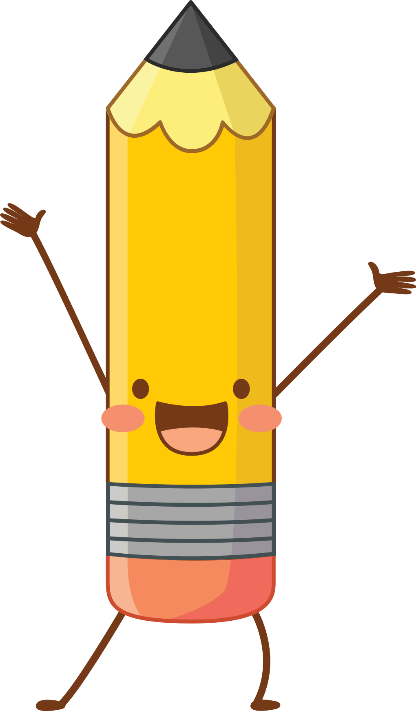
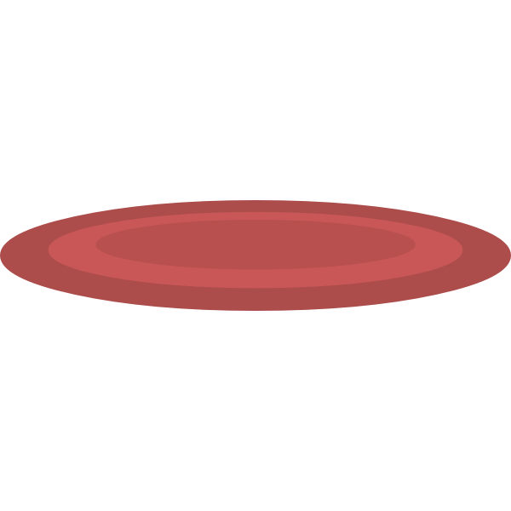

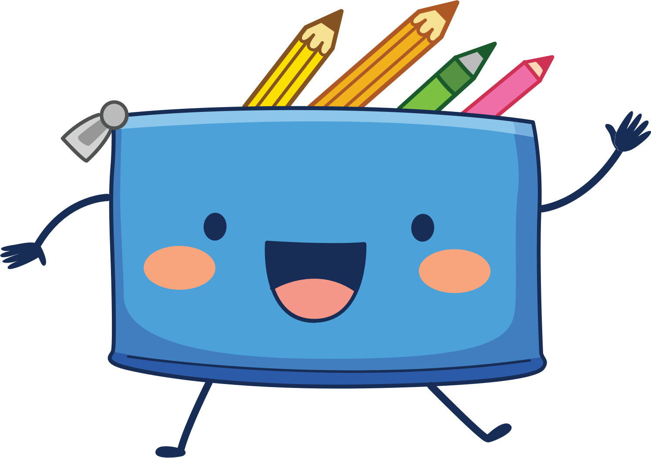
I love English

Slide 3
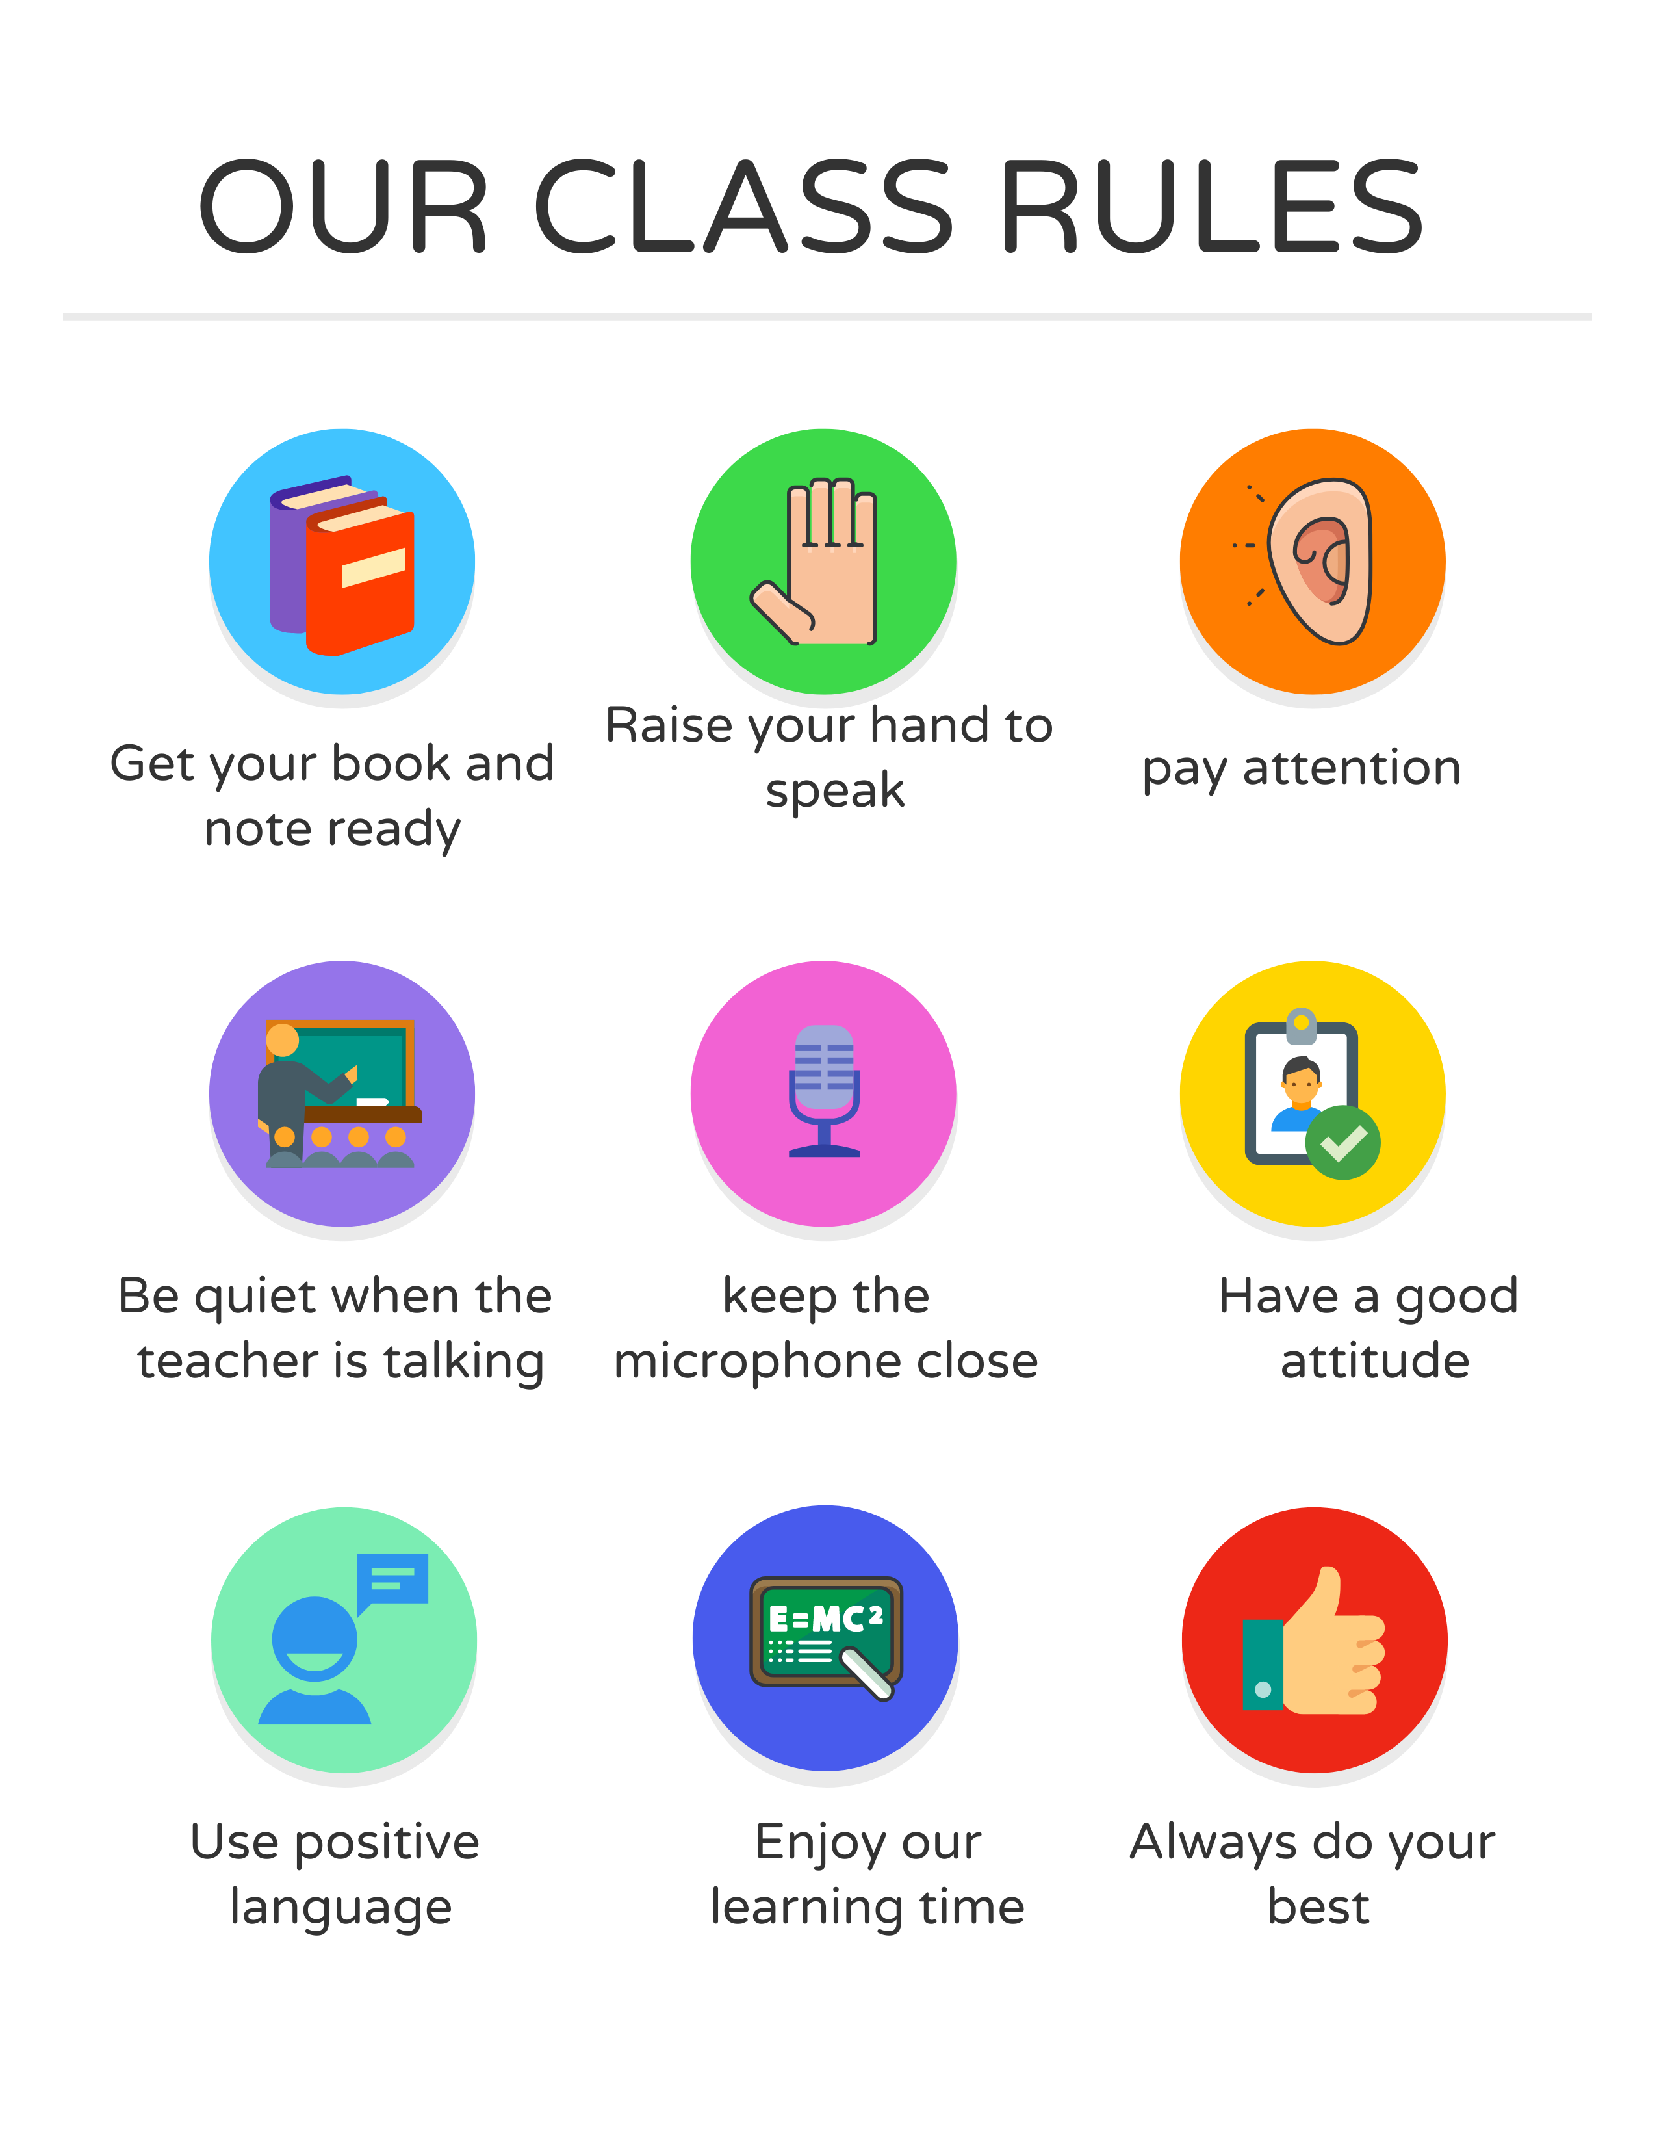
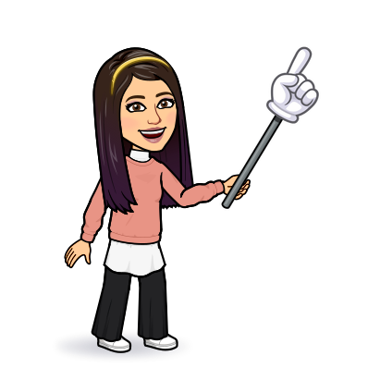
I love English

Slide 4
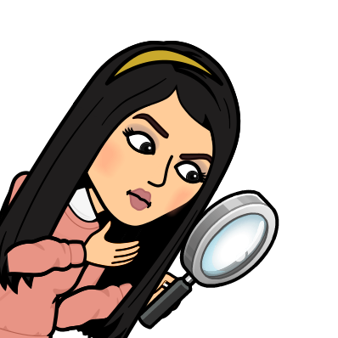

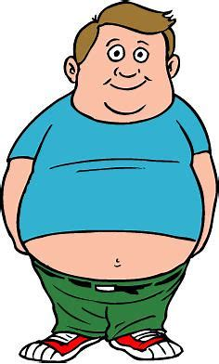
I love English
Revising the previous lesson
Give advice for the following situations:
You must stop at the red light.
You ought to exercise.

Slide 5

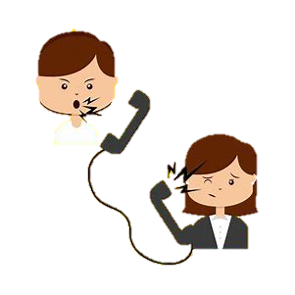

I love English
Mega Goal 2
Unit 3
(Complaints, Complaints)
Conversation
Tuesday
11/7/1442

Slide 6

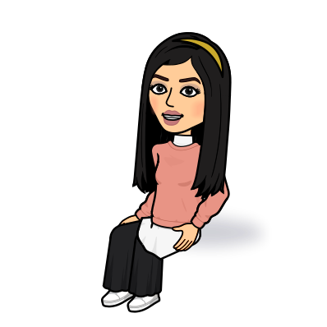
I love English
Lesson Goals
Students will be able to:
Answer specific questions based on a conversation.
Form a conversation to complain about an item.
Use the new expressions in sentences.

Slide 7
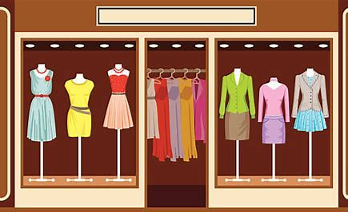
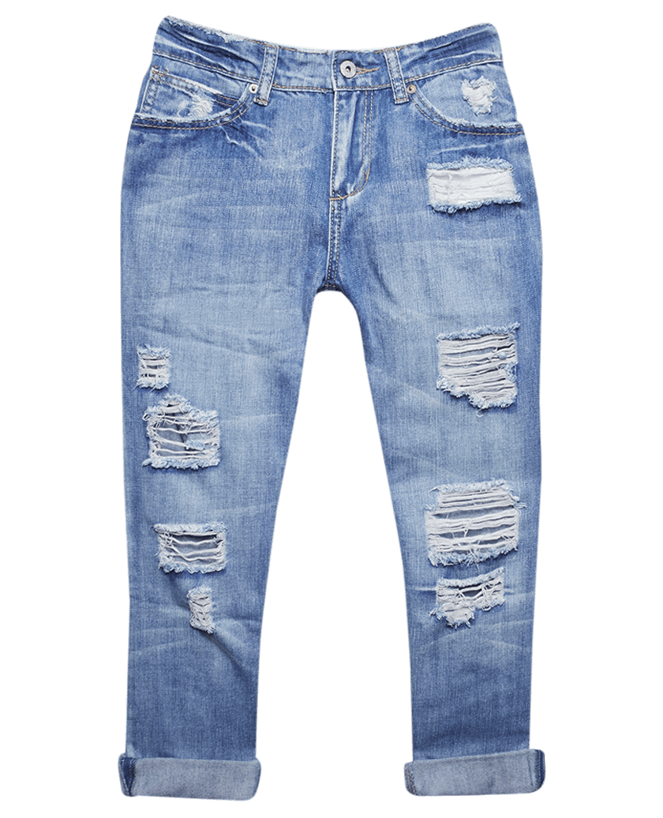

I love English
What’s this place?
What do usually you buy?
Do you follow fashion trends?
Look at the pictures then discuss

Slide 8
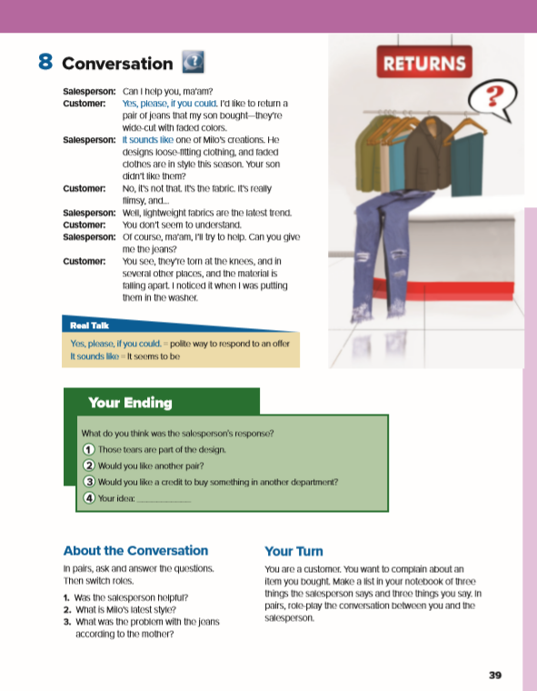
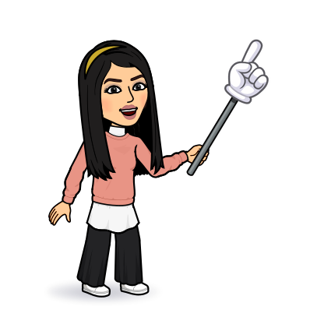
I love English
Open your Student’s book page: 39

Slide 9
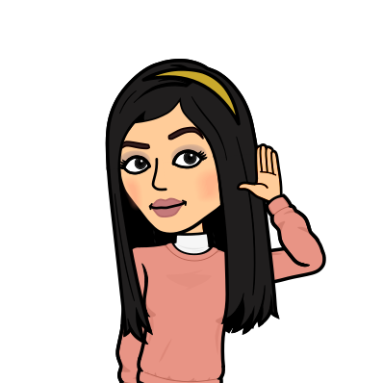
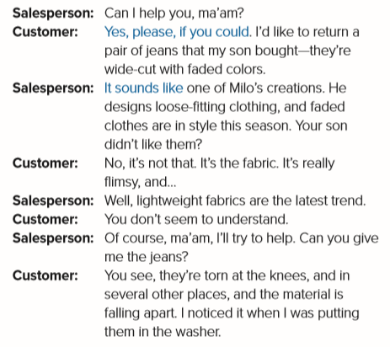
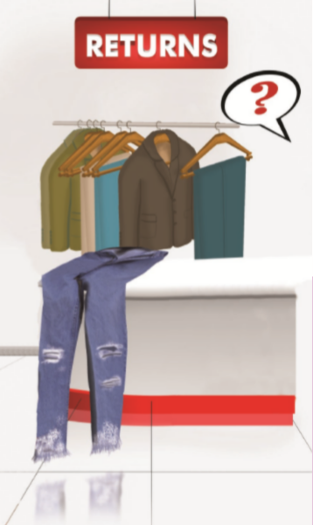

Between whom did the conversation take place?
Where are they?
What do you think the problem is?

Slide 10
(Formal) ma’am is usually used for women of all ages, but not girls
What does the customer want?
She wants to return a pair of jeans that her son bought.
to lose color or brightness
Why?
clothing is quite large and does not fit tightly
Because they’re wide-cut with faded colors.
Does she like the colors?
thin, light, not strong
style
No, she doesn’t.

Slide 11
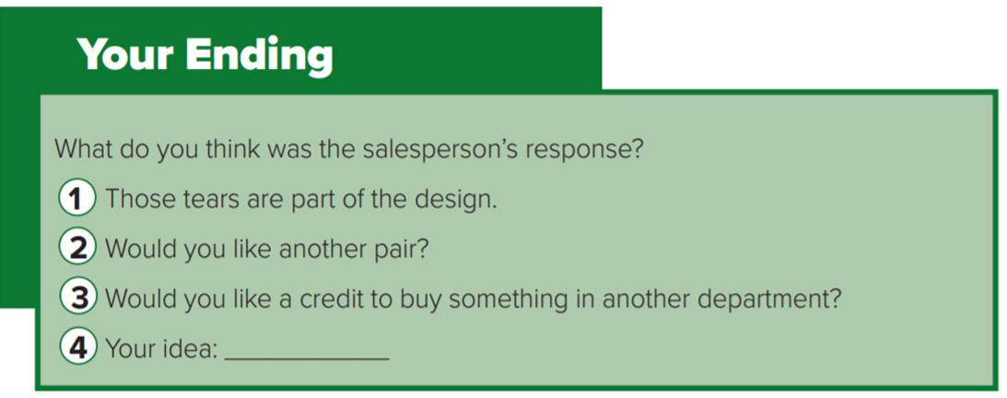
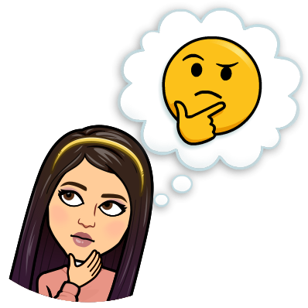

Slide 12
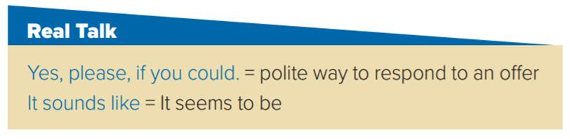
- Can I help you? Yes, please, if you could. I’d like to change this bag with a bigger one.
- That kitten sounds like a human baby.

Slide 13
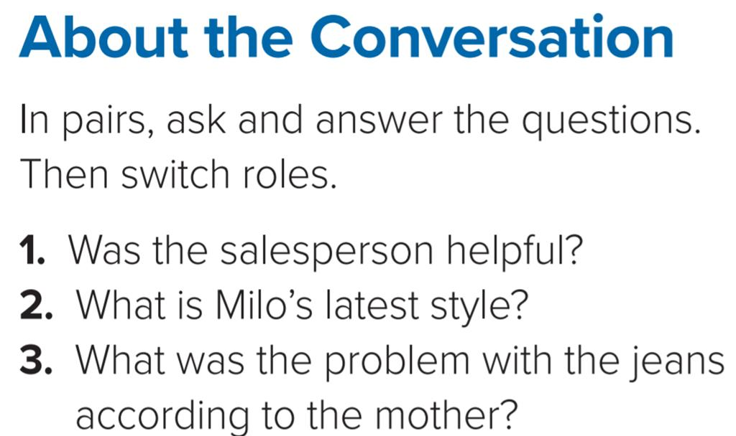
1- The salesperson wanted to be helpful, but she didn’t understand the problem with the jeans. The jeans were in the latest style.
2- Milo designs loose-fitting clothes in faded colors.
3- The mother thinks that the jeans are torn and that the material is falling apart.

Slide 14
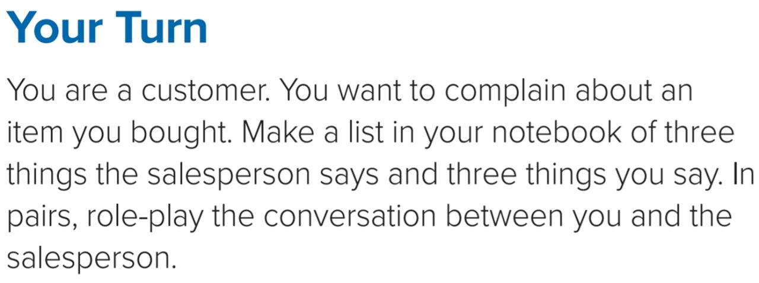
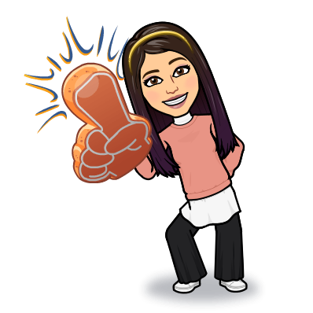

Slide 15

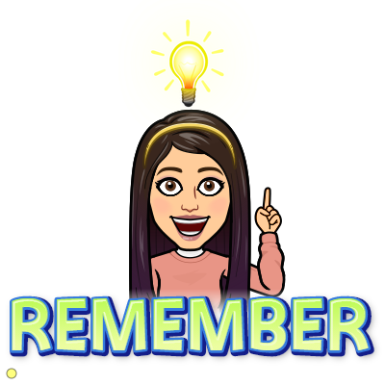
جمال المرأة في احتشامها

Slide 16
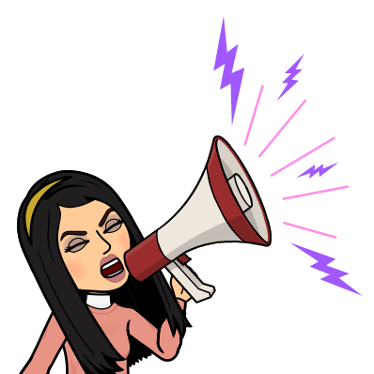
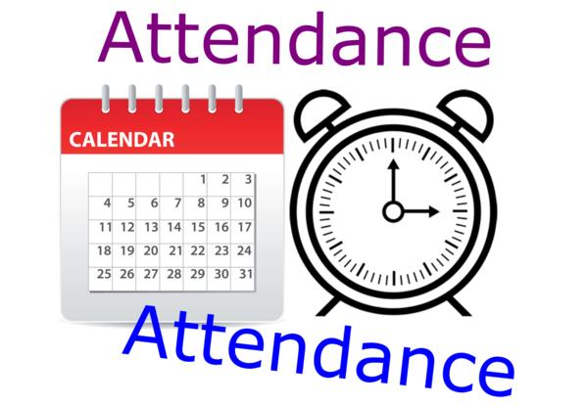
I love English

Slide 17



Homework
I love English

Slide 18
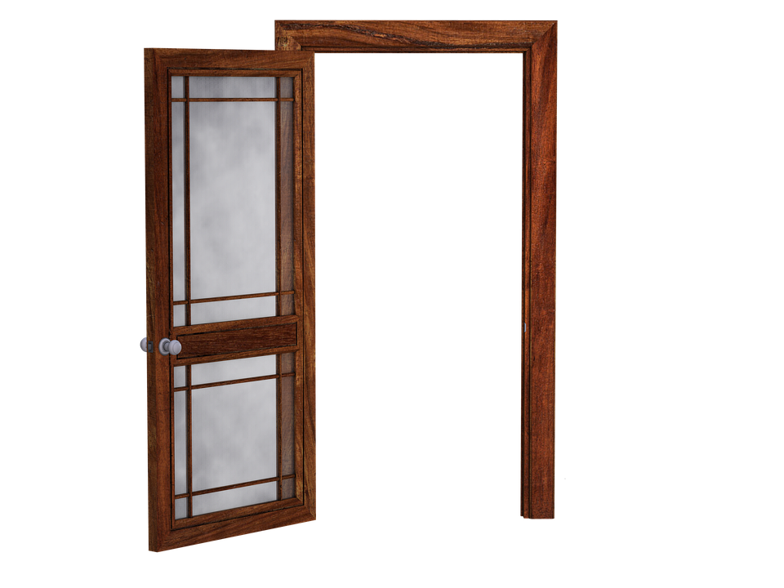
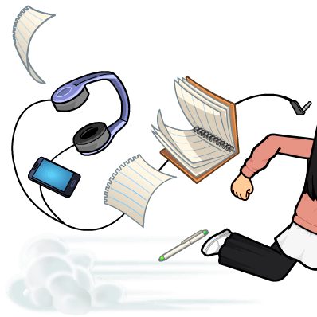
Homework

Slide 19
Homework

Slide 20
Homework

Slide 21
Homework

Slide 22
Homework

Slide 23
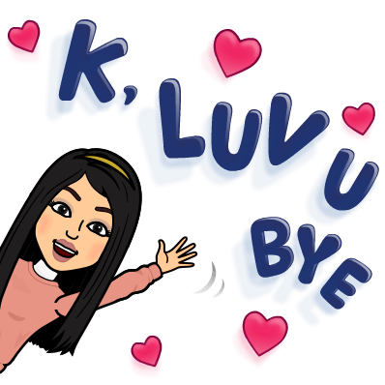
Homework

