Slide 1


Hello My lovely students
I’m your teacher
Hanan AlShobaily

Slide 2




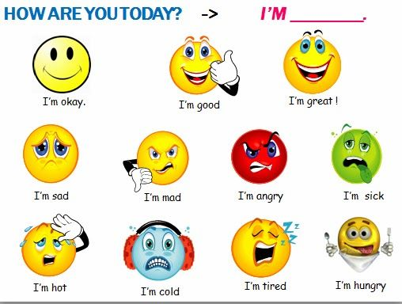
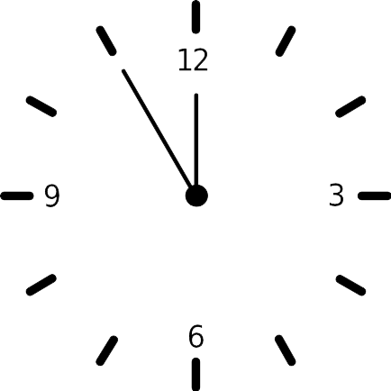
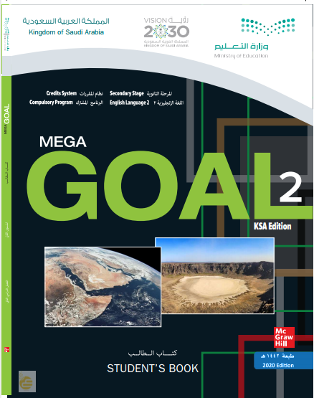

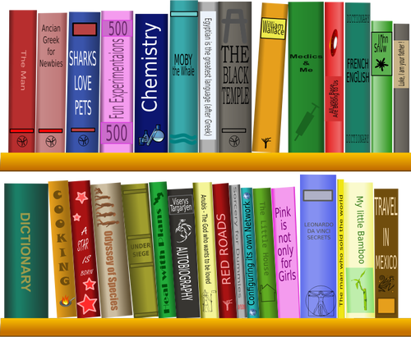
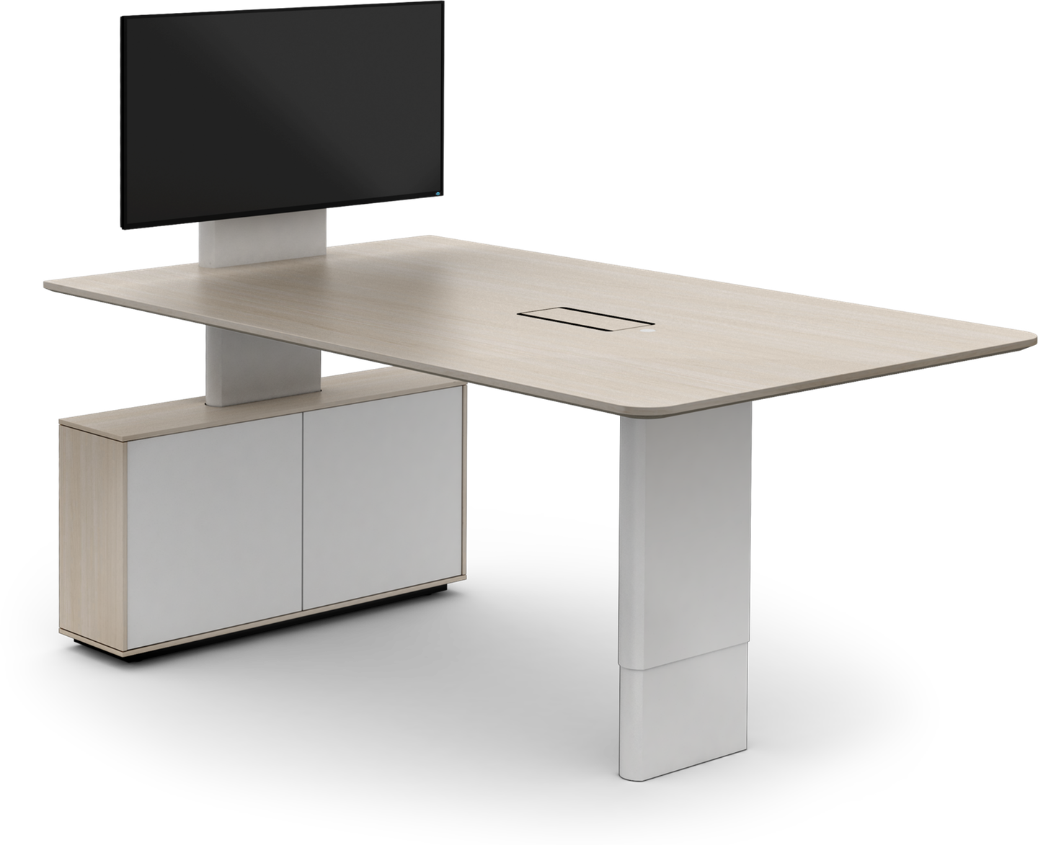
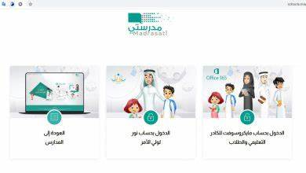







I love English

Slide 3


I love English

Slide 4


I love English
Revising the previous lesson
https://wordwall.net/resource/11419090

Slide 5

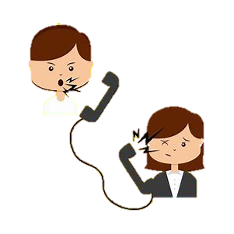

I love English
Mega Goal 2
Unit 3
(Complaints, Complaints)
Form, Meaning and Function
Sunday
16/7/1442

Slide 6


I love English
Lesson Goals
Students will be able to:
Form sentences using the present perfect tense.
Use gerund after certain verbs.

Slide 7


Let’s start with a game
Try to classify the verbs in a minute
https://wordwall.net/resource/676133

Slide 8
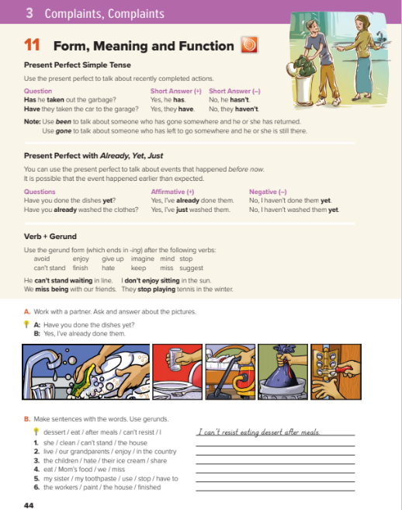

I love English
Open your Student’s book page: 44

Slide 9
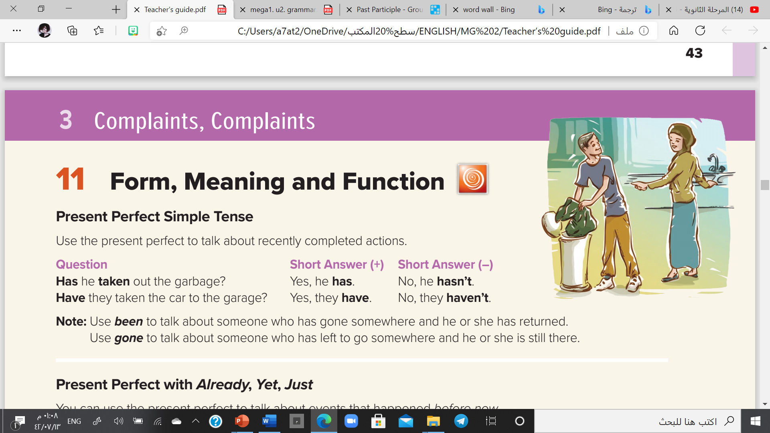

Slide 10


Present Perfect Simple
He
She
I
They
You
We
has
Form
S
+
has / have
+
V3 (past participle)
have
I have finished my homework.
e.g.
He has taken out the garbage.
I have been to Paris.
(It means I’ve travelled to Paris and I’ve returned)
NOTE
NOTE
She has gone to Paris.
Use been to talk about someone who has gone somewhere and he or she has returned
Use gone to talk about someone who has left to go somewhere and he or she is still there
(It means I’ve travelled to Paris and I’m still there, I haven’t returned)

Slide 11
Negative
Form
S
+
has / have
+
not
+
V3 (past participle)
He
has
finished his homework.
e.g.
not

Slide 12
Yes/No Questions
Have
Has
Form
+
S
+
V3 (past participle) ?
Has
has
he
finished his homework
He
.
e.g.
?
Yes, he has.
No, he hasn’t.

Slide 13

https://wordwall.net/resource/11157374

Slide 14
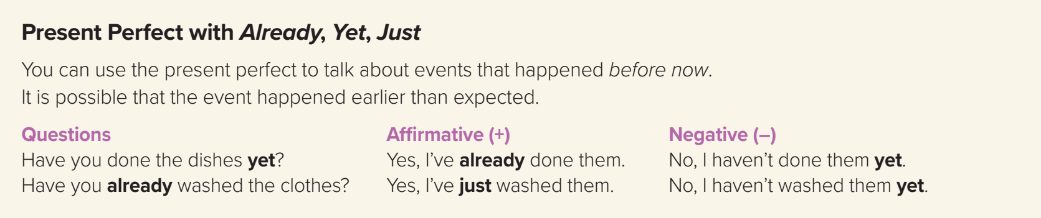

Slide 15
Present Perfect with (Already/yet/just)
❍ Yet
(Used in questions and negative sentences to talk about something which expected to happen at any time up to now)
(It comes at the end)
• Have you written the report yet?
• No, I haven’t written the report yet.
❍ Already
(Used in questions and affirmative sentences to talk about something that happened before now)
(It comes between has/have and the past participle verb or at the end)
• Have you already taken the money?
• I have already taken the money.
• The train has left already!
❍ Just
(Used in questions and affirmative sentences to talk about something that happened very recently)
(It comes between has/have and the past participle verb)
• Have you just taken my pen?
• I have just finished my homework.

Slide 16
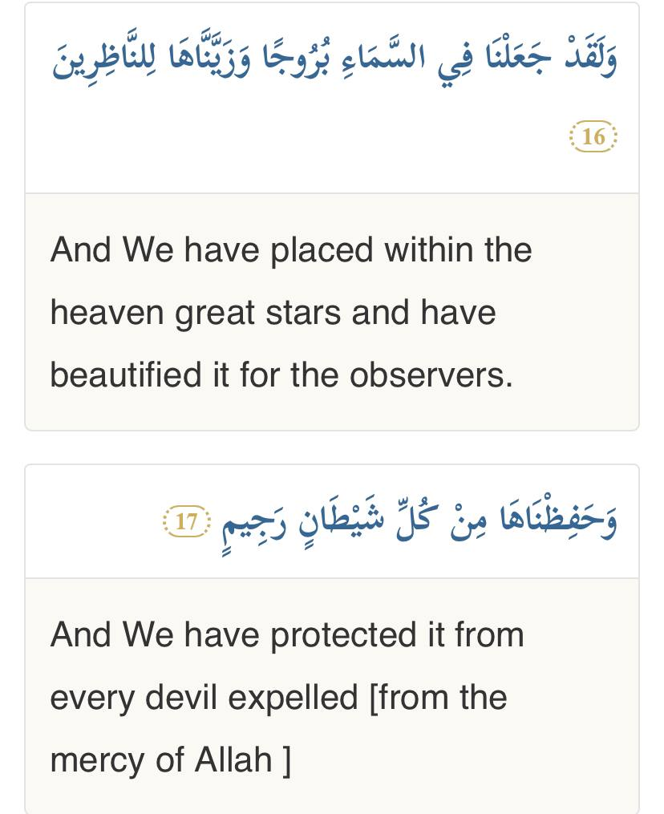
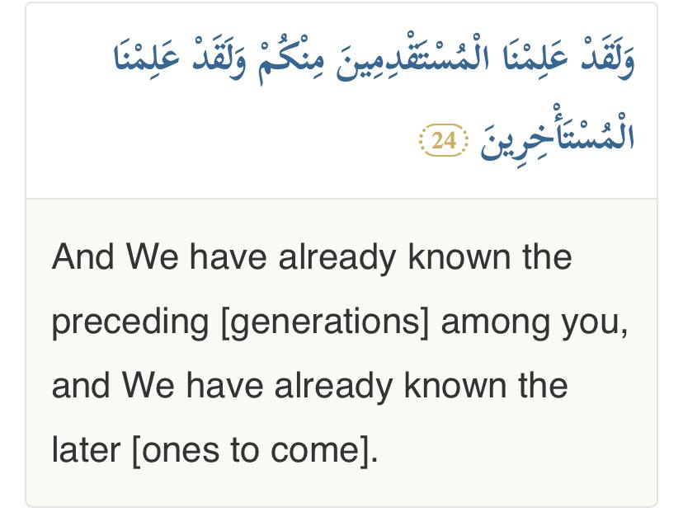
Examples in Quran

Slide 17
Time Expressions
A short time before
Before now
At any time up to now
just
already
yet
Questions
and
positive sentences
comes between has/have and the past participle
Questions
and
positive sentences
comes between has/have and the past participle
or at the end of the clause
Questions
and
negative sentences
comes at the end

Slide 18
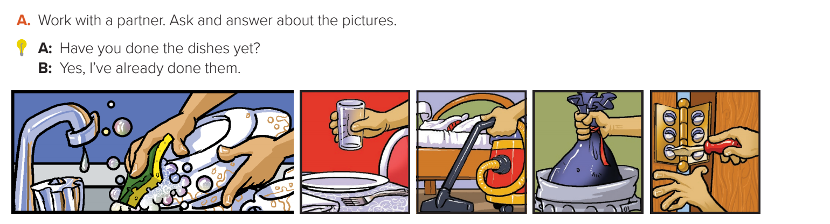
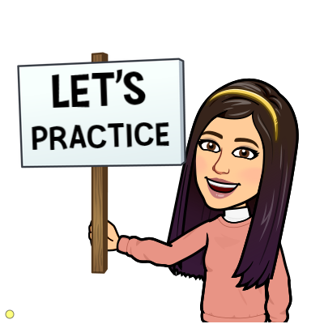
A: Have you cooked dinner yet?
B: Yes. I’ve already eaten it.
A: Have you cleaned your room?
B: Yes. I’ve already done it.
A: Have you taken out the garbage?
B: Yes. I’ve already done it.
A: Have you fixed the door?
B: Yes. I’ve already done it.

Slide 19
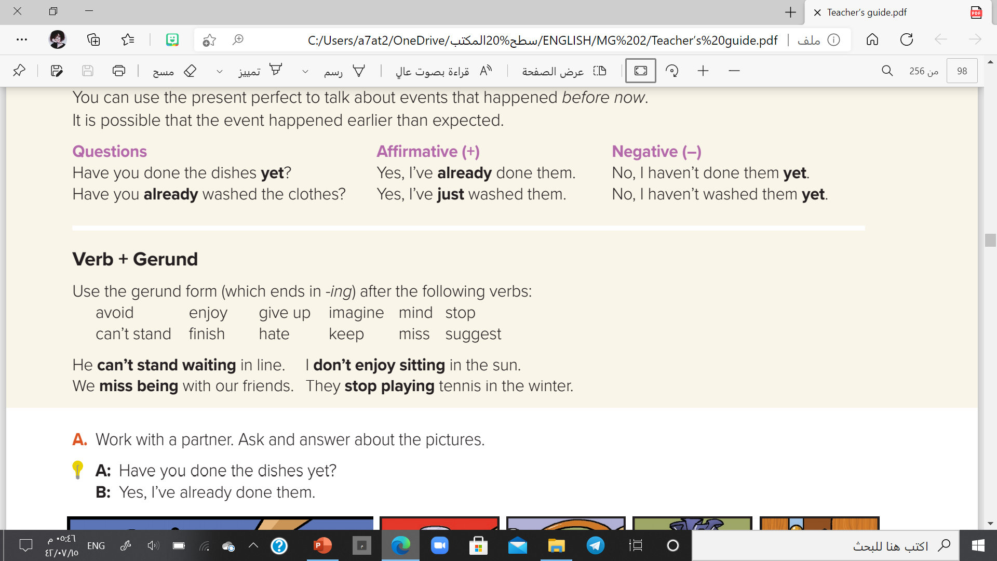

Slide 20
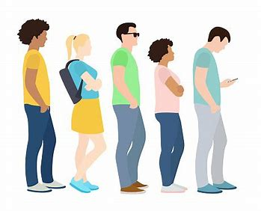
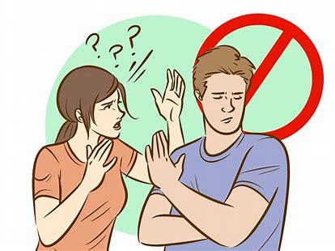
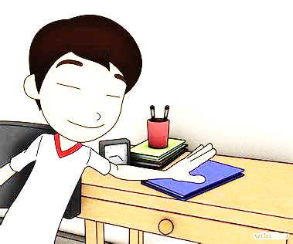
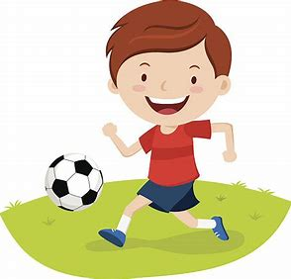
Gerund =
V-ing
Use it after the following verbs
He can’t stand waiting in line.
He avoided talking to her.
He finished doing his homework.
I enjoy playing football.
enjoy
Can’t stand
finish
Give up
mind
avoid
stop
suggest
hate
keep
miss
imagine

Slide 21

https://www.liveworksheets.com/1-jx1776130ff

Slide 22
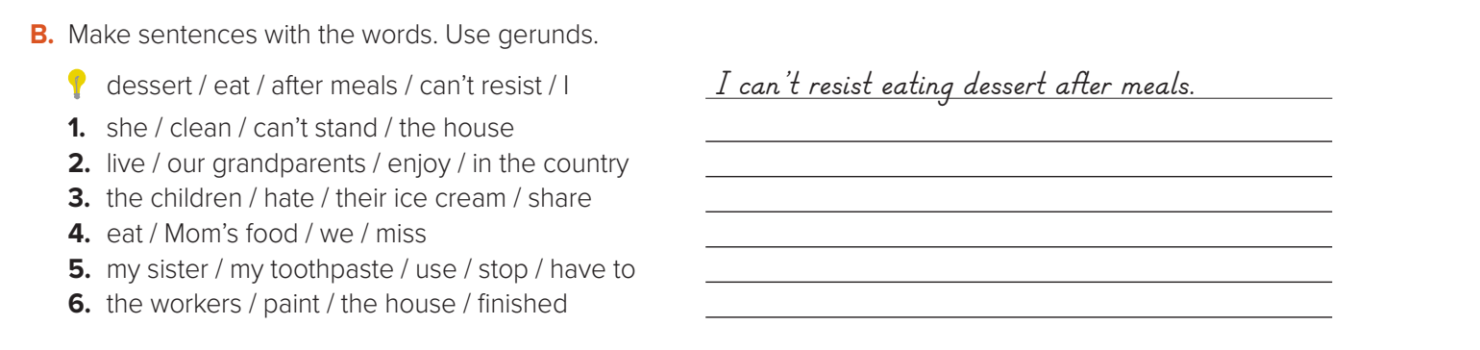
She can’t stand cleaning the house.
Our grandparents enjoyed living in the country.
The children hated sharing their ice cream.
We missed eating Mom’s food.
My sister has to stop using my toothpaste.
The workers have finished painting the house.

Slide 23

You don’t need magic to change the world and make your country better, just keep changing.
Keep improving yourself.
Avoid listening to negative people.
Keep trying and never give up.

Slide 24

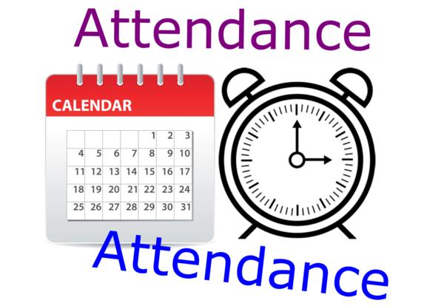
I love English

Slide 25



Homework
I love English
WORKBOOK Page29

Slide 26
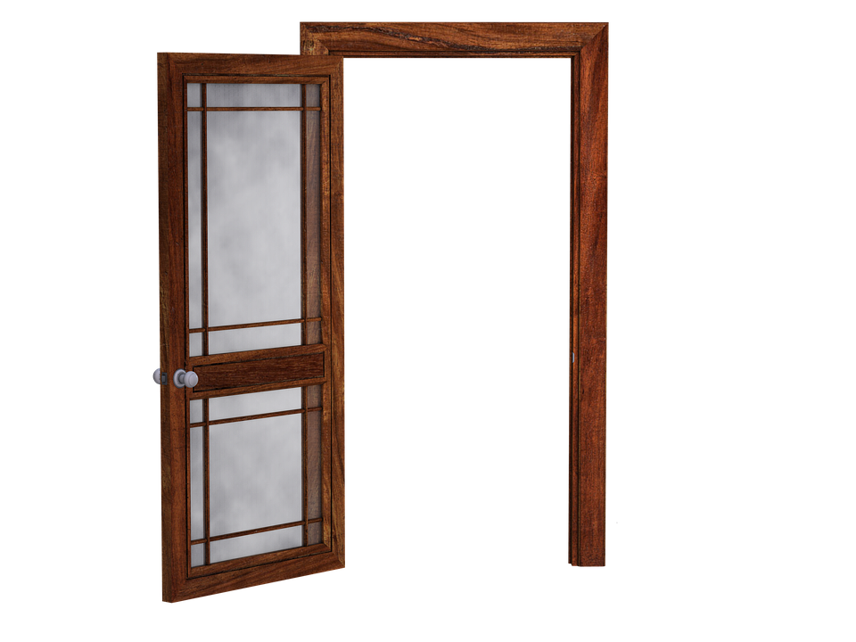
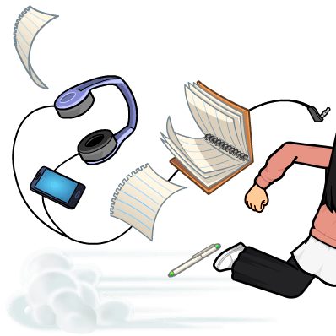
Homework
WORKBOOK Page29

Slide 27
Homework
WORKBOOK Page29

Slide 28
Homework
WORKBOOK Page29

Slide 29
Homework
WORKBOOK Page29

Slide 30
Homework
WORKBOOK Page29

Slide 31

Homework
WORKBOOK Page29

