Slide 1


Hello My lovely students
I’m your teacher
Hanan AlShobaily

Slide 2




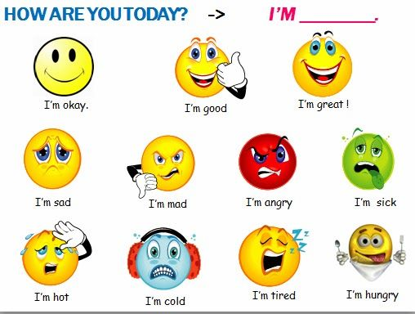
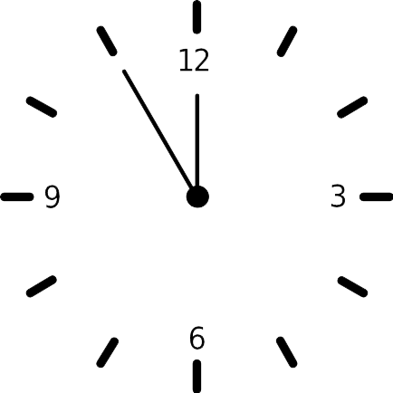
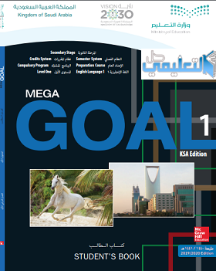

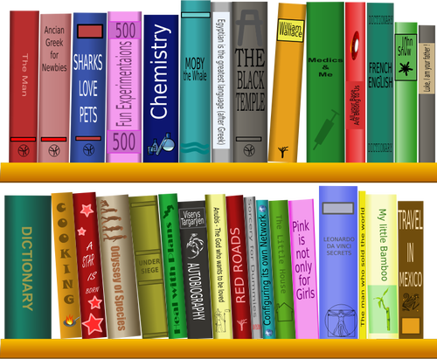
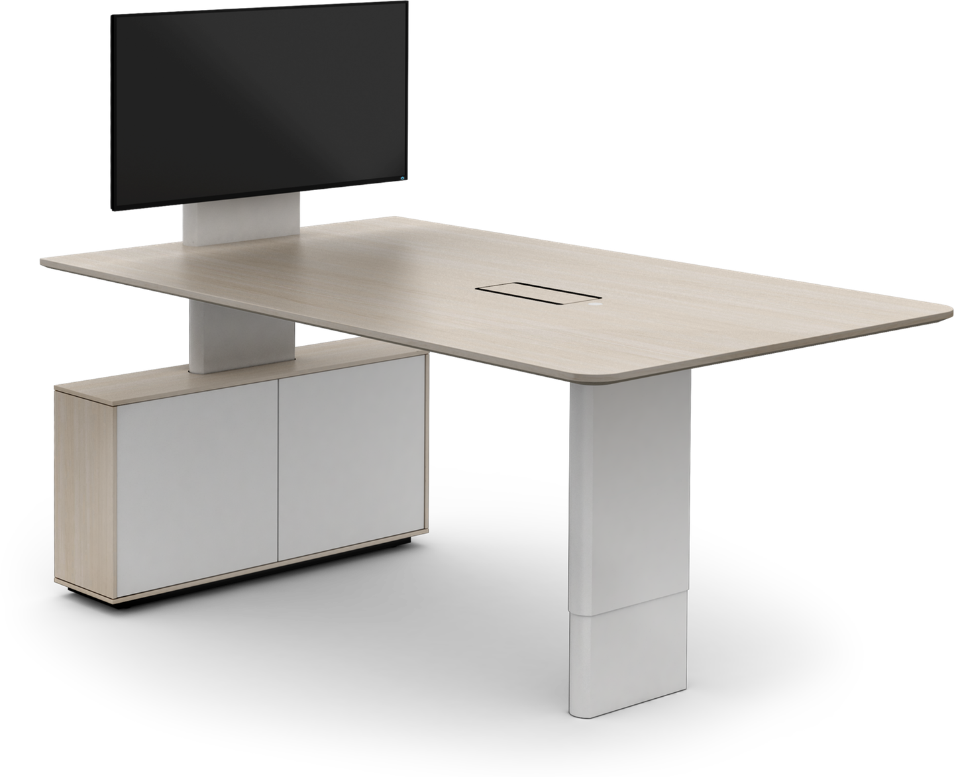
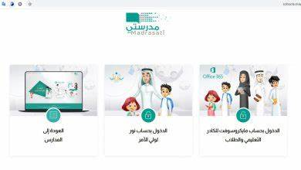



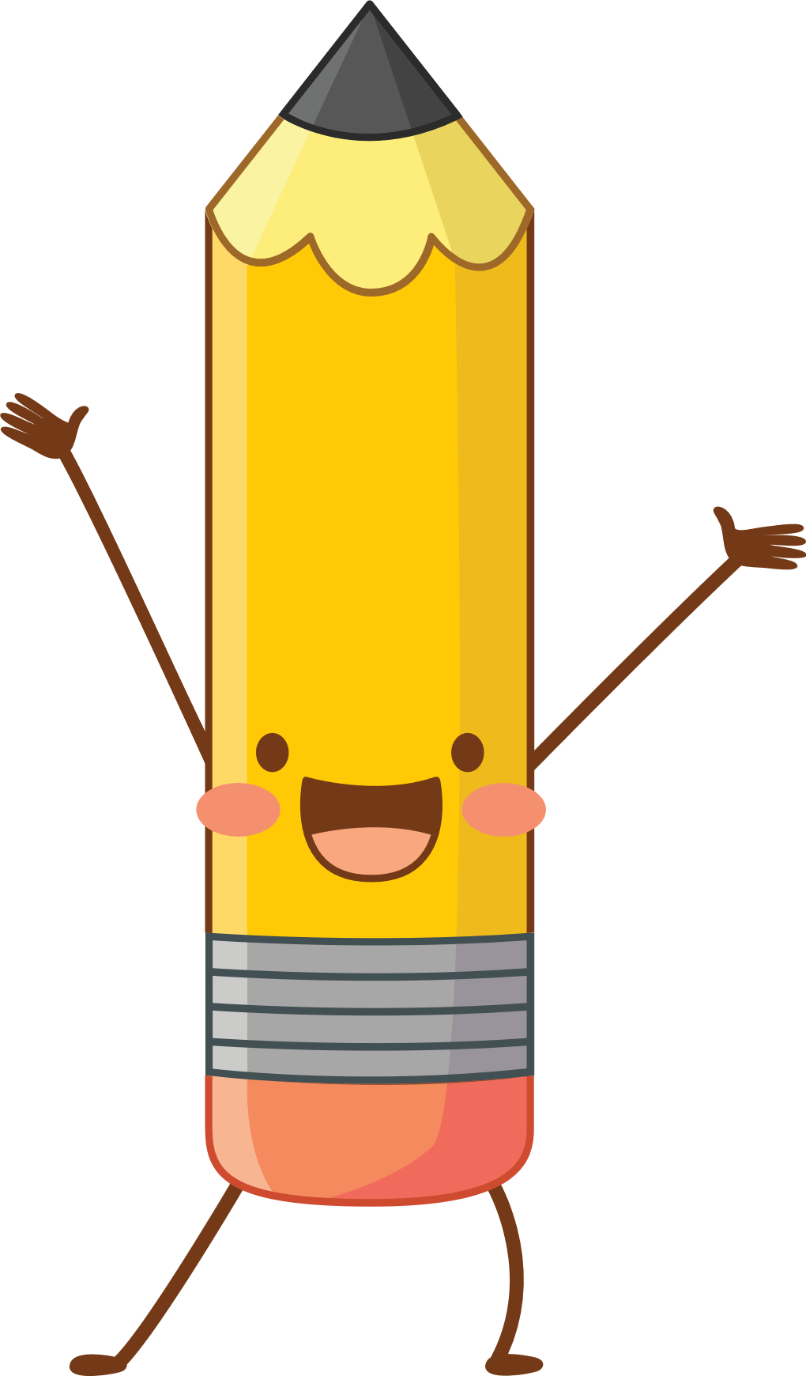
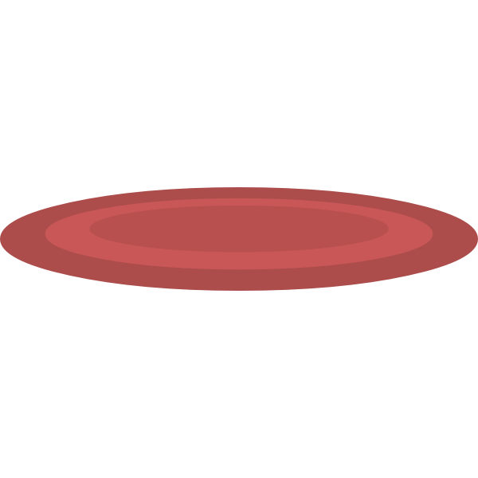


I love English

Slide 3

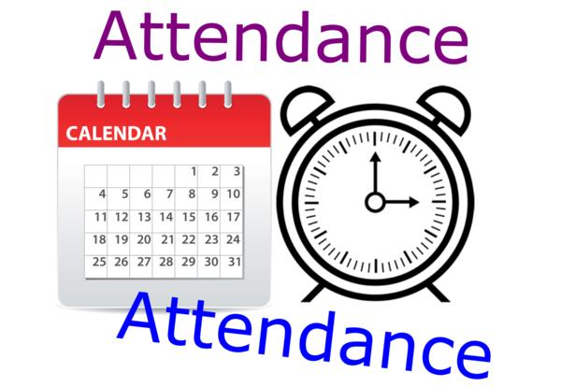
I love English

Slide 4
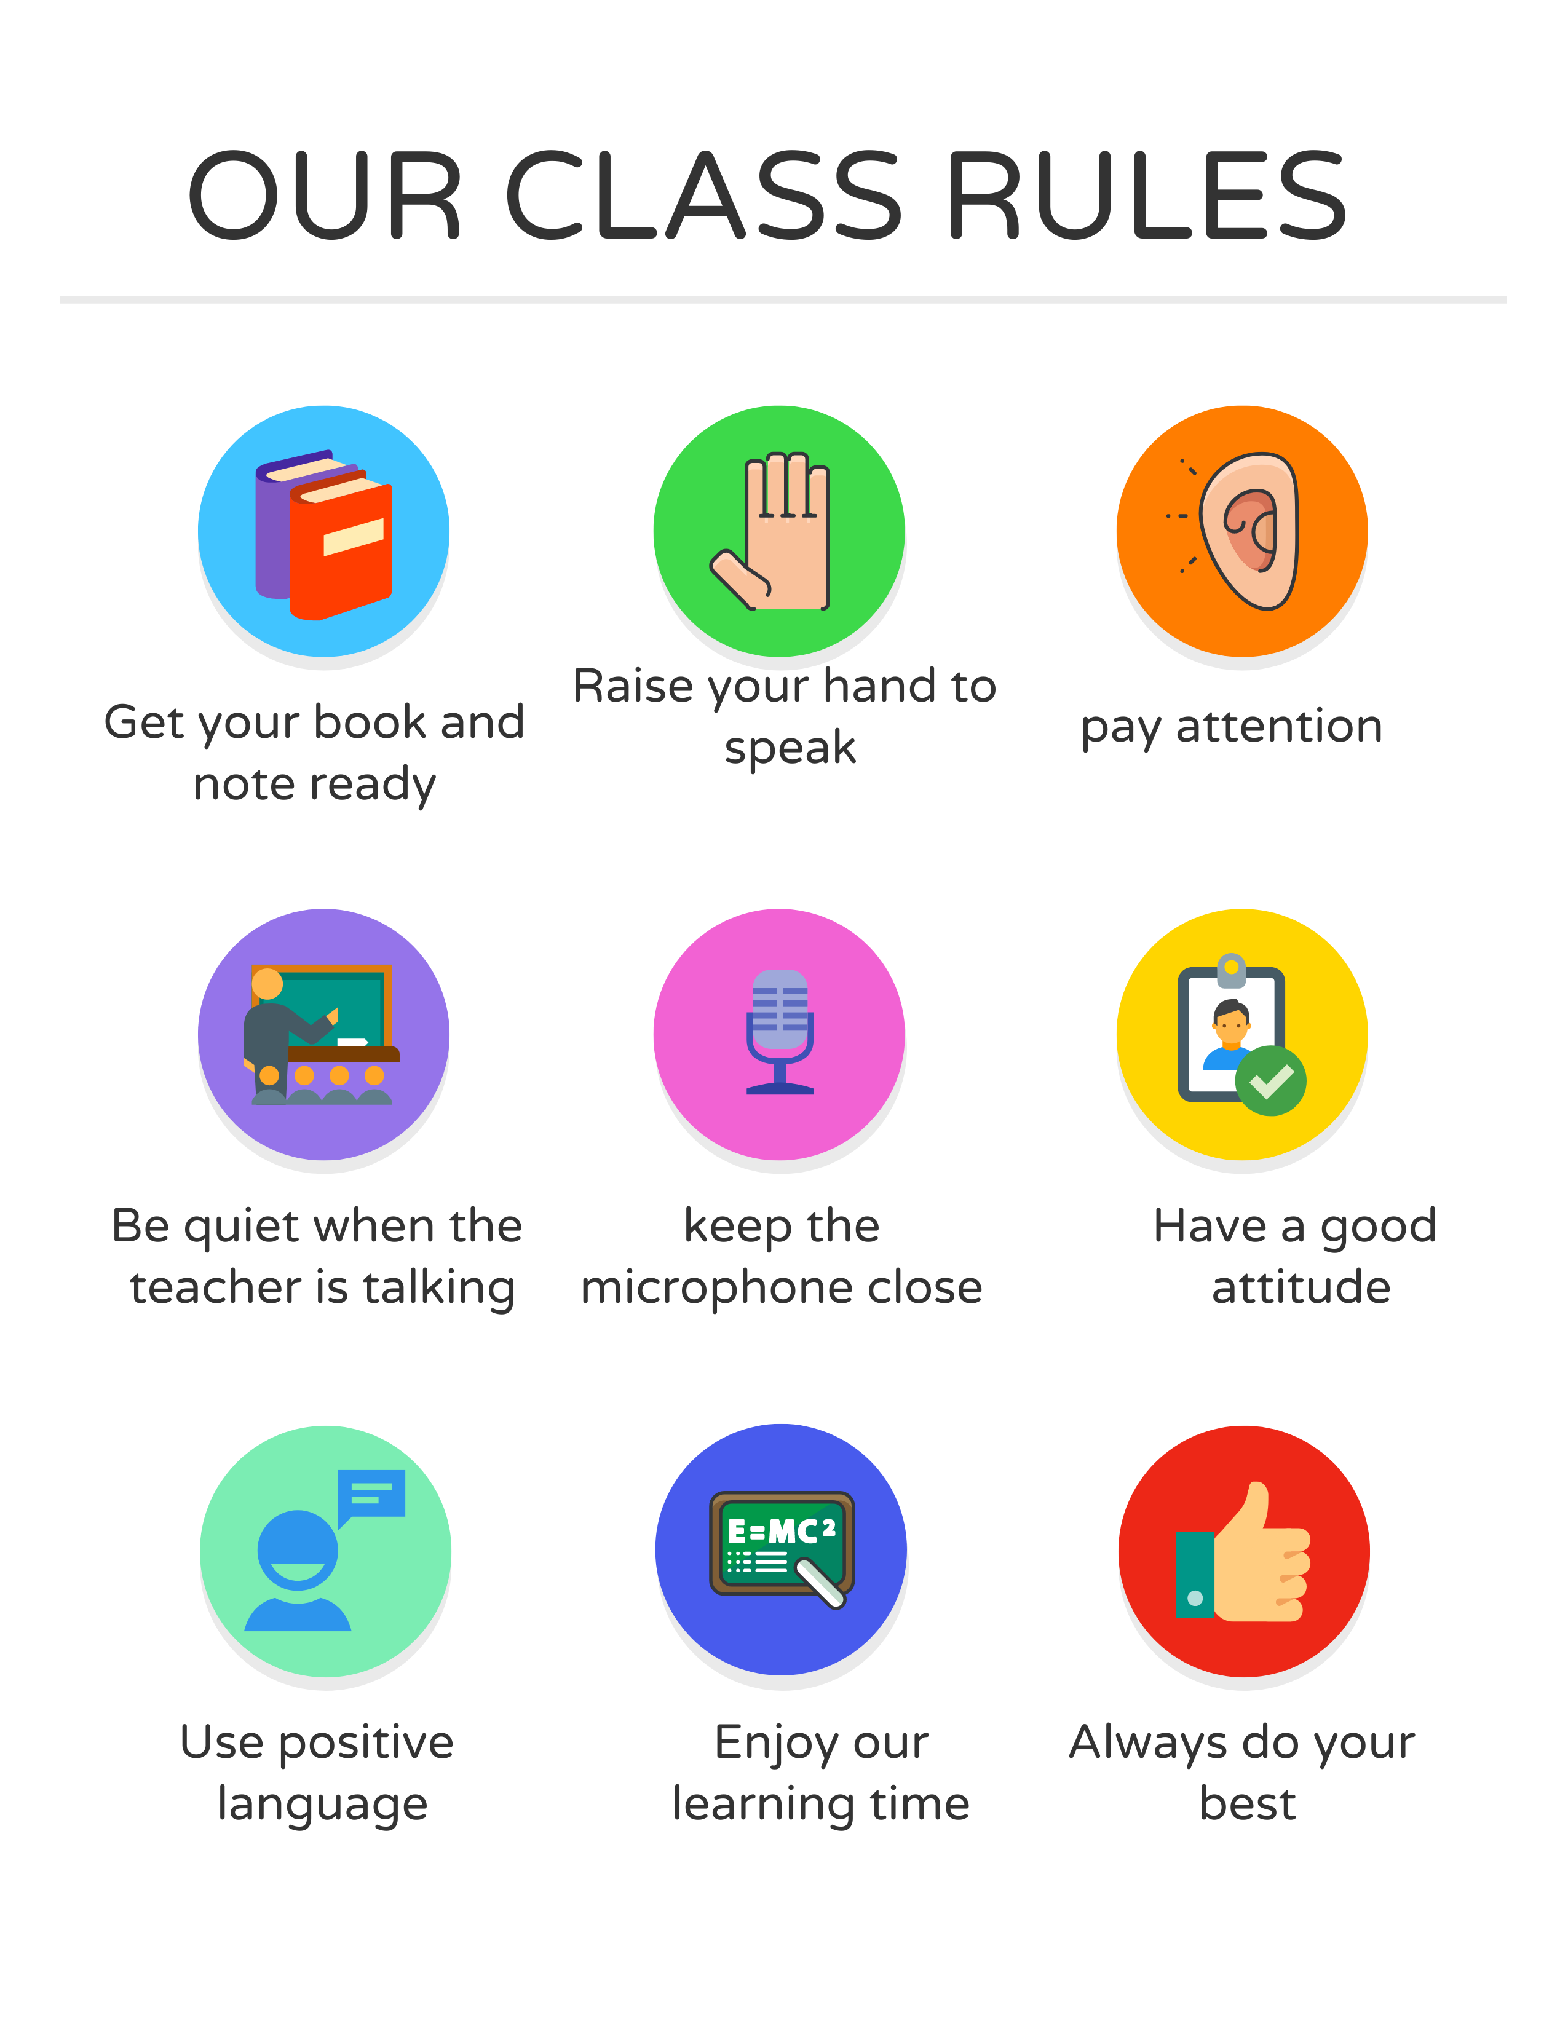

I love English

Slide 5

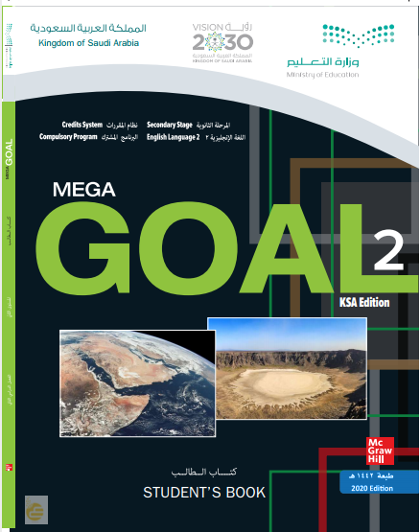

I love English
Revising the previous lesson
https://wordwall.net/resource/11419090

Slide 6

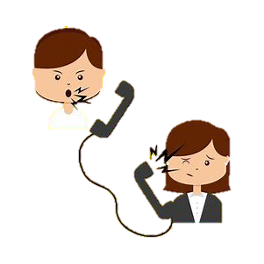

I love English
Mega Goal 2
Unit 3
(Complaints, Complaints)
Form, Meaning and Function
Sunday
16/7/1442

Slide 7

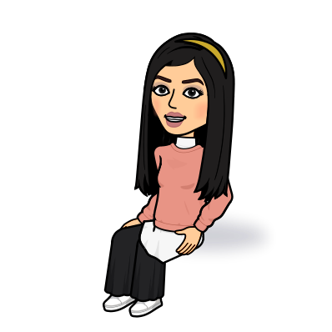
I love English
Lesson Goals
Students will be able to:
Form sentences using the present perfect tense.
Use gerund after certain verbs,
Differentiate between subject pronoun and object pronoun.
Form sentences using infinitive after (Need/Want/Like)
Use two-word verbs as imperative.

Slide 8


Let’s start with a game
Try to classify the verbs in a minute
https://wordwall.net/resource/676133

Slide 9
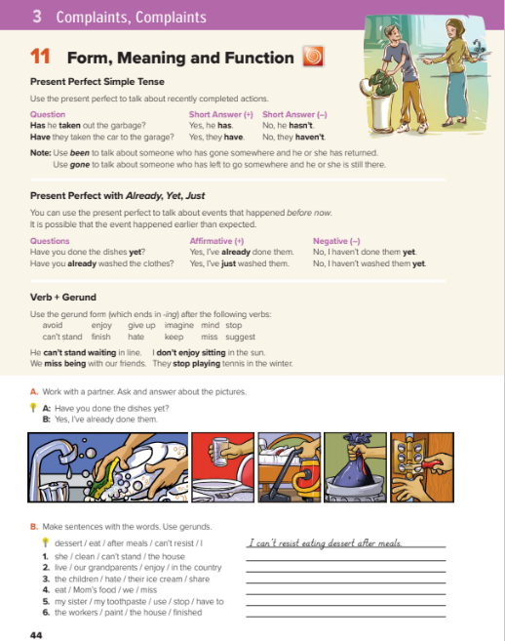

I love English
Open your Student’s book page: 44

Slide 10
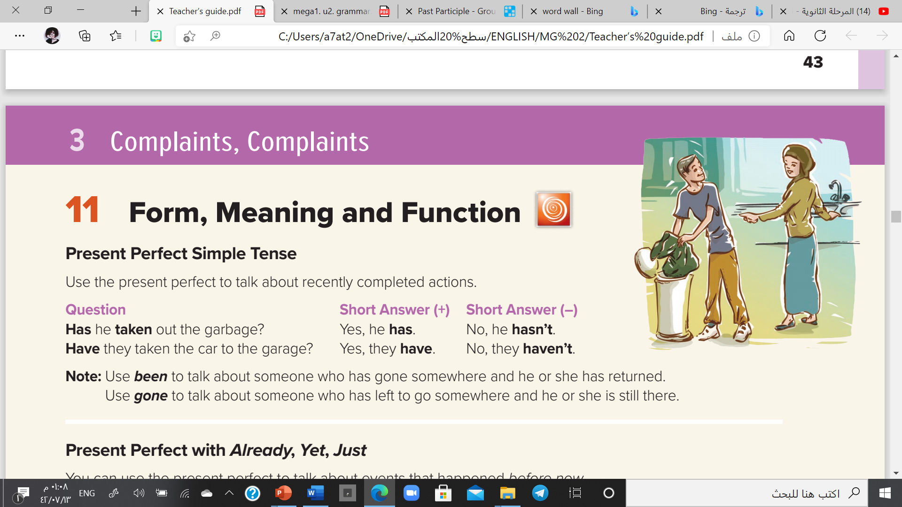

Slide 11

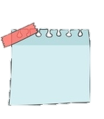
Present Perfect Simple
He
She
I
They
You
We
has
Form
S
+
has / have
+
V3 (past participle)
have
I have finished my homework.
e.g.
He has taken out the garbage.
I have been to Paris.
(It means I’ve travelled to Paris and I’ve returned)
NOTE
NOTE
She has gone to Paris.
Use been to talk about someone who has gone somewhere and he or she has returned
Use gone to talk about someone who has left to go somewhere and he or she is still there
(It means I’ve travelled to Paris and I’m still there, I haven’t returned)

Slide 12
Negative
Form
S
+
has / have
+
not
+
V3 (past participle)
He
has
finished his homework.
e.g.
not

Slide 13
Yes/No Questions
Have
Has
Form
+
S
+
V3 (past participle) ?
Has
has
he
finished his homework
He
.
e.g.
?
Yes, he has.
No, he hasn’t.

Slide 14
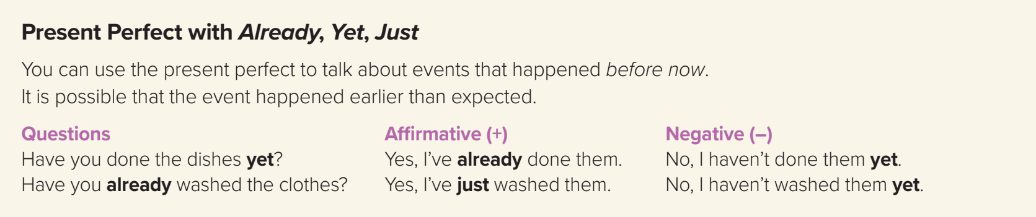

Slide 15
Present Perfect with (Already/yet/just)
❍ Yet
(Used in question and negative sentence to talk about something which expected to happen at any time up to now)
(It comes at the end)
• Have you written the report yet?
• No, I haven’t written the report yet.
❍ Already
(Used in question and affirmative sentence to talk about something that happened before now)
(It comes between has/have and the past participle verb or at the end)
• Have you already taken the money?
• I have already taken the money.
• The train has left already!
❍ Just
(Used in question and affirmative sentence to talk about something that happened very recently)
(It comes between has/have and the past participle verb)
• Have you just taken my pen?
• I have just finished my homework.

Slide 16
Time Expressions
A short time before
Before now
At any time up to now
just
already
yet
Questions
and
positive sentences
comes between has/have and the past participle
Questions
and
positive sentences
comes between has/have and the past participle
or at the end of the clause
Questions
and
negative sentences
comes at the end

Slide 17

https://wordwall.net/resource/11157374

Slide 18
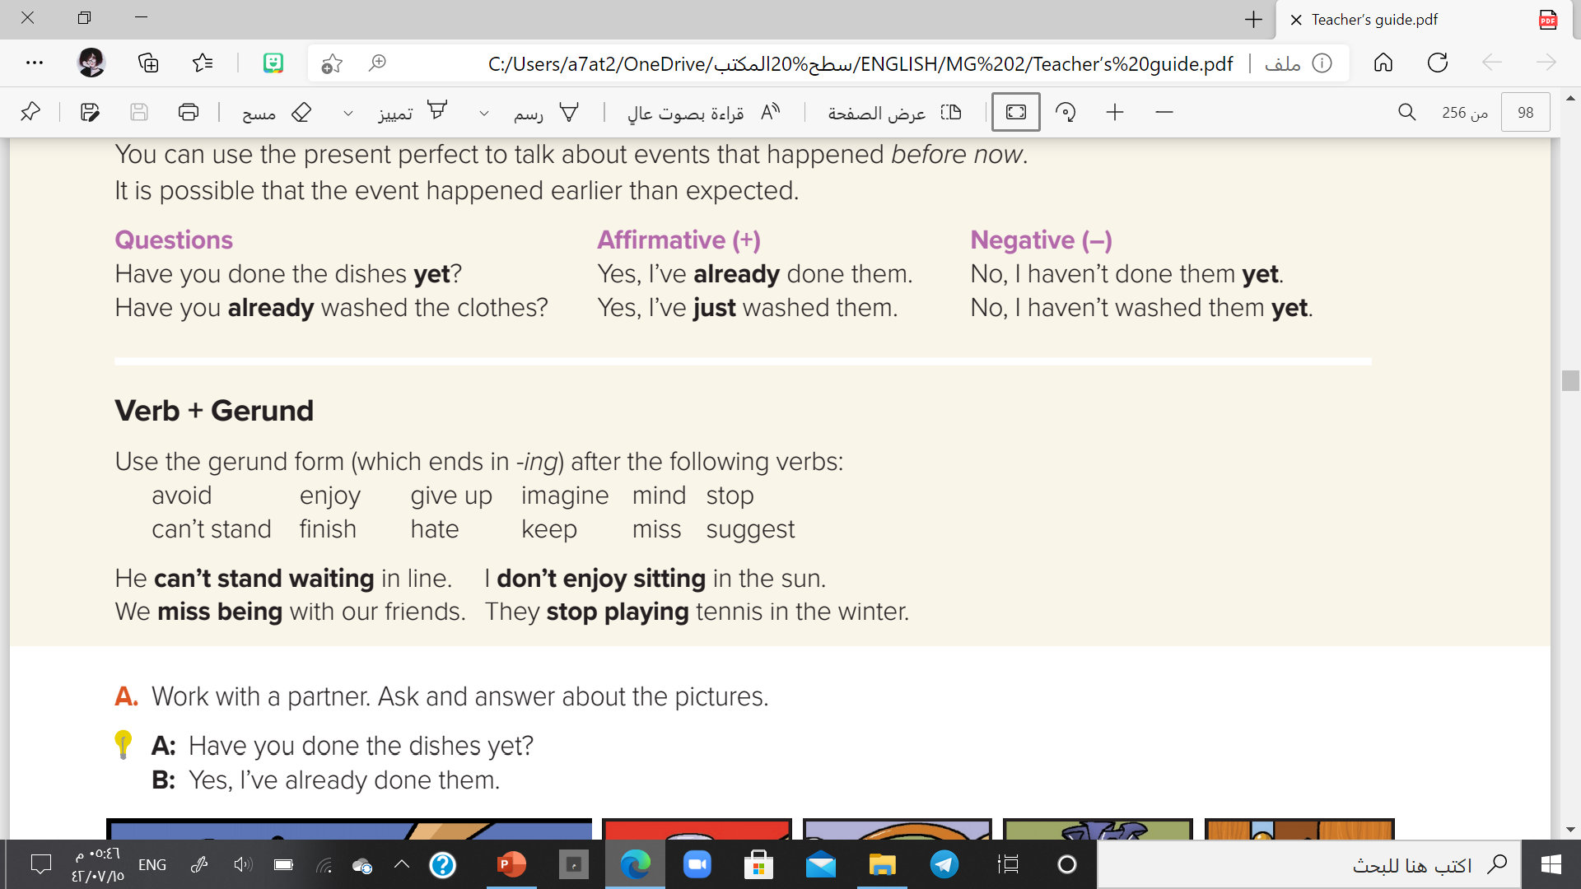

Slide 19
Gerund =
V-ing
Use it after the following verbs
He can’t stand waiting in line.
She avoids talking to her.
He finished doing his homework.
I enjoy playing football.
enjoy
Can’t stand
finish
Give up
mind
avoid
stop
suggest
hate
keep
miss
imagine

Slide 20
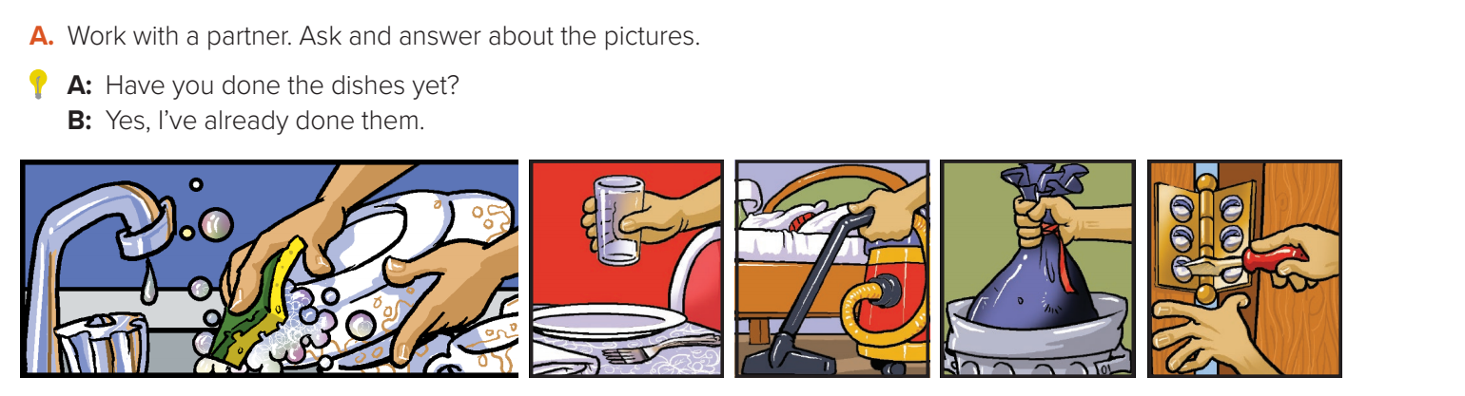
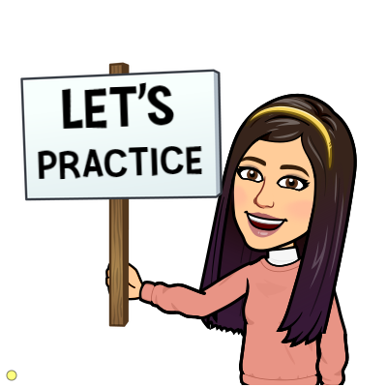
A: Have you cooked dinner yet?
B: Yes. I’ve already eaten it.
A: Have you cleaned your room?
B: Yes. I’ve already done it.
A: Have you taken out the garbage?
B: Yes. I’ve already done it.
A: Have you fixed the door?
B: Yes. I’ve already done it.

Slide 21
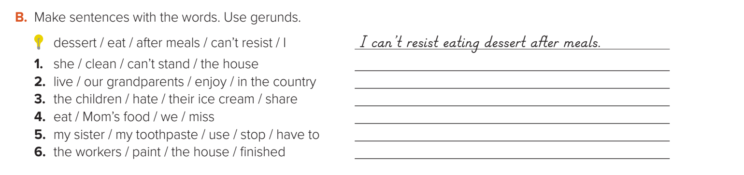
She can’t stand cleaning the house.
Our grandparents enjoyed living in the country.
The children hated sharing their ice cream.
We missed eating Mom’s food.
My sister has to stop using my toothpaste.
The workers have finished painting the house.

Slide 22
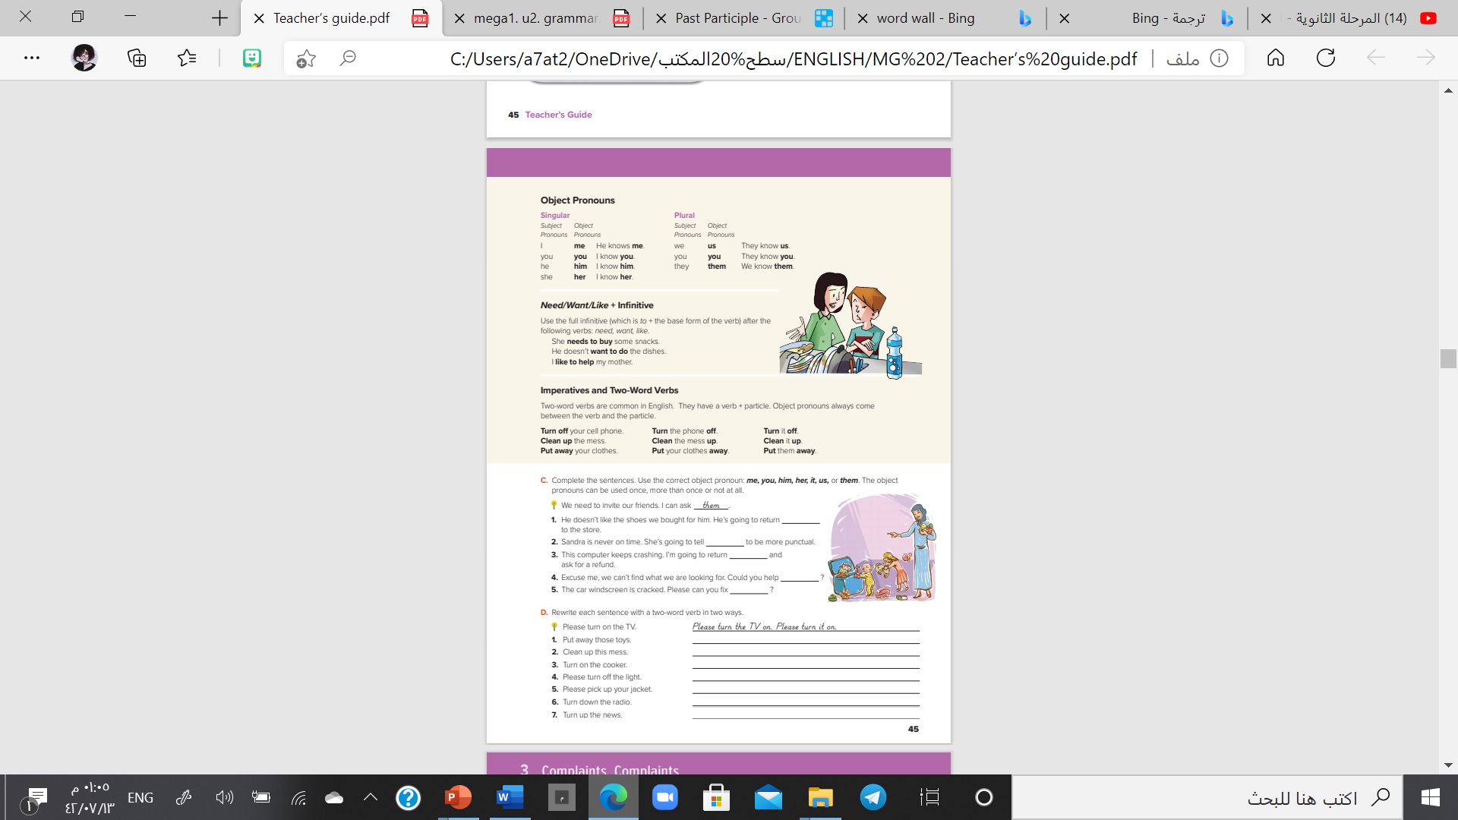
I love English
Open your Student’s book page: 45

Slide 23
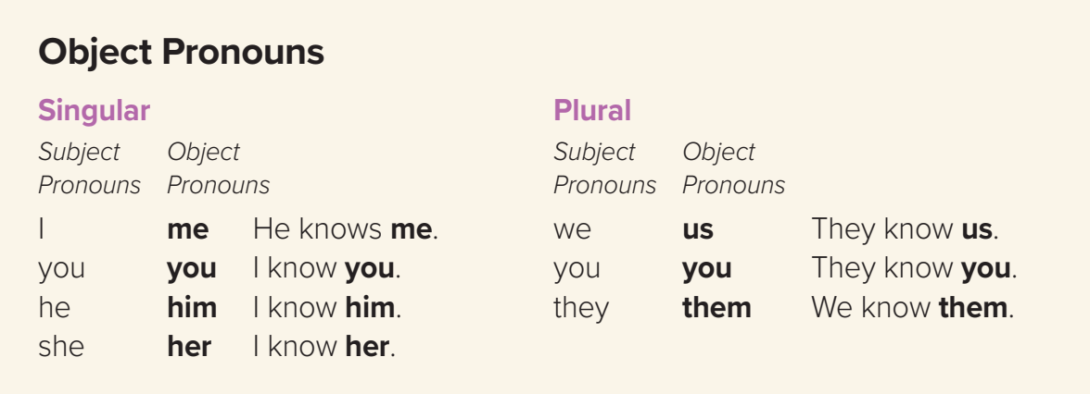
Could you help me, please?
She teaches us English.
I told them to be quite.

Slide 24
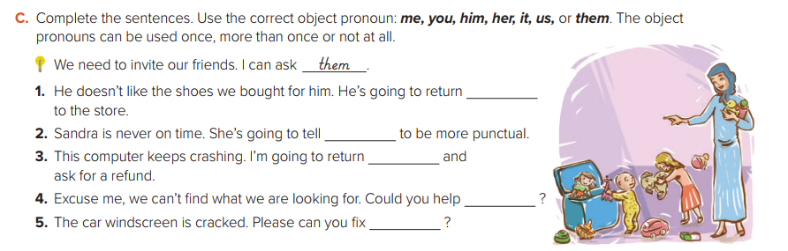
them
her
it
me/us
it

Slide 25
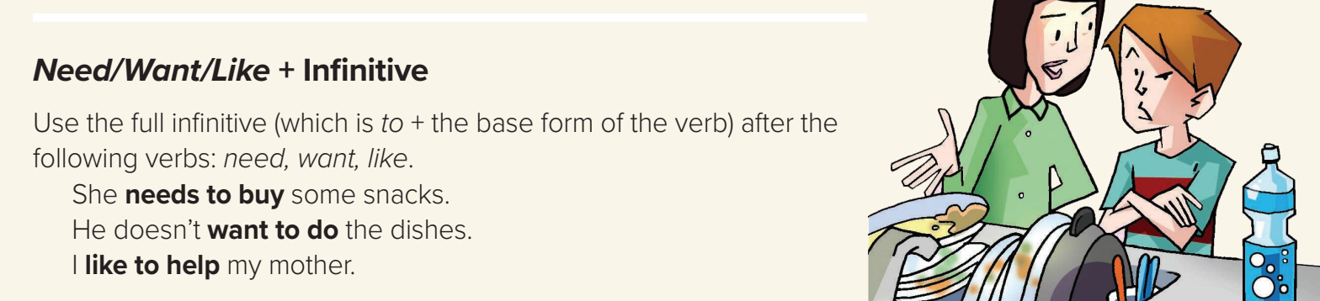
I need to take more exercise.
She wants to get a good grade in English.
I like to watch TV.

Slide 26
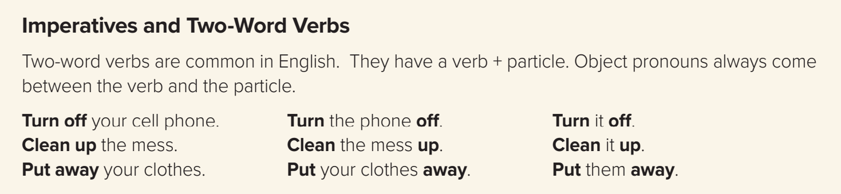
Turn
off
the light.
off
the light
Turn
Turn
the light
it
off

Slide 27
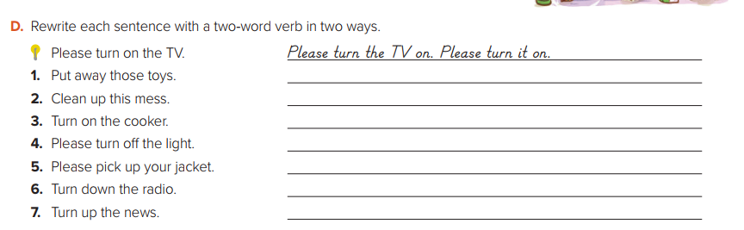
Put those toys away. Put them away .
Clean this mess up. Clean it up .
Turn the cooker on. Turn it on .
Please turn the light off. Please turn it off .
Please pick your jacket up. Please pick it up .
Turn the radio down. Turn it down .
Turn the news up. Turn it up .

Slide 28



Homework
I love English
WORKBOOK Page30

Slide 29
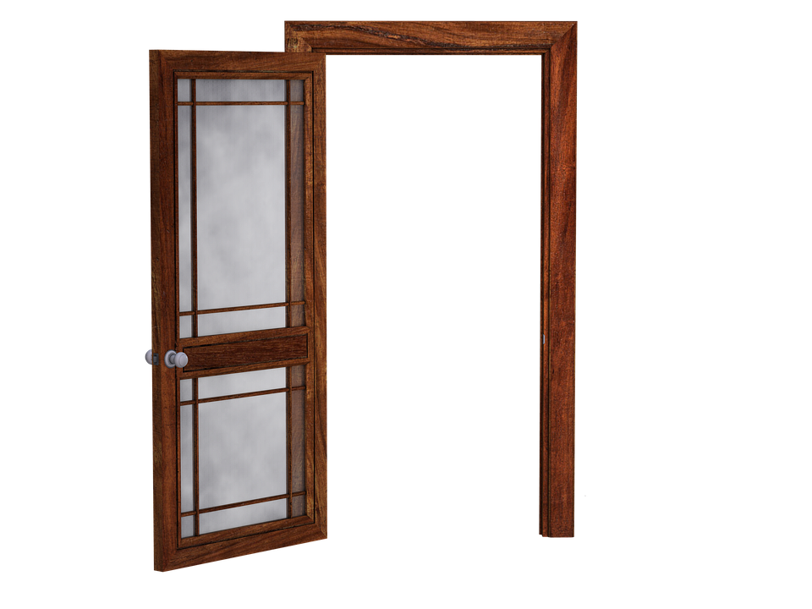
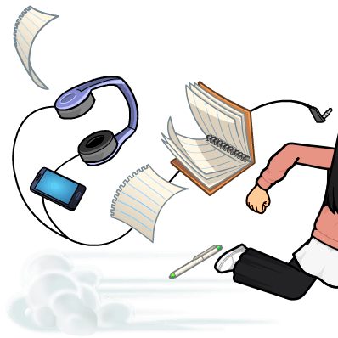
Homework
WORKBOOK Page30

Slide 30
Homework
WORKBOOK Page30

Slide 31
Homework
WORKBOOK Page30

Slide 32
Homework
WORKBOOK Page30

Slide 33
Homework
WORKBOOK Page30

Slide 34

Homework
WORKBOOK Page30

