Slide 1
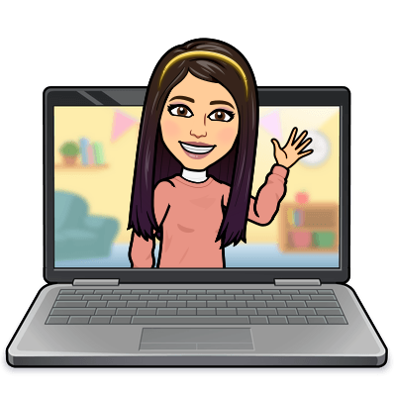

Hello My lovely students
I’m your teacher
Hanan AlShobaily

Slide 2

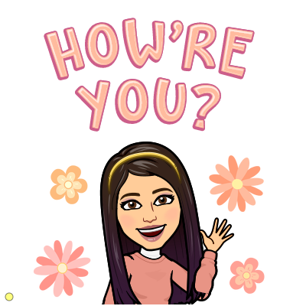


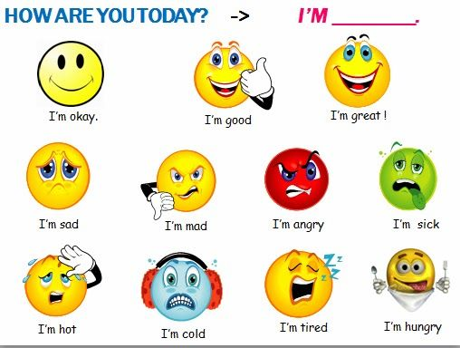
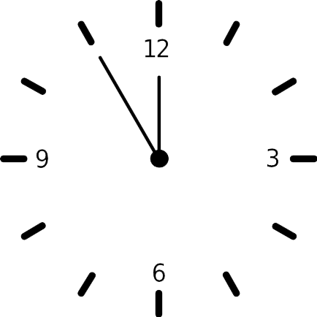



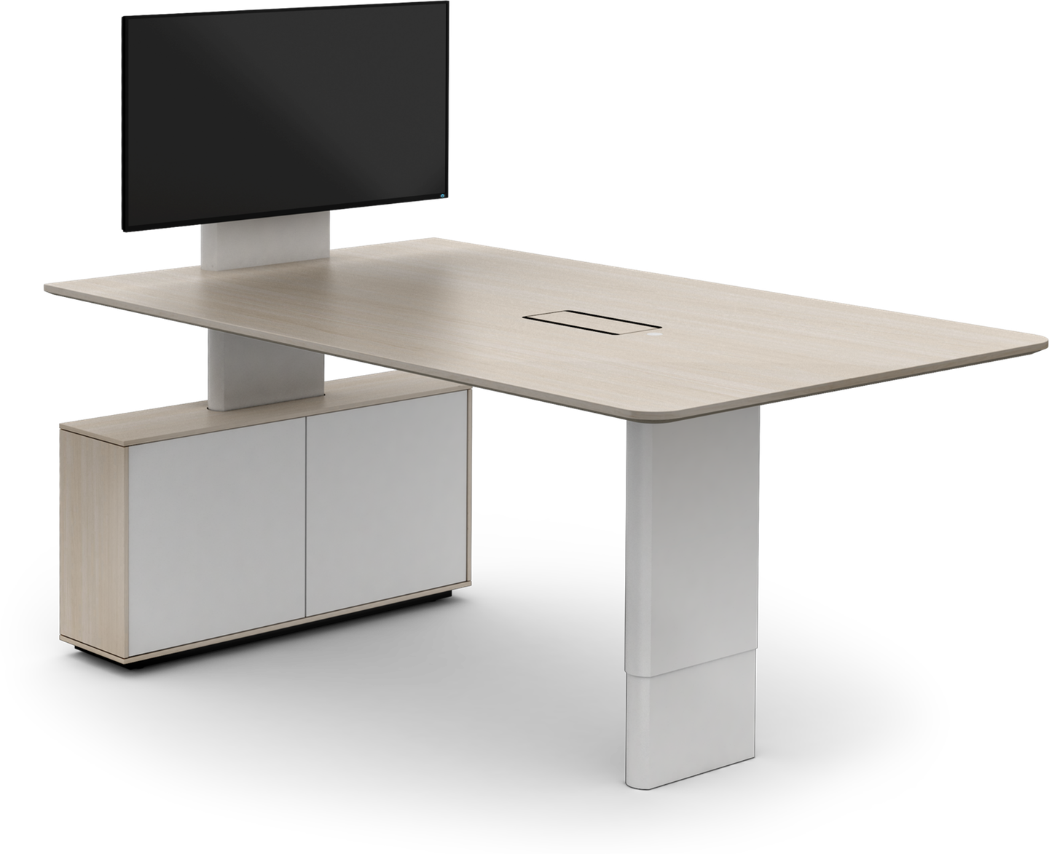
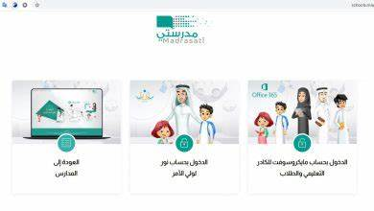







I love English

Slide 3
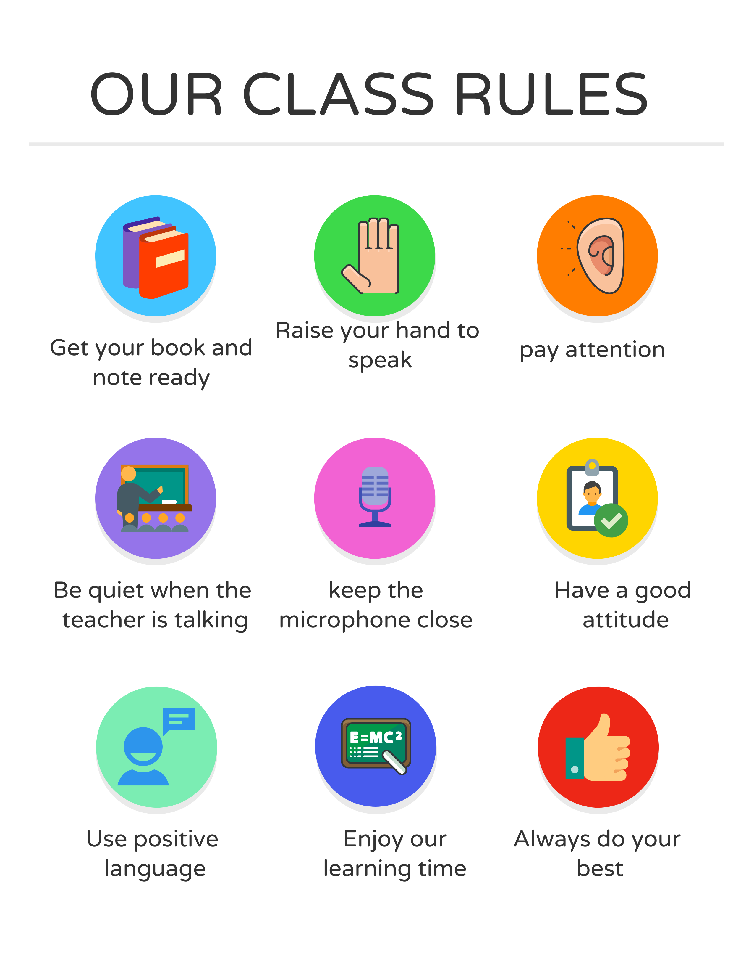
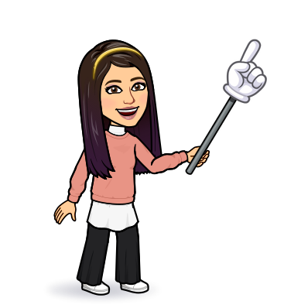
I love English

Slide 4
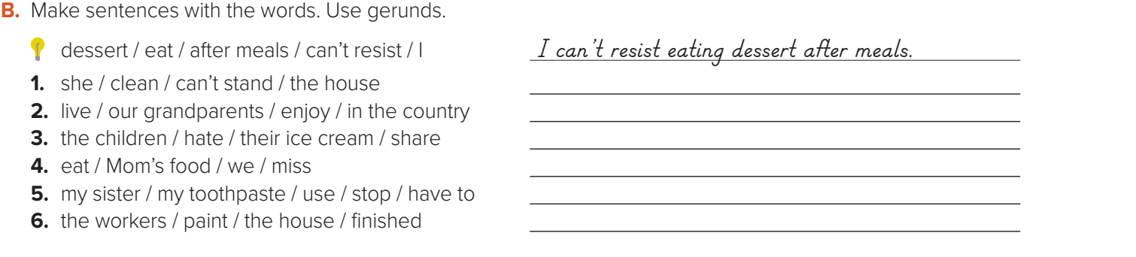
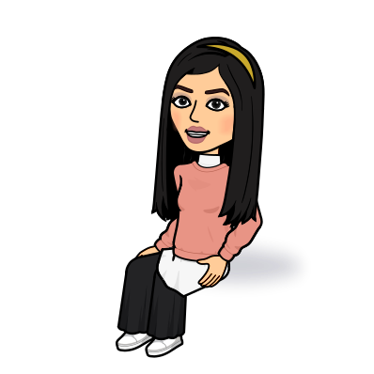
I love English
She can’t stand cleaning the house.
Our grandparents enjoyed living in the country.
Let’s do the homework before starting the lesson.
The children hated sharing their ice cream.
We missed eating Mom’s food.
Mega Goal 2 .. SB (44)
My sister has to stop using my toothpaste.
The workers have finished painting the house.

Slide 5
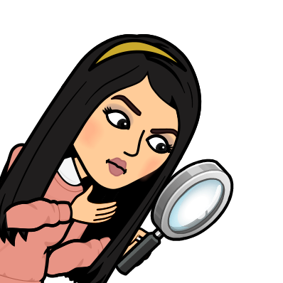


I love English
Revising the previous lesson
https://www.liveworksheets.com/1-tl1777588ks

Slide 6

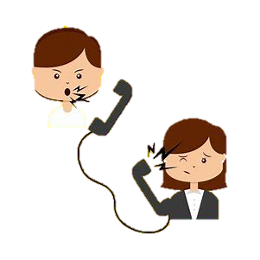

I love English
Mega Goal 2
Unit 3
(Complaints, Complaints)
Form, Meaning and Function
Monday
17/7/1442

Slide 7

I love English
Lesson Goals
Students will be able to:
Differentiate between subject pronoun and object pronoun.
Form sentences using infinitive after (Need/Want/Like)
Use two-word verbs as imperative.

Slide 8
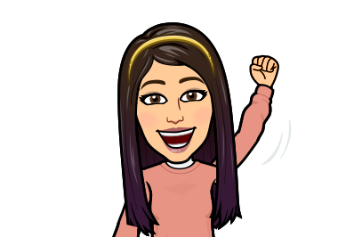
Let’s start with a game
https://wordwall.net/resource/787025

Slide 9
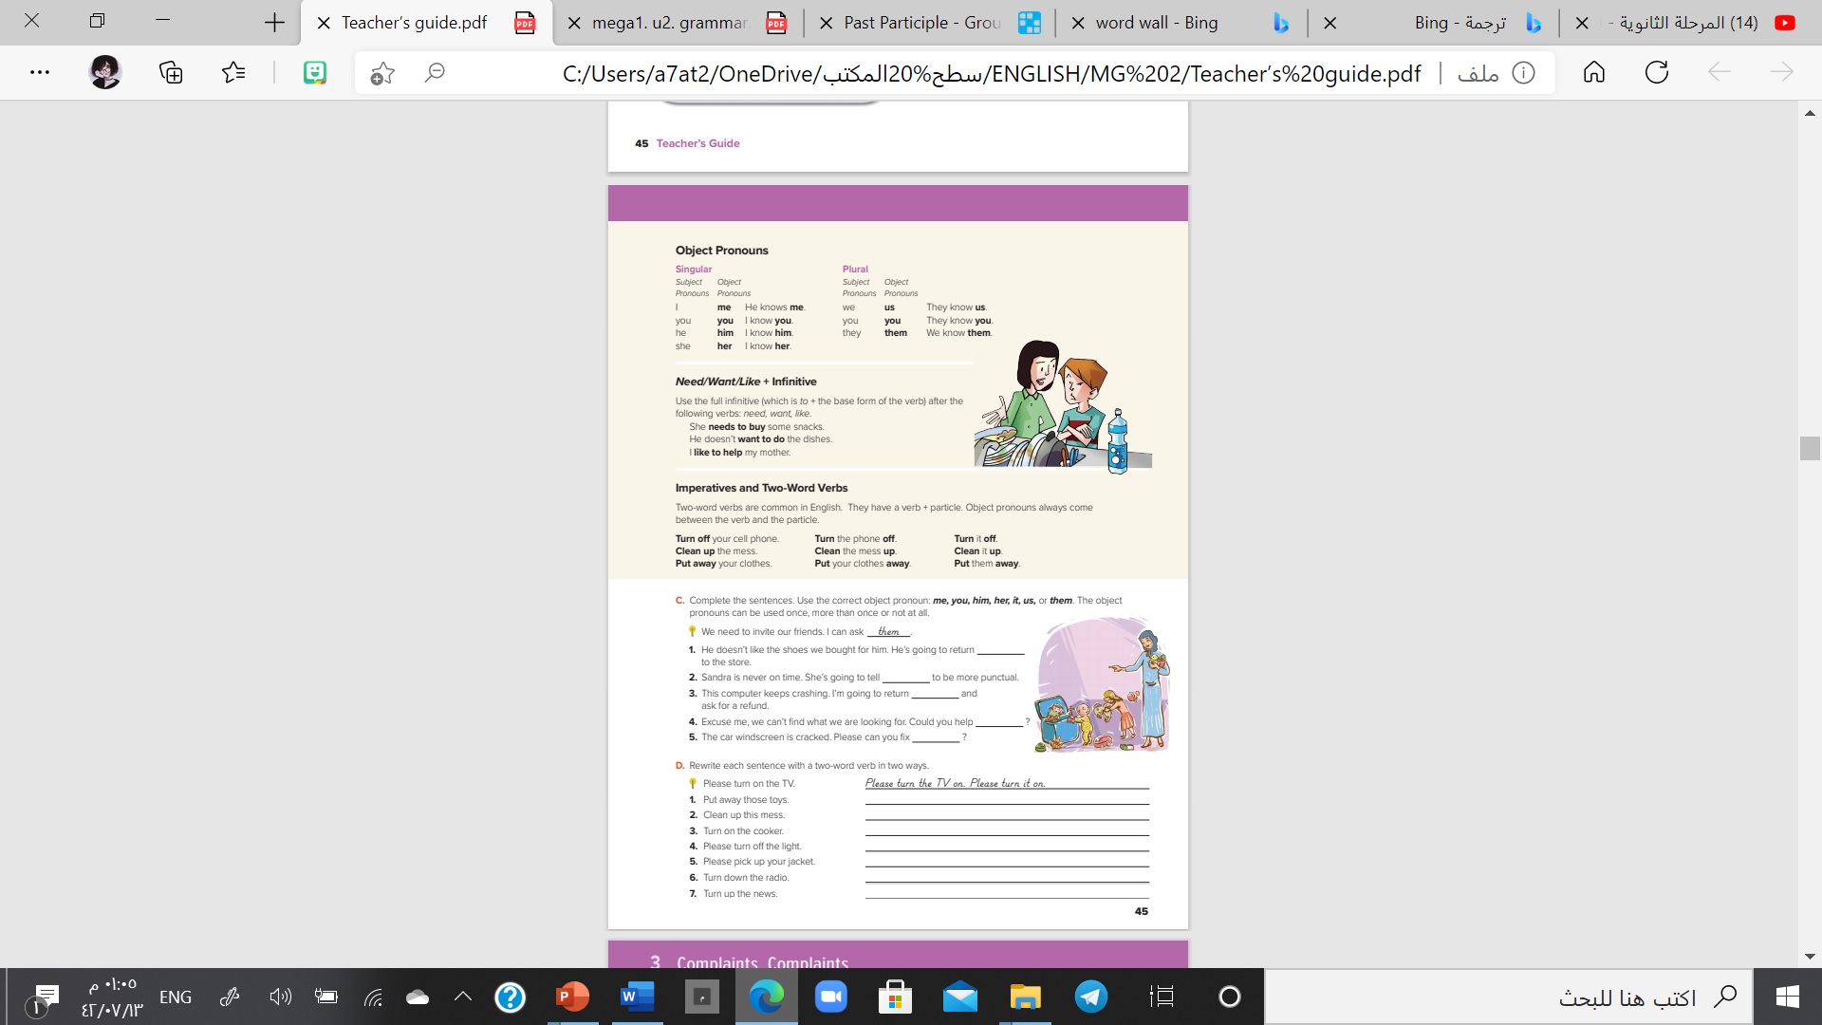
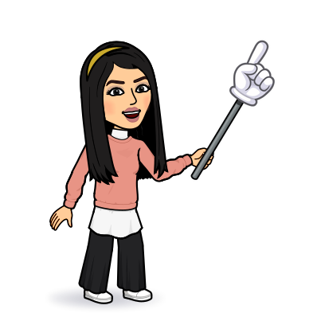
I love English
Open your Student’s book page: 45

Slide 10
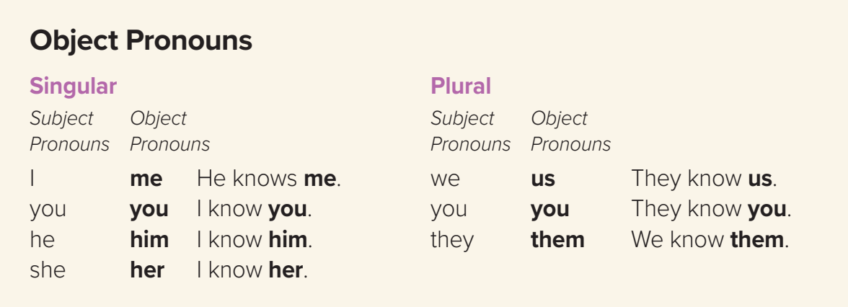
Could you help me, please?
She teaches us English.
I told them to be quite.

Slide 11
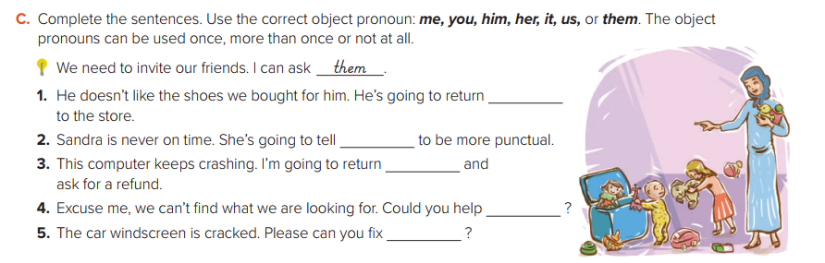
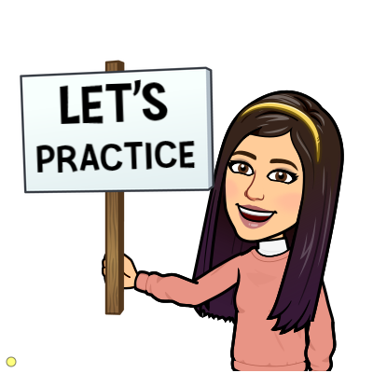
them
her
it
us
it

Slide 12
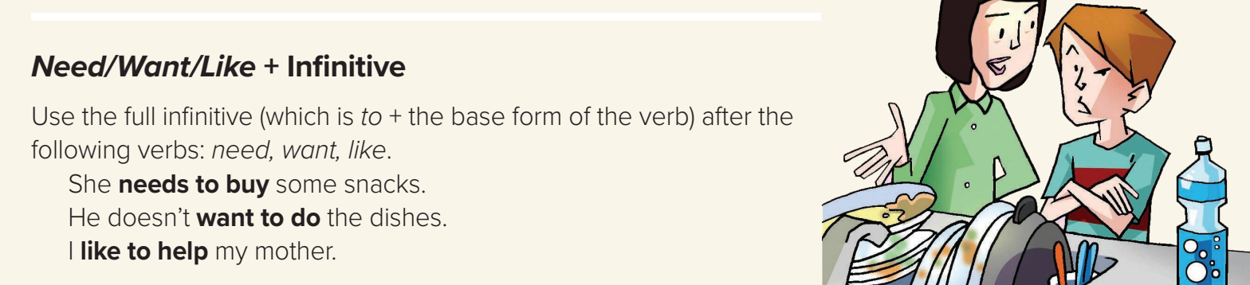
need/ want/ like
infinitive (to+V1 the base form)
Form
S
+
+
I need to take more exercise.
e.g.
She wants to get a good grade in English.
I like to watch TV.

Slide 13
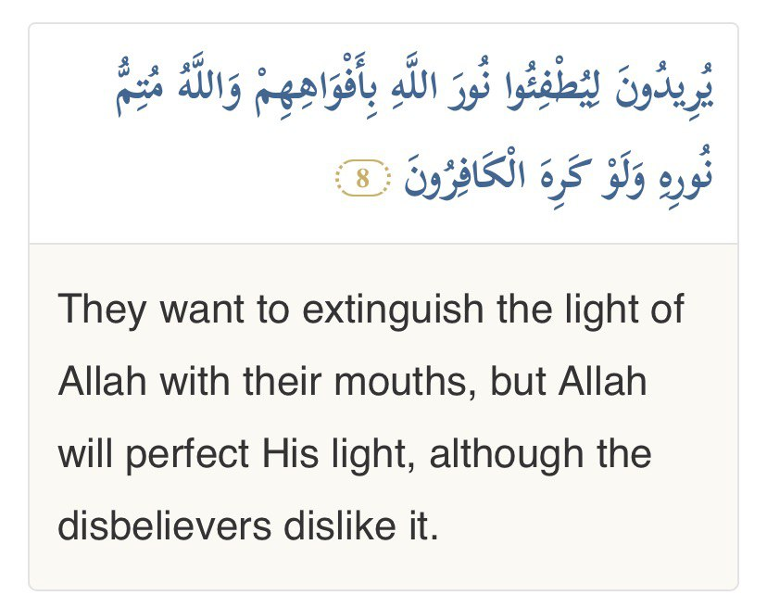

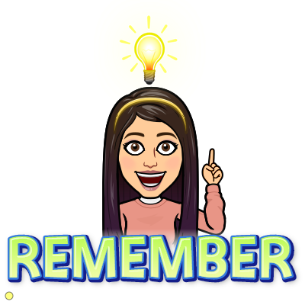
Example in Quran
If you want to talk to Allah, then you need to pray.
If you want Allah to talk to you, then you need to read the Quran.

Slide 14
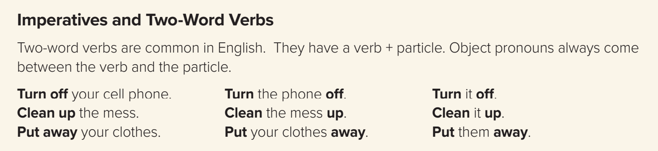
Turn
off
the light.
off
the light
Turn
Turn
the light
it
it
off
off
✗
Turn

Slide 15
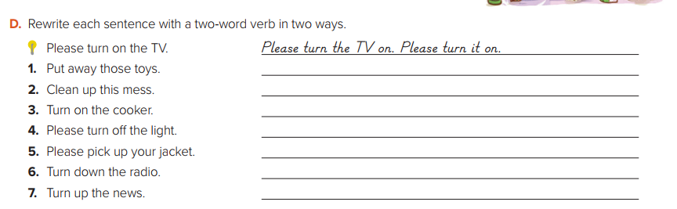
Put those toys away. Put them away.
Clean this mess up. Clean it up.
Turn the cooker on. Turn it on.
Please turn the light off. Please turn it off.
Please pick your jacket up. Please pick it up.
Turn the radio down. Turn it down.
Turn the news up. Turn it up.

Slide 16

Let’s go!
Ready for the last game!
https://wordwall.net/resource/11560268

Slide 17


You don’t need magic to change the world and make your country better.
If you want to develop it, Keep improving yourself.
Avoid listening to negative people.
Keep trying and never give up.

Slide 18

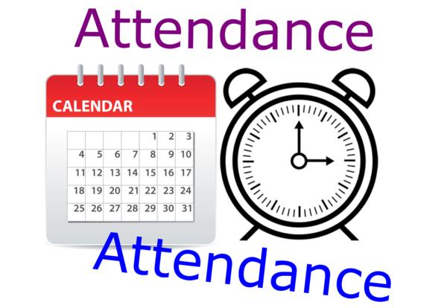
I love English

Slide 19
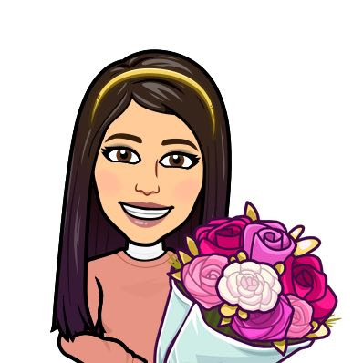

I love English
Thank You
P. Soad Makramy
for attending my class
and
Thank you
my lovely students for your great effort.

Slide 20



Homework
I love English
WORKBOOK Page30

Slide 21
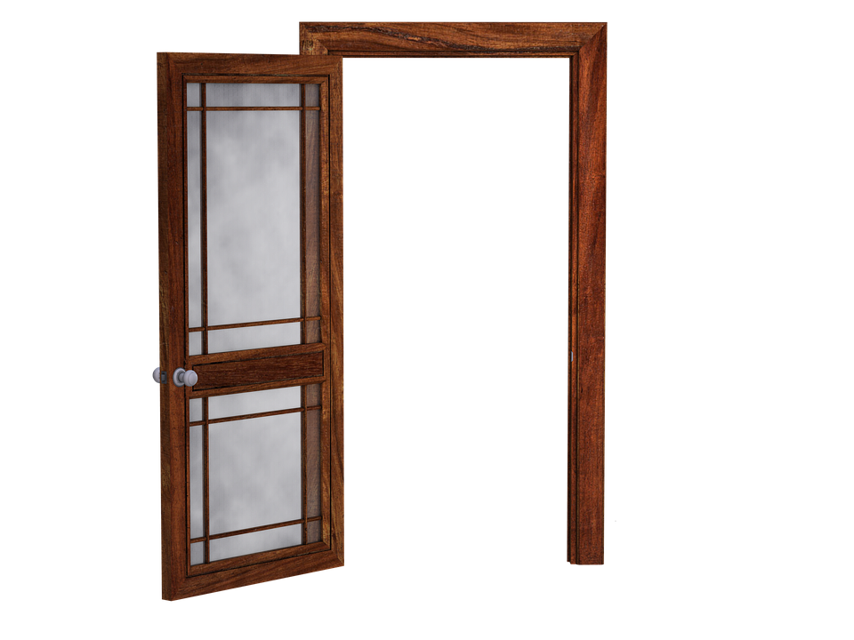
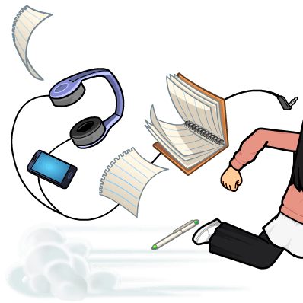
Homework
WORKBOOK Page30

Slide 22
Homework
WORKBOOK Page30

Slide 23
Homework
WORKBOOK Page30

Slide 24
Homework
WORKBOOK Page30

Slide 25
Homework
WORKBOOK Page30

Slide 26
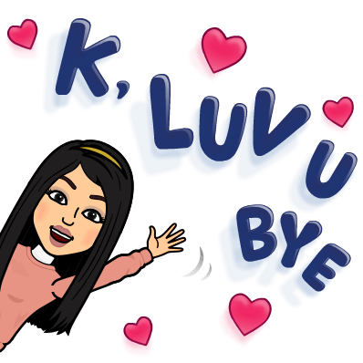
Homework
WORKBOOK Page30

