Slide 1


Hello My lovely students
I’m your teacher
Hanan AlShobaily

Slide 2
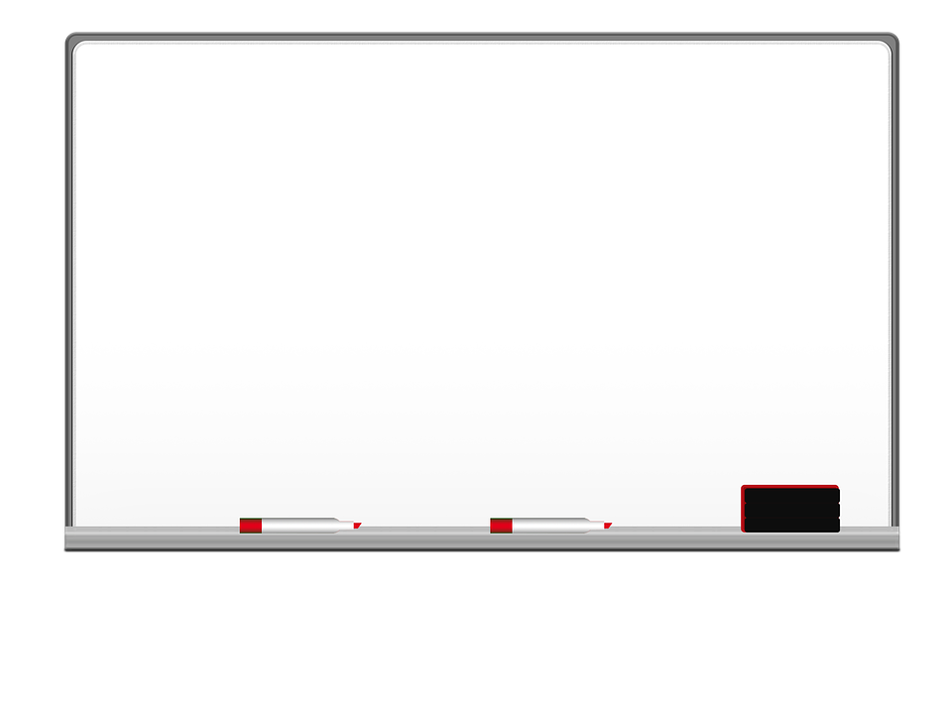

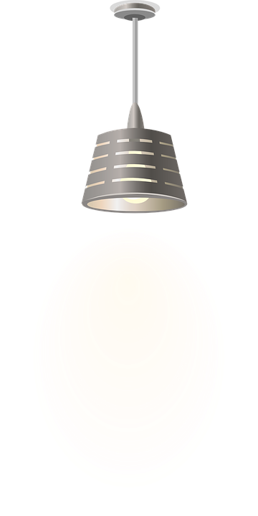

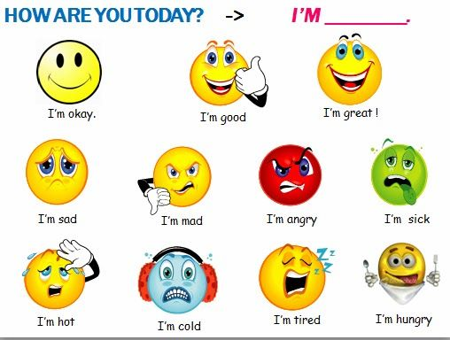
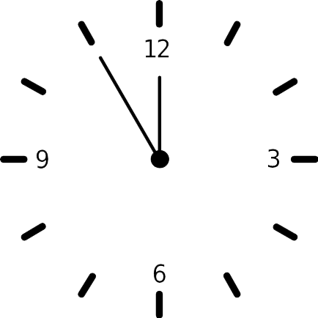



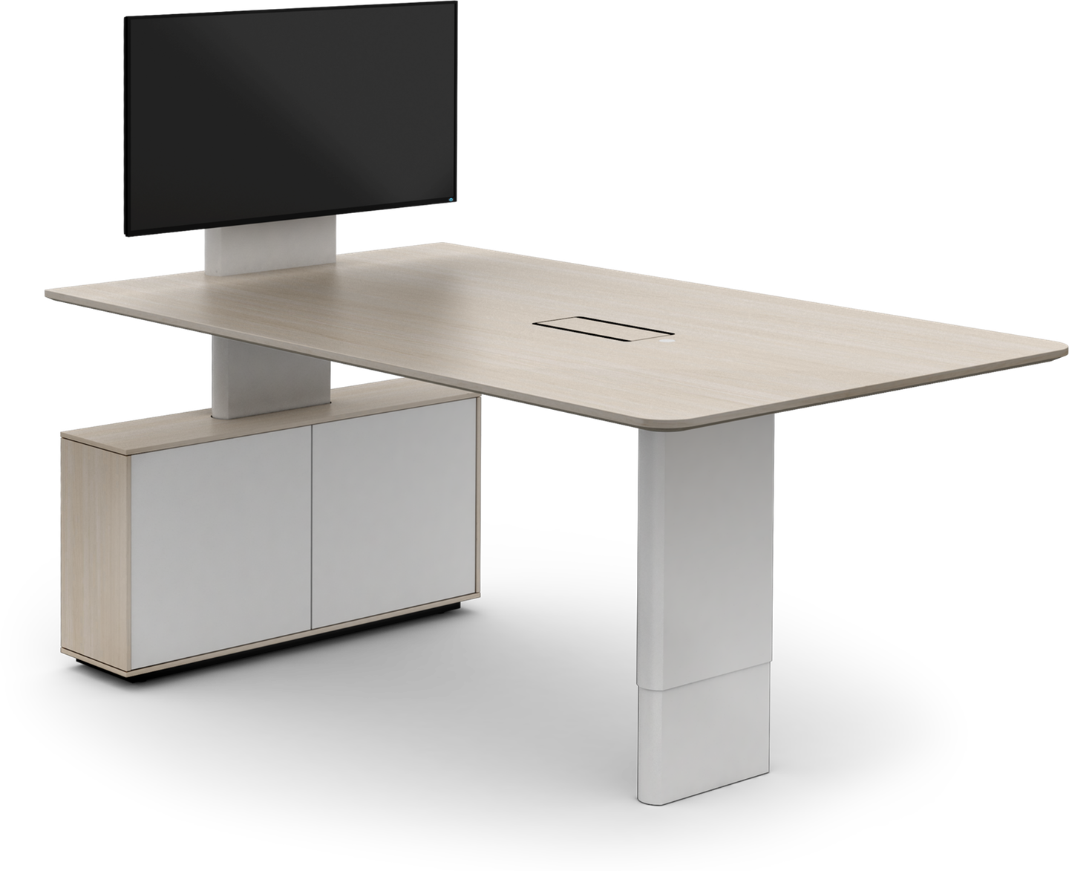








I love English

Slide 3


I love English

Slide 4


I love English

Slide 5
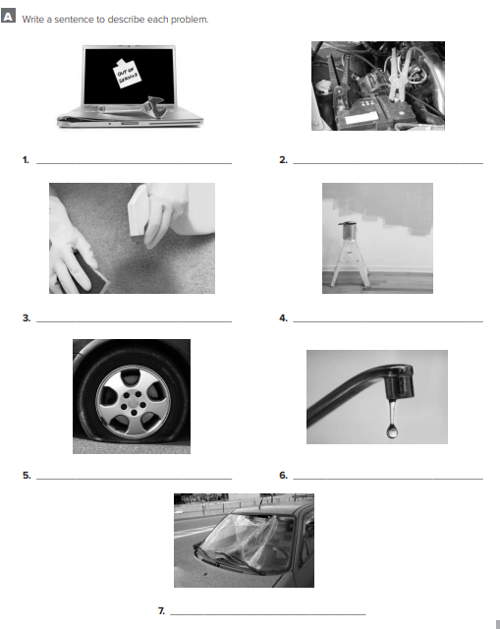

I love English
The computer crashed.
The computer needs to be repaired.
The car has a dead battery.
The battery is dead.
Let’s do the homework before starting the lesson.
Mega Goal 2 .. WB (21)
The carpet has a stain.
The carpet is stained.
The wall needs to be repainted
The car has a flat tire.
There’s a dripping faucet.
The faucet is dripping.
The truck has a cracked windshield.
The windshield is cracked.

Slide 6

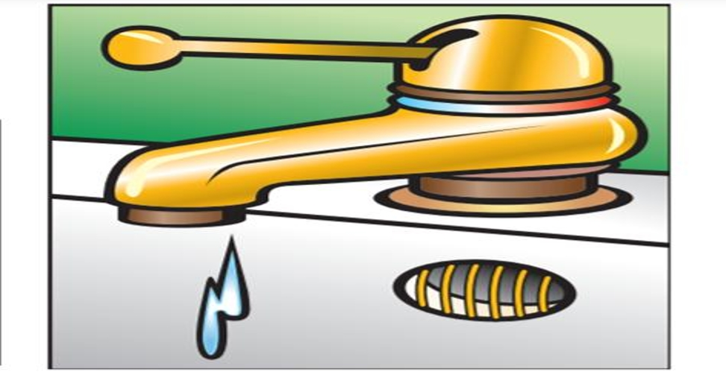
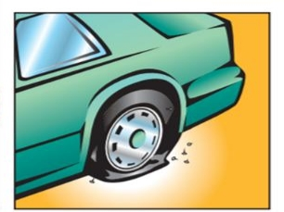
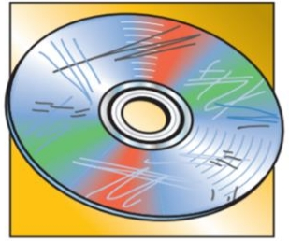
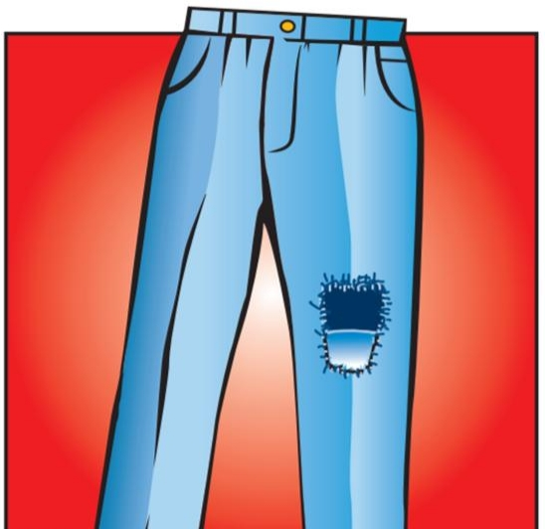
I love English
Revising the previous lesson
Put the words under the suitable picture:
scratched DVD
dripping faucet
torn
flat tire

Slide 7

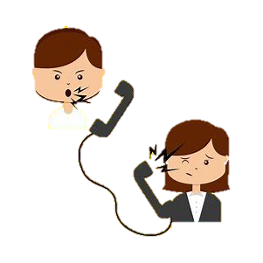

I love English
Mega Goal 2
Unit 3
(Complaints, Complaints)
Grammar
Sunday
9/7/1442

Slide 8

I love English
Lesson Goals
Students will be able to:
Write correct sentences with “need to be”.
Express making someone else do a service by using
“have / get something done”.
Use the past participle as an adjective.
Write what is wrong with a thing in a picture.
Form a solution correctly.
Complete a conversation with the correct form of verbs.

Slide 9


I love English
Past participle | Past simple | Present simple
break
fixed
fix
Classify the verbs
broke
fixed
broken

Slide 10
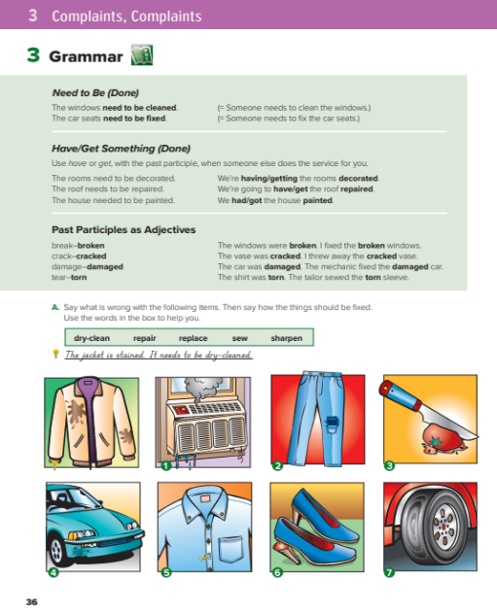

I love English
Open your Student’s book page: 36

Slide 11
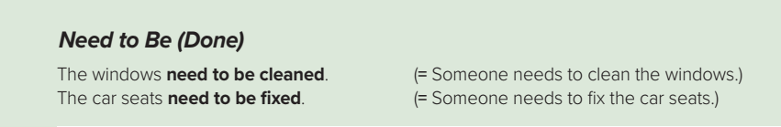
needs
need
Form
S
+
+
to be
+
V (past participle)
The walls need to be repainted.
e.g.
The phone needs to be fixed.

Slide 12

Write the sentence, use (need to be):
1- room / cleaned
The room needs to be cleaned.
2- car / repaired
The car needs to be repaired.
3- pants / sewn
The pants need to be sewn.

Slide 13




In a minute write with your group a list of five things that need to be done to make your school or community better.

Slide 14
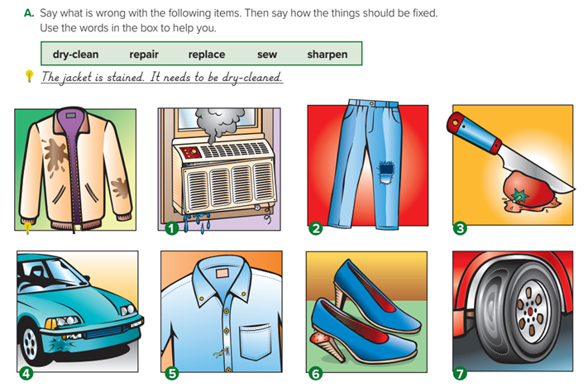
The jacket is stained.
The air-conditioner isn’t working.
The pants are torn.
The knife doesn’t cut.
It needs to be dry-cleaned.
They need to be sewn.
It needs to be sharpened.
It needs to be repaired.

Slide 15
The car has a dent.
The button on the shirt is gone.
The heel on the shoe is broken.
The tire on the car is worn.
The dent needs to be repaired.
It needs to be sewn back on.
It needs to be replaced.
It needs to be replaced.

Slide 16
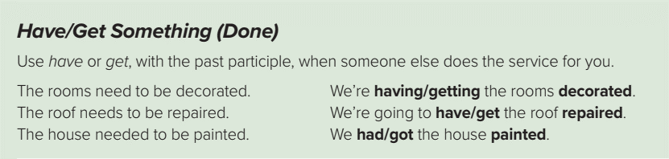
The roof needs to be repaired.
I will repair it this weekend.
(It means I’ll do it myself)
I will have/get it repaired this weekend.
(It means I’ll ask someone else to do it)

Slide 17
It’s a causative verb when we want to talk about something that someone else did for us or for another person.
Use
have/has
get
Form
S
+
+
object
+
V (past participle)
We have/get our windows cleaned.
(someone else usually cleans the windows (present)
I had/got my hair cut.
(someone else cut my hair) (past)
e.g.
We are having/getting our car washed.
(someone else are washing the car now) (progressive)
I will have/get my house painted tomorrow.
(someone else will paint the house) (future)

Slide 18
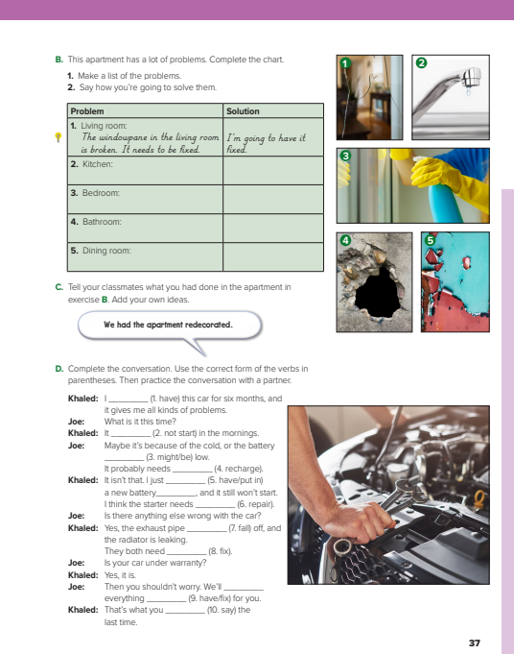
I love English
Open your Student’s book page: 37

Slide 19
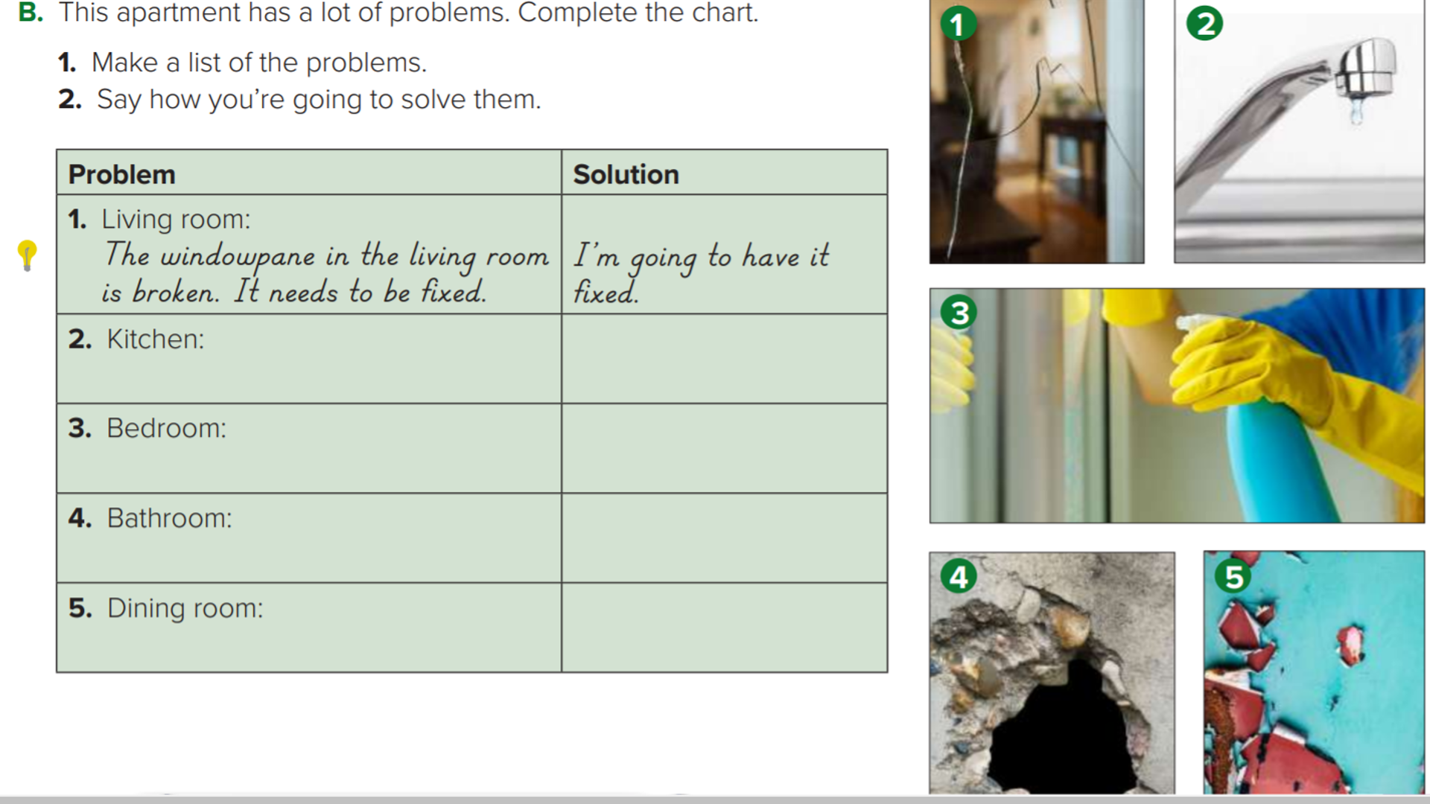
The faucet is dripping. /
It needs to be replaced.
I’m going to have it replaced.
The mirror is stained. /
It needs to be cleaned.
I’m going to have it cleaned.
The wall has a hole in it. /
It needs to be filled.
I’m going to have it filled.
The floor has broken tiles.
They need to be replaced.
I’m going to have them replaced.

Slide 20
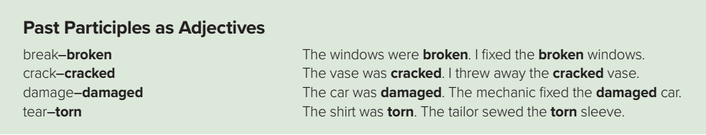
-Past participles can be used as an adjective to describe a noun.
Use
-Verbs that describe a state of being rather than an action, such as ( be, and verbs that are not used with objects, such as smile), cannot be used as past participle adjectives.
I broke a window.
I fixed the broken window.
e.g.
He cracked the vase.
He repaired the cracked vase.
Someone damaged a book.
The book was damaged.
Someone tore the paper.
The paper was torn.

Slide 21
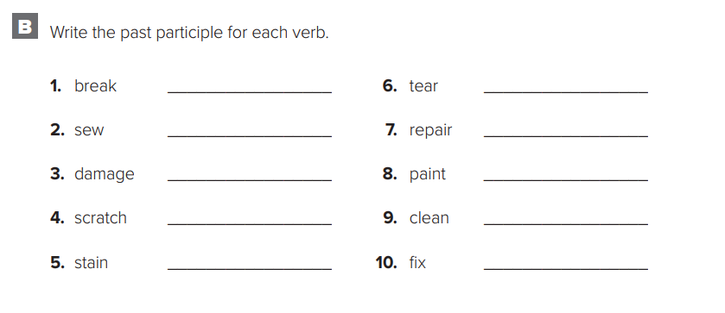
broken
torn
sewn
repaired
Mega Goal 2 .. WB (22)
damaged
painted
scratched
cleaned
stained
fixed

Slide 22


https://wordwall.net/resource/11047001

Slide 23
I love English
Open your Student’s book page: 37

Slide 24
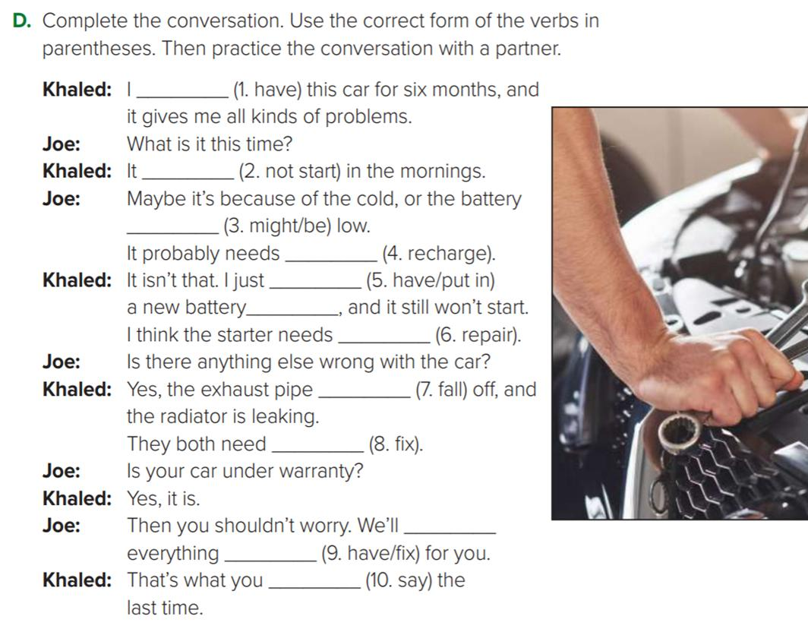
have had
doesn’t start
might be
to be recharged
had
put in
to be repaired
is falling
to be fixed
have
fixed
said

Slide 25



Homework
I love English
WORKBOOK Page22

Slide 26
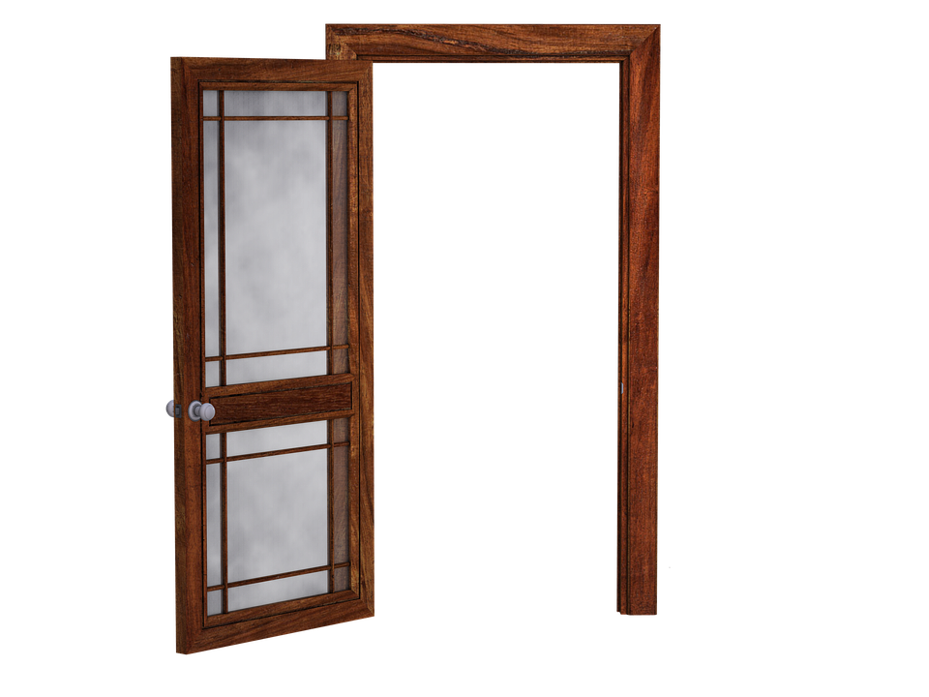
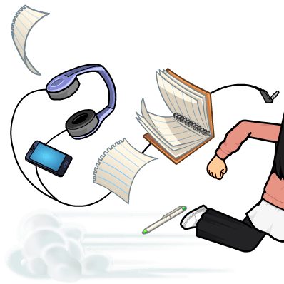
Homework
WORKBOOK Page22

Slide 27
Homework
WORKBOOK Page22

Slide 28
Homework
WORKBOOK Page22

Slide 29
Homework
WORKBOOK Page22

Slide 30
Homework
WORKBOOK Page22

Slide 31

Homework
WORKBOOK Page22

