Slide 1


Hello My lovely students
I’m your teacher
Hanan AlShobaily

Slide 2
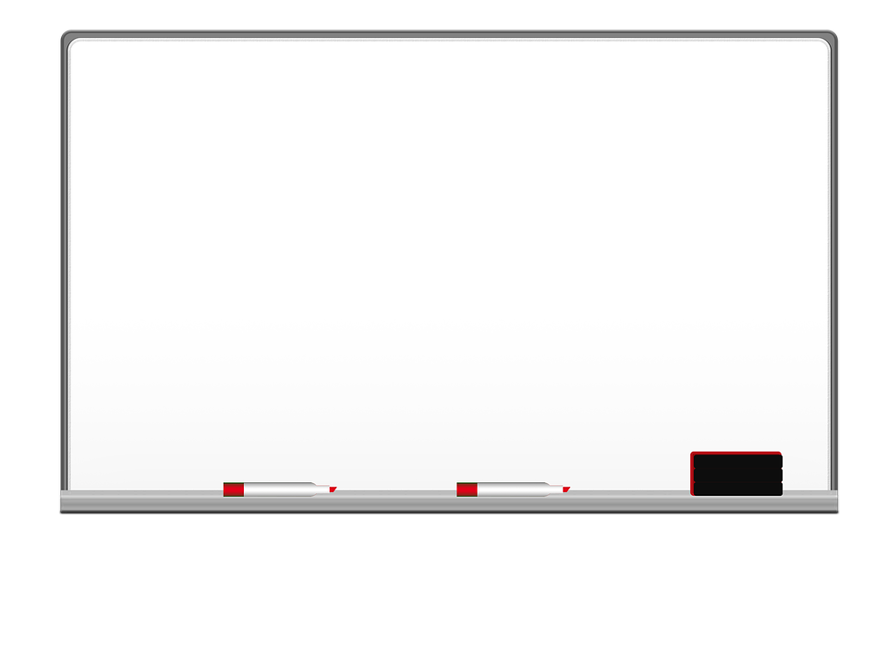

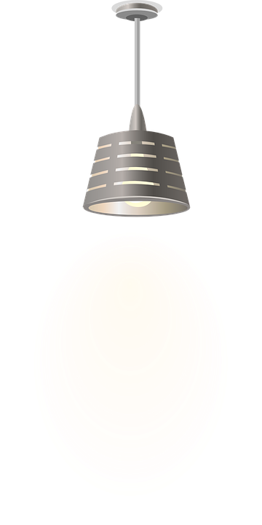

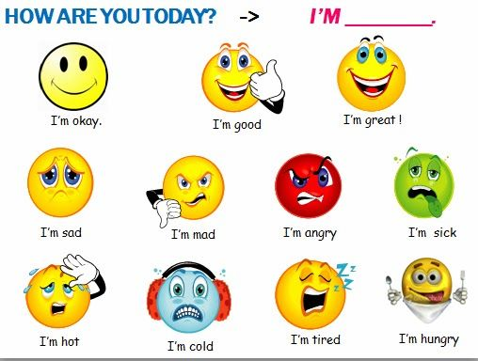
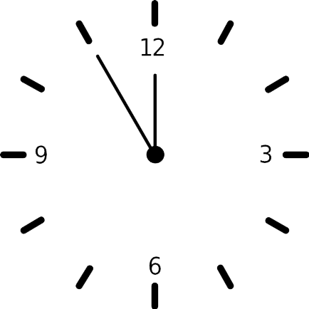



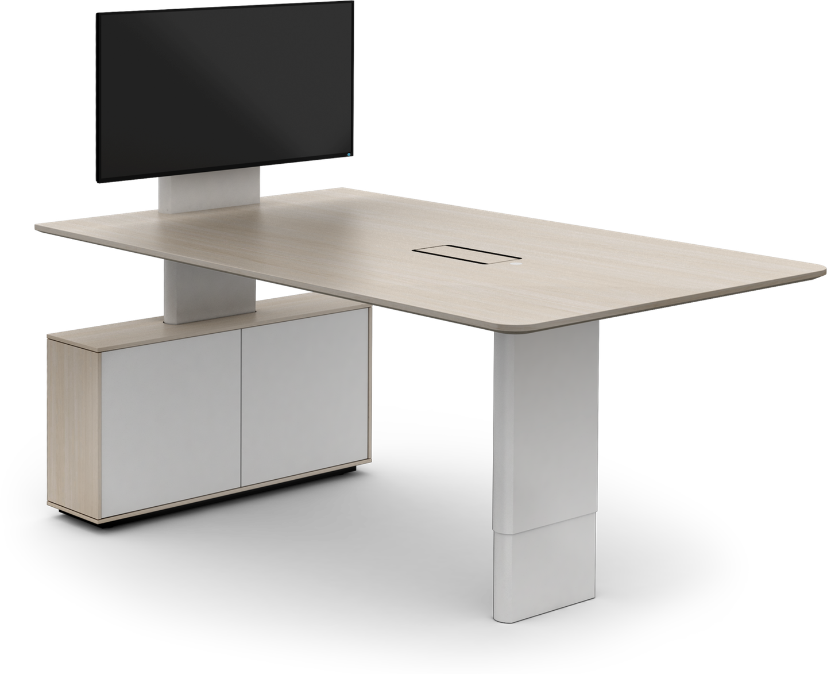
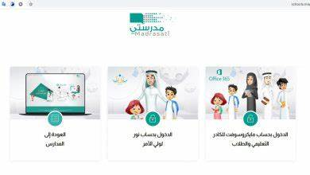







I love English

Slide 3


I love English

Slide 4

I love English
Revising the previous lesson
Match the words with their meaning:
1
fuzzy
episode
2
backup
malfunctioning
3
4
A
B
D
not working correctly
Not clear
C
copy
event

Slide 5

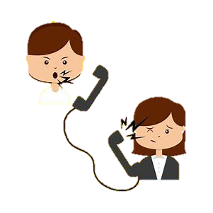

I love English
Mega Goal 2
Unit 3
(Complaints, Complaints)
Writing
Thursday
13/7/1442

Slide 6

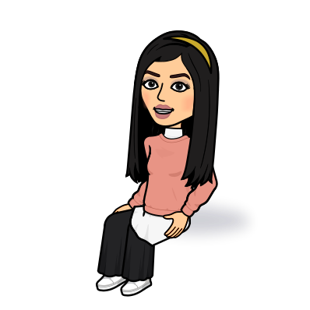
I love English
Lesson Goals
Students will be able to:
Answer questions about a complaint letter.
Write notes about a faulty product.
Write a letter of complaint.

Slide 7
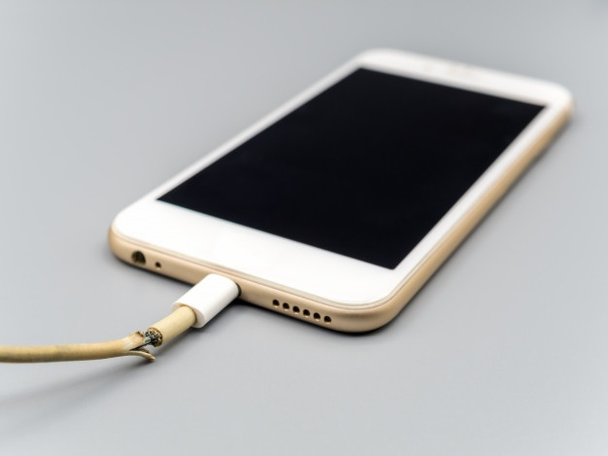
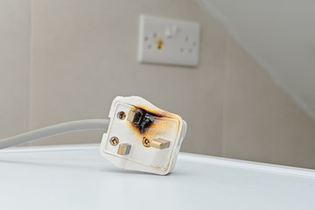
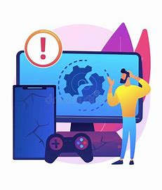
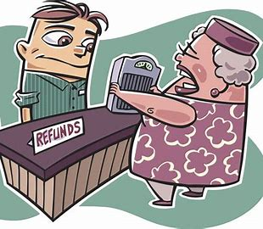

I love English
Look at the pictures then tell me what do you think about it?

Slide 8
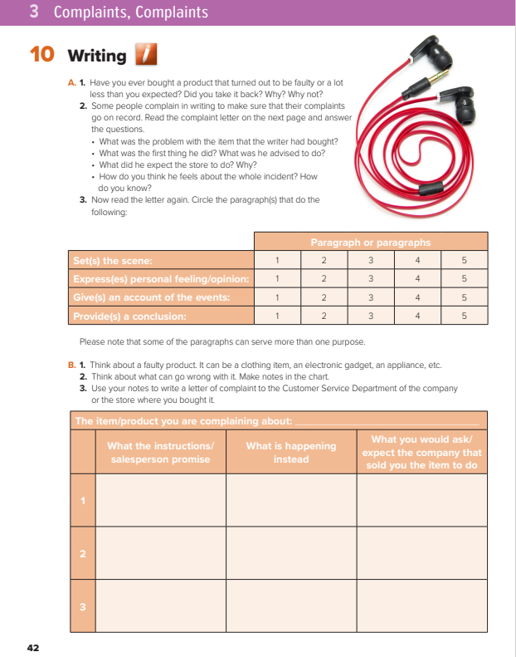

I love English
Open your Student’s book page: 42

Slide 9
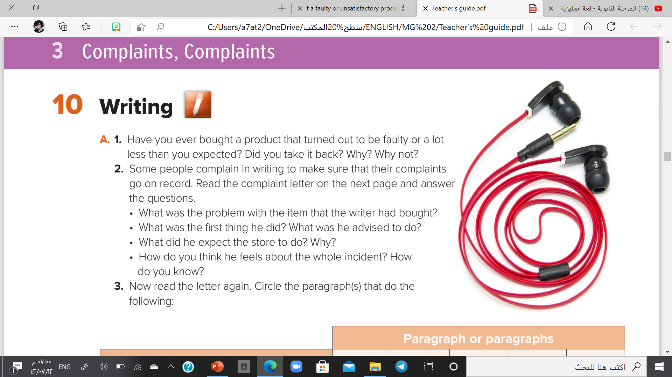
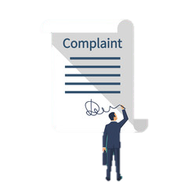

Slide 11

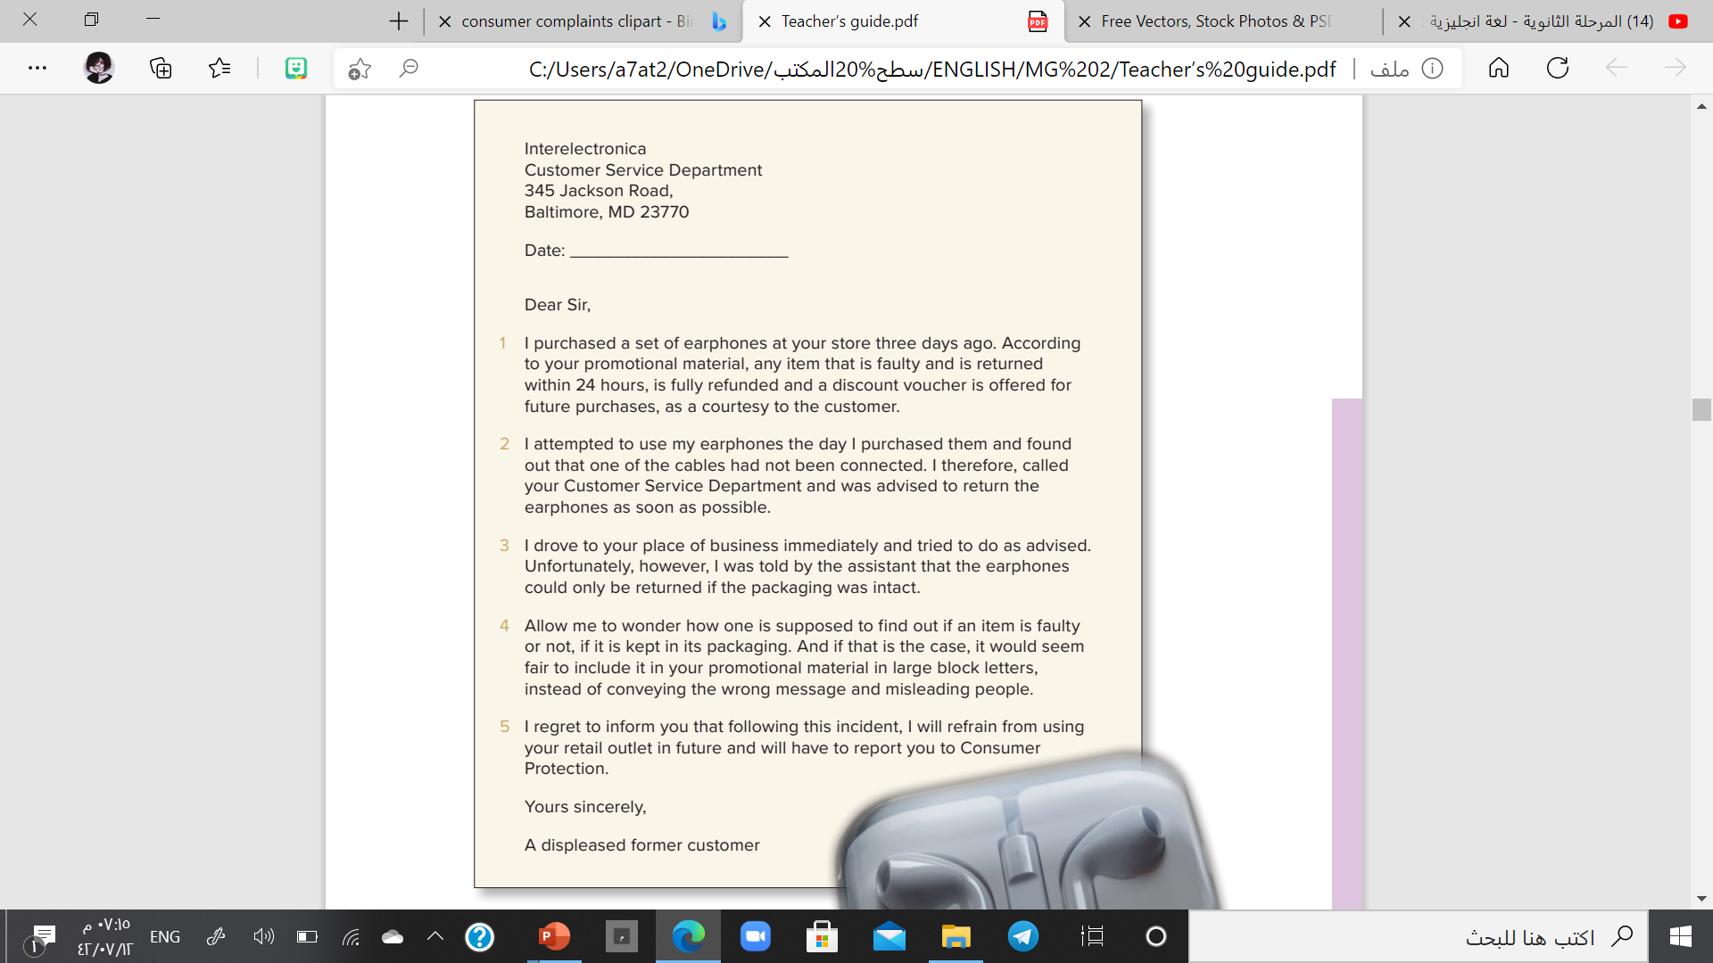
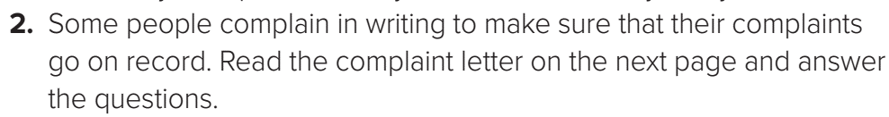

. The earphone cables are not connected.
. He called the Customer Service Department and was advised to return the item as soon as possible.
. He expected the item to be refunded and to be offered a discount voucher for future purchases according to the promotional material of the store.
. He is indignant/very angry. He expresses the way he feels in the content of the last two paragraphs.

Slide 12
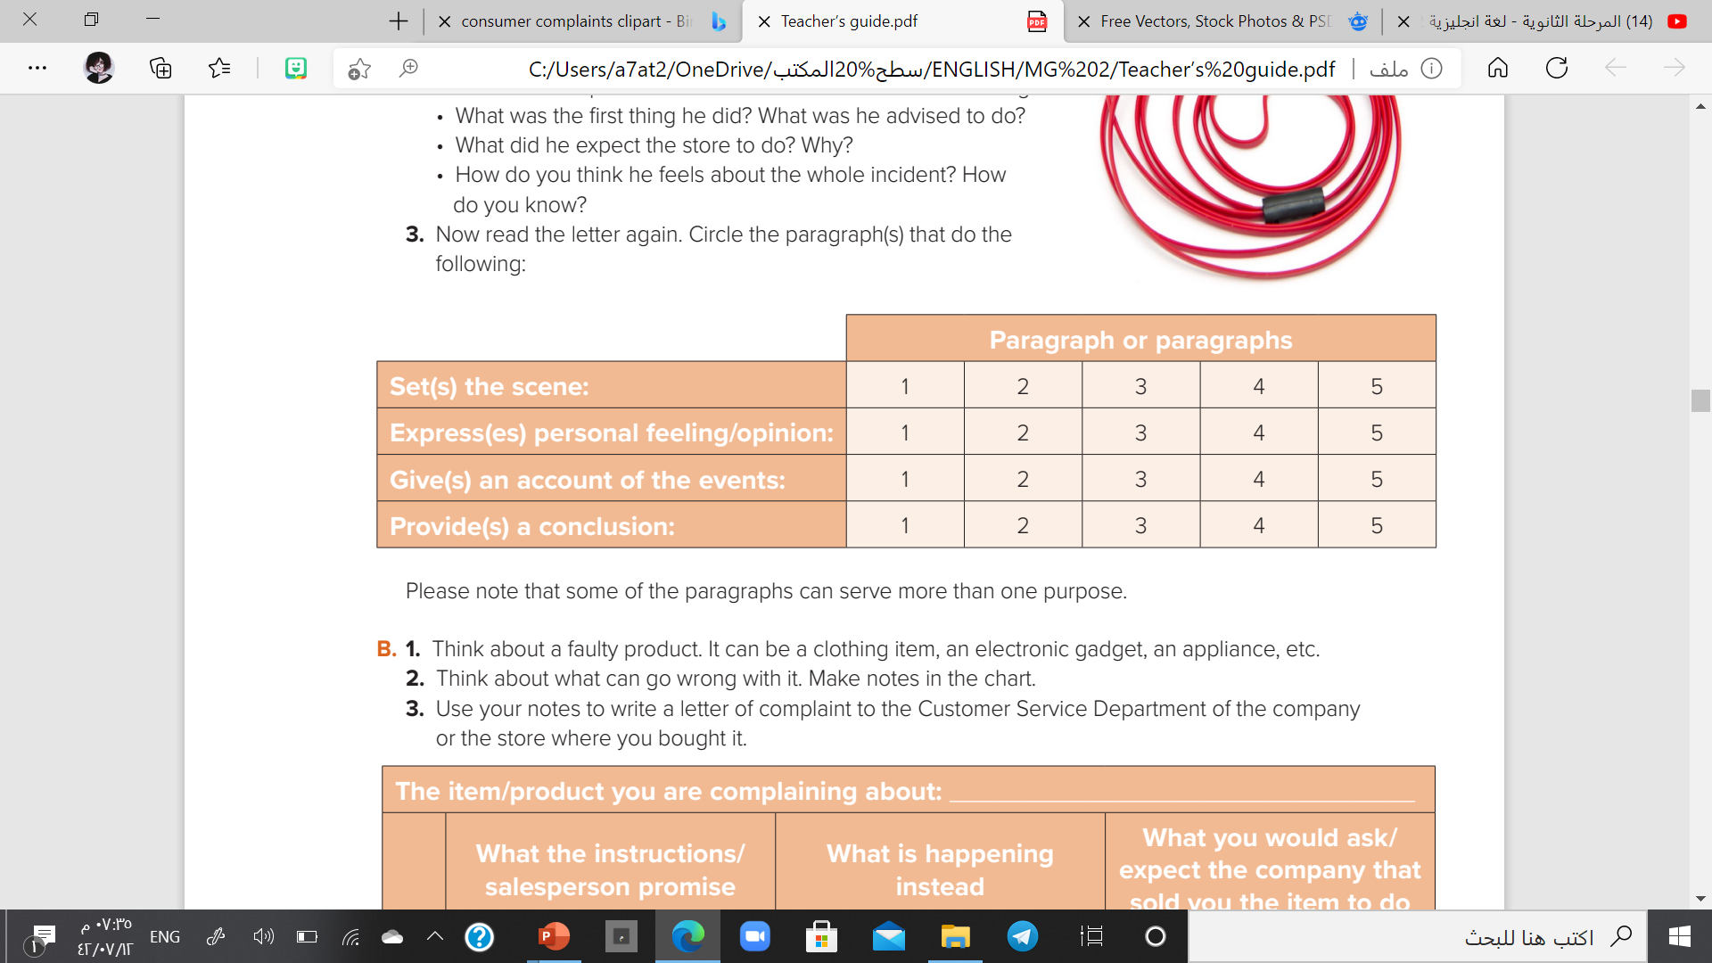

Slide 13
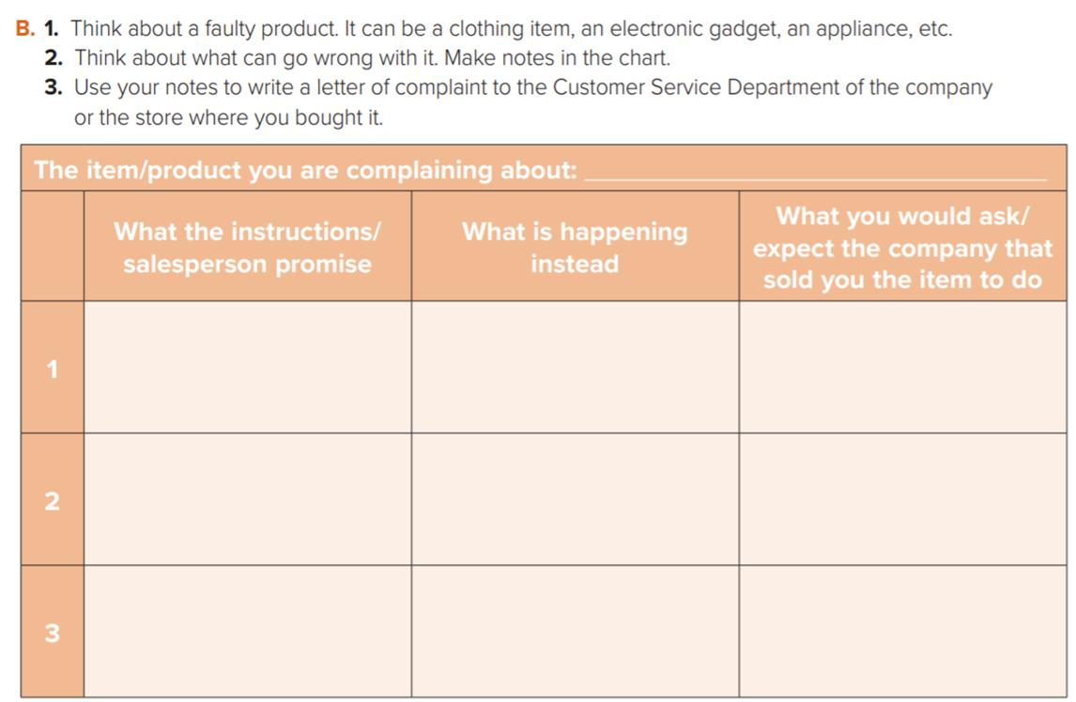
Broken glasses
Refund or change the item
Refund / on sale
Refund or change

Slide 14
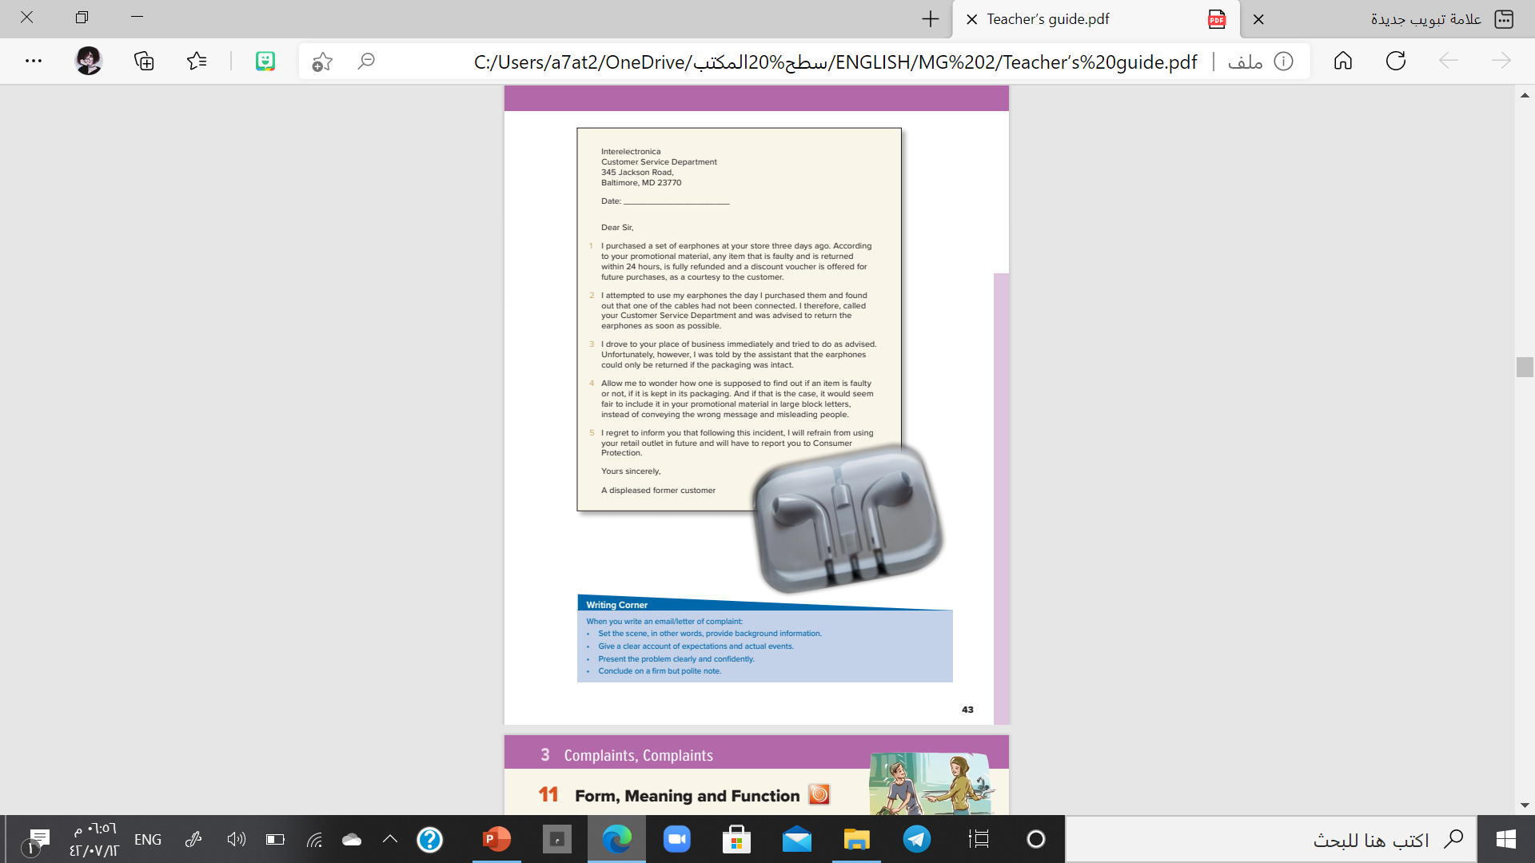
I love English
Open your Student’s book page: 43

Slide 15
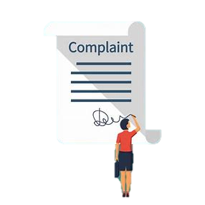
How to write a letter of complaint?
Before you being your draft, gather all the information you will need to include in your complaint
Recipient’s address
Greeting (Formal)
The reason of writing (first sentence)
A brief description of the situation, product or service that you’re unhappy about
How we want the recipient to (solve the problem)
Express your feeling clearly
Closing
Signature

Slide 16
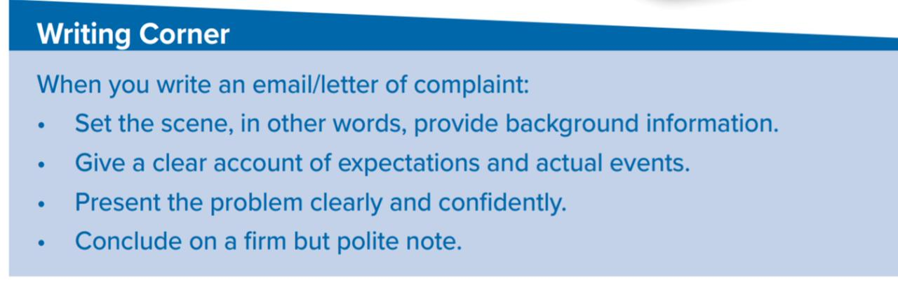

Slide 17


https://wordwall.net/resource/11419090

Slide 18

قال تعالى:
"وَأَقِيمُوا الْوَزْنَ بِالْقِسْطِ وَلَا تُخْسِرُوا الْمِيزَانَ"

Slide 19


I love English

Slide 20



Homework
I love English
Workbook: page 28

Slide 21
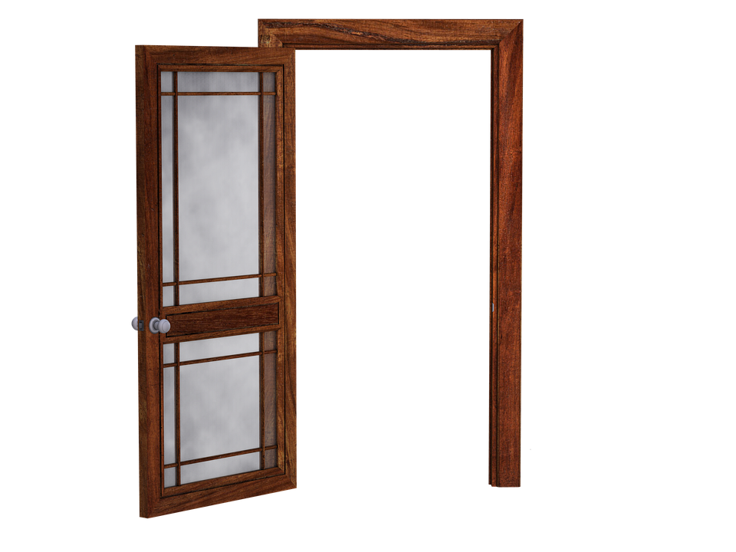
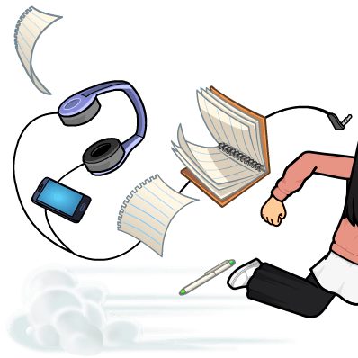
Homework
Workbook: page 28

Slide 22
Homework
Workbook: page 28

Slide 23
Homework
Workbook: page 28

Slide 24
Homework
Workbook: page 28

Slide 25
Homework
Workbook: page 28

Slide 26

Homework
Workbook: page 28

