Slide 1


Welcome to class
T.

Slide 2

1
Unit 3

Slide 3





workbook
Pages 57 , 58

Slide 4
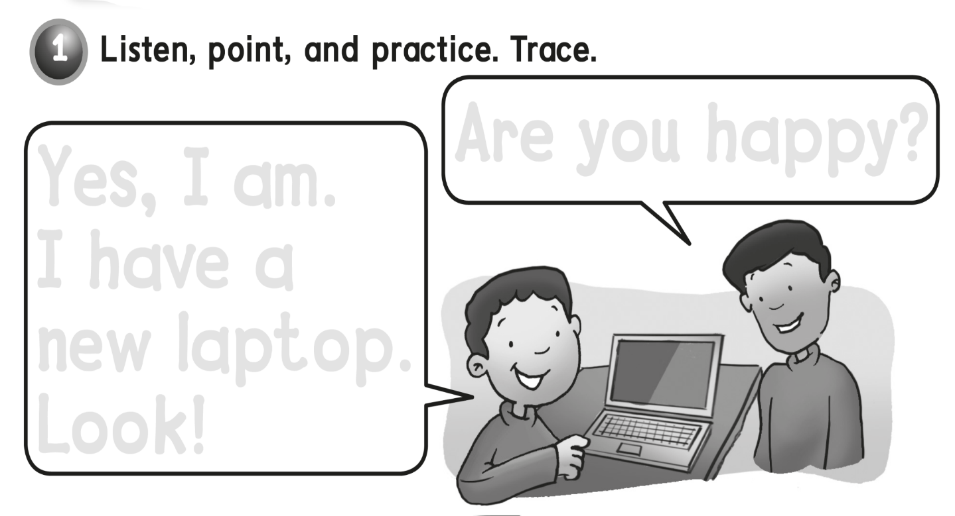
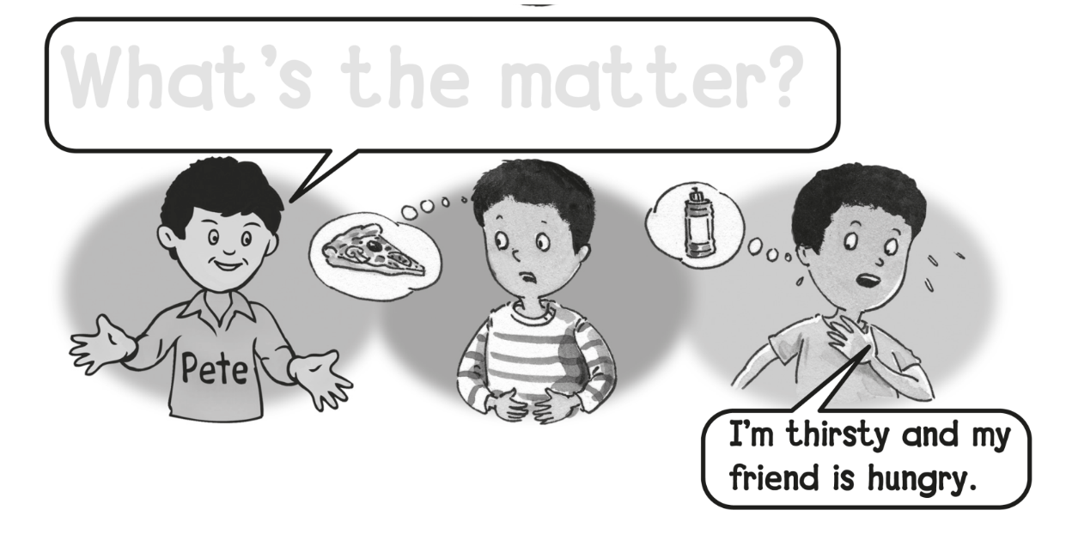
Are you happy ?
Yes, I am.
I have a
new laptop .
Look !
What’s the matter ?

Slide 5
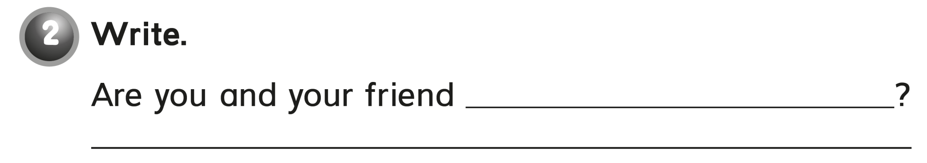
hungry and thirsty
Yes , we are .

Slide 6
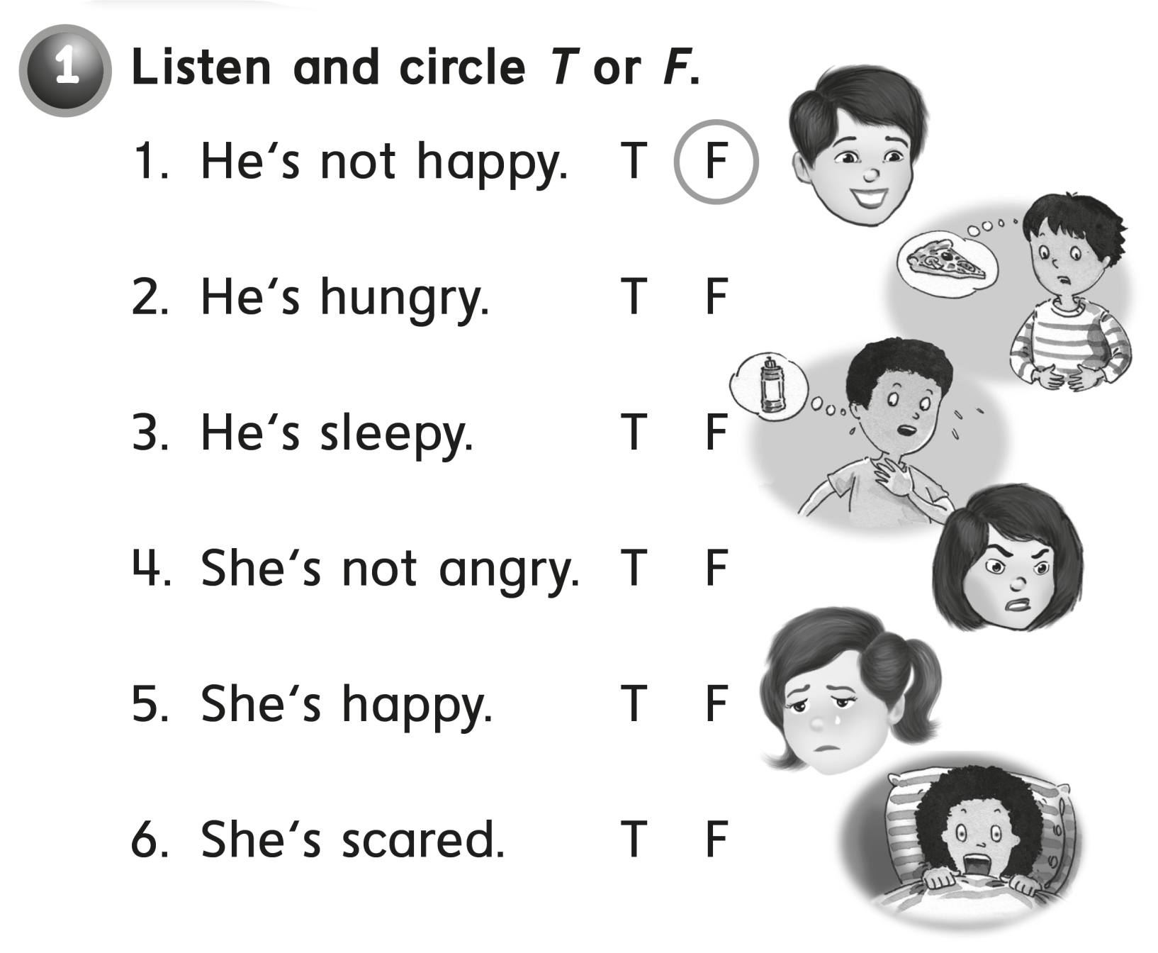

Slide 7
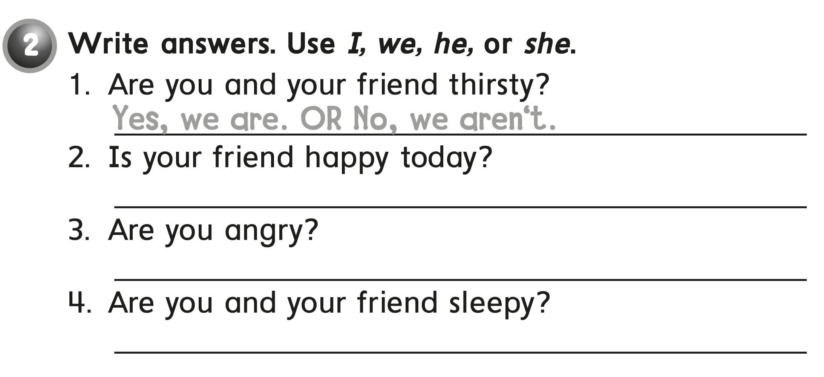
Yes , he is .
NO , I am not .
No , we are not .

Slide 8
workbook
Pages 59 , 60

Slide 9
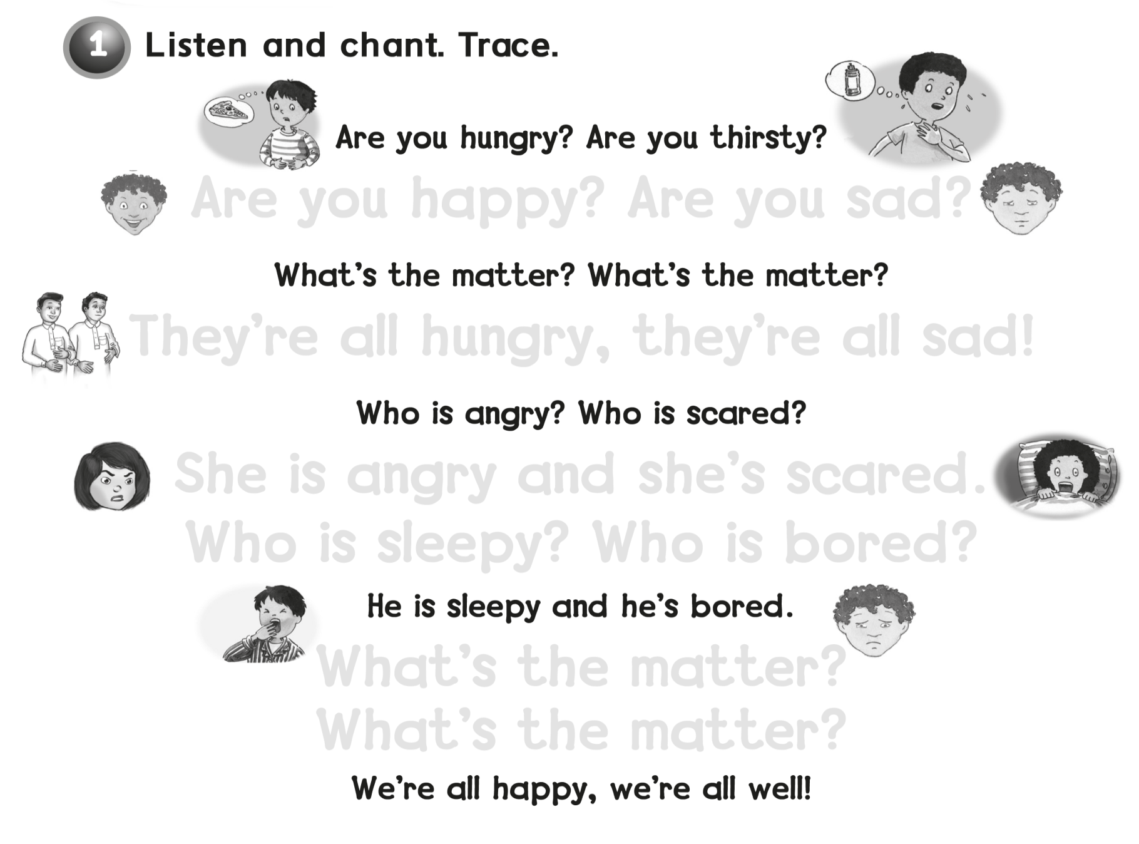
Are you happy ? Are you sad ?
They’re all hungry, they’re all sad !
She is angry and she’s scared
Who is sleepy? Who is bored ?
What’s the matter ?
What’s the matter ?

Slide 10
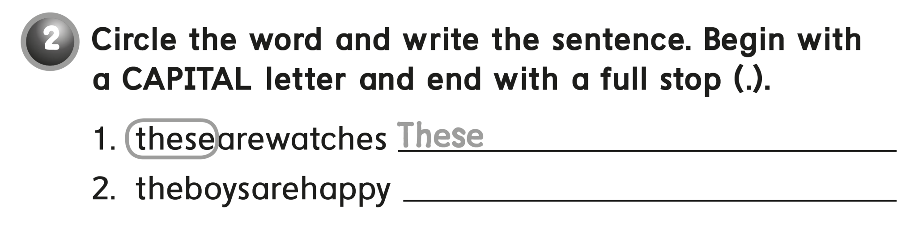
are watches .
The boys are happy .

Slide 11
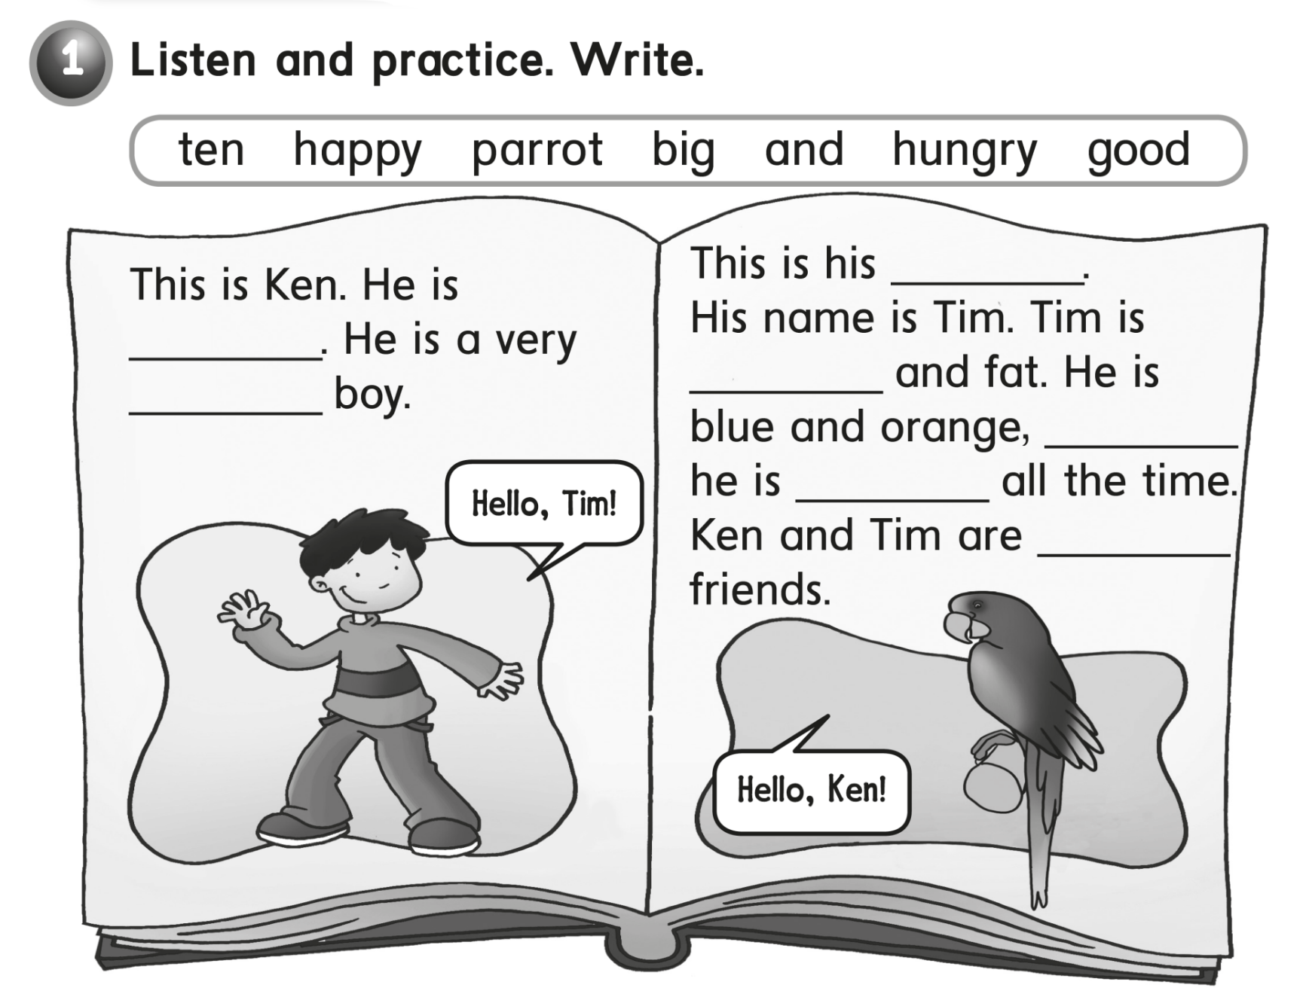
Parrot
ten
happy
big
and
hungry
good

Slide 12
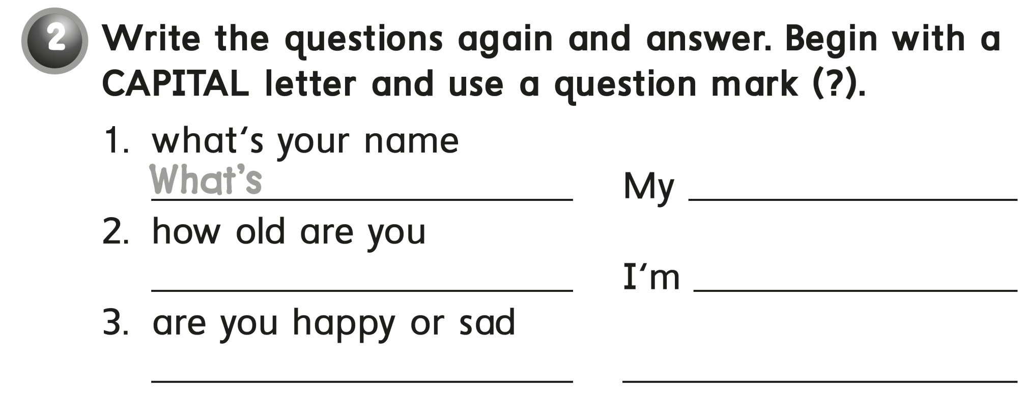
your name ?
name is ………
How old are you ?
10 years old .
Are you happy or sad ?
I am happy .

Slide 13
workbook
Pages 61 , 62

Slide 14
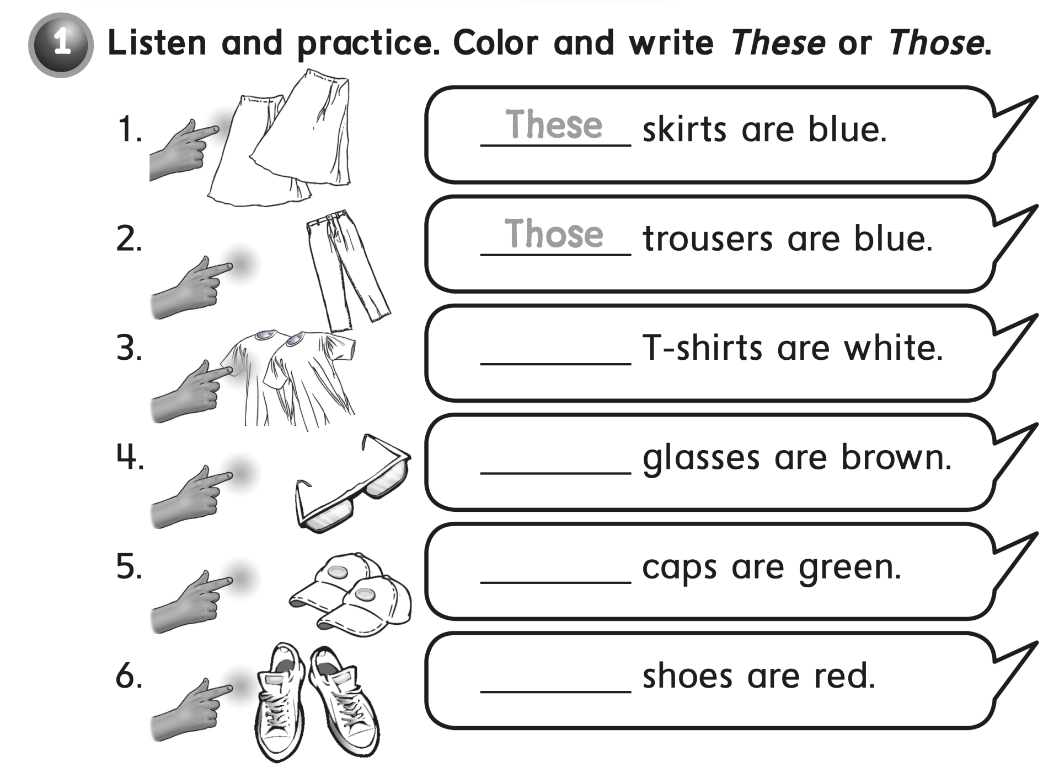
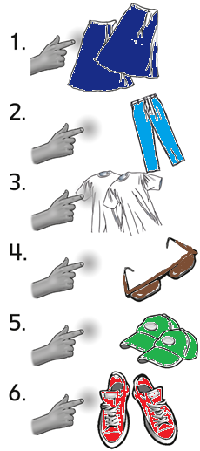
These
Those
Those
These

Slide 15
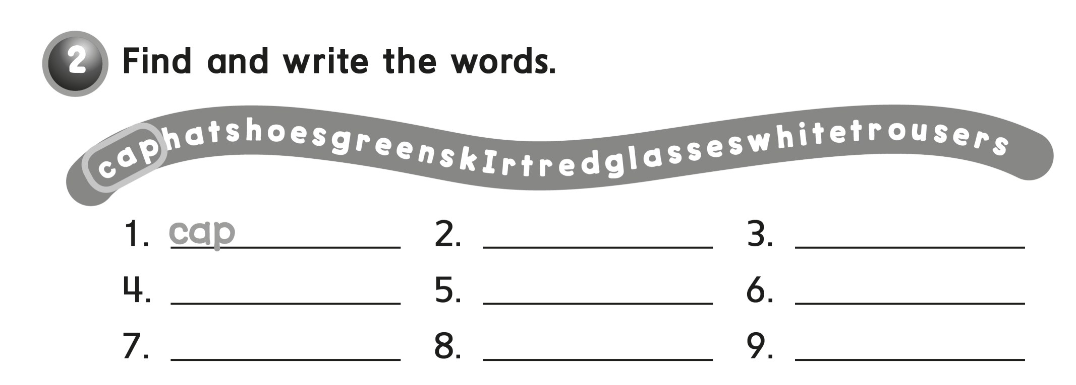
hat
shoes
green
skirt
red
glasses
white
trousers

Slide 16
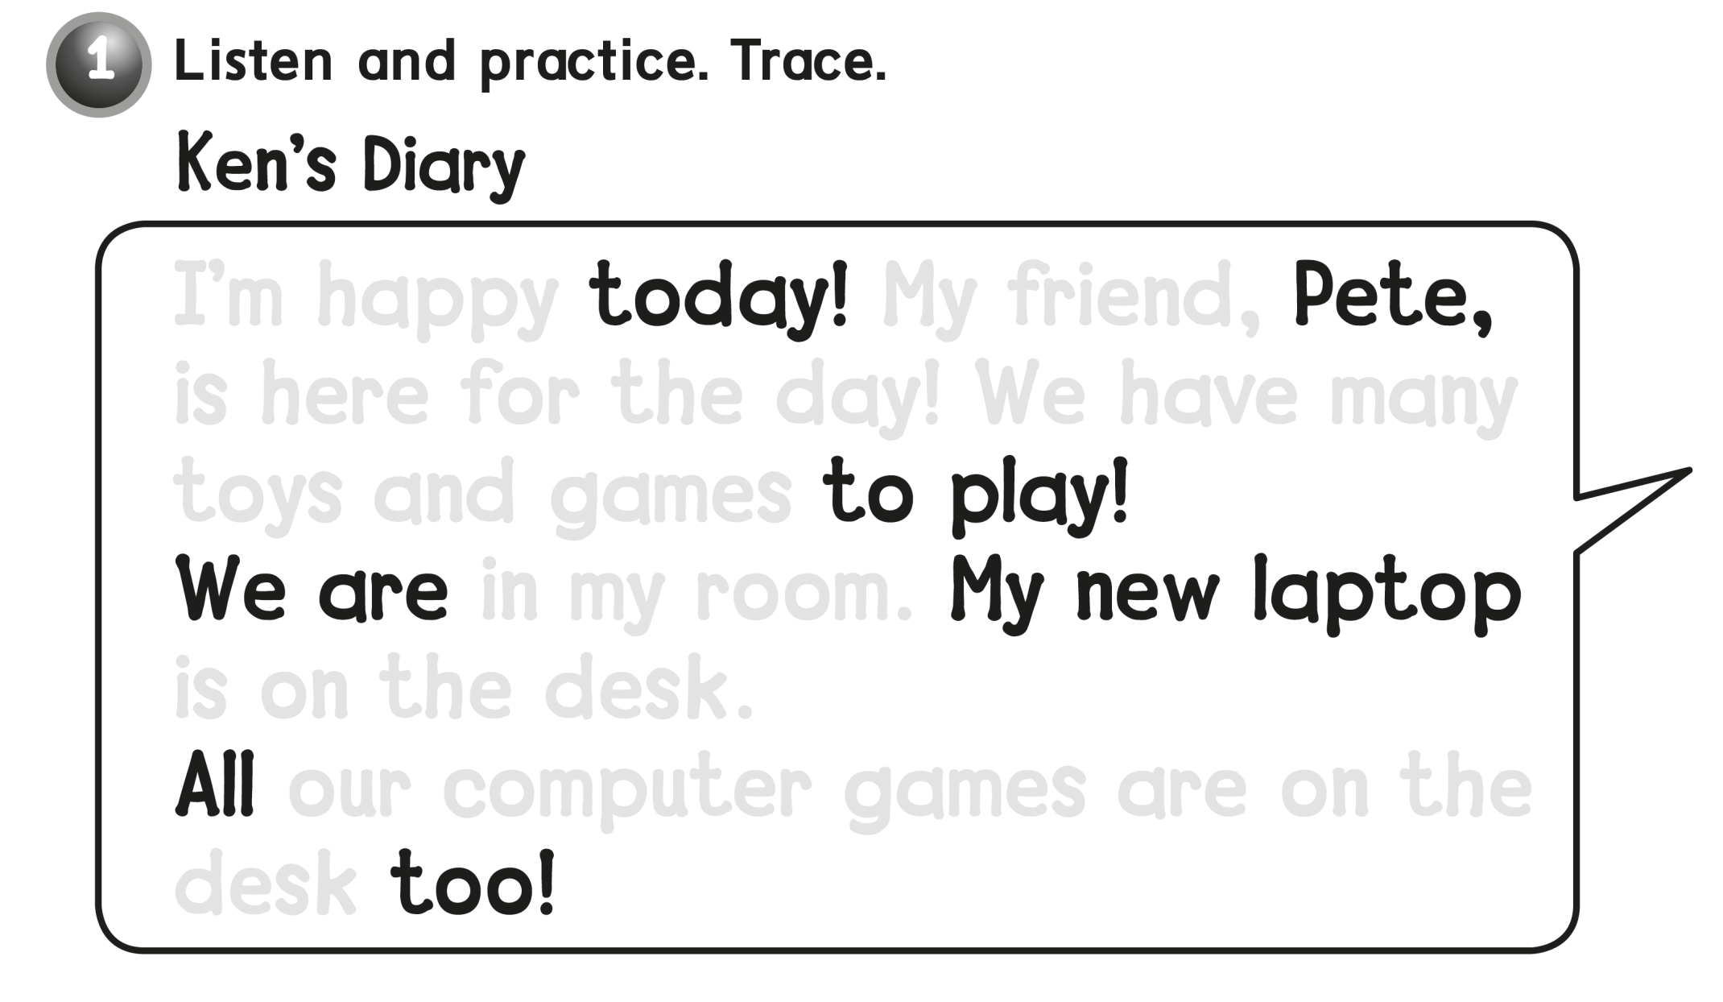
I’m happy My friend,
is here for the day ! We have many
toys and games
in my room
is on the desk .
our computer games are on the
desk

Slide 17
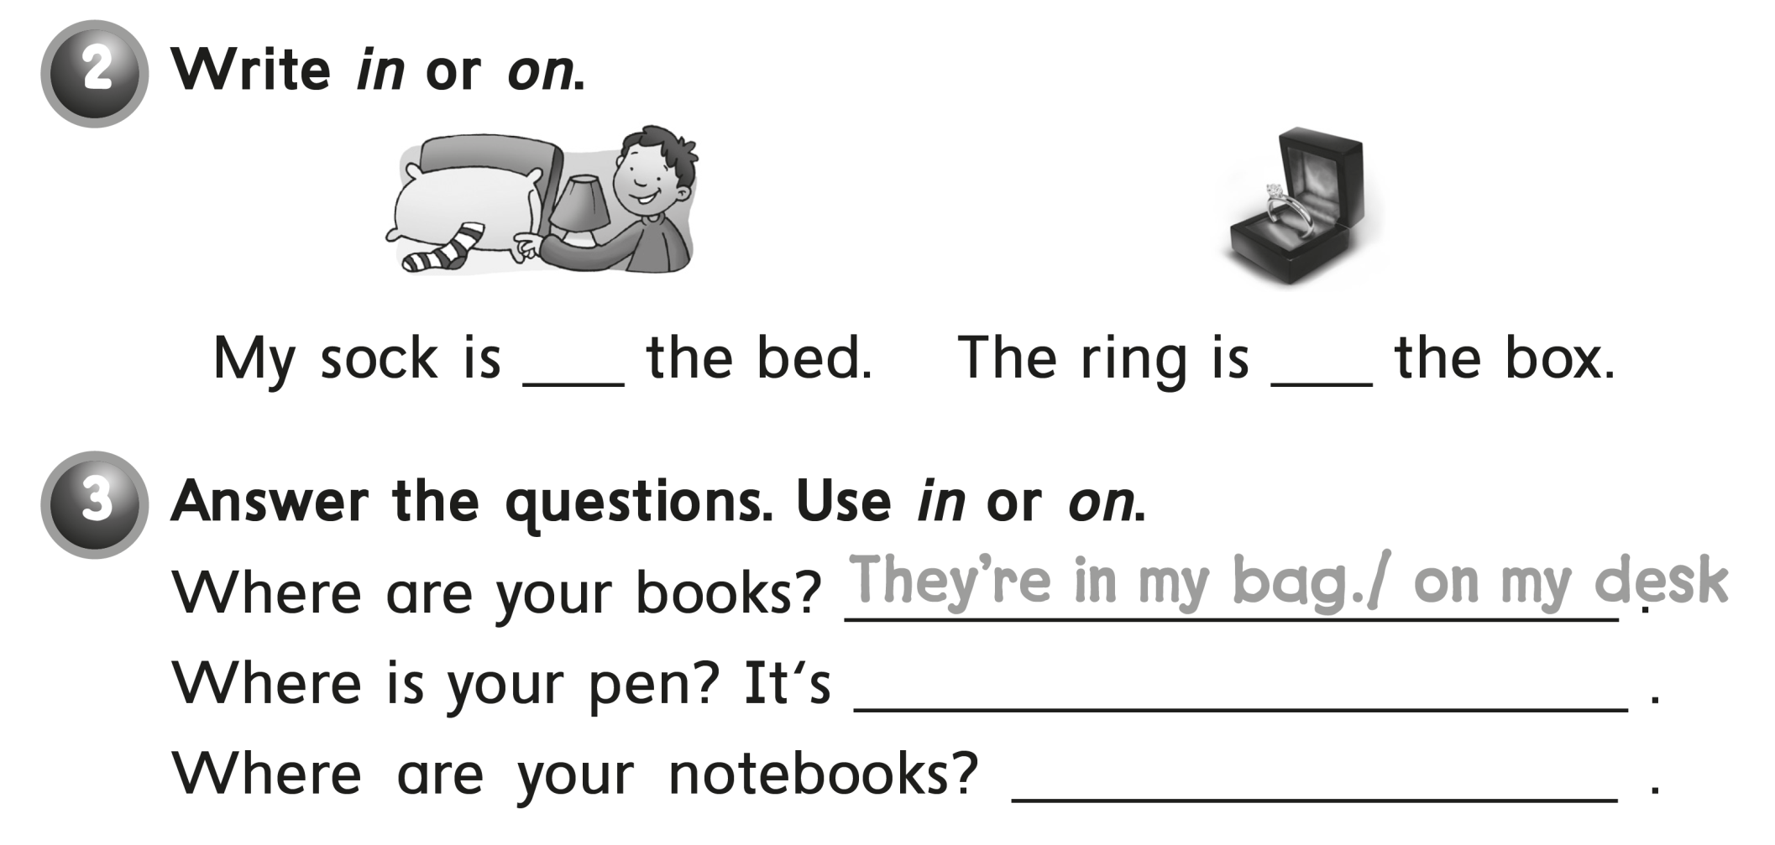
on
in
In my bag
On my desk

Slide 18
workbook
Pages 63 , 64

Slide 19
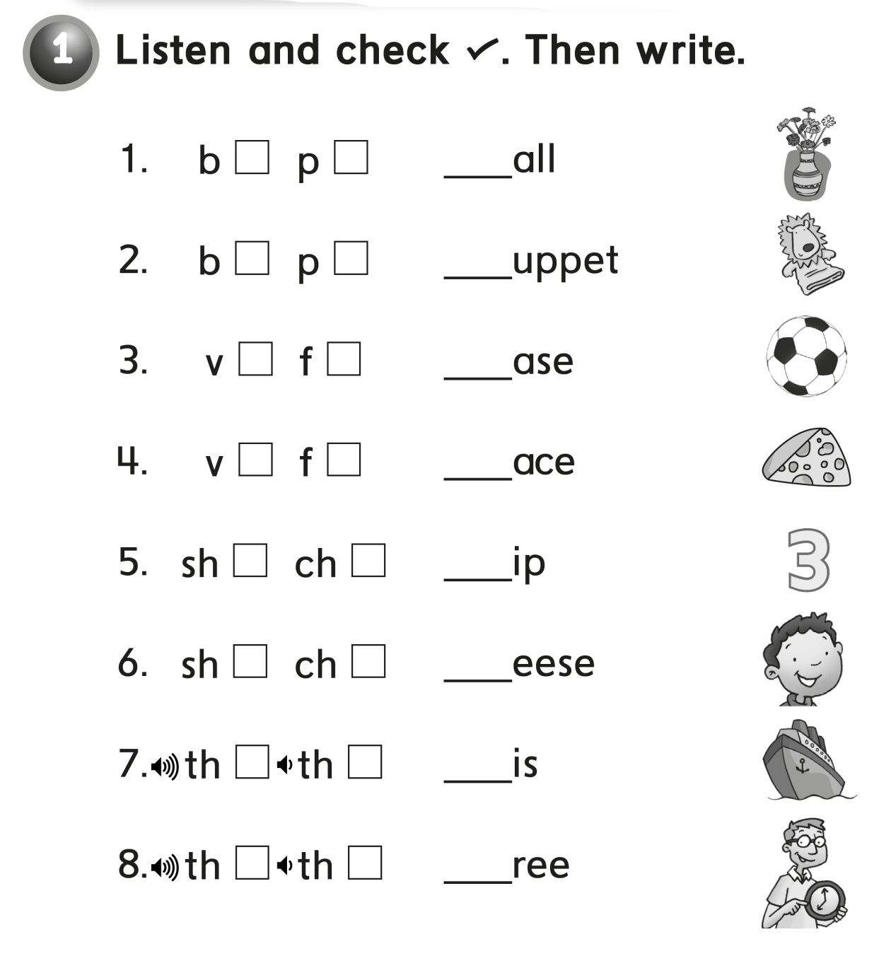
b
p
v
f
sh
ch
th
th

Slide 20
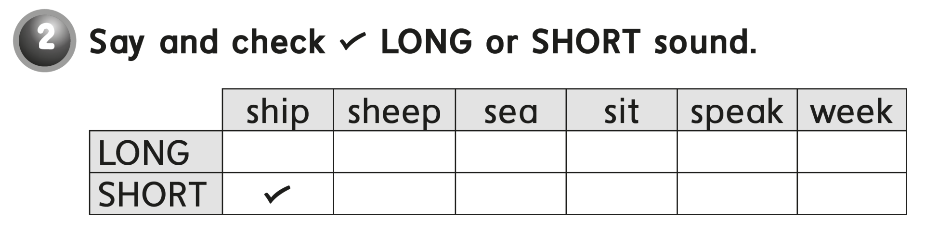
√
√
√
√
√

Slide 21
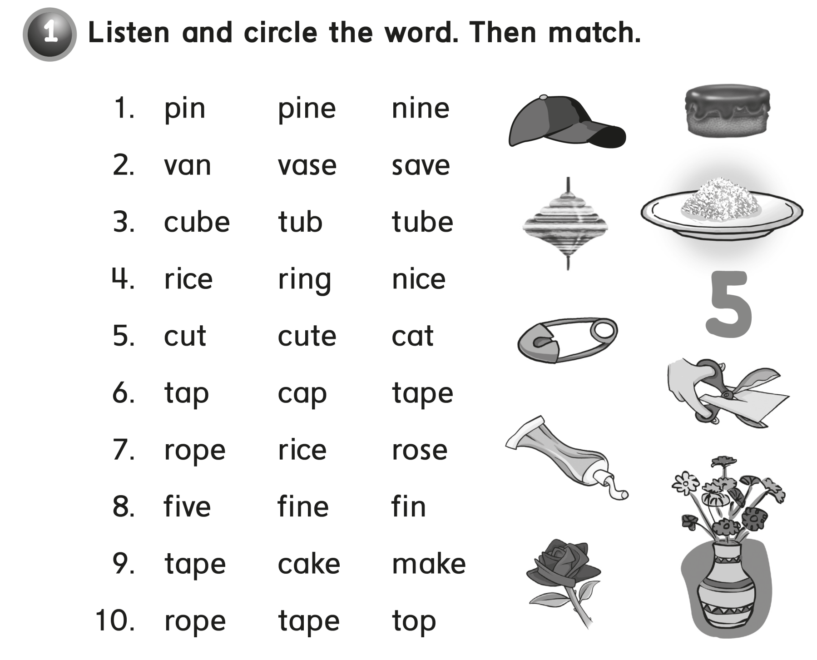

Slide 22
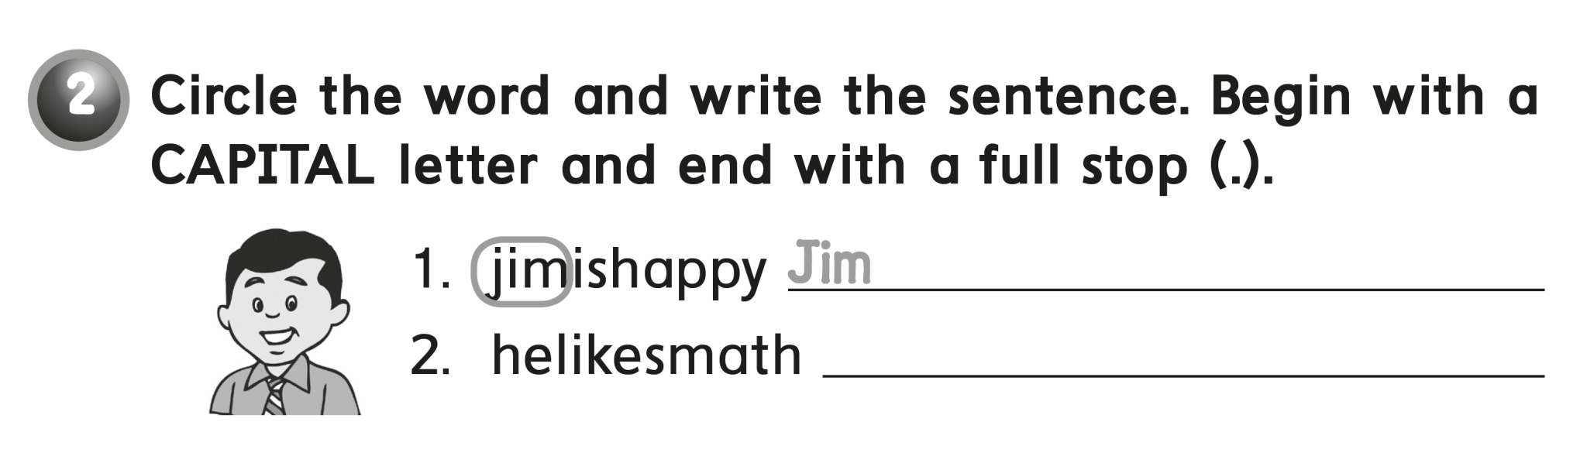
is happy .
He likes math .

Slide 23


