Slide 1

Mega Goal 1.3
Unit 4
I Wonder What Happened
Reading
Done by: Entisar Al-Obaidallah

Slide 2
Lesson Objectives
Read
the passage for specific information
Discuss
the topic of Vision 2030 Kingdom of Saudi Arabia
Match
the words with their meanings
Answer
comprehension questions based on a reading text

Slide 3

What does 2030 remind you of ?

Slide 4
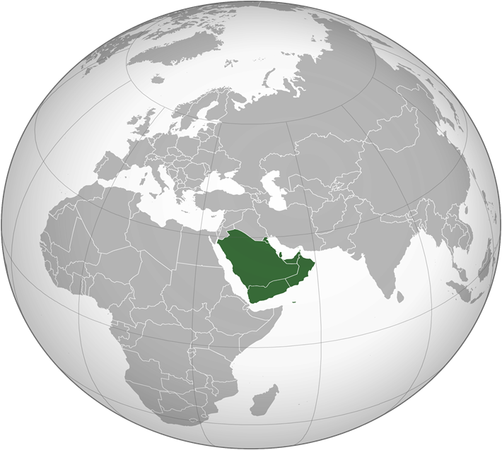
What areas of developments are mentioned in vision 2030 ?
Education
business
Employment
Housing
culture
Healthcare

Slide 5

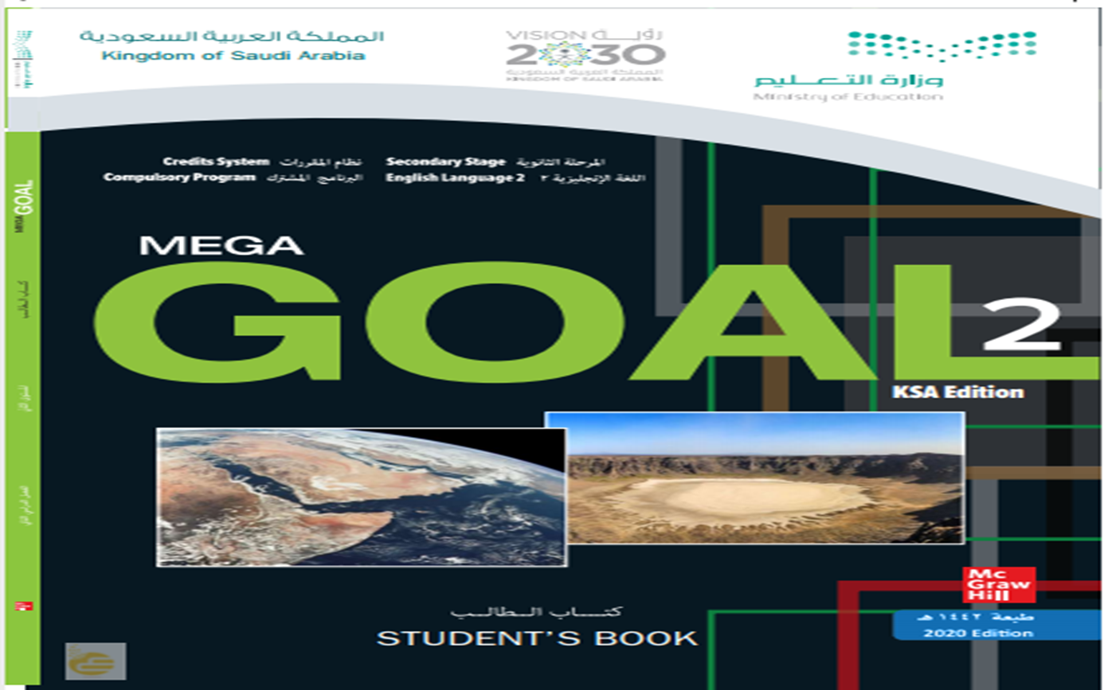
Open students book p.(26)

Slide 6

01 Before Reading

Slide 7
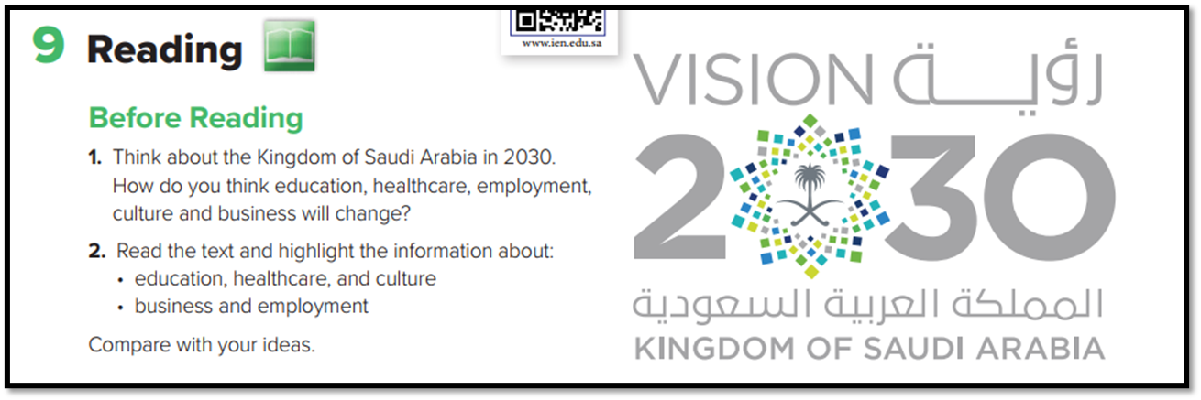

Slide 8
02 While Reading

Slide 9
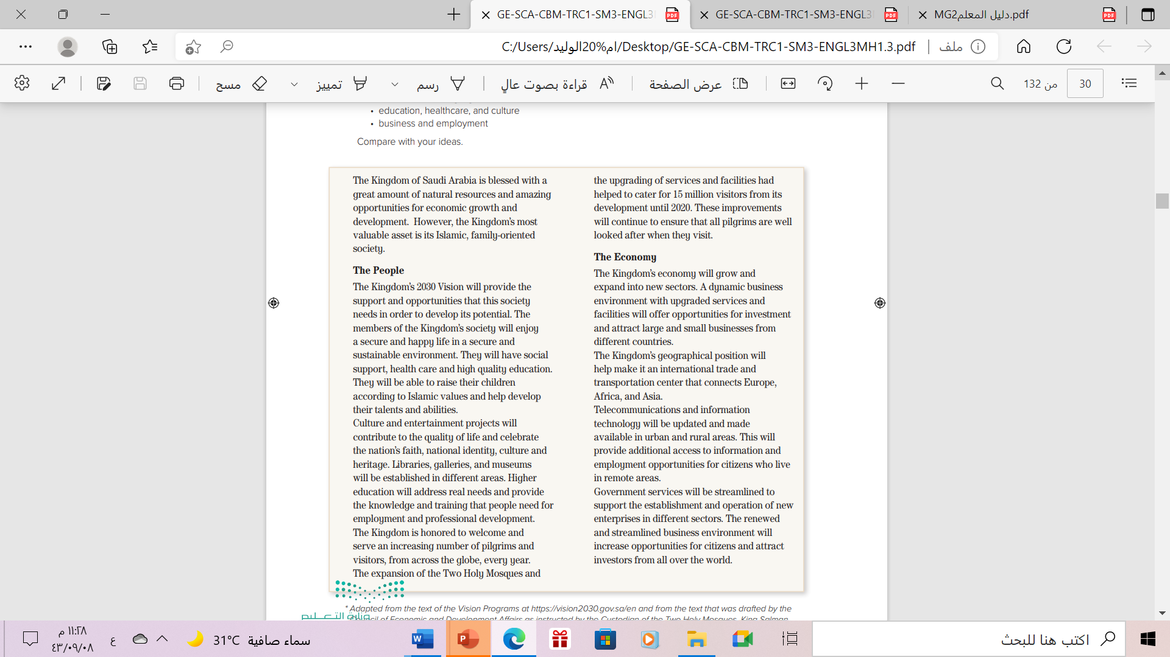
1
How many paragraphs are there ?
There are 8 paragraphs
5
2
How many subheadings are there?
6
7
There are 2 subheadings
3
8
What are they ?
4
The People and The Economy

Slide 10

Listen & Read

Slide 11
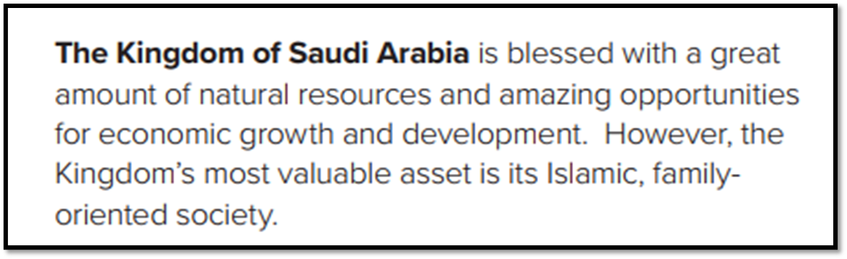
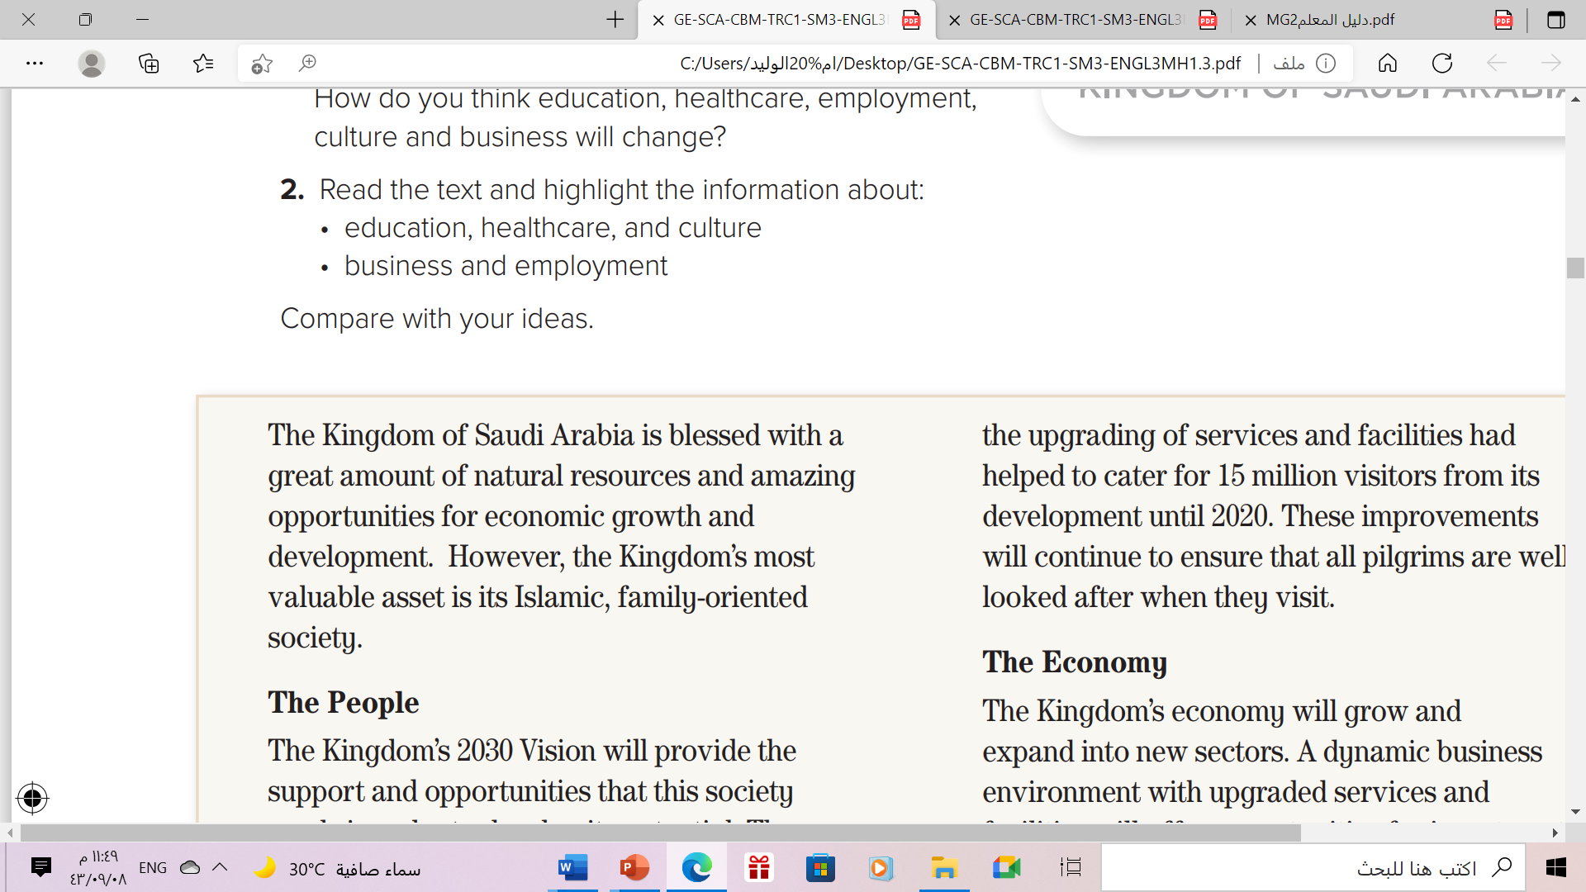
What is the main idea of this paragraph ?
The kingdom most valuable asset .

Slide 12
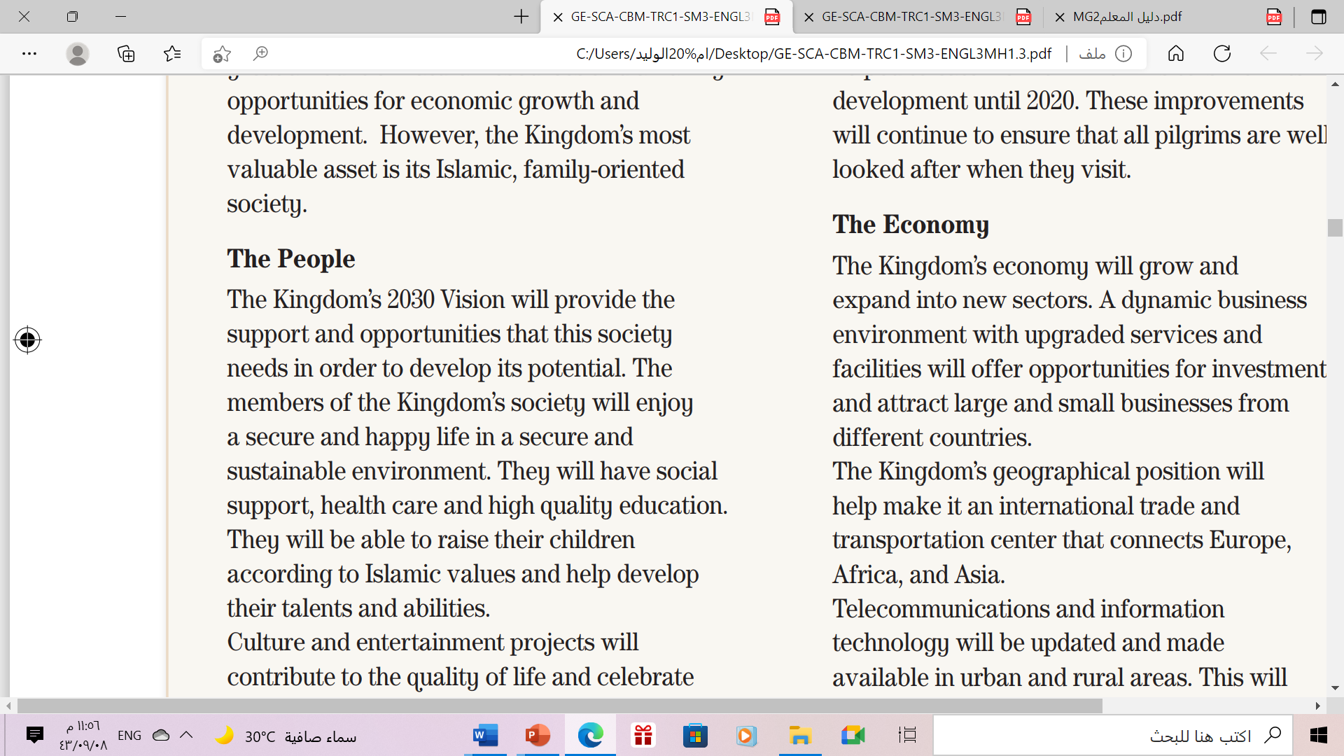
What is the main idea of this paragraph ?
Developing The society Potential

Slide 13
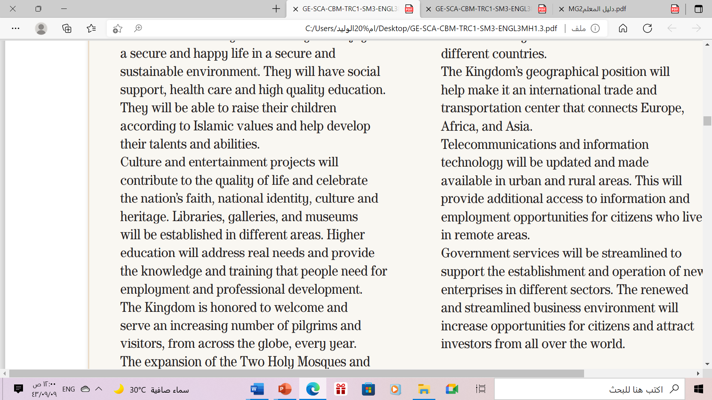
What is the main idea of this paragraph ?
Culture and Entertainment Projects

Slide 14
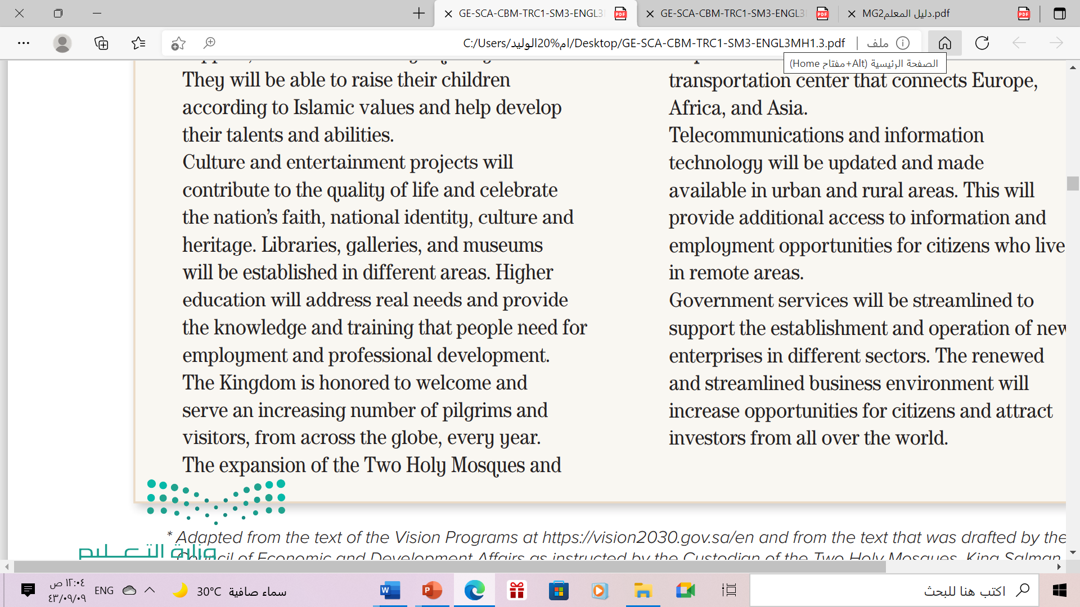
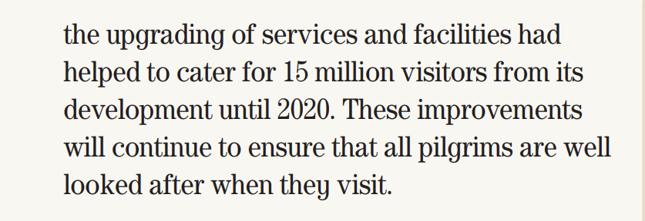
What is the main idea of this paragraph ?
Services and Expansion of the Two Holy Mosques

Slide 15
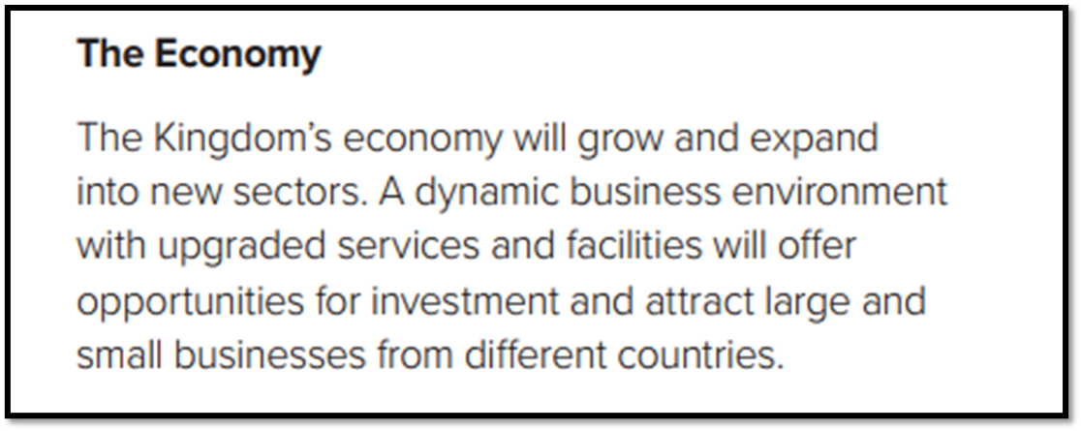
What is the main idea of this paragraph ?
The Kingdom’s Economy growth

Slide 16
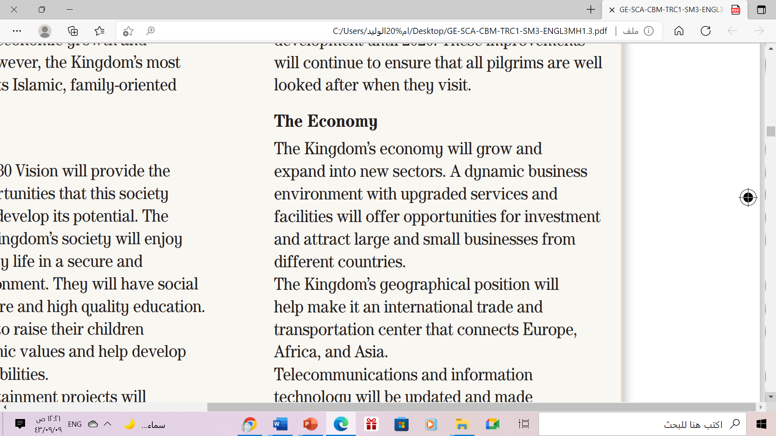

What is the main idea of this paragraph ?
Trading

Slide 17
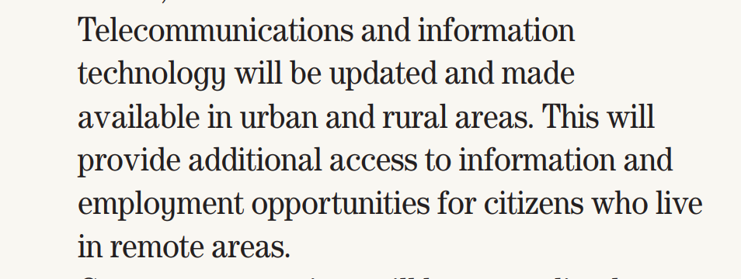
What is the main idea of this paragraph ?
Telecommunication & employment

Slide 18

What is the main idea of this paragraph ?
Supporting business

Slide 19
03 After Reading

Slide 20
Open students book p.(27)

Slide 21
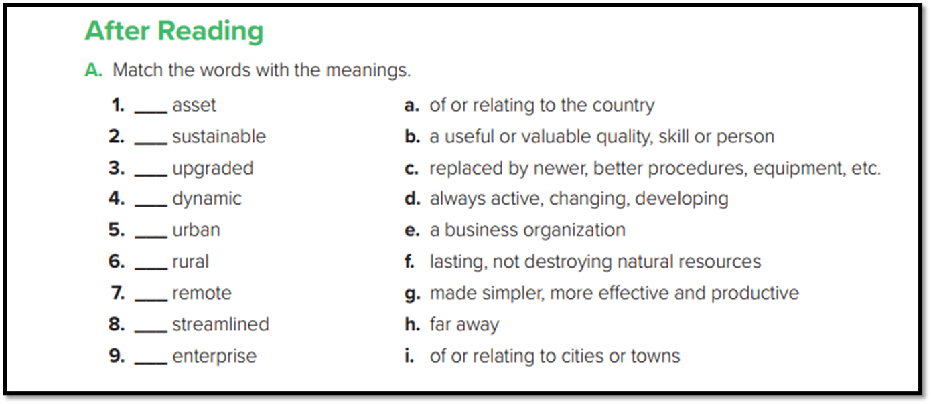
b
f
c
d
i
a
h
g
e

Slide 22
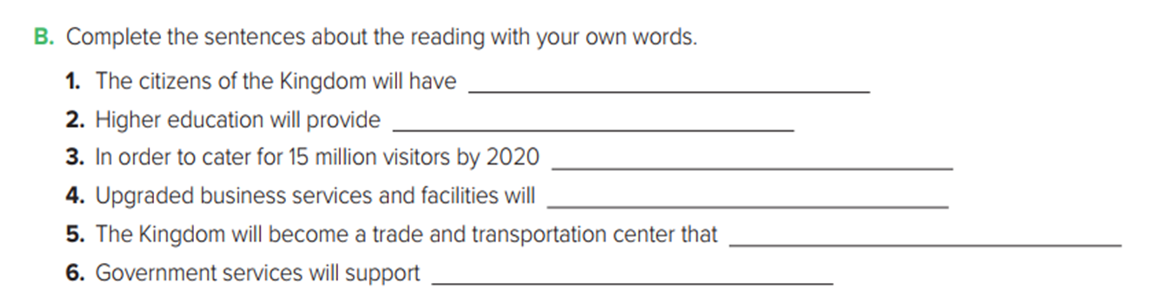
many job opportunities, health care and high quality education .
the training that people need for professional development.
services and facilities have been upgraded .
attract large and small businesses from different countries .
connects Europe, Africa, and Asia.
new businesses in different sectors .

Slide 23
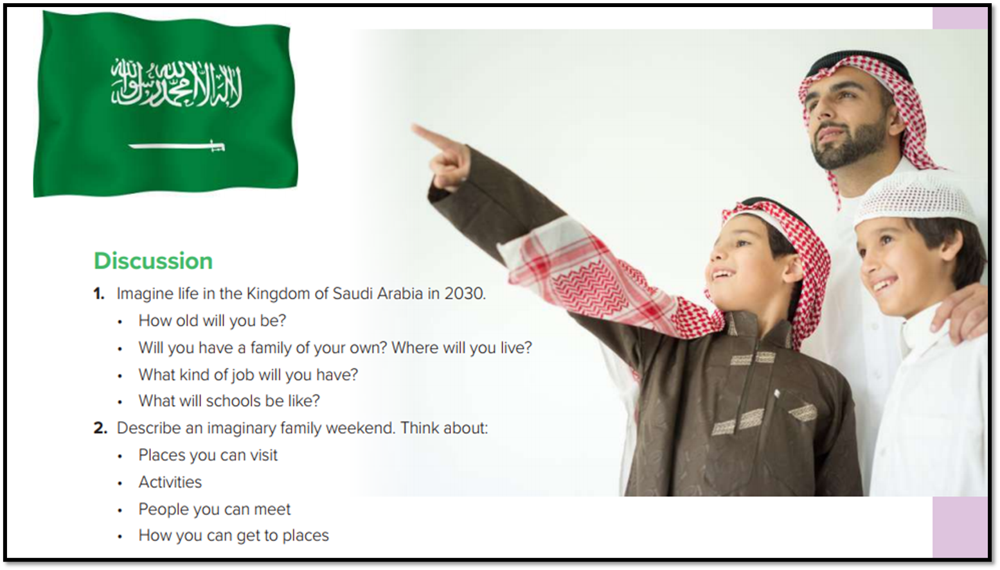

Slide 24


Slide 25

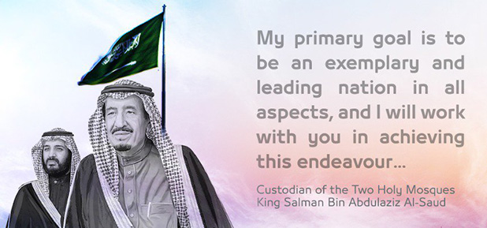

Slide 26

Homework
Workbook p. (94) , exercise (G)

Slide 27

Thanks!

