Slide 1
Unit 4
I Wonder What Happened
Language in Context + Conversation
Mega Goal1.3
Done by: Entisar Al-Obaidallah

Slide 2
Lesson Objectives
Using the expression of “ Real Talk” in correct sentences
The picture using teir own words
Prononcing word-ending er
Describe
Listen
Practice
Answer
Practice
For general understanding and speculate
Some comprehension questions about the converation

Slide 3
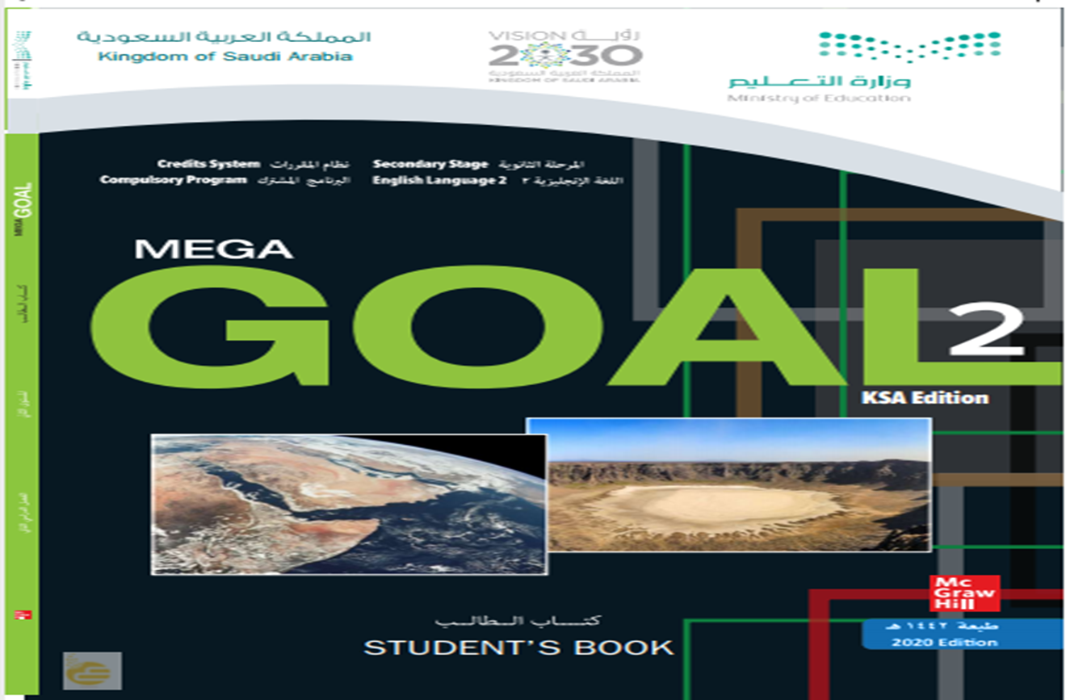
Open
Your student’s book
p. (24)

Slide 4
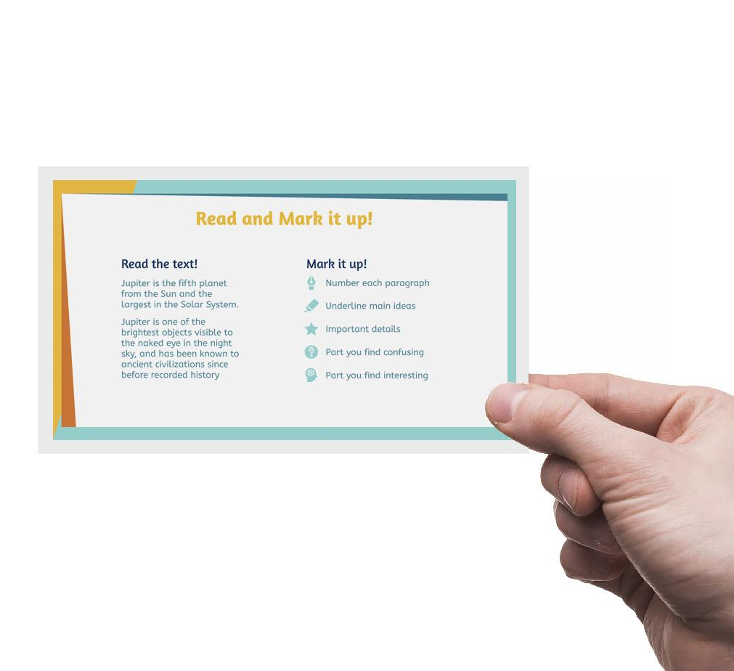
01
Language in Context

Slide 5

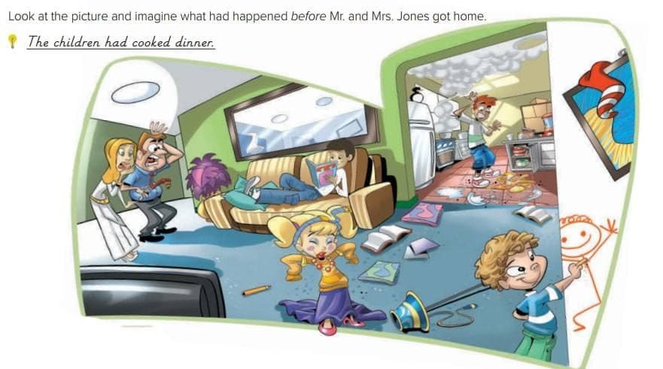
Look at the picture and speculate about what had happened before:
Use had + past participle
They had broken some plates.
The little boy had drawn on the wall.
The girl had worn her mom dress.
They had read some books.

Slide 6

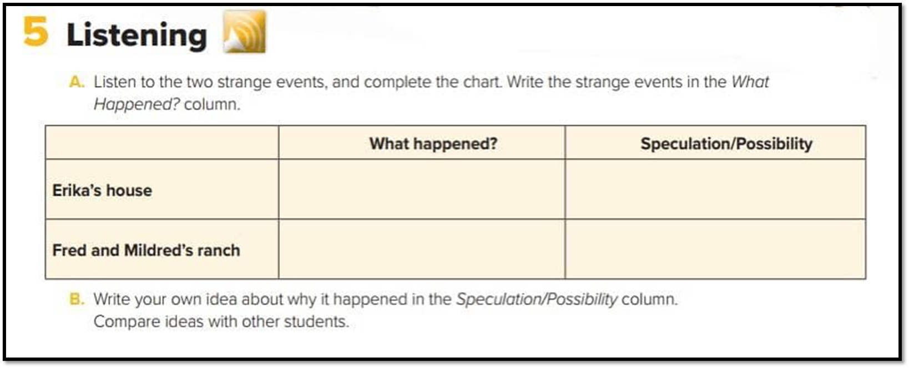
Listen and write what happened
People saw a man in dark pants, white shirt,
and a black tie in Erika’s house. Erika and
her husband also heard noises in the night.
The man might have been a ghost.
Fred and Mildred saw a bright glow from
some bushes. As they got close, they
saw thousands of tiny lights on the bushes
They must have been fireflies.

Slide 7
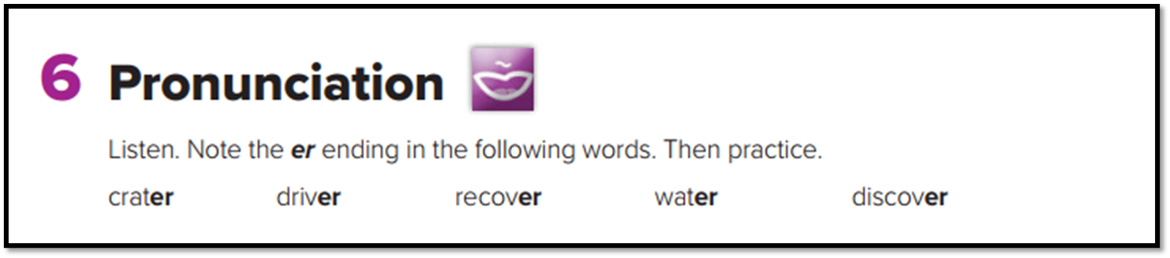
Word-ending er

Slide 8

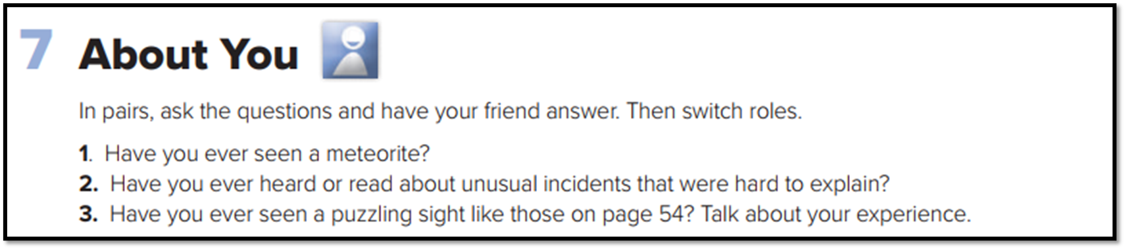

Slide 9
Open
Your student’s book
p. (25)

Slide 10
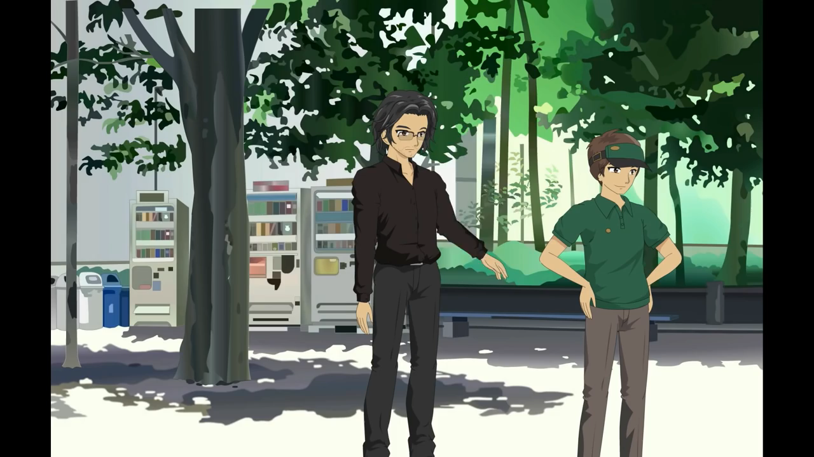
Listen

Slide 11
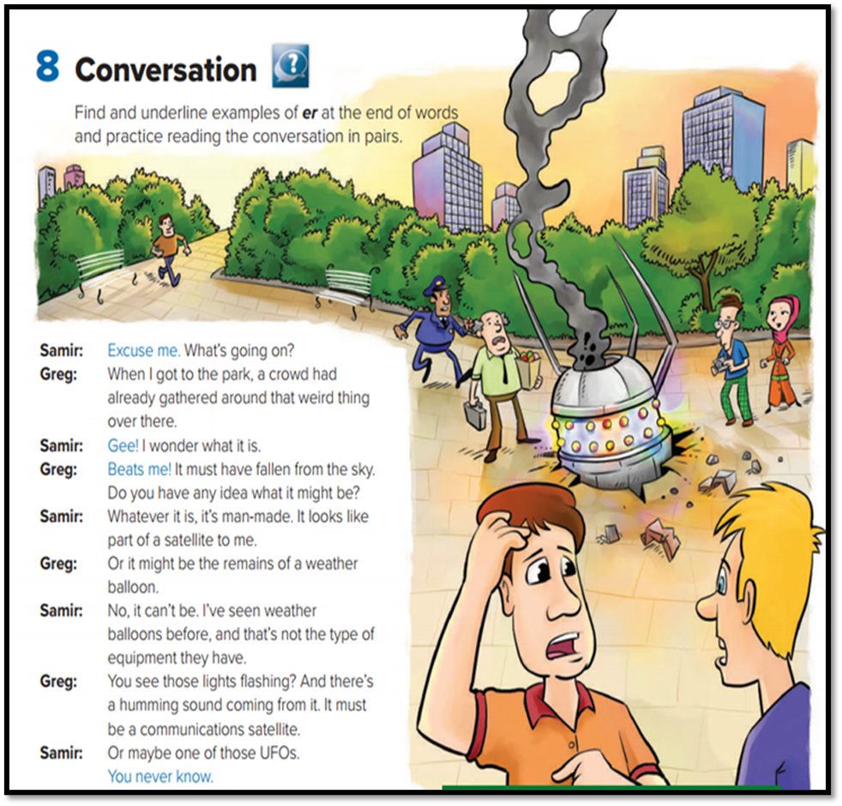
How many persons are there in this conversation? Who are they?
Two persons : Samir and Greg
Where are they?
In the park
What had happened in the park?
a crowd had already gathered around that weird thing over there

Slide 12
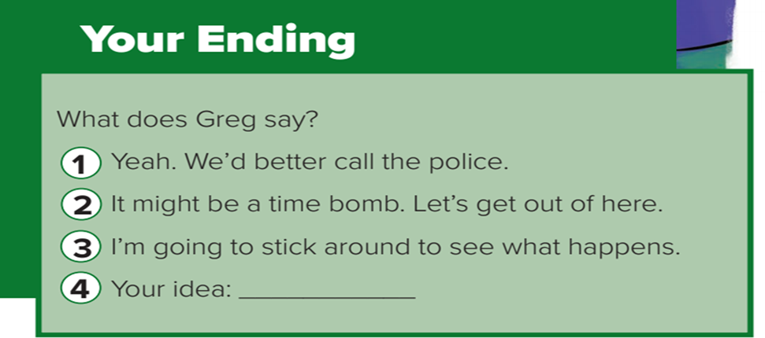
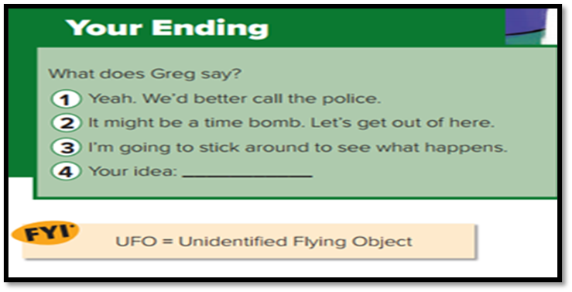
which ending do you think is the most likely?
Write your ending here

Slide 13
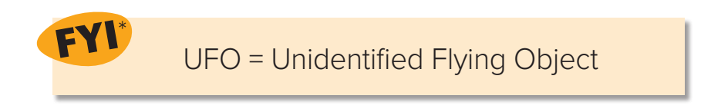
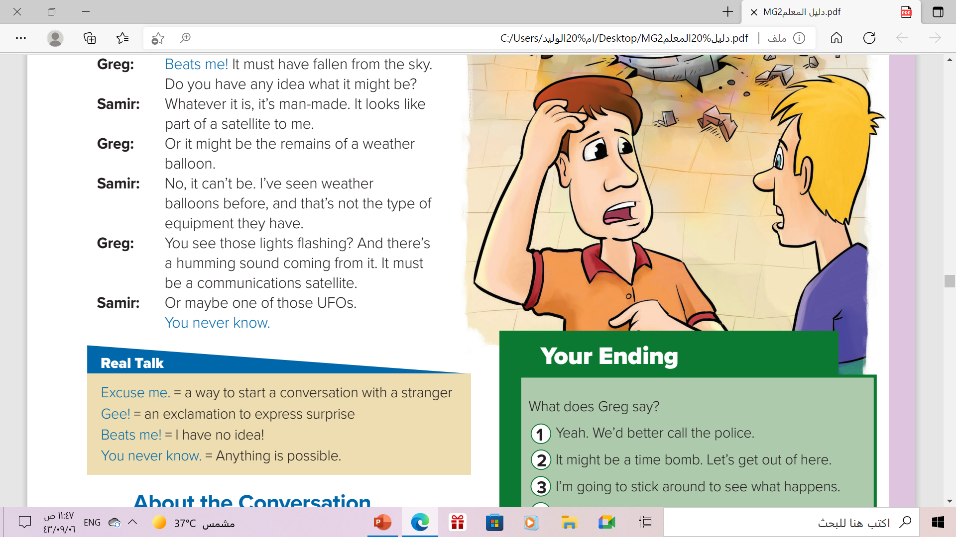

Slide 14

Listen to the conversation again
and underline the expressions
written in blue

Slide 15

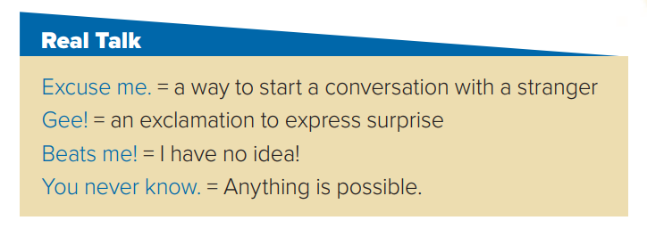

Slide 16

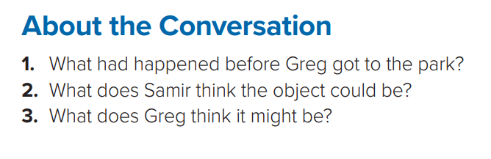
1- A crowd had gathered around a weird object .
2- Samir thought the object could be a satellite .
3- At first Greg thought it might be a weather balloon. But then he changed his mind and thought it must be communications satellite .

Slide 17
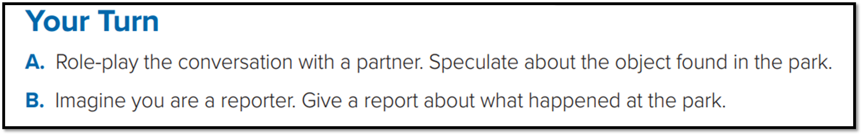

Your Turn

Slide 18

Homework
On workbook p.(91)
exercise ( C )

Slide 19

Thanks!

