Slide 1

Mega Goal 5
Unit4
The World of TV
Reading
Done by: Entisar Al-Obaidallah

Slide 2
Lesson Objectives
1- Give the reason for choosing the movie genre
2- Explain the reasons for disliking a movie.
3- Read the text for specific information
4- Use diagram to make notes before writing
5-Write an expository essay about the formula of TV film genre

Slide 3
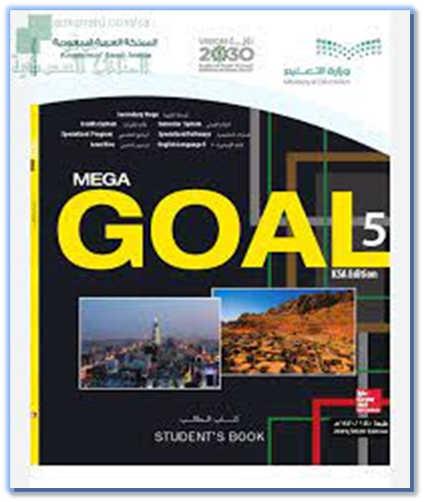
Open
Your student’s book
p. 62

Slide 4
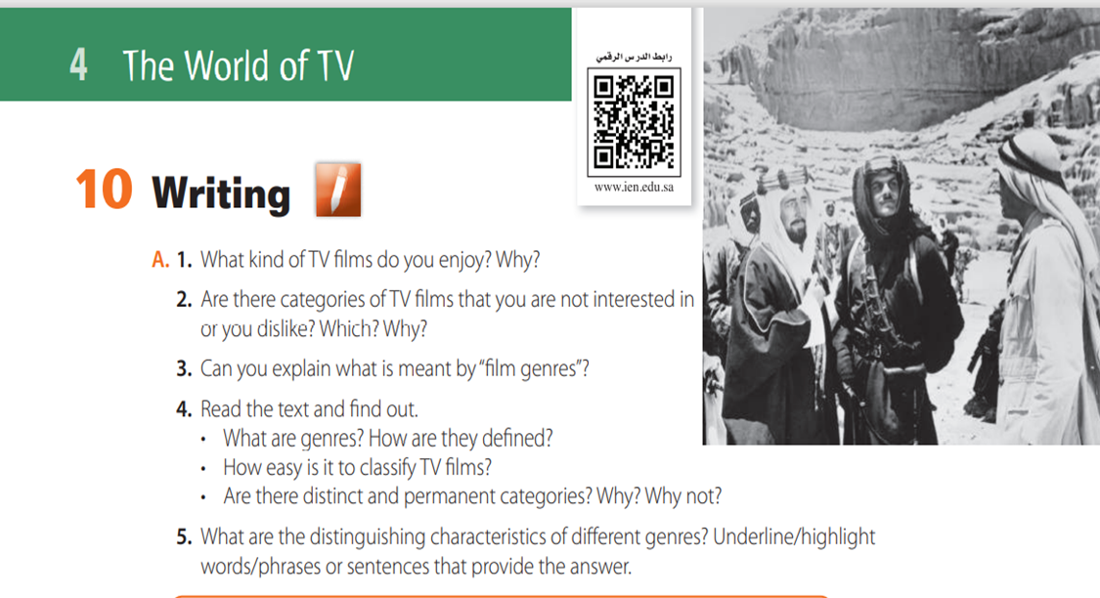

Slide 5
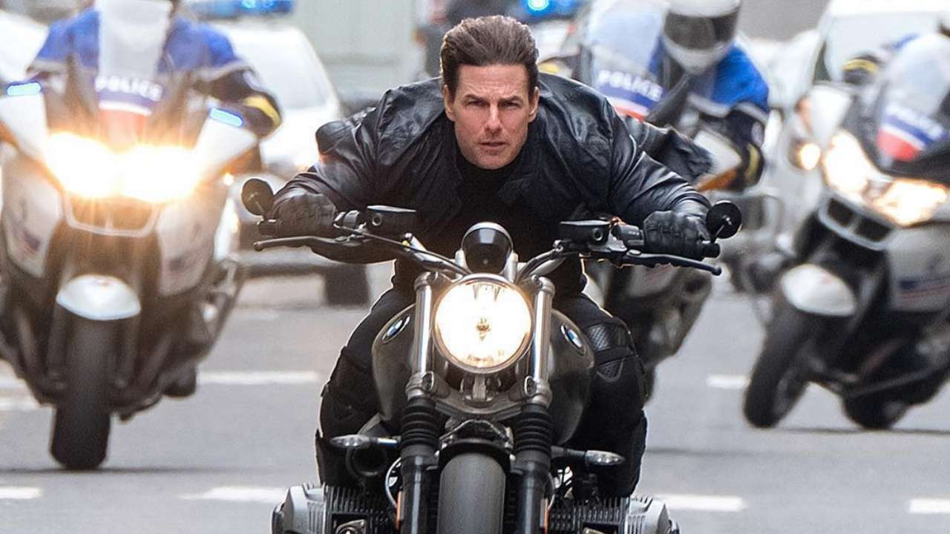

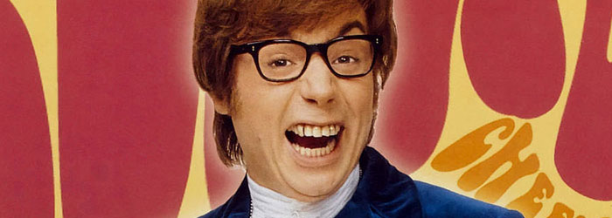
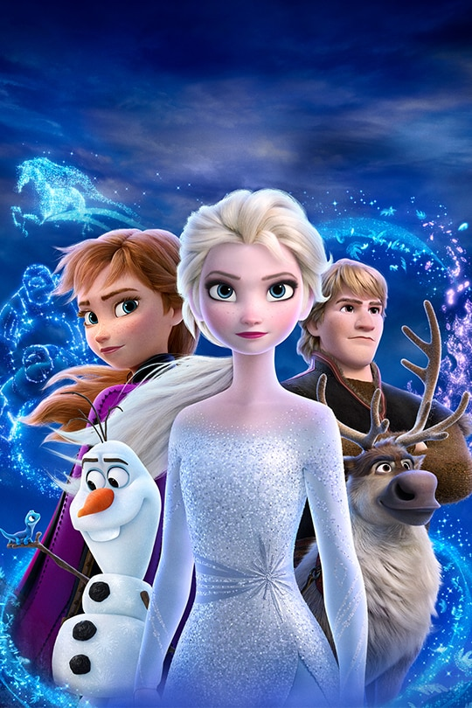
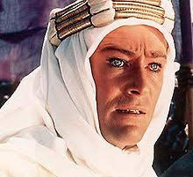

What kind of TV films do you enjoy?
action
adventure
comedy
drama
drama
animation

Slide 6

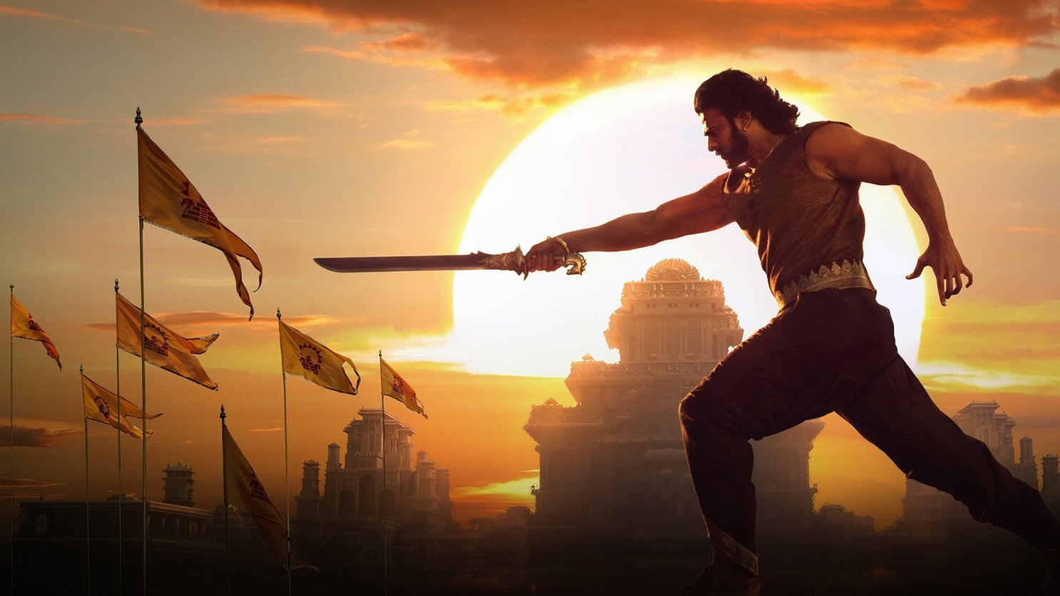

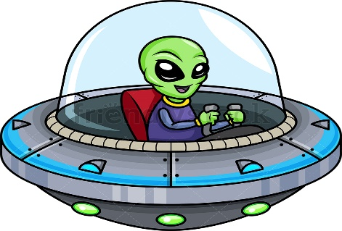
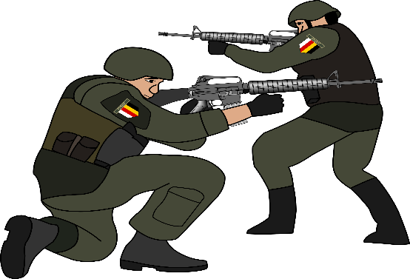
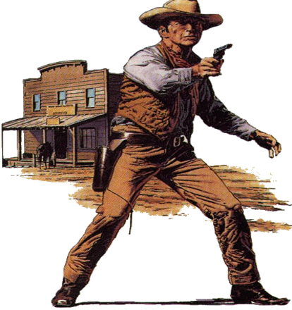
What kind of TV films do you enjoy?
horror
epic
detective
Science fiction
war
western

Slide 7
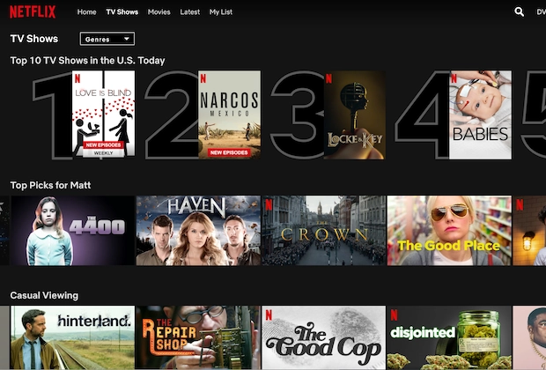
Are there categories of TV films that you are not interested in
or you dislike? Which? Why?

Slide 8

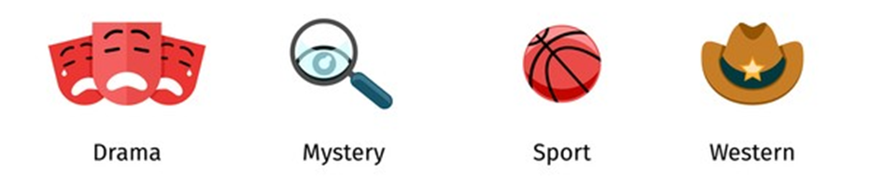

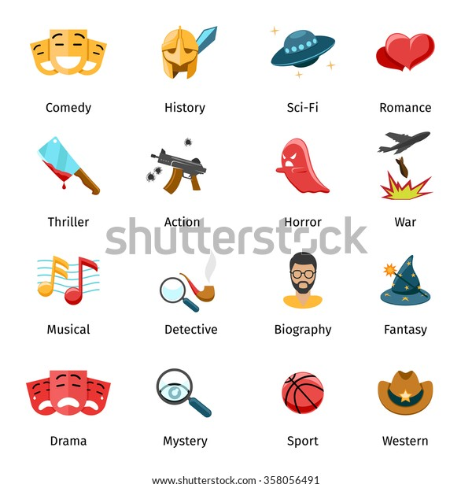
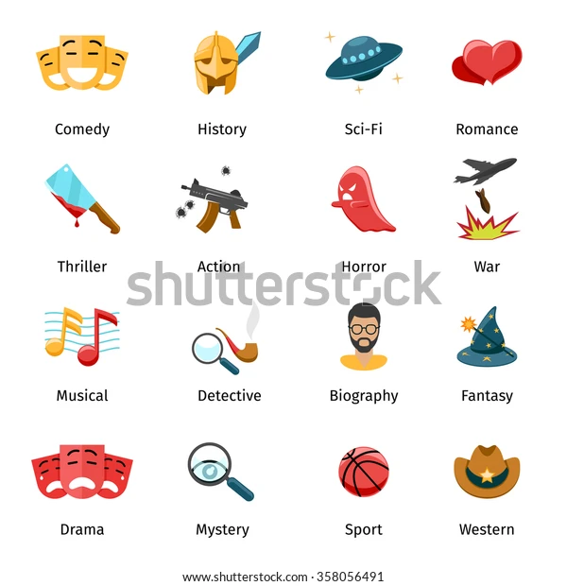
Print master
Can you explain what is meant by “film genres”?
type
genre
category

Slide 9
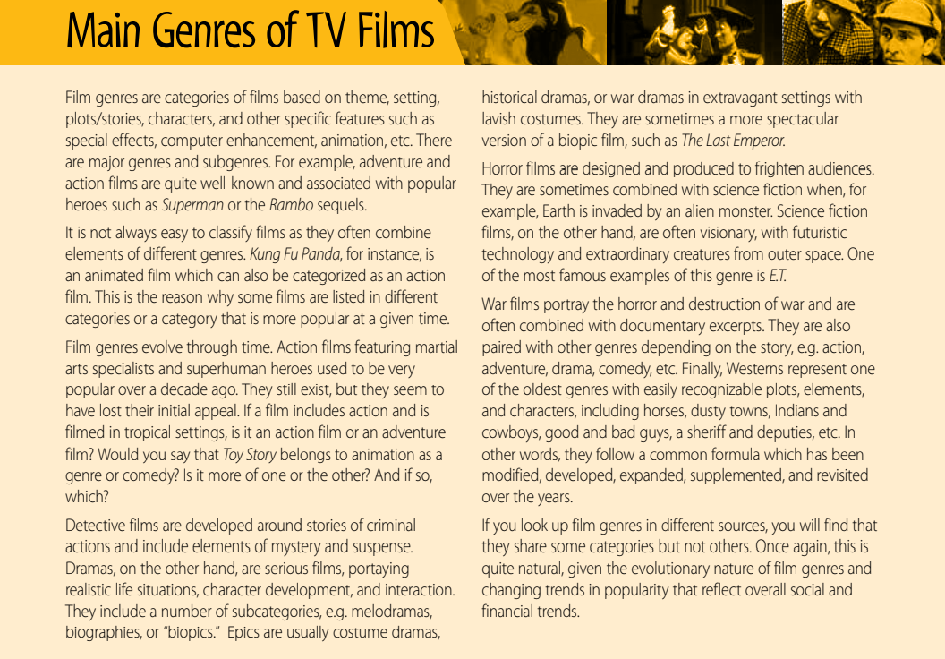
Read the text and answer the following question.

Slide 10
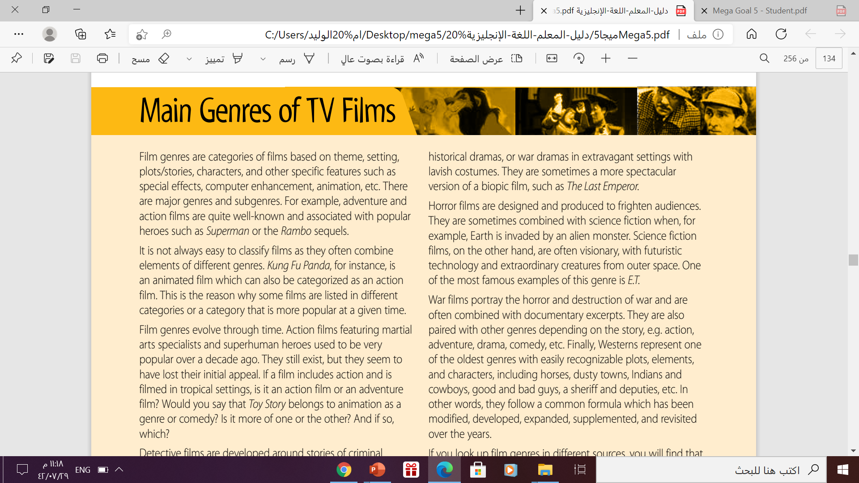
Print master
What are genres? How are they defined?
Categories of films based on theme, setting, plots/ stories, characters, and other specific features such as special effects, computer enhancement, animation, etc.
There are major genres and subgenres.

Slide 11

How easy is it to classify TV films?
It is not always easy to classify films as they often combine
elements of different genres.

Slide 12
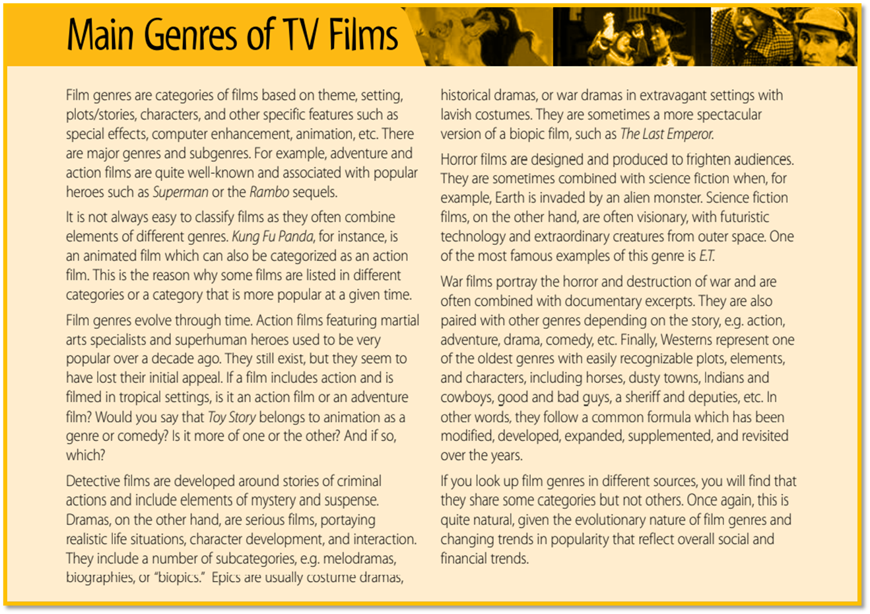
Are there distinct and permanent categories?
Why? Why not?
→No there aren’t because film genres evolve according to appeal.
→For example action films with superhuman heroes used to be popular over a decade ago. They’re not so popular any longer.

Slide 13
5. What are the distinguishing characteristics of different genres? Underline/highlight words/phrases or sentences that provide the answer.
action: martial arts, superhuman heroes
adventure: tropical setting (unusual setting),
comedy: Toy Story (also animated)
drama: serious, realistic life situations, character development, interaction, melodramas, biographies, biopics
animation: Toy Story(cartoon, design)
epics: costume dramas, historical dramas, war dramas, extravagant settings, lavish costumes, spectacular version of biopic film
biopics: The Last Emperor (a film based on a true story)
detective: criminal action, mystery, suspense
horror: frighten audiences, combined with science fiction, earth invaded by alien monster
war: horror and destruction of war, documentary excerpts, paired with other genres
western: oldest genres, recognizable plots, elements & characters, horses, dusty towns, Indians &cowboys, good & bad guys, sheriff & deputies, common formula, modified, revisited
science fiction: earth invaded by alien monster, visionary,
futuristic technology, extraordinary creatures, outer space, ET

Slide 14
Open
Your student’s book
p. 63

Slide 15
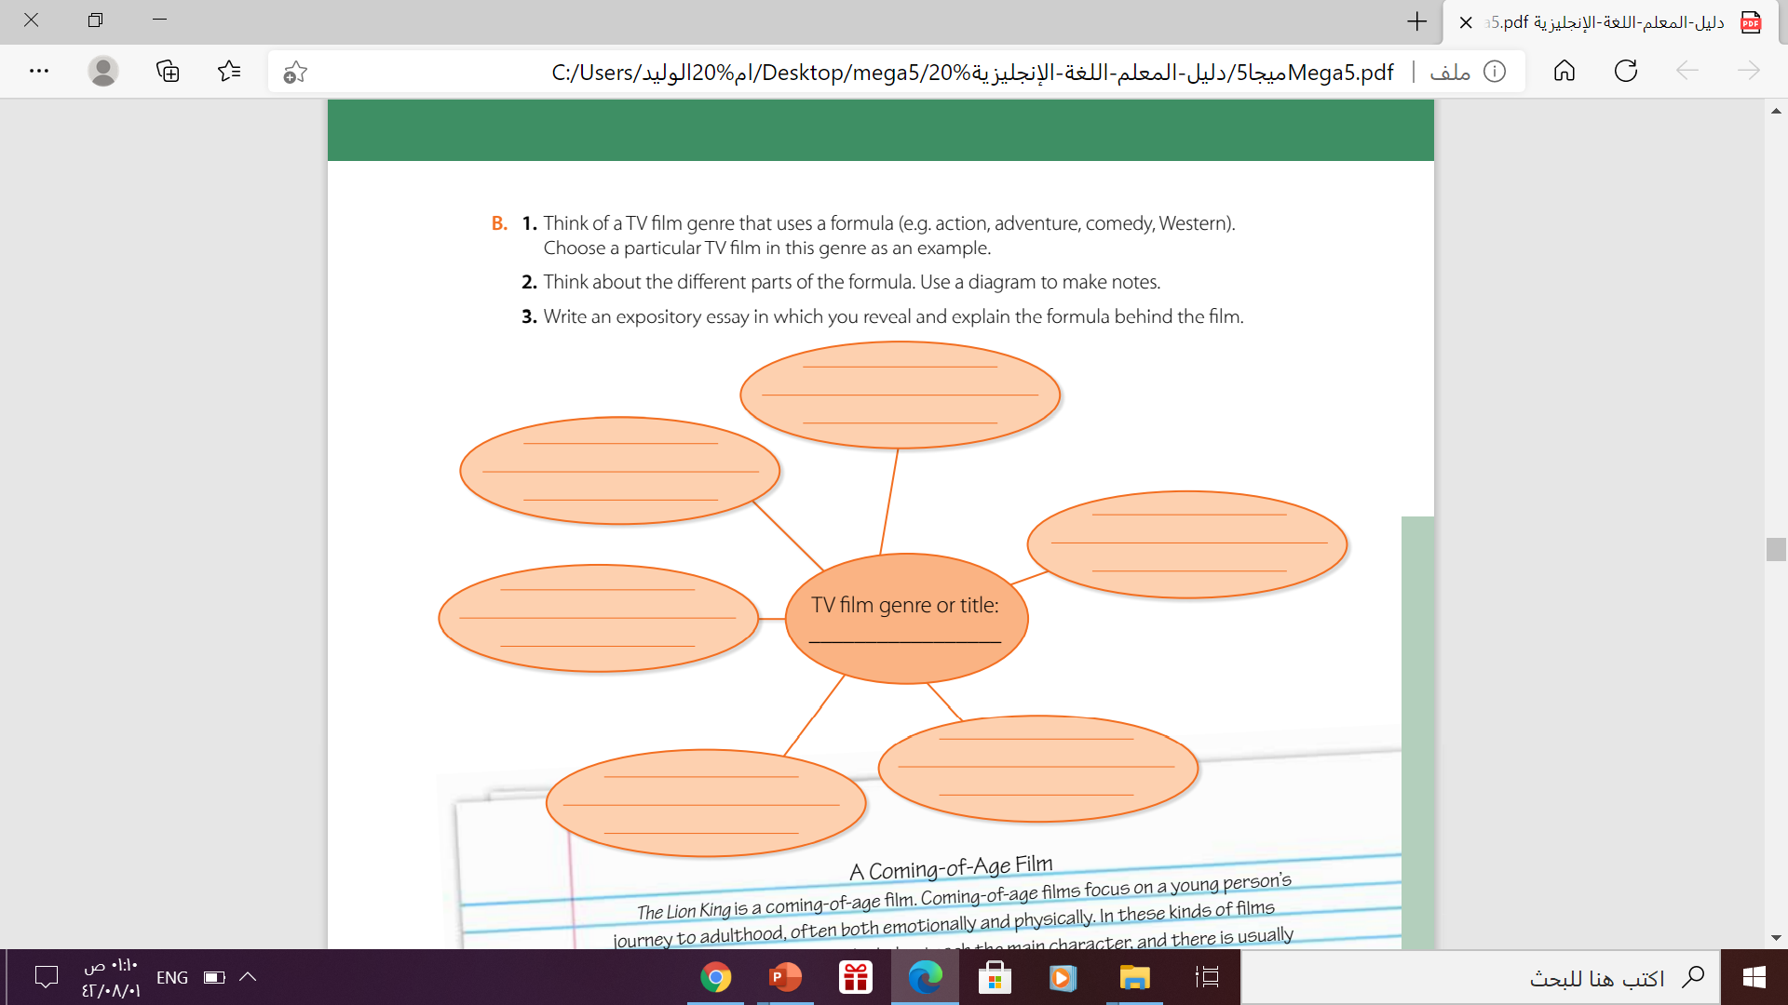
Health, social and
financial challenges
Bonds , feuds , and losses
dramedy
Emotional effects
Drama
Serious , real ,
new attitude
family

Slide 16
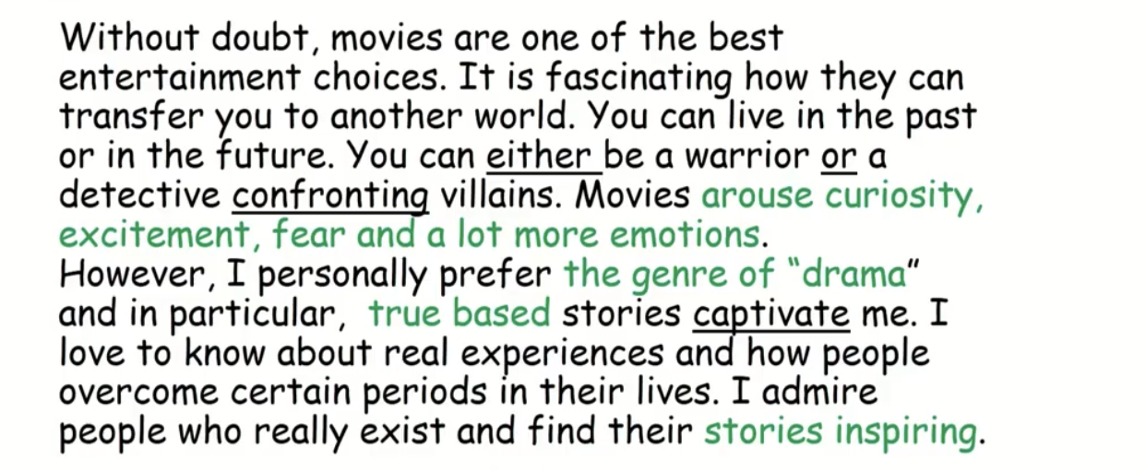
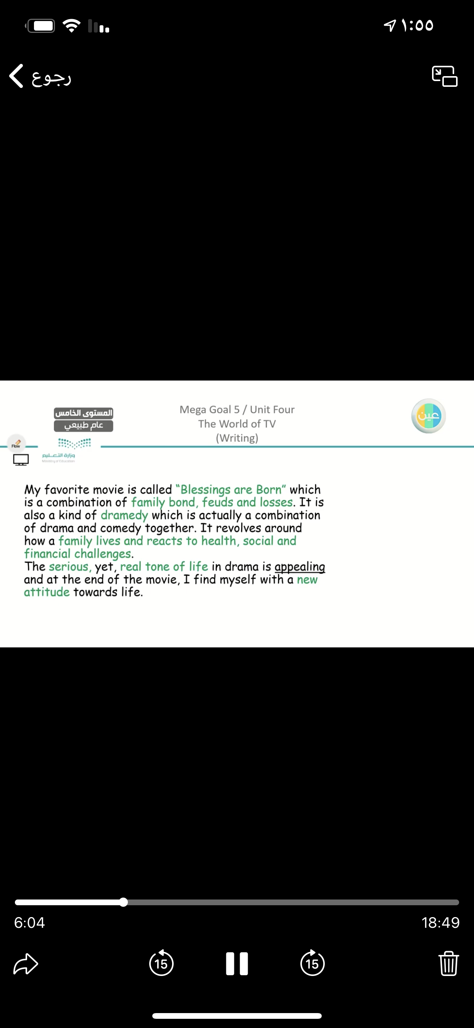
This is the essay:
Blessing are Born

Slide 17
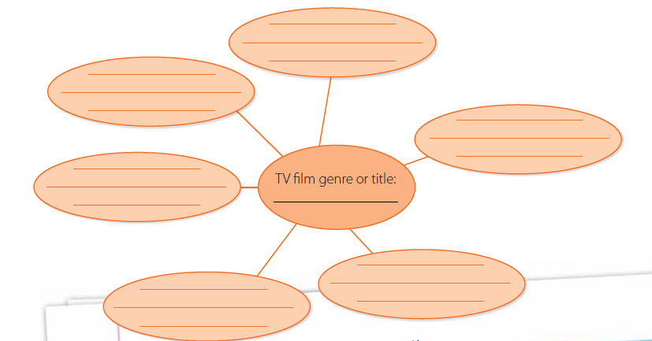
Another Example:
This genre reflects peoples’ lives
Simba had to accept his role as the king of the jungle
Focus on a young person’s journey to adulthood
Lion king is a good example
A coming-of-age
Film/ Lion King
There is a role model who teaches the main character
There is a test that the main character undergoes

Slide 18
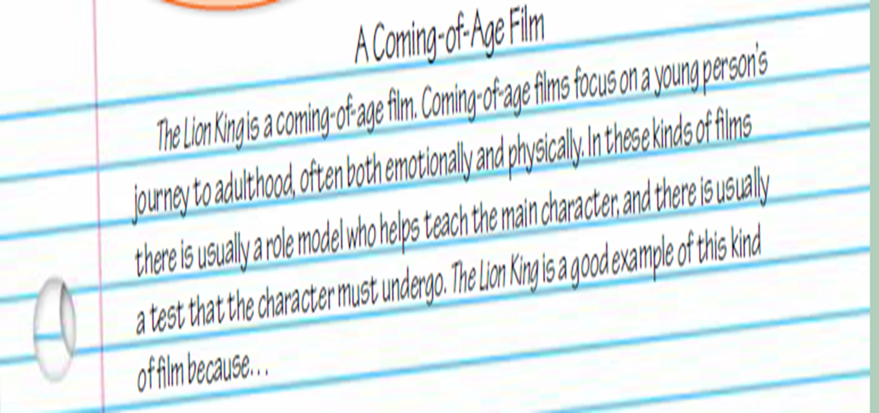
The Expository Essay

Slide 19
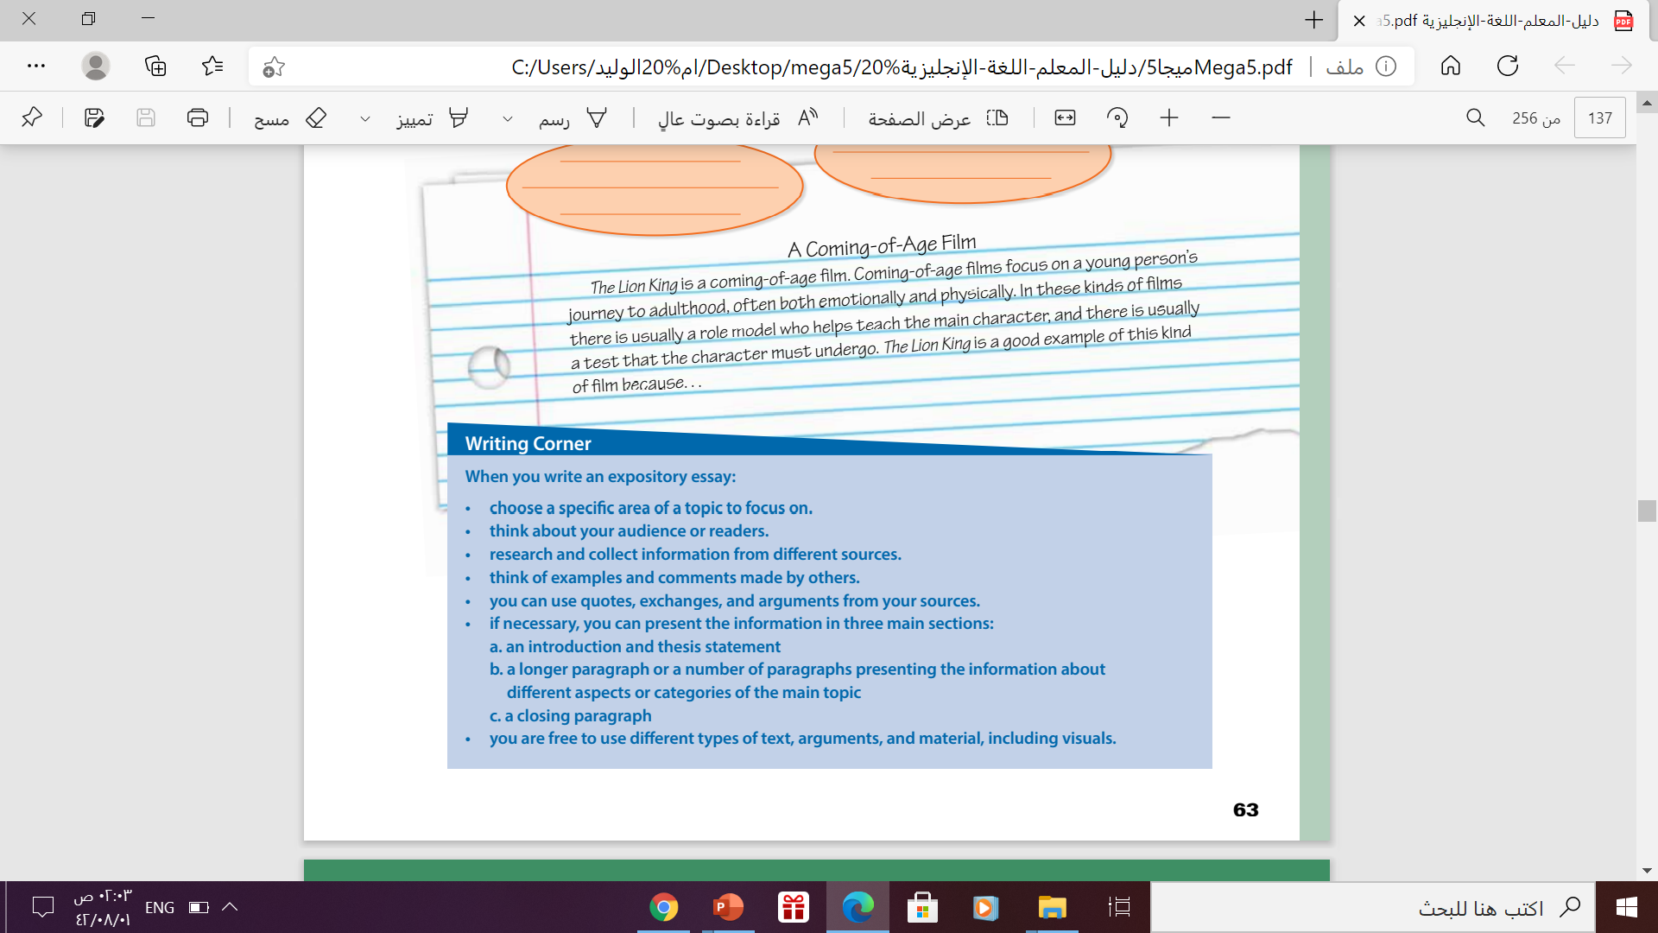
Follow these steps to write the expository essay

Slide 20

Let’s Practice
https://wordwall.net/play/12413/149/419

Slide 21

Thanks!

