Slide 1
Revision
Final Exam
First Term
written

Slide 2


Marks :
10 Listen & speak
30 Written test
5
listening
5
Oral speaking

Slide 3
30 Written test
6 general questions
5 controlled writing
4 reading short sentences
5 grammar
6 Vocabulary
4 spelling

Slide 4





General questions
6 marks

Slide 5
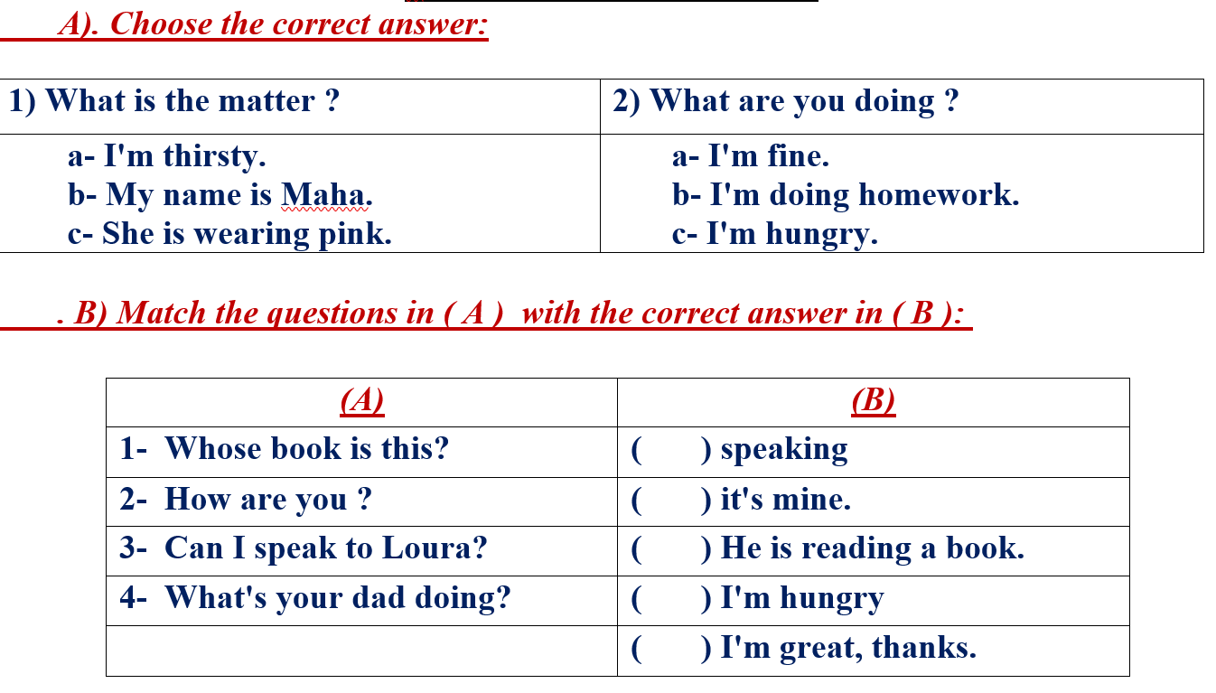

اختاري الإجابة الصحيحة لكل سؤال – ضعي دائرة عليها

Slide 6










ضعي رقم السؤال المناسب أمام الإجابة الصحيحة

Slide 7


1
what’s the matter ?
A
I am thirsty
B
My name is Maha
C
She is wearing pink

Slide 8
2
What are you doing?
A
I am fine
B
I am doing homework
C
I am hungry

Slide 9
3
How are you ?
A
I am sleepy
B
I am doing homework
C
I am great. Thanks

Slide 10
4
Can I speak to Daleen?
A
I am hungry
B
speaking
C
I am fine

Slide 11
5
Whose book is this?
A
It’s mine
B
speaking
C
I am reading

Slide 12
6
What’s your dad doing?
A
It’s mine
B
speaking
C
He is reading a book

Slide 13

Controlled writing
5 marks

Slide 14
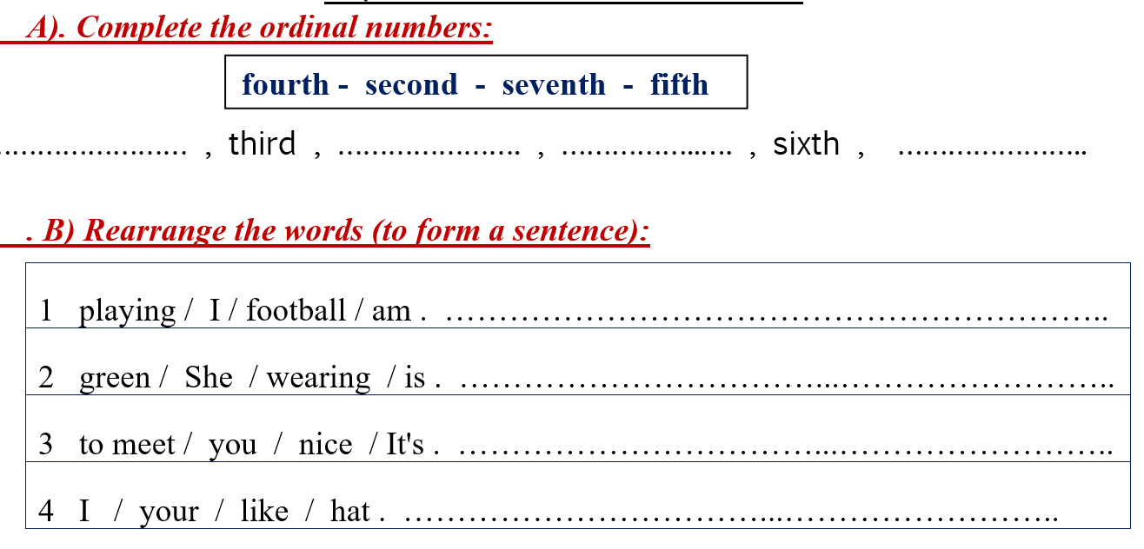
اكملي الأرقام التراتبية بالترتيب الصحيح

Slide 15
ordinal numbers
1
first
5
fifth
9
ninth
2
second
6
sixth
10
Tenth
3
third
7
seventh
8
eighth
4
fourth

Slide 16











اعيدي ترتيب الكلمات لتكون جملة صحيحة

Slide 17
1
playing – I - football - am
I am playing football
………………………………………………………………………….

Slide 18
2
green – she – wearing - is
She is wearing green
………………………………………………………………………….

Slide 19
3
to meet – you – nice – It’s
It’s nice to meet you
………………………………………………………………………….

Slide 20
4
I - your - like - hat
I like your hat
………………………………………………………………………….

Slide 21

Reading short sentences
4 marks

Slide 22
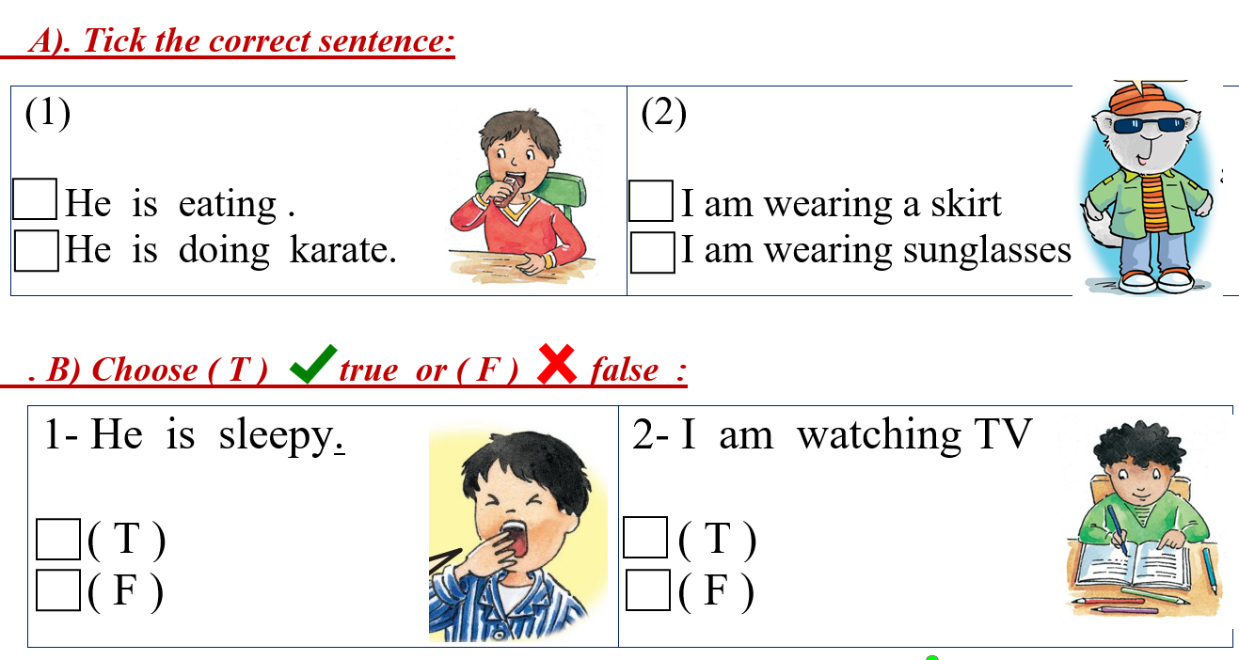






اختاري الجملة الصحيحة المناسبة للصورة

Slide 23





اختاري اذا كانت الجملة صحيحة حسب الصورة T
F اذا كانت خاطئة

Slide 24
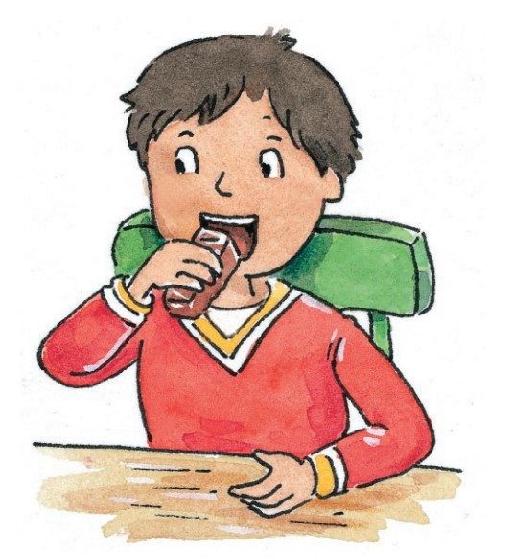

1
He is eating
He is doing karate

Slide 25
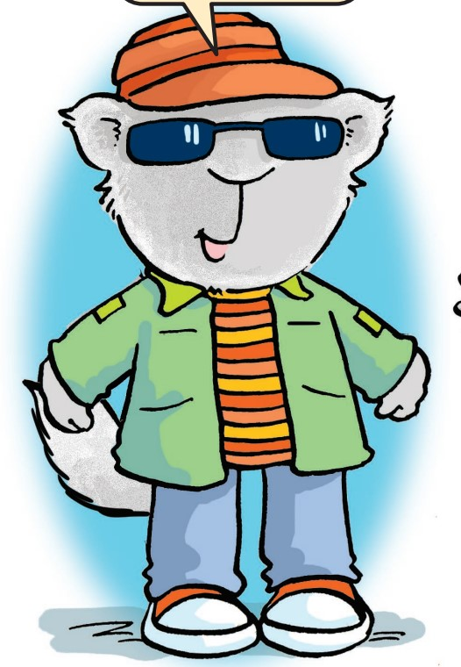

2
I’m wearing a skirt
I’m wearing sunglasses

Slide 26
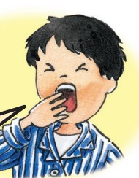
3
He is sleepy
T
F

Slide 27
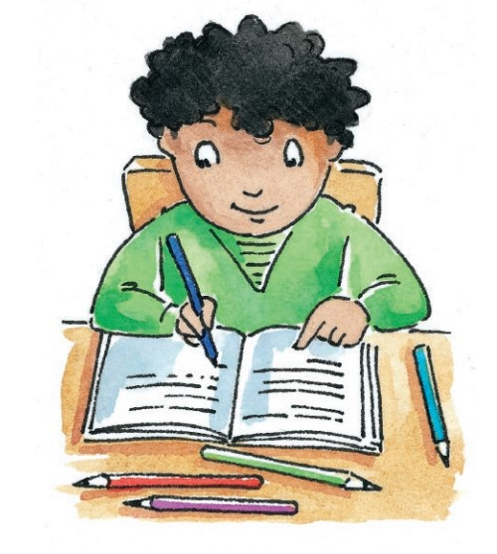
4
I’m watching TV
T
F

Slide 28
Grammar
5 marks

Slide 29
1
She …………. playing computer games
A
B
C
is
am
are

Slide 30
2
……………………. are welcome.
A
B
C
She
He
You

Slide 31
3
What are you ……………………. ?
A
B
C
do
does
doing

Slide 32
4
……………………. hat is this ?
A
B
C
Who’s
Whose
What

Slide 33
5
This is ……………. jacket.
A
B
C
my
mine
me

Slide 34
6
…………………… wearing blue ?
A
B
C
Whose
What
Who’s

Slide 35

He am playing
………………………….……………
is
I is wearing black
……………………………………………..
am

Slide 36
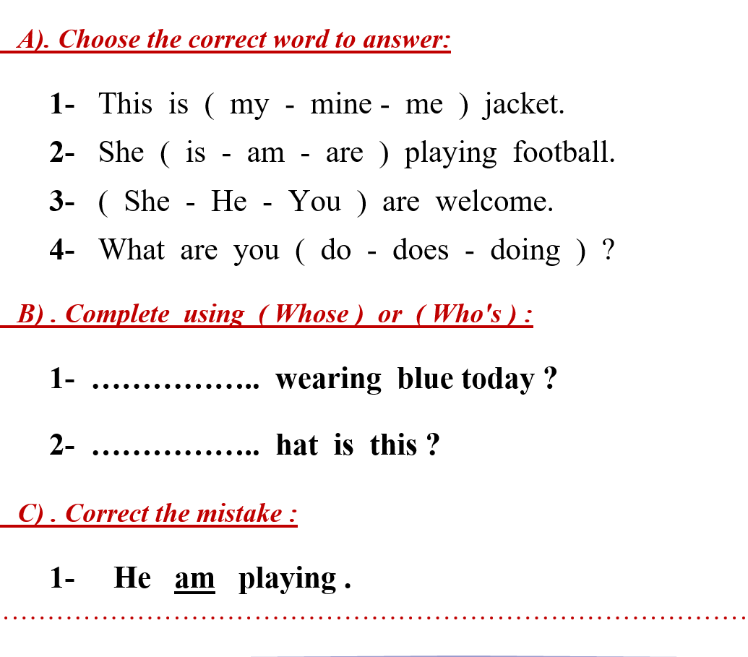









اختاري الكلمة الصحيحة
ضعي دائرة عليها

Slide 37


اختاري أحد الكلمتين بين الاقواس واكتبيها في الفراغ المناسب

Slide 38


صححي الخطأ (الكلمة التي تحتها خط فقط )

Slide 39
Vocabulary
6 marks

Slide 40
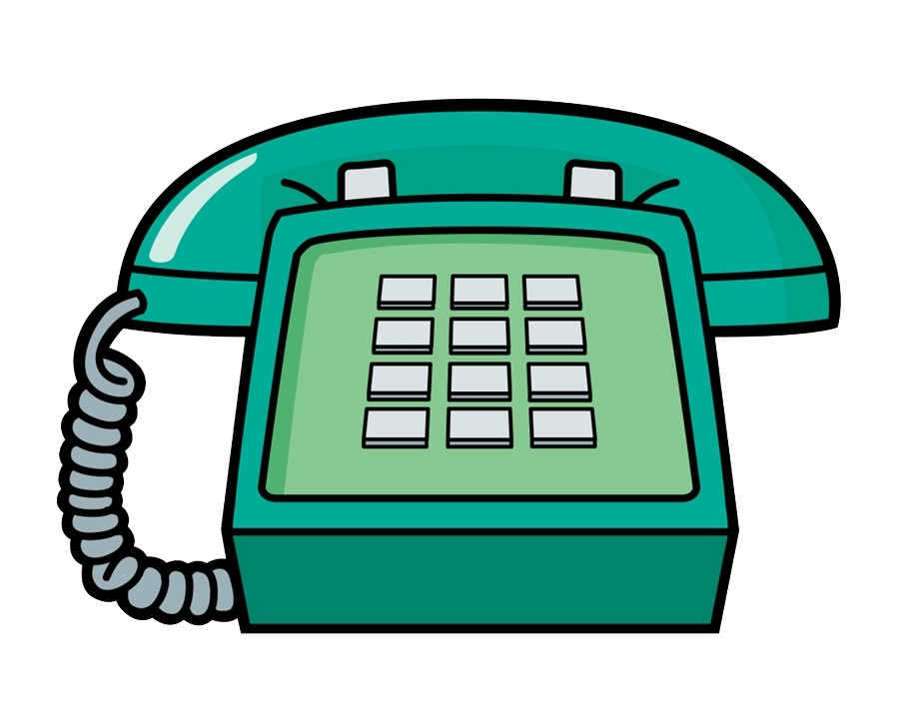
1
phone
time
hot

Slide 41
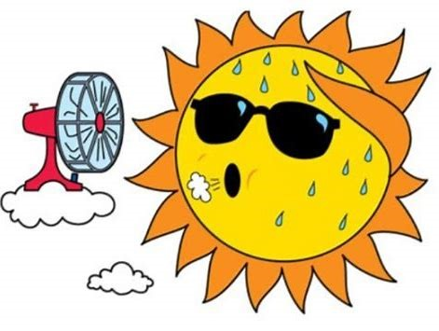
2
phone
time
hot

Slide 42
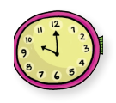
3
phone
time
hot

Slide 43
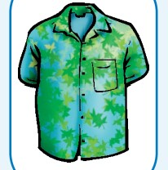
4
T-shirt
yellow
glasses

Slide 44
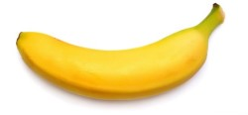
5
T-shirt
yellow
glasses

Slide 45
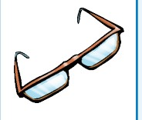
6
T-shirt
yellow
glasses

Slide 46
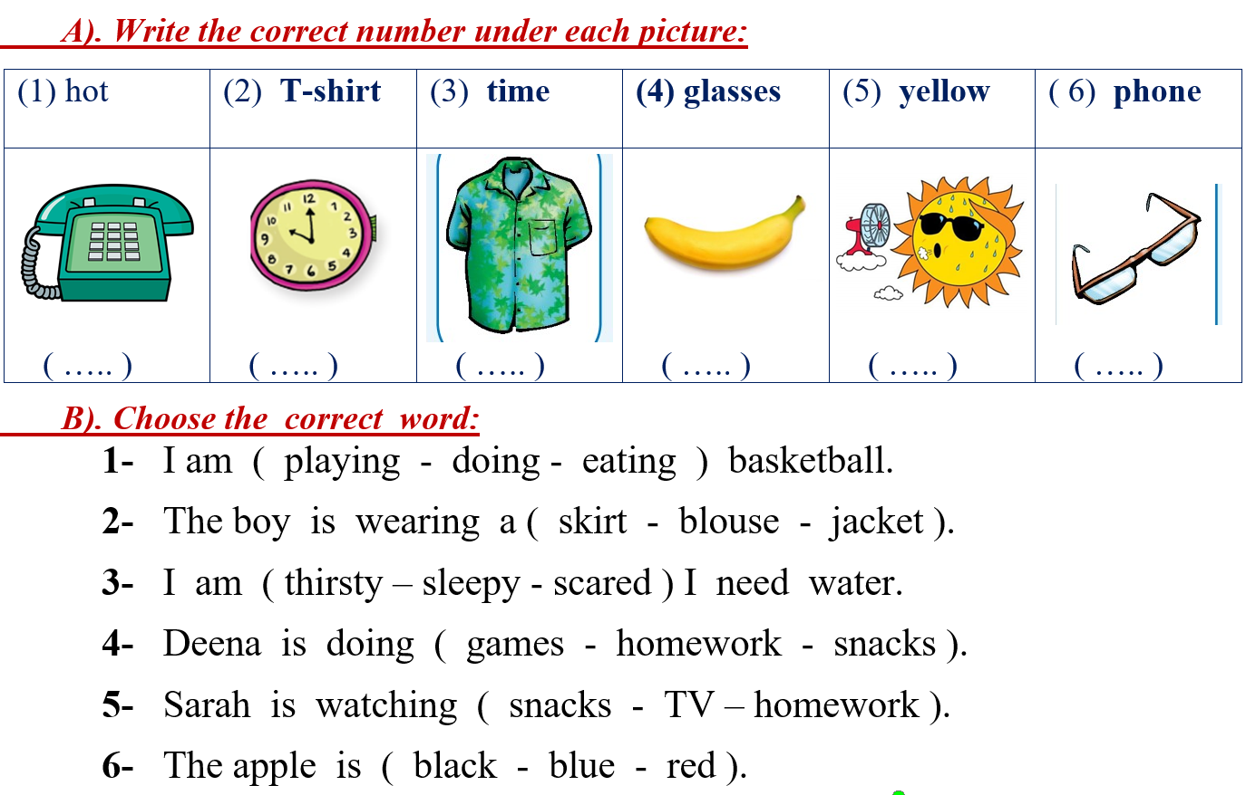










اكتبي رقم الكلمة الصحيحة تحت الصورة المناسبة

Slide 47
1
I am ………………… basketball
A
B
C
playing
doing
eating

Slide 48
2
The boy is wearing a ………….
A
B
C
skirt
blouse
jacket

Slide 49
3
I am ………….. , I need water
A
B
C
thirsty
sleepy
scared

Slide 50
4
Deem is doing …………………
A
B
C
games
homework
apple

Slide 51
5
Sarah is watching …………………
A
B
C
coffee
TV
homework

Slide 52
5
The apple is …………………
A
B
C
black
blue
red

Slide 53


اختاري الكلمة الصحيحة
ضعي دائرة عليها

Slide 54
spelling
4 marks

Slide 55
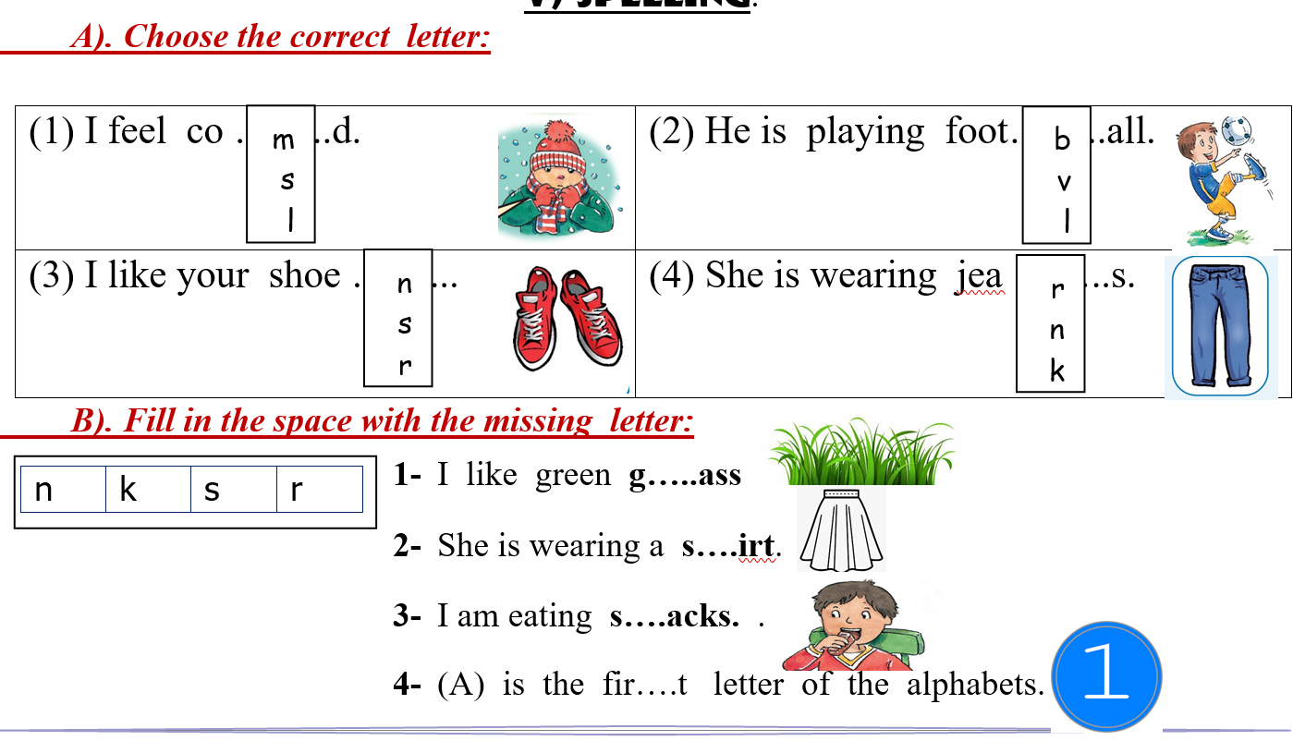



اختاري الحرف الصحيح
ضعي دائرة عليه

Slide 56

اكتبي الحرف الصحيح في الفراغ – تأكدي من اختيار جميع الحروف

Slide 57
Choose the correct letter:
Shoe…….
n | s
p | k
foot……all
m | s
b | k
Co……..d
s | m
d | l
s…..irt
v | s
d | k
Fir…….t
b | r
s | c
Jea……s
n | c
p | g
g……ass
z | s
t | r
s……acks
n | s
r | d

Slide 58
Prepared By
Dalal Al-Juaid
t.me/dalalforenglish

